Slide 1
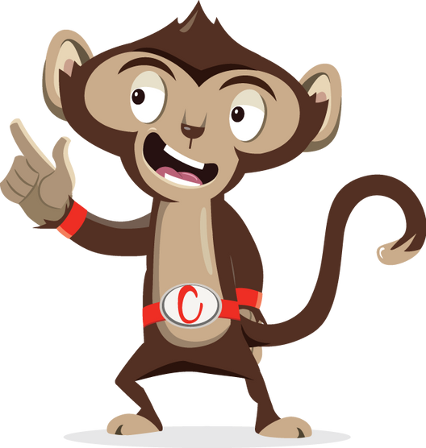


Brain Gym

Slide 2
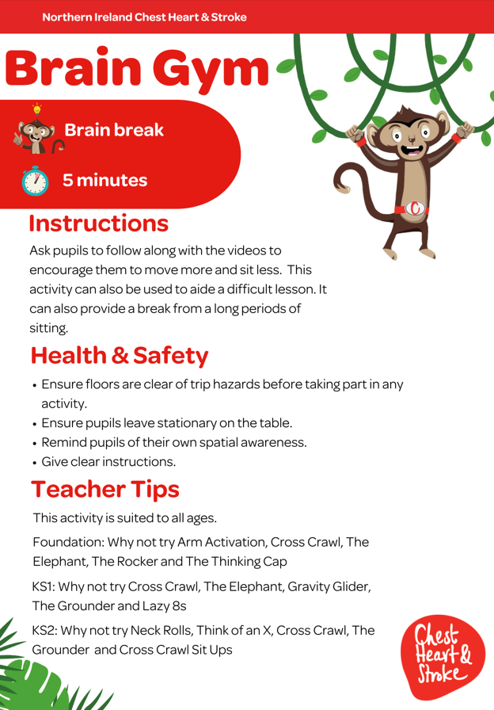

Slide 3
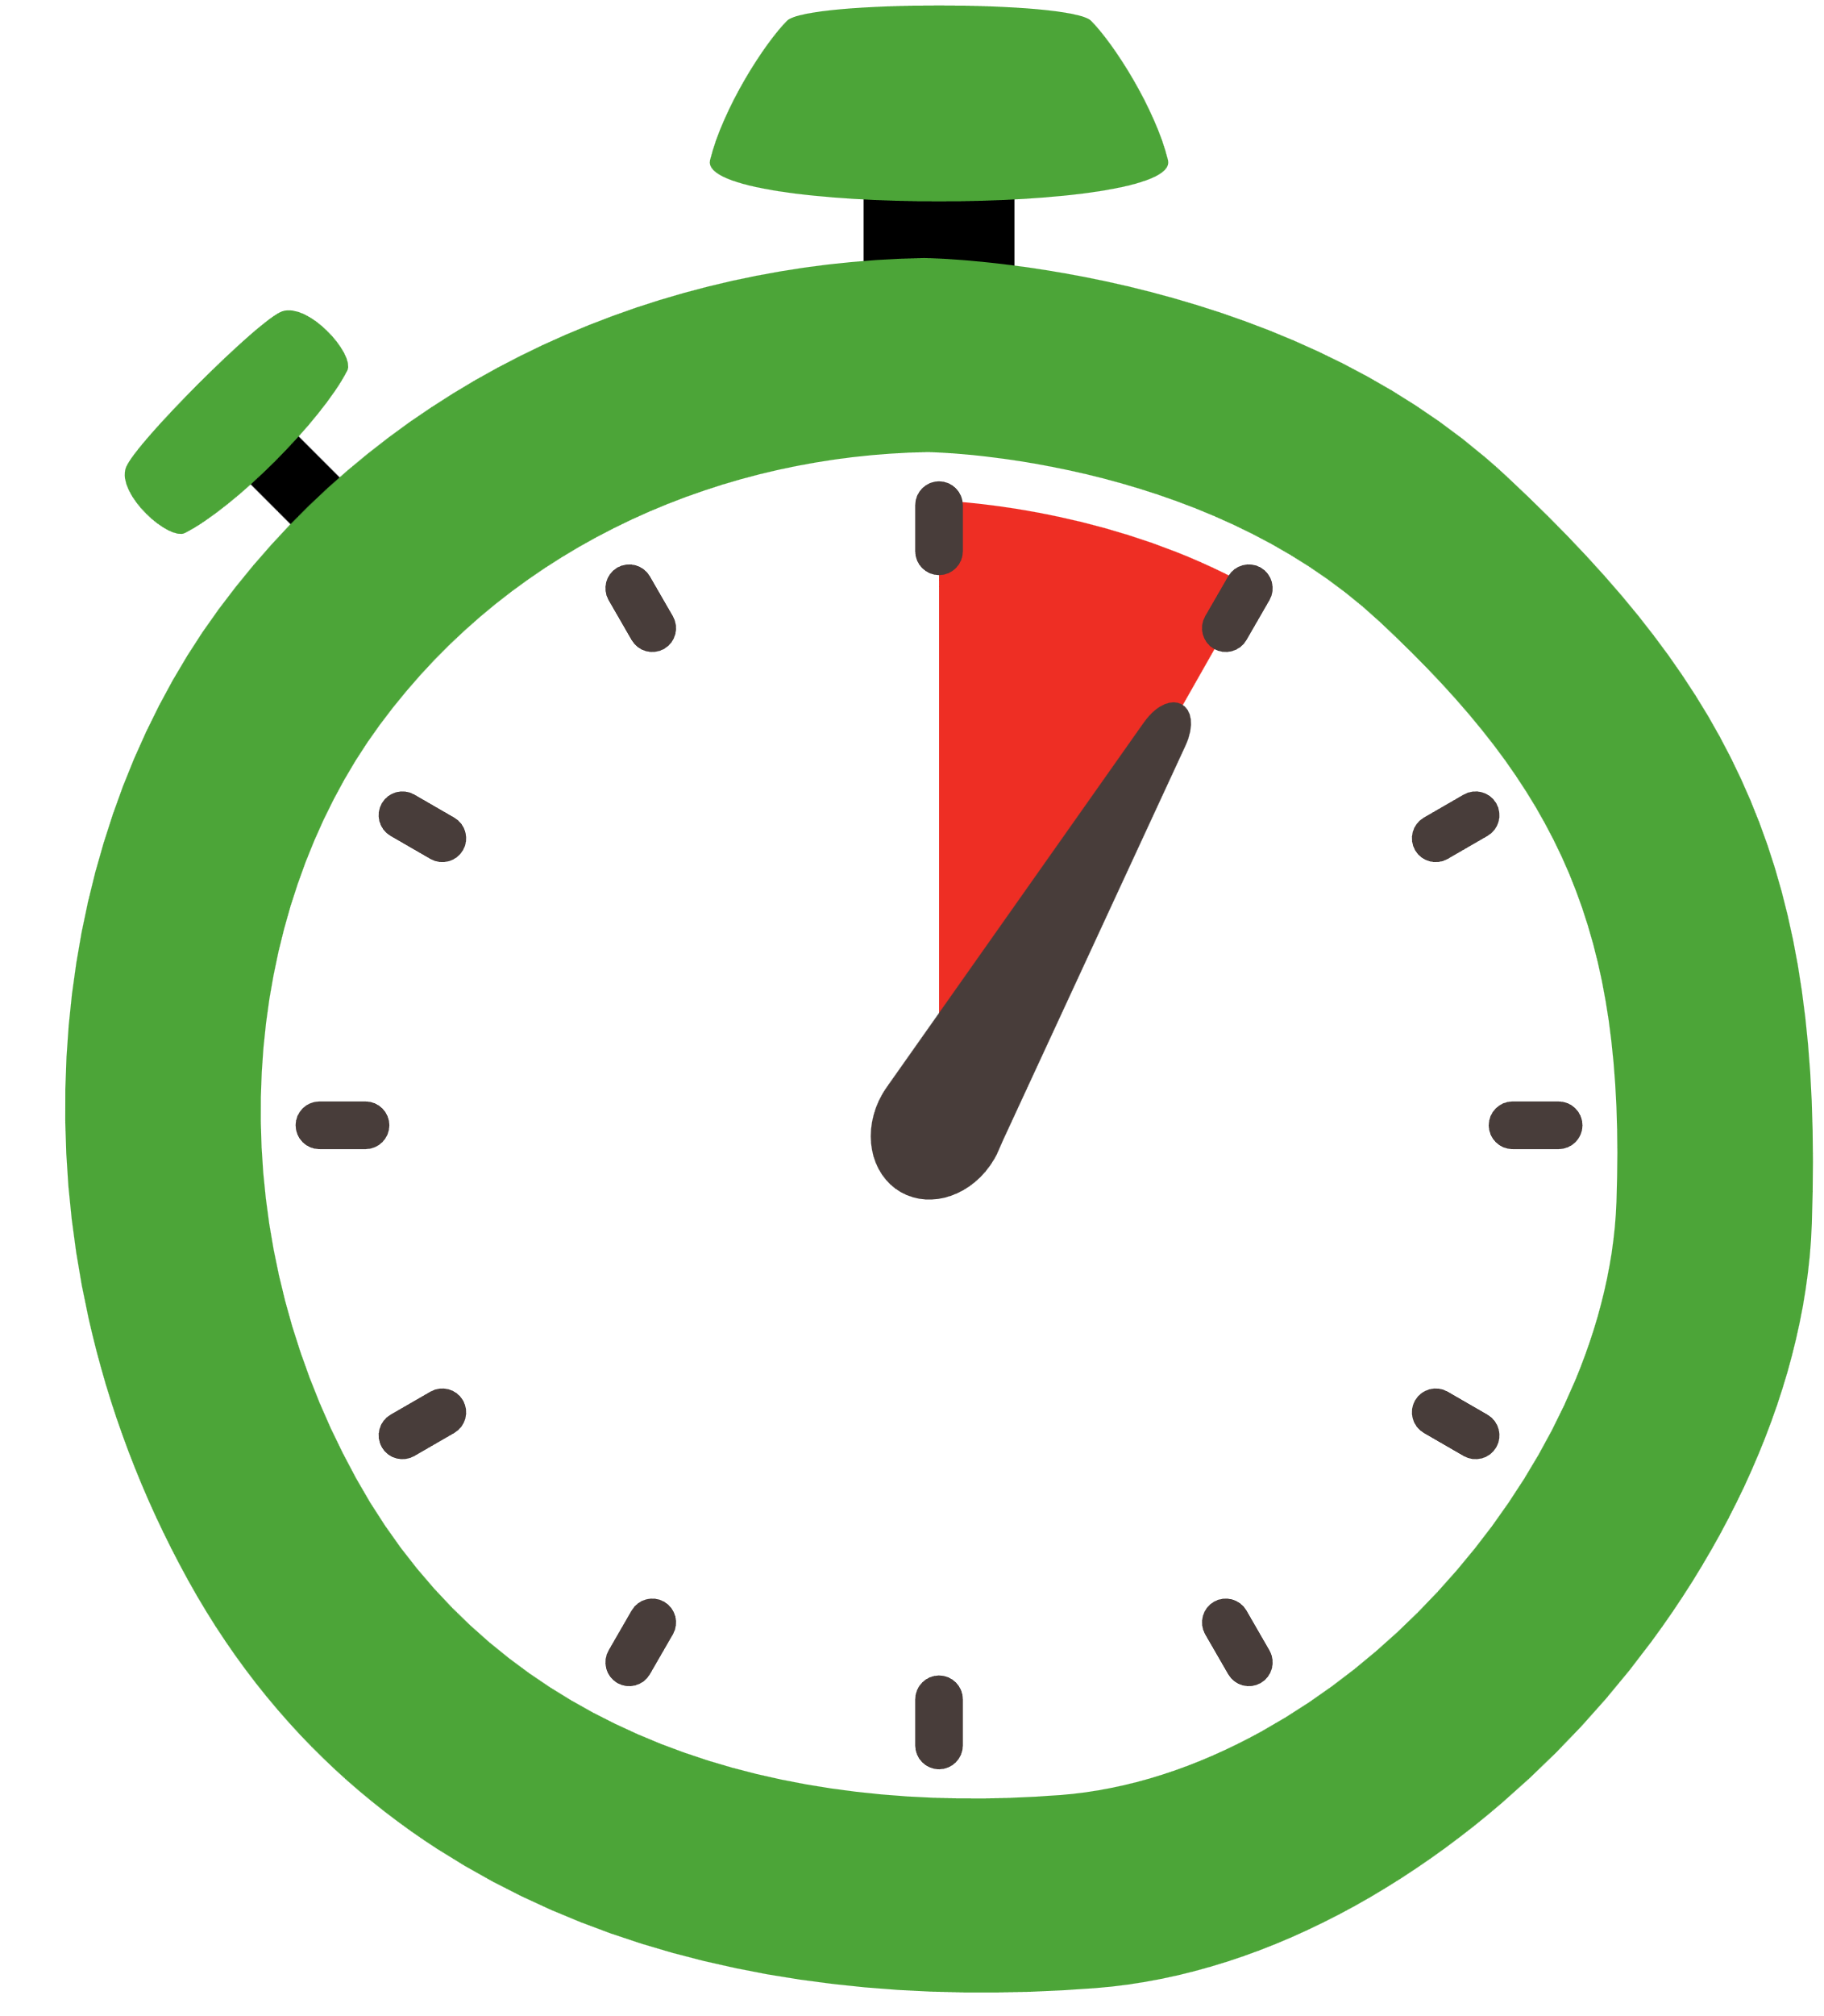

Foundation Level
Time:
5 mins
Resources :
Stopwatch

Slide 4

Arm Activation
30 seconds
Stand, reach one hand up towards the ceiling (palm facing in)
Place the other hand on outside of your elbow
Push you arm away from you (hold for about 3s)
Then push it towards your ear (hold for about 3s)
Then push the arm behind you (hold for about 3s)
Repeat on other side and switch arms.

Slide 5
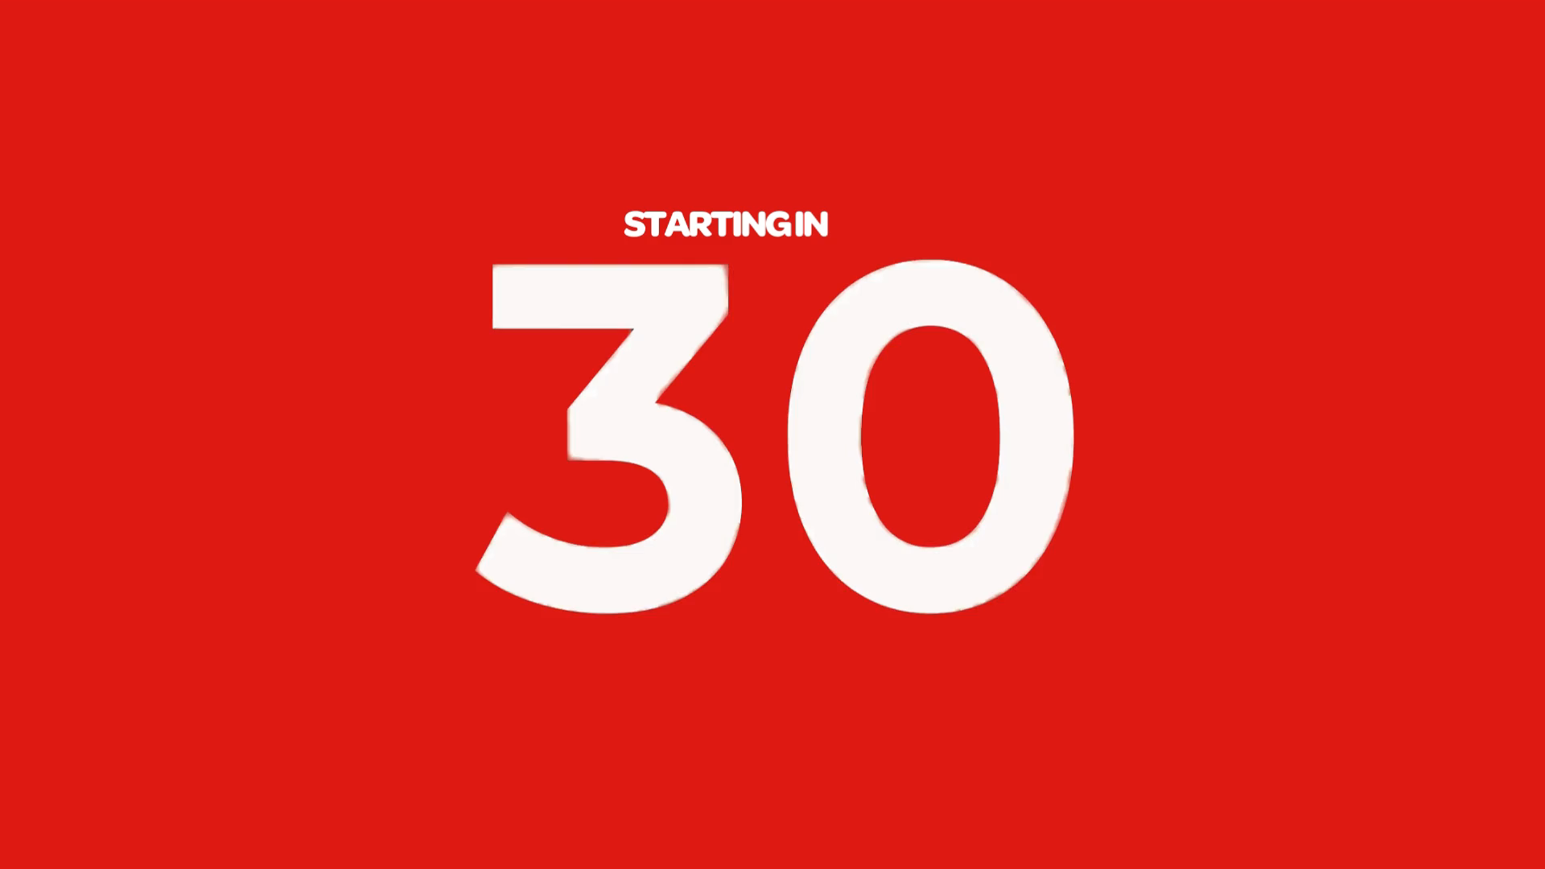
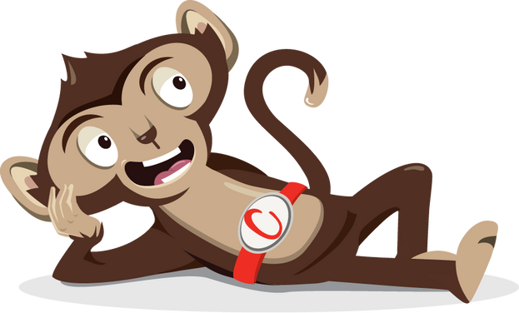
Rest

Slide 6
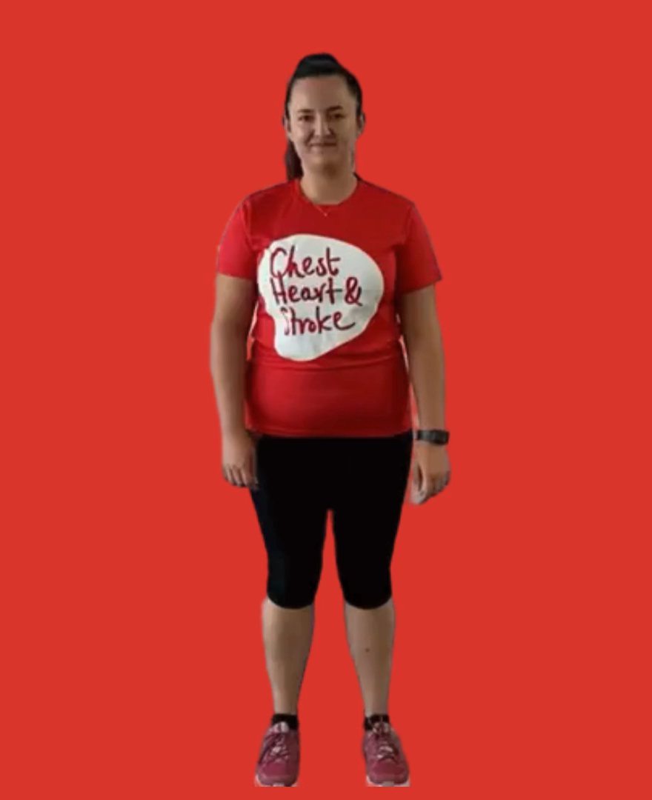
Cross Crawl
30 seconds
While standing, march on the spot
Bring your opposite elbow to the opposite knee
Twist your body as you touch your knees

Slide 7
Rest

Slide 8
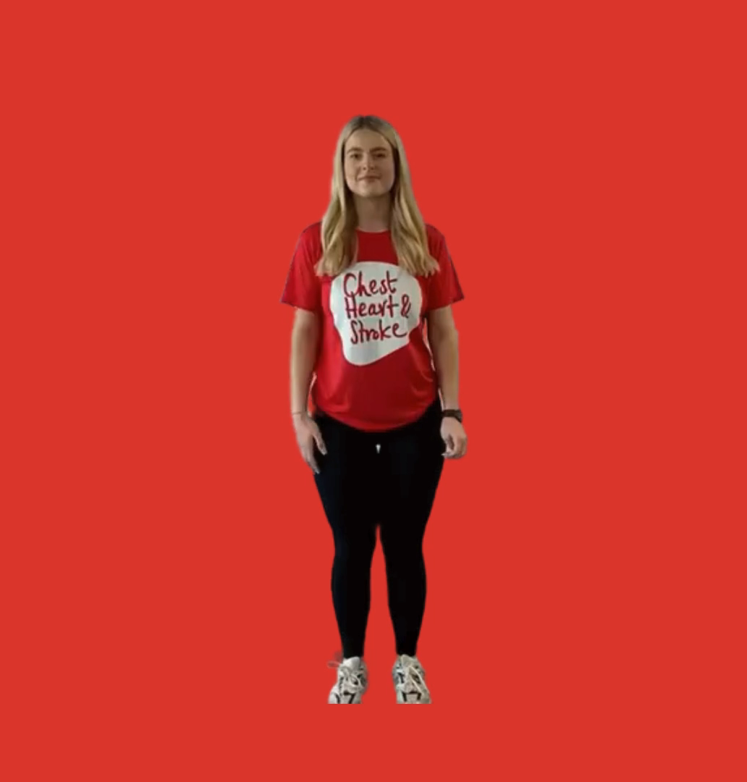
The Elephant
30 seconds
Place your ear on your right shoulder
Extend your right arm
Draw a lazy number 8 (lying on its side), when you are at the bottom bend your knees, when you are at the top straighten your knees
Change sides

Slide 9
Rest

Slide 10
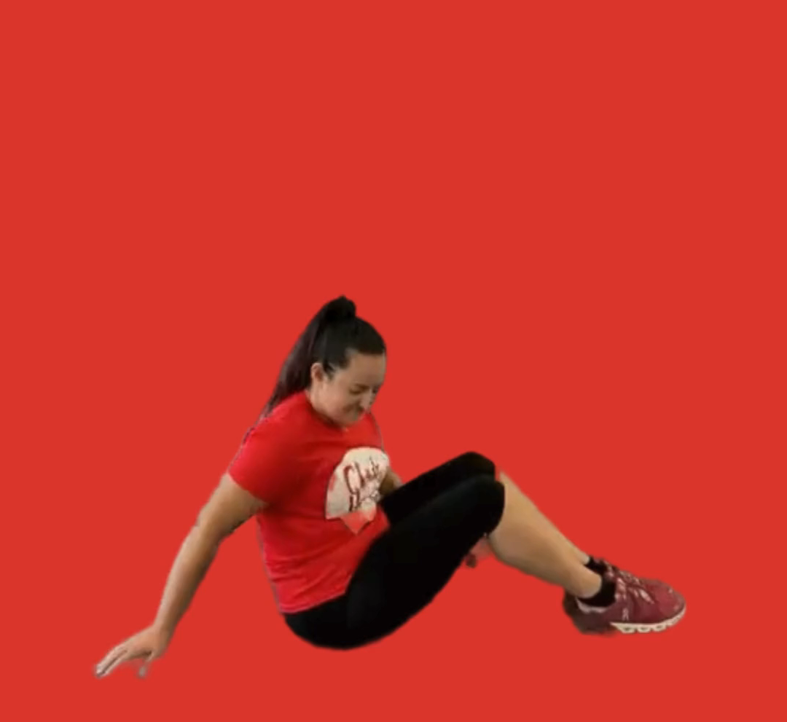
The Rocker
30 seconds
Sit on the floor
Bend your knees with your feet together (or crossed)
Place your hands behind you
Your weight will be in your hips and your hands
Rock in small circles back and forth one direction, then change direction

Slide 11
Rest

Slide 12

The Thinking Cap
30 seconds
Place your fingers on the top of each ear
Gently unroll the curved parts of the edges of both ears at the same time
Start at the top and work your way to the bottom
Then change and start at the bottom and work your way to the top

Slide 13
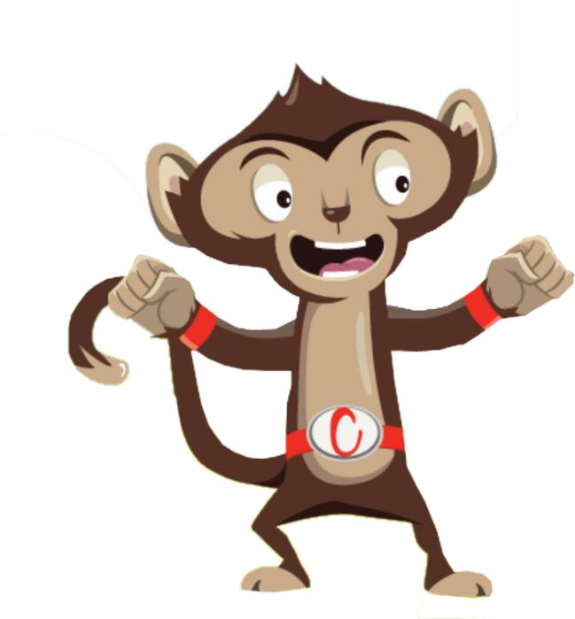
Finished!

