Slide 1
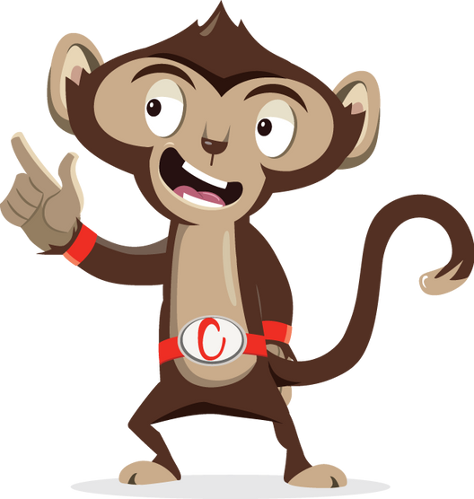


Brain Gym

Slide 2
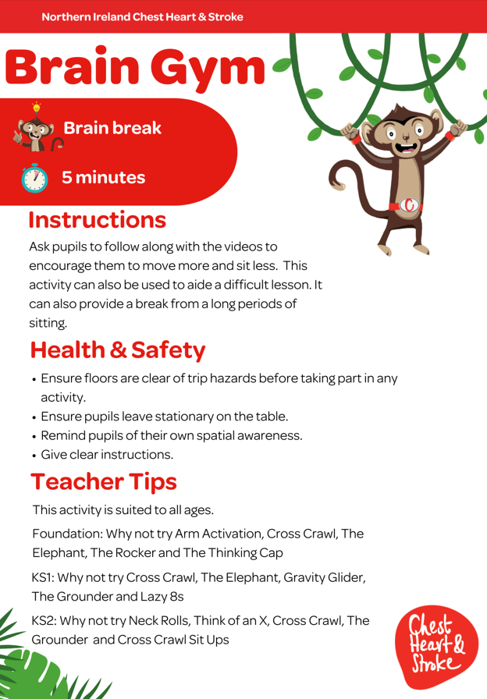

Slide 3


Key Stage 1
Time:
5 minutes
Resources :
Stopwatch

Slide 4
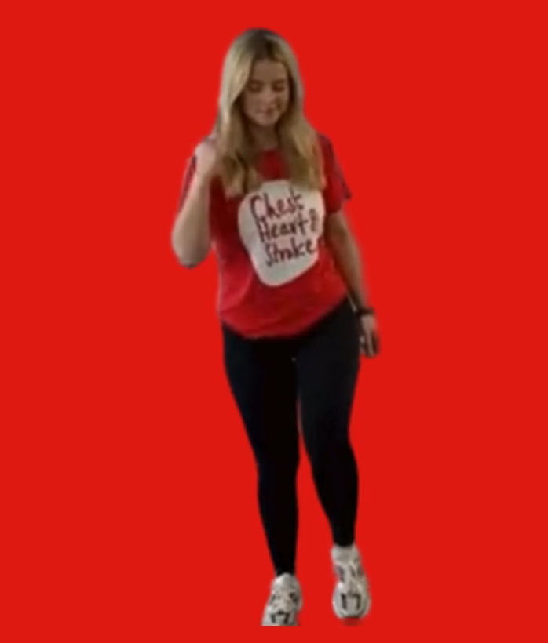
Cross Crawl
40 seconds
While standing, march on the spot
Bring your opposite elbow to the opposite knee
Twist your body as you touch your knees

Slide 5
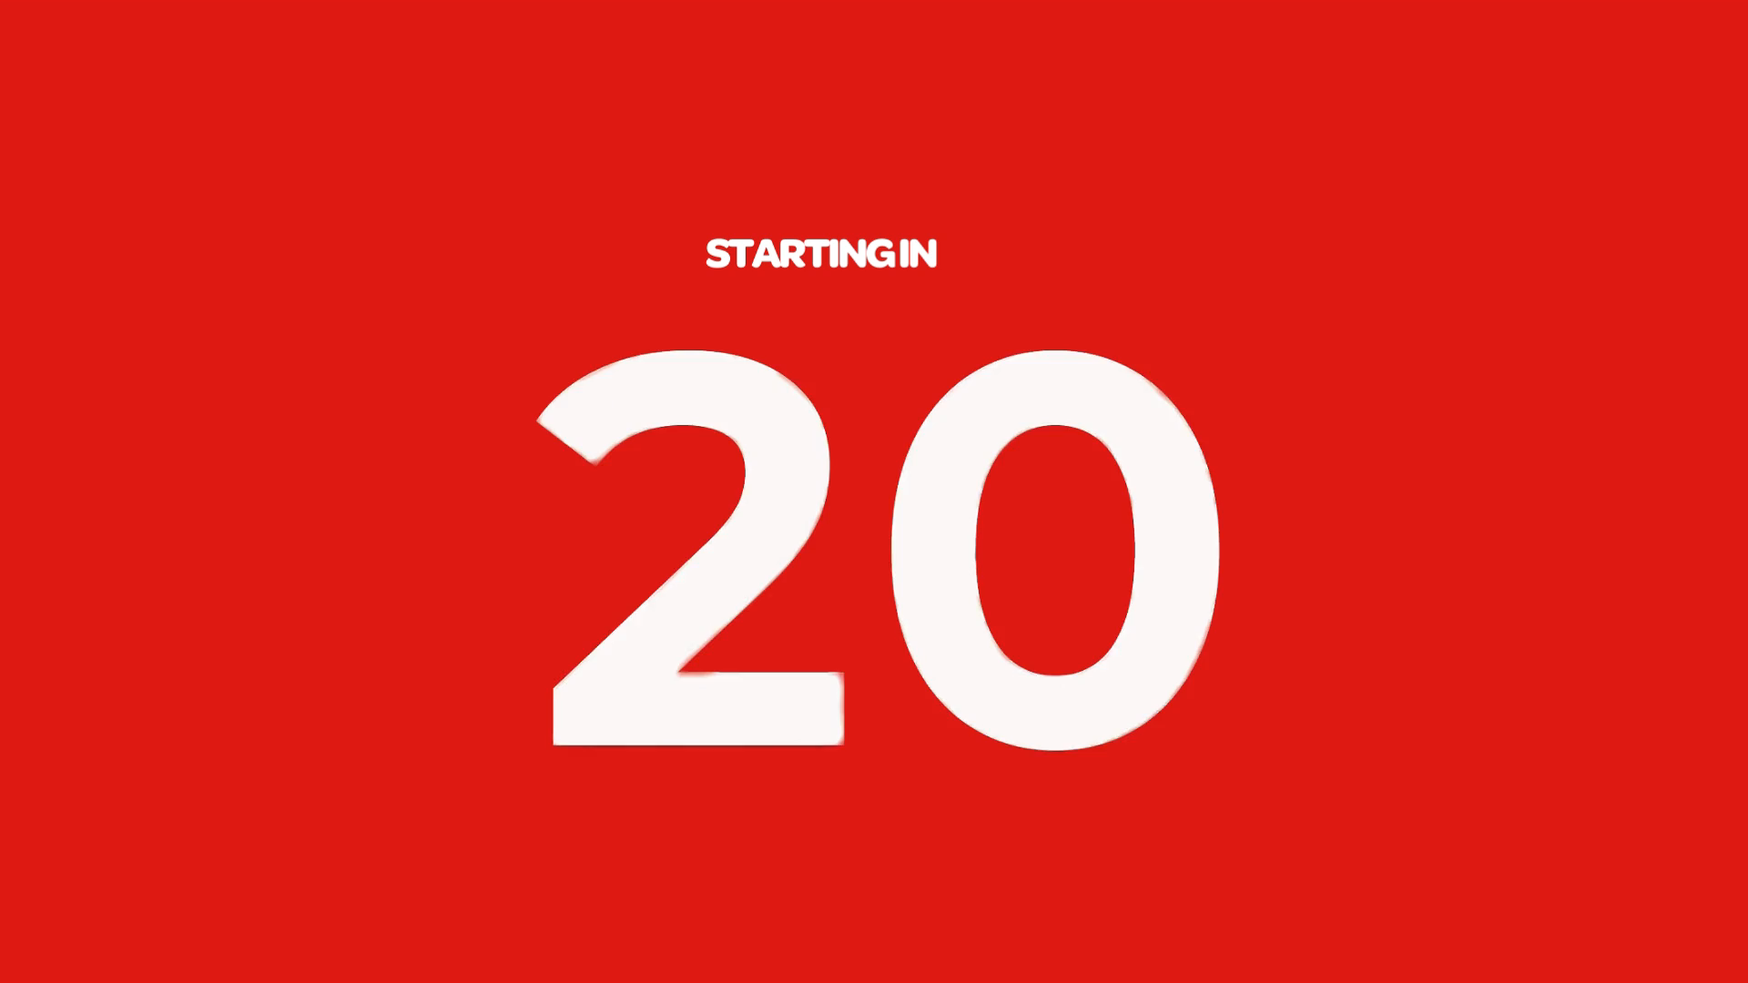
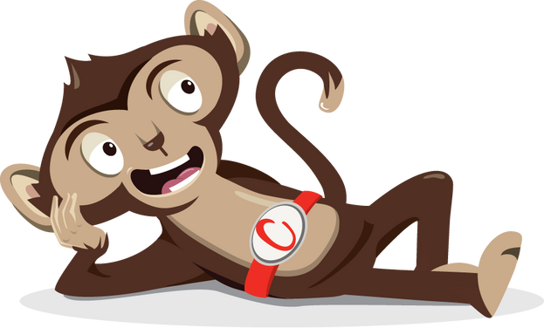
Rest

Slide 6
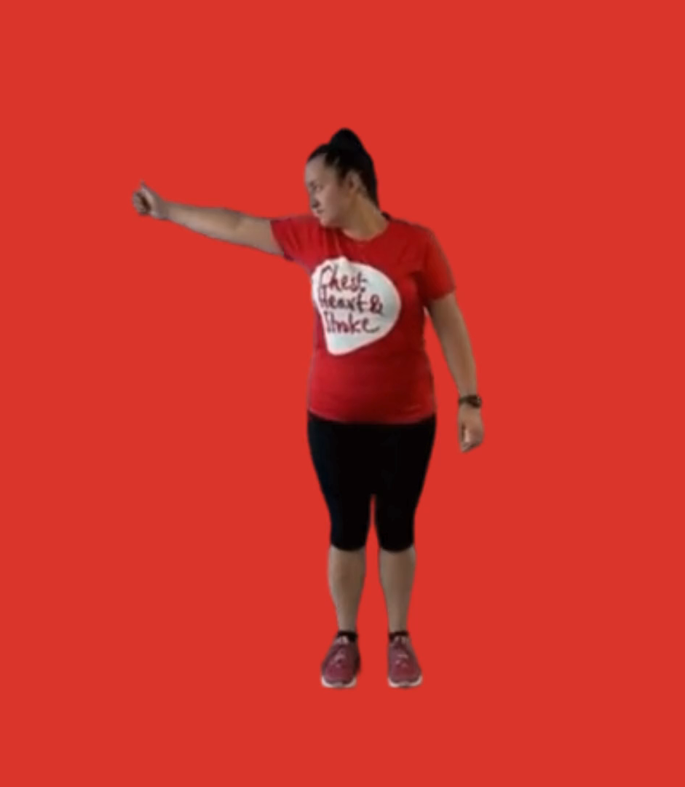
The Elephant
40 seconds
Place your ear on your right shoulder
Extend your right arm
Draw a lazy number 8 (lying on its side), when you are at the bottom bend your knees, when you are at the top straighten your knees
Change sides

Slide 7
Rest

Slide 8
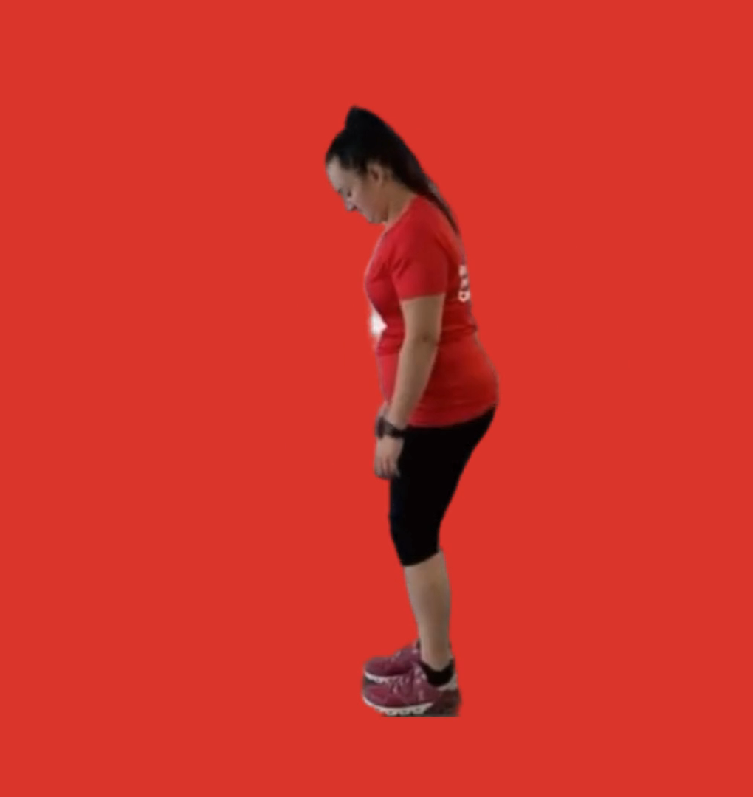
Gravity Glider
40 seconds
Stand and bend both knees crossing your feet over
Exhale as you lean forward slowly and glide your arms down your legs
Now glide back up until you are standing upright
Cross your feet the other way and repeat

Slide 9
Rest

Slide 10
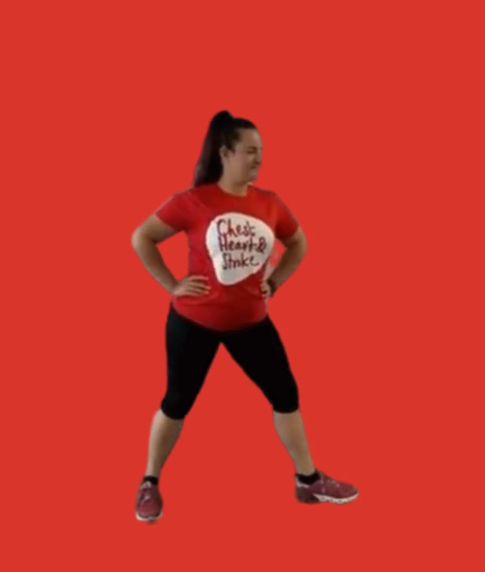
The Grounder
40 seconds
Hold a warrior yoga pose (front leg bent, back leg straight)
Inhale, straighten your knee
Exhale bend the knee again
Change legs and repeat

Slide 11
Rest

Slide 12

Lazy 8
40 seconds
Put one arm out directly in front of you and point your thumb to the ceiling
Draw a large lying on its side
Start up to the left, down then back through the centre and up to the right
Focus your eyes on your thumb
Change hands and repeat

Slide 13
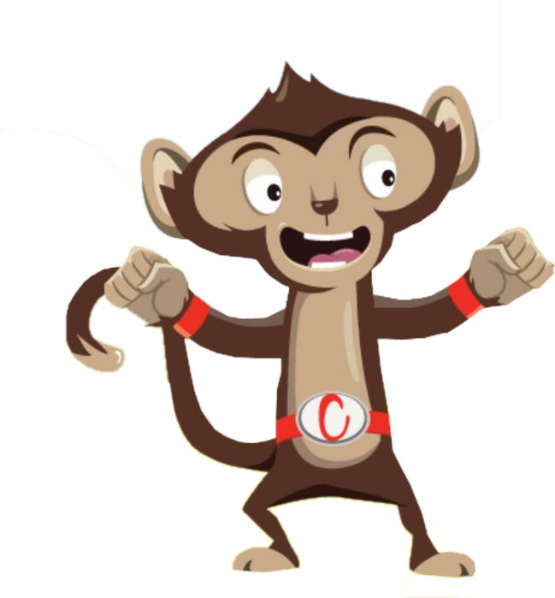
Finished!

