Slide 1
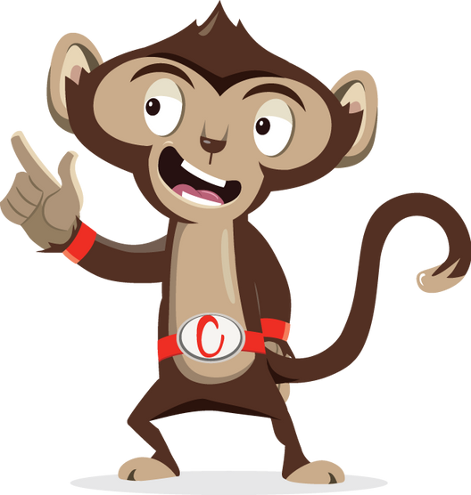


Brain Gym

Slide 2
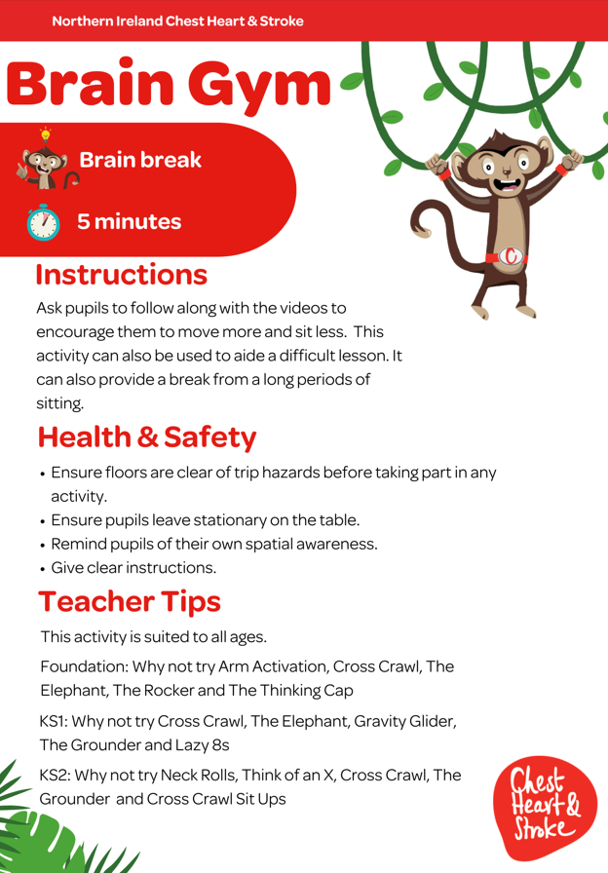

Slide 3
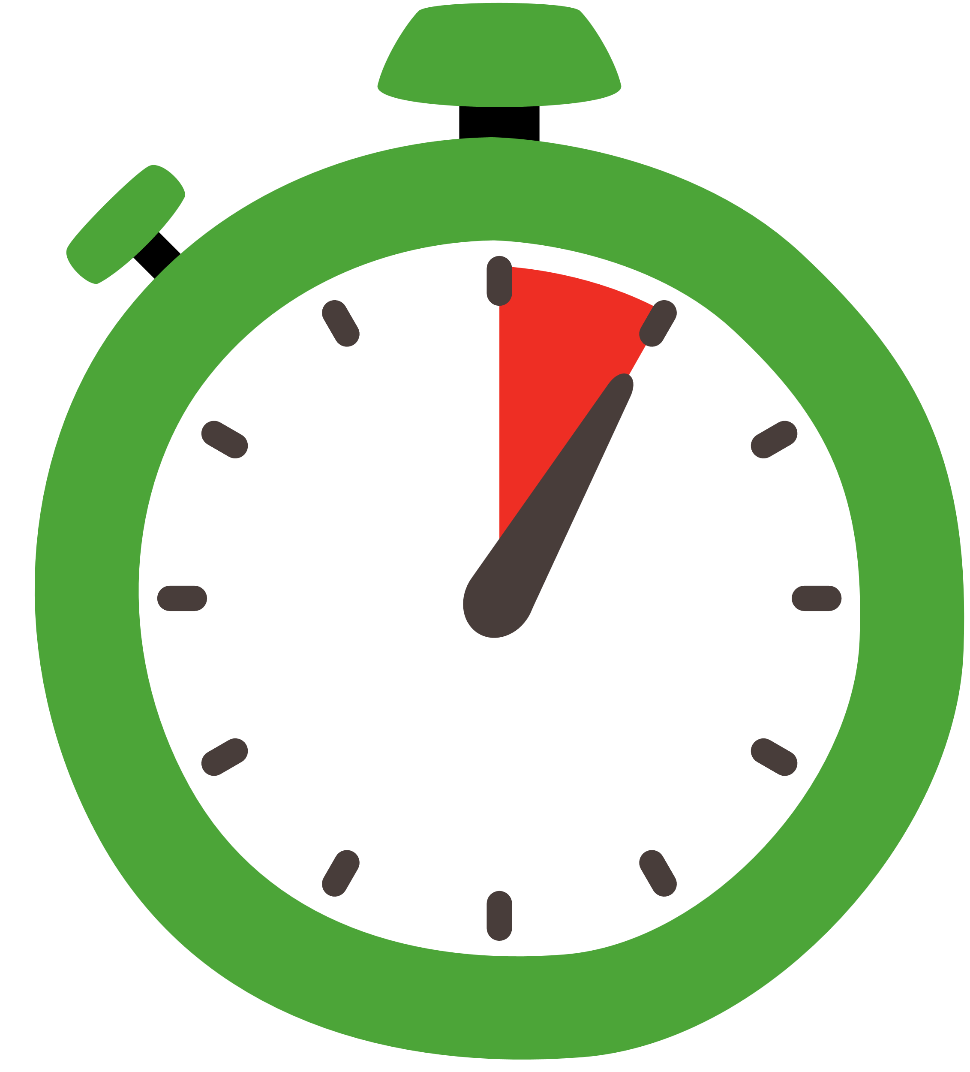

Key Stage 2
Time:
5 minutes
Resources :
stopwatch

Slide 4

Neck Rolls
40 seconds
While standing, relax your shoulders, drop your head and look down
Let your head rotate gently one direction drawing a full circle
Change direction and repeat

Slide 5
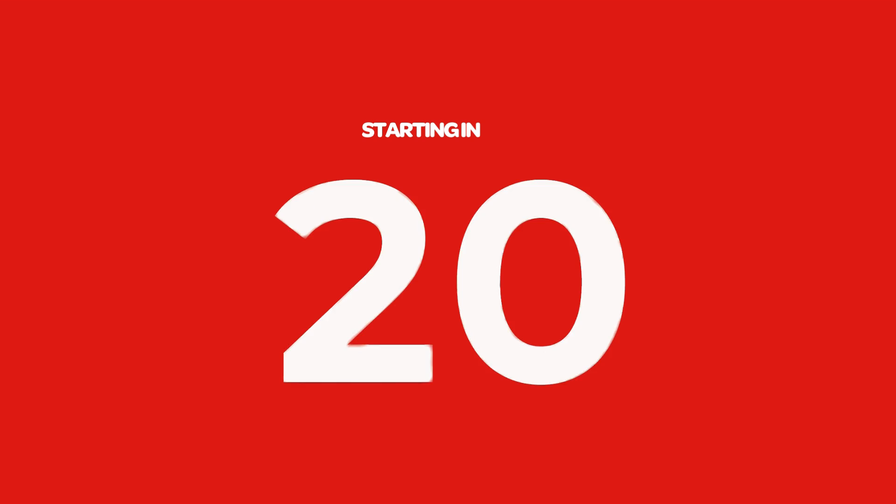
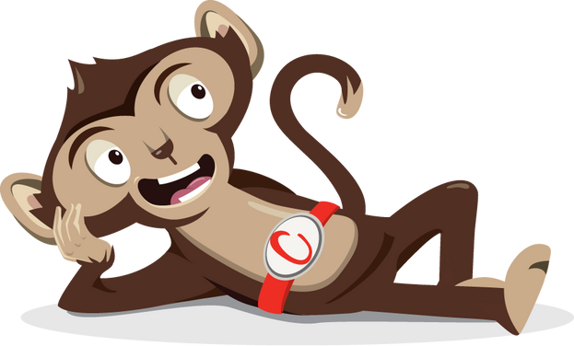
Rest

Slide 6
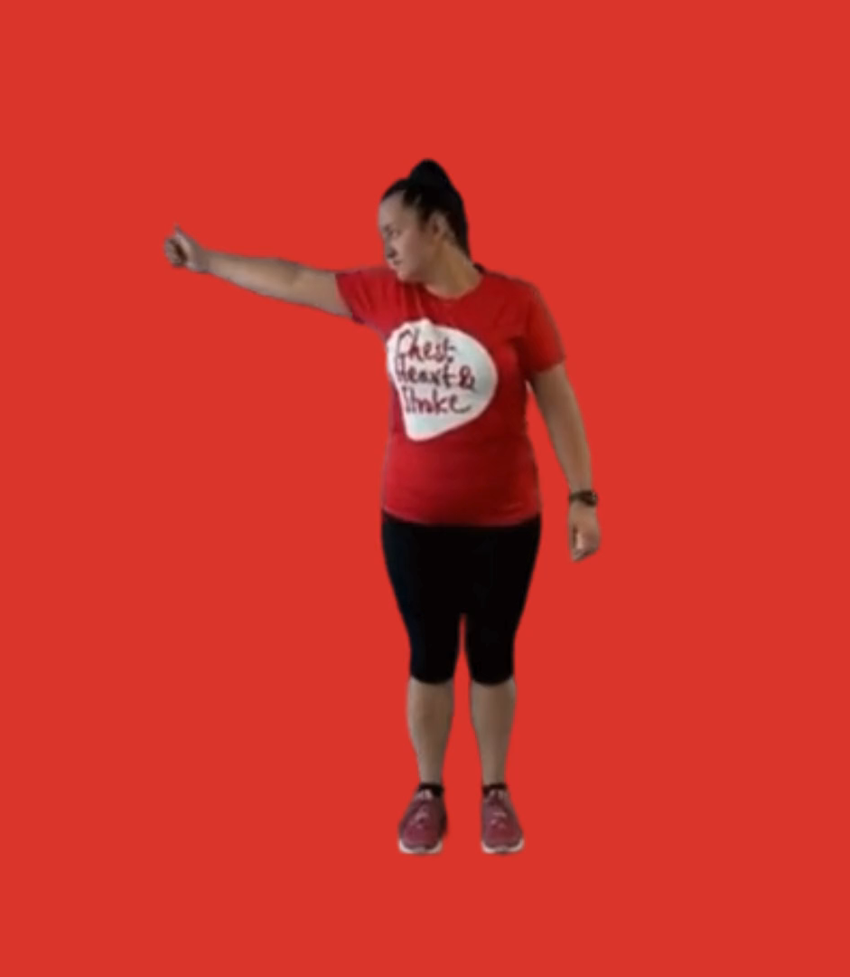
The Elephant
40 seconds
Place your ear on your right shoulder
Extend your right arm
Draw a lazy number 8 (lying on its side), when you are at the bottom bend your knees, when you are at the top straighten your knees
Change sides

Slide 7
Rest

Slide 8
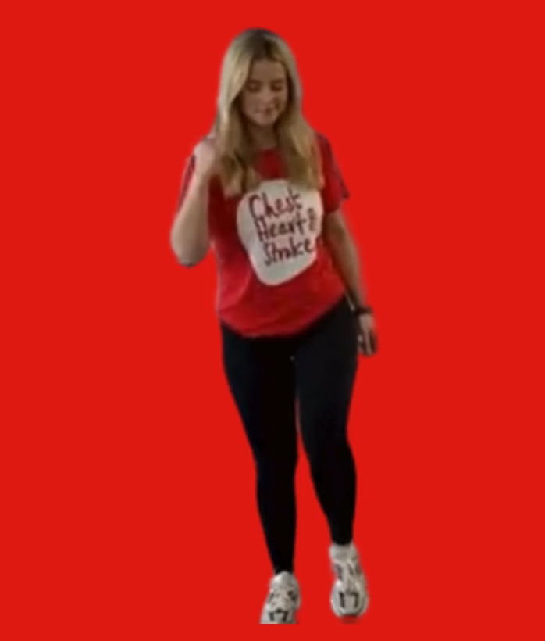
Cross Crawl
40 seconds
While standing, march on the spot
Bring your opposite elbow to the opposite knee
Twist your body as you touch your knees

Slide 9
Rest

Slide 10
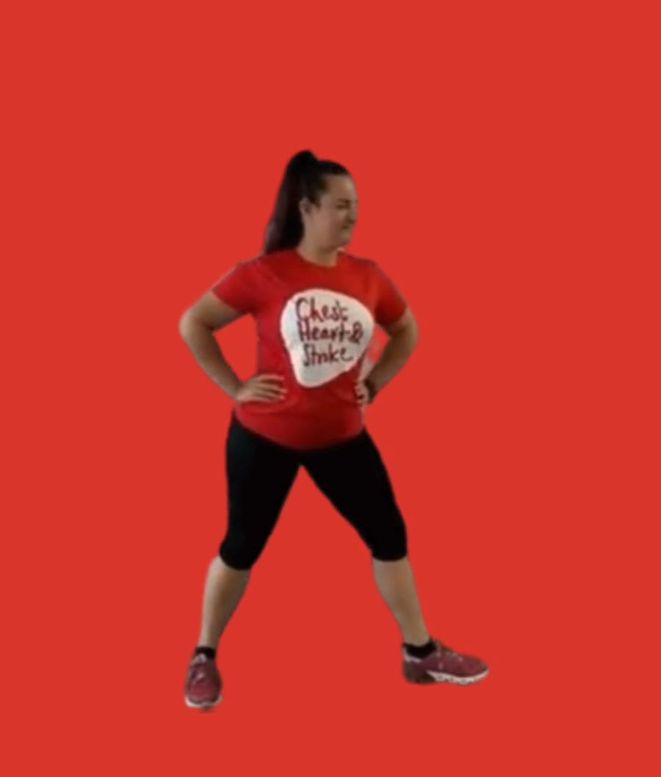
The Grounder
40 seconds
Hold a warrior yoga pose (front leg bent, back leg straight)
Inhale, straighten your knee
Exhale bend the knee again
Change legs and repeat

Slide 11
Rest

Slide 12
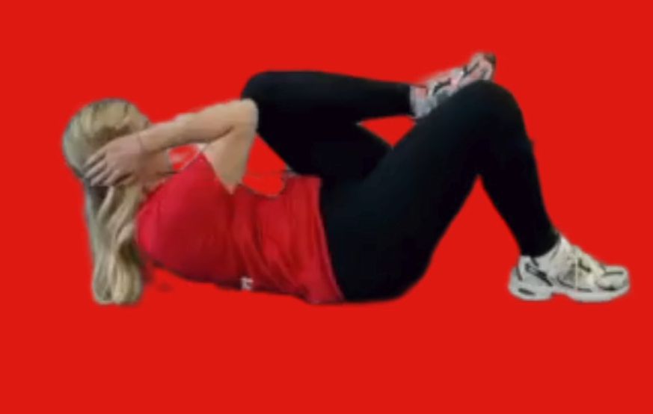
Cross Crawl Sit Ups
40 seconds
Sit on the floor
Similar to standing cross crawl, put arms behind your head
Raise opposite knee to opposite elbow (while keeping other foot on the floor)
Then change sides
Notes:
You will need a timer for this slide as this is just an image.

Slide 13
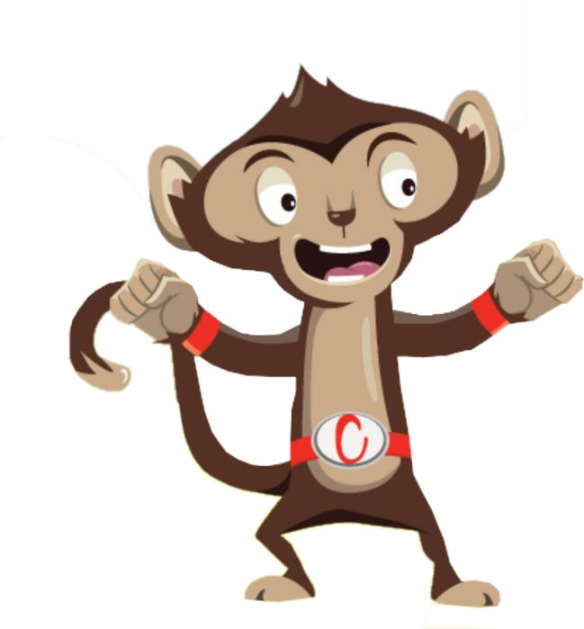
Finished!

