Slide 1



Learn a New Language

Slide 2
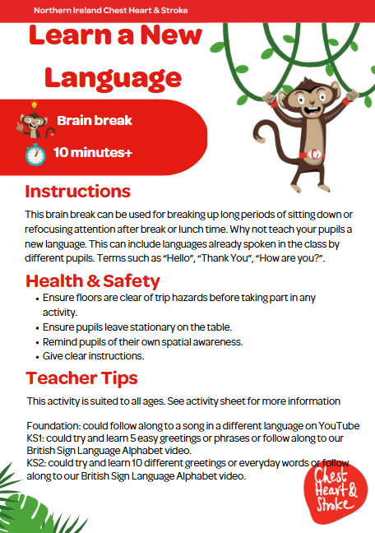

Slide 3

Foundation, KS1 & KS2
Time: 3 -5 minutes
Notes:
Ask pupils to copy the actions for each number for 30s, then rest for 30s. Repeat for a total of 5 times.

Slide 4

Get Ready to Follow Along

Slide 5

Insert Video!

