Slide 1



Lily Pad

Slide 2
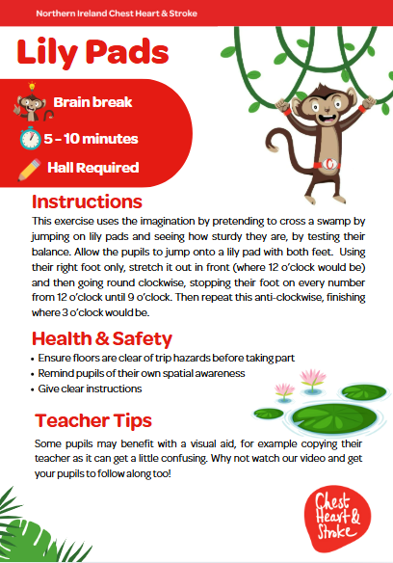

Slide 3

Foundation, KS1 & KS2
Time: 5 -10 minutes
Notes:
Ask pupils to copy the actions for each number for 30s, then rest for 30s. Repeat for a total of 5 times.

Slide 4
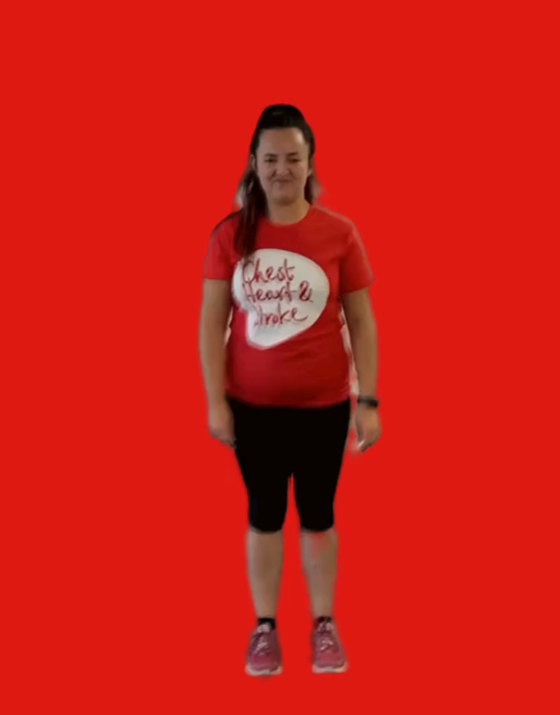
Start by jumping onto the first lily pad
Using your right foot only, stretch it out in front (where 12 o’clock would be)
Then go around clockwise, stop your foot on every number from 12 o’clock until 9 o’clock
Then repeat this anti-clockwise, finishing where 3 o’clock would be
Repeat this sequence three times, each time imagining that the lily pad has got bigger, so you need to stretch

