Slide 1
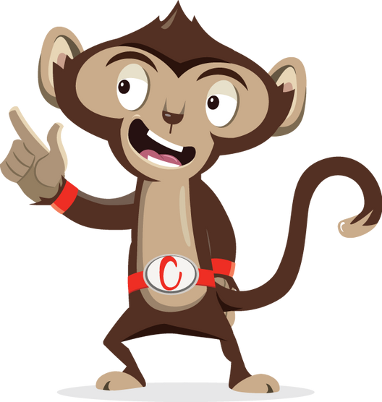


Would You Rather?

Slide 2
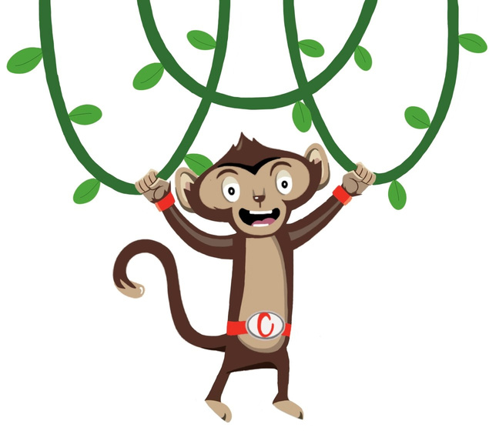
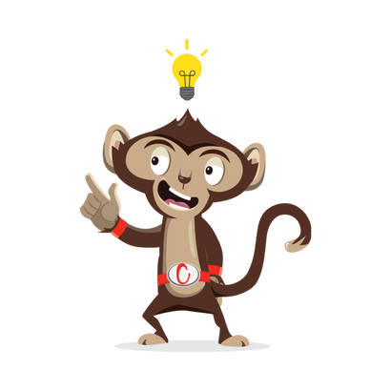

Would You Rather
Brain break
5 minutes
Instructions
Place two coloured pieces of paper or objects on either side of the room. Use these to represent the answers to a series of ‘would you rather’ questions.
Health & Safety
  Ensure floors are clear of trip hazards before taking part in any activity.
  Ensure pupils leave stationary on the table.
  Remind pupils of their own spatial awareness.
  Give clear instructions.
Teacher Tips
This activity is suited to all ages.
Refer to the activity powerpoint for example questions to ask.
Foundation: Can be simplified by asking ‘which do you like more’. For example, cats or dogs.

Slide 3


Foundation Level
Time: 5 minutes
Resources : 2x coloured pieces of paper or objects
Notes:
Ask pupils to copy the actions for each number for 30s, then rest for 30s. Repeat for a total of 5 times.

Slide 4

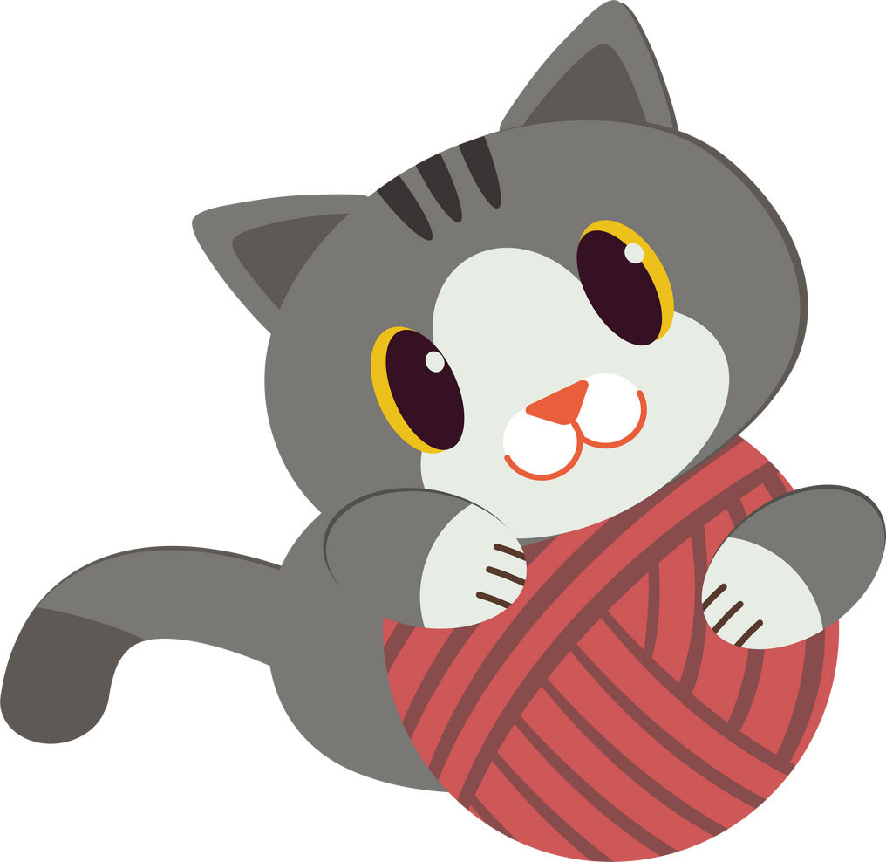
Which do you like more?
or
Dogs
Cats

Slide 5

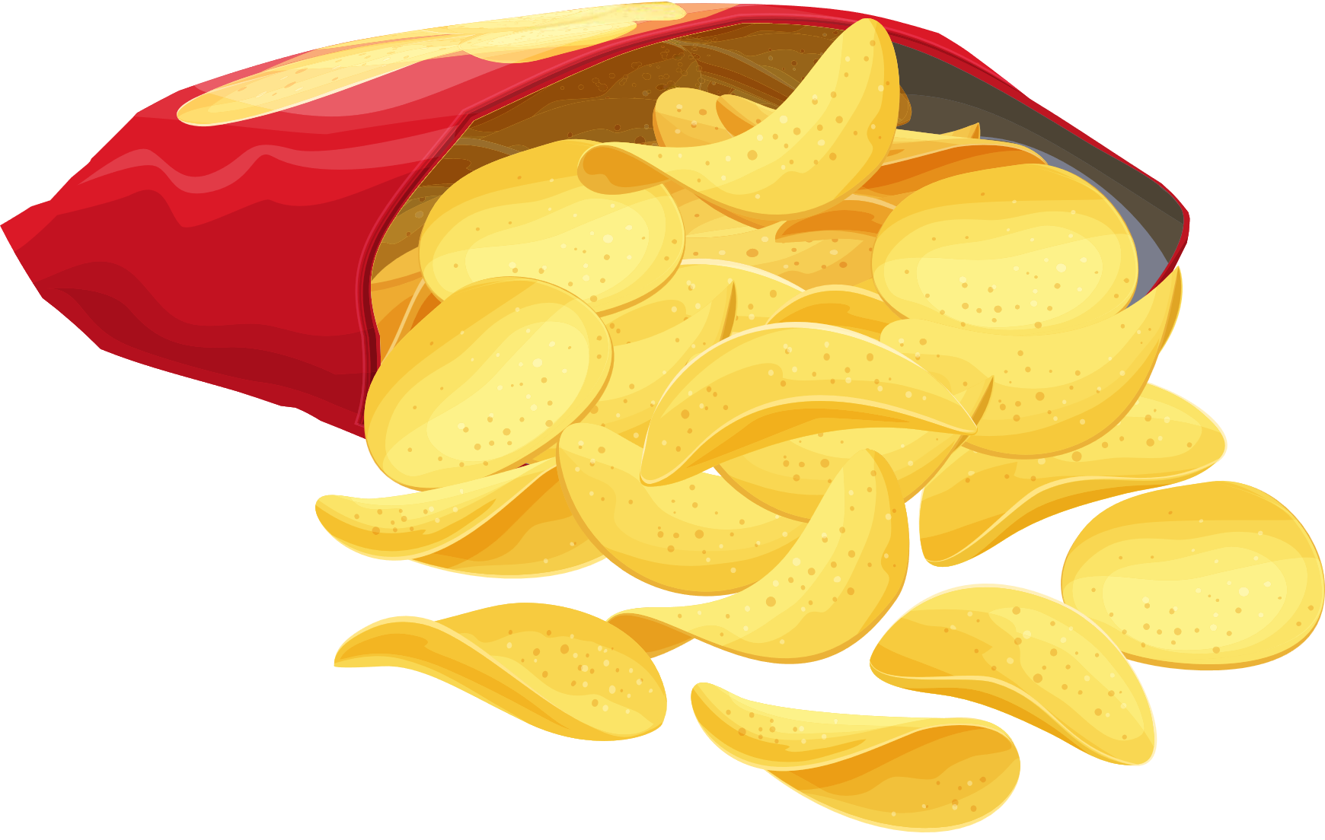
Which do you like more?
or
Chocolate
Crisps

Slide 6


Which do you like more?
or
Sand
Sea

Slide 7


Which do you like more?
or
Sun
Snow

Slide 8


Which do you like more?
or
Apple
Banana

Slide 9
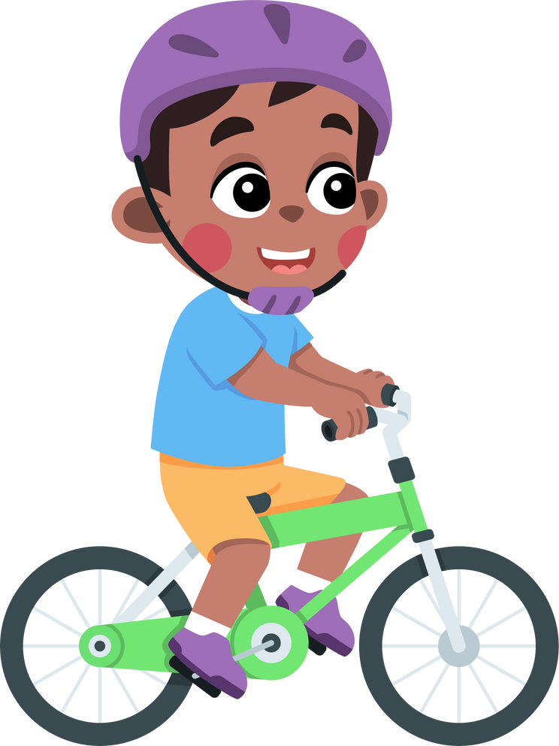
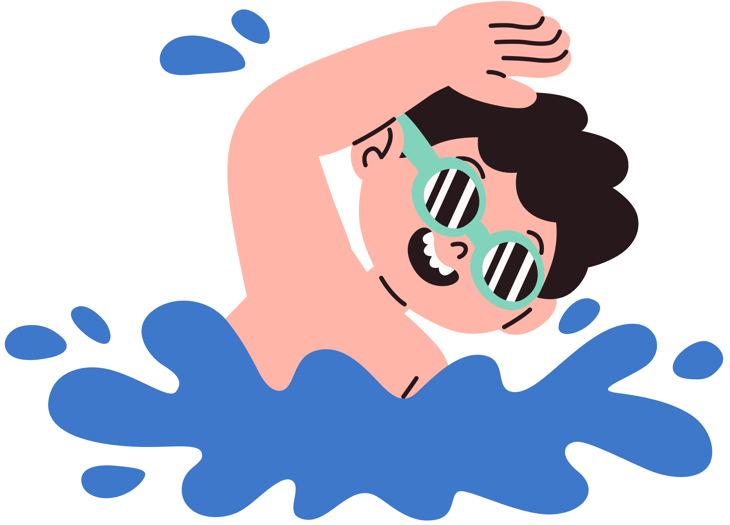
Which do you like more?
or
Swimming
Riding your bike

Slide 10


Which do you like more?
or
Football
Skipping

Slide 11


Which do you like more?
or
Water
Milk

Slide 12

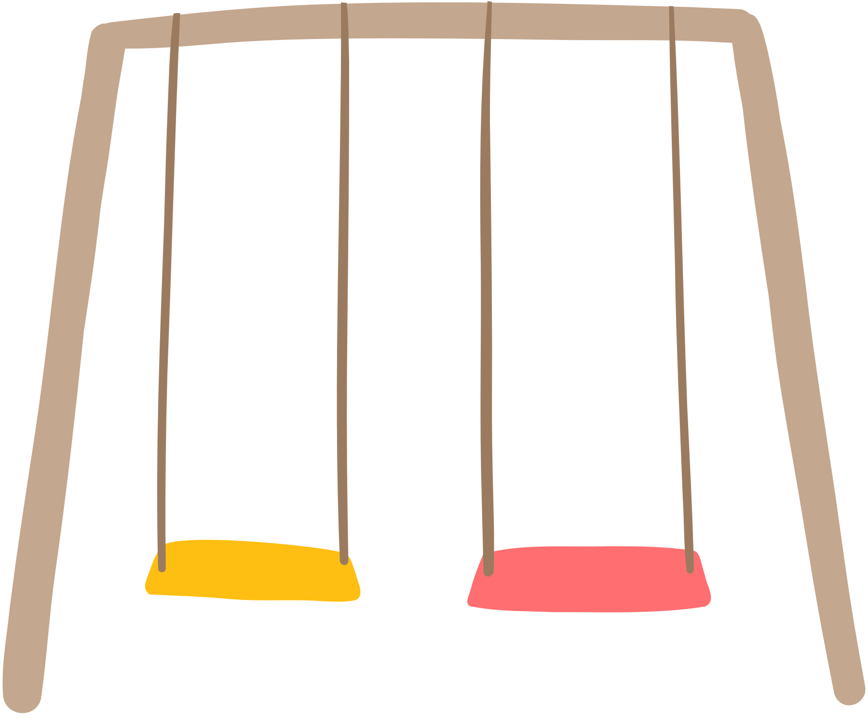
Which do you like more?
or
Watching a movie
Going to the park

Slide 13


Which do you like more?
or
Colouring in
Reading a book

Slide 14
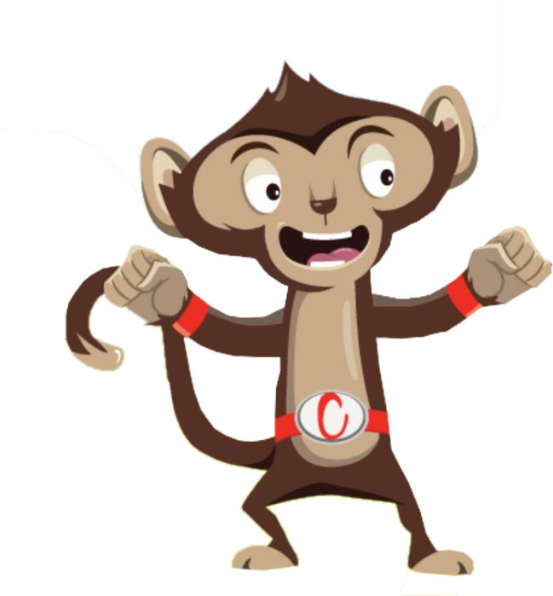
Finished!

