Slide 1
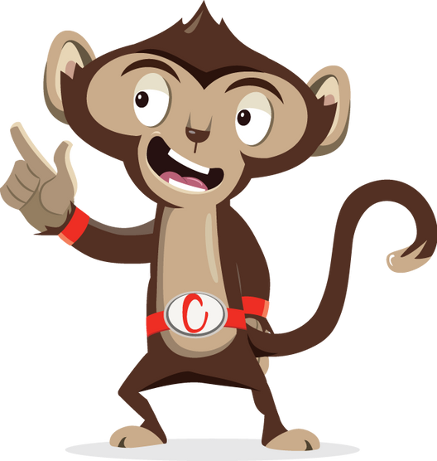


Would You Rather?

Slide 2
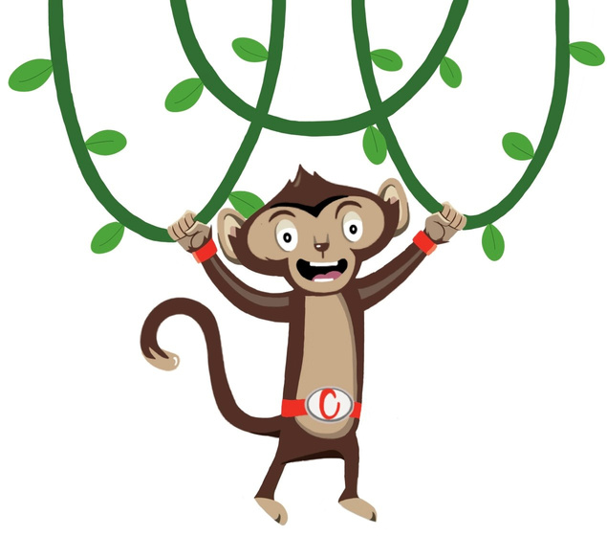


Would You Rather
Brain break
5 minutes
Instructions
Place two coloured pieces of paper or objects on either side of the room. Use these to represent the answers to a series of ‘would you rather’ questions.
Health & Safety
  Ensure floors are clear of trip hazards before taking part in any activity.
  Ensure pupils leave stationary on the table.
  Remind pupils of their own spatial awareness.
  Give clear instructions.
Teacher Tips
This activity is suited to all ages.
Refer to the activity powerpoint for example questions to ask.
Foundation: Can be simplified by asking ‘which do you like more’. For example, cats or dogs.

Slide 3


Key Stage 1 & 2
Time: 5 minutes
Resources : 2x coloured pieces of paper or objects

Slide 4


Would you rather?
or
Be a famous singer
Be a famous actor

Slide 5
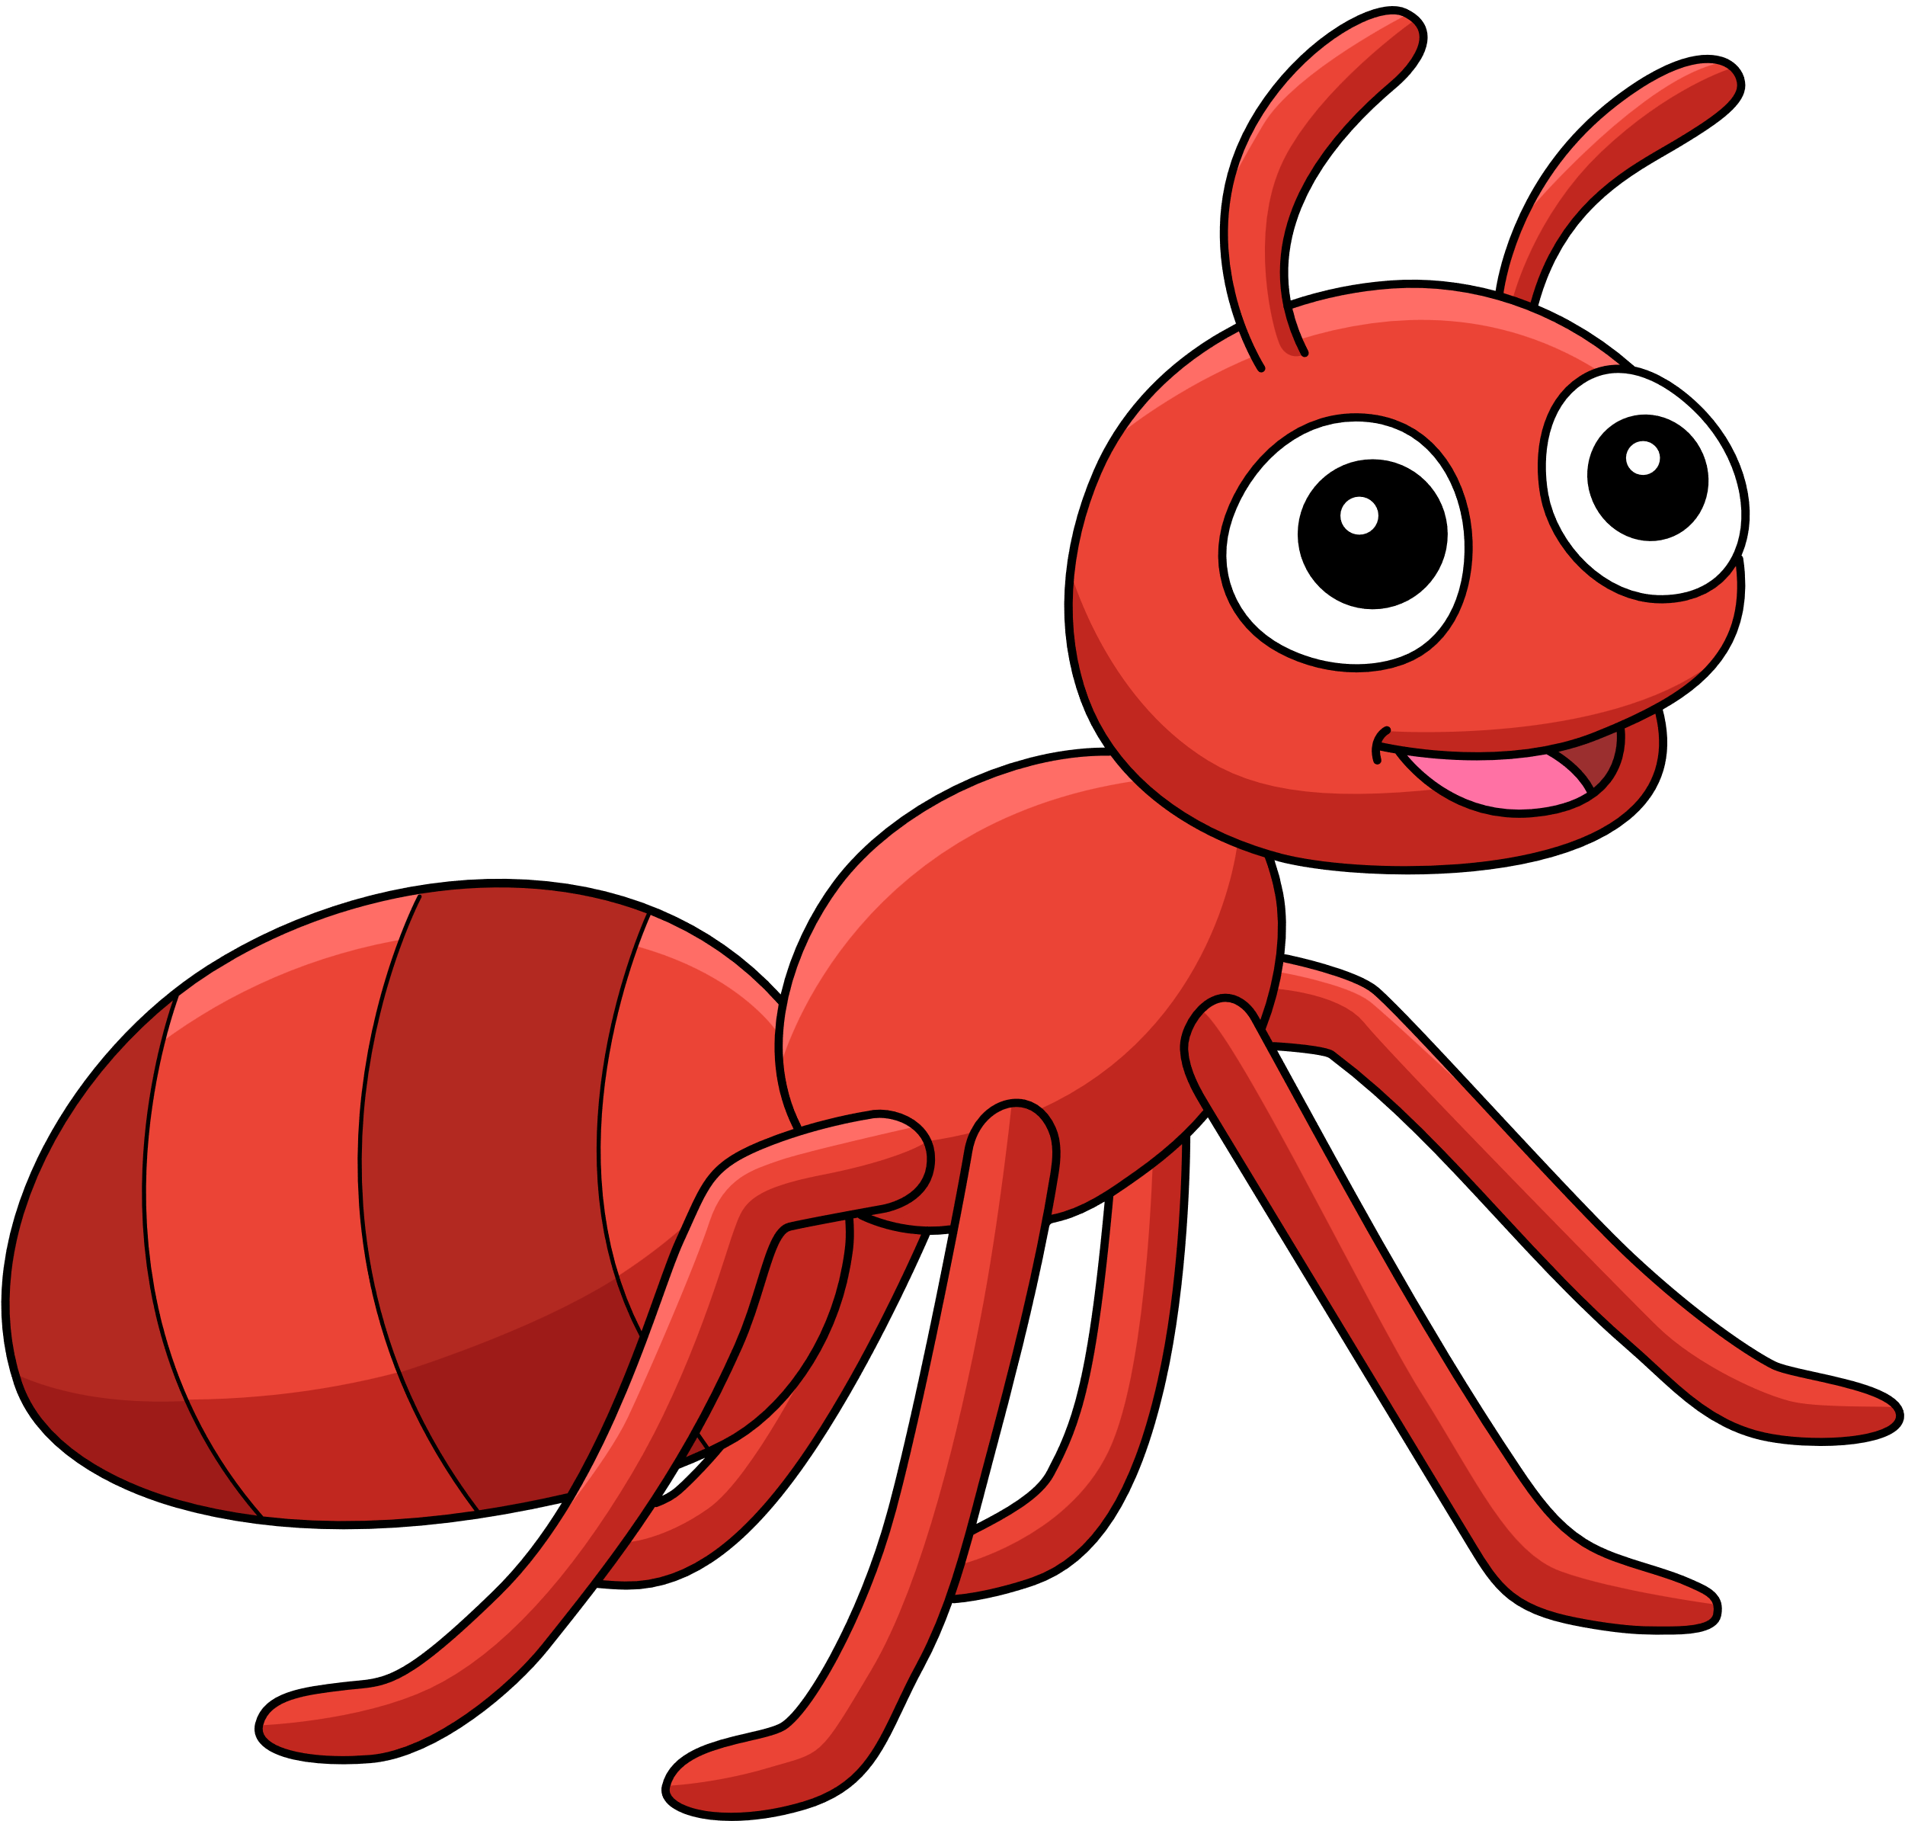

Would you rather?
or
Be an ant
Be a fly

Slide 6


Would you rather?
or
Always be too warm
Always be too cold

Slide 7

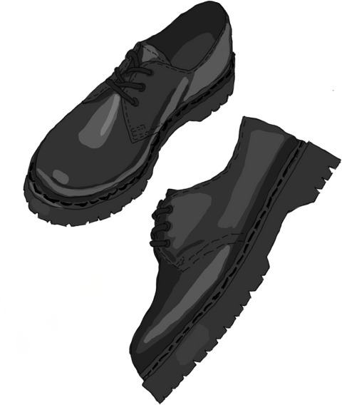
Would you rather?
or
Go to school with two different shoes
Go to school with your uniform inside out

Slide 8


Would you rather?
or
A cupcake
A slice of cake

Slide 9
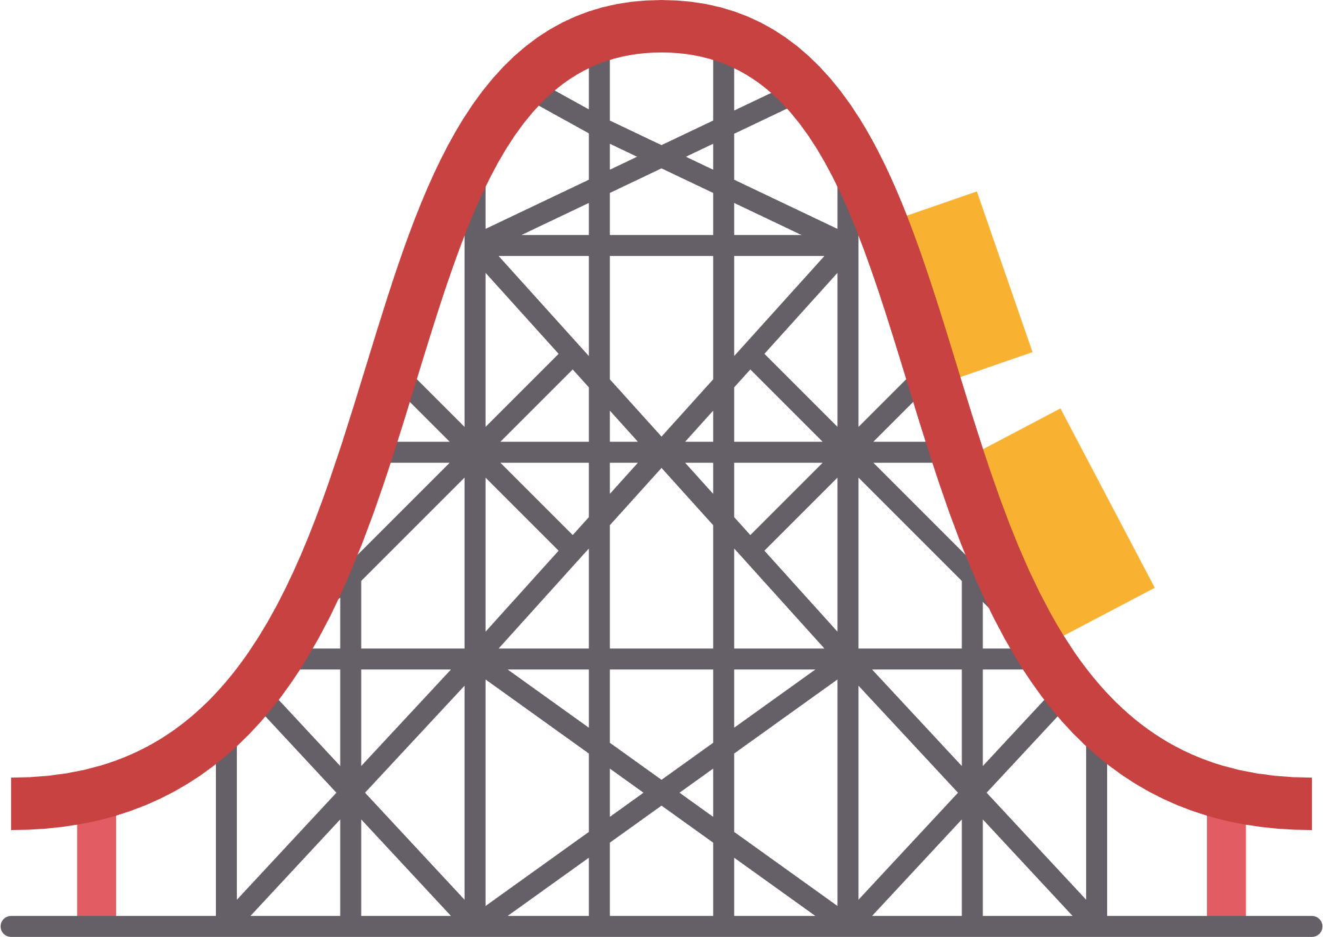

Would you rather?
or
Ride on a rollercoaster
Go down a waterslide

Slide 10

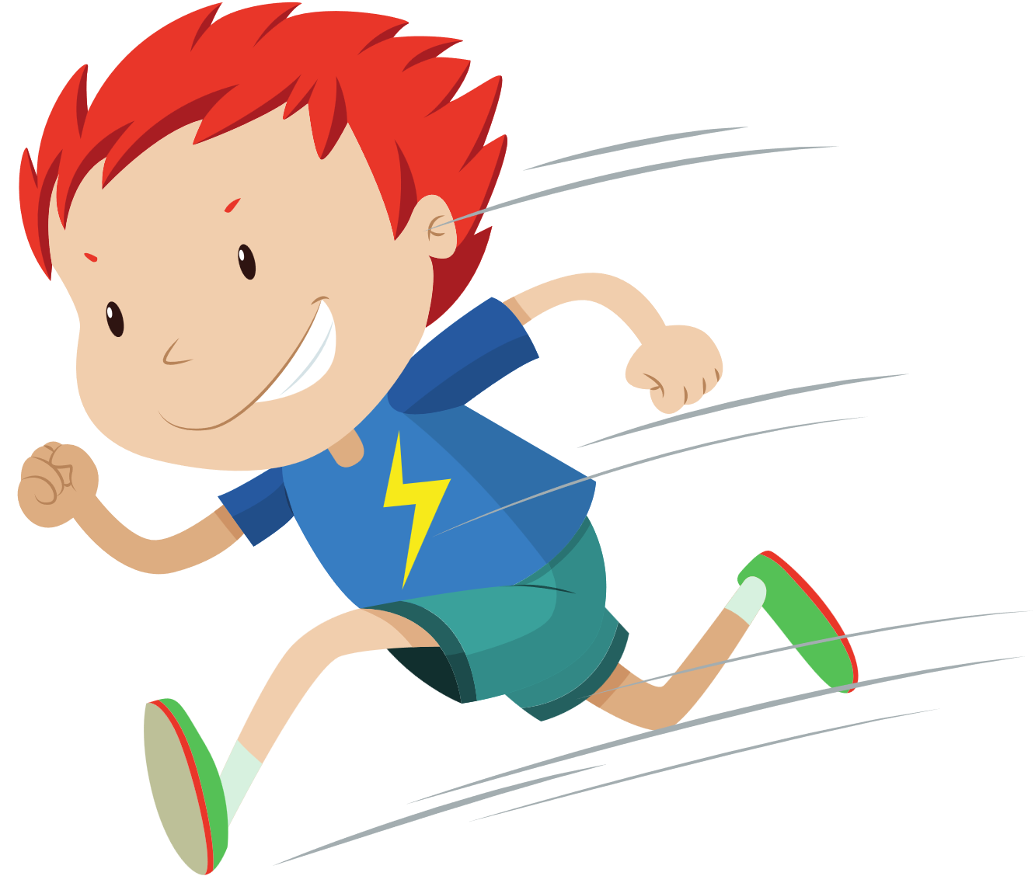
Would you rather?
or
Have super speed
Have super strength

Slide 11

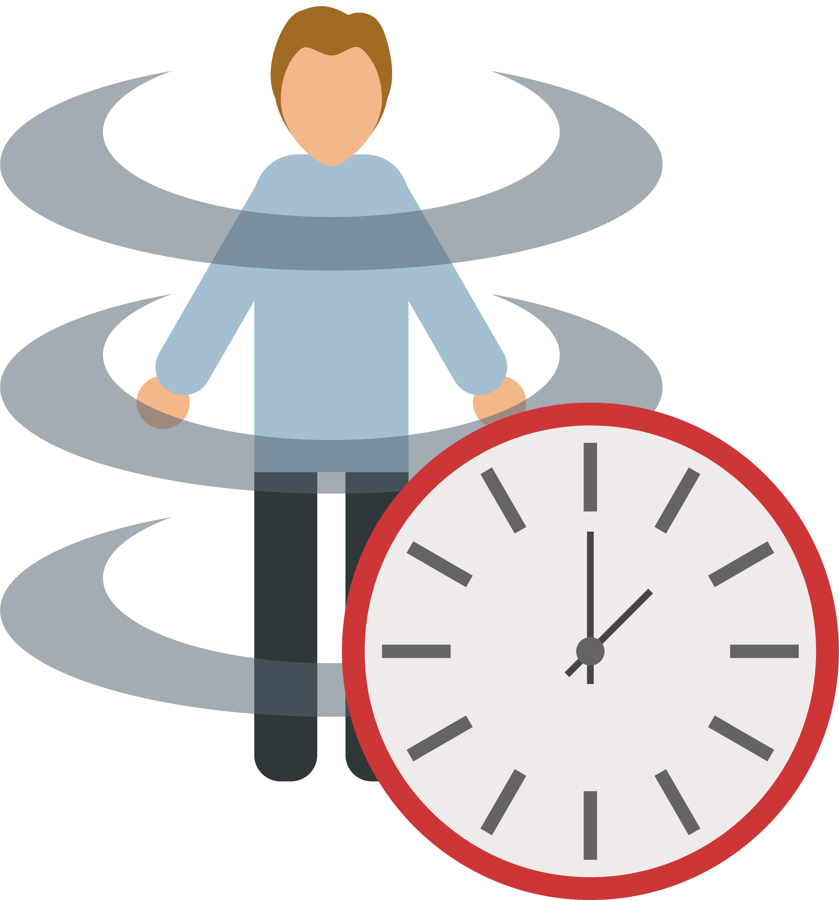
Would you rather?
or
Be invisible
Be able to time travel

Slide 12


Would you rather?
or
Have no YouTube
Have no Netflix

Slide 13


Would you rather?
or
Sunshine
Rain

Slide 14
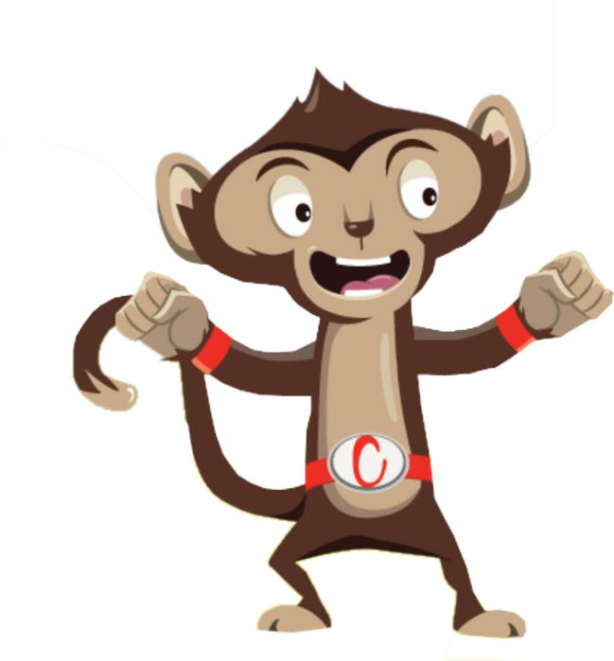
Finished!

