Slide 1



Active Alphabet

Slide 2
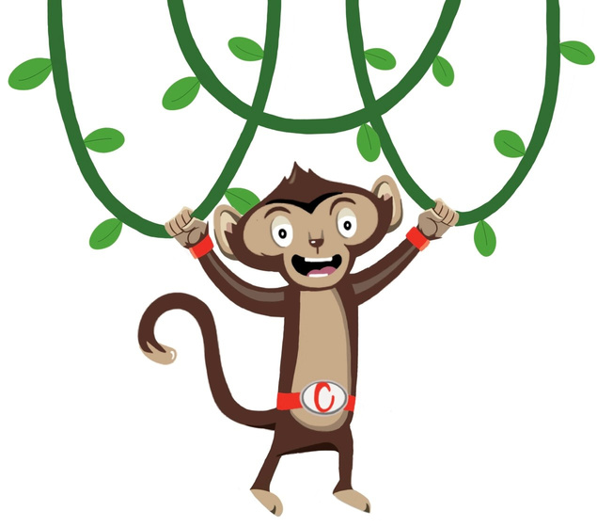


Active Alphabet
Cardio Booster
5 minutes
Instructions
This active break can be used for transitioning between lessons and break times. Ask the pupils to spell out different words using the corresponding movements attached to each of the letters of the alphabet. Which can be found on PowerPoint. These are on PowerPoint.
Health & Safety
  Ensure floors are clear of trip hazards before taking part in any activity
  Push in all chairs
  Ensure pupils leave stationary on the table
  Remind pupils of their own spatial awareness
  Give clear instructions.
Teacher Tips
Suitable for all ages
Foundation: Pupils can spell out their name, or current topic words they are learning.
Key Stage 1: Pupils can spell current topic words or their full name.
Key Stage 2: Pupils can spell more difficult topic words they are learning, could also be made into a team game. Pupils can also try to figure out what their partner is spelling.

Slide 3


Active Alphabet
(Suited to All Levels)
Time: 5 minutes
Resources : none

Slide 4
