Slide 1
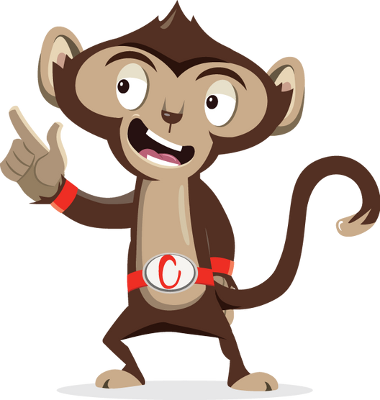


Animal Actions

Slide 2
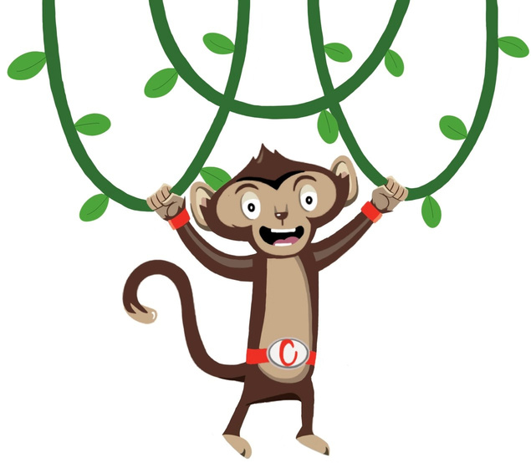

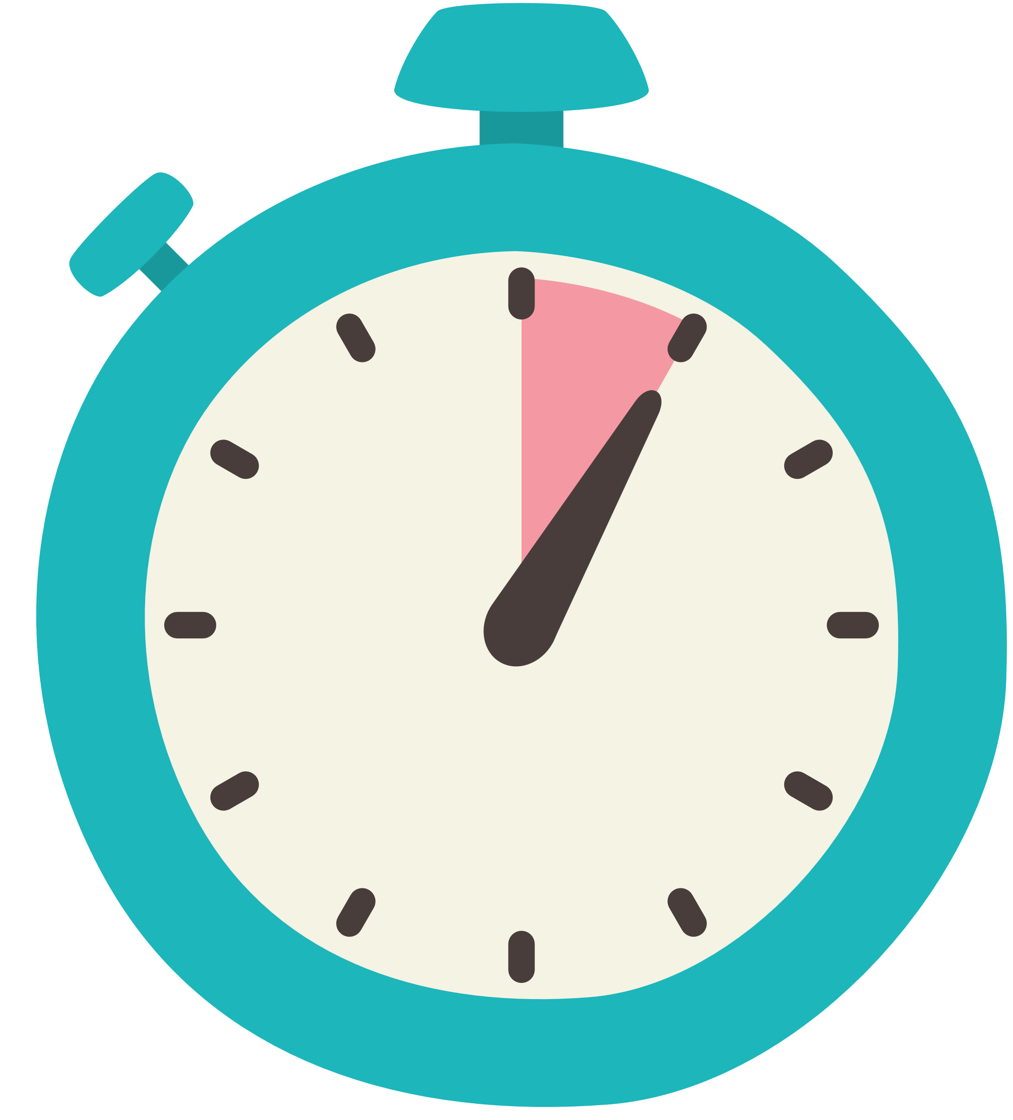

Animal Actions
Cardio Booster
5 Minutes
Stopwatch
Instructions
This activity can be done standing at desks with chairs pushed in. Click on the animal images to press play and then click again to stop on an animal movement . Get pupils to imitate the animal movement for 30 seconds. Repeat to complete all the animal movements.
Health & Safety
  Ensure floors are clear of trip hazards before taking part in any activity, especially if taking place in a playground
  Remind pupils of their own spatial awareness
  Ensure pupils know who to tell if they feel unwell while exercising
  Give clear instructions
Teacher Tips
Suitable for all ages. The activity has been created as a PowerPoint. The movements are a looping video so can start and stop as many times as you wish.
Foundation & KS1 can follow the same video
KS2 have more complex exercises

Slide 3


Foundation Level & Key Stage 1
Time: 5 minutes
Resources : stopwatch
Notes:
Ask pupils to copy the actions for each number for 30s, then rest for 30s. Repeat for a total of 5 times.

Slide 4
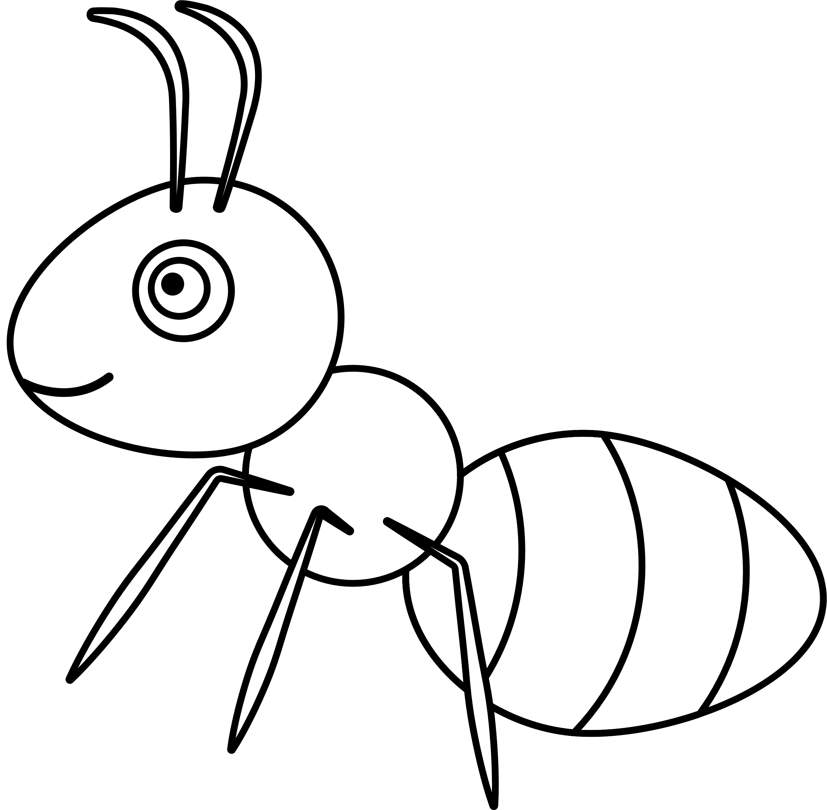


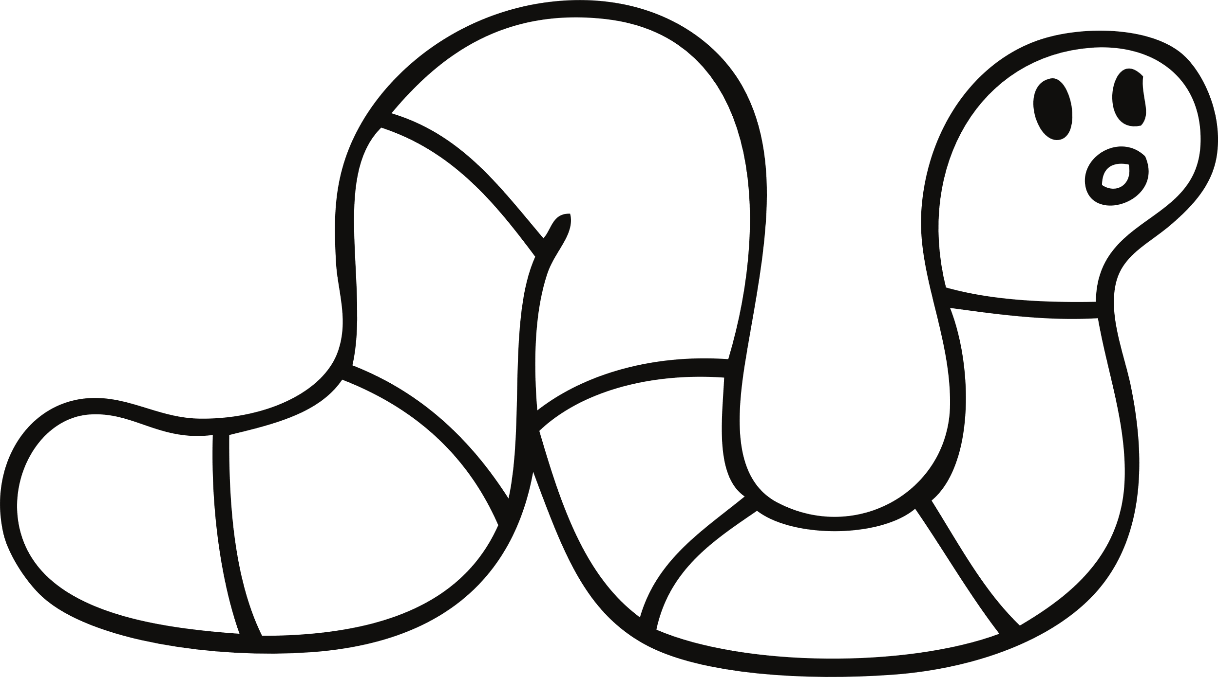
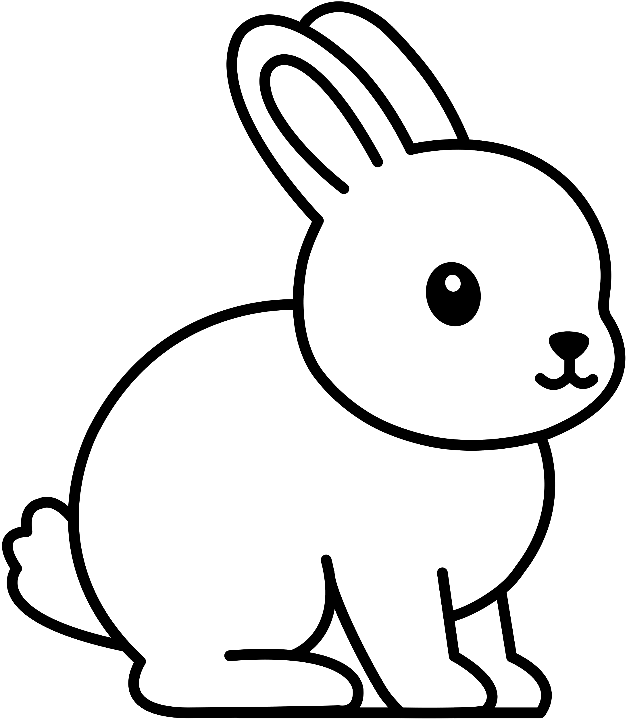
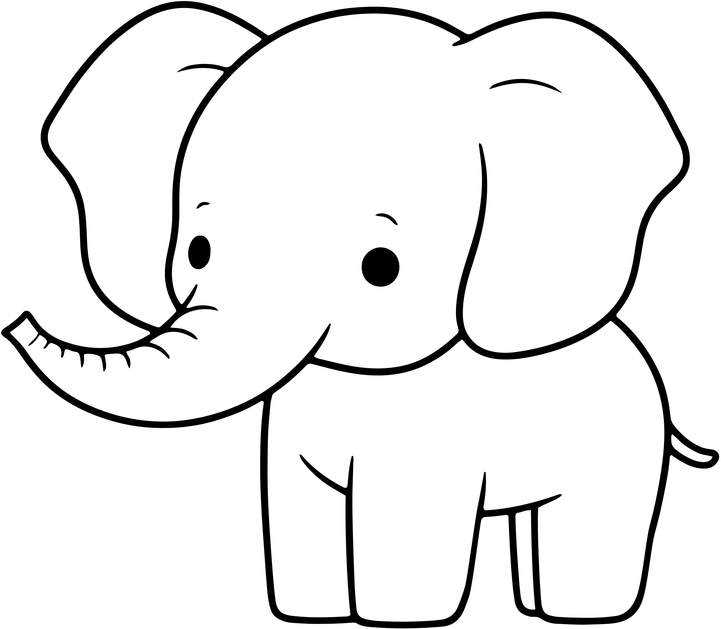
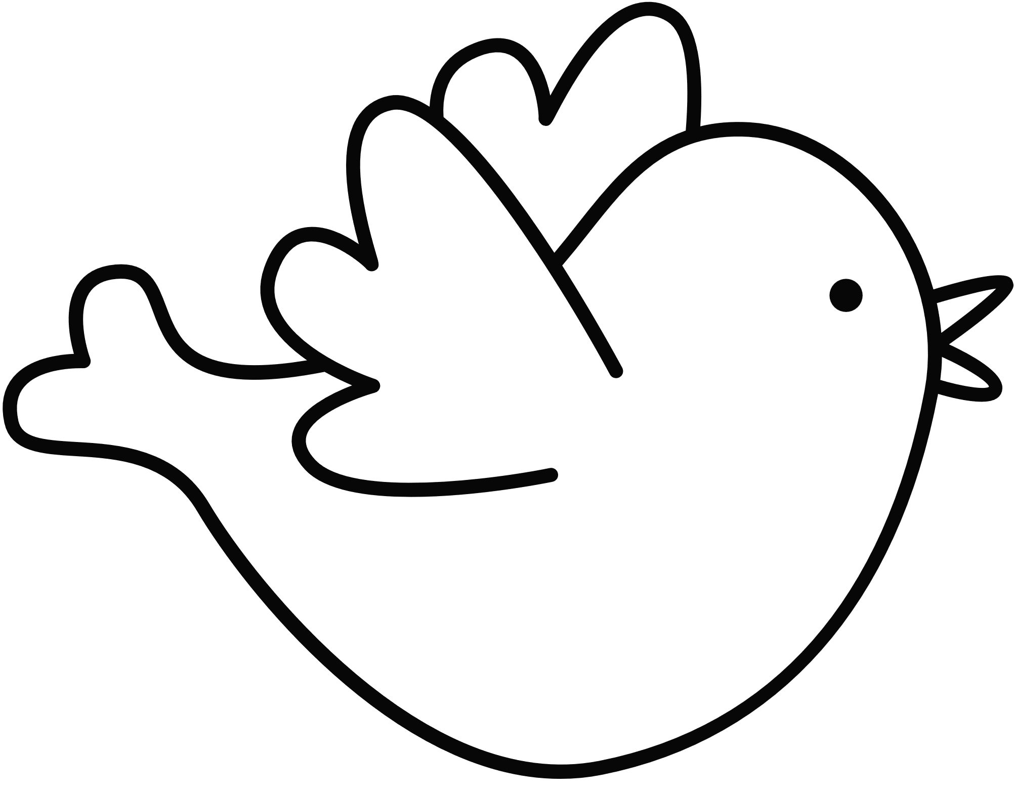
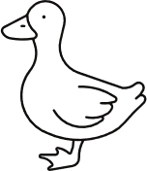

​
  Select ‘Start slideshow from beginning’ ​
  Click on the animal to press play, then click again to stop. (Note: the animal movements are a looping video so you can start and stop as many times as you like). ​
  Guide pupils through the movements
March
Clap
Stretch
like an ant
like a seal
like a cat
Wriggle
Hop
Stomp
like a worm
like a rabbit
like an elephant
Flap
Waddle
Snap
like a bird
like a duck
like a crocodile

Slide 5
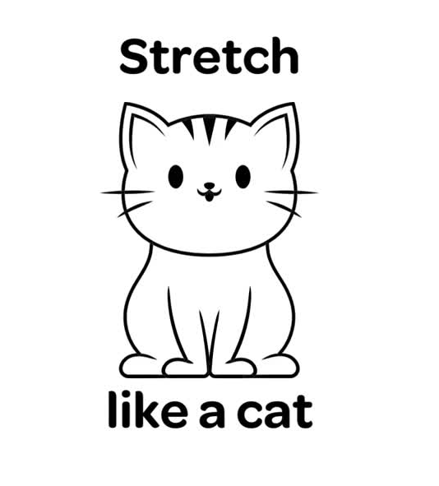

Slide 6
Key Stage 2
Time:
5 minutes
Resources :
stopwatch

Slide 7

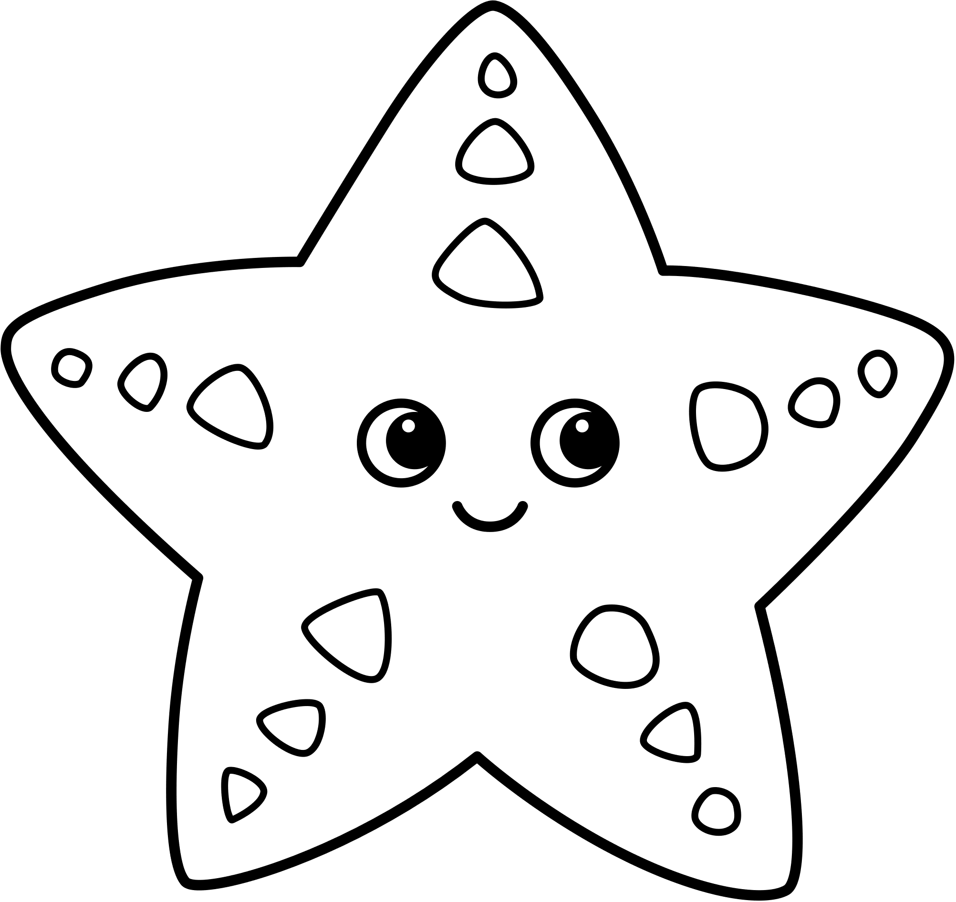
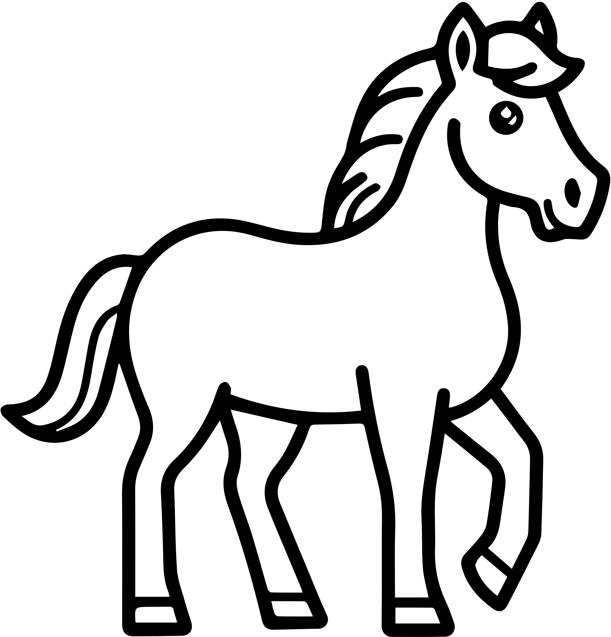
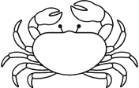
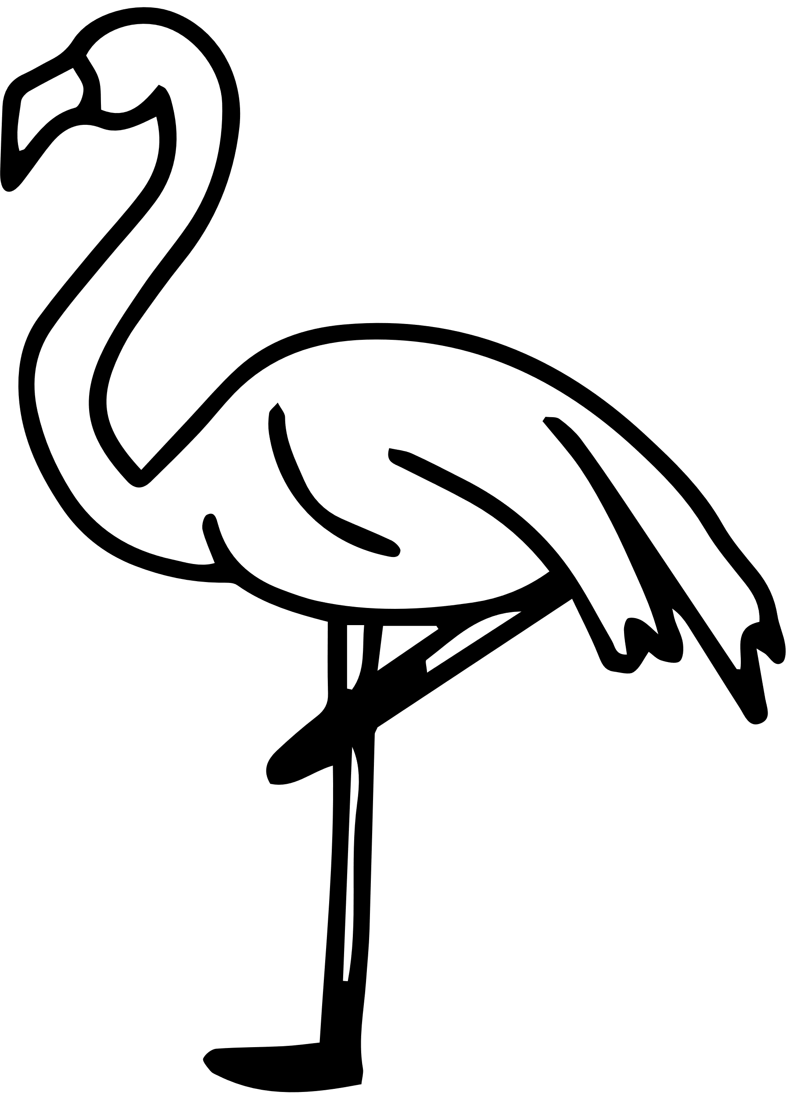
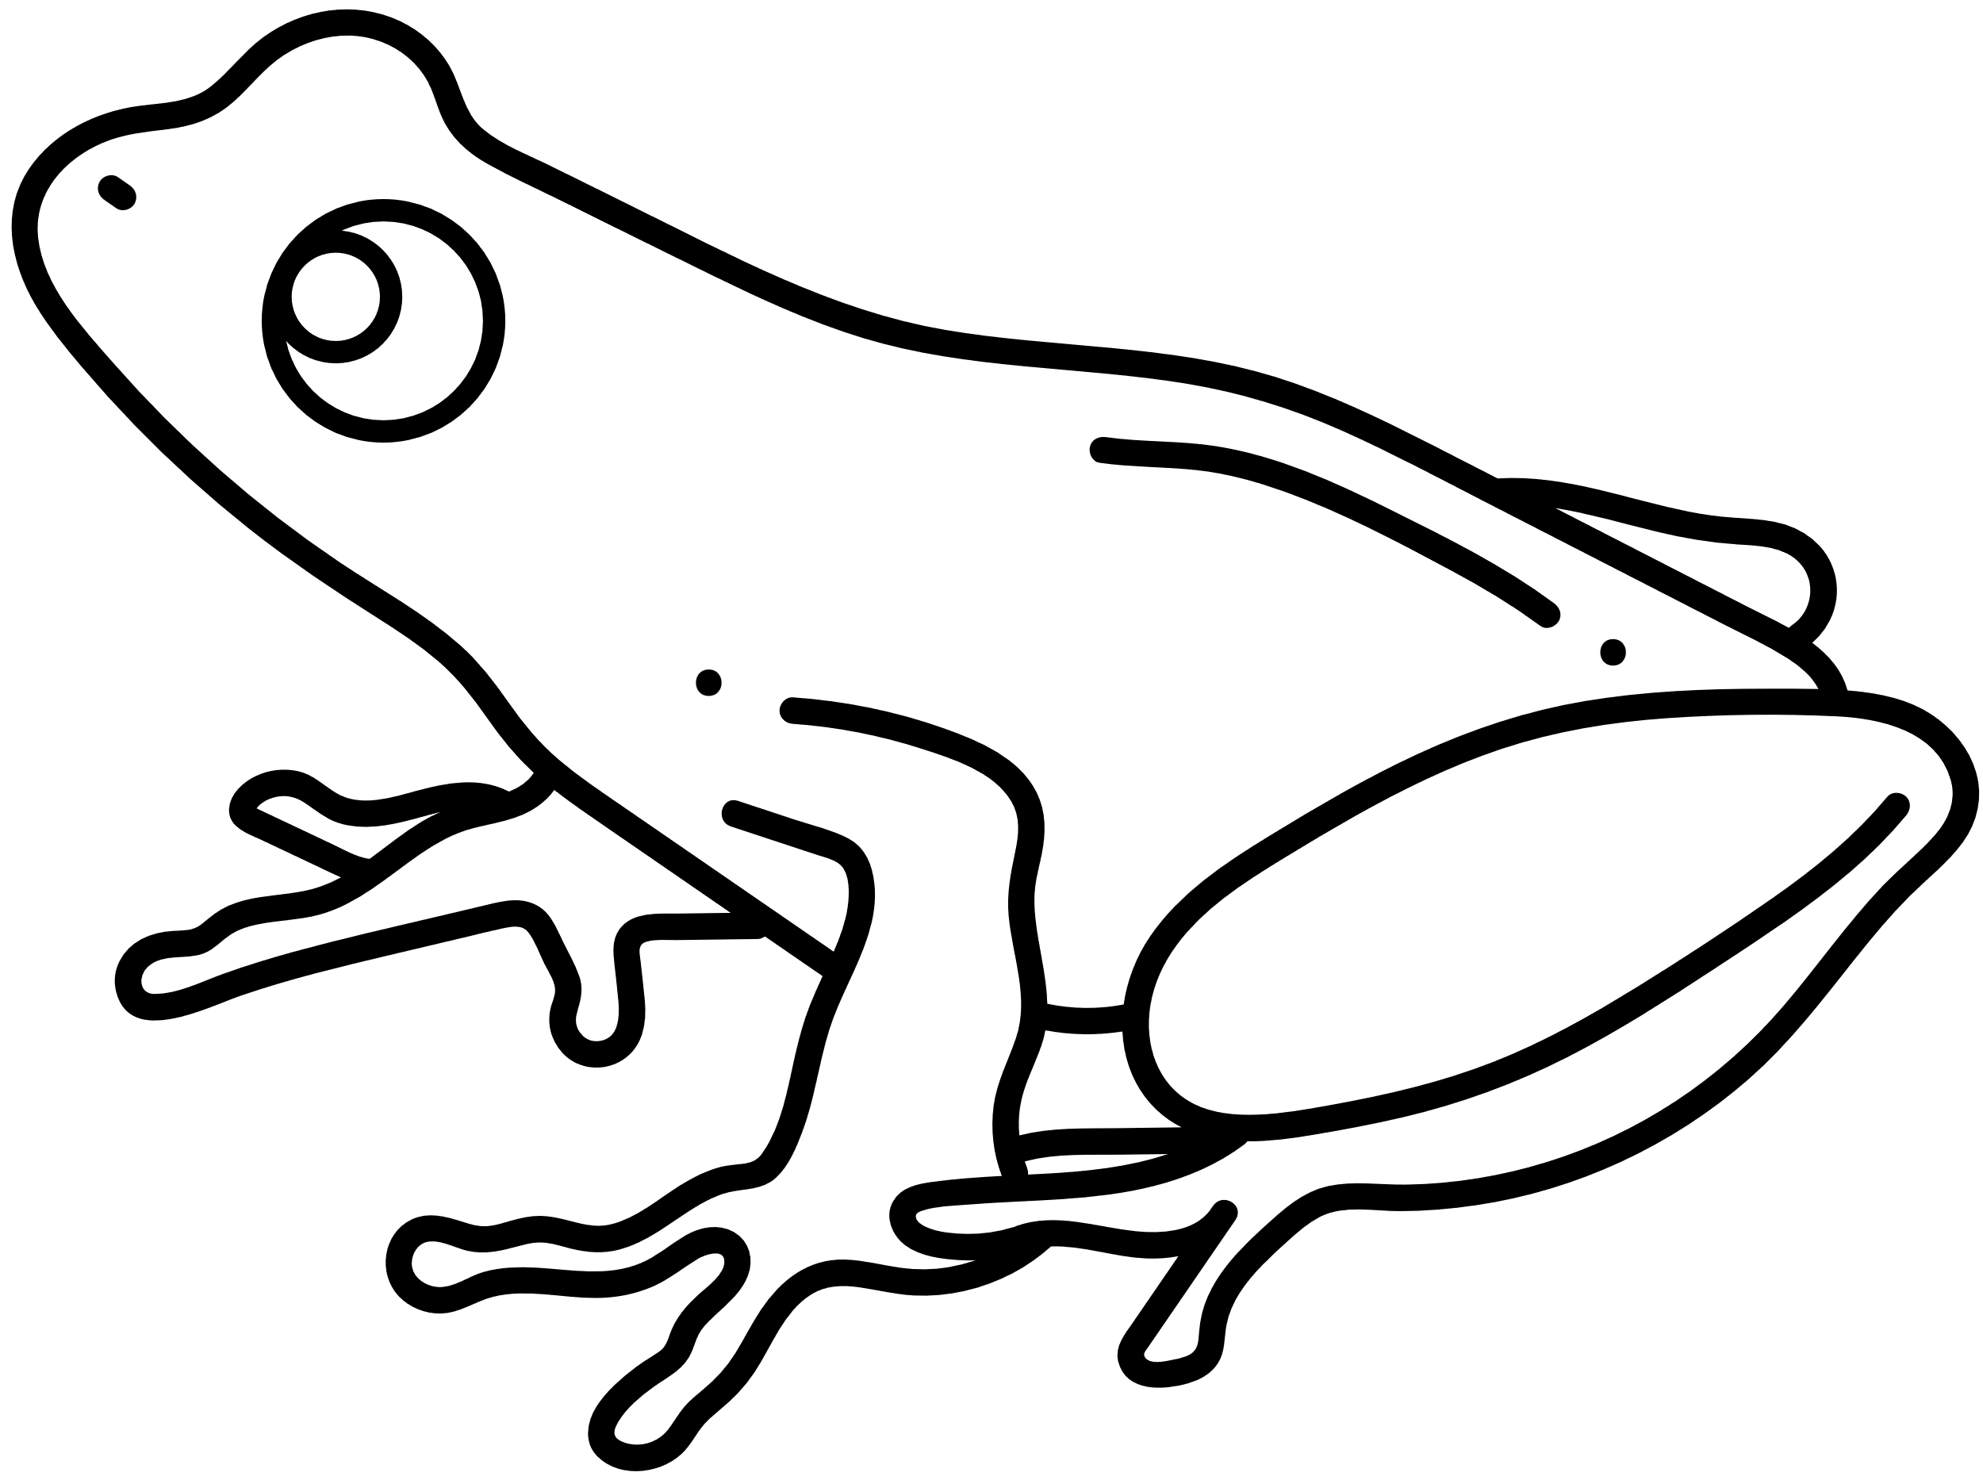
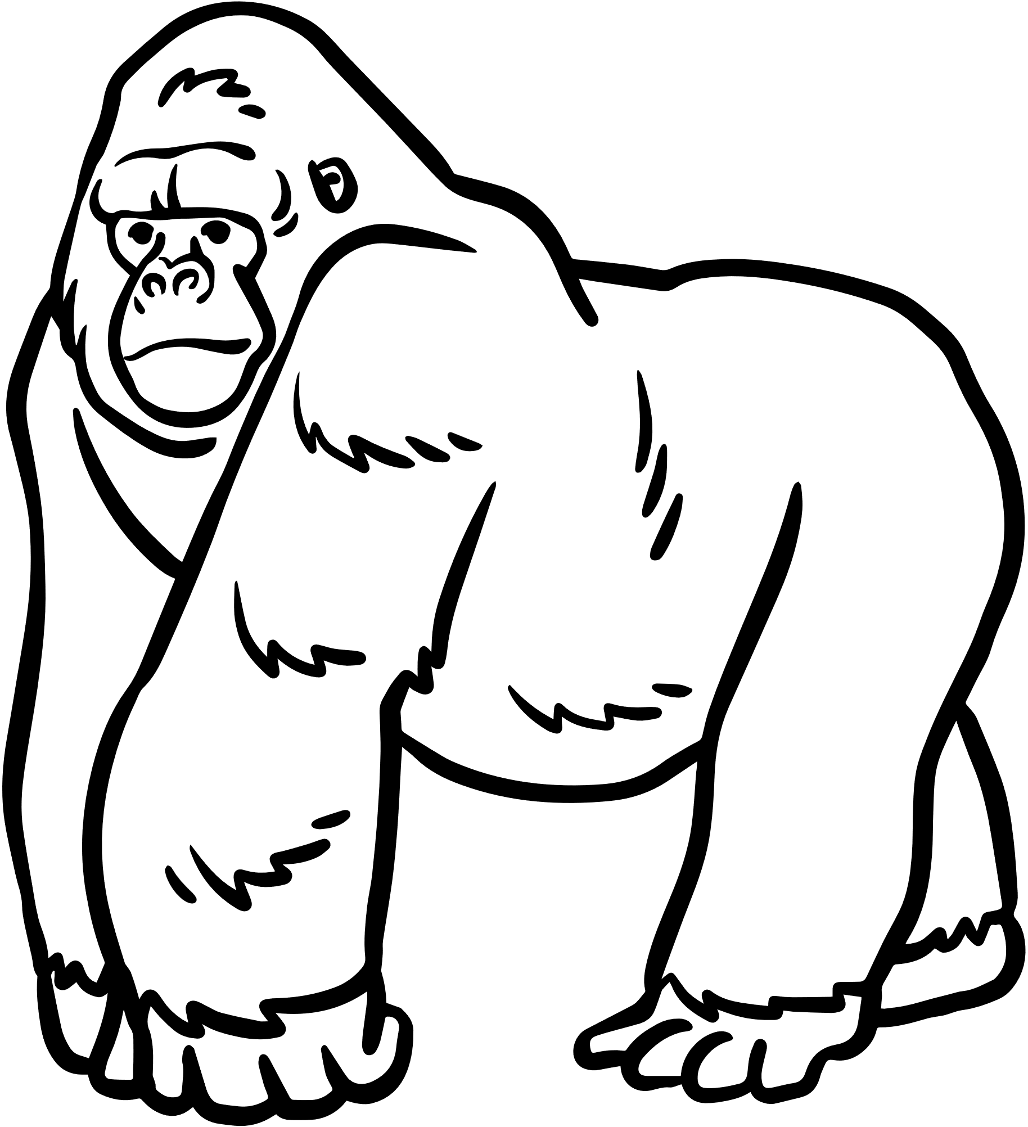

​
  Select ‘Start slideshow from beginning’ ​
  Click on the animal to press play, then click again to stop. (Note: the animal movements are a looping video so you can start and stop as many times as you like). ​
  Guide pupils through the movements
Run
Stomp
Star Jump
like a cheetah
like an elephant
like a starfish
Gallop
Walk
Stand
like a horse
like a crab
like a flamingo
Jump
Pound
Slither
like a frog
like a gorilla
like a cheetah

Slide 8
