Slide 1
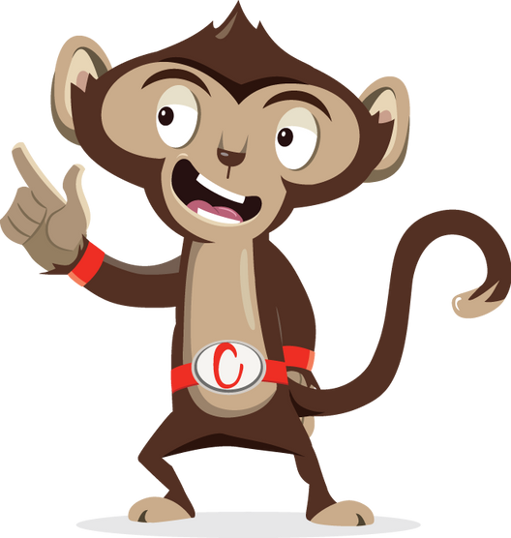


Movement Break

Slide 2
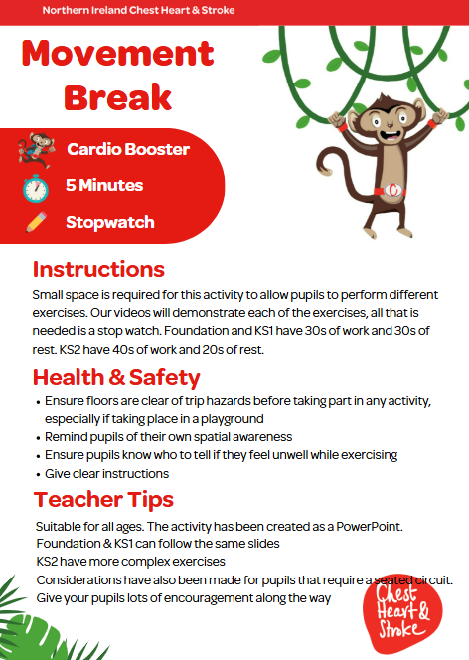

Slide 3


Foundation Level & Key Stage 1
Time: 5 minutes
Resources : stopwatch

Slide 4
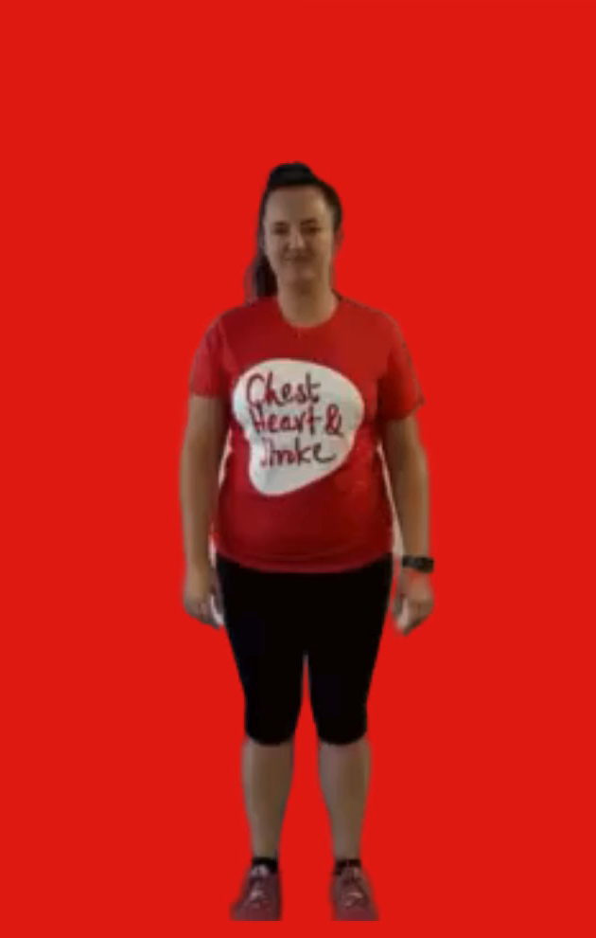
March on the spot
30 seconds
Lift your knee up about waist height
At the same time move your opposite arm
Repeat this motion, changing legs and arms each time like you are marching

Slide 5
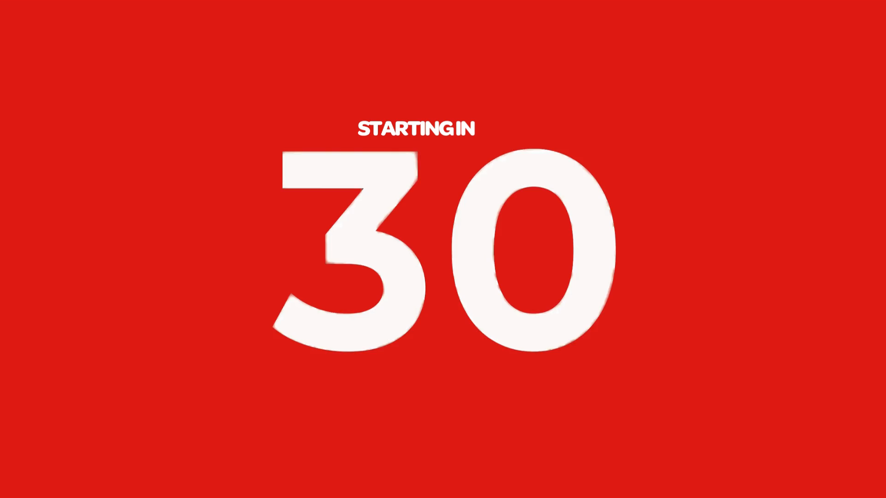
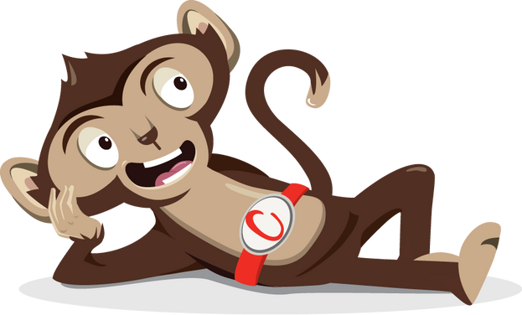
Rest

Slide 6
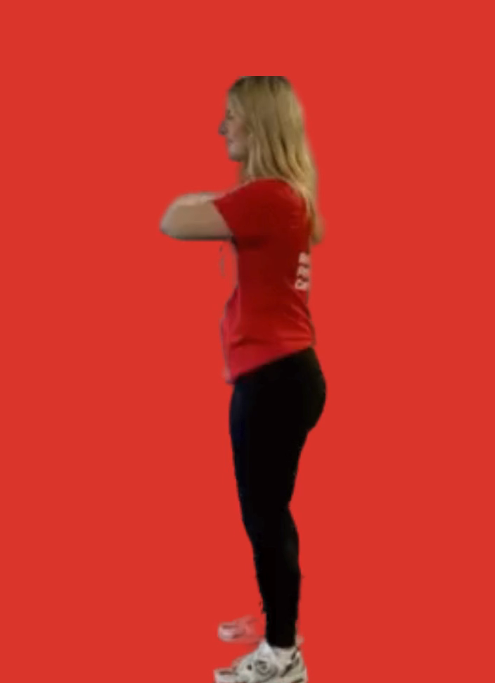
Squats
30 seconds
Start with your feet about shoulder width apart
Cross your arms over your shoulders
Imagine you are sitting on a chair behind you, drive your bottom back and bend your legs
Stop in line with your knees
Keep your feet flat on the floor

Slide 7
Rest

Slide 8
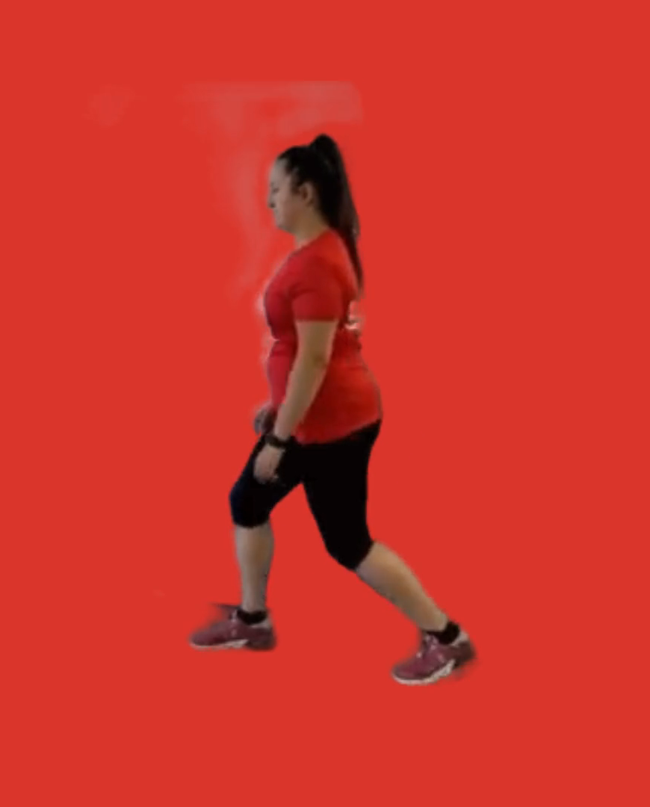
Lunges
30 seconds
Take a big step forward with one foot
Bend both legs and look straight ahead
Keep your back straight, imagine you are trying to put your back knee on the floor (using ball of foot on back leg)
Push through both feet to a standing position
Repeat and change legs halfway

Slide 9
Rest

Slide 10
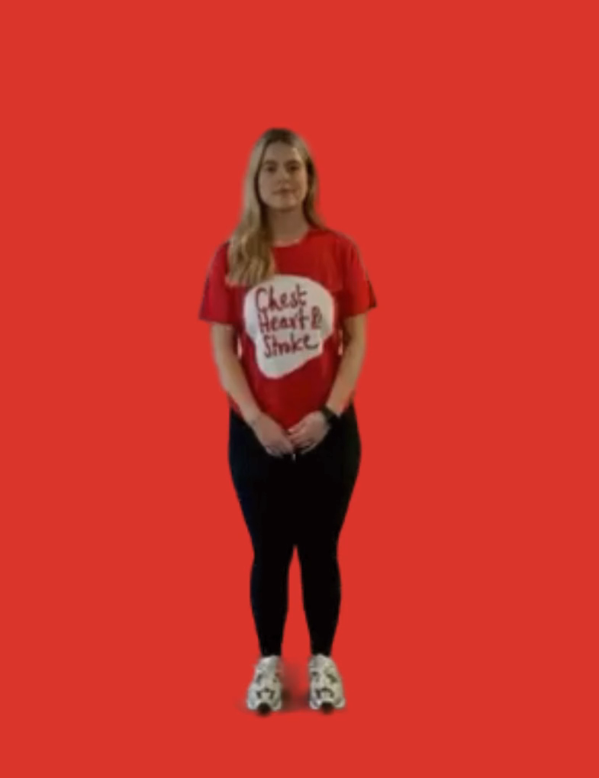
Jumping Jacks
30 seconds
Stand with your feet about shoulder width
Bend your knees while jumping your feet to the side
At the same time raise both arms out to either sides of your head
Making a star shape
Jump your feet and arms back to the middle and repeat

Slide 11
Rest

Slide 12
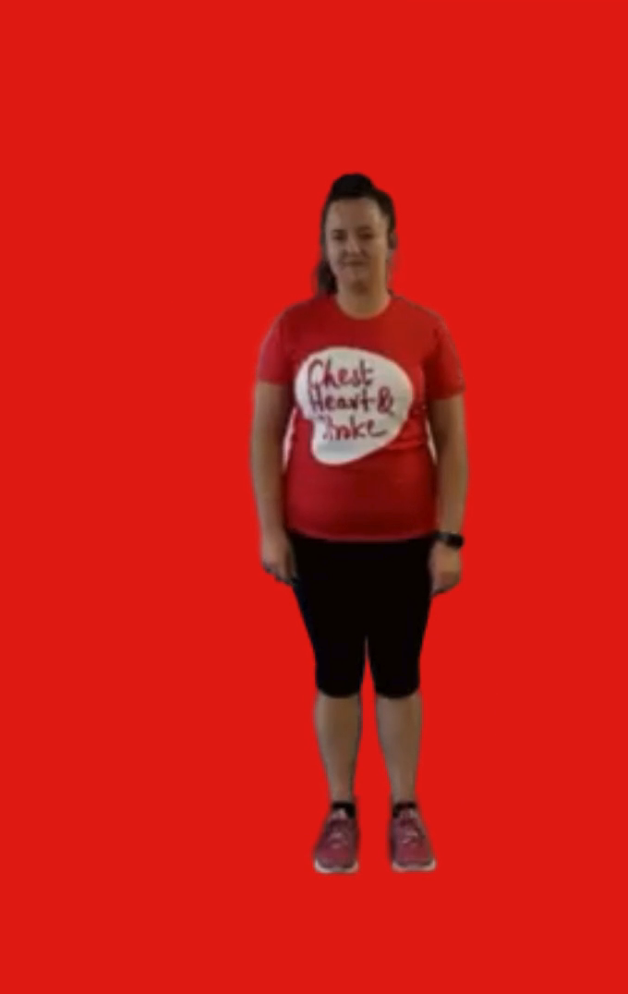
Hopping on 1 leg
15 seconds on each leg
Option 1: you can keep two feet together and bounce for 30s
Option 2: lift one leg up off the floor and gently hop on the spot for 15 seconds then change legs

Slide 13
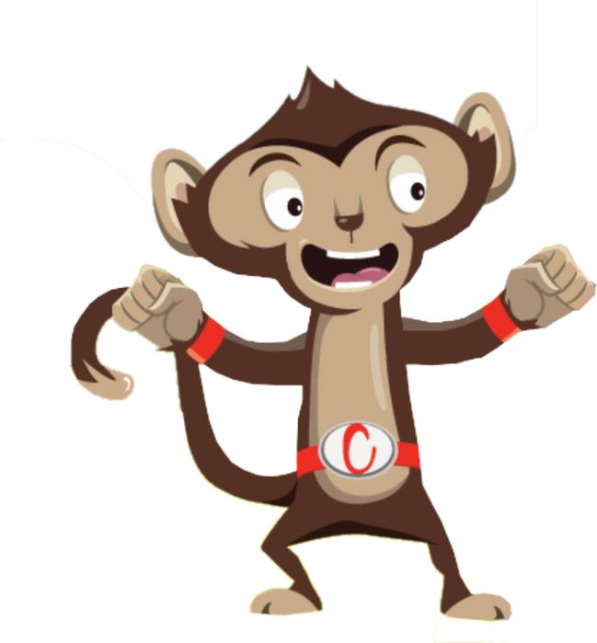
Finished!

