Slide 1



Movement Break

Slide 2
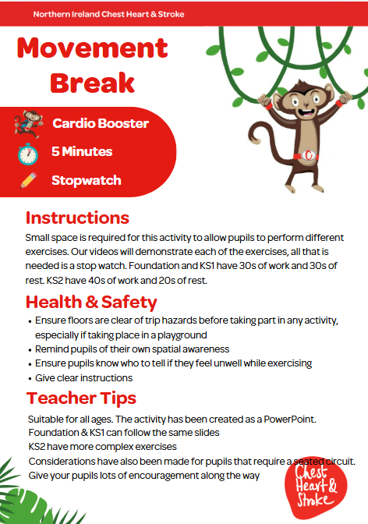

Slide 3


Key Stage 2
Time:
5 minutes
Resources :
stopwatch

Slide 4
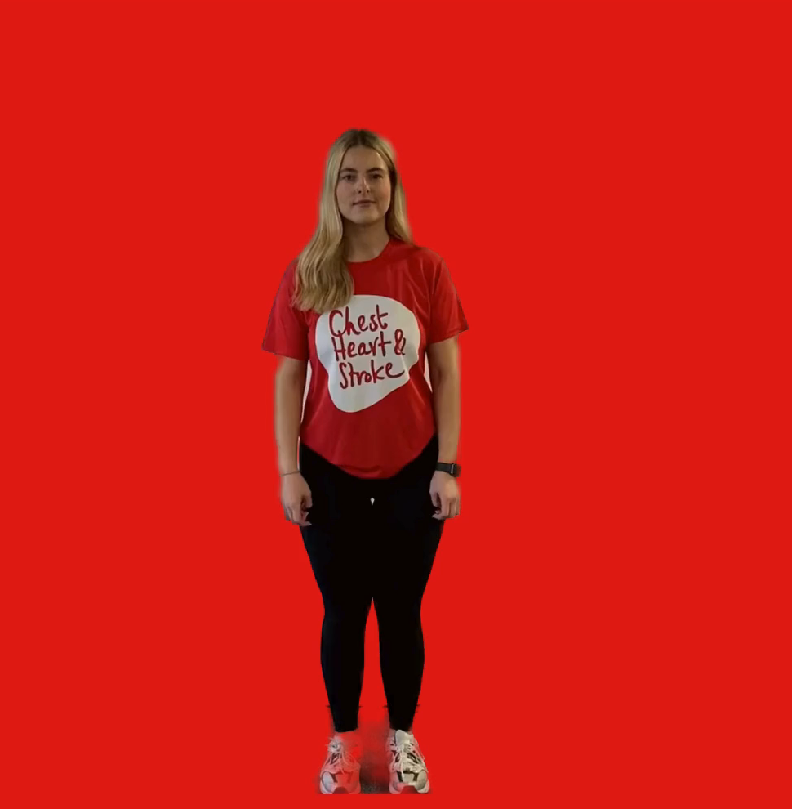
Star Jumps
40 seconds
Start with feet hip width apart
Crouch down and touch the floor
Then jumping up, spring into the air with your arms and legs out like a star

Slide 5
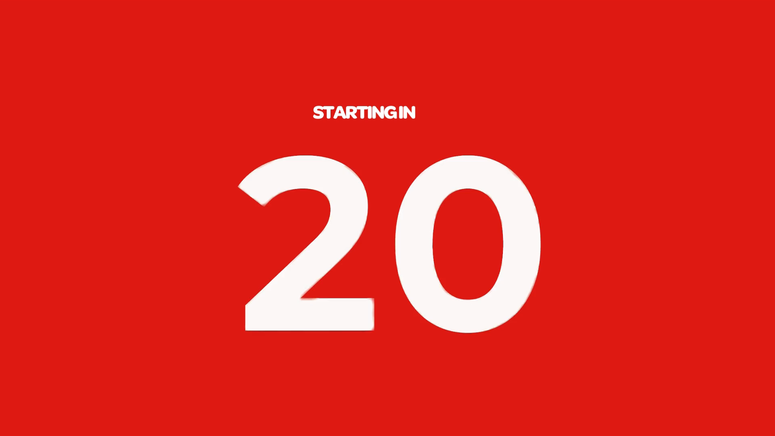
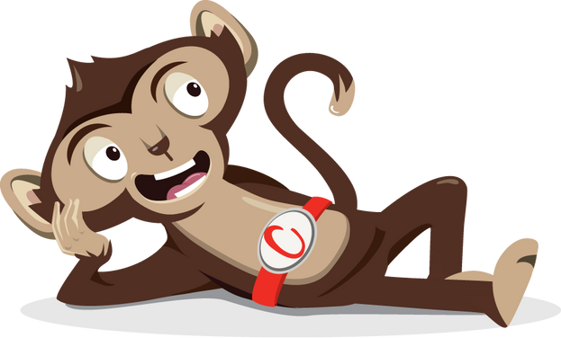
Rest

Slide 6
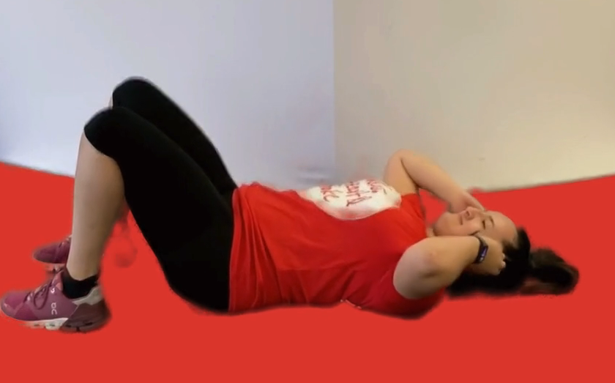
Crunches
40 seconds
Start by lying on the floor and bend your knees so your feet are flat on the floor
Place your hands by your ears
Lift your shoulders off the floor and squeeze your tummy muscles

Slide 7
Rest

Slide 8
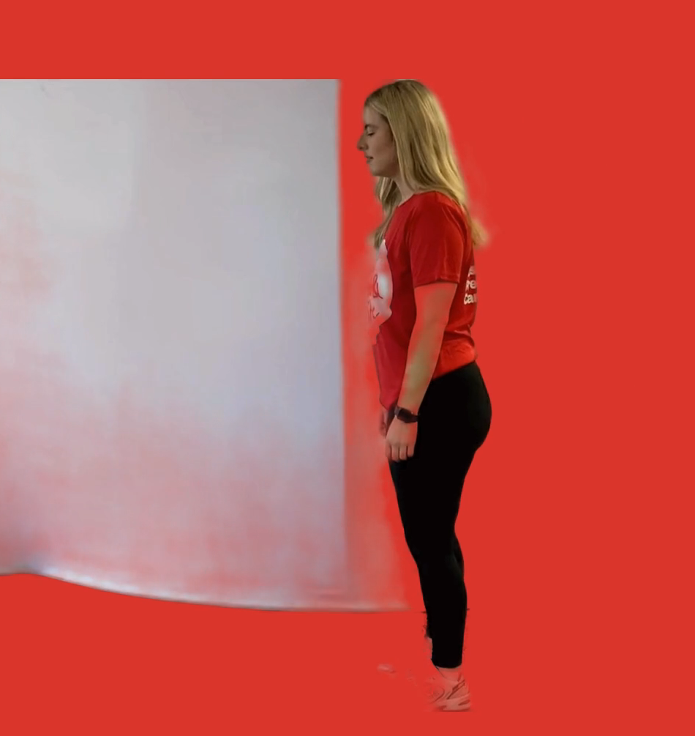
Lunges
40 seconds
Take a big step forward with one foot
Bend both legs and look straight ahead
Keep your back straight, imagine you are trying to put your back knee on the floor (using ball of foot on back leg)
Push through both feet to a standing position
Repeat and change legs halfway

Slide 9
Rest

Slide 10
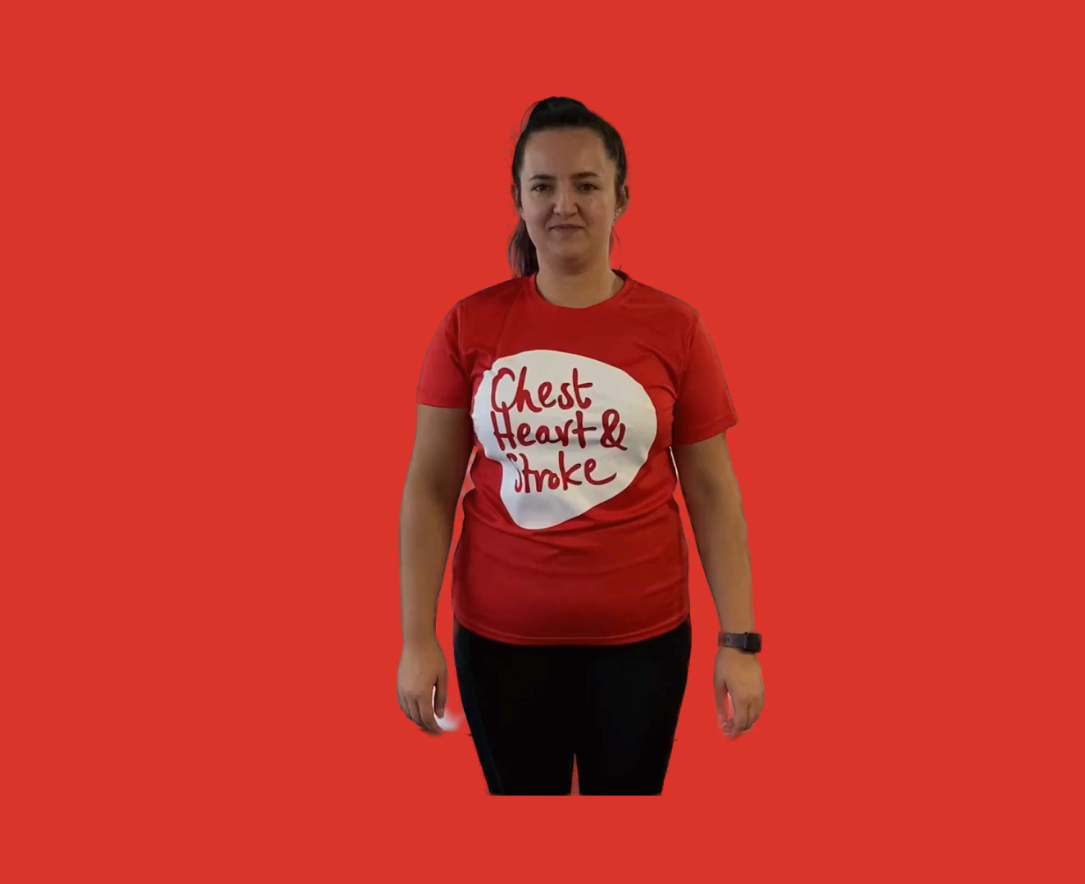
Arm Circles
40 seconds
While standing stretch both arms out to either side in line with your shoulders
Draw small circles in one direction
Then change direction

Slide 11
Rest

Slide 12
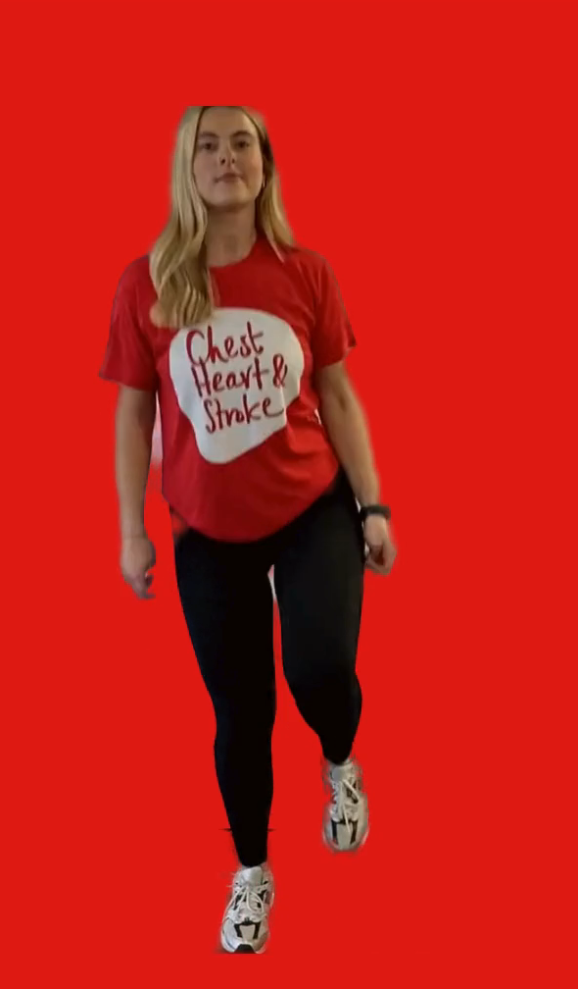
Hopping on 1 leg
20 seconds each leg
Option 1: you can keep two feet together and bounce for 40s
Option 2: lift one leg up off the floor and gently hop on the spot for 15 seconds then change legs

Slide 13
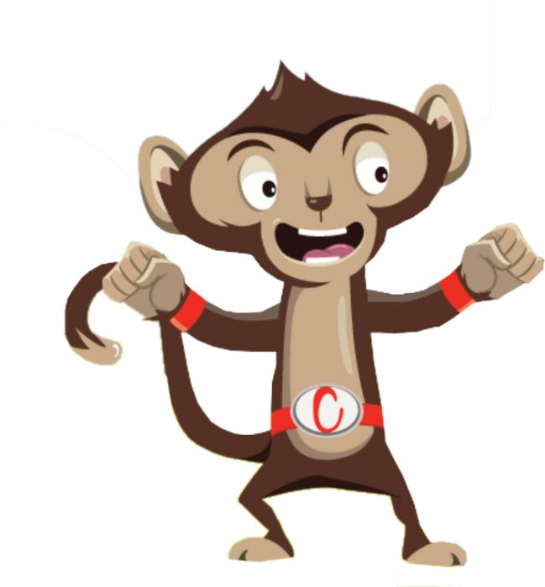
Finished!

