Slide 1



Movement Break

Slide 2
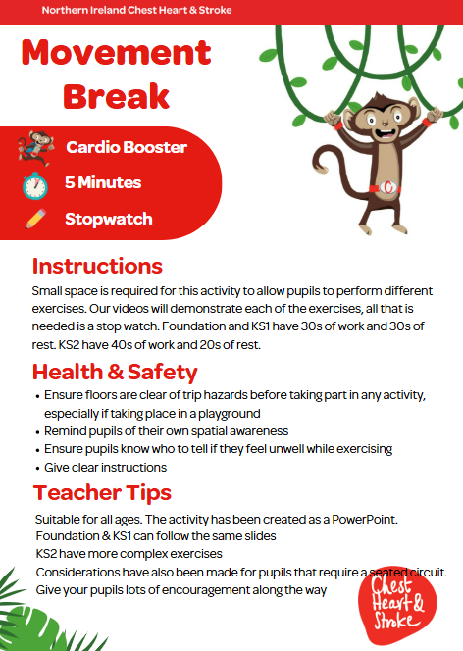

Slide 3
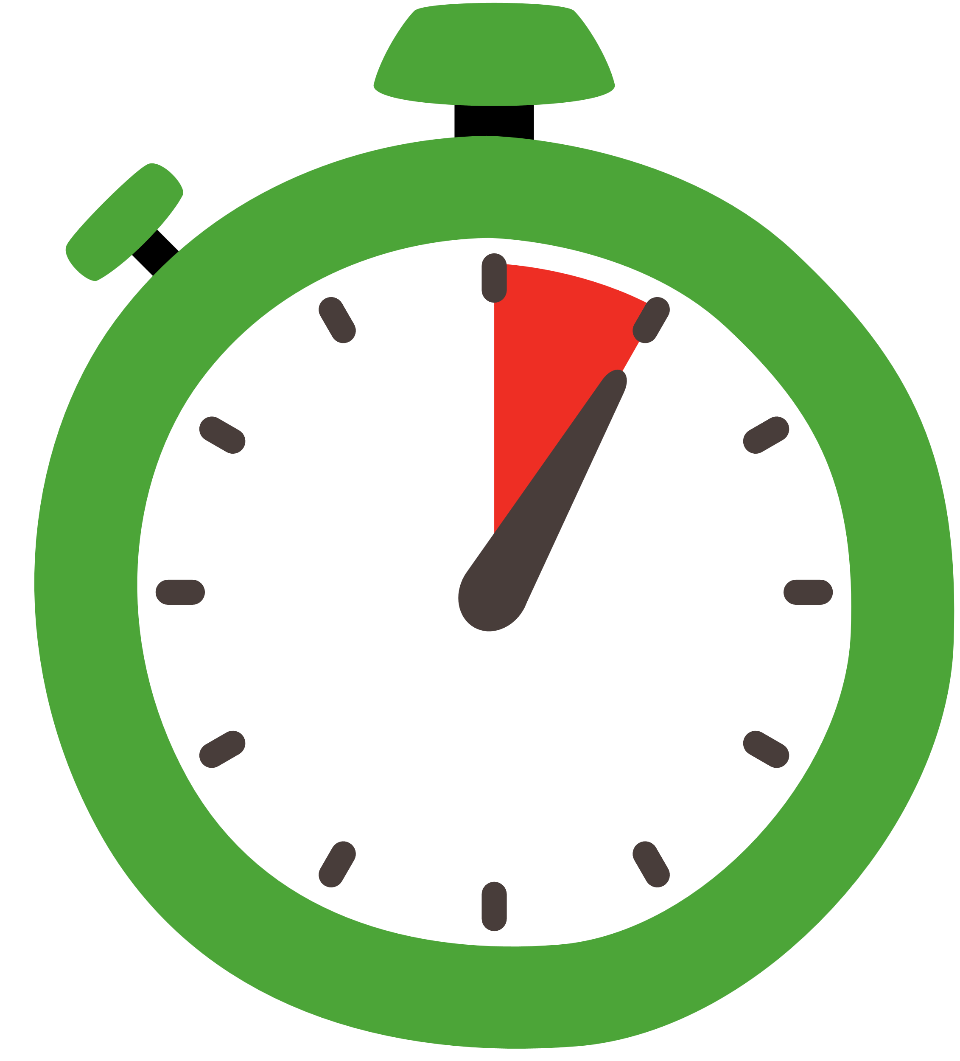

Seated Exercises
Time:
5 mins
Resources :
Stopwatch

Slide 4
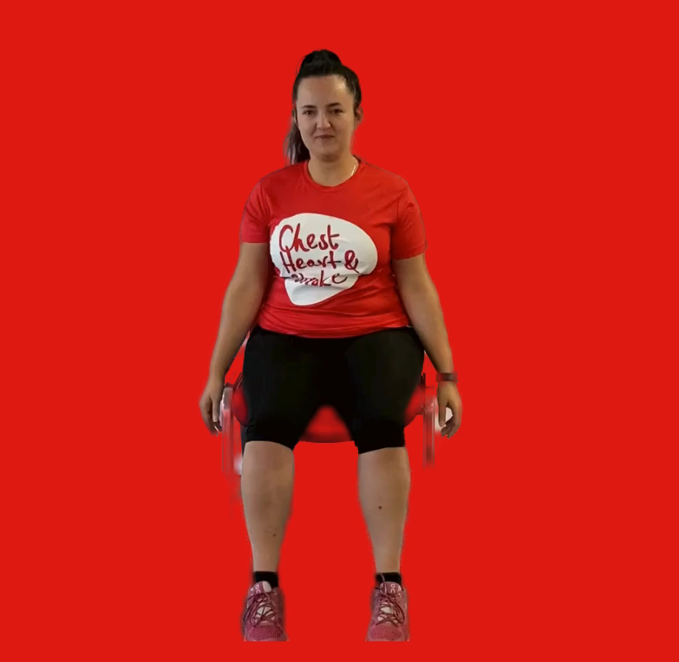
Side Reaches
40 seconds
While seated lean to the side so you feel a gentle stretch on the opposite side (hand about knee level)
Swap sides each time

Slide 5
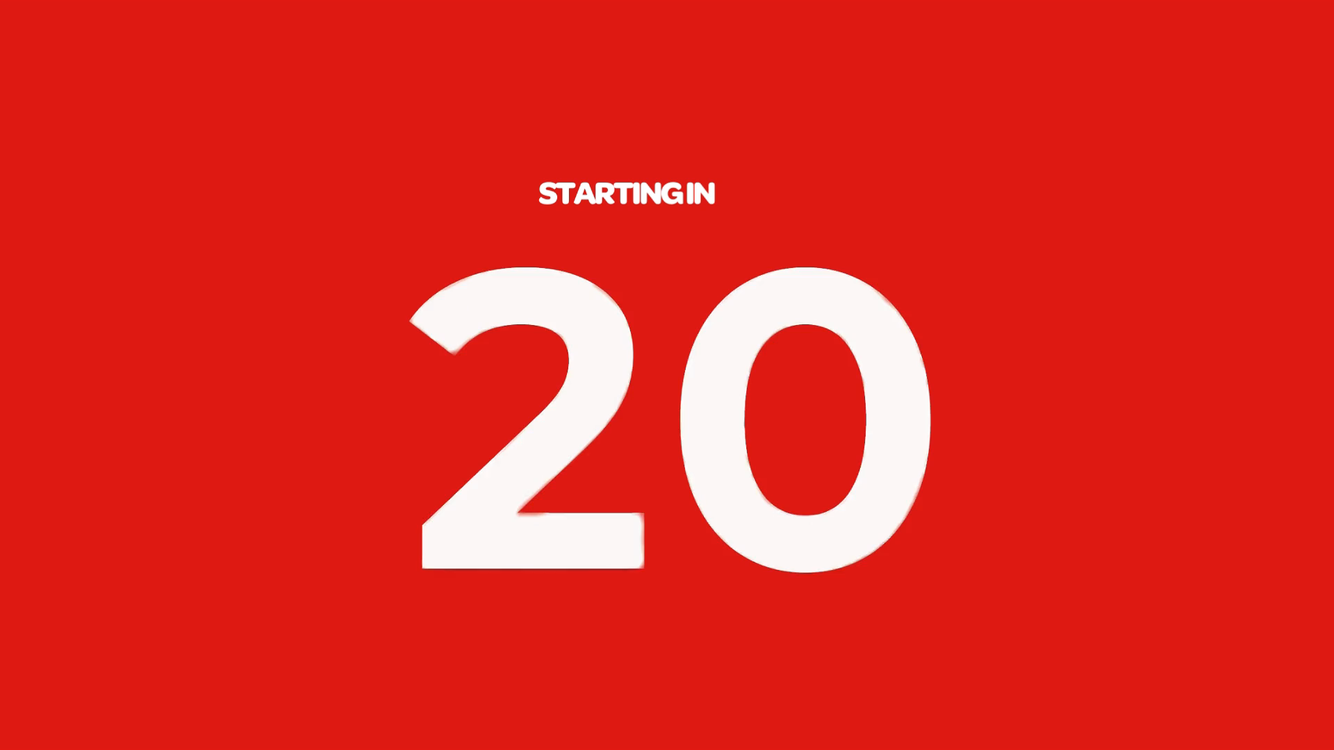
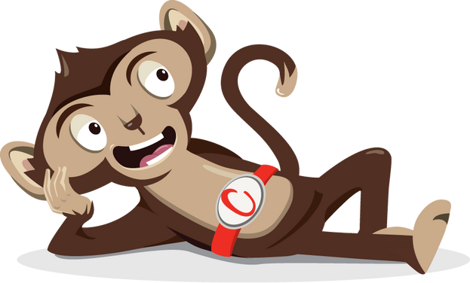
Rest

Slide 6
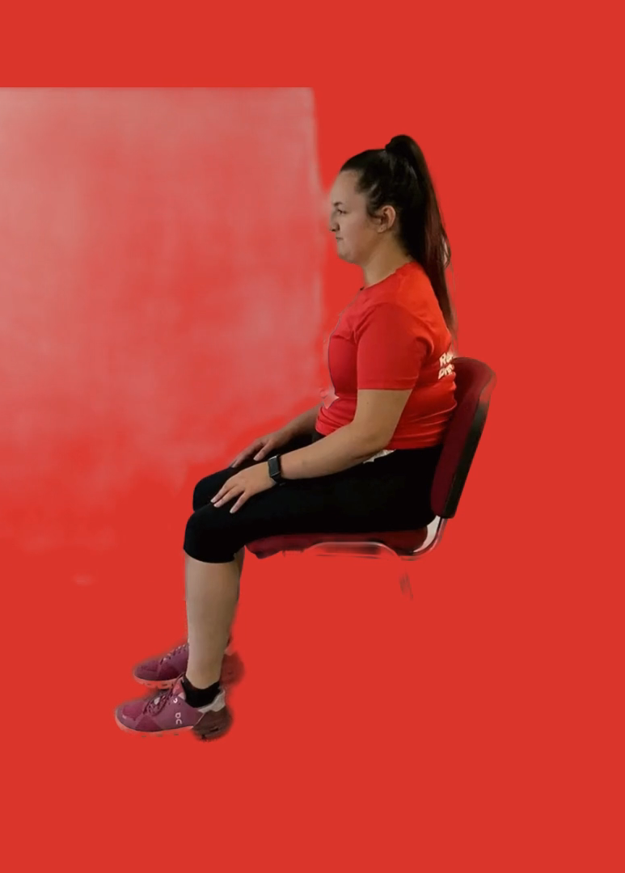
Seated Crunches
40 seconds
While seated put your hands by your ears
Bend forward keeping your back as straight as you can

Slide 7
Rest

Slide 8
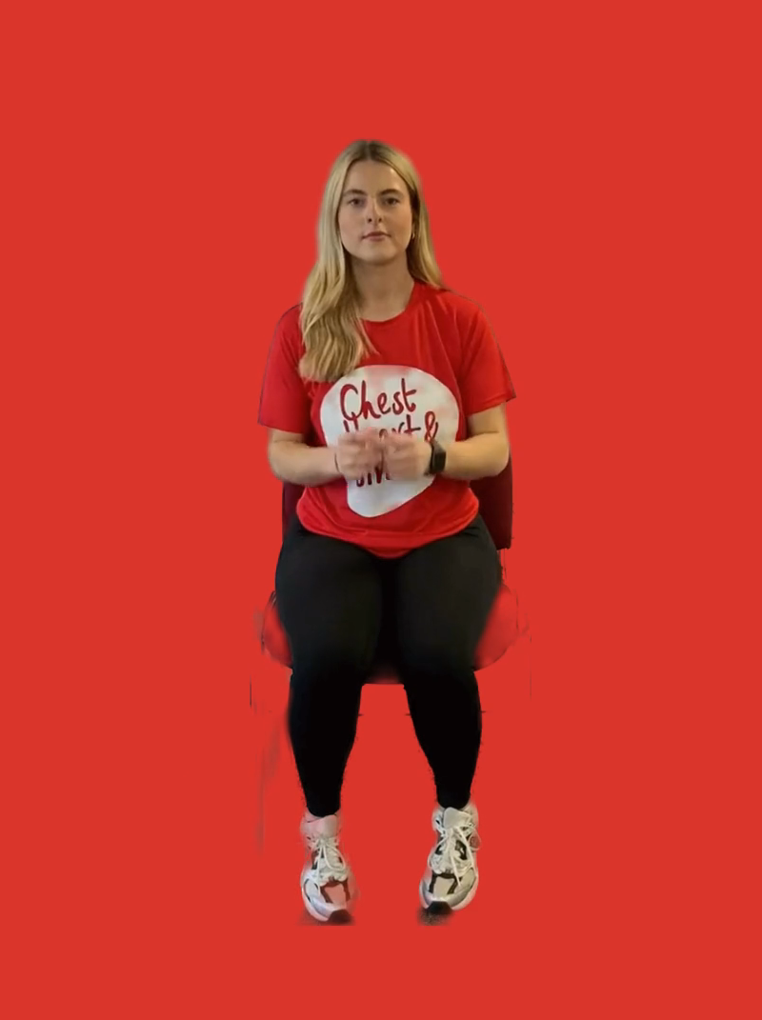
Cross Punches
40 seconds
While seated make a fist with both hands
Punch in front of you
Change hands each time

Slide 9
Rest

Slide 10
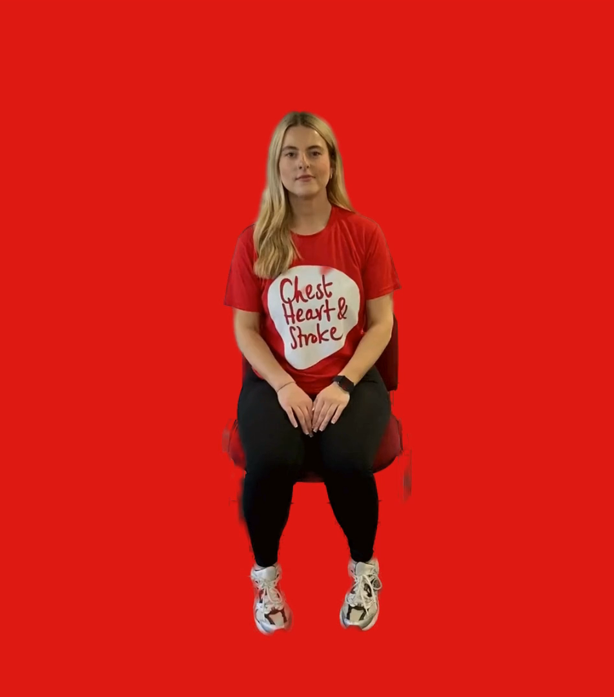
Shoulder Press
40 seconds
While seated imagine you are lifting something towards the ceiling
Place both hands above each shoulder, palms facing up
Press both arms up towards the ceiling together

Slide 11
Rest

Slide 12
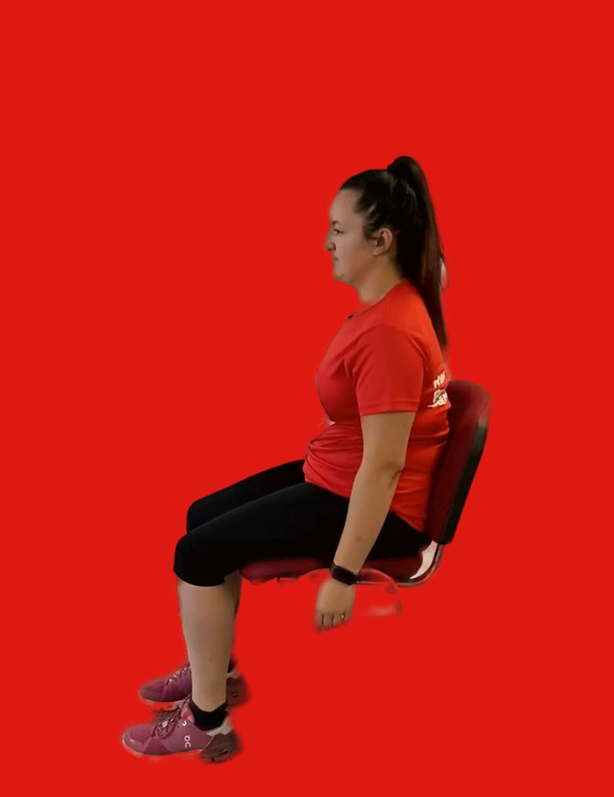
Shoulder Rolls
40 seconds
While seated bring your shoulders up to your ears and roll them backwards
Halfway through, change direction and roll your shoulders forwards

Slide 13
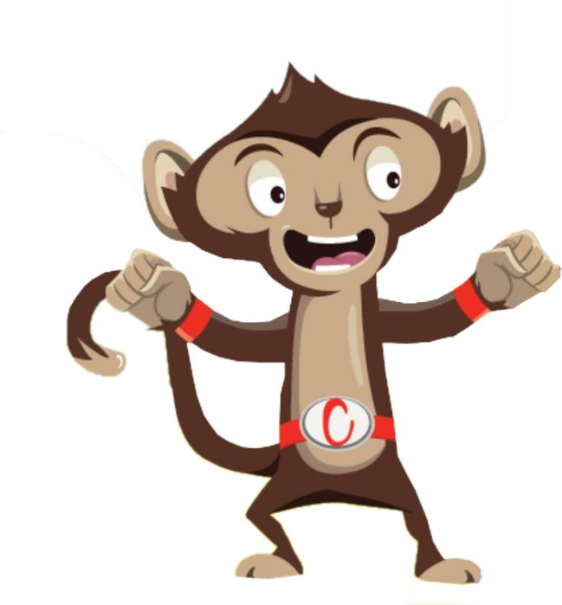
Finished!

