Slide 1

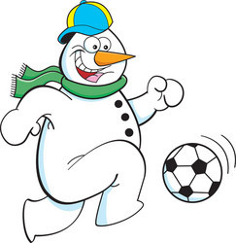




Sporty Snowman

Slide 2



Sporty snowman
Cardio Booster
5-10 minutes
Instructions
This active break can be used for transitioning between lessons and break times. Ask the pupils to follow along the PowerPoint to complete each exercise. This will spell out SNOWMAN once completed.
Health & Safety
  This is best performed in a big room with space to move around
  Ensure floors are clear of trip hazards before taking part in any activity
  Remind pupils of their own spatial awareness and ensure they spread out
  Give clear instructions.
Teacher Tips
Suitable for all ages
Foundation and KS1: Pupils complete each exercise for 20 seconds. There is a 20 second rest between each one.
KS2: Pupils perform more advanced exercises. Pupils complete each exercise for 40 seconds. There is a 20 second rest between each one.

Slide 3


Foundation Level & Key Stage 1
Time: 5 minutes
Resources : stopwatch

Slide 4
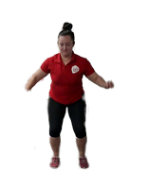
S
tar Jumps
30s

Slide 5
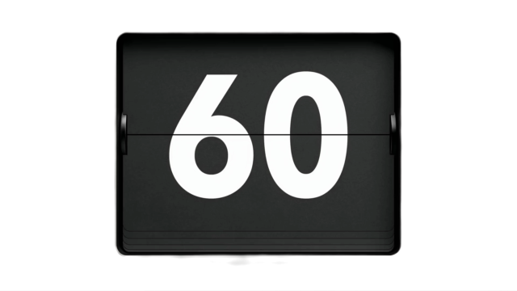
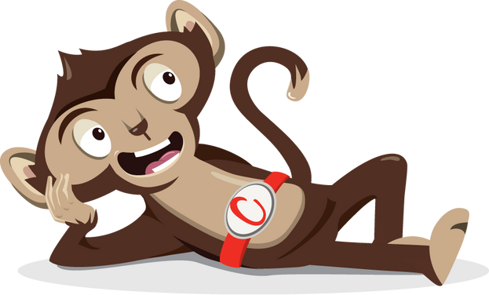
Rest

Slide 6
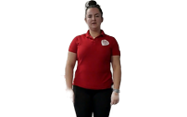
N
eck rolls
Change direction halfway through!
30s

Slide 7
Rest

Slide 8
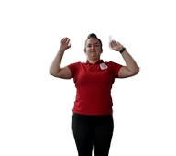
O
verhead press
30s

Slide 9
Rest

Slide 10
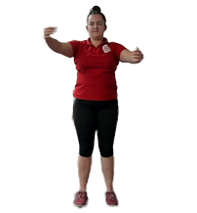
W
arm hugs
30s

Slide 11
Rest

Slide 12
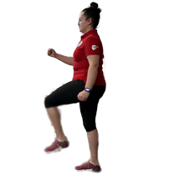
M
arch on the spot
30s

Slide 13
Rest

Slide 14
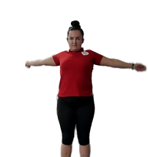
A
rm circles
30s

Slide 15
Rest

Slide 16
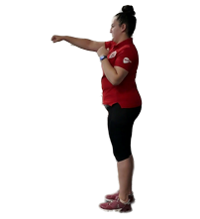
N
inja Punches
30s

Slide 17

Finished!
The first letter in each exercise appeared in a different colour. This spells out....
SNOWMAN
Well done!

