Slide 1

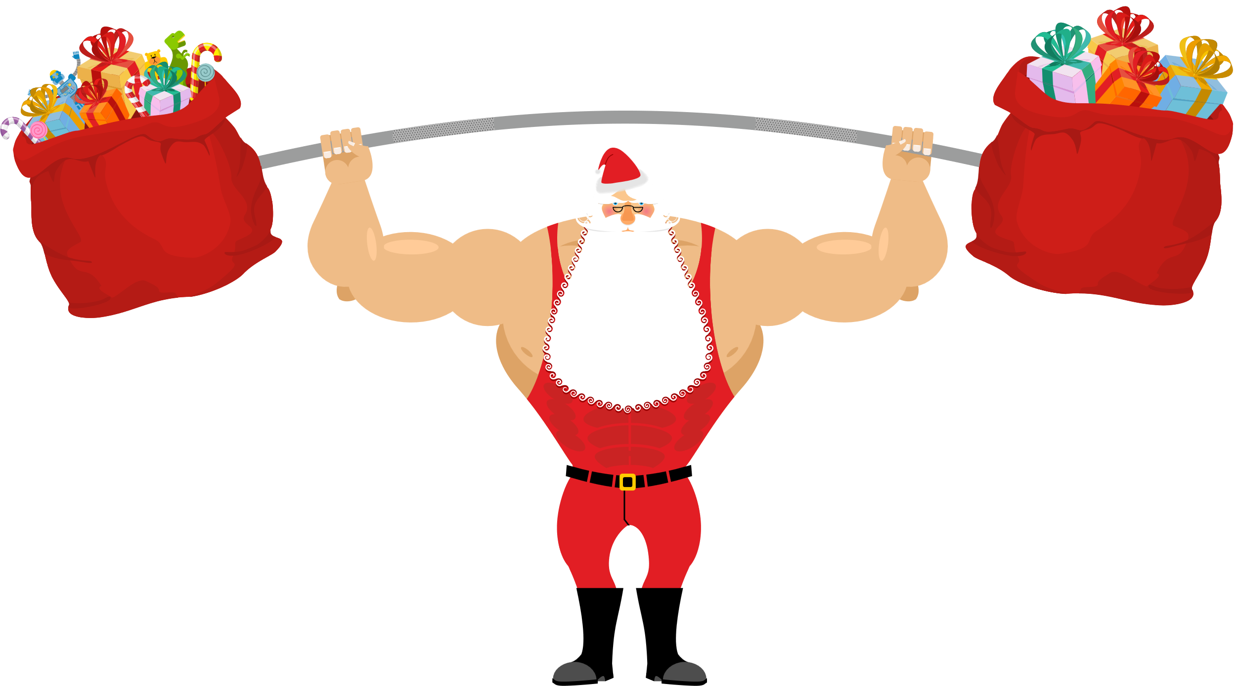




Strong Santa

Slide 2



Strong Santa
Cardio Booster
5-8 minutes
Instructions
This active break can be used for transitioning between lessons and break times. Ask the pupils to follow along the PowerPoint to complete each exercise. This will spell out SANTA once completed.
Health & Safety
  This is best performed in a big room with space to move around
  Ensure floors are clear of trip hazards before taking part in any activity
  Remind pupils of their own spatial awareness and ensure they spread out
  Give clear instructions.
Teacher Tips
Suitable for all ages
Foundation and KS1: Pupils complete each exercise for 20 seconds. There is a 20 second rest between each one.
KS2: Pupils perform more advanced exercises. Pupils complete each exercise for the allocated time. There is a 20 second rest between each one.

Slide 3


Foundation Level & Key Stage 1
Time: 3-4 minutes
Resources : stopwatch

Slide 4
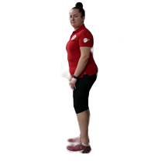
S
quats
20s

Slide 5
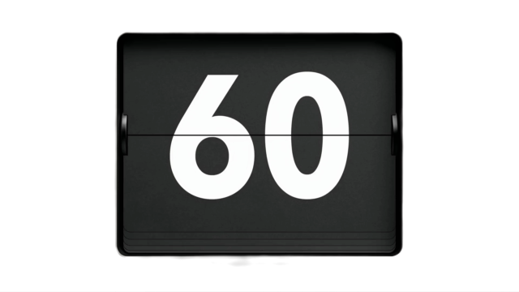

Rest

Slide 6
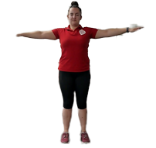
A
rm circles
Change direction halfway through!
20s

Slide 7
Rest

Slide 8
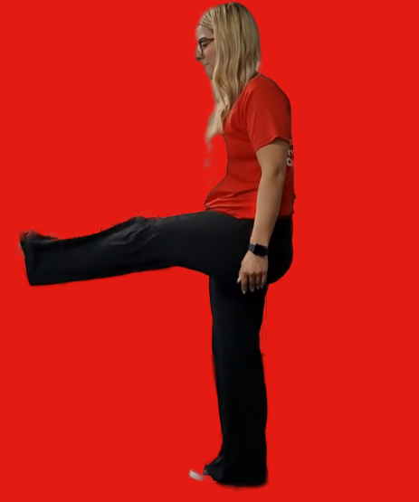
N
inja kicks
20s

Slide 9
Rest

Slide 10

T
oe touches
20s

Slide 11
Rest

Slide 12
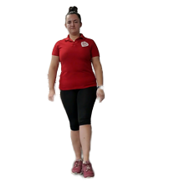
A
nkle rolls
Change direction halfway through!
20s

Slide 13
Rest

Slide 14

Finished!
The first letter in each exercise appeared in different colour. This spells out....
SANTA
Well done!

