Slide 1



How Much Is it?

Slide 2



How Much Is it?
Lively Lesson
5 minutes
Instructions
This activity break is mainly a numeracy activity. It involves pupils thinking about money and counting using pretend coins and helping to familarise themselves with the different amounts. Ask pupils to stand for this short activity
Health & Safety
  Ensure floors are clear of trip hazards before taking part in any activity.
  Ensure pupils leave stationary on the table.
  Remind pupils of their own spatial awareness.
  Give clear instructions.
Teacher Tips
This activity is suited to all ages. See PowerPoint for more details.
Foundation: this could involve playing shop in different groups. Where the teacher sets an amount for 3 or 4 different items (up to 5p) and pupils count their coins to pay.
KS1 & KS2: follow along with our PowerPoint and ask the pupils to select which answer they think is correct using our different answer scheme.

Slide 3
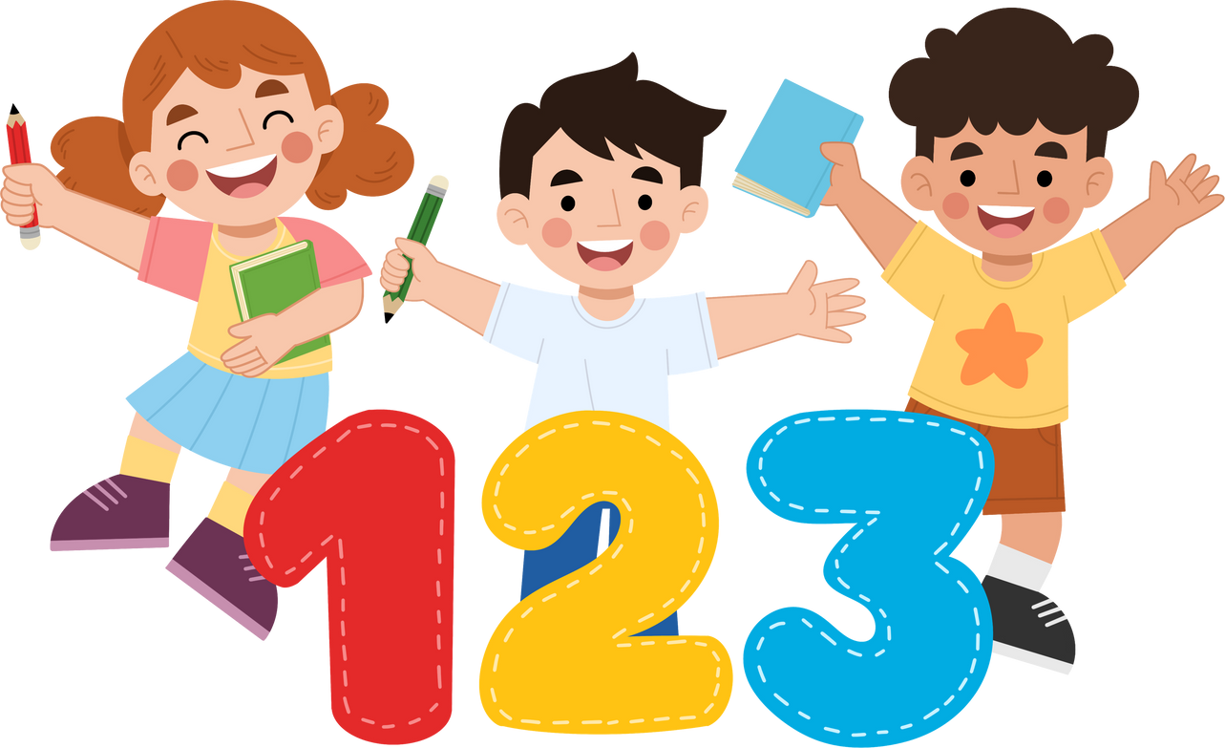


Foundation
Time: 5 minutes
Resources : Shop Keeping
Items

Slide 4

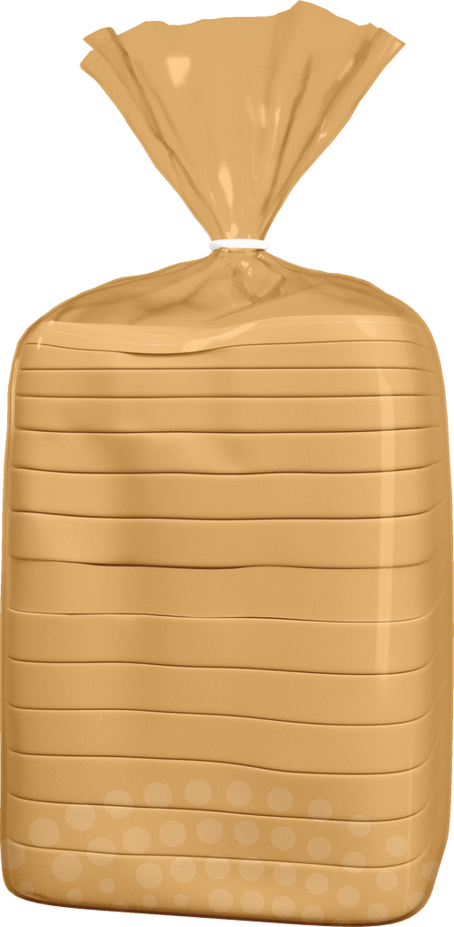



Instructions
Divide pupils into groups giving them different items to sell to their tables as shop keepers. Using pretend 1ps or counters to encourage pupils to count up to 10p. The teacher can put stickers on items to let pupils know how much they cost eg. apples = 2p, bread = 5p etc. Then change over the shop keeper so all the pupils can have a go.
Encourage play and creativity with this exercise. Perhaps to begin with show an example of how you would use your coins to count to eg. 3p for the pencil.

Slide 5

KS1
Time: 5 minutes
Notes:
Different Items with price tag will be shown on the screen. Ask pupils how they would make this amount of money by copying the position beside the answer.

Slide 6
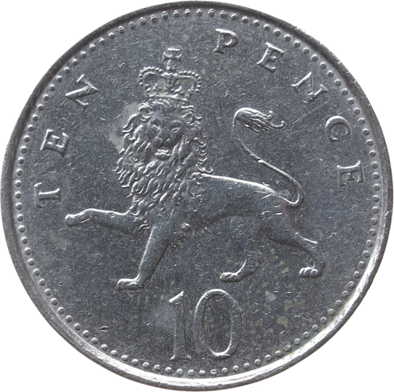
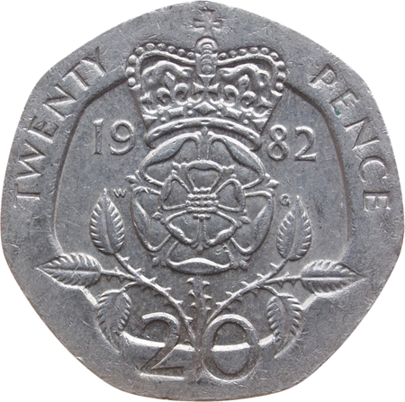

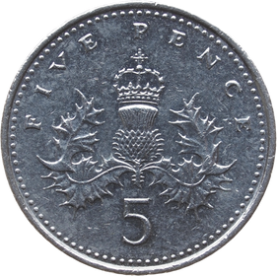
How much is it?
Stand with hands on your head
1.
2.
3.
30p
Stand with arms folded
Stand with hands on shoulders

Slide 7
Correct Answer is:
Stand with hands on your head
30p
1.

Slide 8
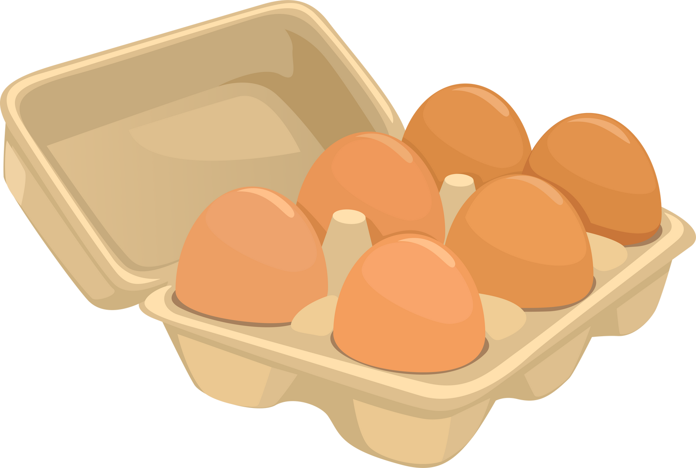
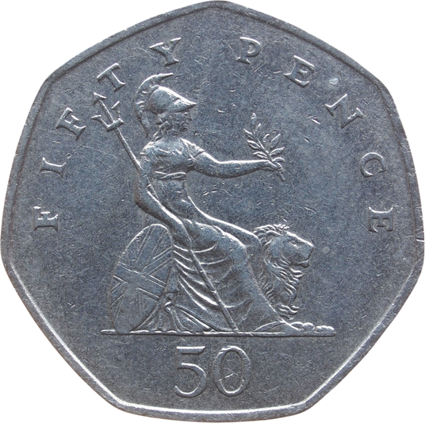
How much is it?
Stand with hands on your head
1.
2.
3.
Stand with arms folded
75p
Stand with hands on shoulders

Slide 9
Correct Answer is:
3.
Stand with hands on shoulders
75p

Slide 10

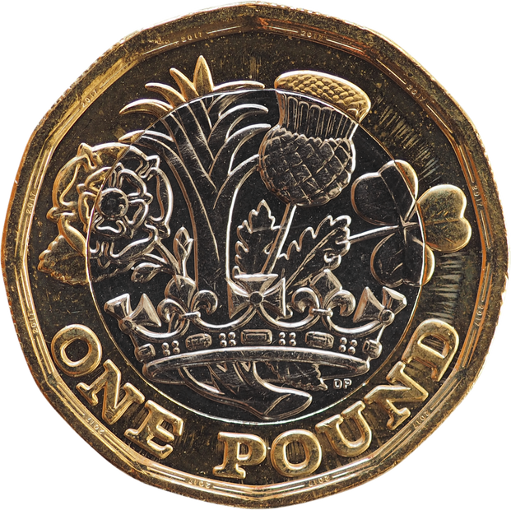
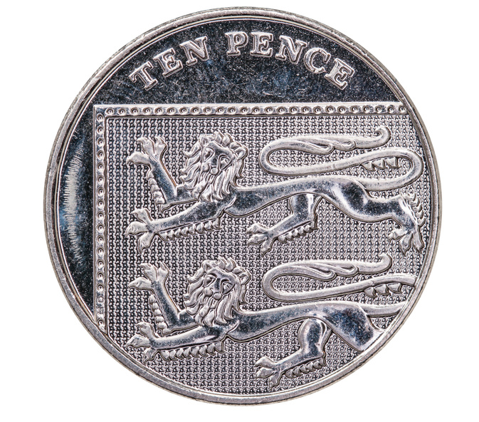
How much is it?
Stand with hands on your head
1.
2.
3.
Stand with
arms folded
£1.30
Stand with hands on shoulders

Slide 11
Correct Answer is:
Stand with hands on your head
1.
£1.30

Slide 12
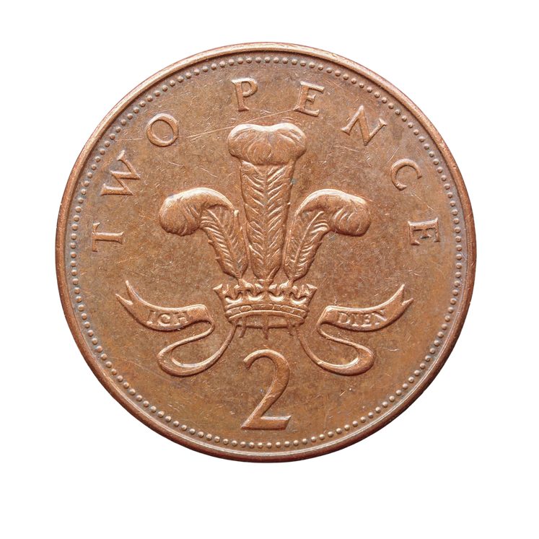
How much is it?
Stand with
hands on
your head
1.
2.
3.
Bread
Stand with
arms folded
Stand with
hands on shoulders
£2.55

Slide 13
Correct Answer is:
3.
Stand with
hands on shoulders
Bread
£2.55

Slide 14
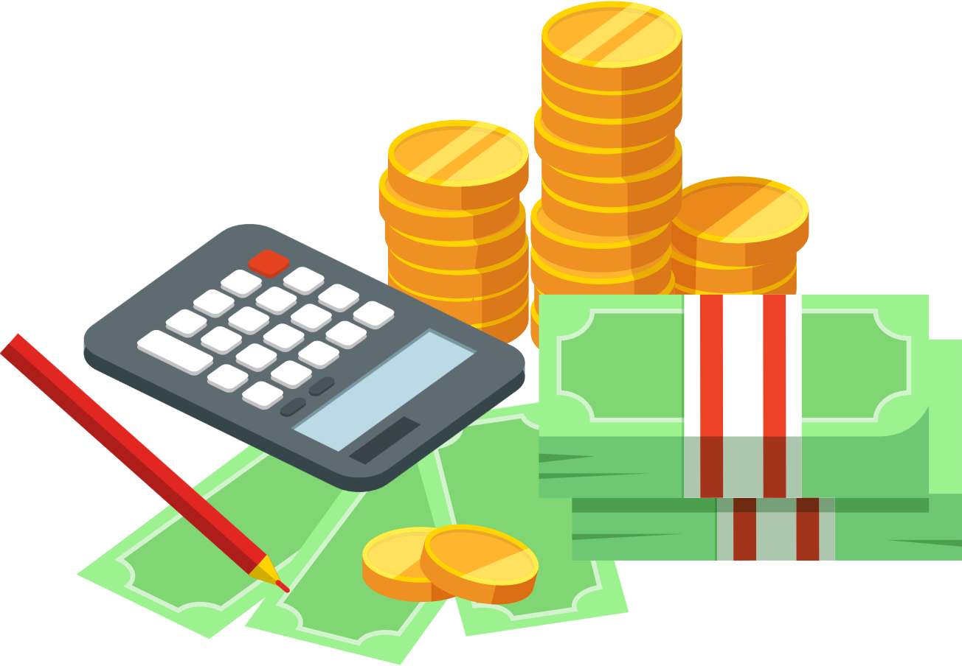
KS2
Time: 5 minutes
Notes:
Different Items with price tag will be shown on the screen. Ask pupils how they would make this amount of money by copying the position beside the answer.

Slide 15

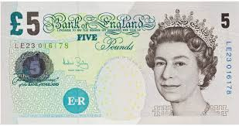
How much is it?
Balance on one leg
1.
2.
3.
Stand
with
hands on
head
£5.85
Stand
with feet together

Slide 16
Correct Answer is:
Balance on one leg
1.
£5.85

Slide 17


How much is it?
1.
2.
3.
Balance on one leg
£2.50
Stand
with
hands on
head
£3.20
Add these items together for the answer
Stand
with feet together

Slide 18
Correct Answer is:
2.
£2.50
Stand
with
hands on
head
£3.20
Add these items together for the answer

Slide 19
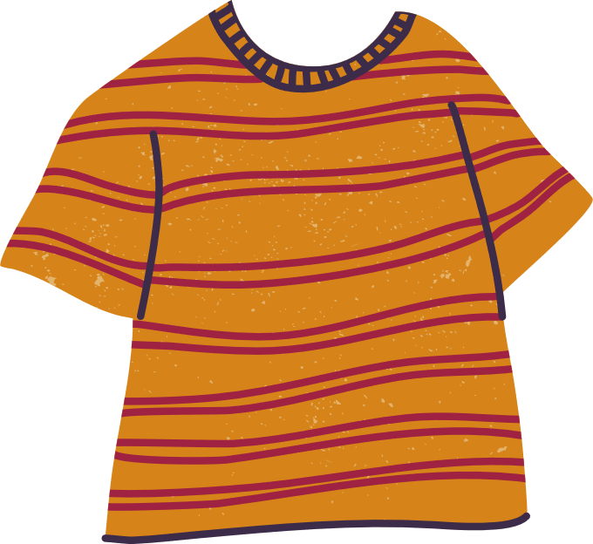
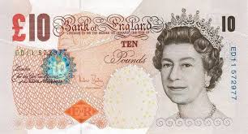
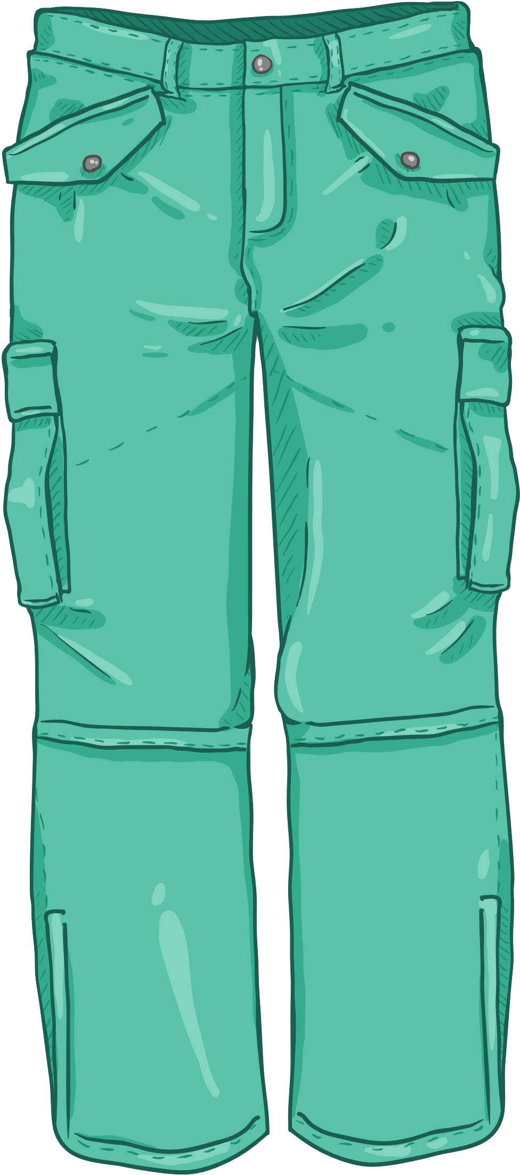
How much is it?
1.
2.
3.
Balance on one leg
£5.75
Stand
with
hands on
head
£4.25
Stand
with feet together

Slide 20
Correct Answer is:
£5.75
1.
Balance on one leg
£4.25

Slide 21
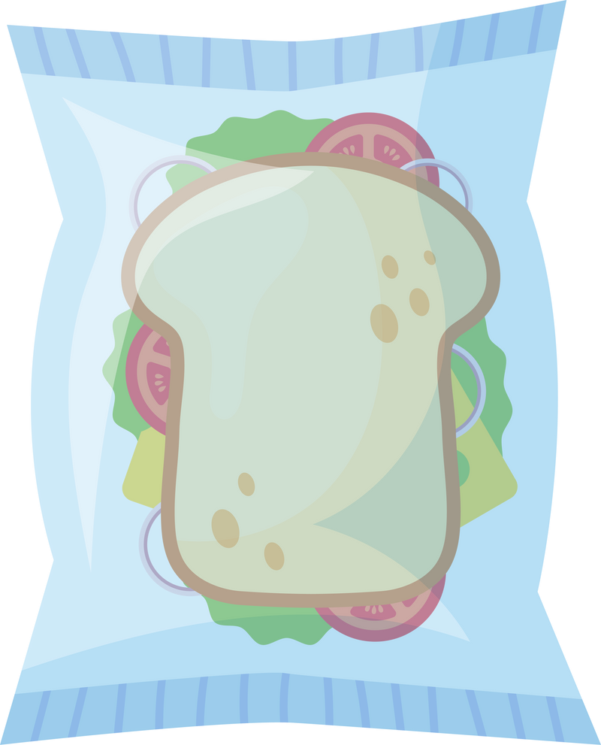

How much is it?
1.
2.
3.
Balance on one leg
£6.25
Stand
with
hands on
head
£3.00
Stand
with feet together
£0.75

Slide 22
Correct Answer is:
3.
£6.25
Stand
with feet together
£3.00
£0.75

