Slide 1



All Aboard

Slide 2



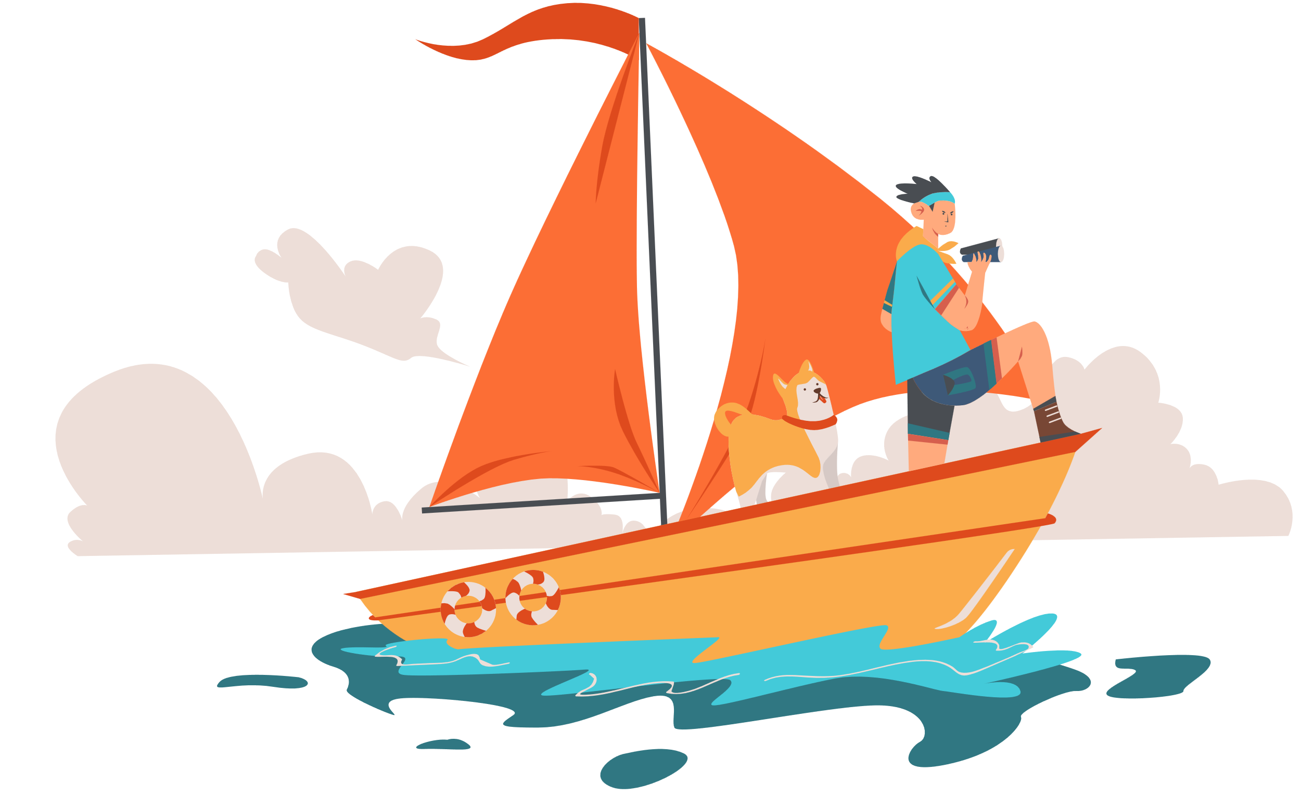
All Aboard
Monkey Madness
5 minutes
Instructions
Take your pupils on a nautical adventure as you go through our short Power Point with questions along the way. Place a red object on one side of the room and a blue on the other side. The answers to each of the questions are written in blue or red. The pupils must answer by moving to the side of the room they think the answer is.
Health & Safety
  Ensure floors are clear of trip hazards before taking part in any activity.
  Ensure pupils leave stationary on the table.
  Remind pupils of their own spatial awareness.
  Give clear instructions.
Teacher Tips
This activity is suited to all ages. See our PowerPoint for more information.
If space is limited you can ask your pupils to stand in a particular position for example, if they think the answer is red = stand and put their hands on their head, if they think the answer is blue = stand and put their hands on their shoulders.

Slide 3


KS1
Time:
5 minutes
Resources :
Stopwatch

Slide 4
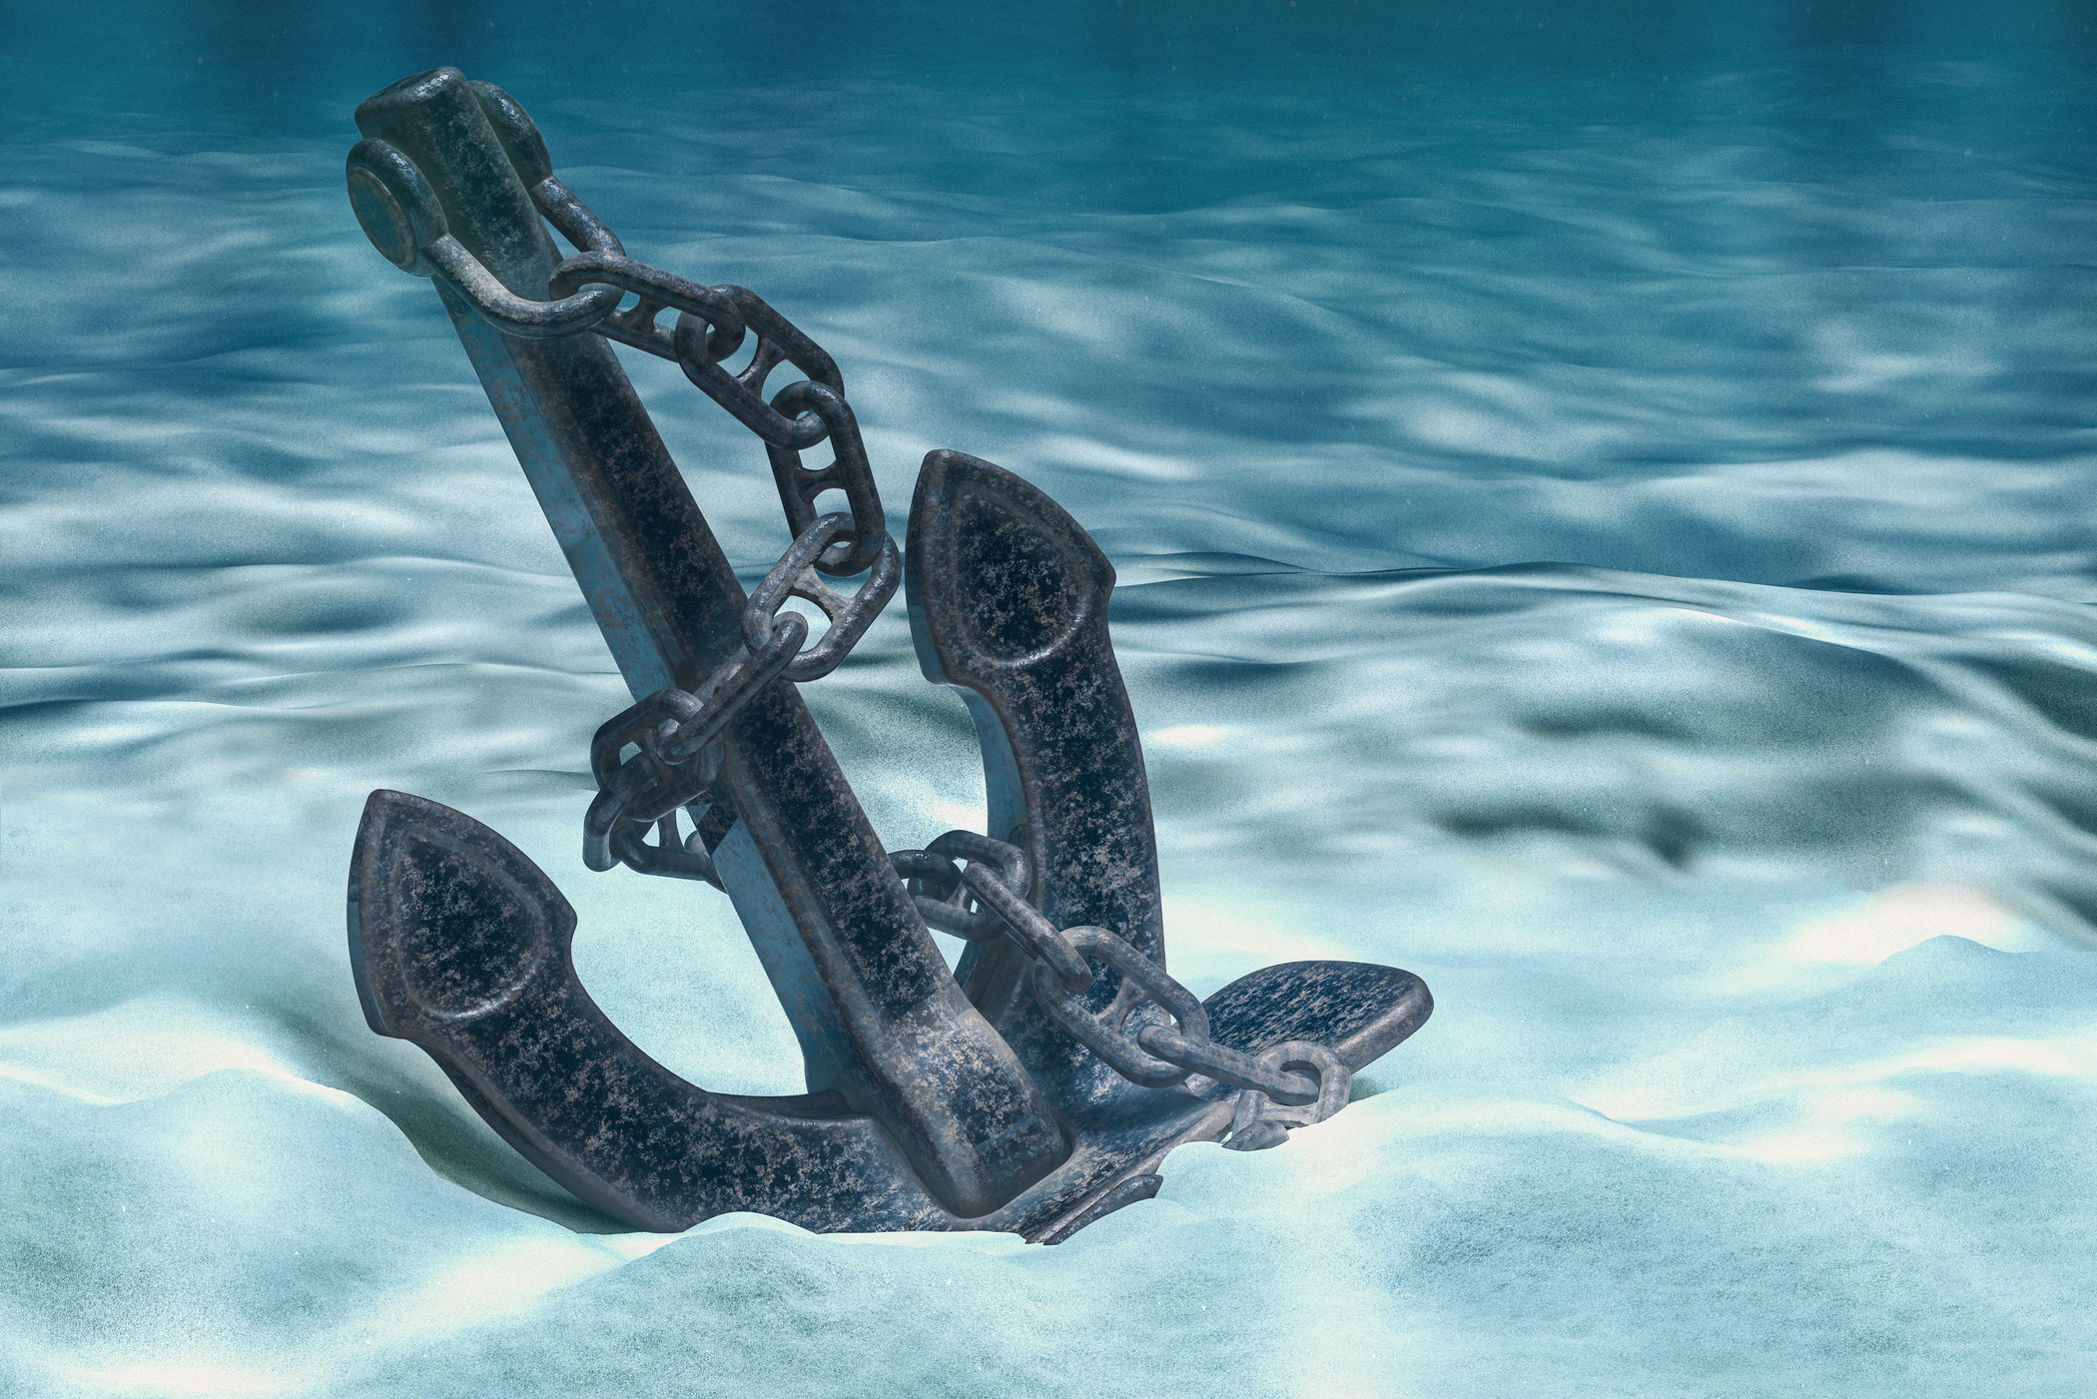
What is the object called that holds a ship in place?
Anchor
Hook

Slide 5
Correct Answer is:
Anchor

Slide 6
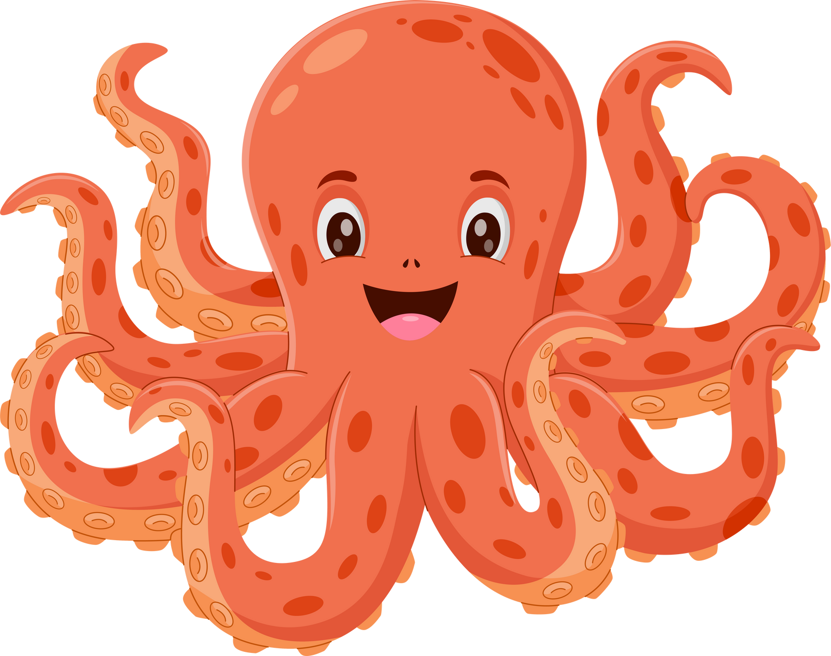
How many legs does an Octopus have?
10
8

Slide 7
Correct Answer is:
8

Slide 8
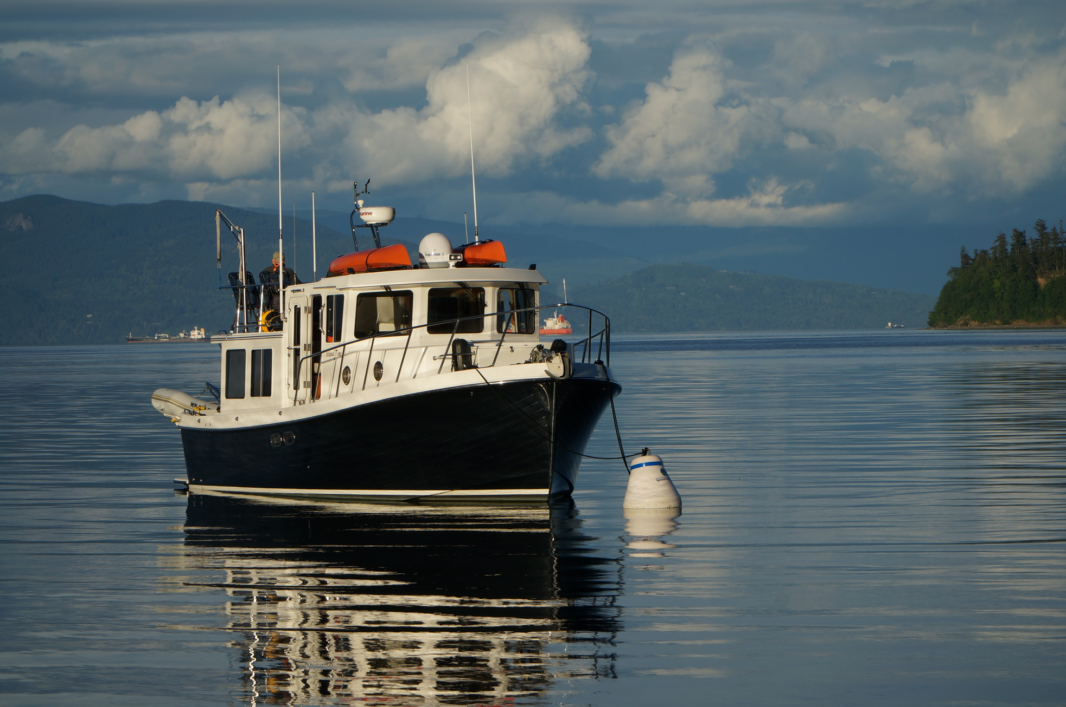
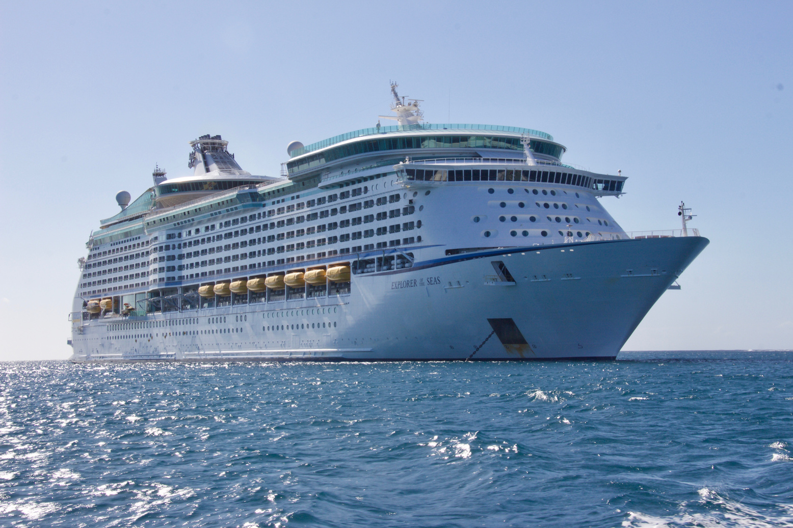
Which is the biggest a boat or a ship?
Boat
Ship

Slide 9
Correct Answer is:
Ship

Slide 10
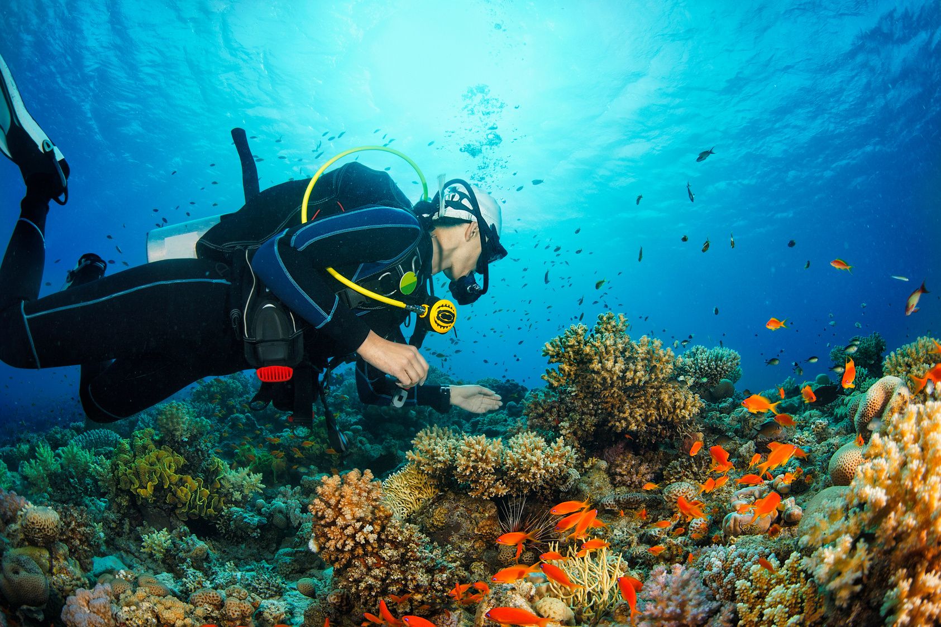
What is this person doing?
Scuba Diving
Swimming

Slide 11
Correct Answer is:
Scuba Diving

Slide 12
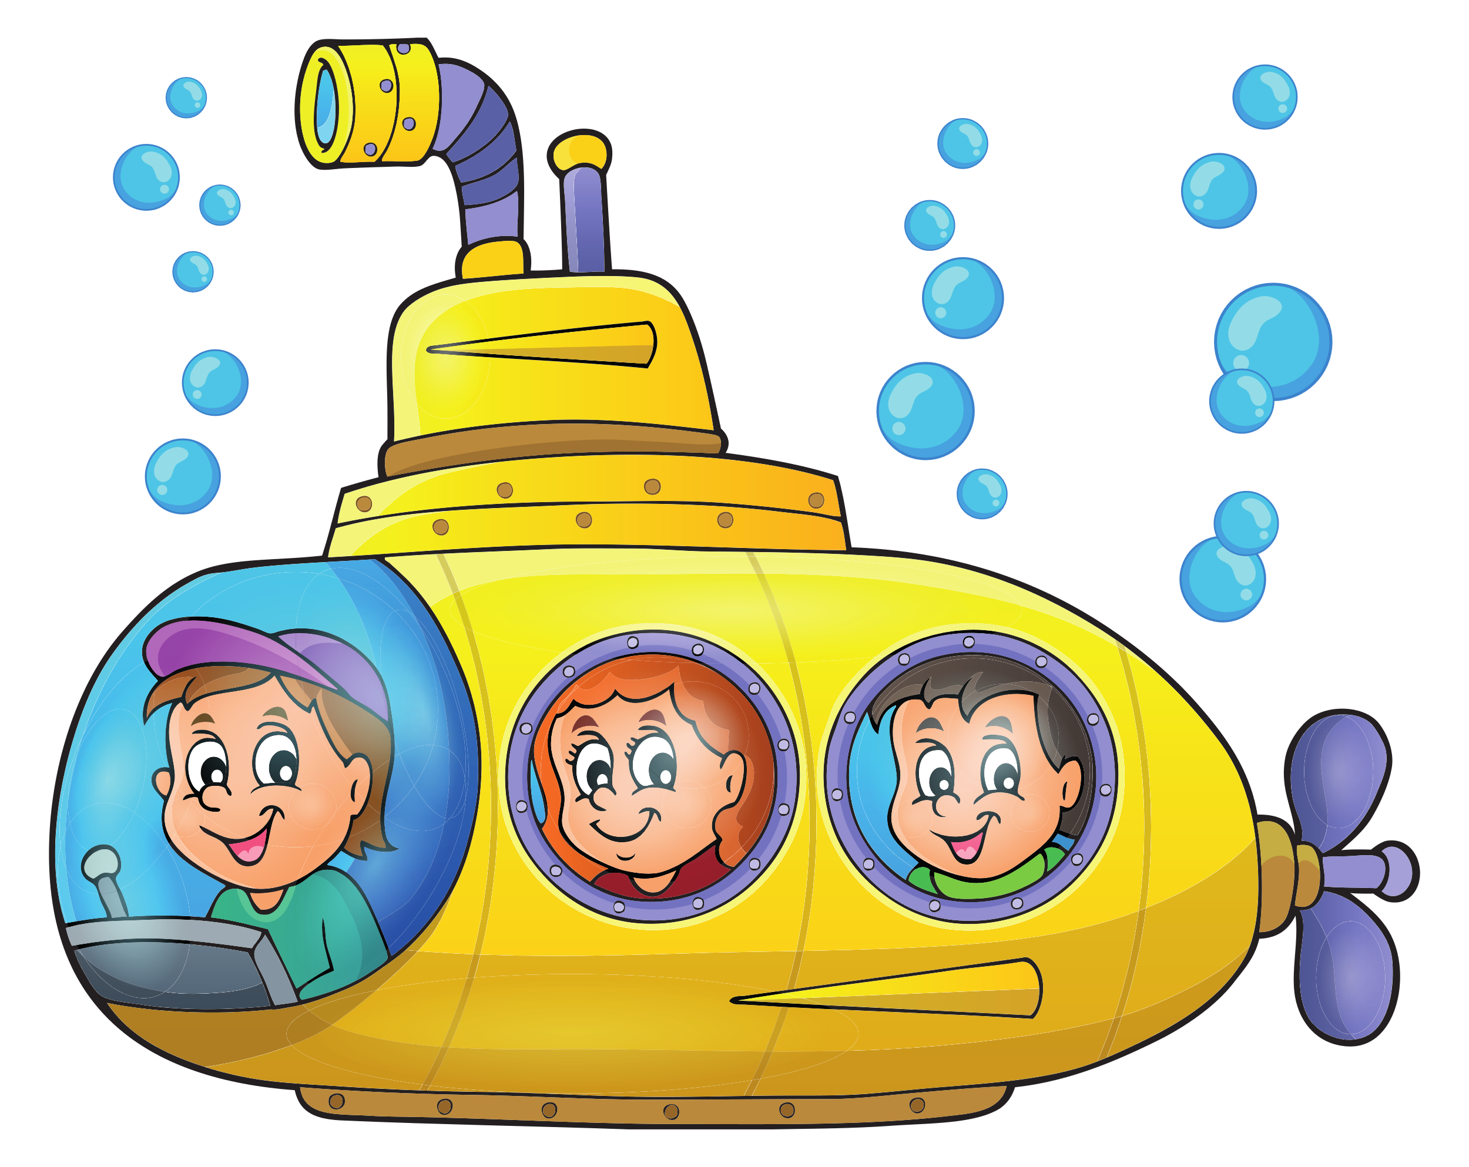
What is this underwater ship called?
Subline
Submarine

Slide 13
Correct Answer is:
Submarine

Slide 14

Finished!
Well Done you have completed
our All Aboard quiz!

