Slide 1



All Aboard

Slide 2



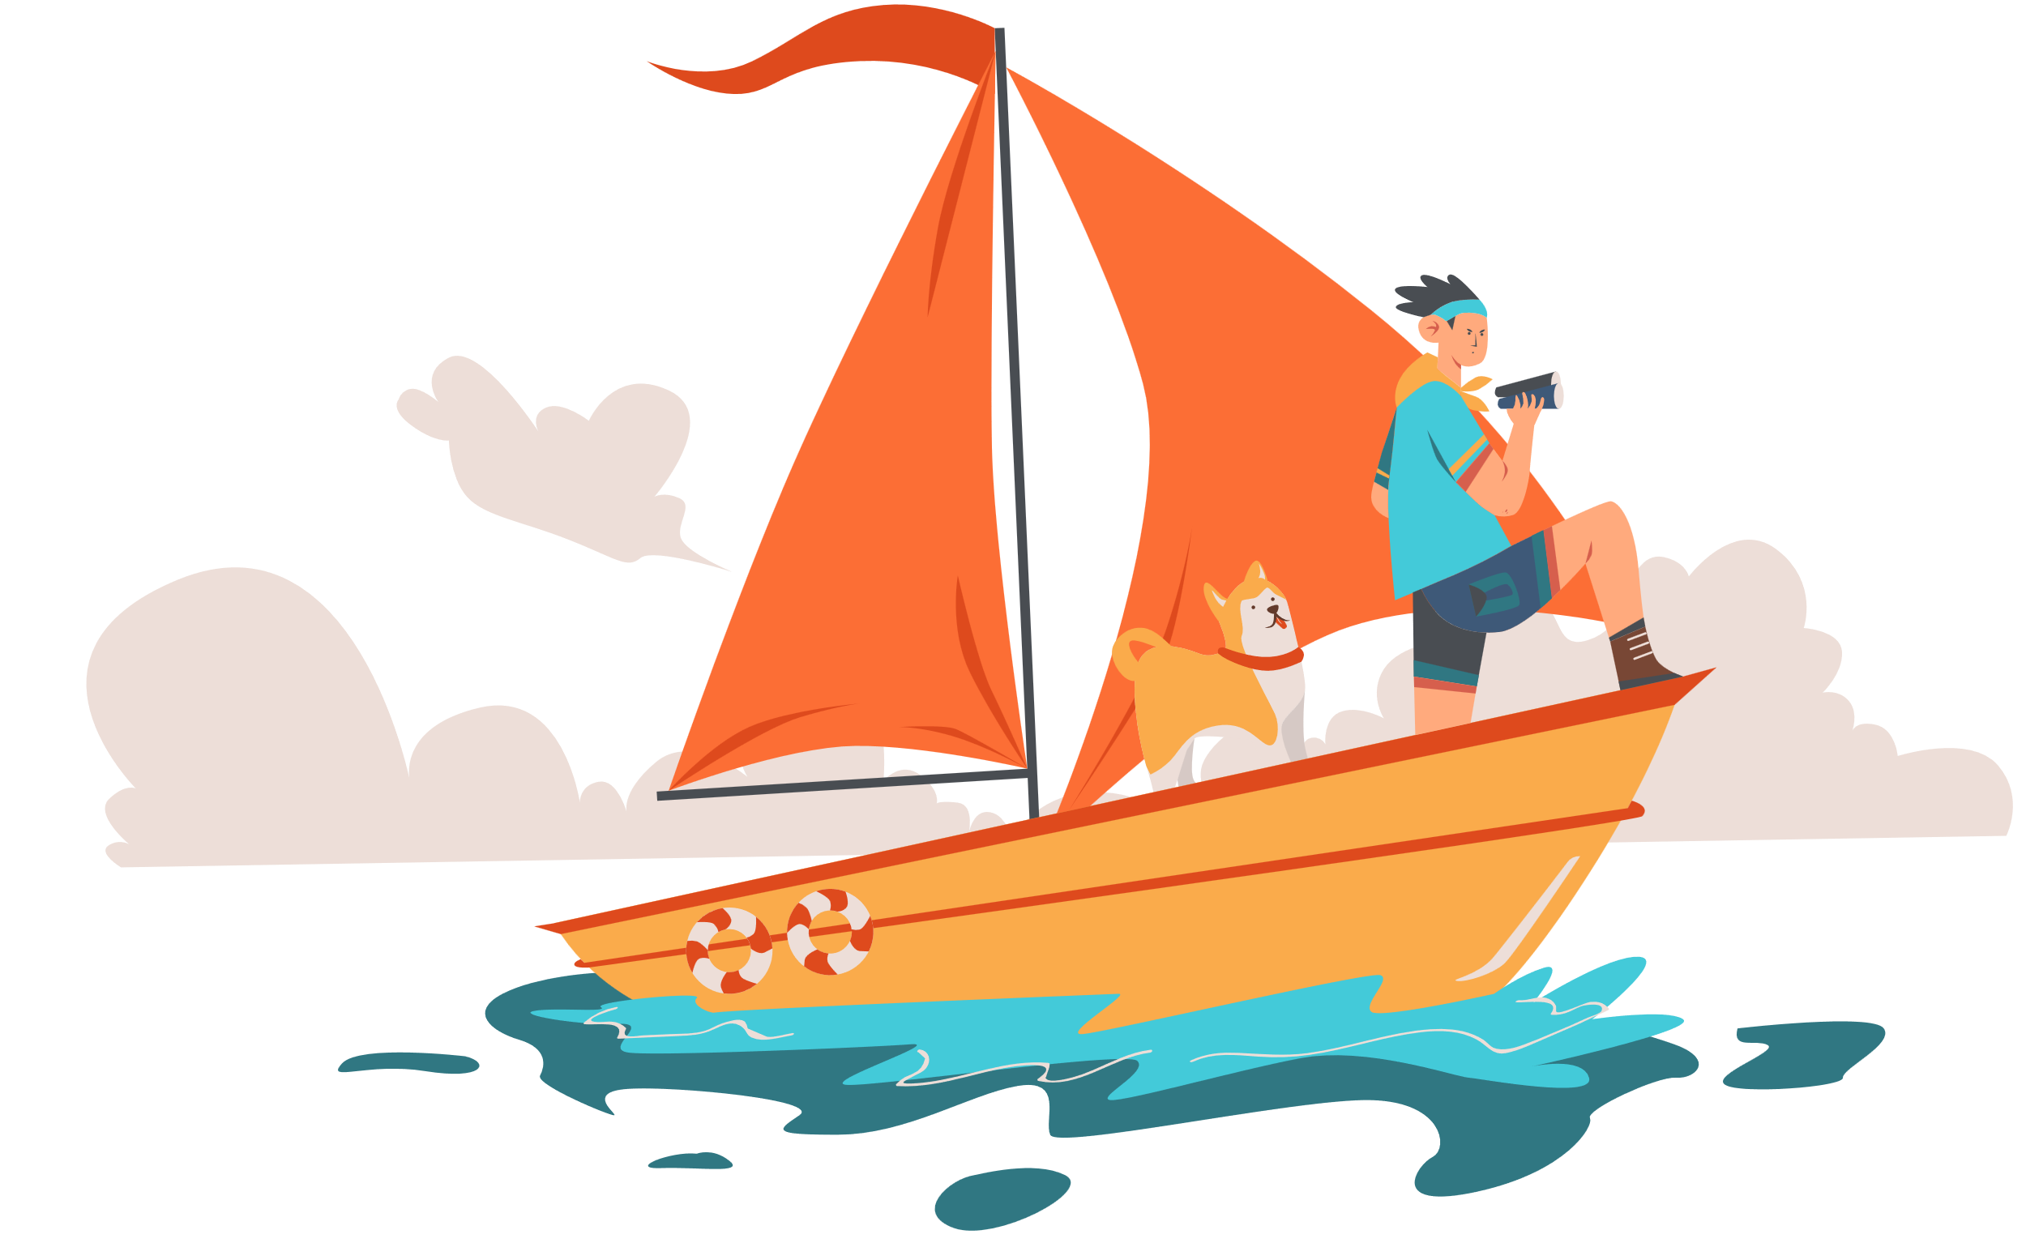
All Aboard
Monkey Madness
5 minutes
Instructions
Take your pupils on a nautical adventure as you go through our short Power Point with questions along the way. Place a red object on one side of the room and a blue on the other side. The answers to each of the questions are written in blue or red. The pupils must answer by moving to the side of the room they think the answer is.
Health & Safety
  Ensure floors are clear of trip hazards before taking part in any activity.
  Ensure pupils leave stationary on the table.
  Remind pupils of their own spatial awareness.
  Give clear instructions.
Teacher Tips
This activity is suited to all ages. See our PowerPoint for more information.
If space is limited you can ask your pupils to stand in a particular position for example, if they think the answer is red = stand and put their hands on their head, if they think the answer is blue = stand and put their hands on their shoulders.

Slide 3


KS2
Time:
5 minutes
Resources :
Stopwatch

Slide 4
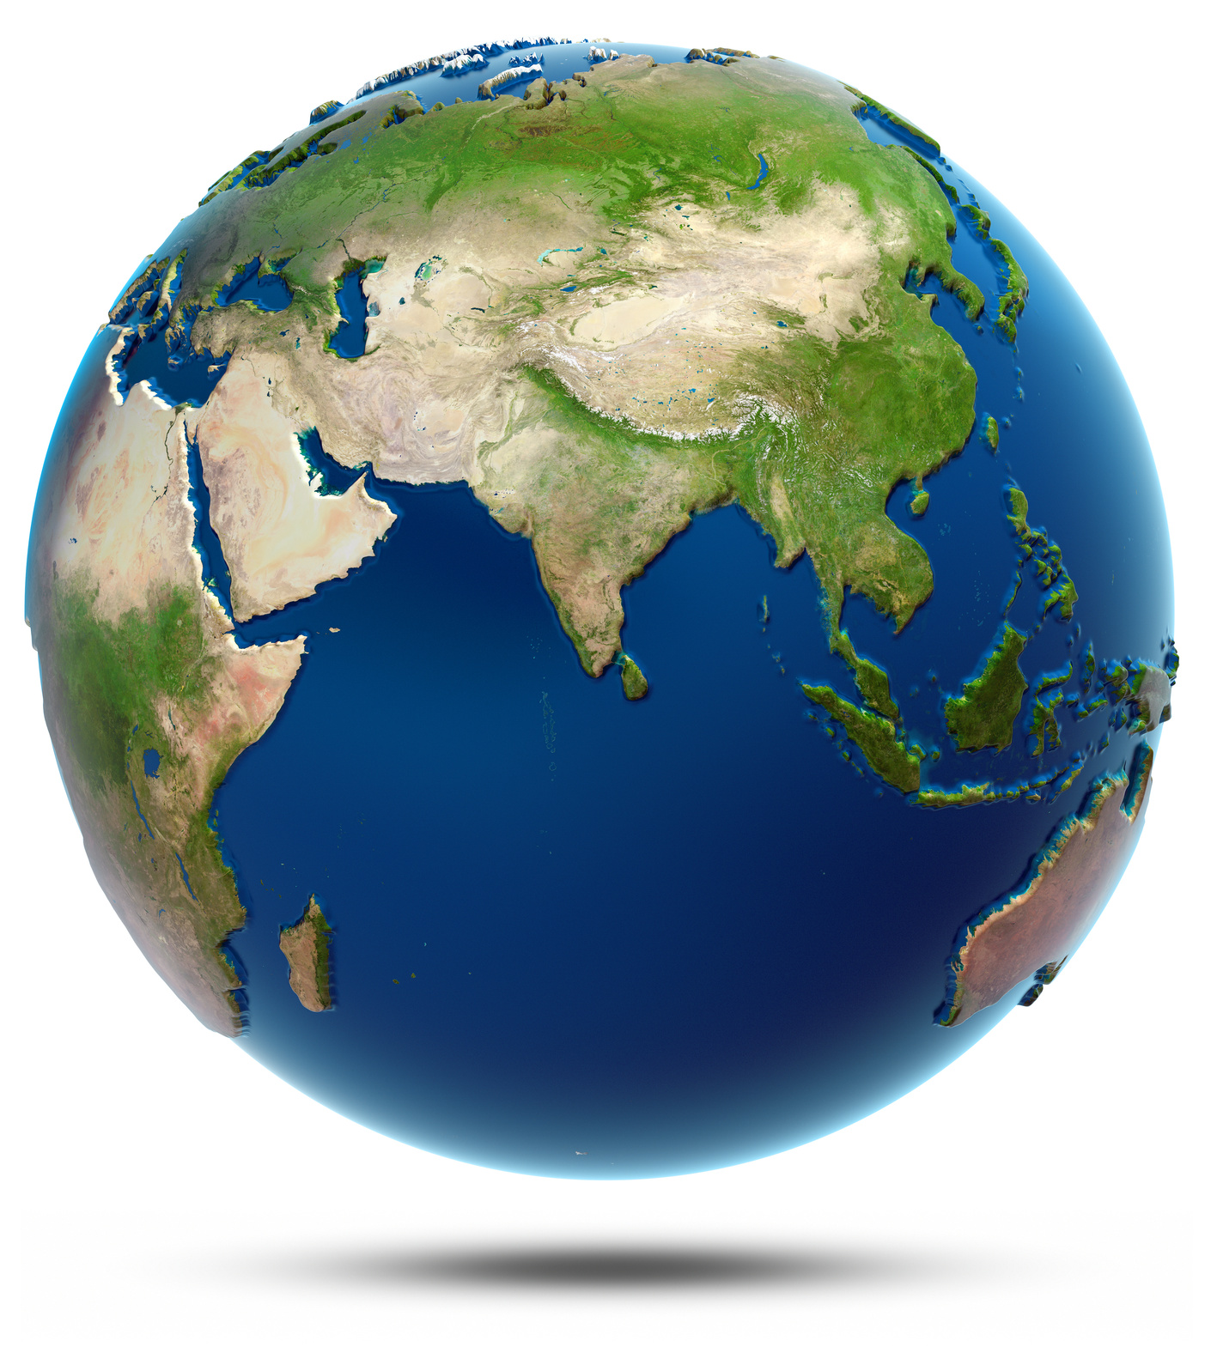
What percentage of the
earths surface is covered by water?
60%
70%

Slide 5
Correct Answer is:
70%

Slide 6
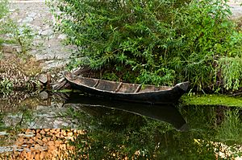
What is the name of the
oldest type of boat?
Dugin
Dugout

Slide 7
Correct Answer:
Dugout

Slide 8
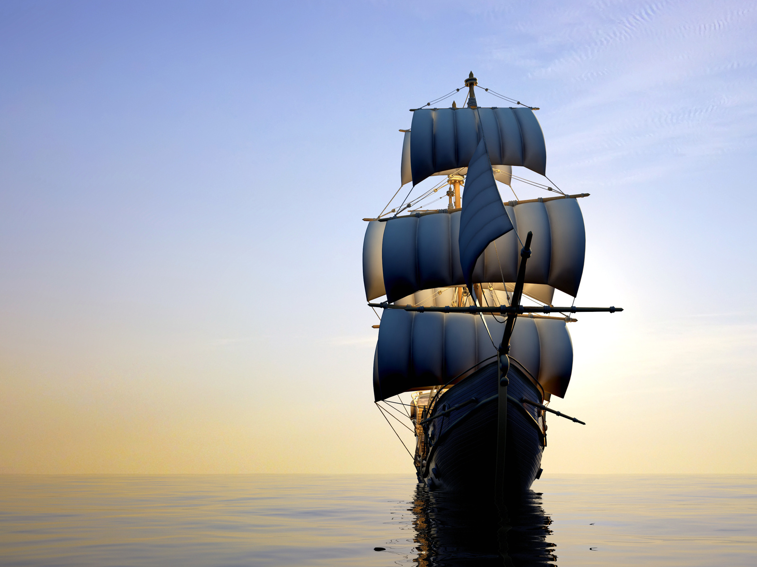
What is the left side of a ship called?
Port
Starboard

Slide 9
Correct Answer is:
Port

Slide 10
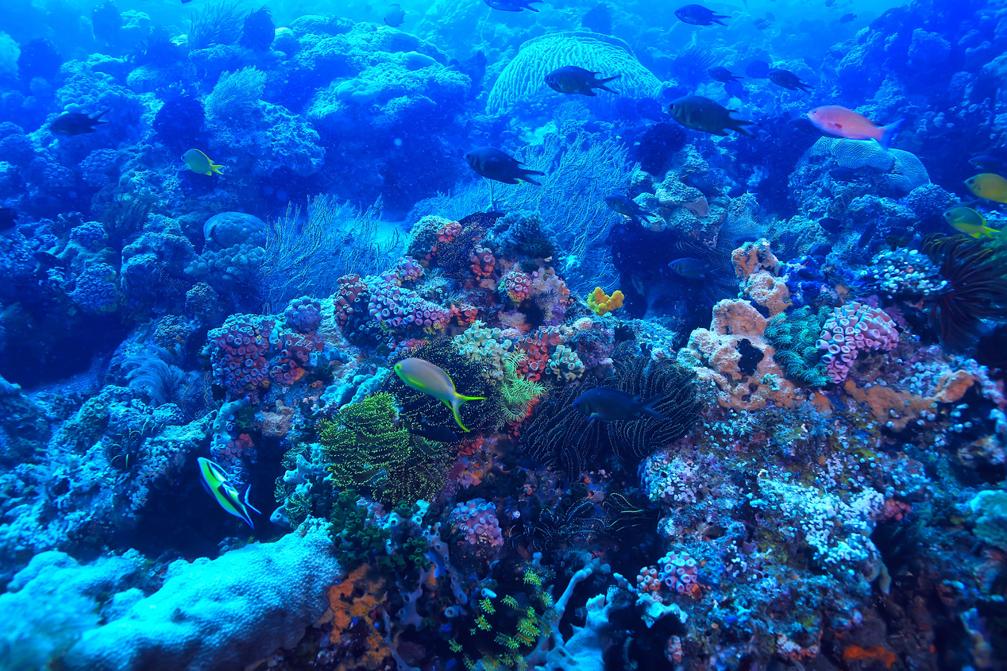
How much of the worlds oceans
have we explored?
15%
5%

Slide 11
Correct Answer is:
5%

Slide 12
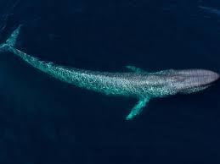
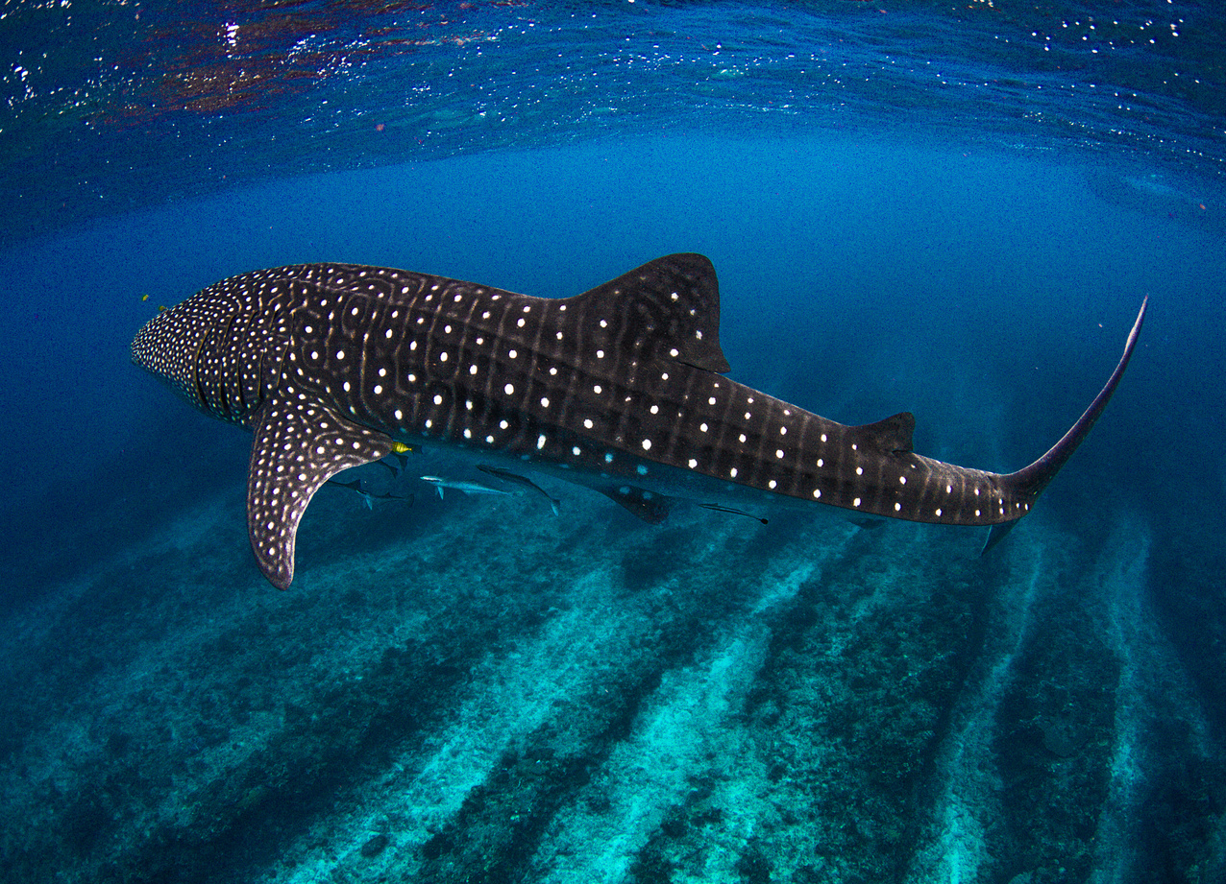
What is the largest animal in the ocean?
Whale Shark
Blue
Whale

Slide 13
Correct Answer:
Blue
Whale

Slide 14
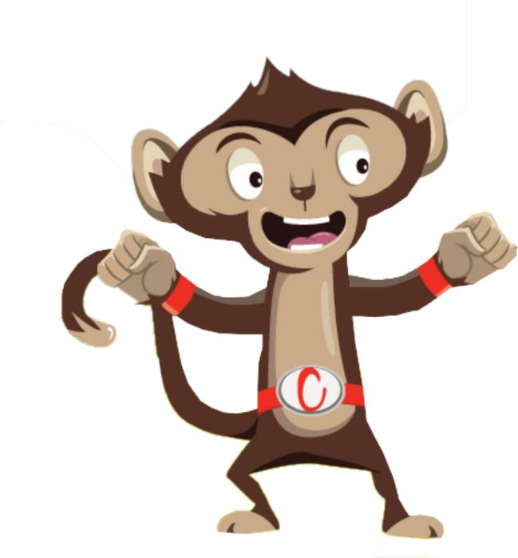
Finished!
Well Done you have completed
our All Aboard quiz!

