Slide 1





Chester’s Christmas Quiz

Slide 2




Chester’s
Christmas Quiz
Monkey Madness
5 minutes
Instructions
Take your pupils on a Christmas adventure as you go through our short Power Point with questions along the way. Place a red object on one side of the room and a green on the other side. The answers to each of the questions are written in green or red. The pupils must answer by moving to the side of the room they think the answer is.
Health & Safety
  Ensure floors are clear of trip hazards before taking part in any activity.
  Ensure pupils leave stationary on the table.
  Remind pupils of their own spatial awareness.
  Give clear instructions.
Teacher Tips
This activity is suited to all ages. See PowerPoint for more information - there are separate powerpoints for foundation, KS1 and KS2
If space is limited you can ask your pupils to stand in a particular position for example, if they think the answer is red = stand and put their hands on their head, if they think the answer is green = stand and put their hands on their shoulders.

Slide 3

Foundation Level
Time:
5 mins

Slide 4

What colour is Rudolph’s nose?
Brown
Red

Slide 5
Correct Answer is:
Red

Slide 6
What date is Christmas day?
25th December
24th December

Slide 7
Correct Answer is:
25th December

Slide 8

What are Santa’s little helpers called?
Elves
Fairies

Slide 9
Correct Answer is:
Elves

Slide 10

What treat is left out for Santa?
Sweets and gingerbread men
Milk and cookies

Slide 11
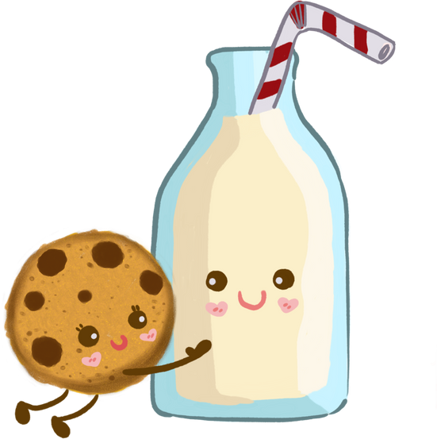
Correct Answer is:
Milk and cookies

Slide 12

What treats are left out for the reindeer?
Carrots
Peas

Slide 13

Correct Answer is:
Carrots

Slide 14

Finished!
Well Done you have completed
our Christmas quiz!

