Slide 1





Chester’s Christmas Quiz

Slide 2




Chester’s
Christmas Quiz
Monkey Madness
5 minutes
Instructions
Take your pupils on a Christmas adventure as you go through our short Power Point with questions along the way. Place a red object on one side of the room and a green on the other side. The answers to each of the questions are written in green or red. The pupils must answer by moving to the side of the room they think the answer is.
Health & Safety
  Ensure floors are clear of trip hazards before taking part in any activity.
  Ensure pupils leave stationary on the table.
  Remind pupils of their own spatial awareness.
  Give clear instructions.
Teacher Tips
This activity is suited to all ages. See PowerPoint for more information - there are separate powerpoints for foundation, KS1 and KS2
If space is limited you can ask your pupils to stand in a particular position for example, if they think the answer is red = stand and put their hands on their head, if they think the answer is green = stand and put their hands on their shoulders.

Slide 3


KS1
Time:
5 minutes
Resources :
Stopwatch

Slide 4
What date is Boxing Day?
25th December
26th December

Slide 5
Correct Answer is:
26th December

Slide 6
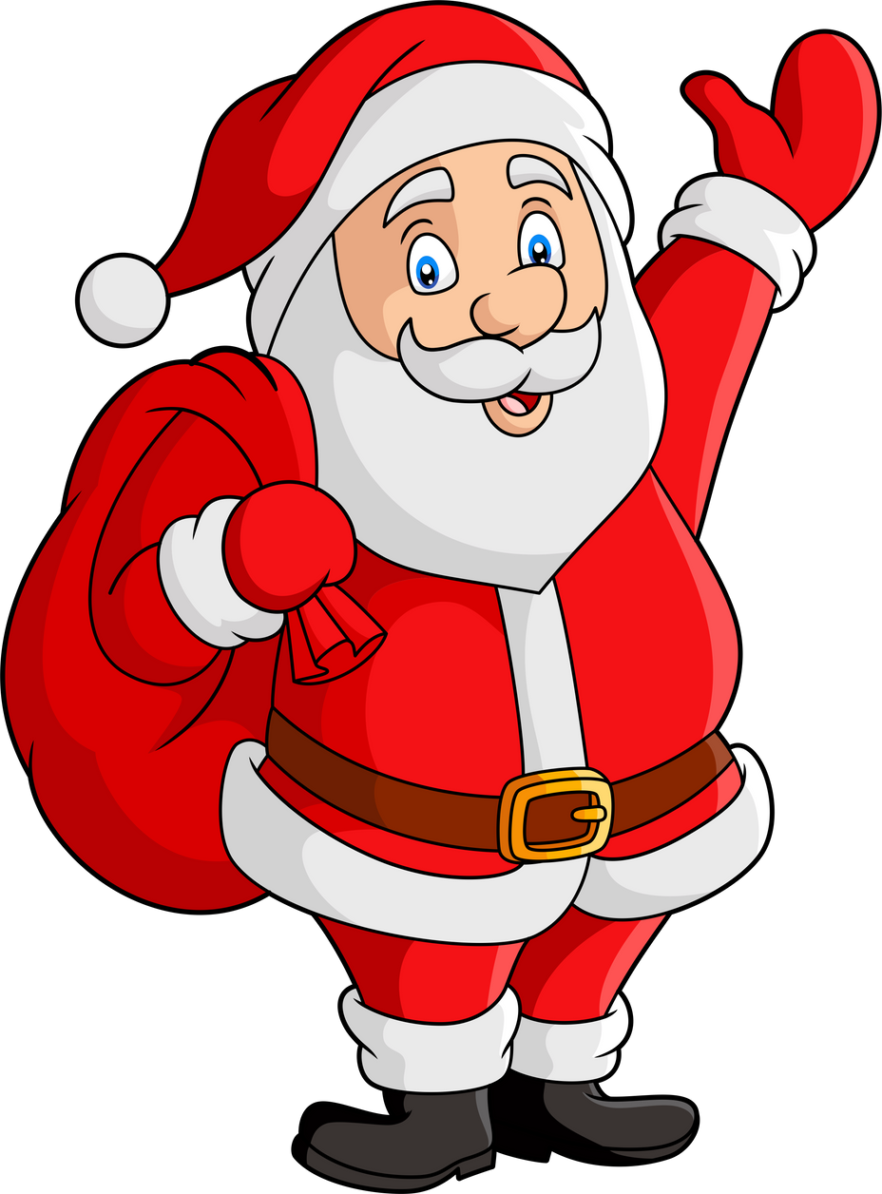
What is another name for Santa Claus?
Father Presents
Father Christmas

Slide 7
Correct Answer is:
Father Christmas

Slide 8
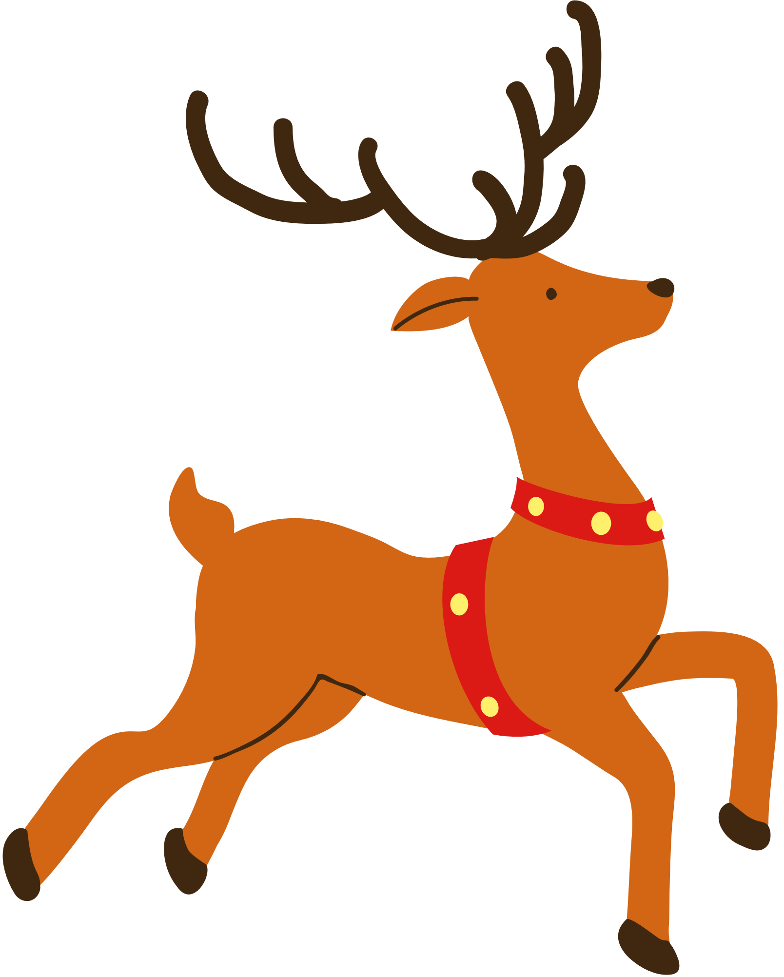
How many reindeer pull Santa’s Sleigh?
9 reindeer
7 reindeer

Slide 9
Correct Answer is:
9 reindeer

Slide 10

What is this person doing?
Wrapping Christmas presents
Singing Christmas carols

Slide 11
Correct Answer is:
Singing Christmas carols

Slide 12

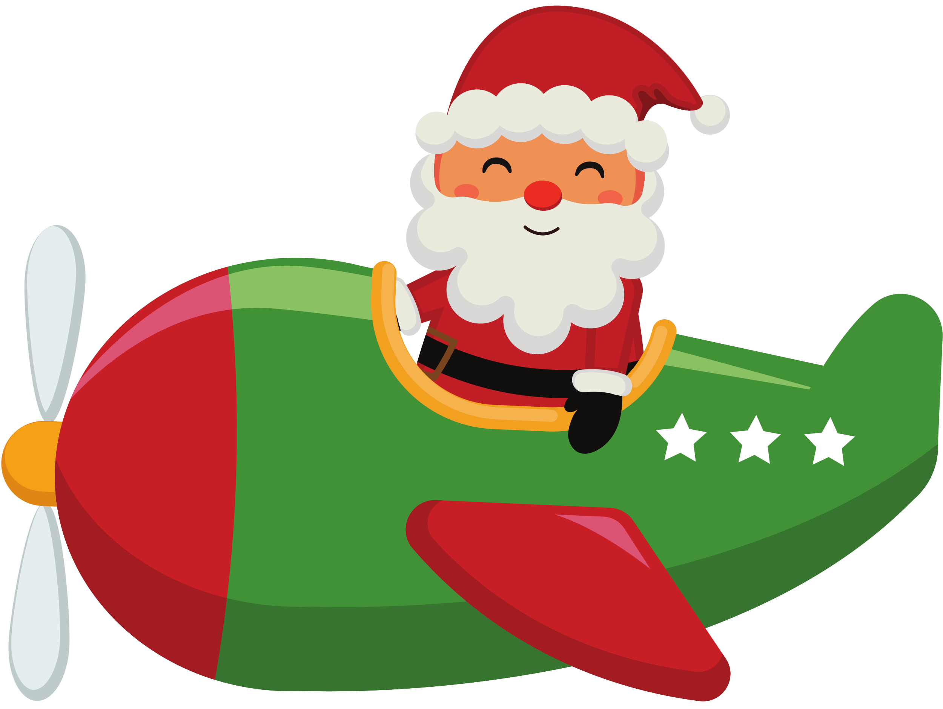
What is Santa’s mode of transport?
Sleigh
Plane

Slide 13
Correct Answer is:
Sleigh

Slide 14

Finished!
Well Done you have completed
our Christmas quiz!

