Slide 1





Chester’s Christmas Quiz

Slide 2




Chester’s
Christmas Quiz
Monkey Madness
5 minutes
Instructions
Take your pupils on a Christmas adventure as you go through our short Power Point with questions along the way. Place a red object on one side of the room and a green on the other side. The answers to each of the questions are written in green or red. The pupils must answer by moving to the side of the room they think the answer is.
Health & Safety
  Ensure floors are clear of trip hazards before taking part in any activity.
  Ensure pupils leave stationary on the table.
  Remind pupils of their own spatial awareness.
  Give clear instructions.
Teacher Tips
This activity is suited to all ages. See PowerPoint for more information - there are separate powerpoints for foundation, KS1 and KS2
If space is limited you can ask your pupils to stand in a particular position for example, if they think the answer is red = stand and put their hands on their head, if they think the answer is green = stand and put their hands on their shoulders.

Slide 3


KS2
Time:
5 minutes
Resources :
Stopwatch

Slide 4

Which type of tree is used for Christmas trees?
Pine tree
Palm tree

Slide 5

Correct Answer is:
Pine tree

Slide 6
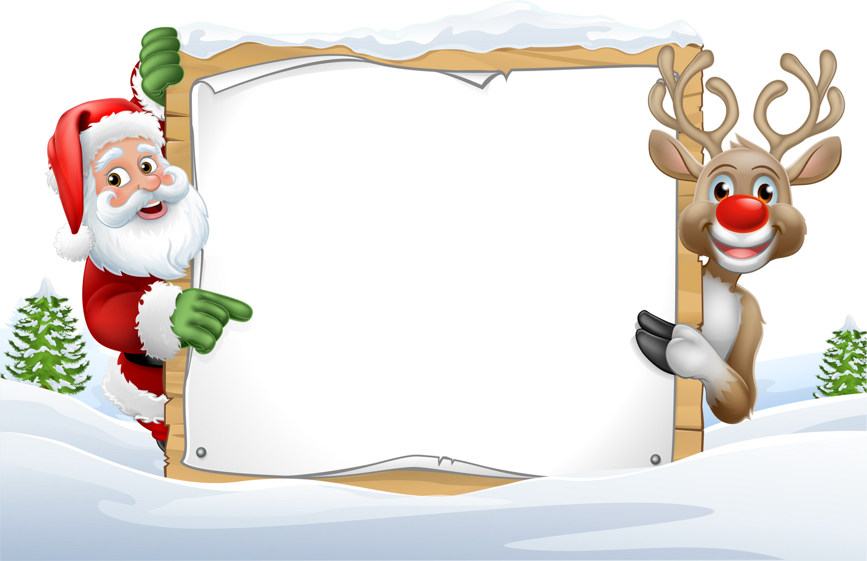

True or false: Christmas is during the Summer in Australia
True
False

Slide 7


Correct Answer:
True!

Slide 8
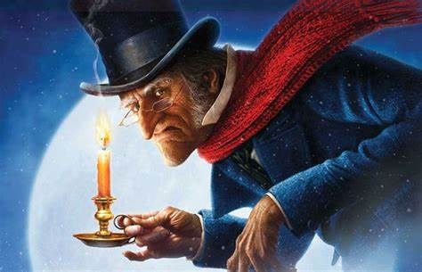
In the film “A Christmas Carol”.
What is the first name of Scrooge?
Edward
Ebenezer

Slide 9
Correct Answer is:
Ebenezer
Scrooge

Slide 10
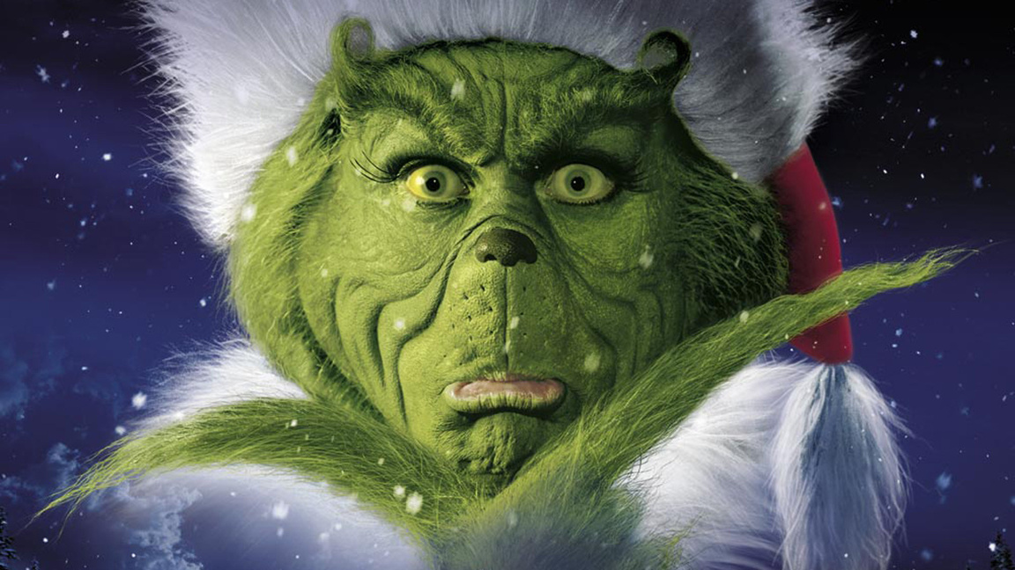
What town does The Grinch live in?
Whoville
Howville

Slide 11
Correct Answer is:
Whoville

Slide 12

Which train transports children to the north pole?
The Polar
Trainline
The Polar
Express

Slide 13
Correct Answer:
The Polar Express!

Slide 14

Finished!
Well Done you have completed
our Christmas quiz!

