Slide 1
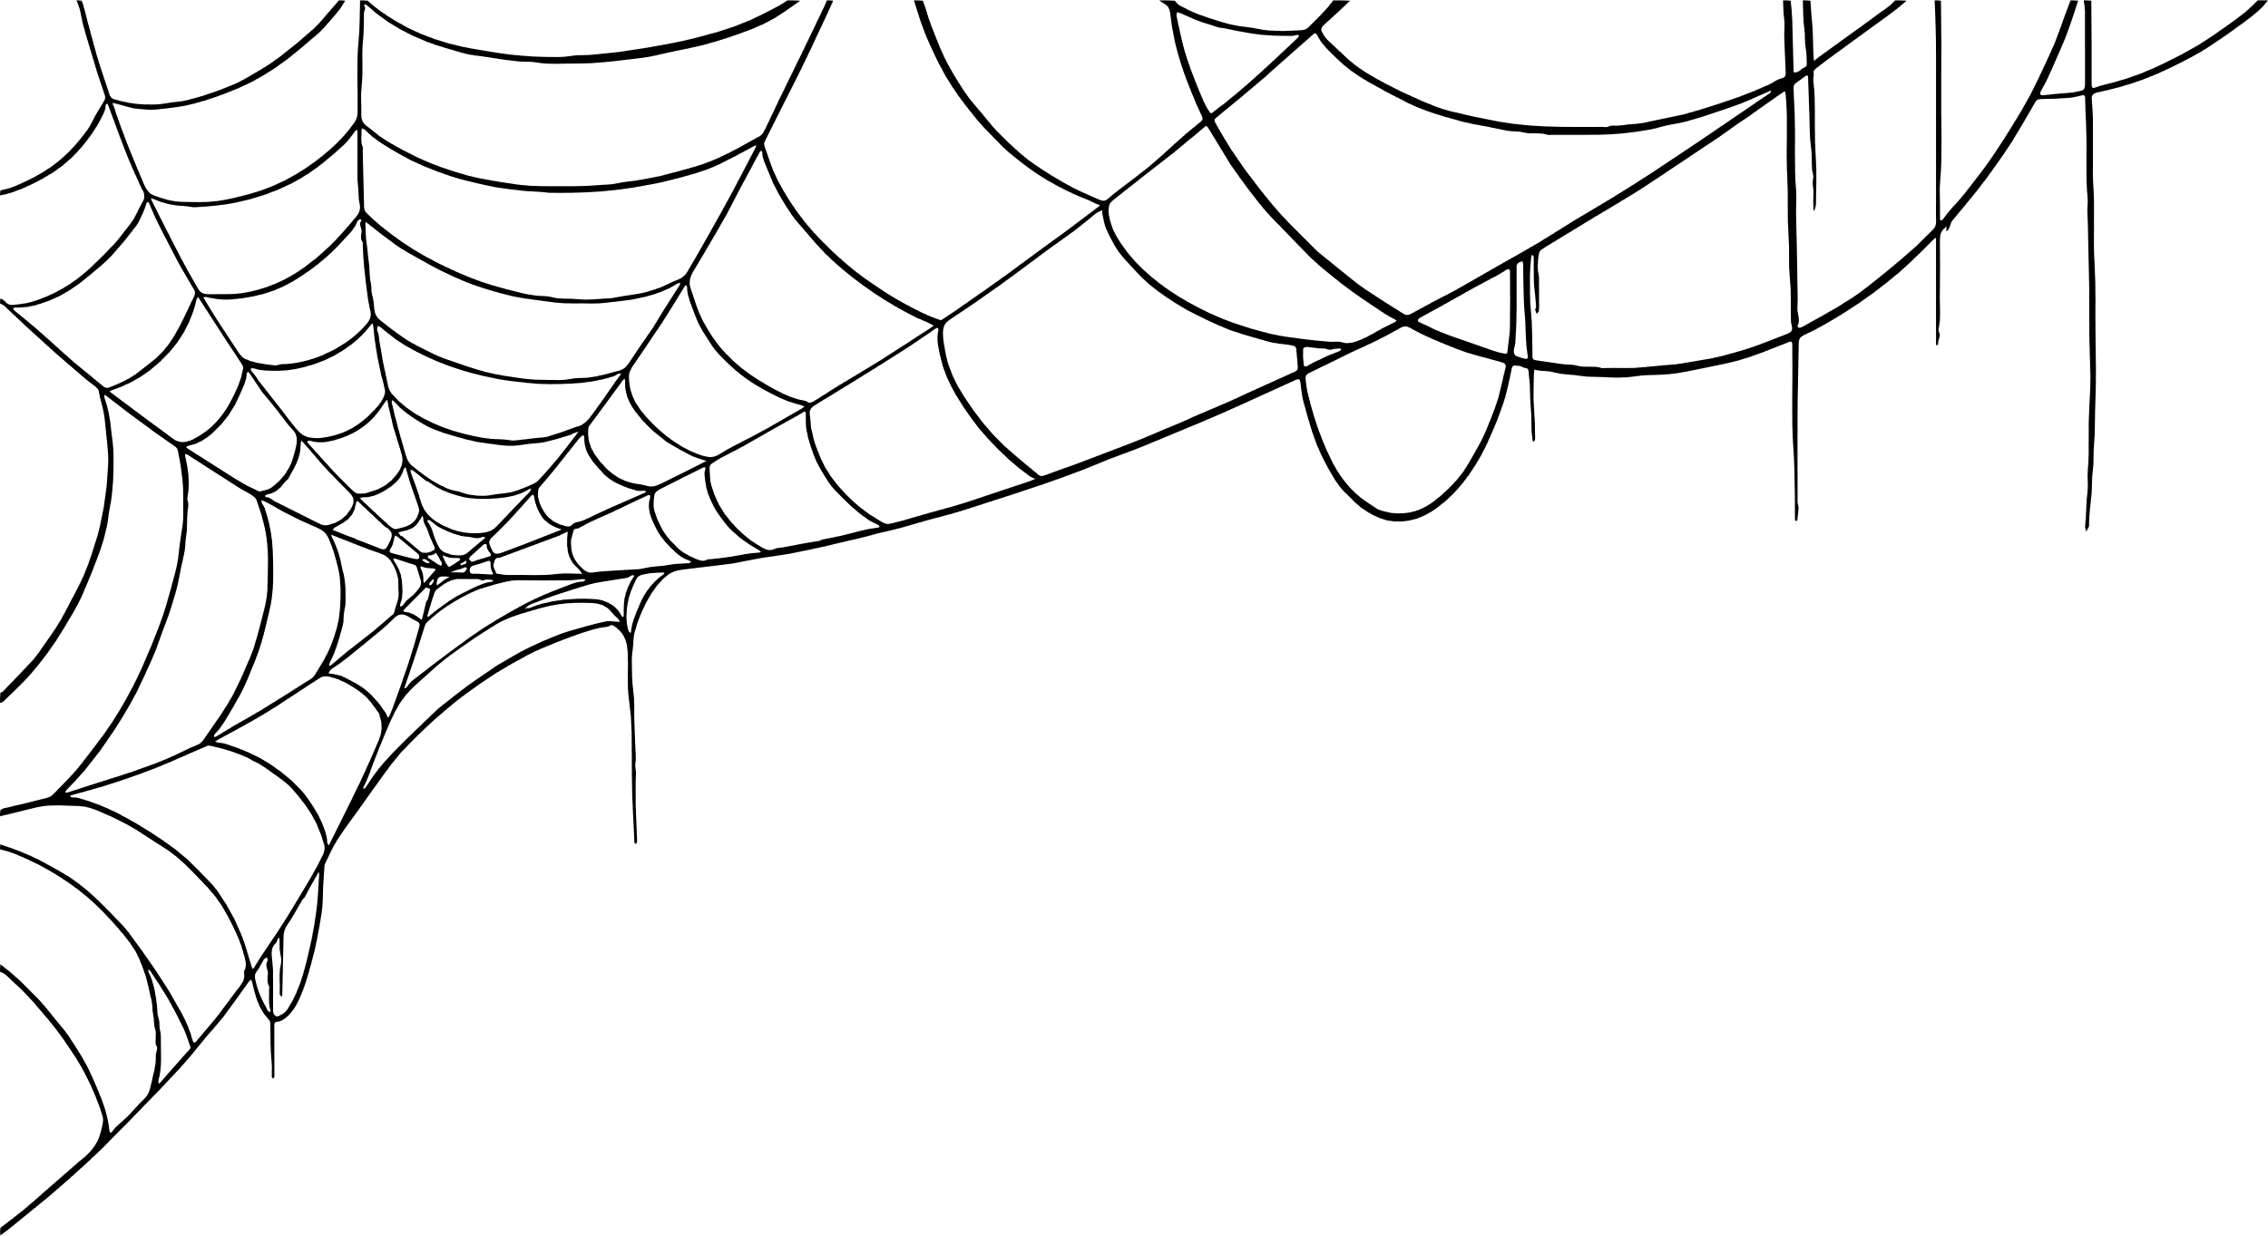





Chester’s Halloween Quiz

Slide 2





Chester’s
Halloween Quiz
Monkey Madness
5 minutes
Instructions
Take your pupils on a Halloween adventure as you go through our short Power Point with questions along the way. Place a red object on one side of the room and a green on the other side. The answers to each of the questions are written in green or red. The pupils must answer by moving to the side of the room they think the answer is.
Health & Safety
  Ensure floors are clear of trip hazards before taking part in any activity.
  Ensure pupils leave stationary on the table.
  Remind pupils of their own spatial awareness.
  Give clear instructions.
Teacher Tips
This activity is suited to all ages. See PowerPoint for more information - there are separate powerpoints for foundation, KS1 and KS2
If space is limited you can ask your pupils to stand in a particular position for example, if they think the answer is red = stand and put their hands on their head, if they think the answer is green = stand and put their hands on their shoulders.

Slide 3

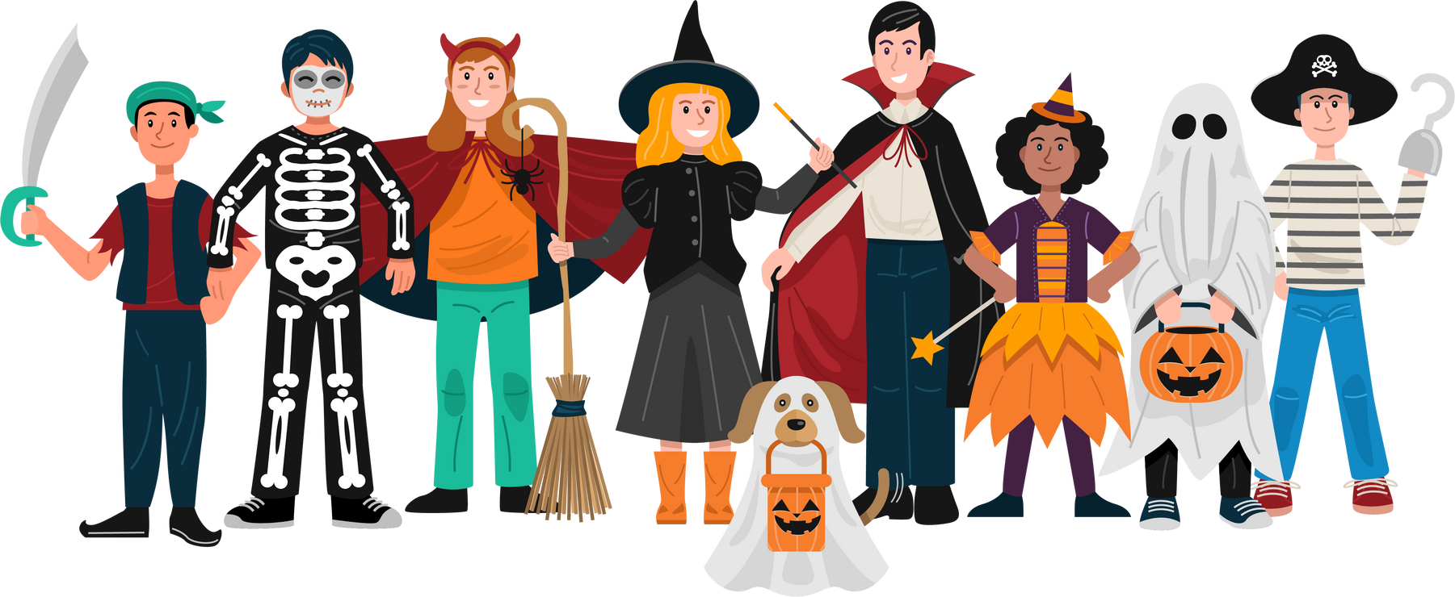
Foundation Level
Time:
5 mins

Slide 4

What colour is the witches hat?
Purple
Black

Slide 5
Correct Answer is:
Purple

Slide 6

What date is Halloween day?
30th October
31st October

Slide 7
Correct Answer is:
31st October

Slide 8
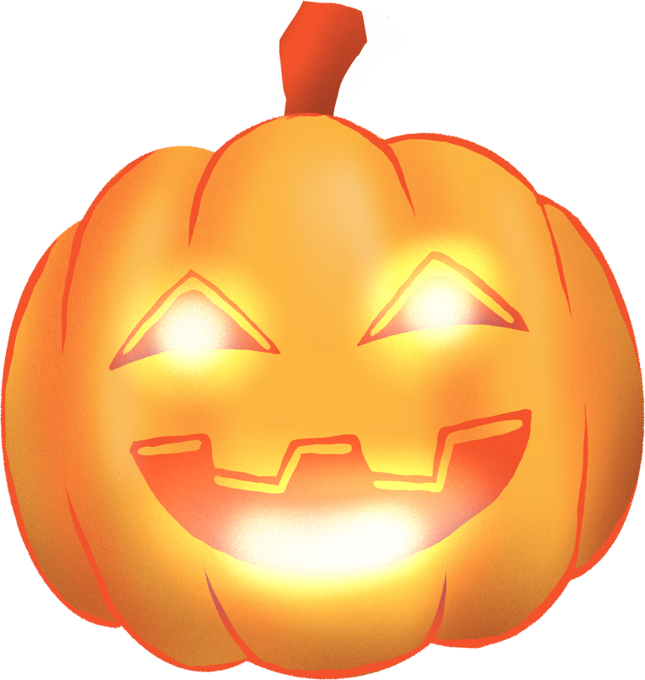
What do you usually carve at Halloween?
Pumpkin
Potato

Slide 9
Correct Answer is:
Pumpkin

Slide 10

What do you collect door to door at Halloween?
Crisps
Sweets and treats

Slide 11
Correct Answer is:
Sweets and treats

Slide 12

What does a witch use to travel?
Broom
Broomstick

Slide 13
Correct Answer is:
Broomstick

Slide 14

Finished!
Well Done you have completed
our Halloween quiz!

