Slide 1
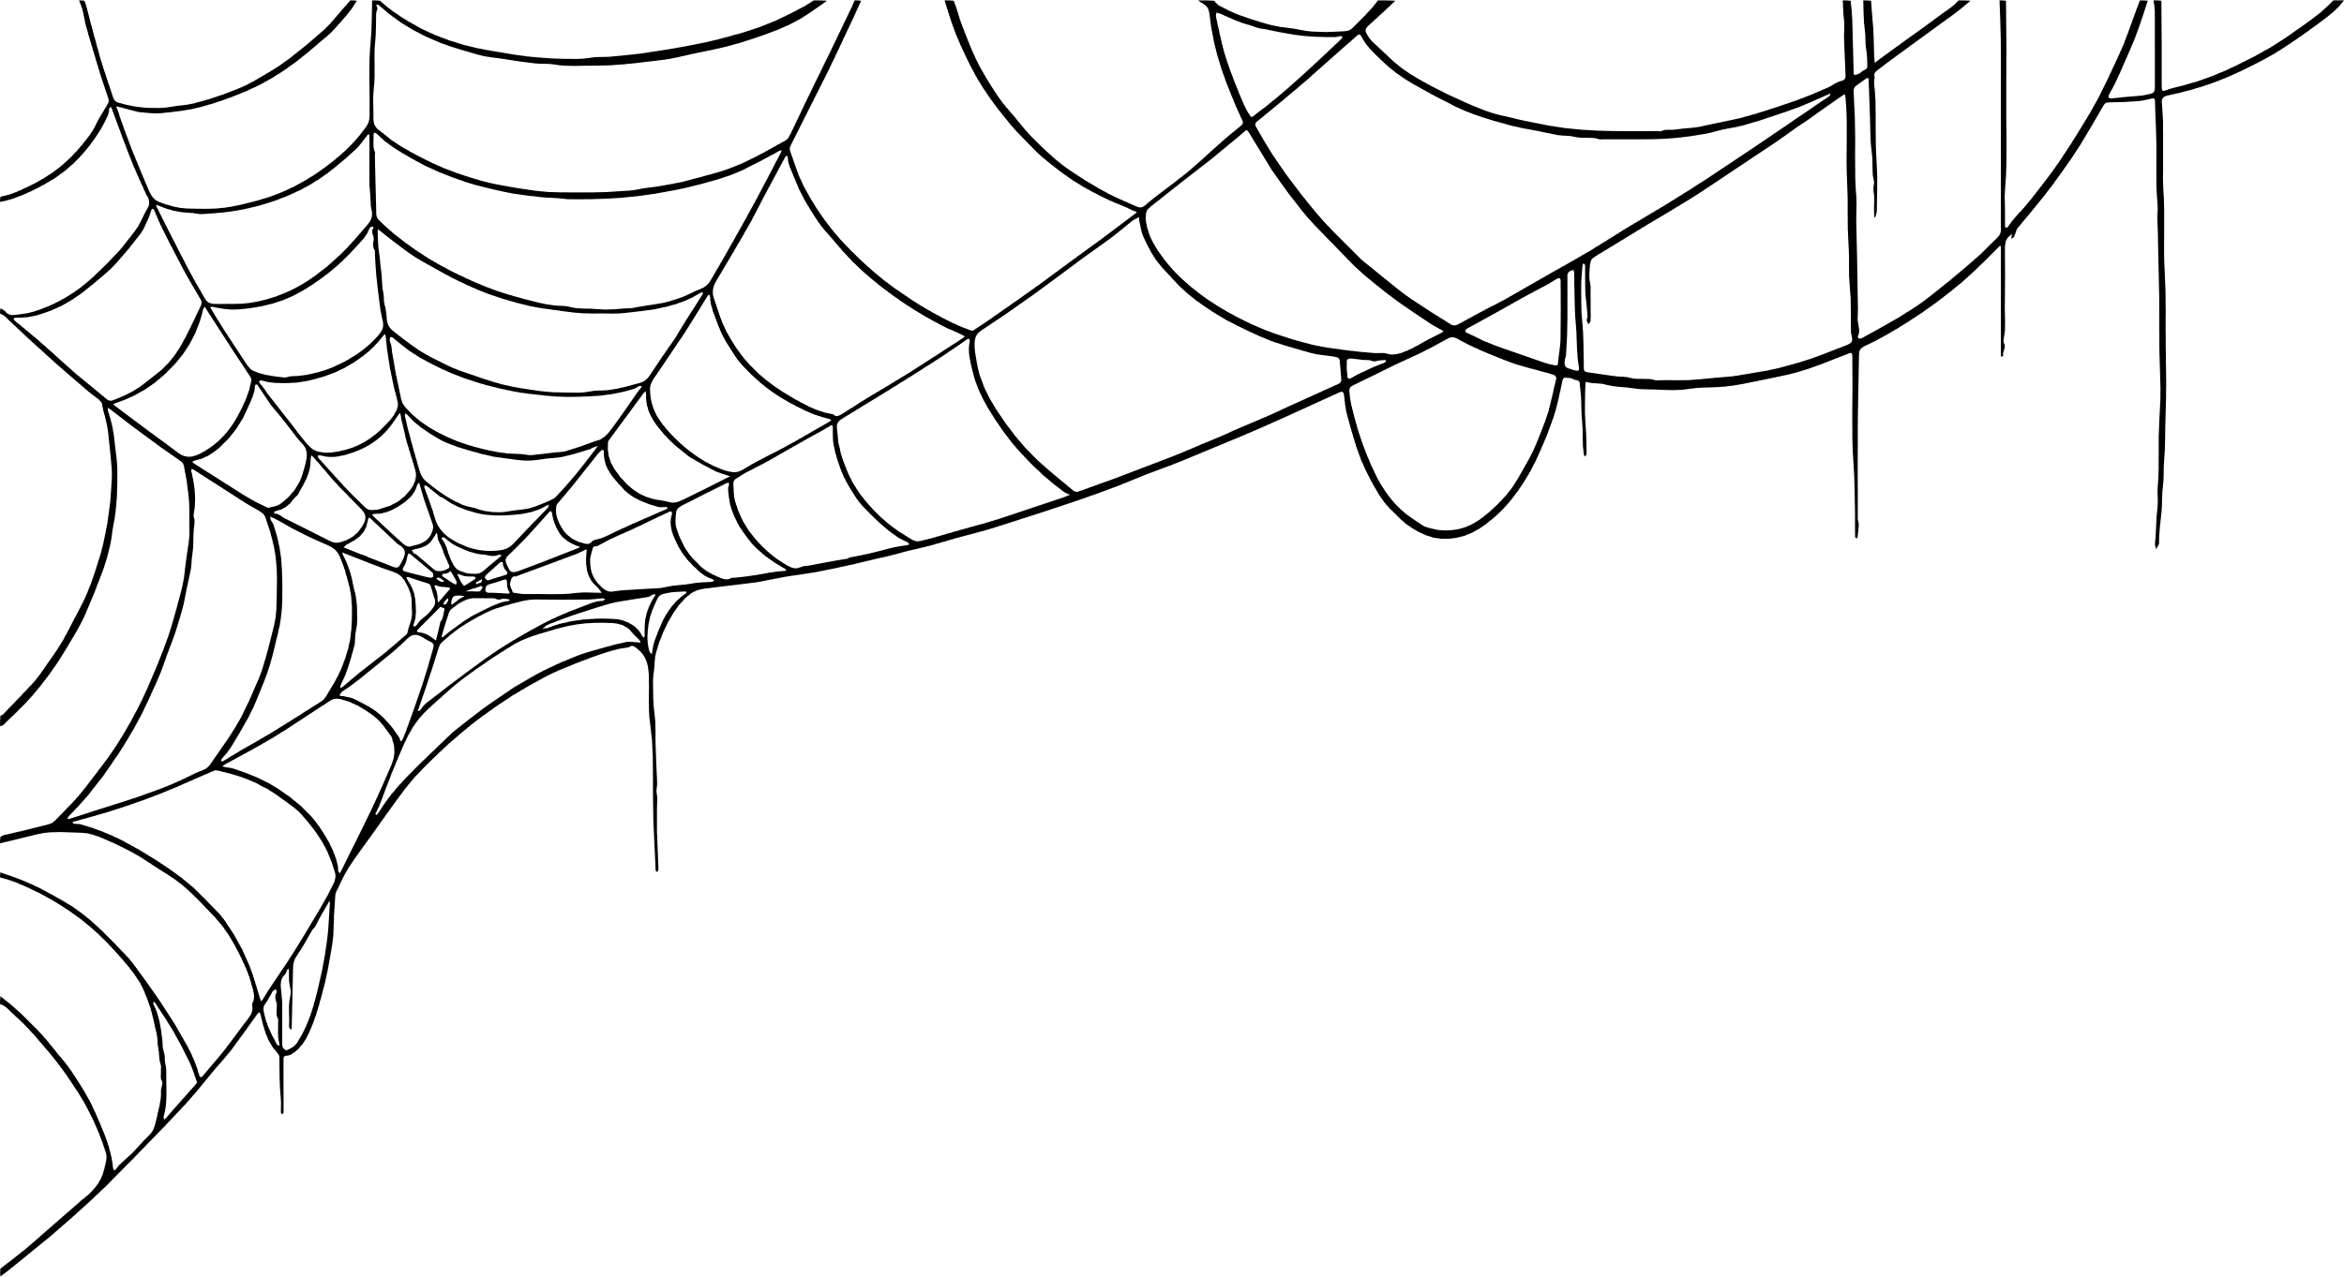





Chester’s Halloween Quiz

Slide 2





Chester’s
Halloween Quiz
Monkey Madness
5 minutes
Instructions
Take your pupils on a Halloween adventure as you go through our short Power Point with questions along the way. Place a red object on one side of the room and a green on the other side. The answers to each of the questions are written in green or red. The pupils must answer by moving to the side of the room they think the answer is.
Health & Safety
  Ensure floors are clear of trip hazards before taking part in any activity.
  Ensure pupils leave stationary on the table.
  Remind pupils of their own spatial awareness.
  Give clear instructions.
Teacher Tips
This activity is suited to all ages. See PowerPoint for more information - there are separate powerpoints for foundation, KS1 and KS2
If space is limited you can ask your pupils to stand in a particular position for example, if they think the answer is red = stand and put their hands on their head, if they think the answer is green = stand and put their hands on their shoulders.

Slide 3

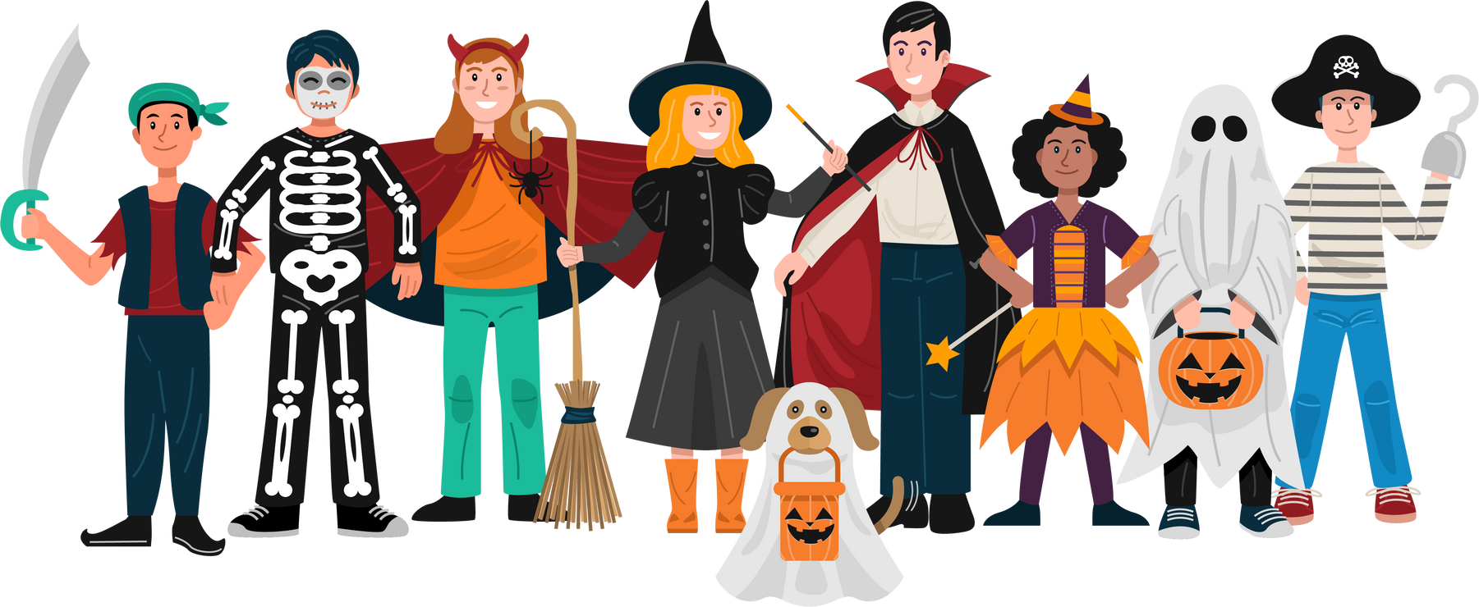
KS1
Time:
5 mins

Slide 4

What fruit is usually dunked in water at Halloween?
Apples
Pears

Slide 5
Correct Answer is:
Apples

Slide 6

What are vampires scared of?
Chocolate
Sunlight

Slide 7
Correct Answer is:
Sunlight

Slide 8

How many legs does a spider have?
8
5

Slide 9
Correct Answer is:
8

Slide 10

In Roald Dhal’s book “The Witches”, witches turn children into?
Monkeys
Mice

Slide 11
Correct Answer is:
Mice

Slide 12

What animal is considered a witches best friend?
Cat
Bat

Slide 13
Correct Answer is:
Cat

Slide 14

Finished!
Well Done you have completed
our Halloween quiz!

