Slide 1
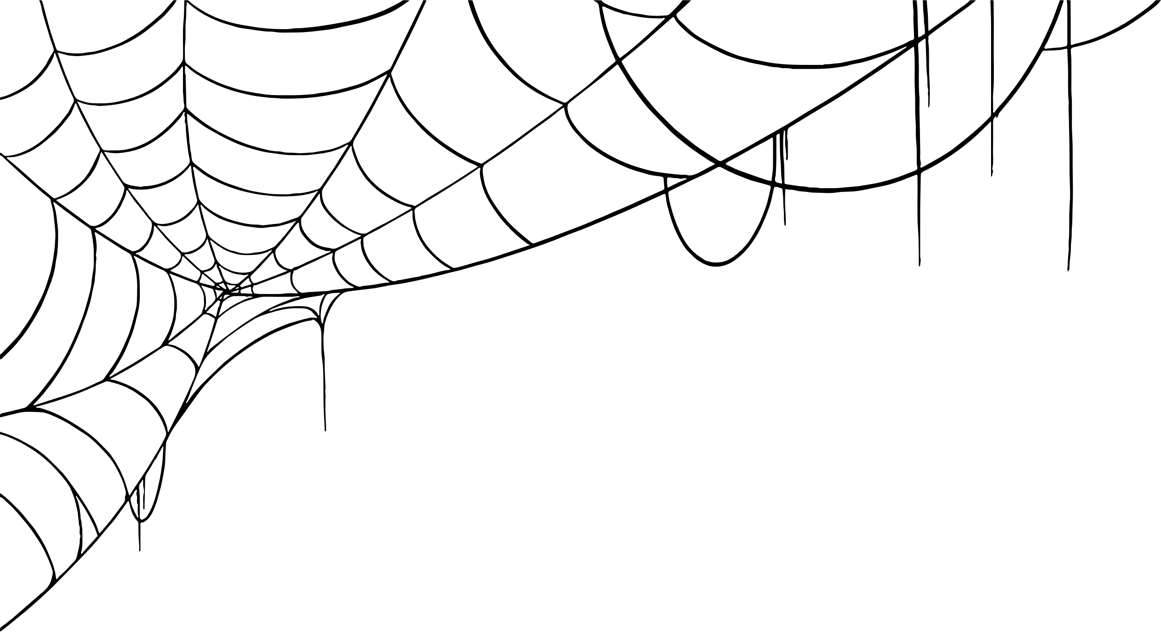




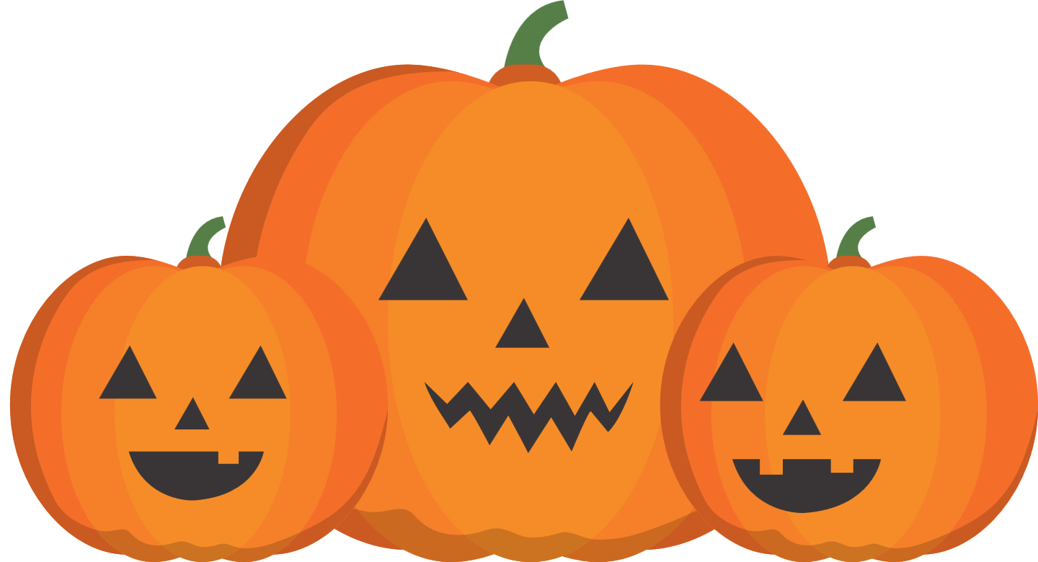
Chester’s Halloween Quiz

Slide 2

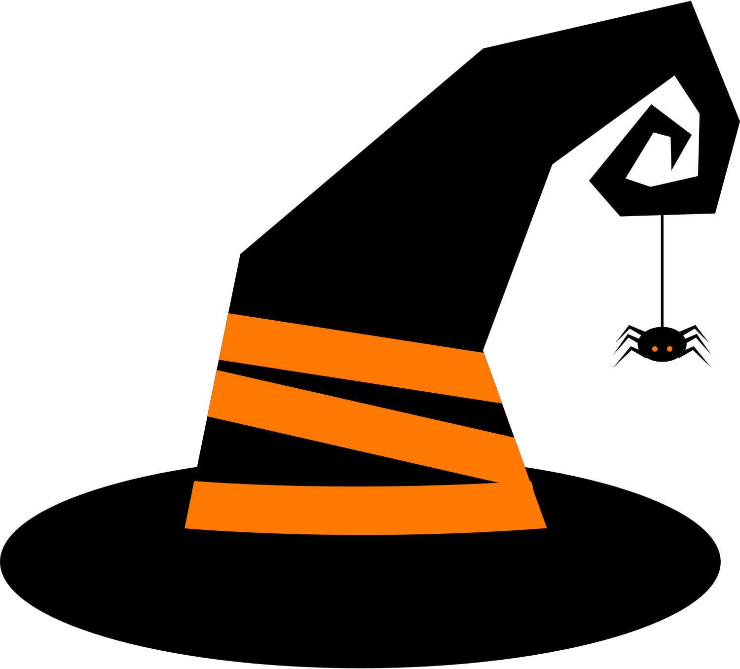


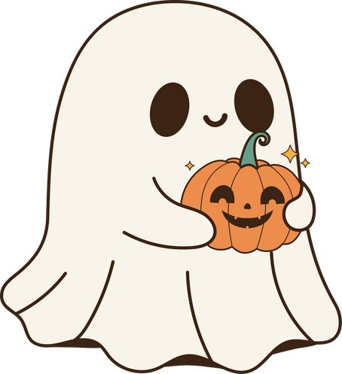
Chester’s
Halloween Quiz
Monkey Madness
5 minutes
Instructions
Take your pupils on a Halloween adventure as you go through our short Power Point with questions along the way. Place a red object on one side of the room and a green on the other side. The answers to each of the questions are written in green or red. The pupils must answer by moving to the side of the room they think the answer is.
Health & Safety
  Ensure floors are clear of trip hazards before taking part in any activity.
  Ensure pupils leave stationary on the table.
  Remind pupils of their own spatial awareness.
  Give clear instructions.
Teacher Tips
This activity is suited to all ages. See PowerPoint for more information - there are separate powerpoints for foundation, KS1 and KS2
If space is limited you can ask your pupils to stand in a particular position for example, if they think the answer is red = stand and put their hands on their head, if they think the answer is green = stand and put their hands on their shoulders.

Slide 3

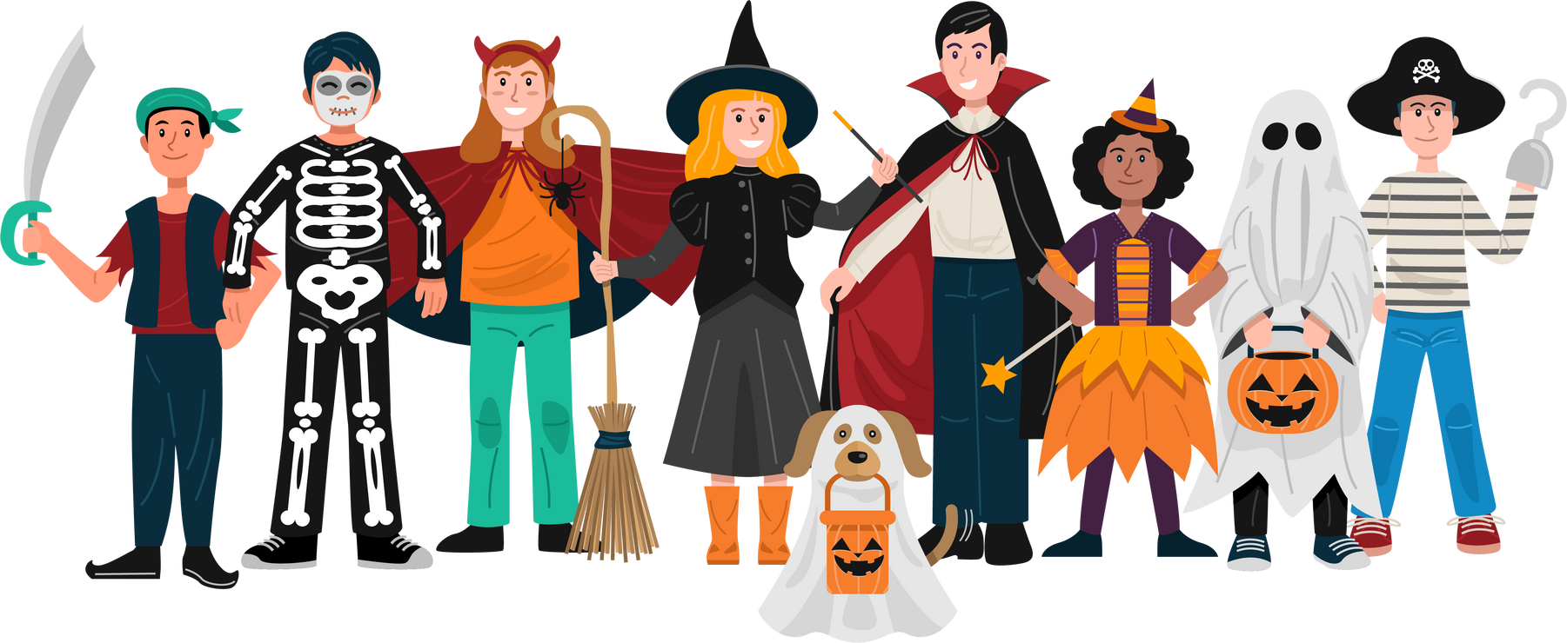
KS2
Time:
5 mins

Slide 4

What animals are vampires supposed to turn into?
Bats
Rats

Slide 5
Correct Answer is:
Bats

Slide 6

What country celebrates Day of The Dead?
Spain
Mexico

Slide 7
Correct Answer is:
Mexico

Slide 8
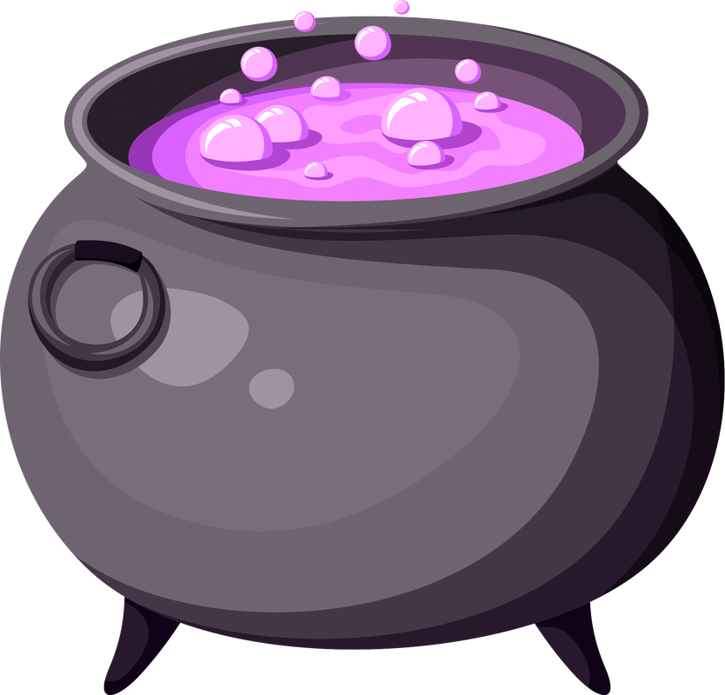
What is the name of the pot witches use to make their potions?
Trough
Cauldron

Slide 9
Correct Answer is:
Cauldron

Slide 10

What is the name of “He who must not be named” in Harry Potter?
Lord Voldemort
Dumbledore

Slide 11
Correct Answer is:
Lord Voldemort

Slide 12

Where did the idea of dressing up for Halloween come from?
To chase away Ghosts
For people to know who is trick or treating

Slide 13
Correct Answer is:
To chase away Ghosts

Slide 14

Finished!
Well Done you have completed
our Halloween quiz!

