Slide 1
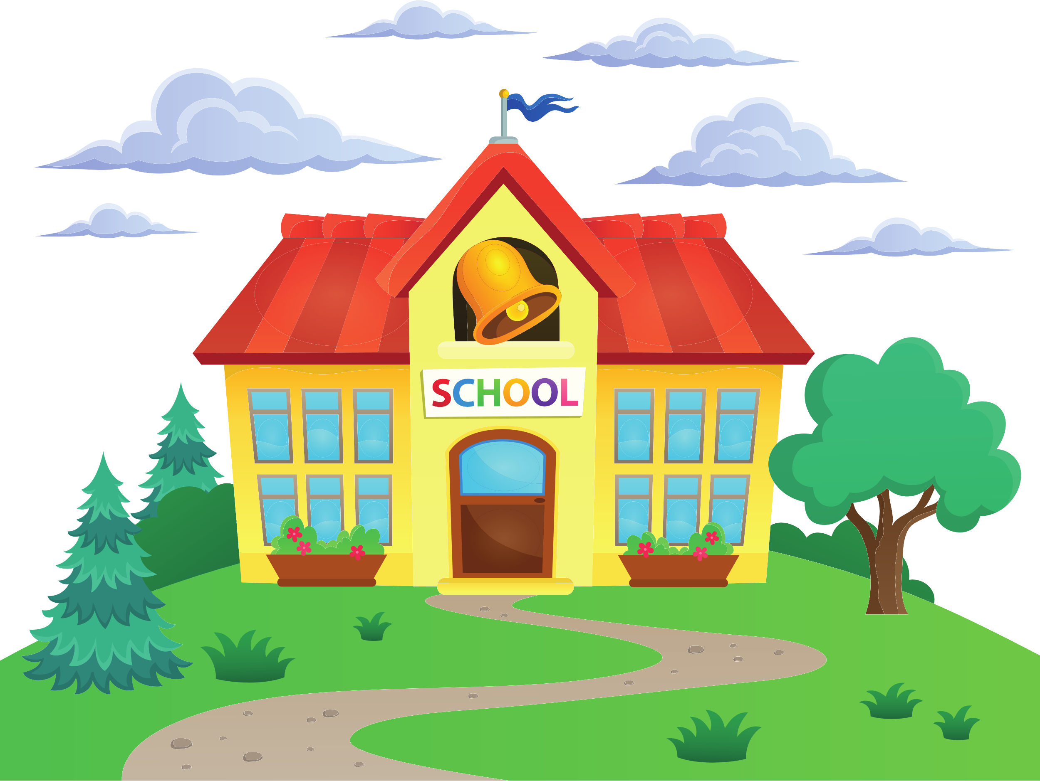
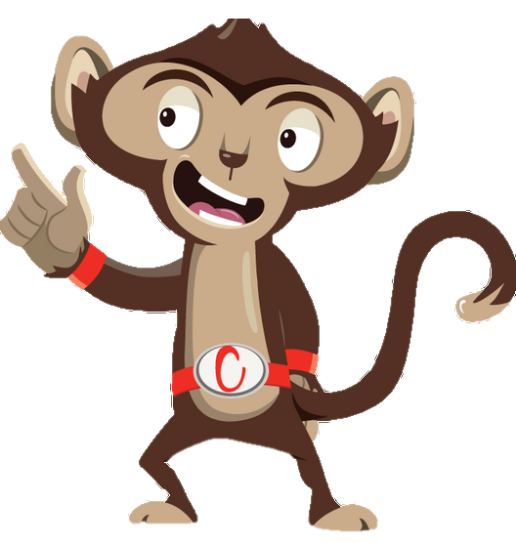


Chester’s Active Quest: Week 7

Slide 2
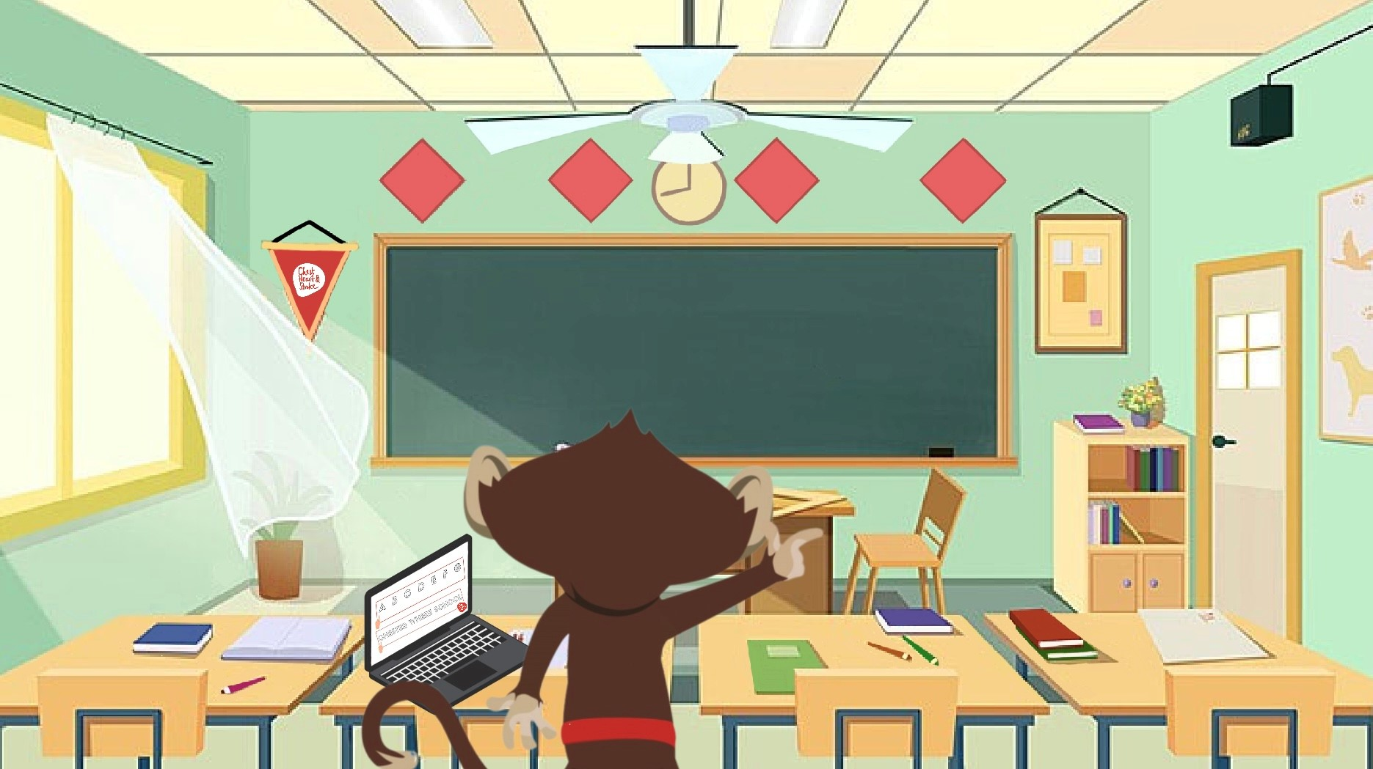

Notes:
Chester is working on his creative writing story homework. He gets stuck and doesn’t know what to write next, which is very frustrating. He finds himself listening to the wonderful bird song outside in the jungle, he peers out the window to listen. He is very distracted and is finding it hard to concentrate. He suddenly remembers what his teacher, Mrs. Liona, had said that morning. "If you get stuck with your homework, try an active break," she suggested. He grabs his tablet and eagerly searches for a brain break activity on YouTube. He finds one where he can draw different shapes in the air with his hands. The lively music starts, and the instructor on the screen begins guiding him through the exercise. "Let's draw a small triangle with both of our hands at the same time!" the instructor said cheerfully. Chester follows along, drawing two small triangles in the air with his hands. "This is great fun!" he laughs. "Now, let's try a different shape, draw a rectangle with both hands, " the instructor continues. Chester's concentrates as his arms moved wider and he draws two rectangles. "Now, your final challenge is to draw a rectangle with one hand and a triangle with the other, at the same time!". Chester giggles as he makes several attempts to draw both shapes at the same time. The video ends and Chester feels refreshed and ready to concentrate. His frustration is gone now, he smiles as he sits back down at his desk, picks up his pen and continues writing his story.

Slide 3
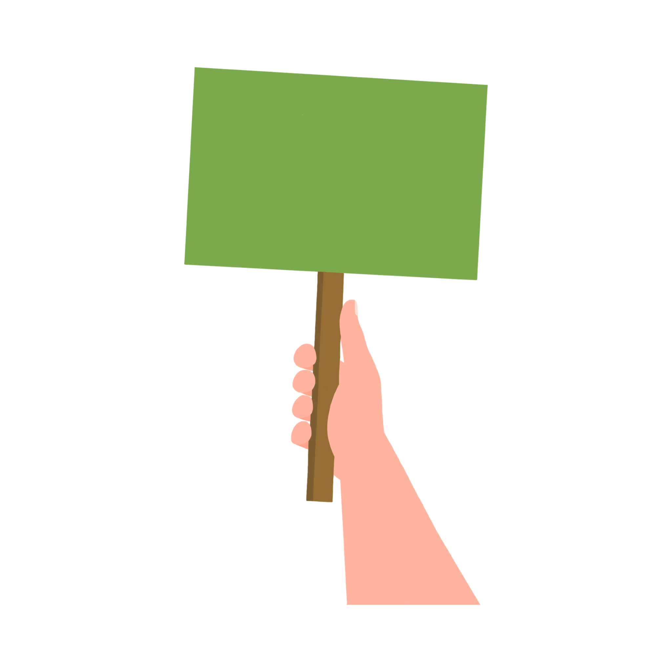


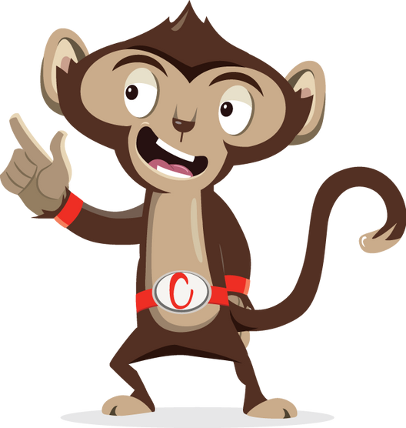

Brain breaks keep our body healthy
TRUE
FALSE
Notes:
Ask pupils to answer through movement: green = stand with hands on head, red = stand as tall as you can with arms in air

Slide 4
The correct answer is:
TRUE
FALSE
Notes:
Being active during a brain break allows more oxygen to flow into the brain which can help with focus and attention. This helps you move more and sit less keeping your heart healthy.

Slide 5
Brain breaks count towards our 60 minutes of physical activity a day
TRUE
FALSE
Notes:
Ask pupils to answer through movement: green = stand with hands on head, red = stand as tall as you can with arms in air

Slide 6
The correct answer is:
FALSE
TRUE
Notes:
Unfortunately, unless your heart is beating fast, you are slightly out of breath and can still talk to a friend a quick brain break does not count towards your 60 minutes. But it is important to do low level activity too to stay healthy where you breath normally and your heart beats normally.

Slide 7
Brain breaks can improve your mood
TRUE
FALSE
Notes:
Ask pupils to answer through movement: green = stand with hands on head, red = stand as tall as you can with arms in air

Slide 8
The correct answer is:
TRUE
FALSE
Notes:
Physical activity has been shown to improve mood, reduce stress and even help motivate some pupils. So any brain break that involves moving is a great way to boost your mood.

Slide 9
After break/lunch I am ready to do schoolwork:
YES
NO
Notes:
Ask pupils to answer through movement: green = stand with hands on head, red = stand as tall as you can with arms in air
There is no right or wrong answer here. Some pupils might say yes because they were able to get outside, get some fresh air and keep active. So they have had a good break before starting work again.
Others might say no because they might experience the post lunch slump and might actually feel like they need a sleep. Because they’ve eaten their lunch and sat down the whole time. This is the perfect time for a brain break, to wake up the brain before starting into some work.

Slide 10
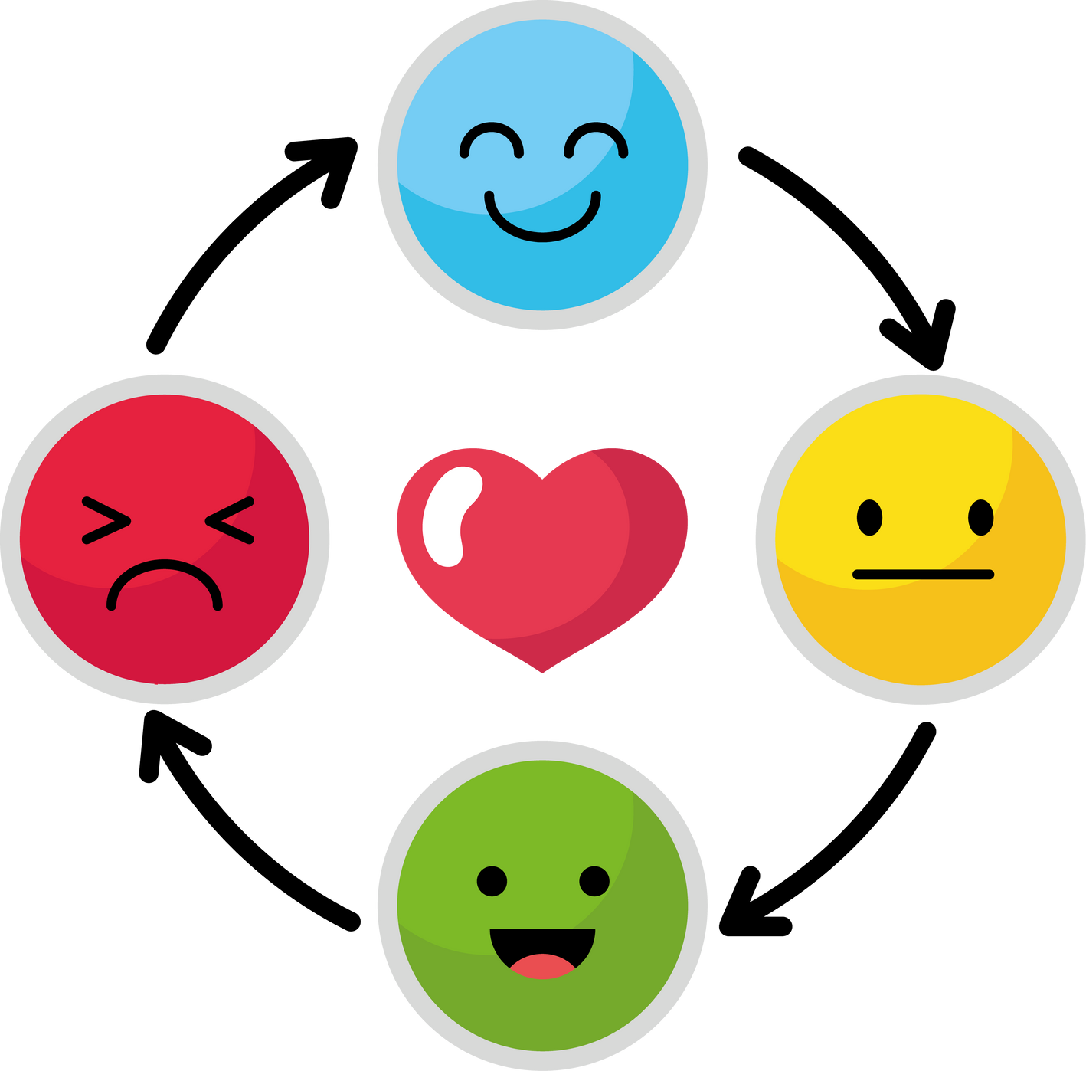
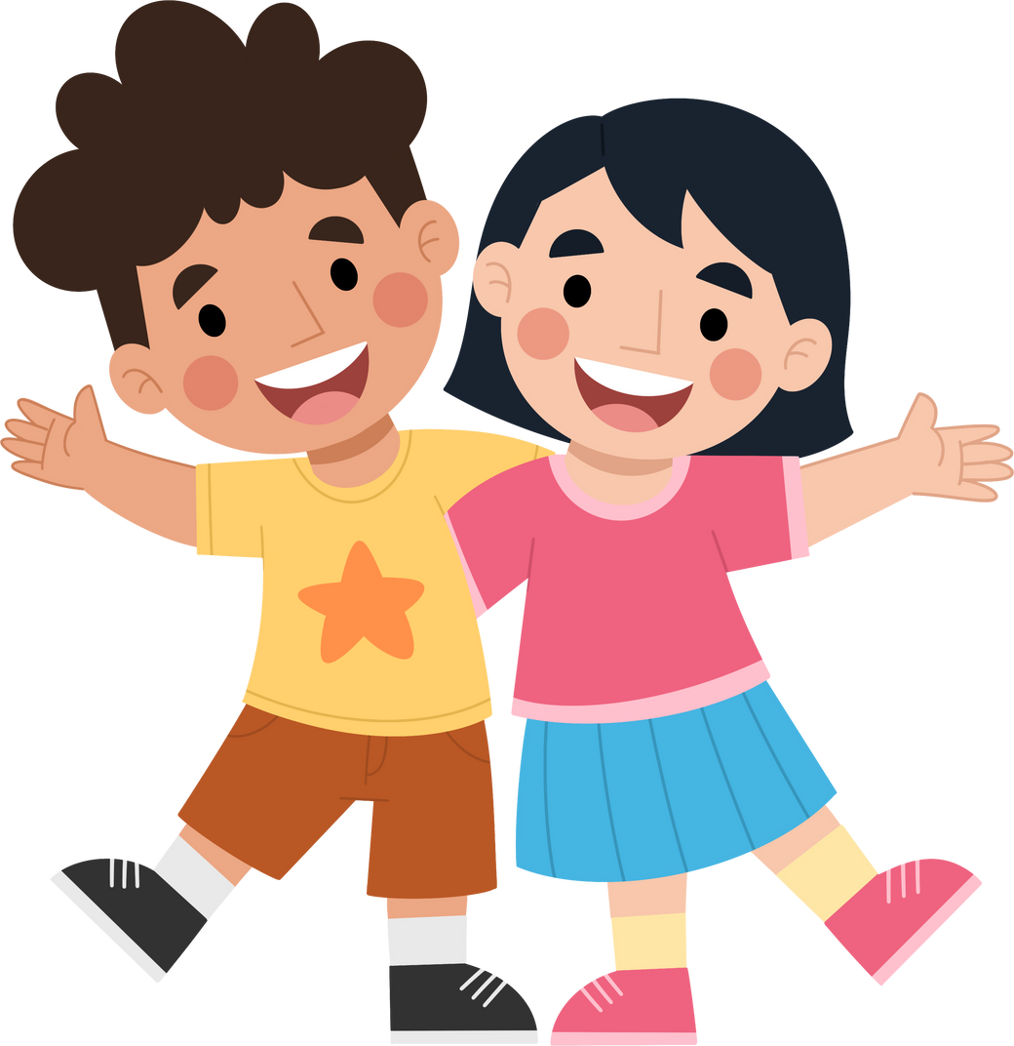
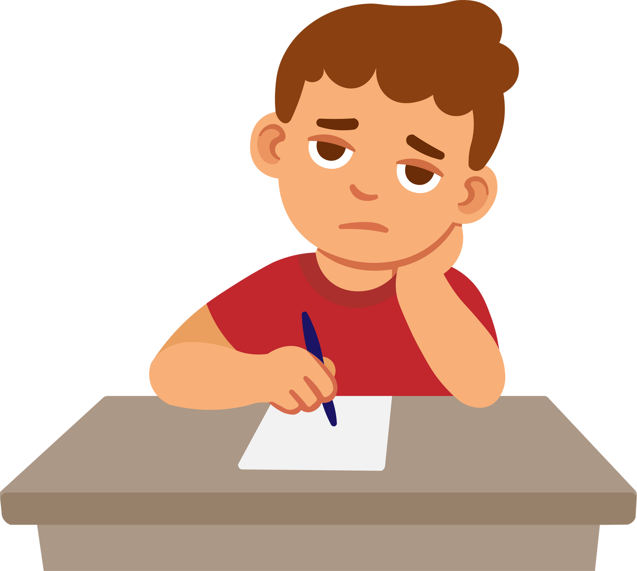
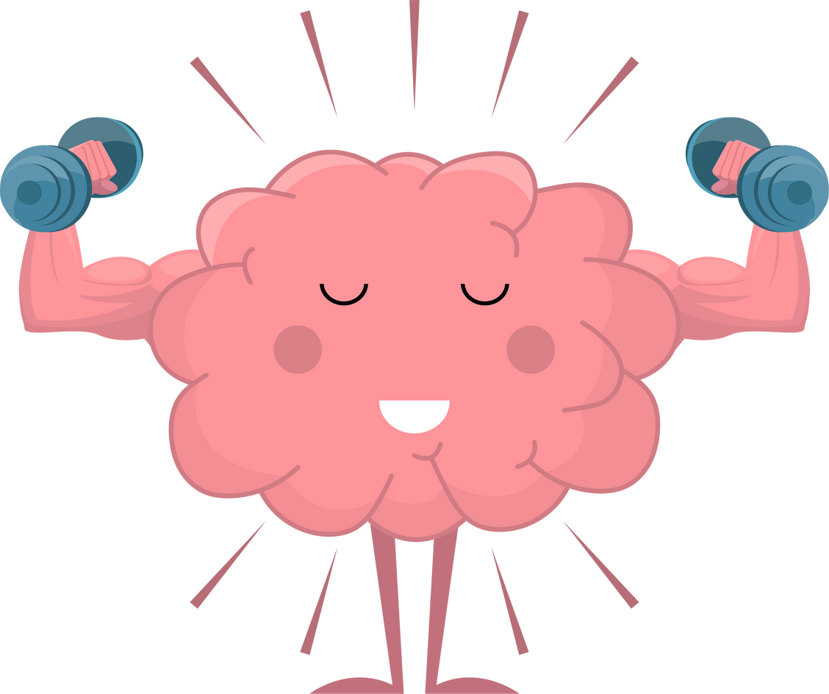
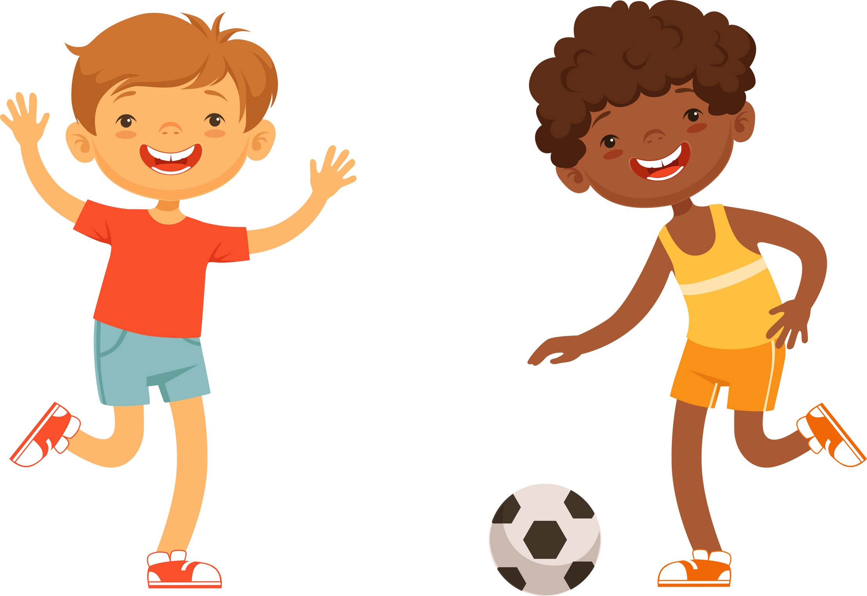
Benefits of Brain Breaks
Notes:
Brain breaks are especially great for when you have been sitting doing some work for a long time. They can help you focus by giving your brain a boost of energy, they can improve your mood by making you feel happy and can recharge the brain. Giving the parts that were working hard a well deserved break. Brain breaks can also help children learn how to self regulate – this means being able to recogonise when you are struggling with something or need help with your work. By moving our bodies more and sitting less we are keeping ourselves healthy.

Slide 11
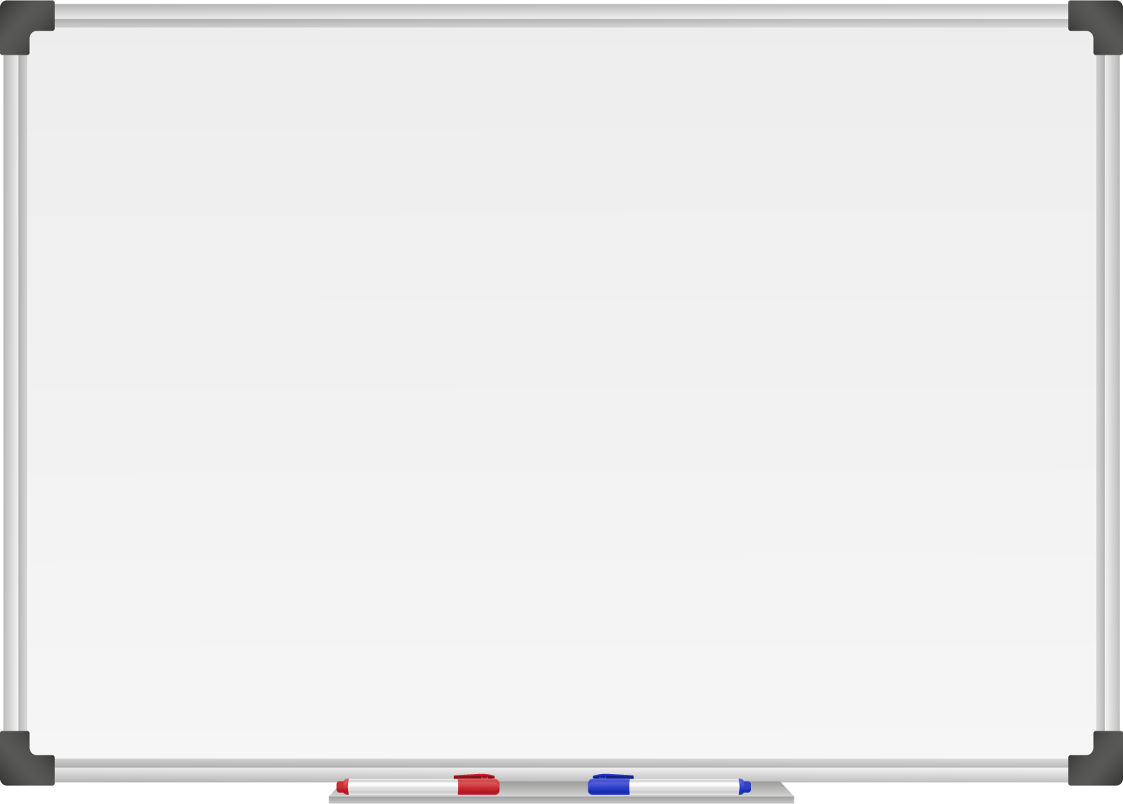







WELL DONE! You have unlocked number 7!
10 Ways to Move More Sit Less
  ____ ________
  ____ ____ __ ____
  ____ ____ ____ ____ _ ____ _ ____
Morning Stretch
Walk, cycle or scoot to school
Play games with friends at break and lunch
Remember to move for 5 – 10 minutes every hour
Play for 60 minutes a day
Move more with family outdoors
Supercharge your homework with a brain break
Notes:
Well done you have unlocked the 7th way to move more sit less. Which is to boost your homework with a brain break.

Slide 12
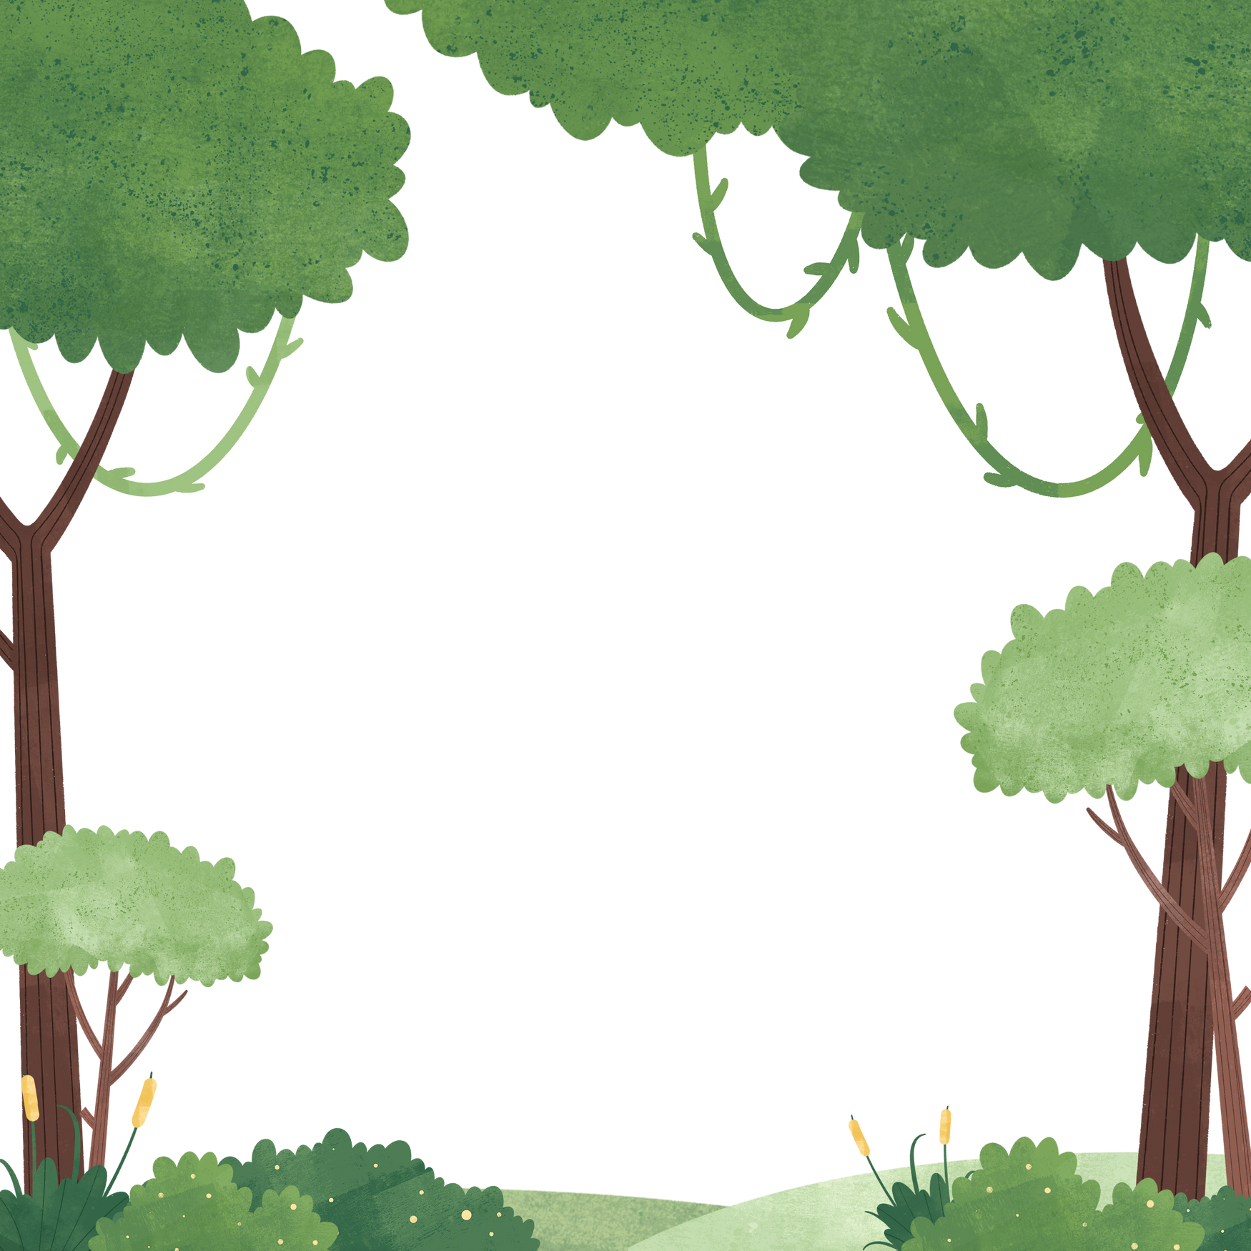

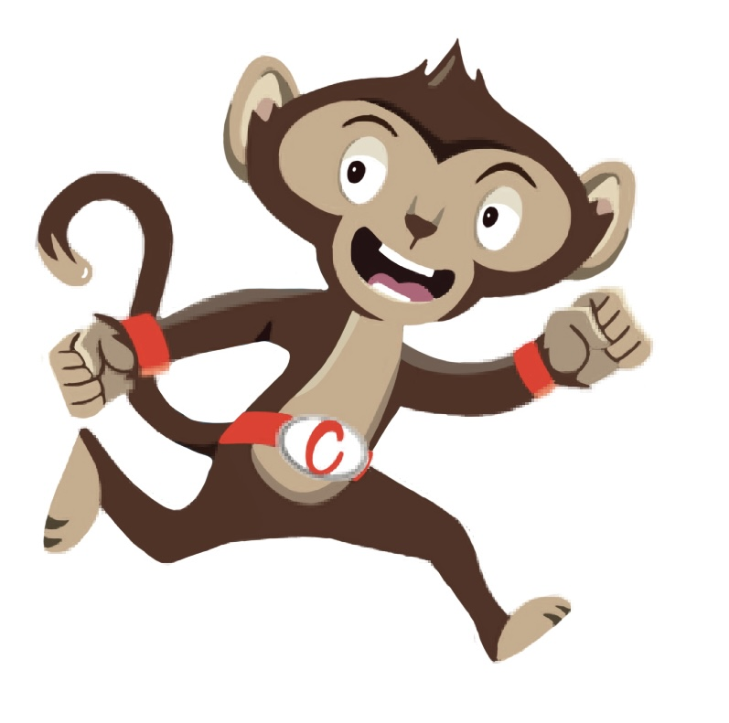
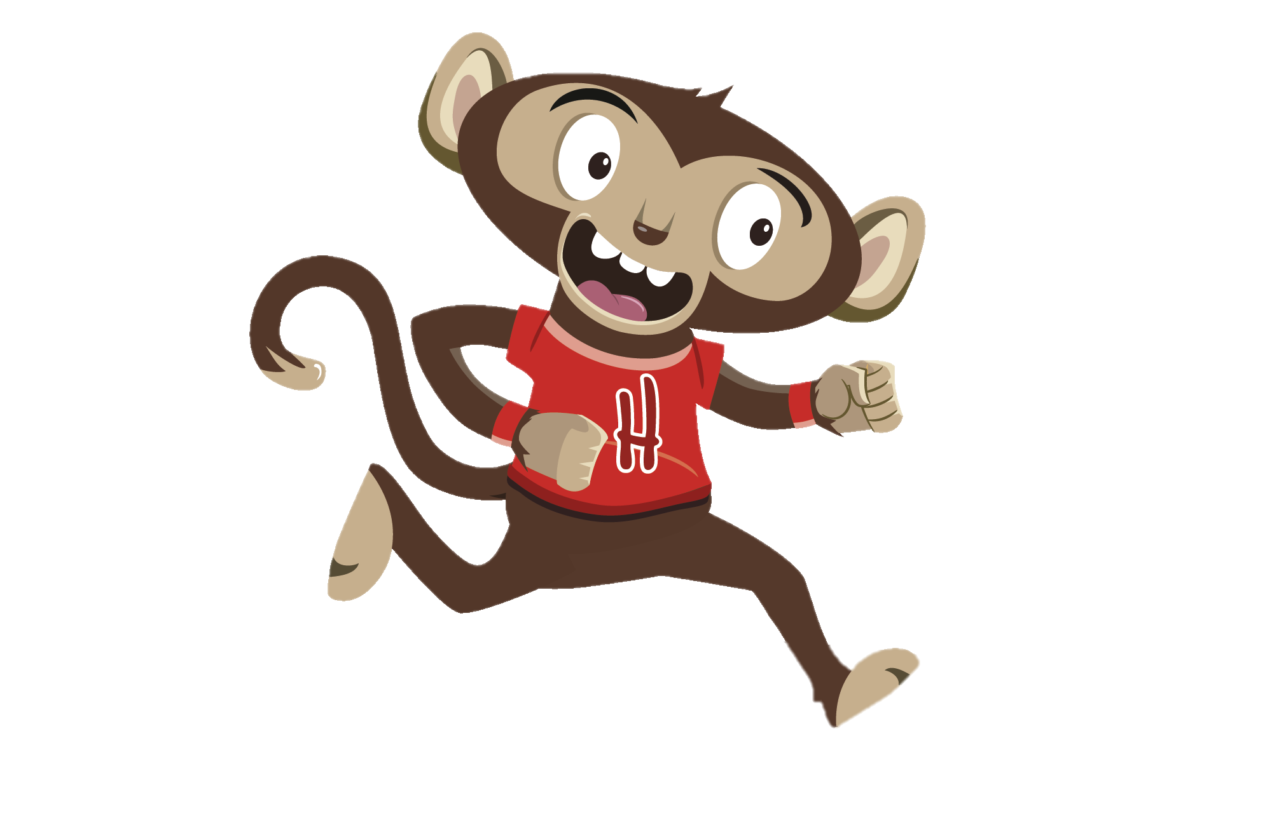
“Don’t worry Heartley, let’s do a fun brain break together ”
“I think I need a break, this homework is very hard”
You have gained 7 healthy hearts!

Slide 13
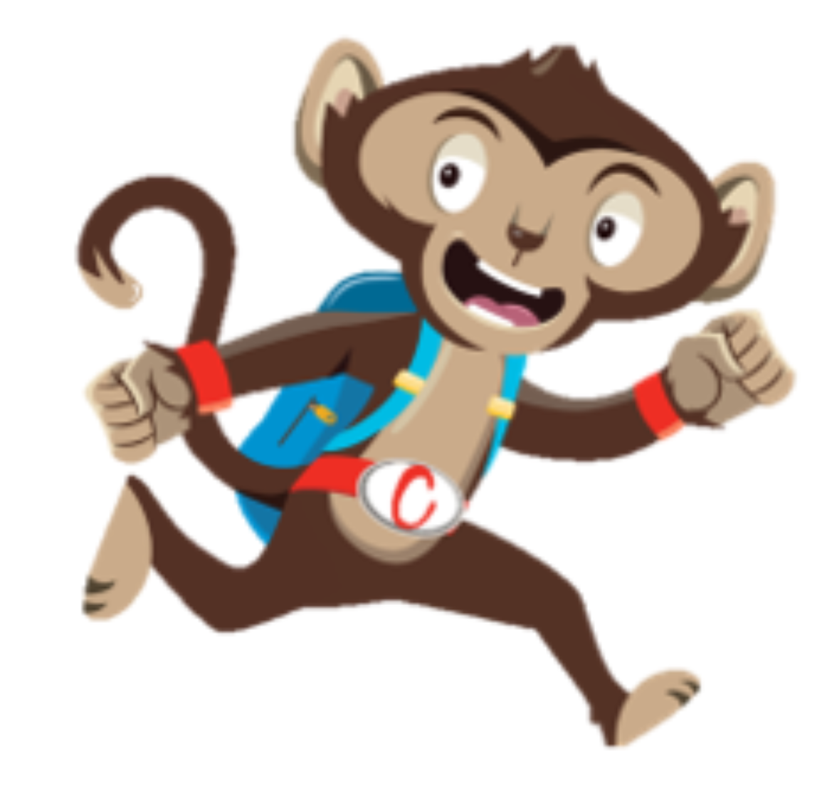
Brain Breaks
Our brains need a break too, these can help you stay focused.
Why not try a Brain Break Activity

