Slide 1
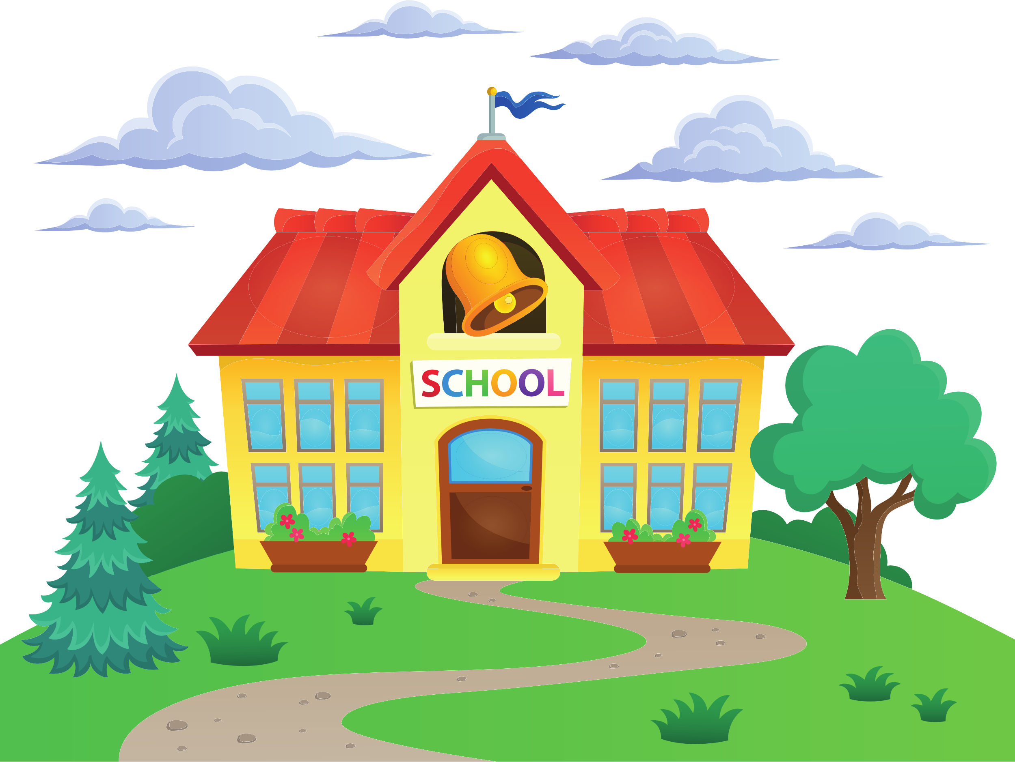
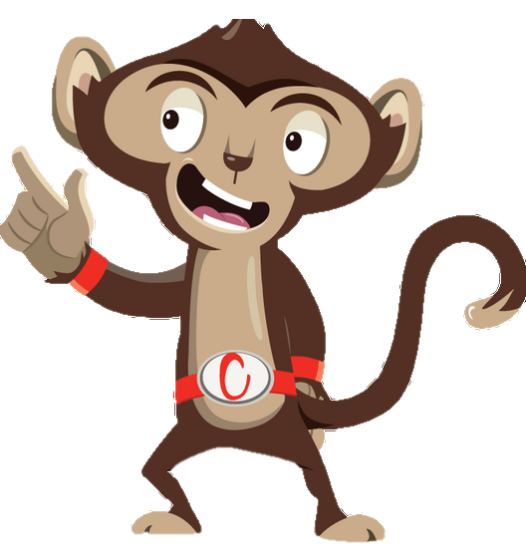


Chester’s Active Quest: Week 7

Slide 2
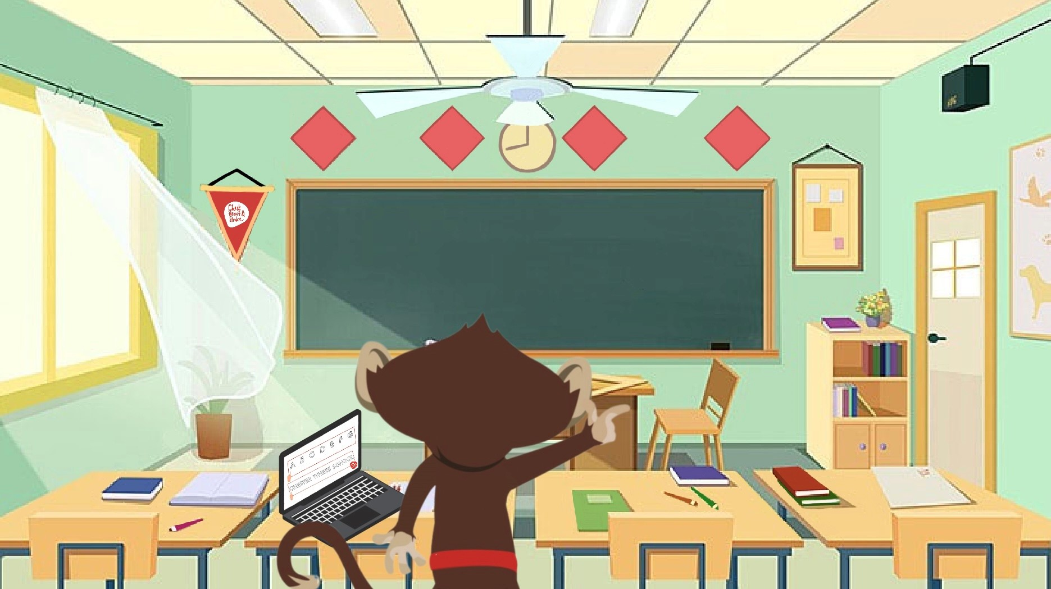

Notes:
Chester is sitting at his desk, frowning at his homework. He is practicing writing the letters "Q" and "W," but no matter how hard he tries, it just doesn’t look right. His "Q" looks like a squiggle, and his "W" is too wobbly. "This is so hard," Chester sighs, feeling cross. He puts down his pencil and looks at his pile of toys. "Maybe I'll just play with my toys," he thought. As Chester picks up his favorite toy car, he remembers what his teacher, Mrs. Liona, had said that morning. "If you get stuck with your homework, try an active break," she suggested.
Chester's eyes lit up. "An active break! That's a great idea!" He grabs his tablet and searches for a brain break video on YouTube. He finds one where he can draw shapes in the air with his hands.
Chester stands up, stretches, and presses play. The lively music starts, and the instructor on the screen begins guiding him through the exercise. "Let's draw a small square with our hands!" the instructor says cheerfully.
Chester follows along, drawing a small square in the air with his hands. "This is fun!" he giggles.
"Now, let's draw a bigger square," the instructor continues. Chester's arms move even wider as he draws a bigger square. "Now let's draw the biggest square you can make!" Chester stretches his arms out as far as he can, drawing a huge imaginary square in the air. He laughs, enjoying moving around and getting rid of the cross feeling. The video ends and Chester feel refreshed and happy. He sits back down at his desk, ready to tackle his homework again.

Slide 3
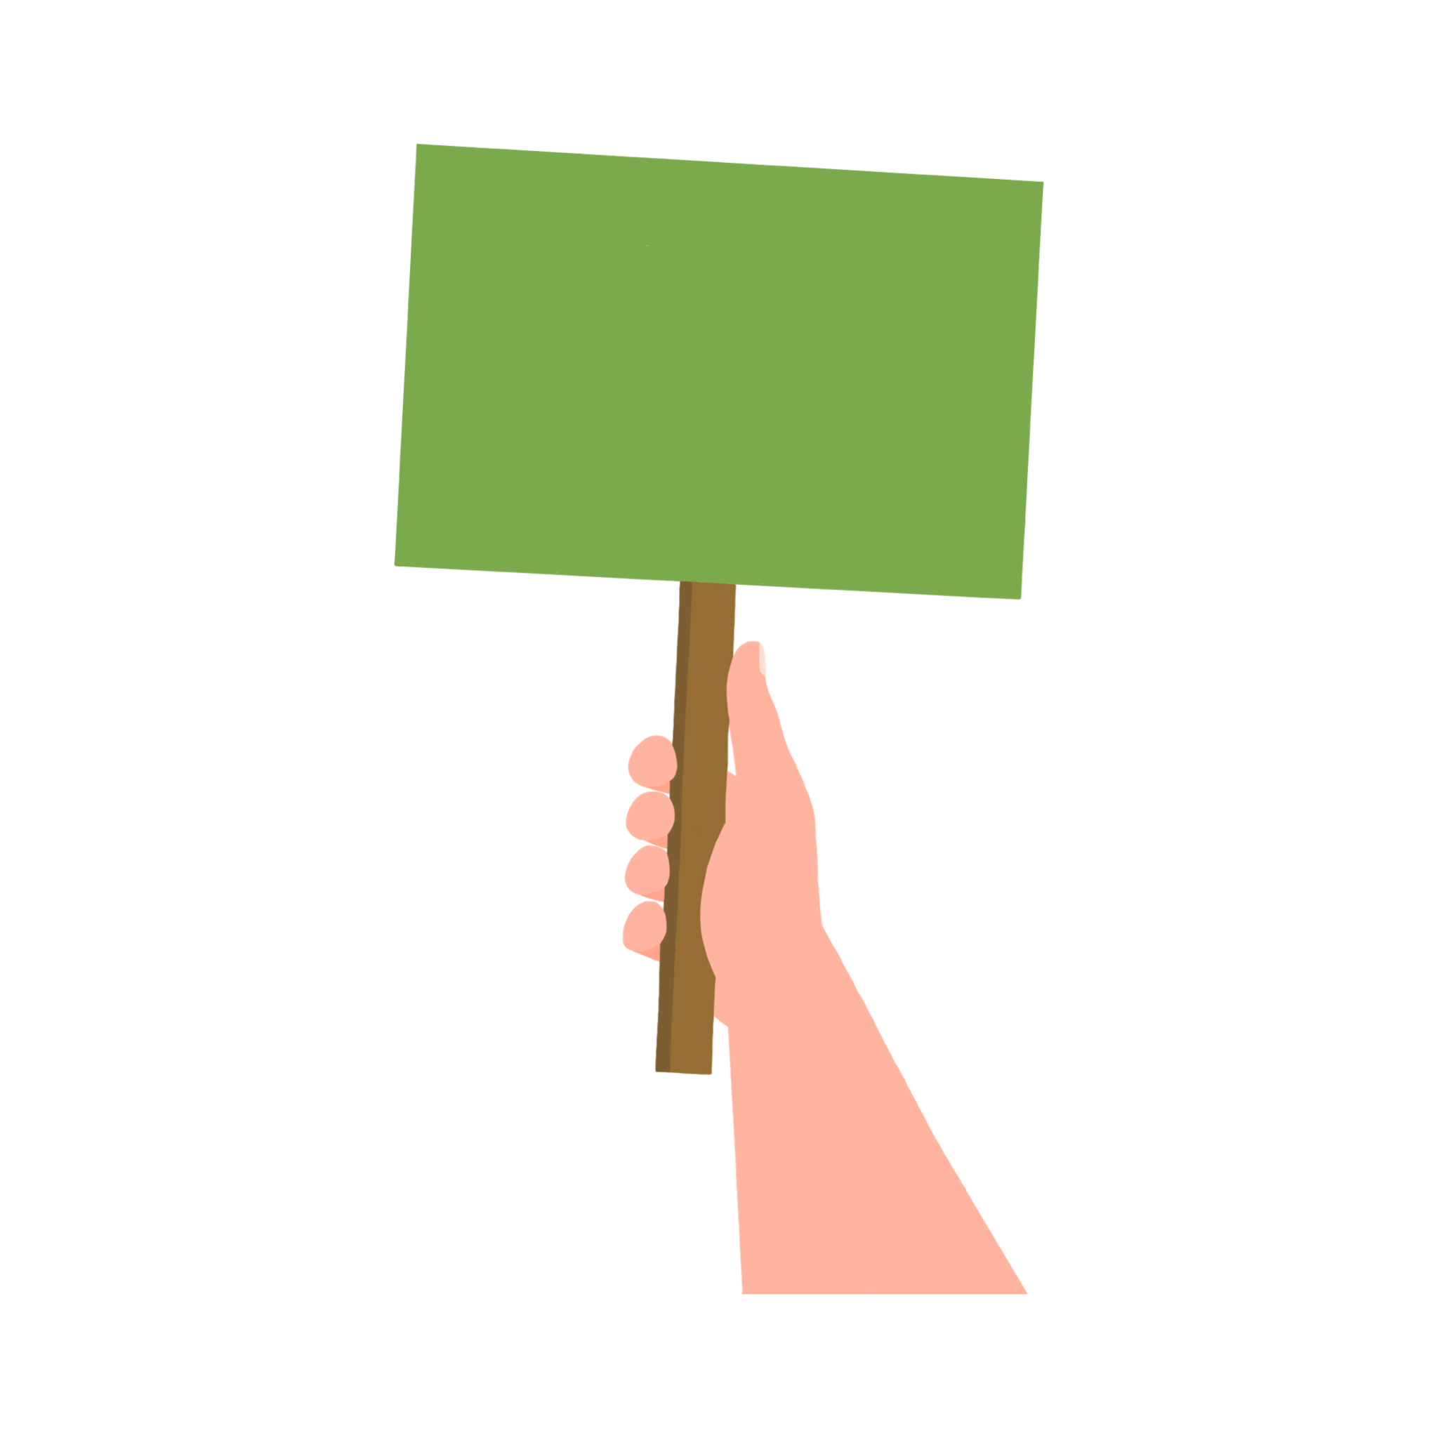
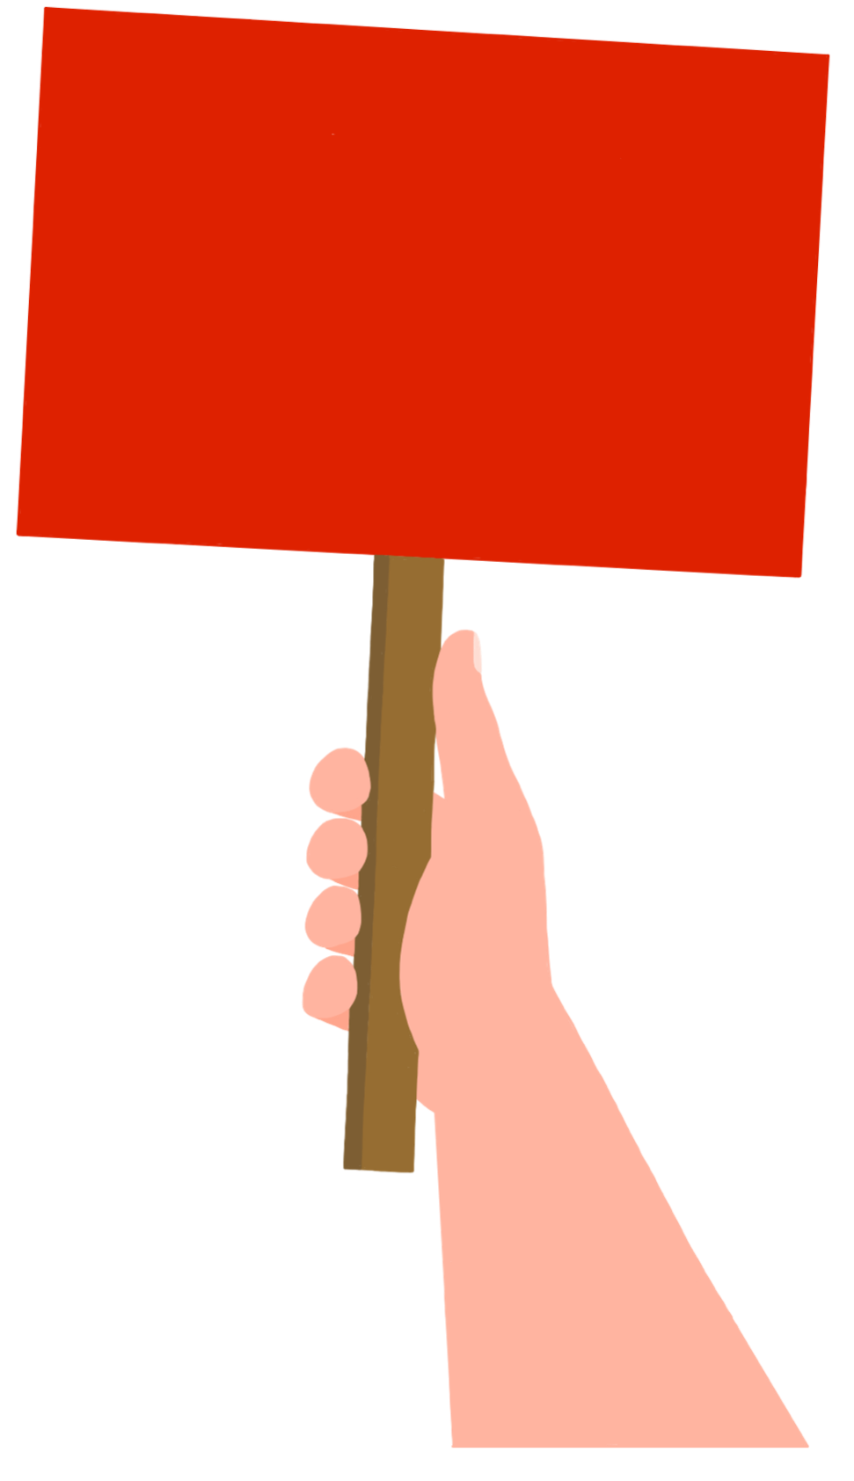

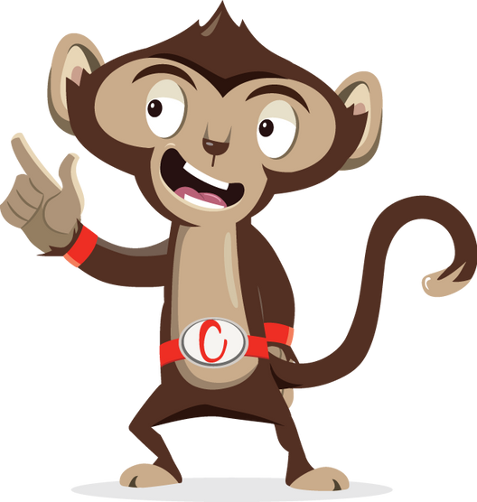

Do you like to:
SING
DANCE
Notes:
Ask pupils to answer through movement: green = stand with arms folded, red = stand as tall as you can with arms in air

Slide 4
Do you like to take breaks when doing homework?
YES
NO
Notes:
Ask pupils to answer through movement: green = stand with arms folded red= stand as tall as you can with arms in air

Slide 5
Do you like playing games that make you move?
YES
NO
Notes:
Ask pupils to answer through movement: green = stand with arms folded red = stand as tall as you can with arms in air

Slide 6
After break/lunch I am ready to do schoolwork:
YES
NO
Notes:
Ask pupils to answer through movement: green = stand with arms folded, red = stand as tall as you can with arms in air

Slide 7
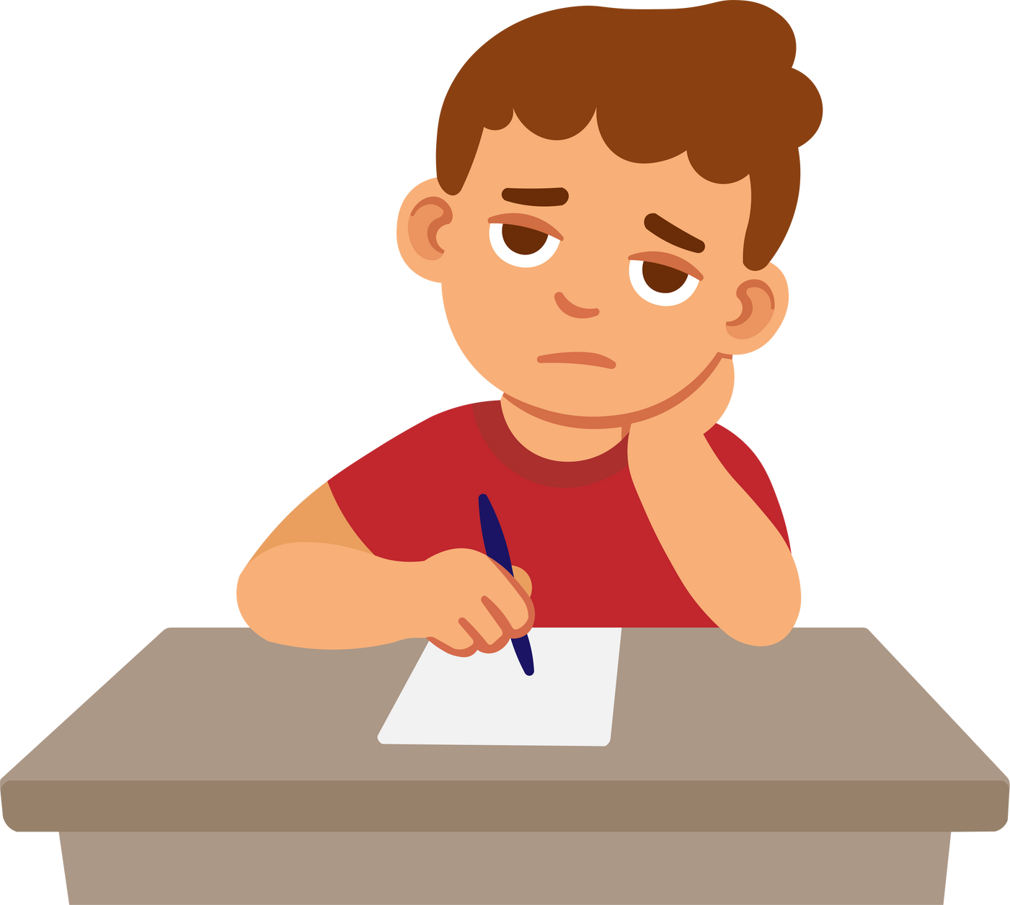
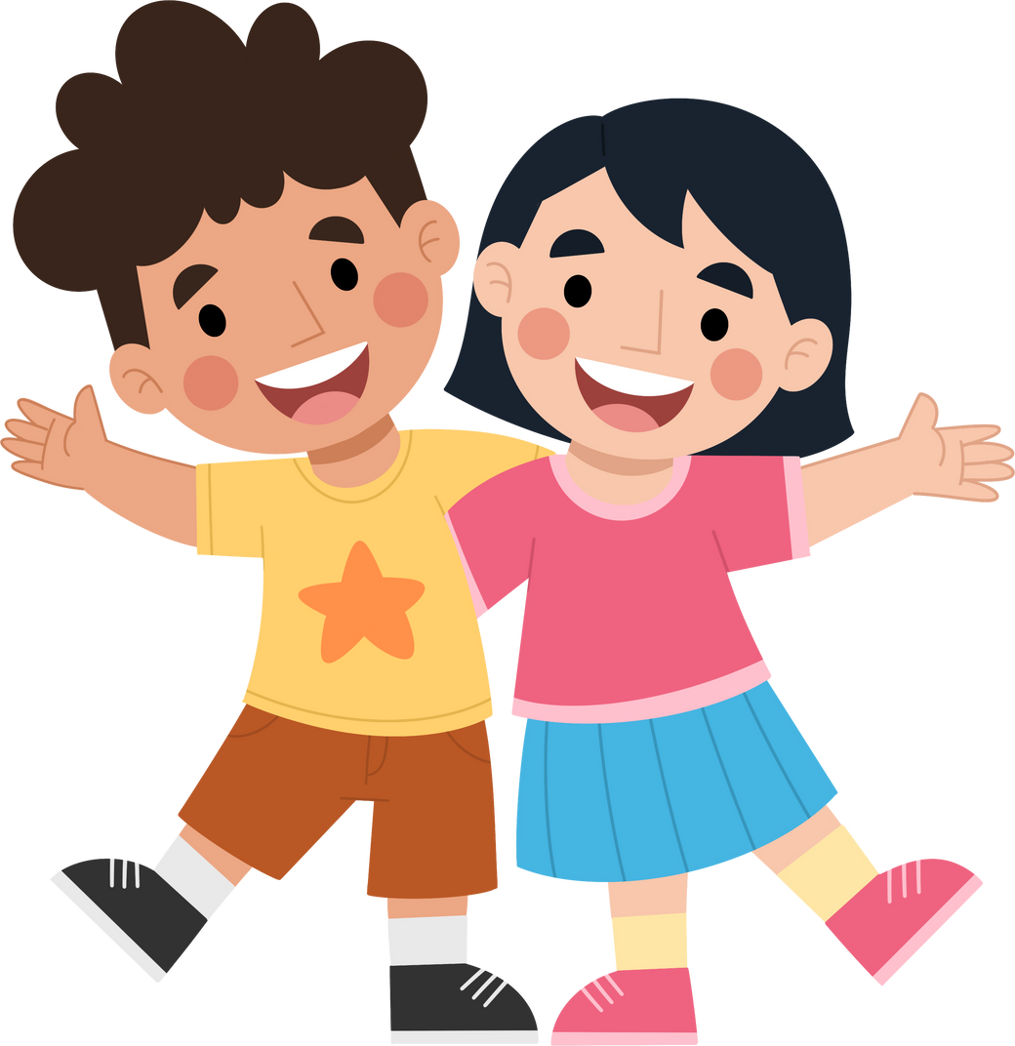
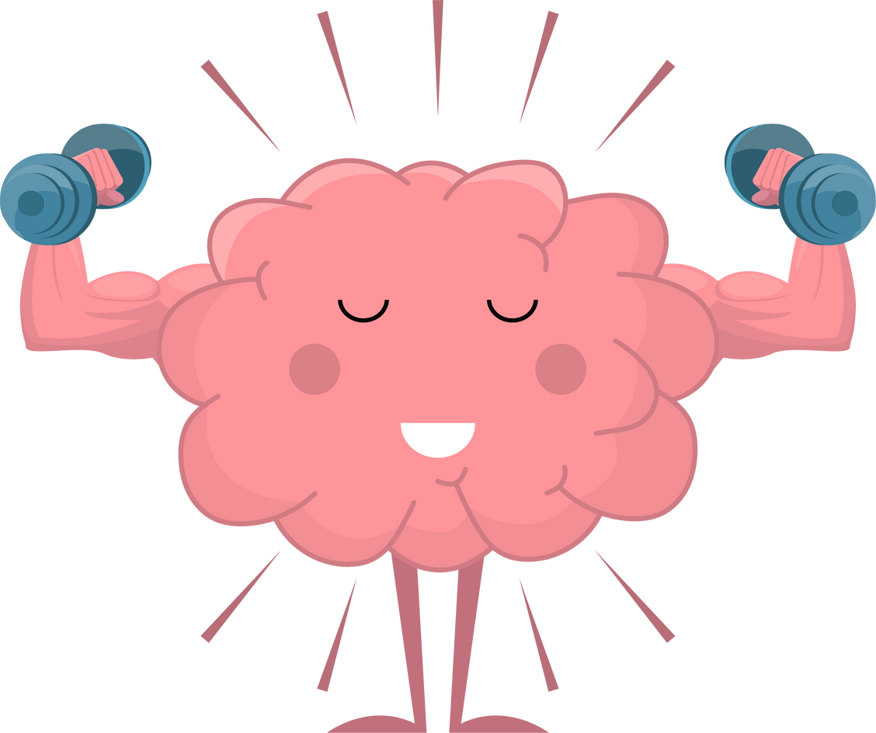
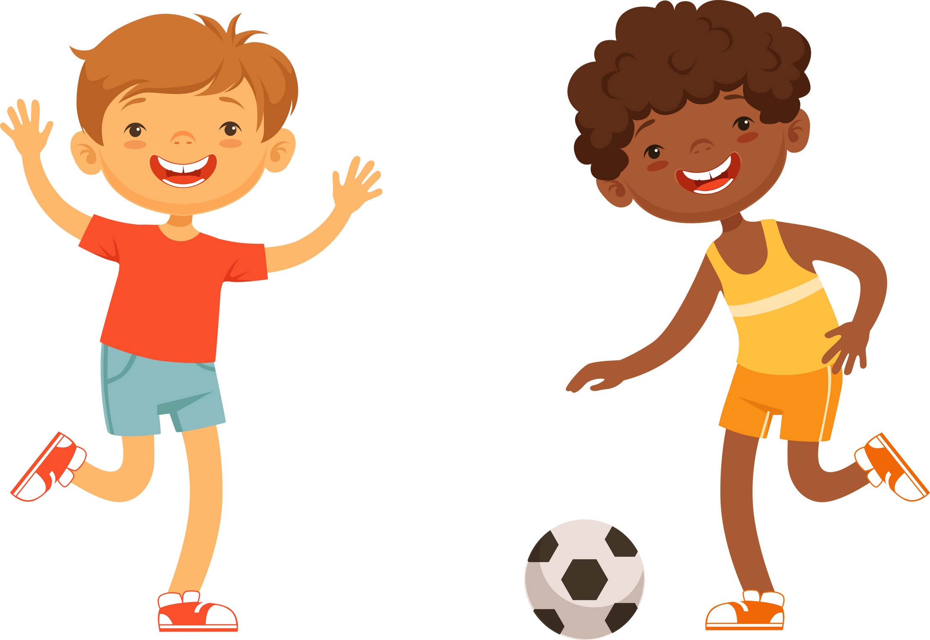
Benefits of Brain Breaks
Notes:
Brain breaks are great for when you have been doing some work and sitting for a long time. They can help you focus by giving your brain a boost of energy, they can improve your mood by making you feel happy and keep us healthy by moving more and sitting less.

Slide 8
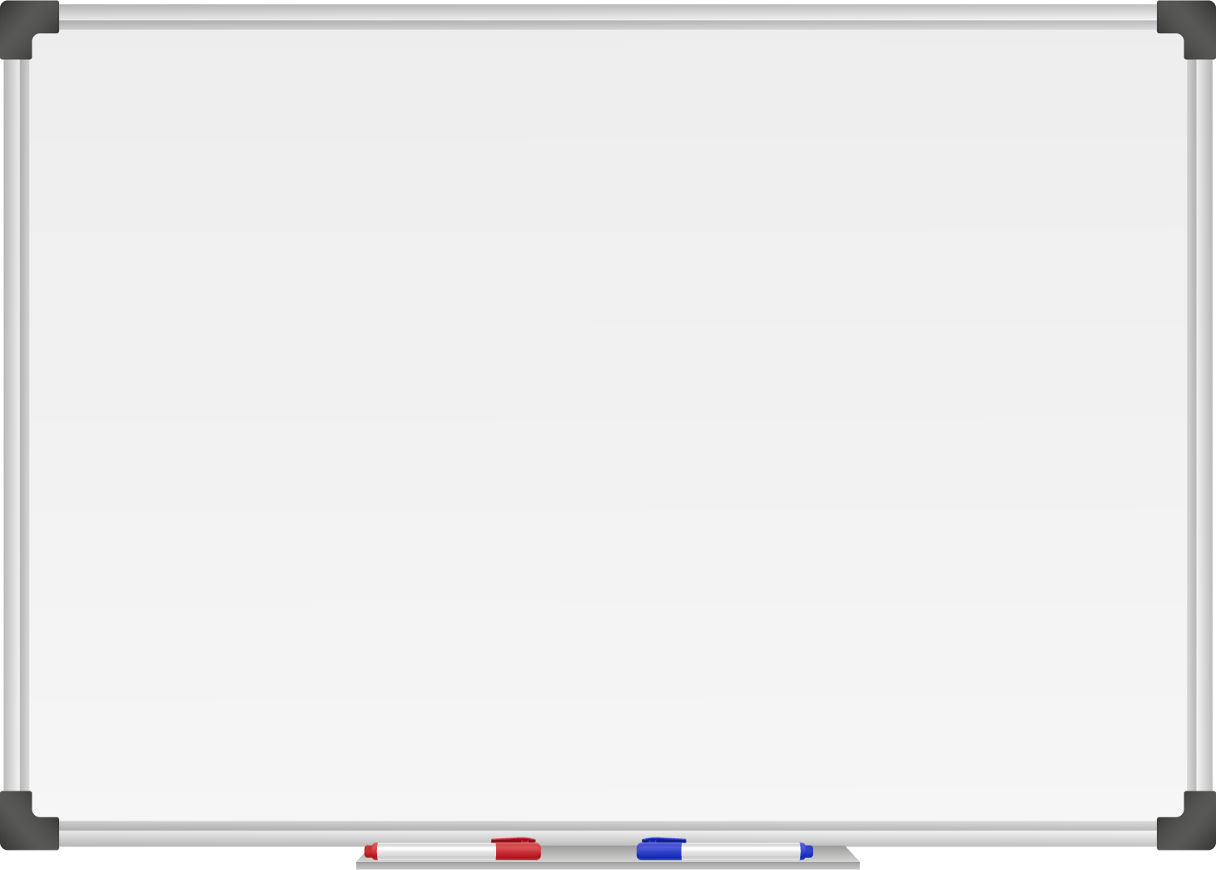







WELL DONE! You have unlocked number 7!
10 Ways to Move More Sit Less
  ____ ________
  ____ ____ __ ____
  ____ ____ ____ ____ _ ____ _ ____
Morning Stretch
Walk, cycle or scoot to school
Play games with friends at break and lunch
Remember to move for 5 – 10 minutes every hour
Play for 60 minutes a day
Move more with family outdoors
Boost your homework with a brain break
Notes:
Well done you have unlocked the 7th way to move more sit less. Which is to boost your homework with a brain break. Like Chester if you are ever struggling with your homework a brain break might be something that can help you with your work.

Slide 9
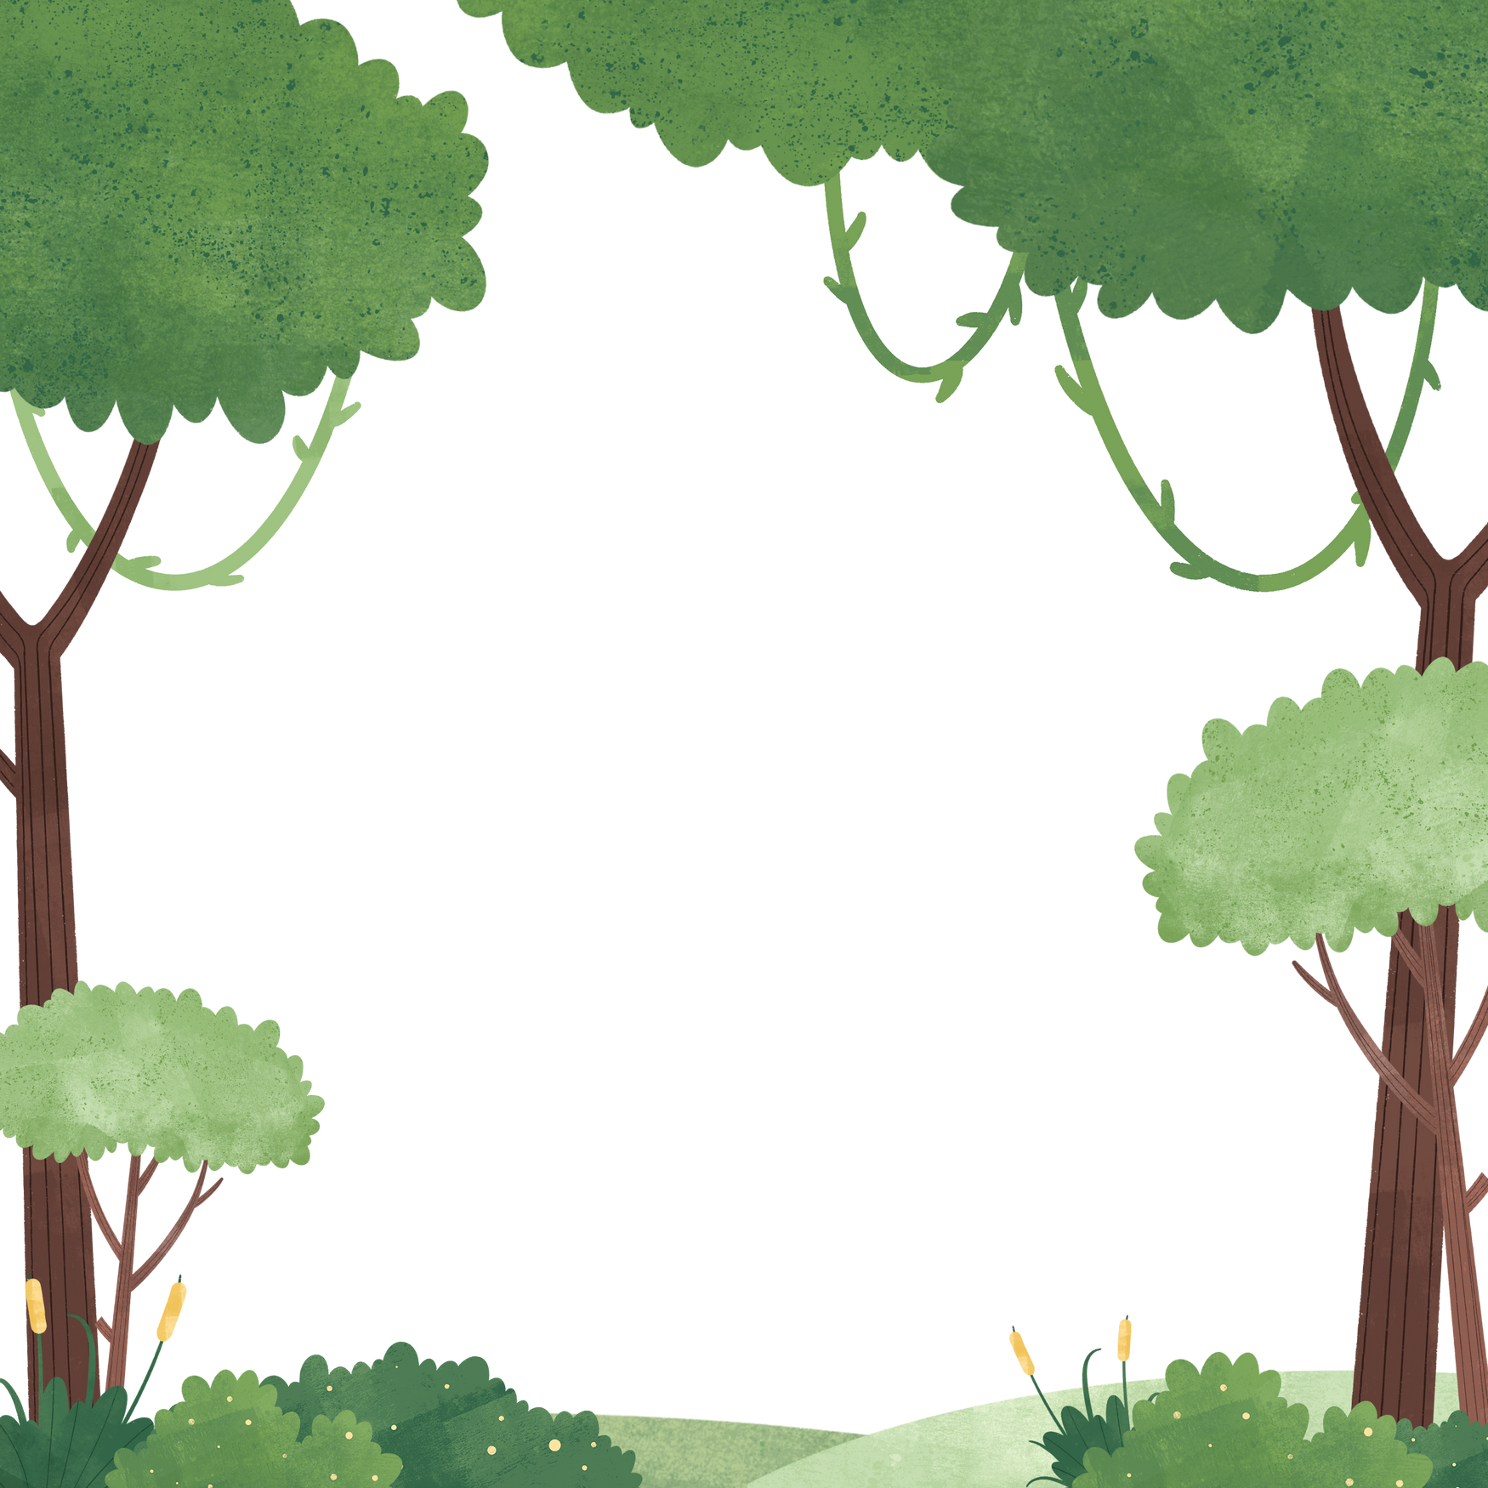

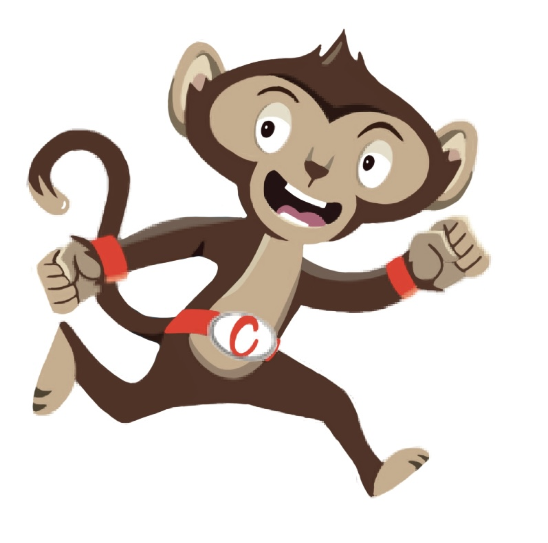
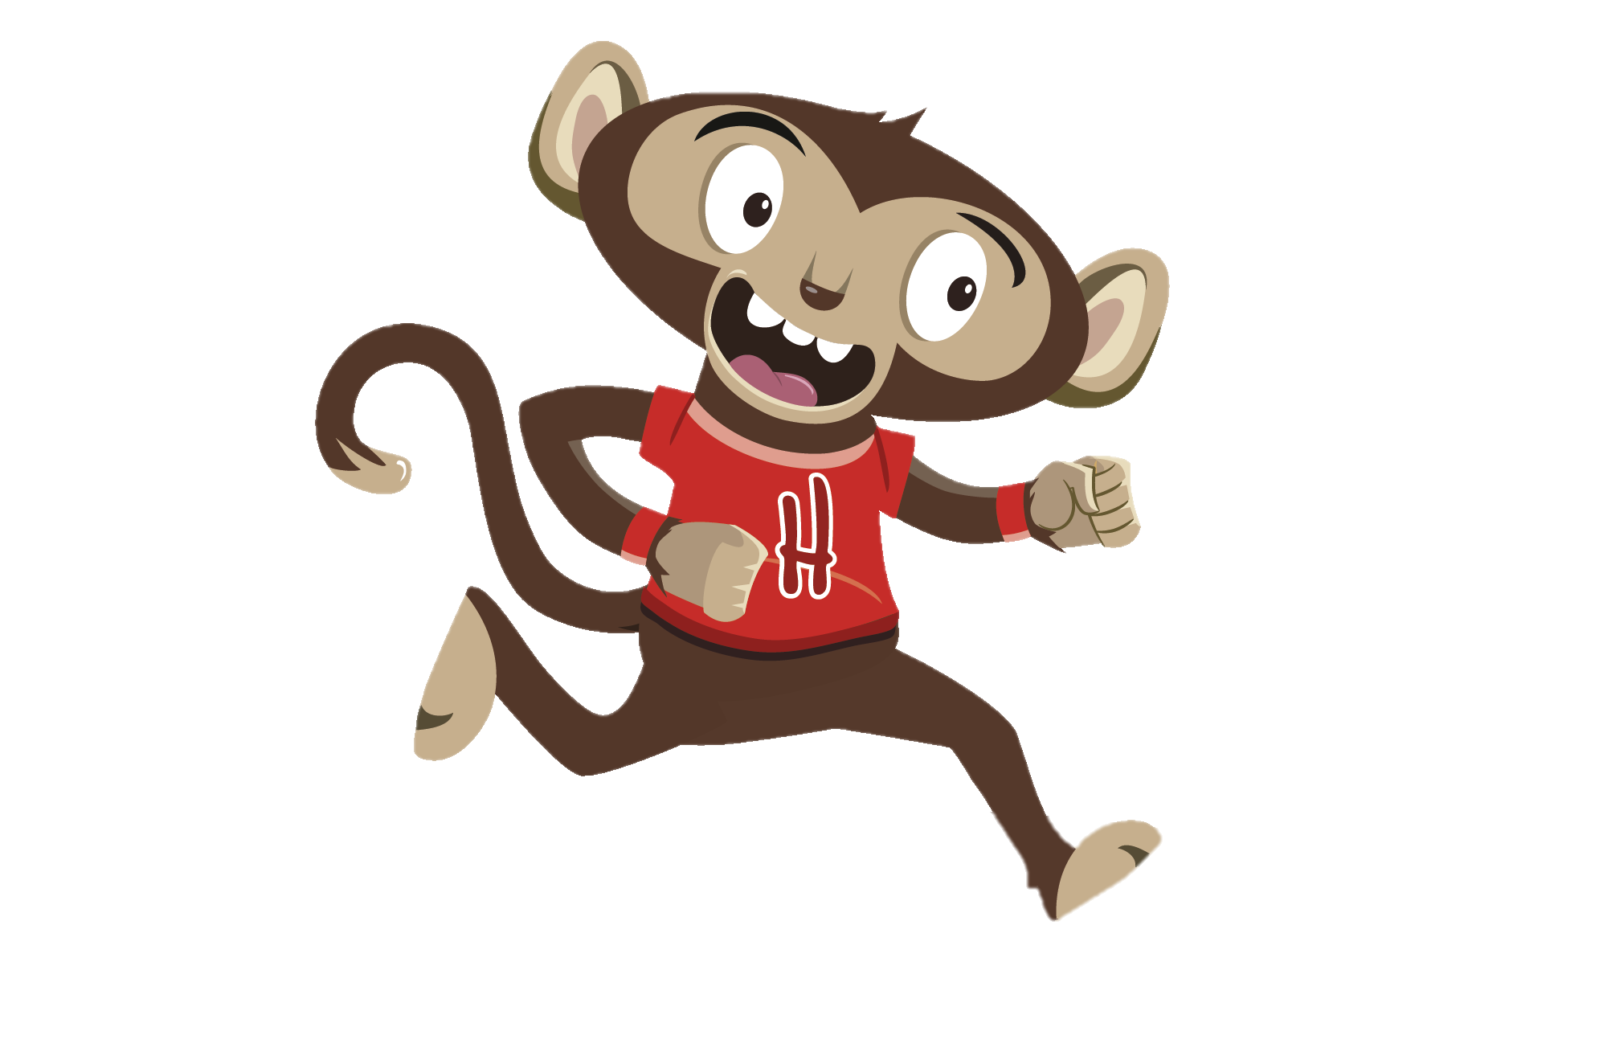
“Don’t worry Heartley, let’s do a fun brain break together ”
“I think I need a break, this homework is very hard”
You have gained 7 healthy hearts!

Slide 10
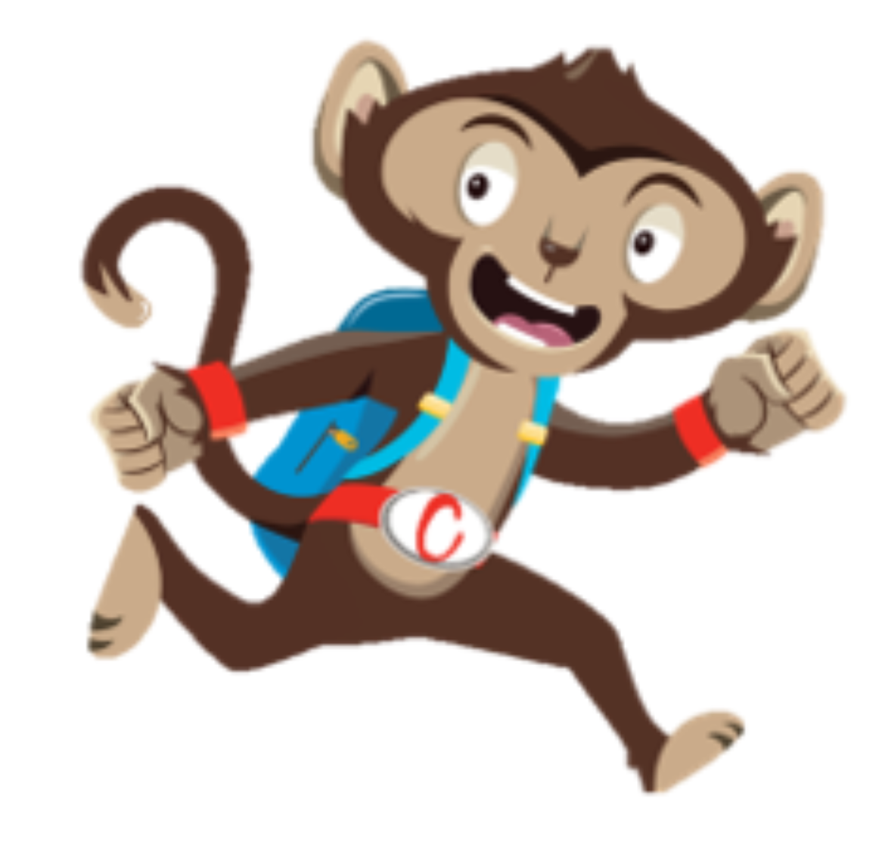
Brain Breaks
Our brains need a break too, these can help you stay focused.
Why not try a Brain Break Activity
Notes:
Our brains work very hard everyday and sometimes they need a break too, this can help us stay focused. This week why not try one of our brain break activities and see if you fly through your school work after.

