Slide 1

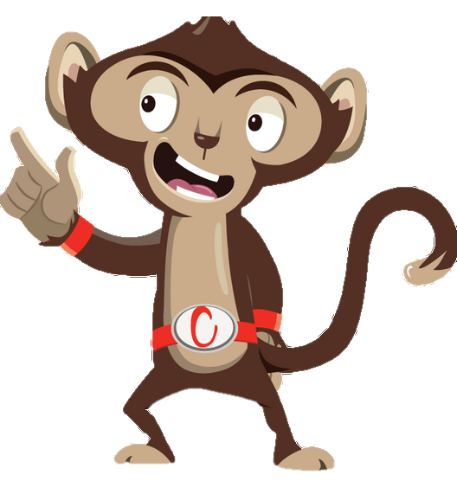


Chester’s Active Quest: Week 1

Slide 2
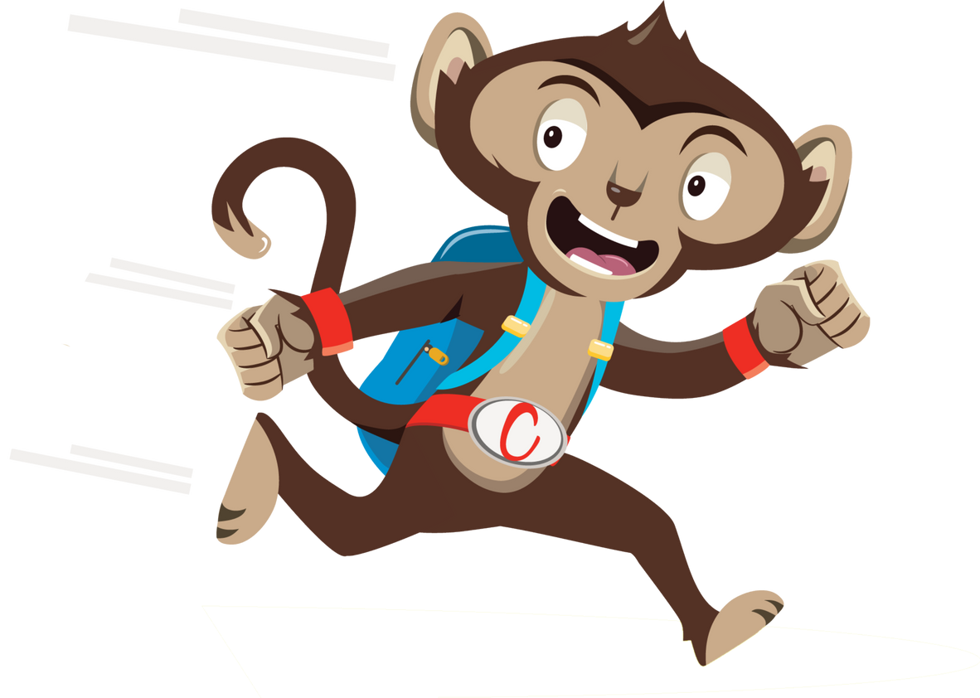

“What are we waiting for, let’s go!”
Collect a healthy to complete the Quest
Notes:
This is Chester the monkey. He needs your help to complete his quest of unlocking the 10 Ways to Move More Sit Less. To do this you will need to work together to find the missing words, solve the riddles, unscramble the pictures and answer questions.
Answer correctly and you will gain a healthy heart that will unlock one of the 10 Ways to Move More Sit Less.

Slide 3
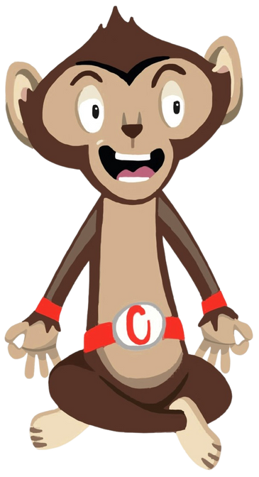
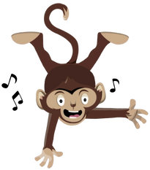
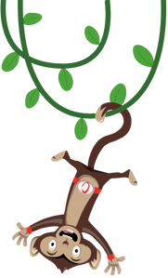

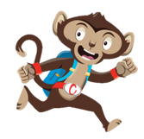
Chester’s five active break themes:
  Chill with Chester
  Lively Lesson
  Monkey Madness
  Brain Break
  Cardio Booster
Notes:
Each week you will follow Chester’s story as he goes on a quest to find the 10 Ways to Move More Sit Less. This will follow one of our five active break themes

Slide 4
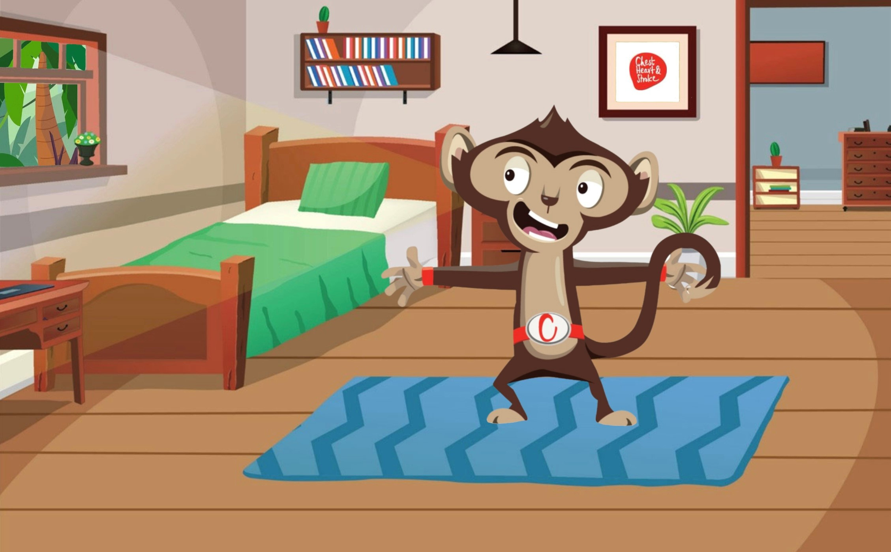
Notes:
Chester the monkey is woken up by the chirping birds outside his treehouse window. With a big yawn and a stretch, he hops out of bed and gets his school bag ready. He can’t wait to see all his friends at school. Before he leaves, he has time for a quick morning stretch. Chester excitedly rolls out his exercise mat, puts one foot at the top of the mat and the other close to the back. Stretching is a great way to move more and sit less. He bends his front leg and keeps the back leg straight. He opens his arms one in front, one behind. He thinks to himself this is much harder than it looks, as he wobbles from side to side. Holding this pose is all about balance, so he squeezes all the muscles in his body tightly to help him concentrate, without falling. He holds this position while taking long, deep breaths. This morning stretch will boost his mood and loosen any tight muscles. “Goodbye Mum”, he shouts. “Have a great day Chester and don’t forget your breakfast”, his mum replies with a smile as she hands him a banana on his way out. He eagerly scurries out of the treehouse door. He feels relaxed, focused, and ready to begin his adventure to school. With a big leap he grabs onto his first vine and swings off to school.

Slide 5
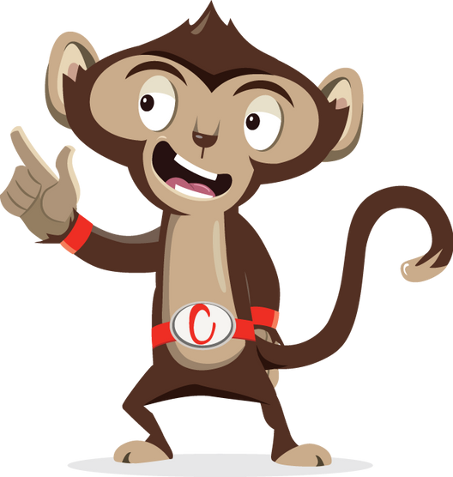

Why does Chester like to stretch in the morning?
1
2
3

Slide 6
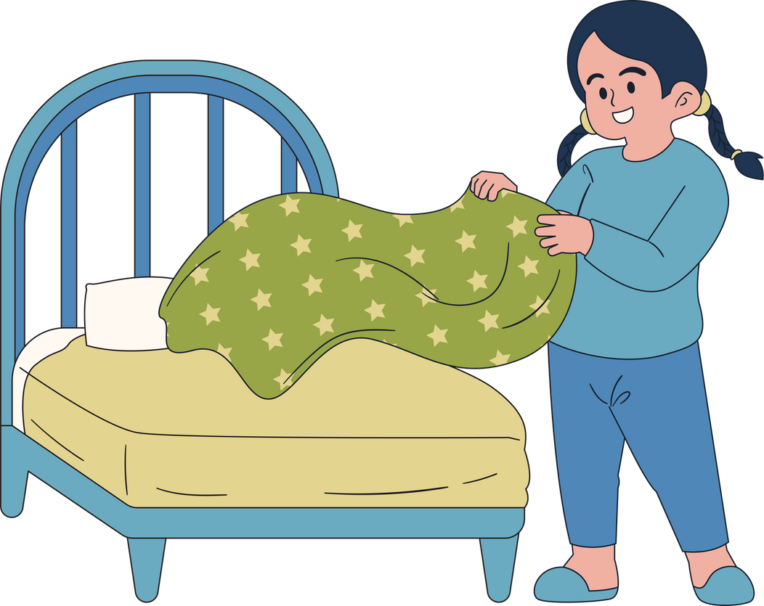
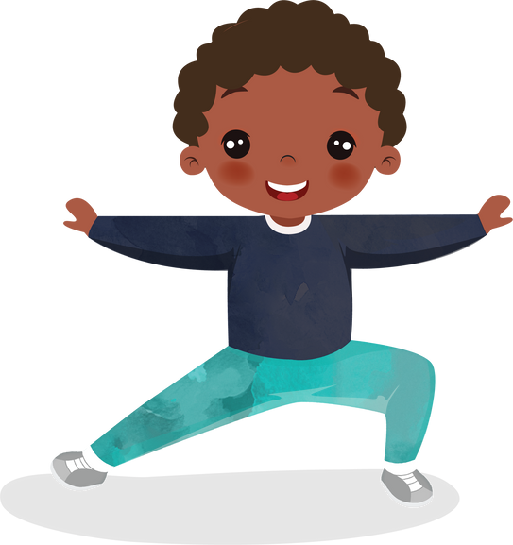
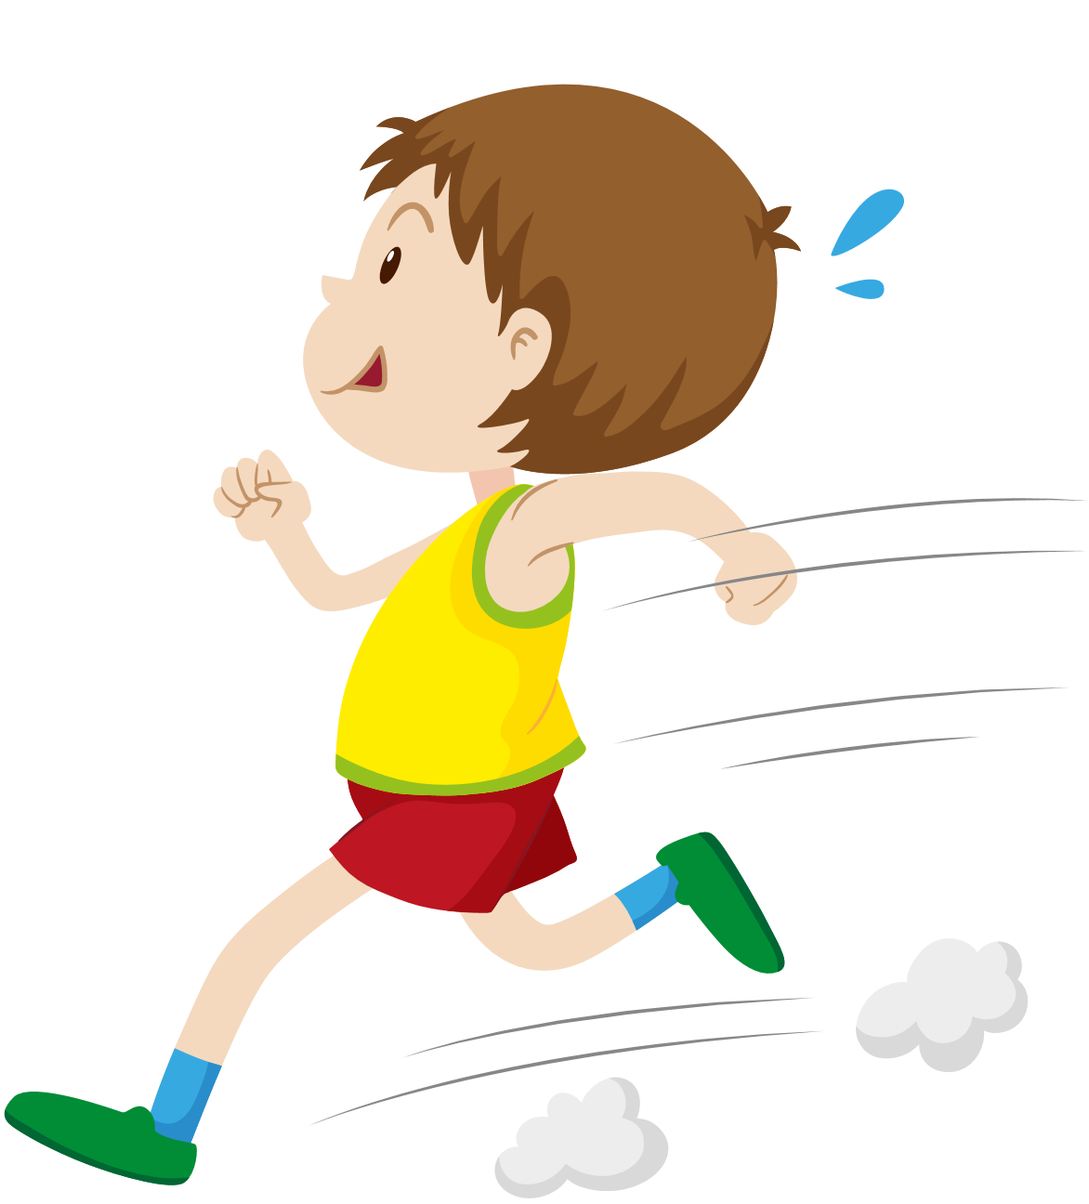
Why does Chester like to stretch in the morning?
1
So, he doesn’t have to make his bed
2
To improve his mood, loosen tight muscles & feel relaxed
3
He stretches to warm up before his journey to school

Slide 7
Why does Chester like to stretch in the morning?
2
To improve his mood, loosen tight muscles & feel relaxed

Slide 8
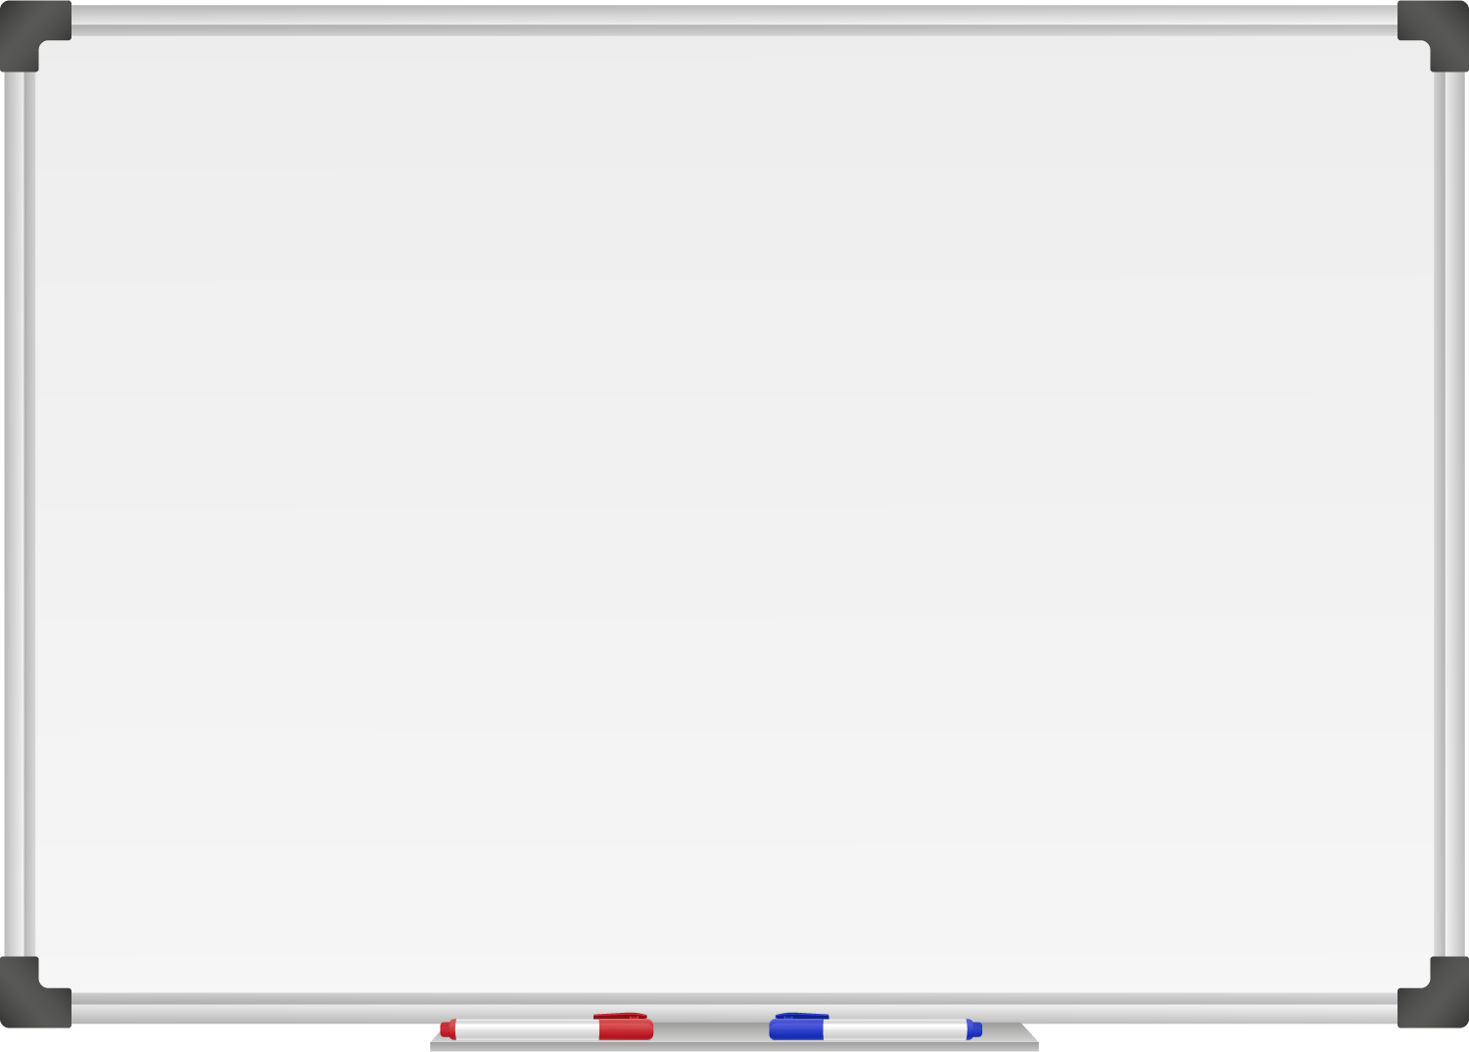







WELL DONE! You have unlocked Number 1!
10 Ways to Move More Sit Less
  ____ ____ ____ __ ____
  ____ ____ ____ ____ __ ____ ____
  ____ __ ____ ____ ____
  ____ ___ __ ____ _ ___
  ____ ____ ____ ____ ____
  ____ ____ ____ ___ _ ____ ____
  ____ ________
  ____ ____ __ ____
  ____ ____ ____ ____ _ ____ _ ____
Morning Stretch

Slide 9
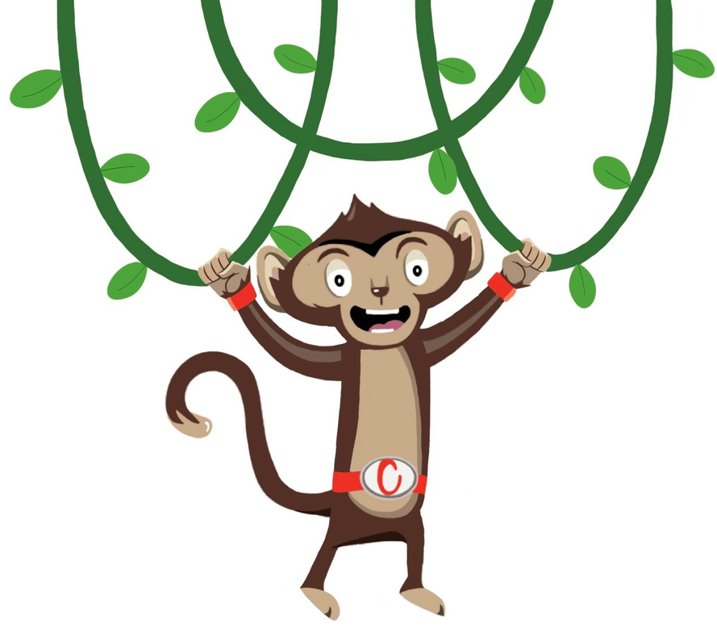
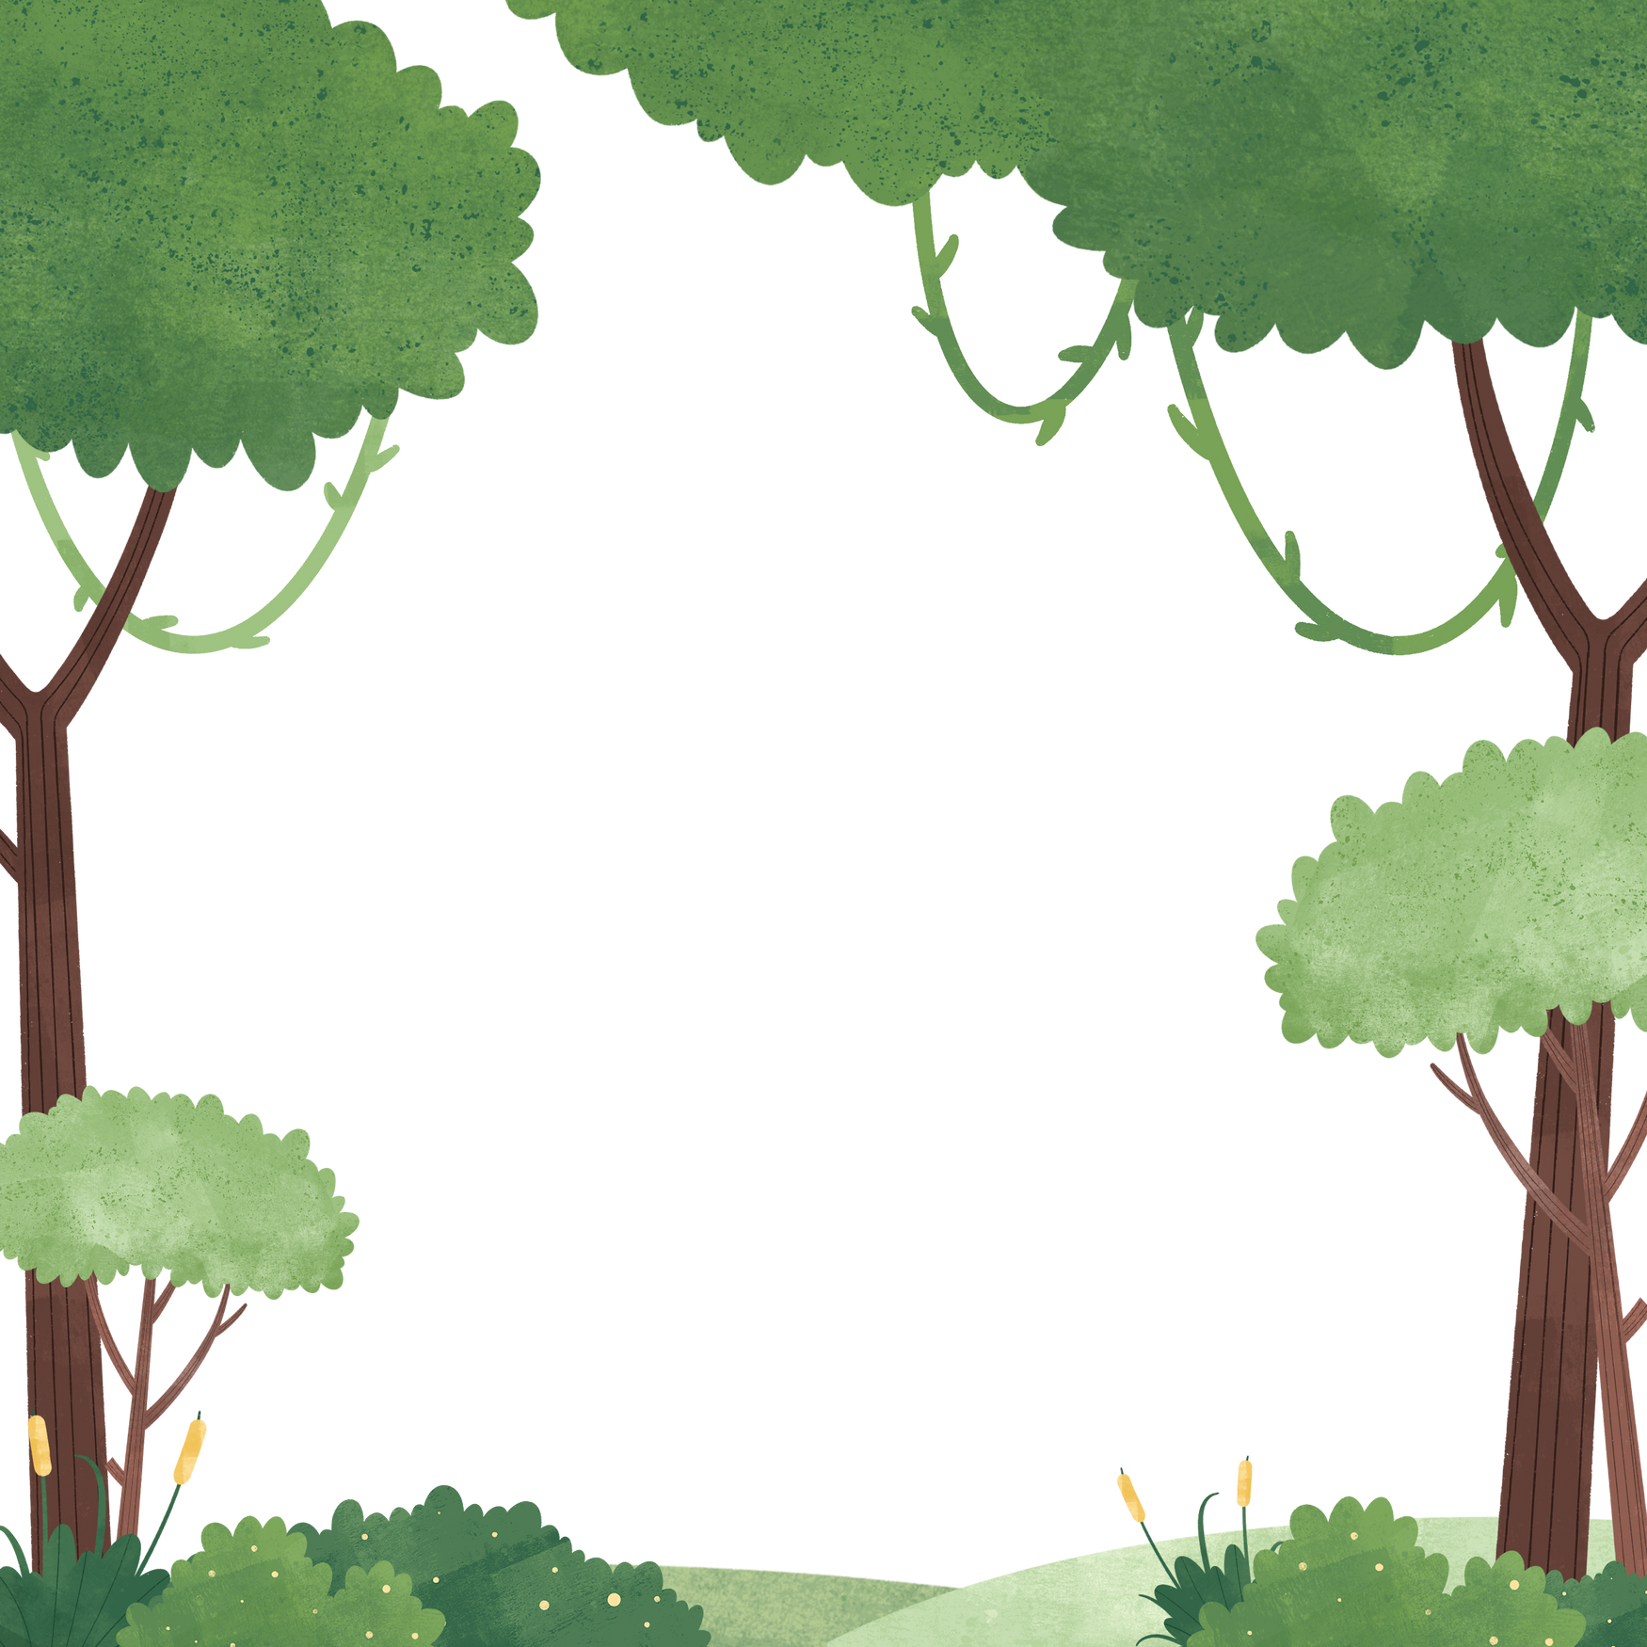

“Watch Out! The rest of the challenges won’t be so easy....”
You have a gained a healthy heart!

Slide 10
Chill with Chester
Stretching can:
  Make you feel more relaxed
  Boost your mood
  Help with sore muscles
Why not try Chill with Chester

