Slide 1
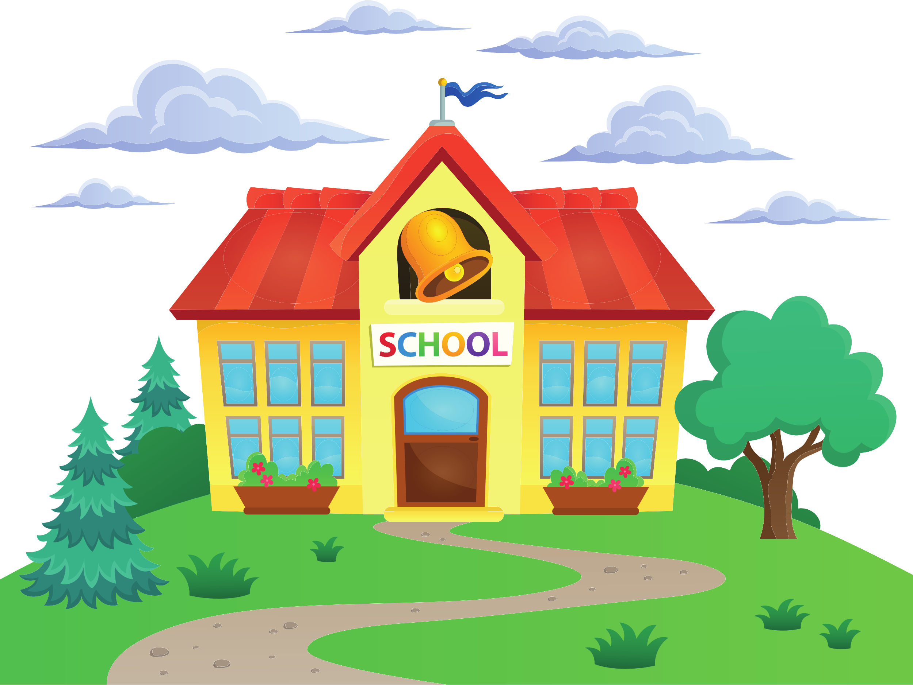
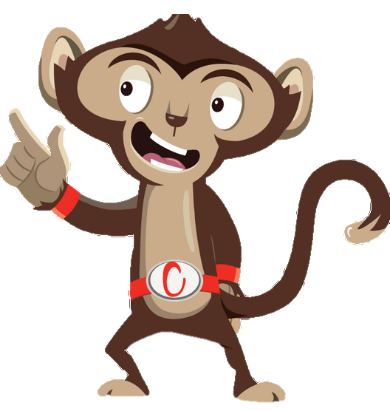


Chester’s Active Quest: Week 2

Slide 2
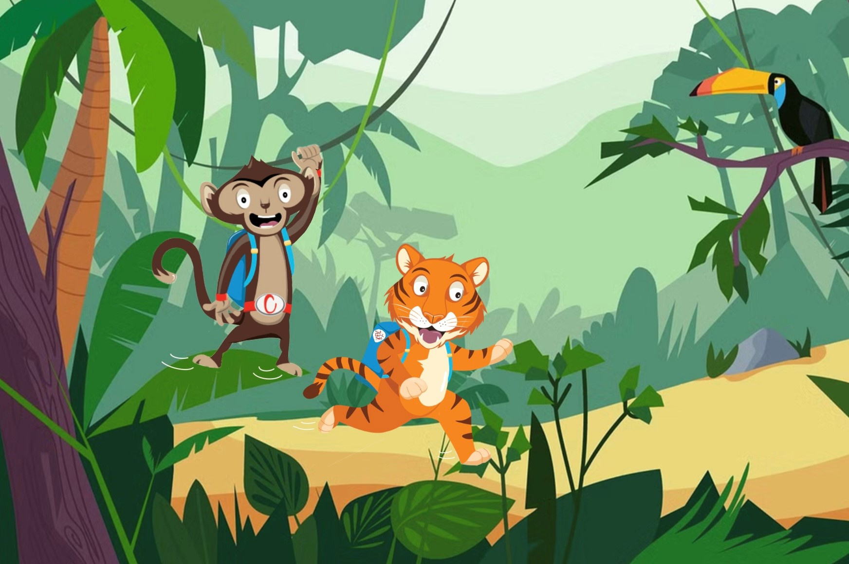

Notes:
Chester is swinging through the jungle. The lively sounds of chatter and rustling leaves make his journey to school thrilling. He sees his friend Timmy the tiger. He shouts down “Good morning Timmy, would you like to go to school together?”. Timmy smiles, “Yes of course”. They travel to school together, Timmy on foot and Chester swinging above his head. They talk about what things they are most excited for that day. Chester says he can’t wait to play in the sand. Timmy says he can’t wait to do some singing. They talk and laugh all the way to the school gates. Chester carefully climbs down the tall tree to join Timmy. What a great way to stay active and have fun in the morning.

Slide 3
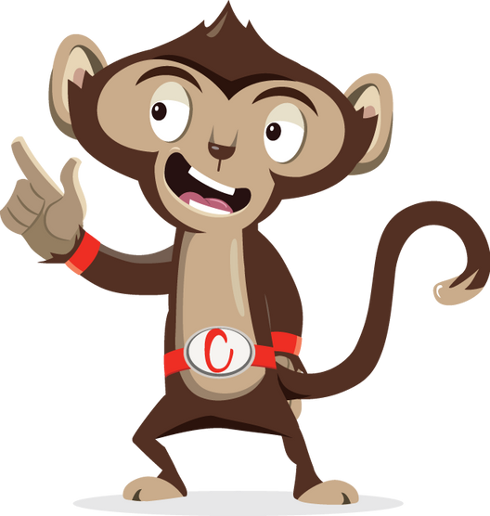
1
How does Chester get to school?
2
3
Notes:
Ask pupils to answer the question while standing. If pupils think the answer is A = they stand with their hands on their head, B = stand with arms crossed and C = stand with both hands in the air. If space is not limited, put the letters A, B and C around the room and ask pupils to move to the area they think the answer is.

Slide 4
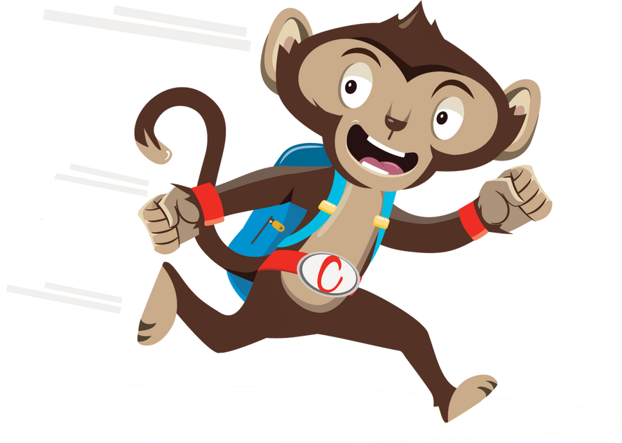
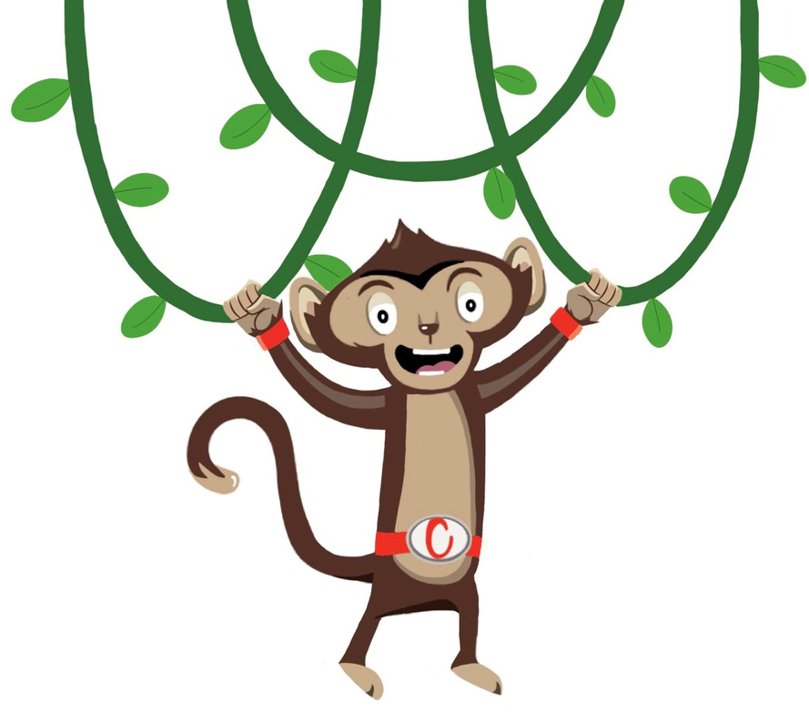

1
Run
How does Chester get to school?
2
Swing
3
Jump

Slide 5
How does Chester get to school?
2
Swing

Slide 6
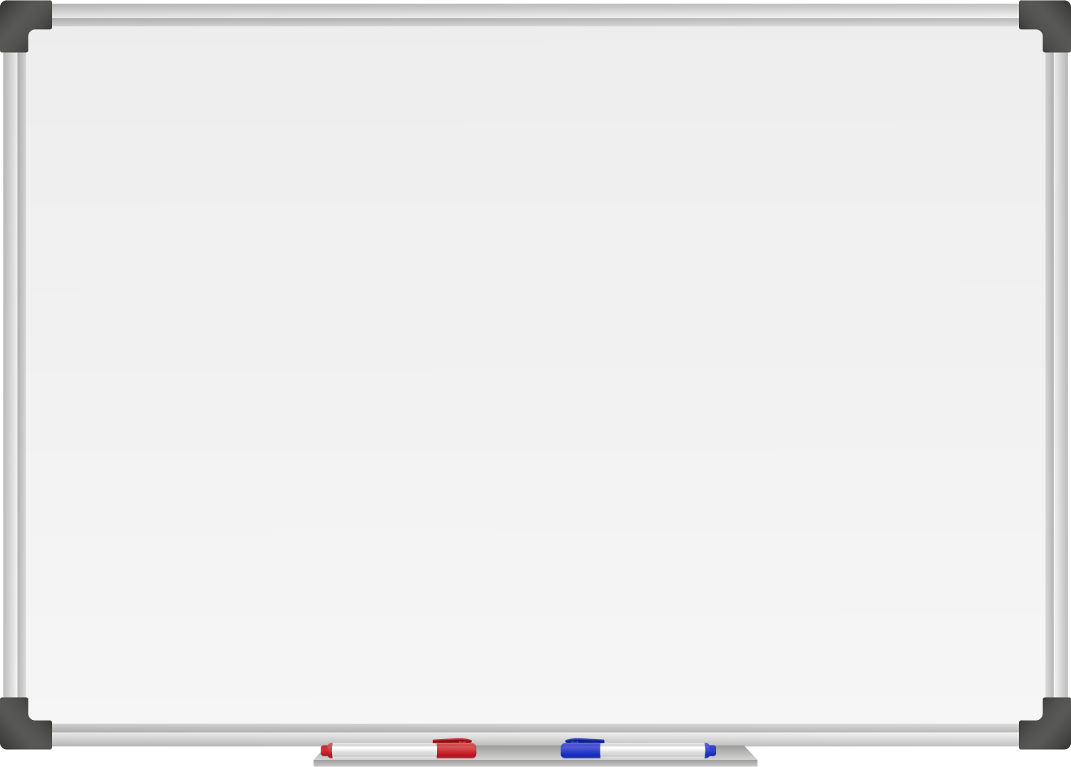







WELL DONE! You have unlocked number 2!
10 Ways to Move More Sit Less
  ____ ____ ____ ____ __ ____ ____
  ____ __ ____ ____ ____
  ____ ___ __ ____ _ ___
  ____ ____ ____ ____ ____
  ____ ____ ____ ___ _ ____ ____
  ____ ________
  ____ ____ __ ____
  ____ ____ ____ ____ _ ____ _ ____
Morning Stretch
Walk, cycle or scoot to school

Slide 7

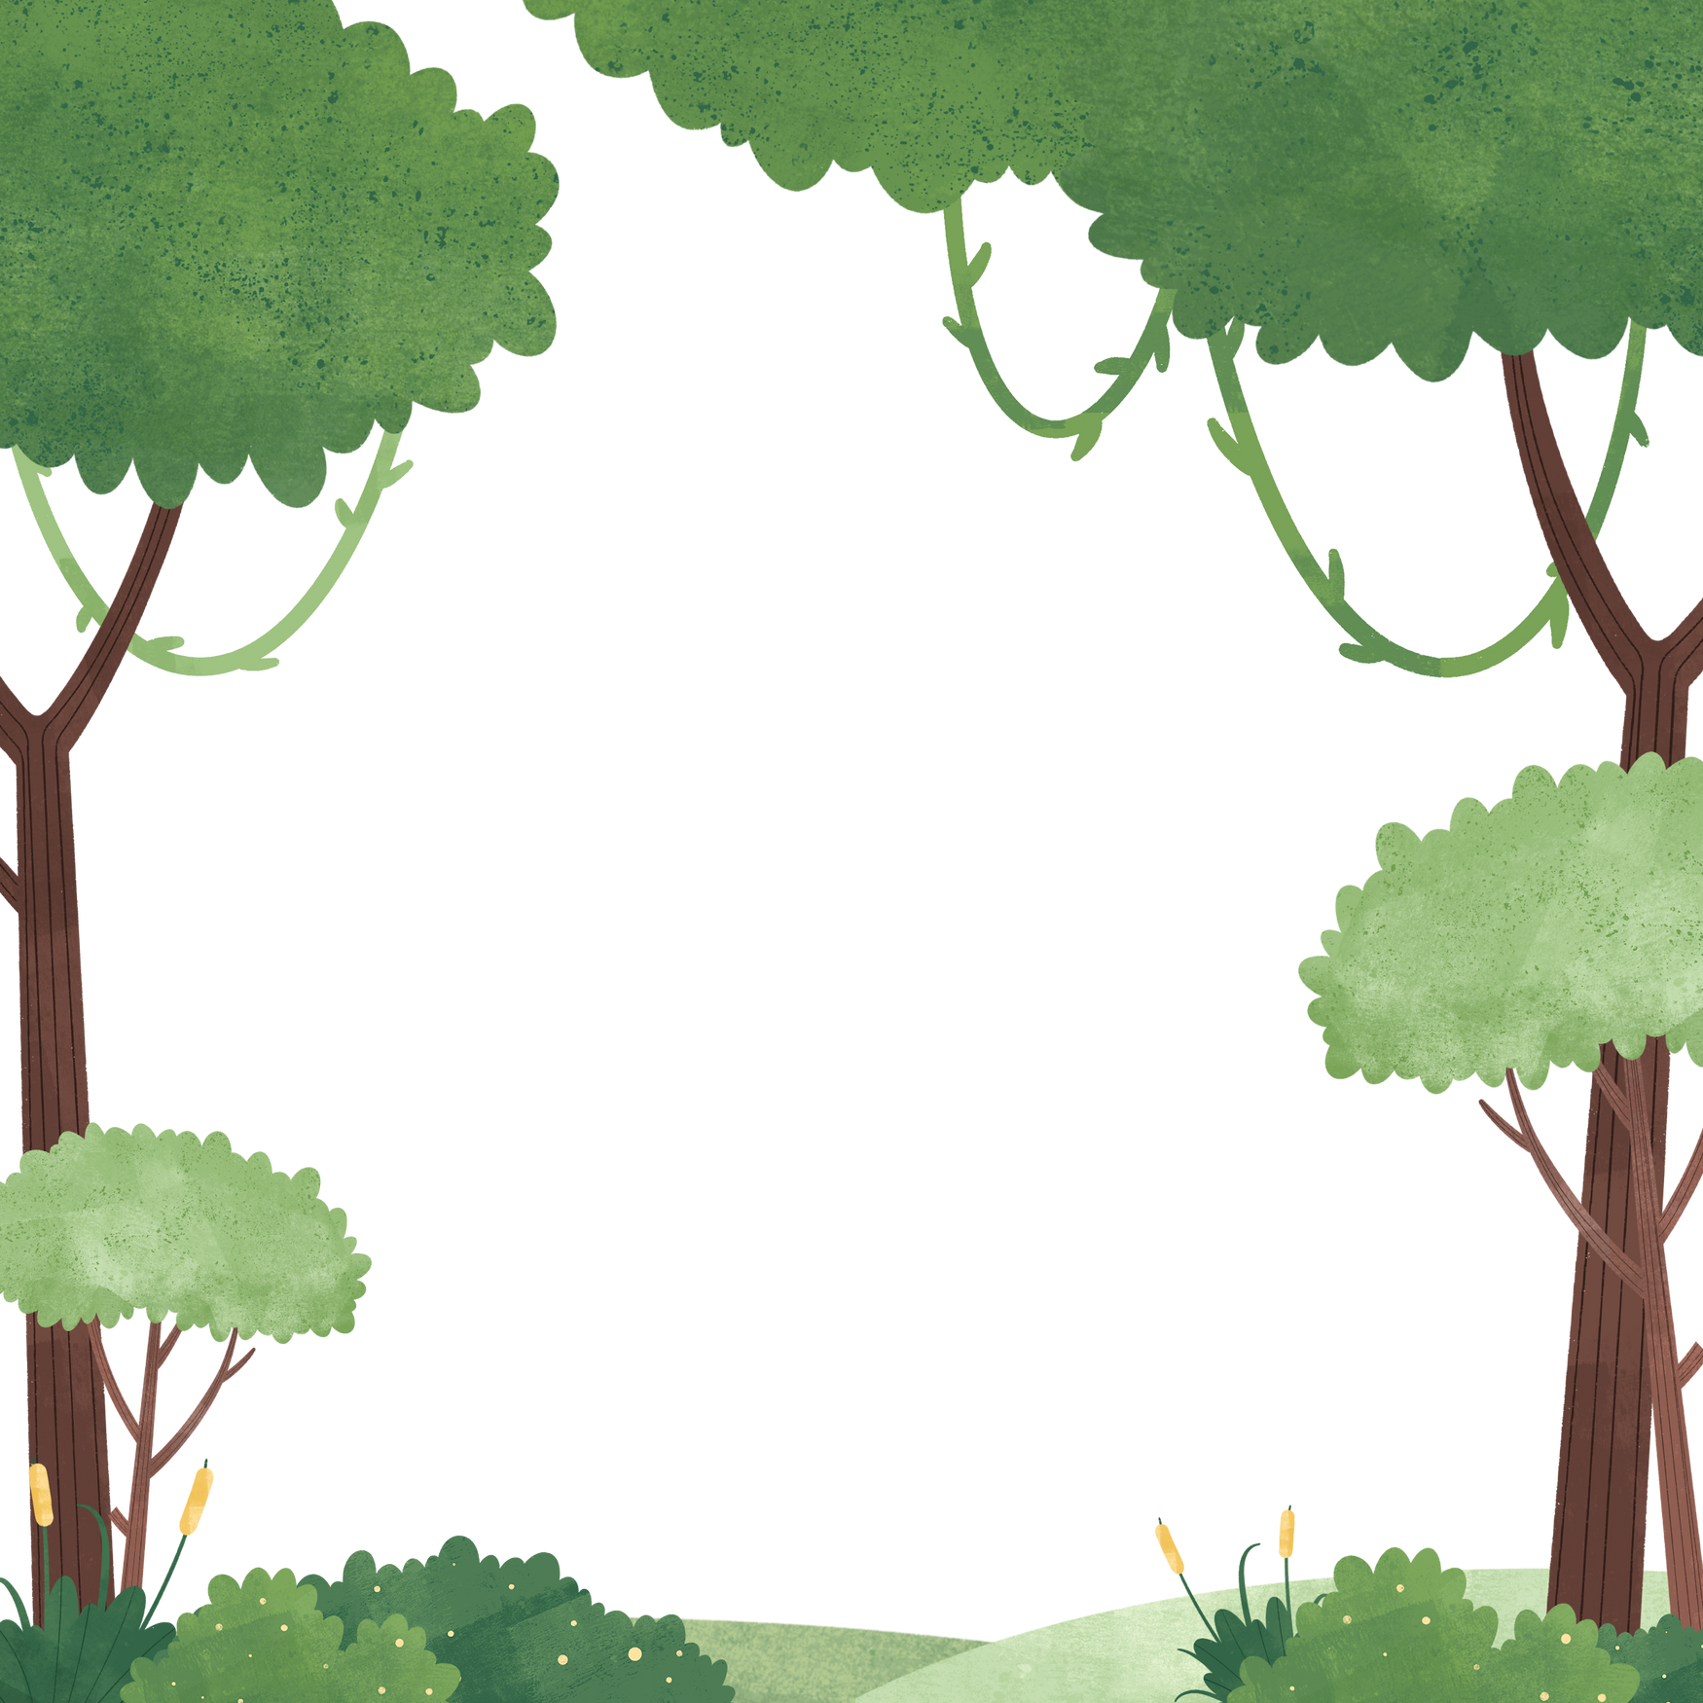
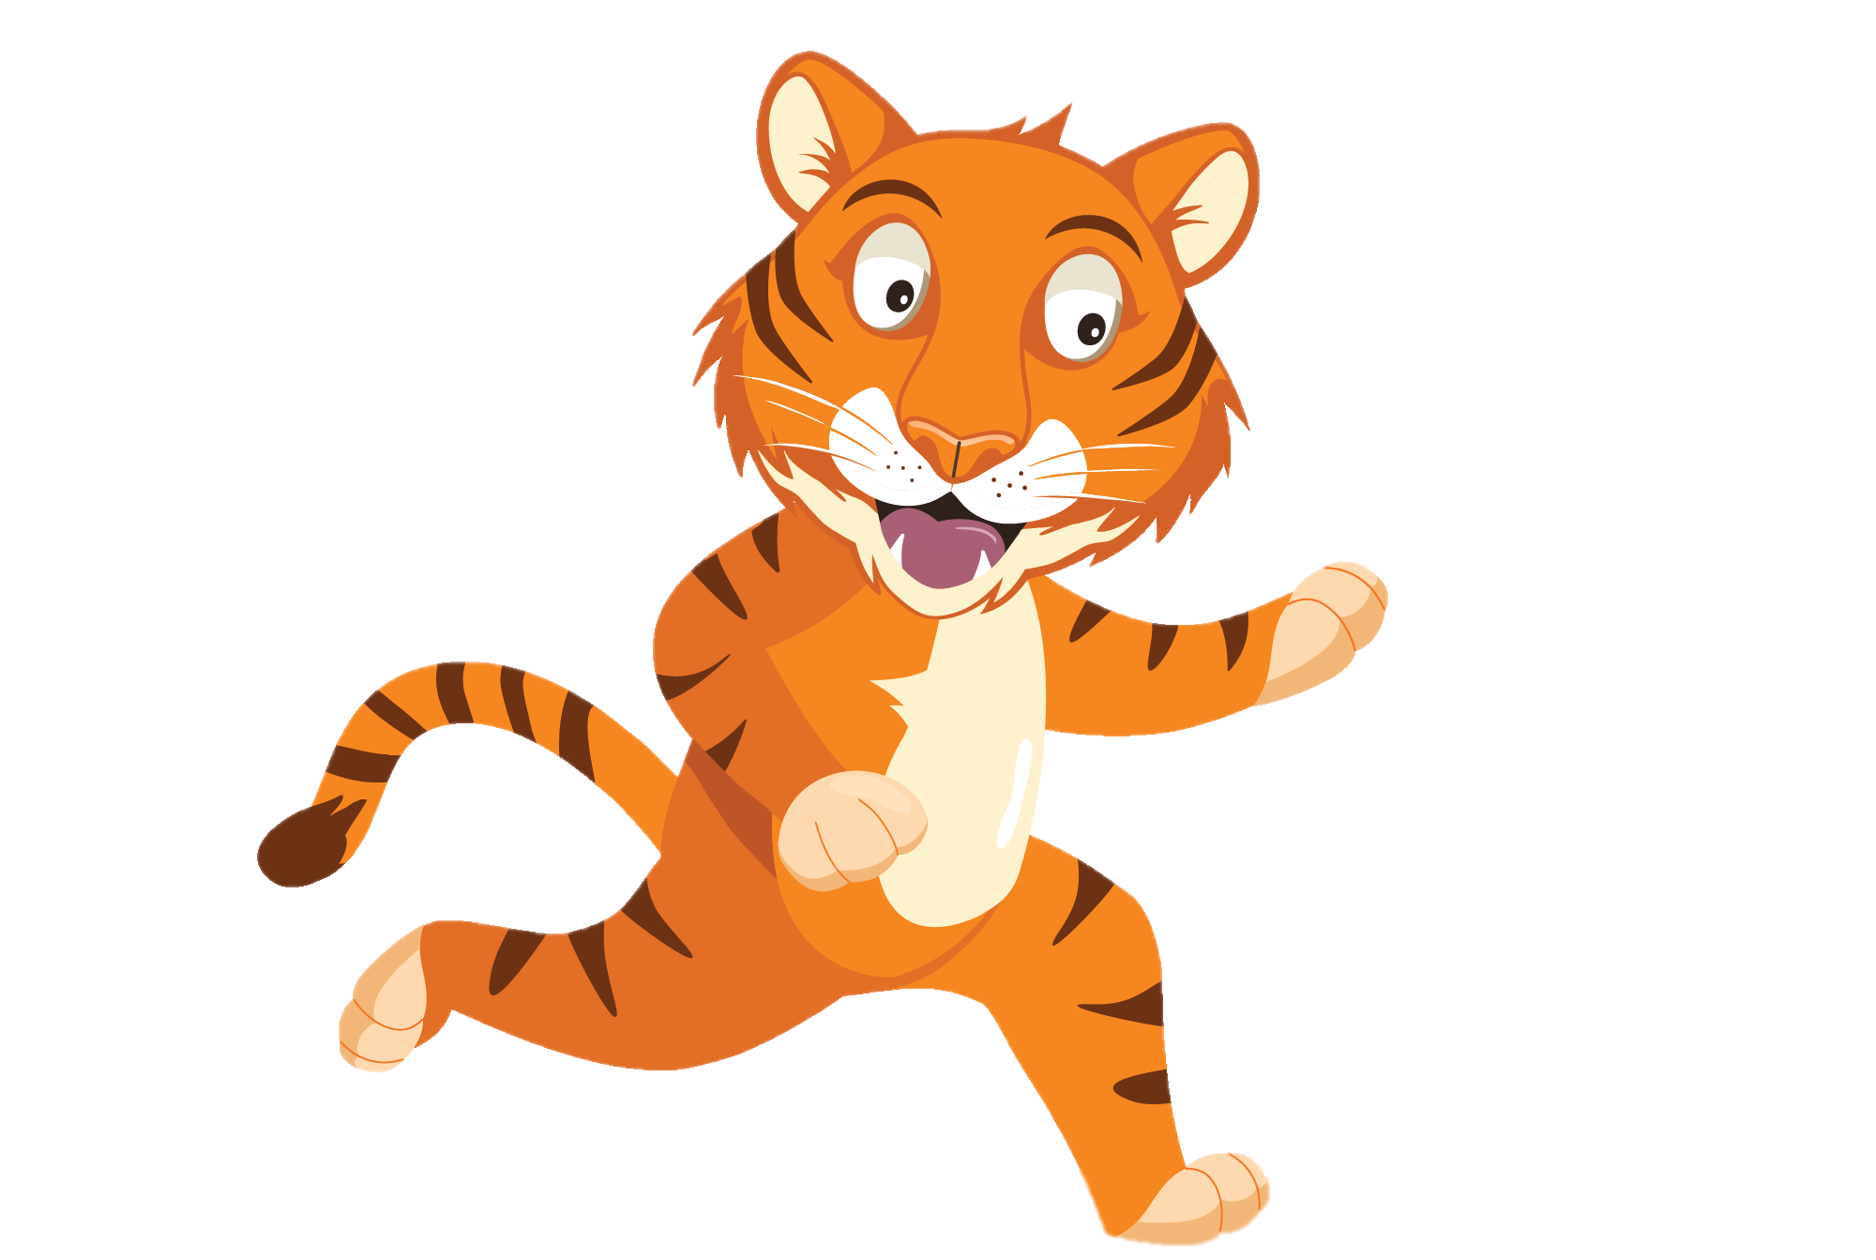
“ Travelling to school with friends is so much fun”
“ Wait for me
Chester!”
You have gained 2 healthy hearts!

Slide 8
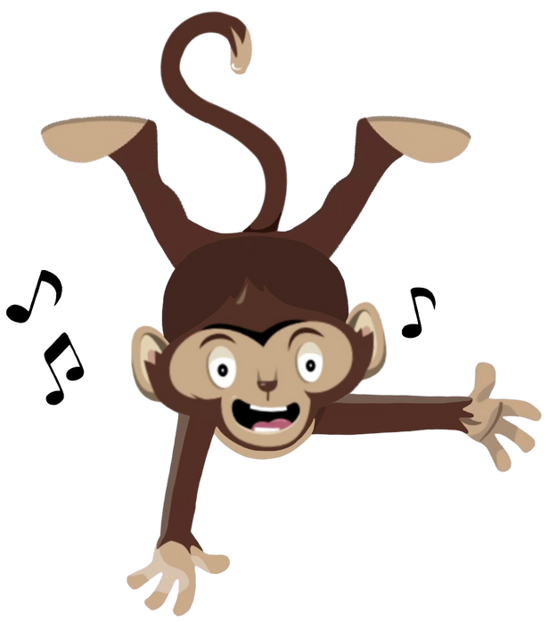
Lively Lesson
Active Travel to school is a great way to move more and sit less.
Try walking, cycling or using your scooter to see your friends.
Why not try a Chester’s Lively Lesson
Notes:
This week why not try one of our lively lessons each day and see if you feel energized

