Slide 1
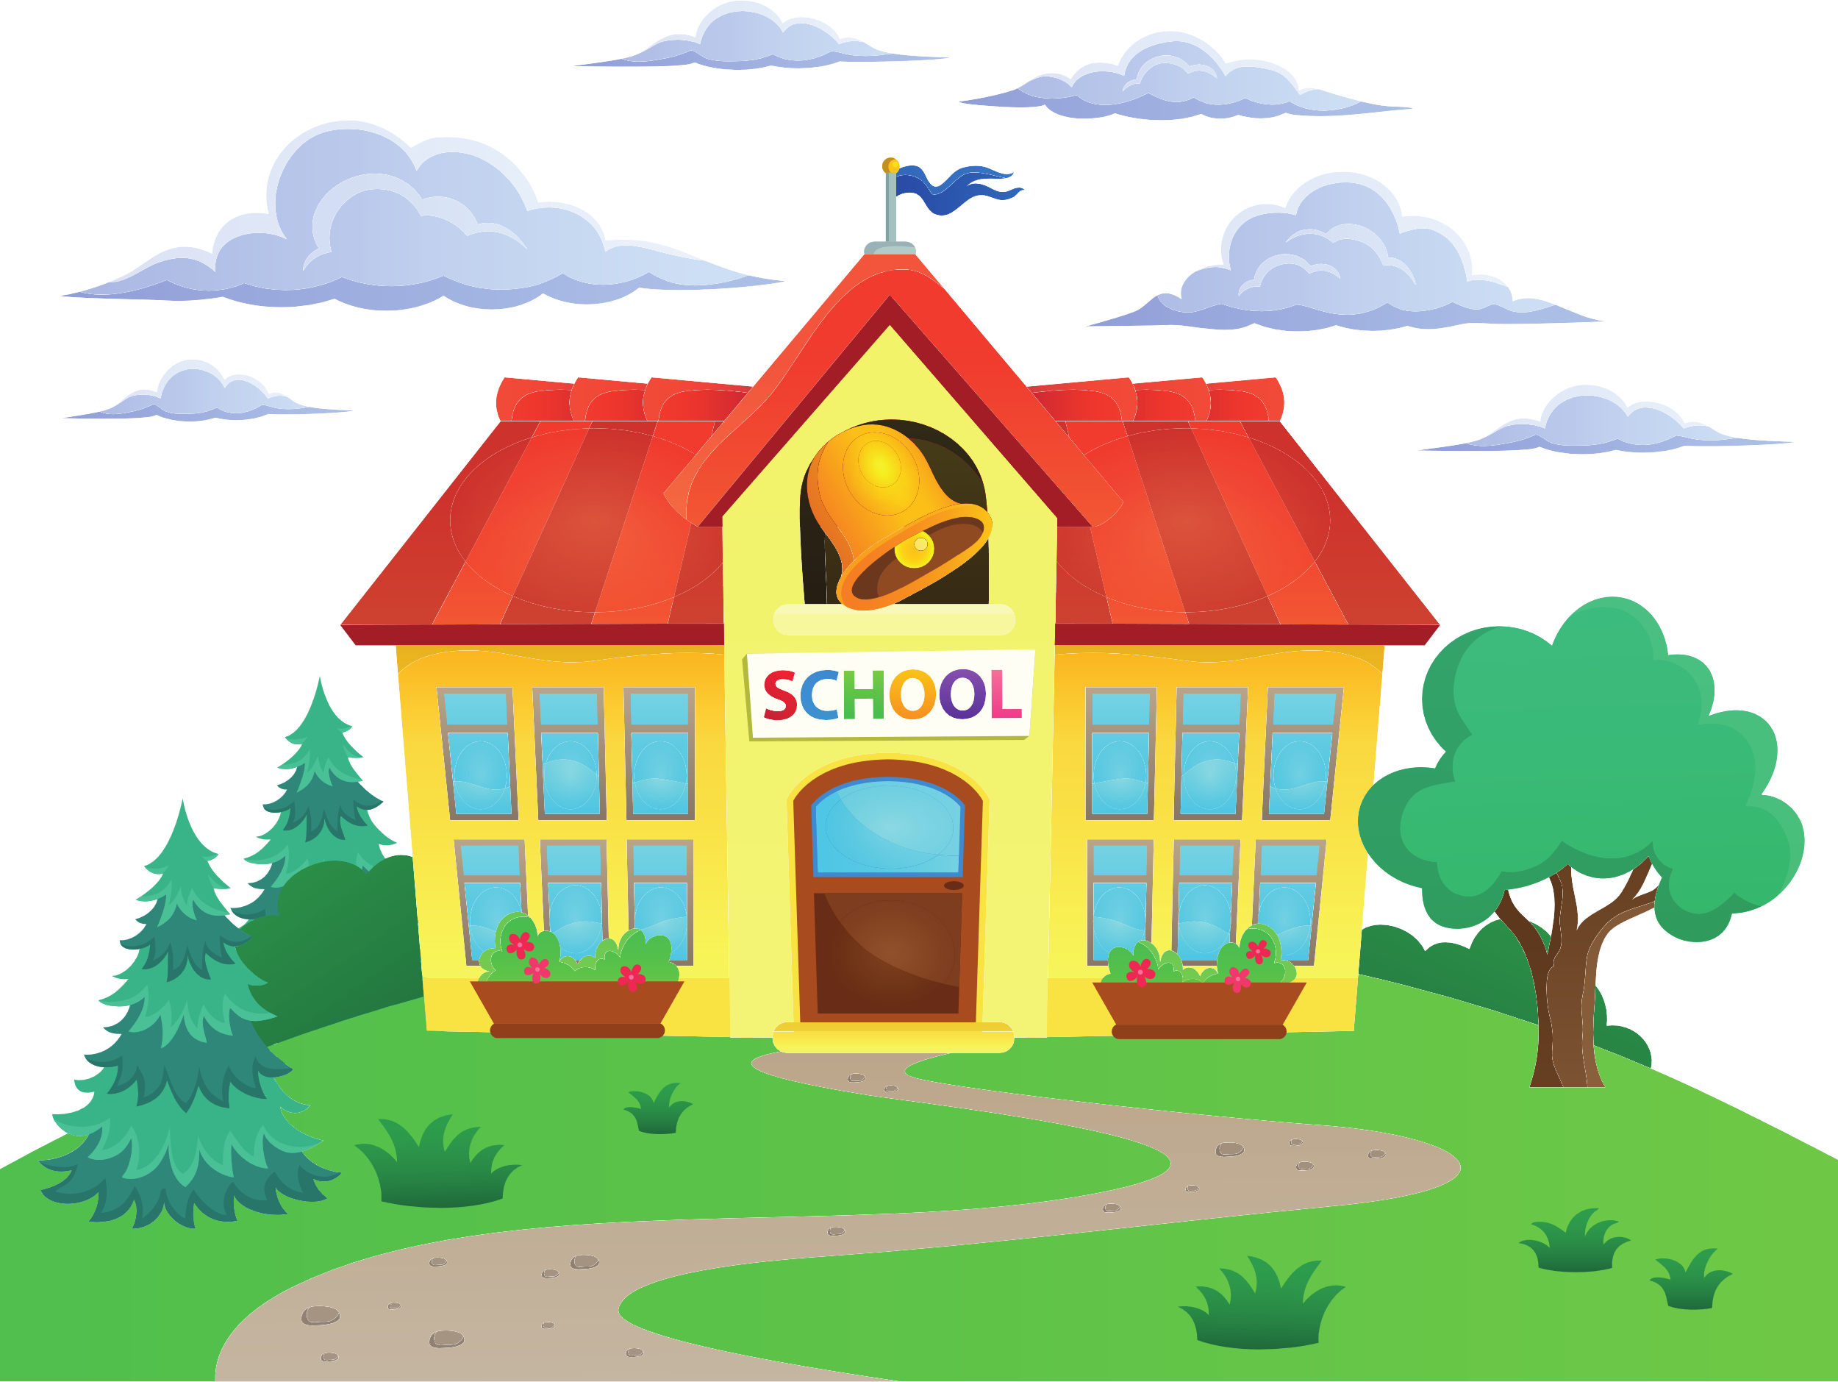
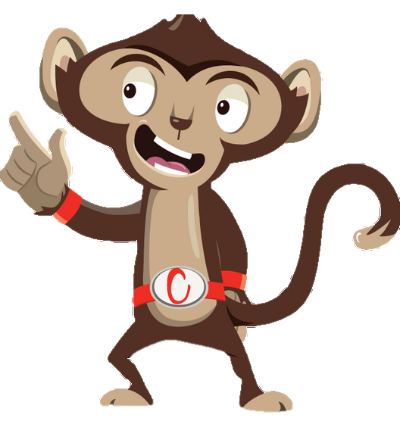


Chester’s Active Quest: Week 2

Slide 2
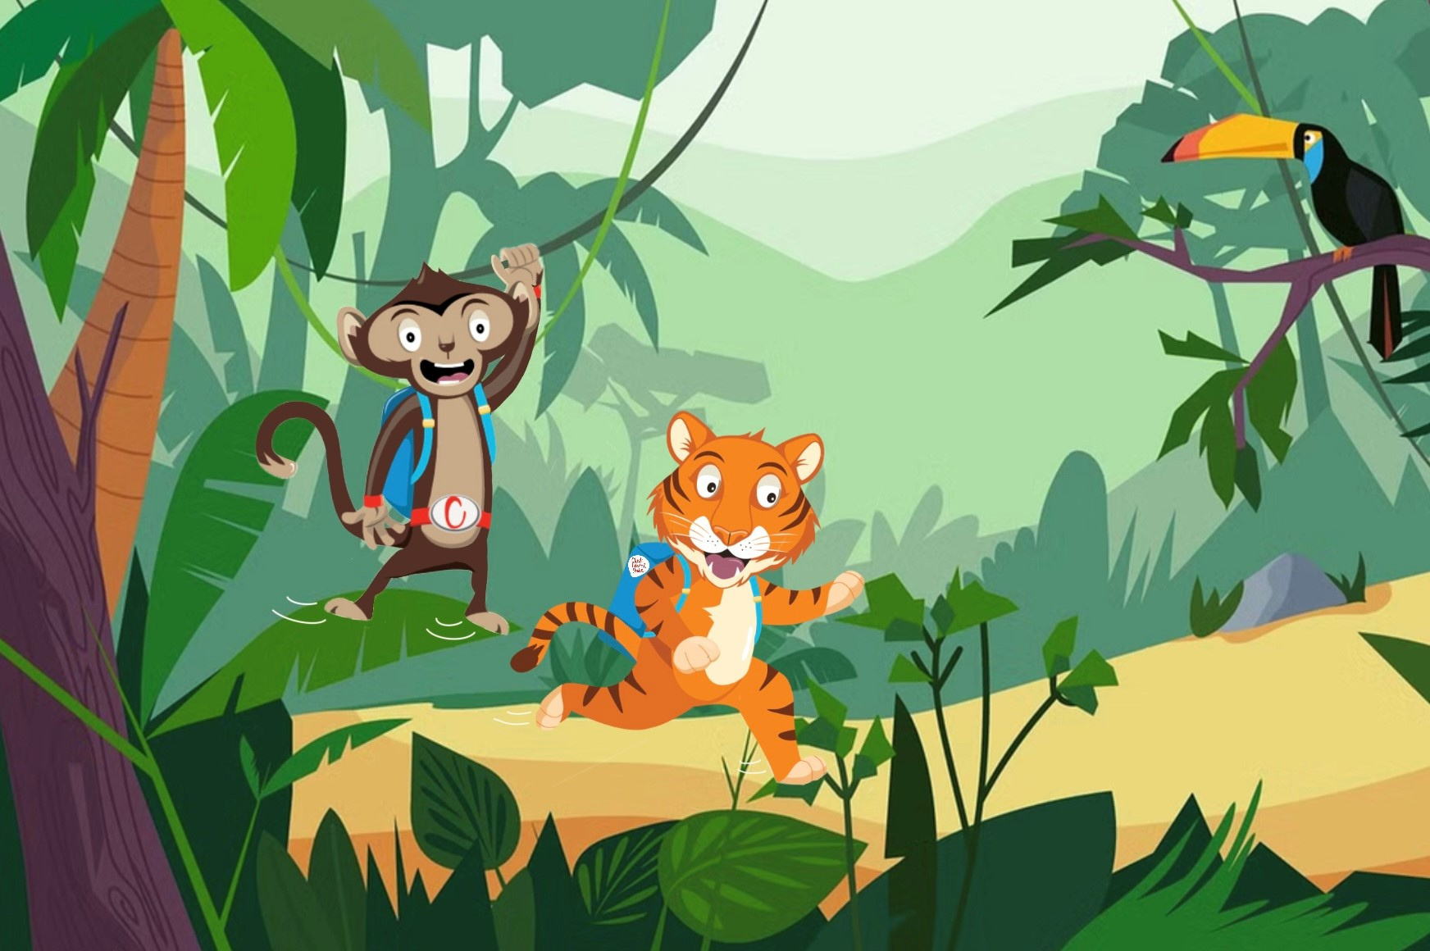

Notes:
Chester is swinging from vine to vine towards school. The lively hustle and bustle of chatter brings the jungle to life. He sees his friend Timmy the tiger. He shouts down “Good morning Timmy, would you like to go to school together?”. Timmy replies, “Yes of course”. Chester continues to swing above Timmy’s head as they talk about what they are most excited for. Chester says he can’t wait to play football at break time and Timmy says he can’t wait to start a new book in class. They talk and laugh all the way to the school gate. They are having so much fun together that they didn’t realize how quickly they travelled to school. Chester carefully climbs down the tall tree to join Timmy. What a great way to stay active and have fun in the morning.

Slide 3
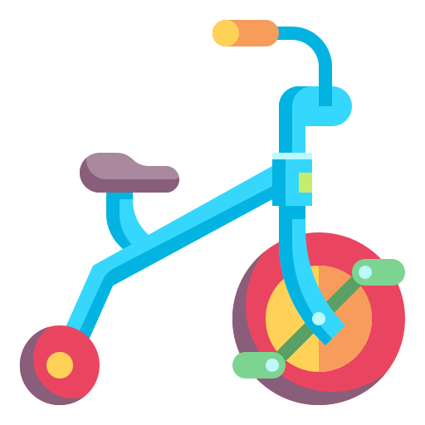
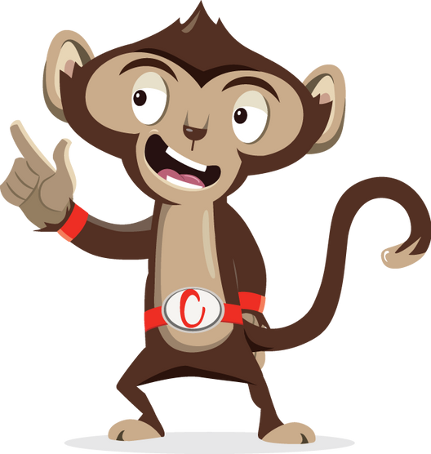

What else can Chester use to travel to school?
_ I _ E
OR
S _ O O _ _ R
Notes:
Ask pupils to answer the question while standing. If pupils think the answer is A = they stand with their hands on their head, B = stand with arms crossed and C = stand with both hands in the air. If space is not limited, put the letters A, B and C around the room and ask pupils to move to the area they think the answer is.

Slide 4
What else can Chester use to travel to school?
B I K E
OR
S C O O T E R

Slide 5
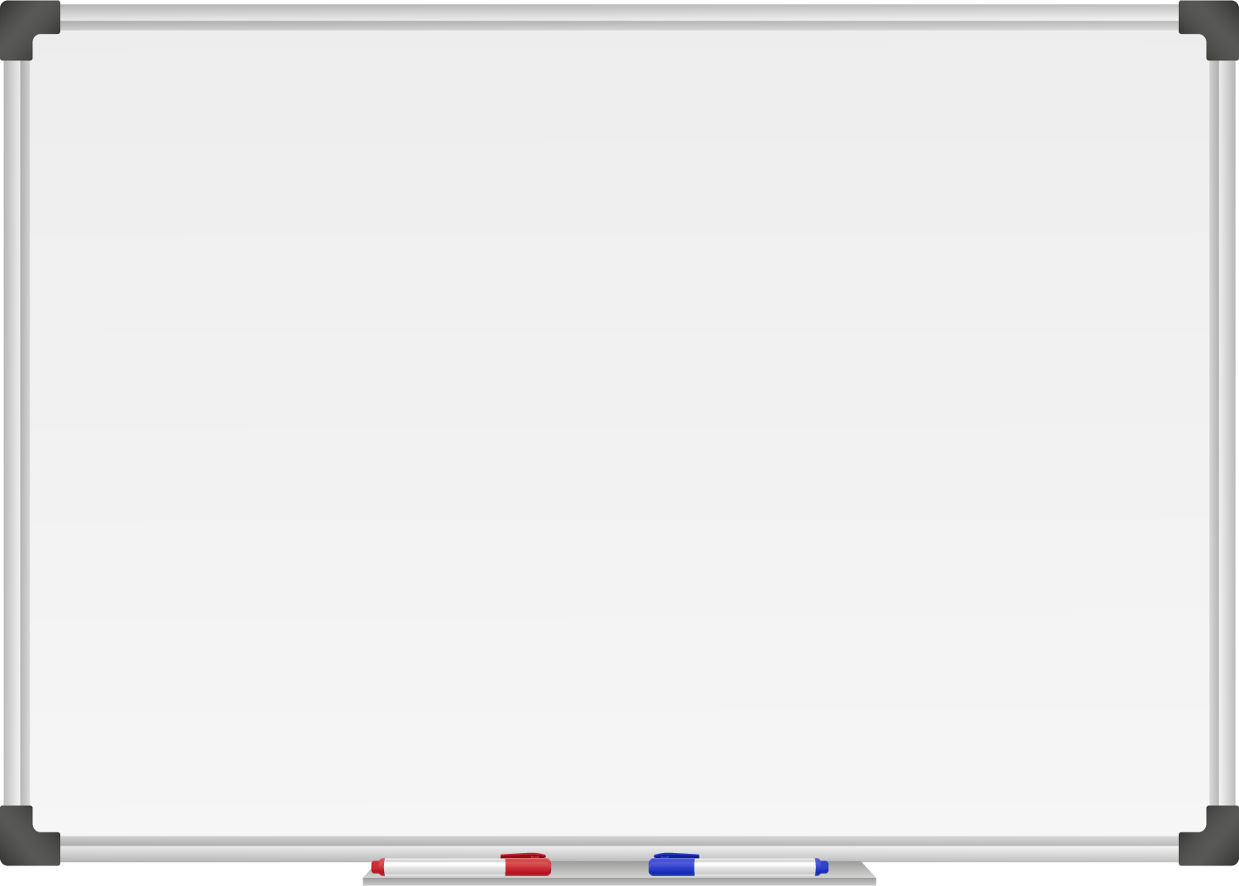







WELL DONE! You have unlocked number 2!
10 Ways to Move More Sit Less
  ____ ____ ____ ____ __ ____ ____
  ____ __ ____ ____ ____
  ____ ___ __ ____ _ ___
  ____ ____ ____ ____ ____
  ____ ____ ____ ___ _ ____ ____
  ____ ________
  ____ ____ __ ____
  ____ ____ ____ ____ _ ____ _ ____
Morning Stretch
Don’t be late get a move on as you walk, cycle or scoot to school

Slide 6

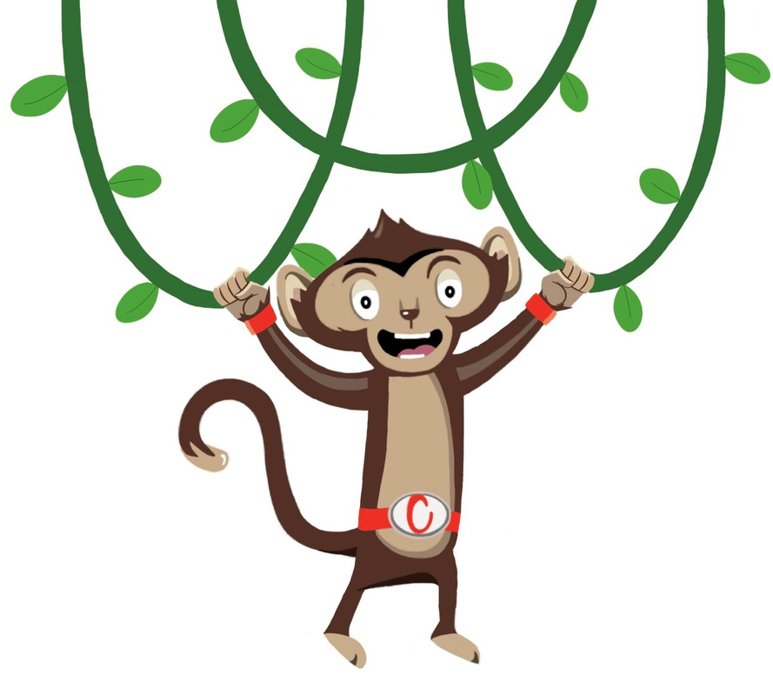
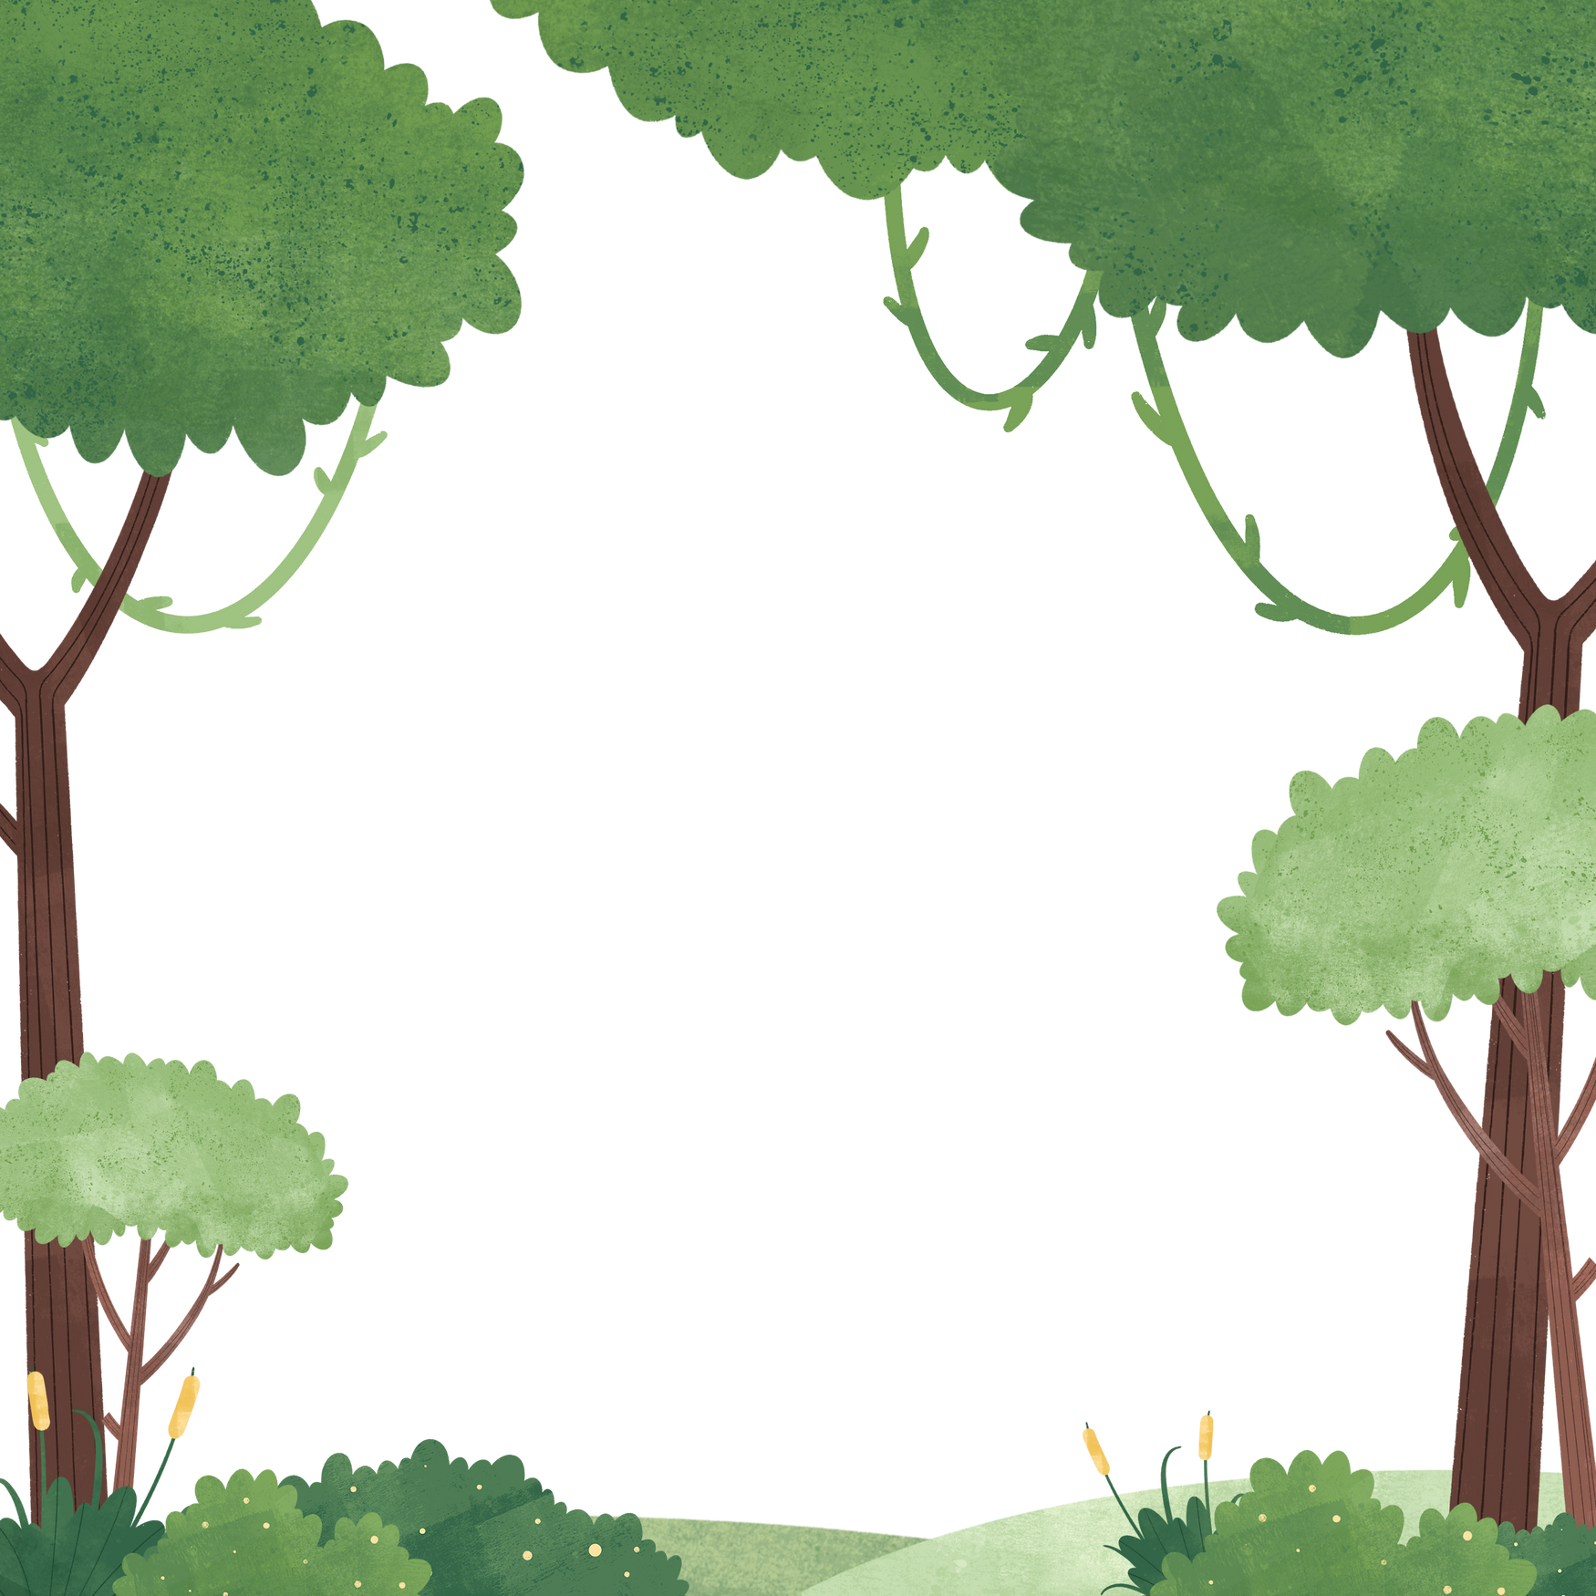
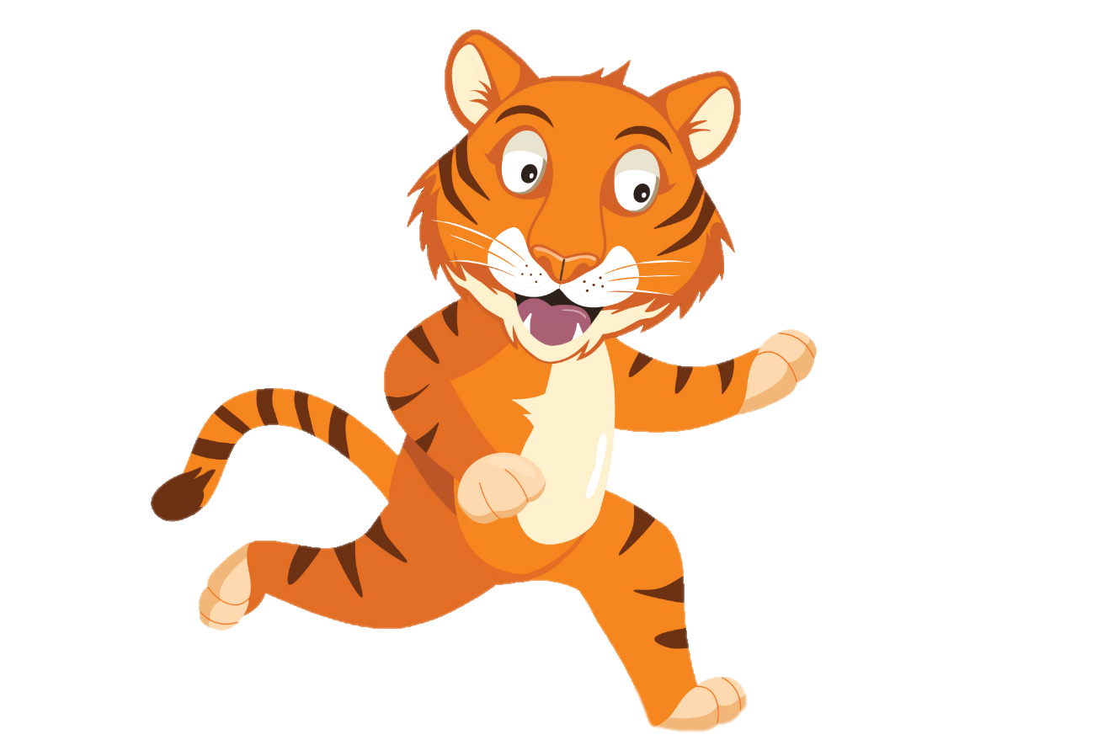
“ Travelling to school with friends is so much fun”
“ Wait for me
Chester!”
You have gained 2 healthy hearts!

Slide 7
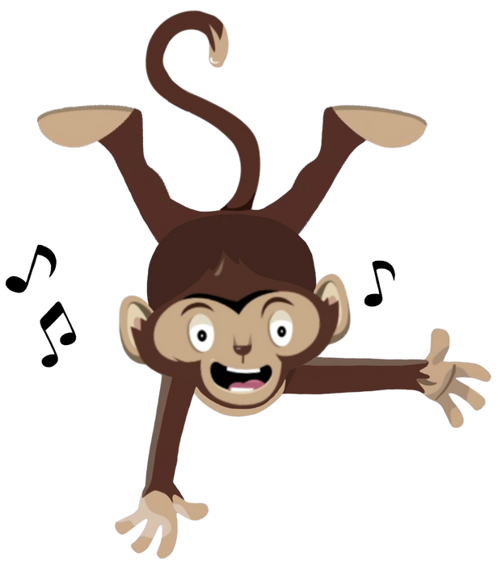
Lively Lesson
Active Travel to school is a great way to move more and sit less.
Try walking, cycling or using your scooter to see your friends.
Why not try a Chester’s Lively Lesson
Notes:
This week why not try one of our lively lessons each day this week and see if you feel energized

