Slide 1
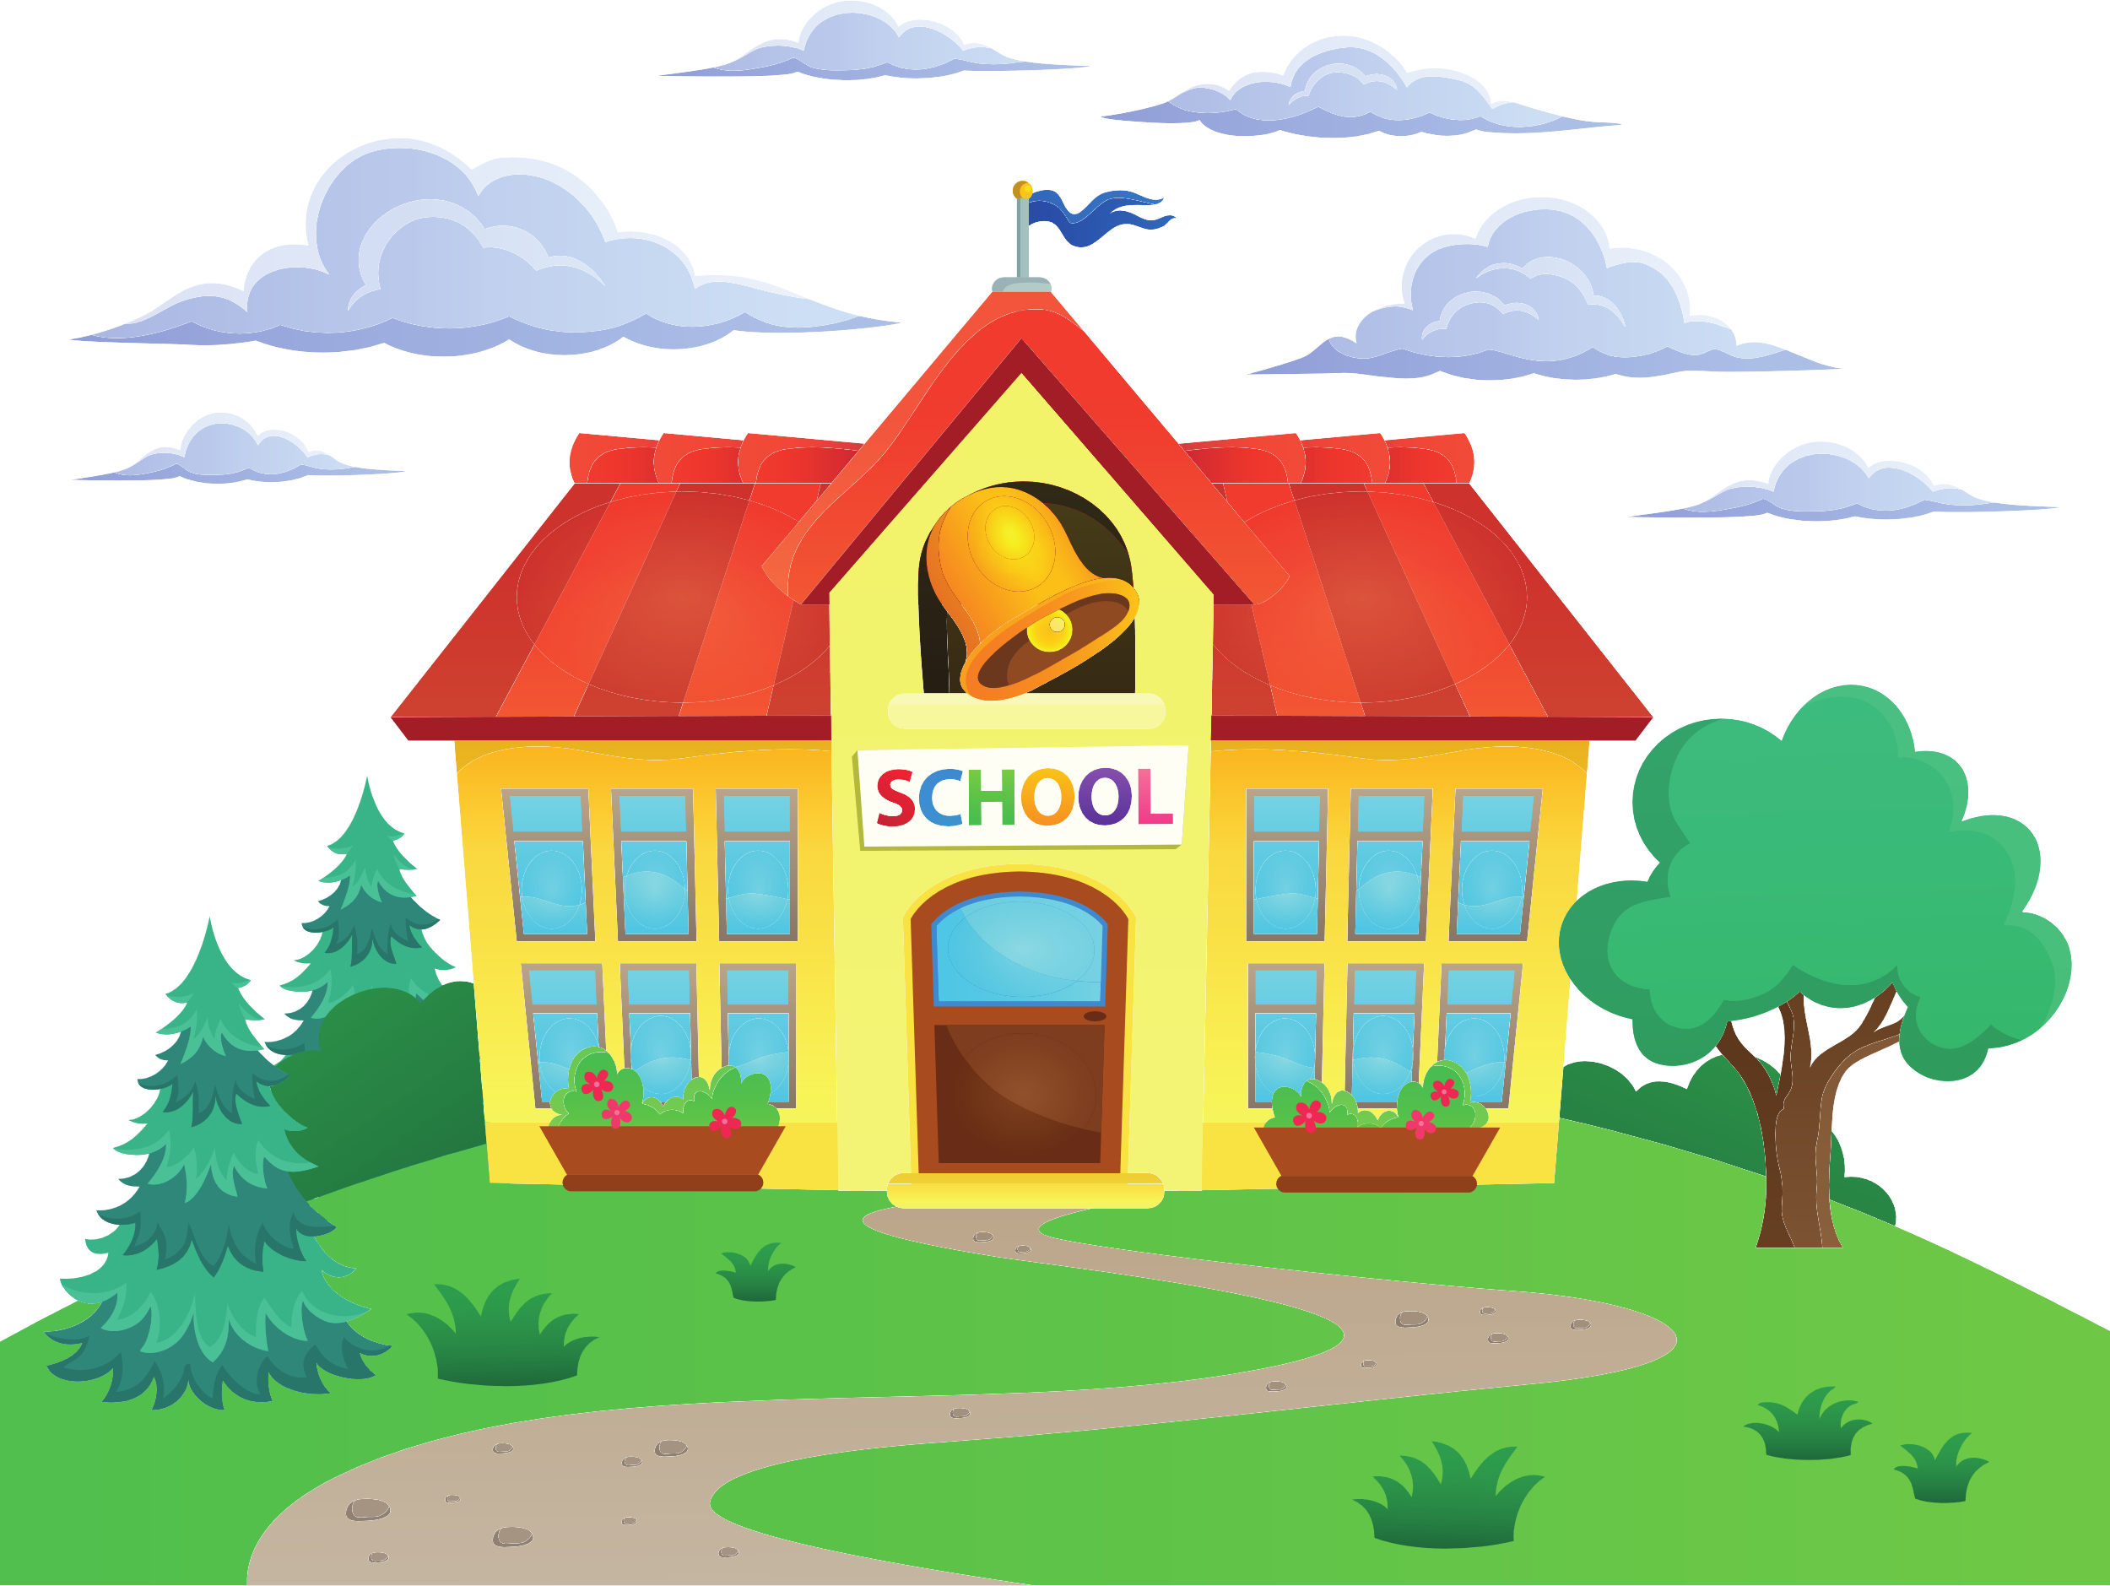



Chester’s Active Quest: Week 3

Slide 2
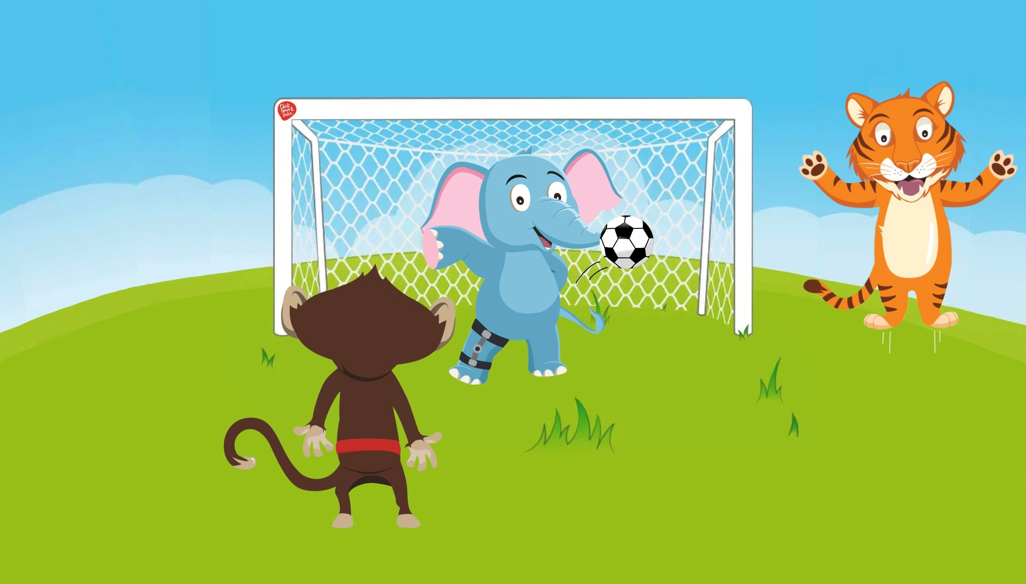

Notes:
Chester and Timmy love to play football outside in the grassy playground. Especially, on a bright sunny day. Chester bounces the ball off the nearby tree to complete an incredible pass to Timmy, but it zooms past him and lands beside Ellie the elephant. She has been watching them play but looks sad. They ask her if she wants to play football with them. She shakes her head and says quietly, “I’d like to, but I’m not very fast because of my leg”. Chester and Timmy know exactly what to do. They know everyone should be able to have fun in the playground and not be sad. “Have you ever been a goalkeeper?”, Timmy asks. “No, but I’d love to try”, replies Ellie smiling. They wave her over to stand inside the goal. “Then we can all take turns at being the goalkeeper”, Chester says. Ellie realizes that she can use her trunk to stop the ball in a big, fast, swoop. Timmy and Chester are amazed, “Well Done Ellie! That was great!” they shout. They all celebrate and cheer. Playing together with your friends during break and lunch time is a great way to stay active and have lots of fun.

Slide 3

1
How can you keep moving at break and lunch?
2
3
Notes:
Ask pupils to answer the question while standing. If pupils think the answer is A = they stand with their hands on their head, B = stand with arms crossed and C = stand with both hands in the air. If space is not limited, put the letters A, B and C around the room and ask pupils to move to the area they think the answer is.

Slide 4
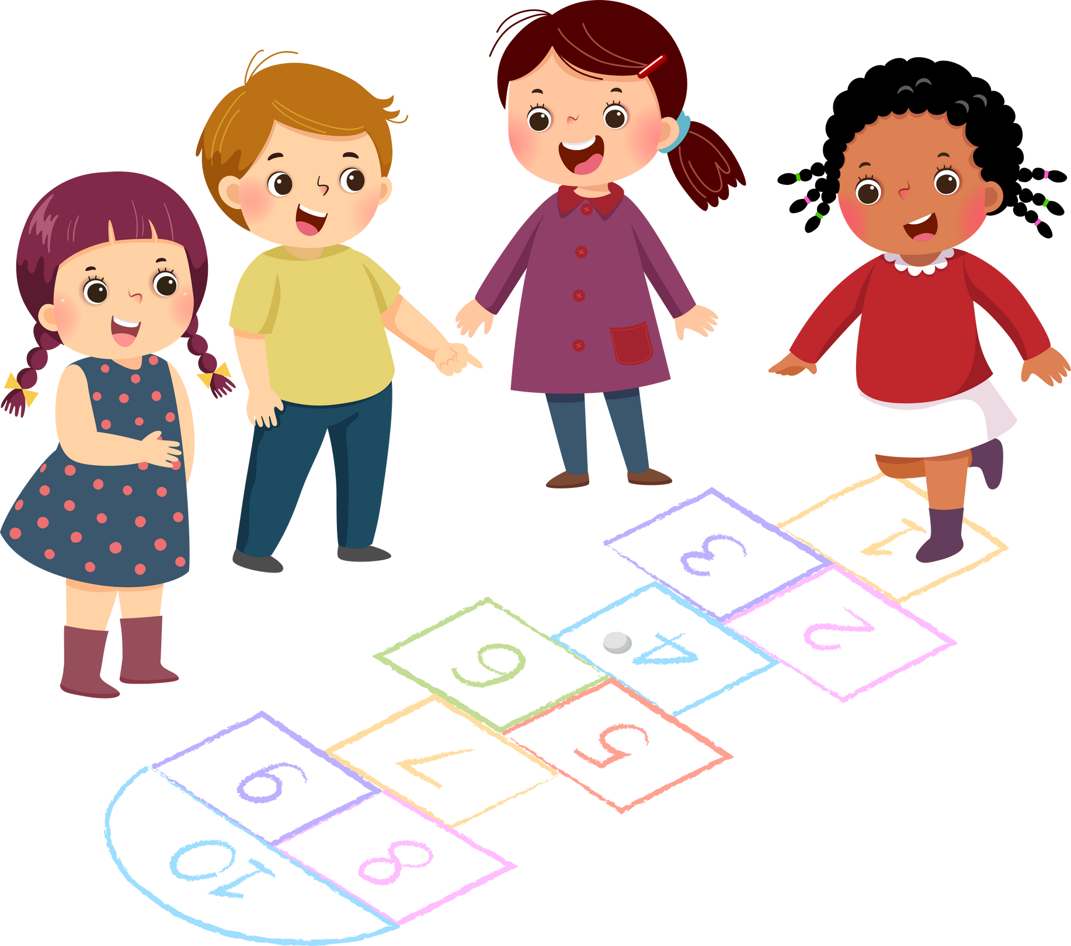
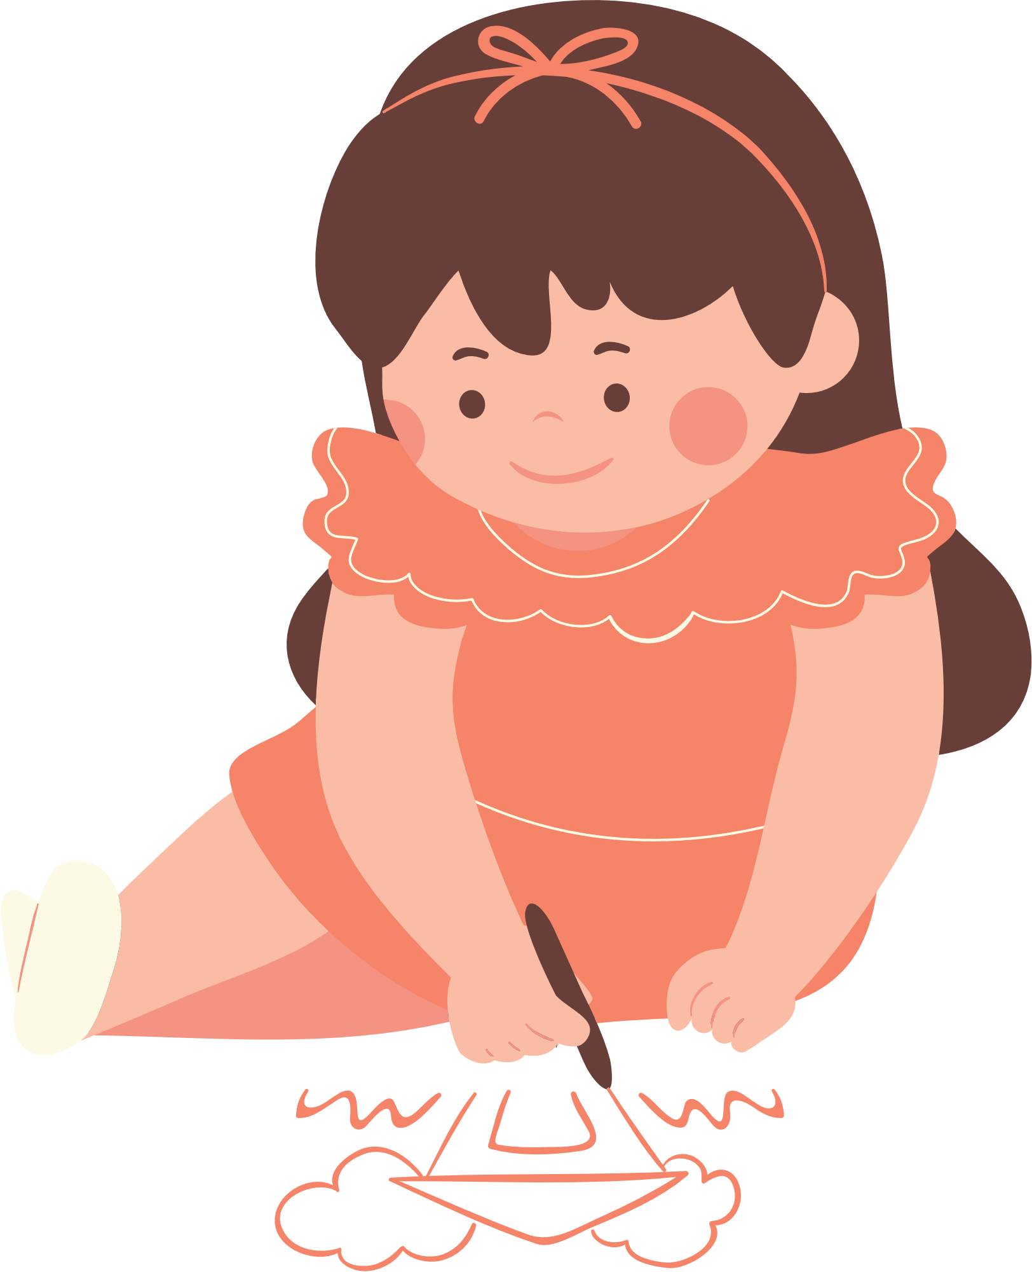
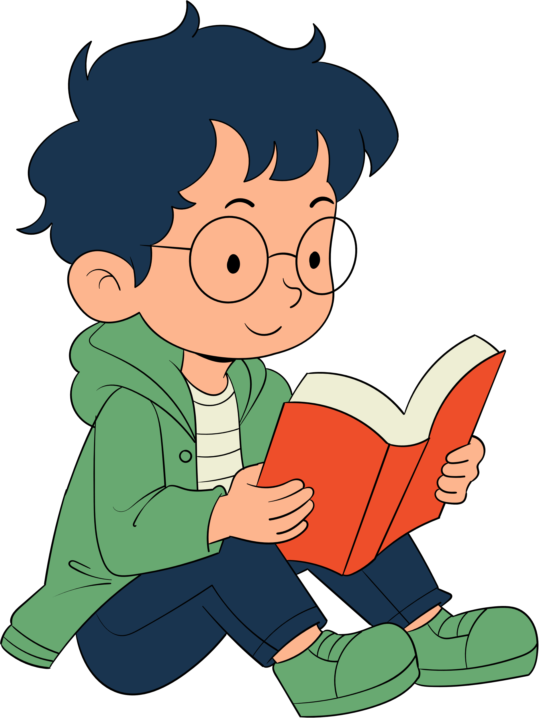
1
How can you keep moving at break and lunch?
Play with friends
2
Sit and draw
3
Read a book

Slide 5
1
How can you keep moving at break and lunch?
Play with friends

Slide 6
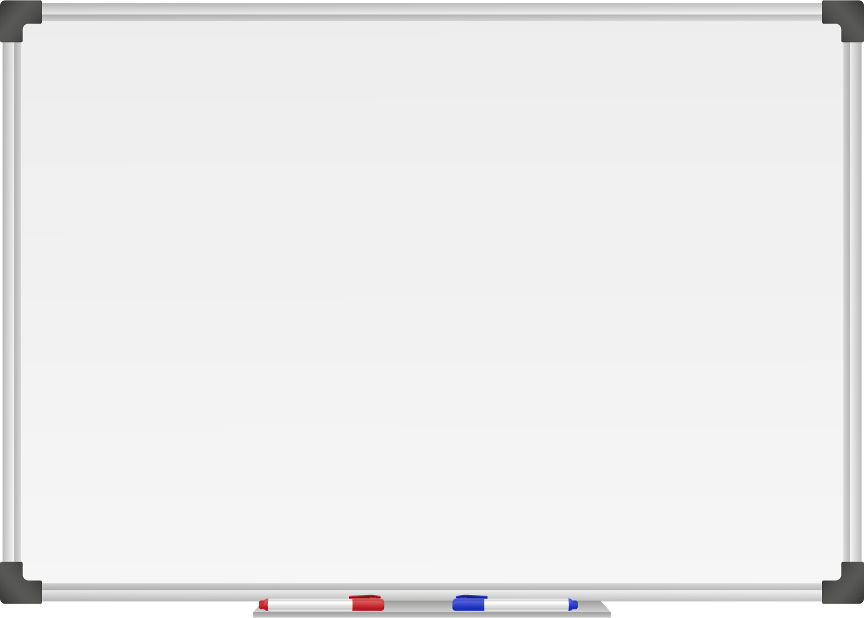







WELL DONE! You have unlocked number 3!
10 Ways to Move More Sit Less
  ____ __ ____ ____ ____
  ____ ___ __ ____ _ ___
  ____ ____ ____ ____ ____
  ____ ____ ____ ___ _ ____ ____
  ____ ________
  ____ ____ __ ____
  ____ ____ ____ ____ _ ____ _ ____
Morning Stretch
Walk, cycle or scoot to school
Play games with friends at break and lunch

Slide 7
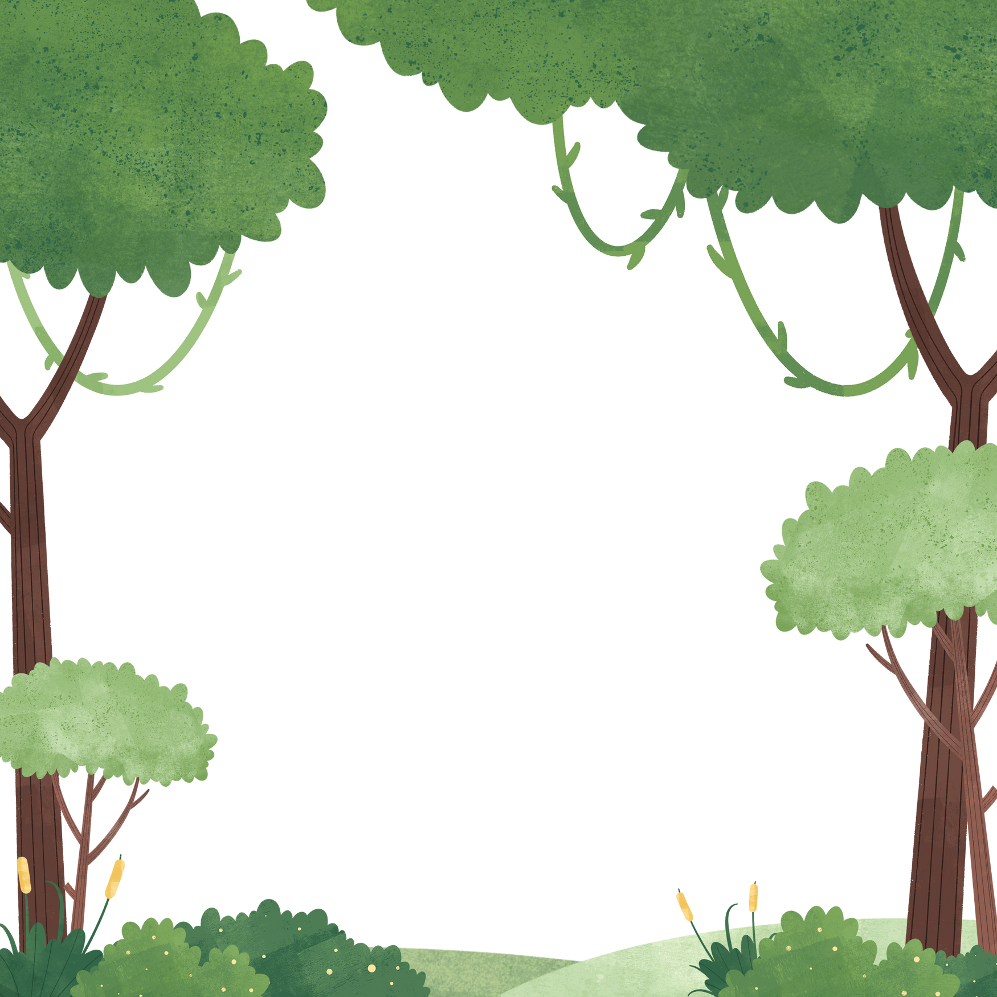

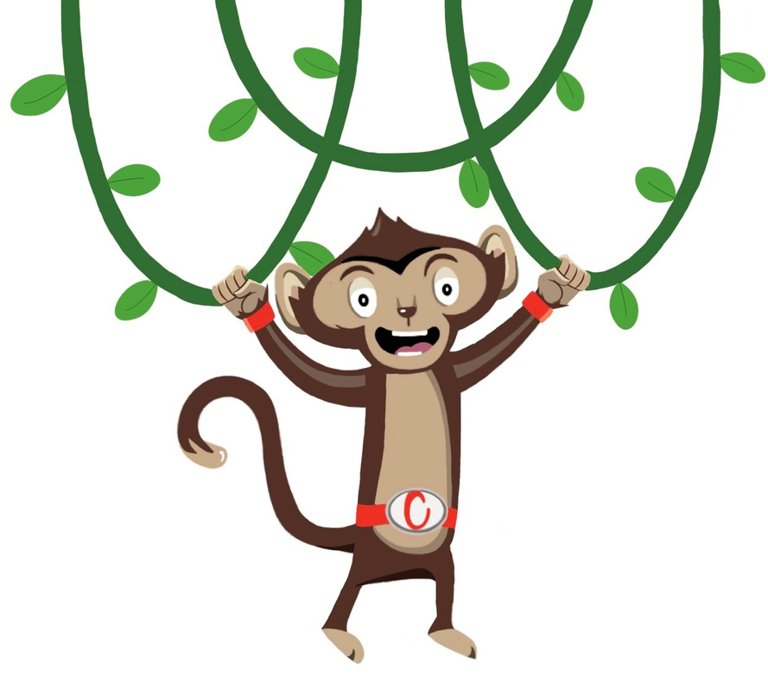

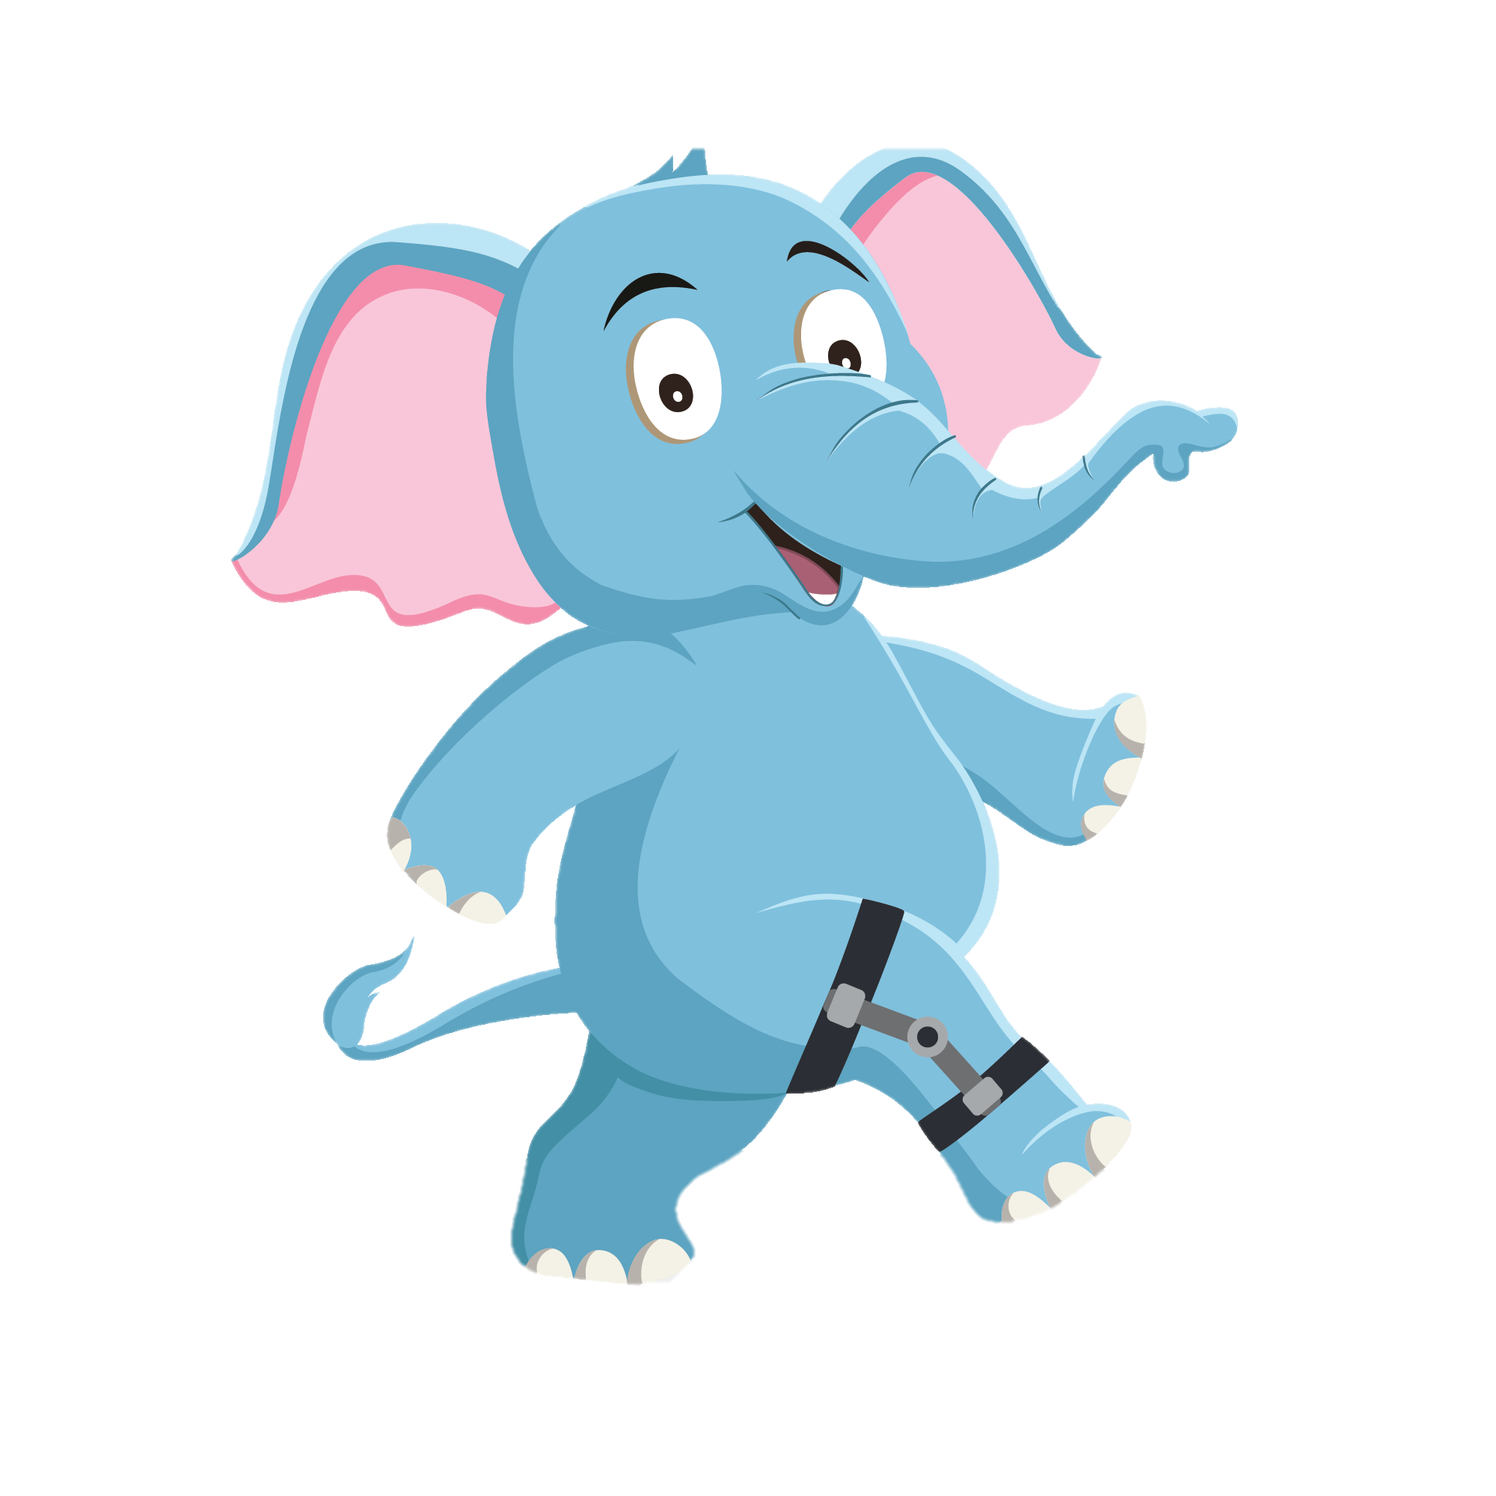
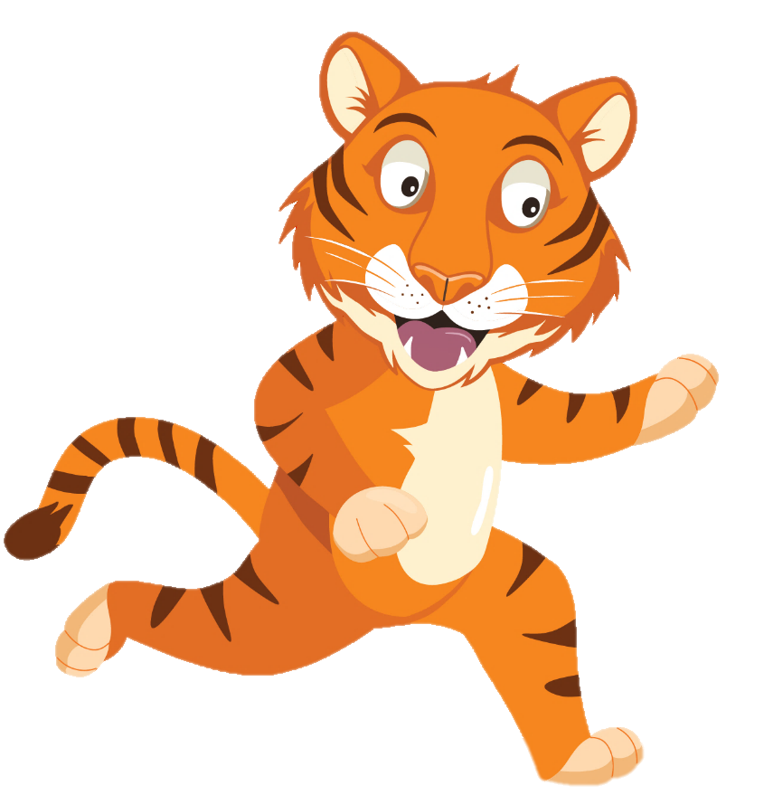
“I’ll get the ball, don’t worry”
“WOW! Timmy that kick was awesome”
“ Uh oh”
You have gained 3 healthy hearts!

Slide 8
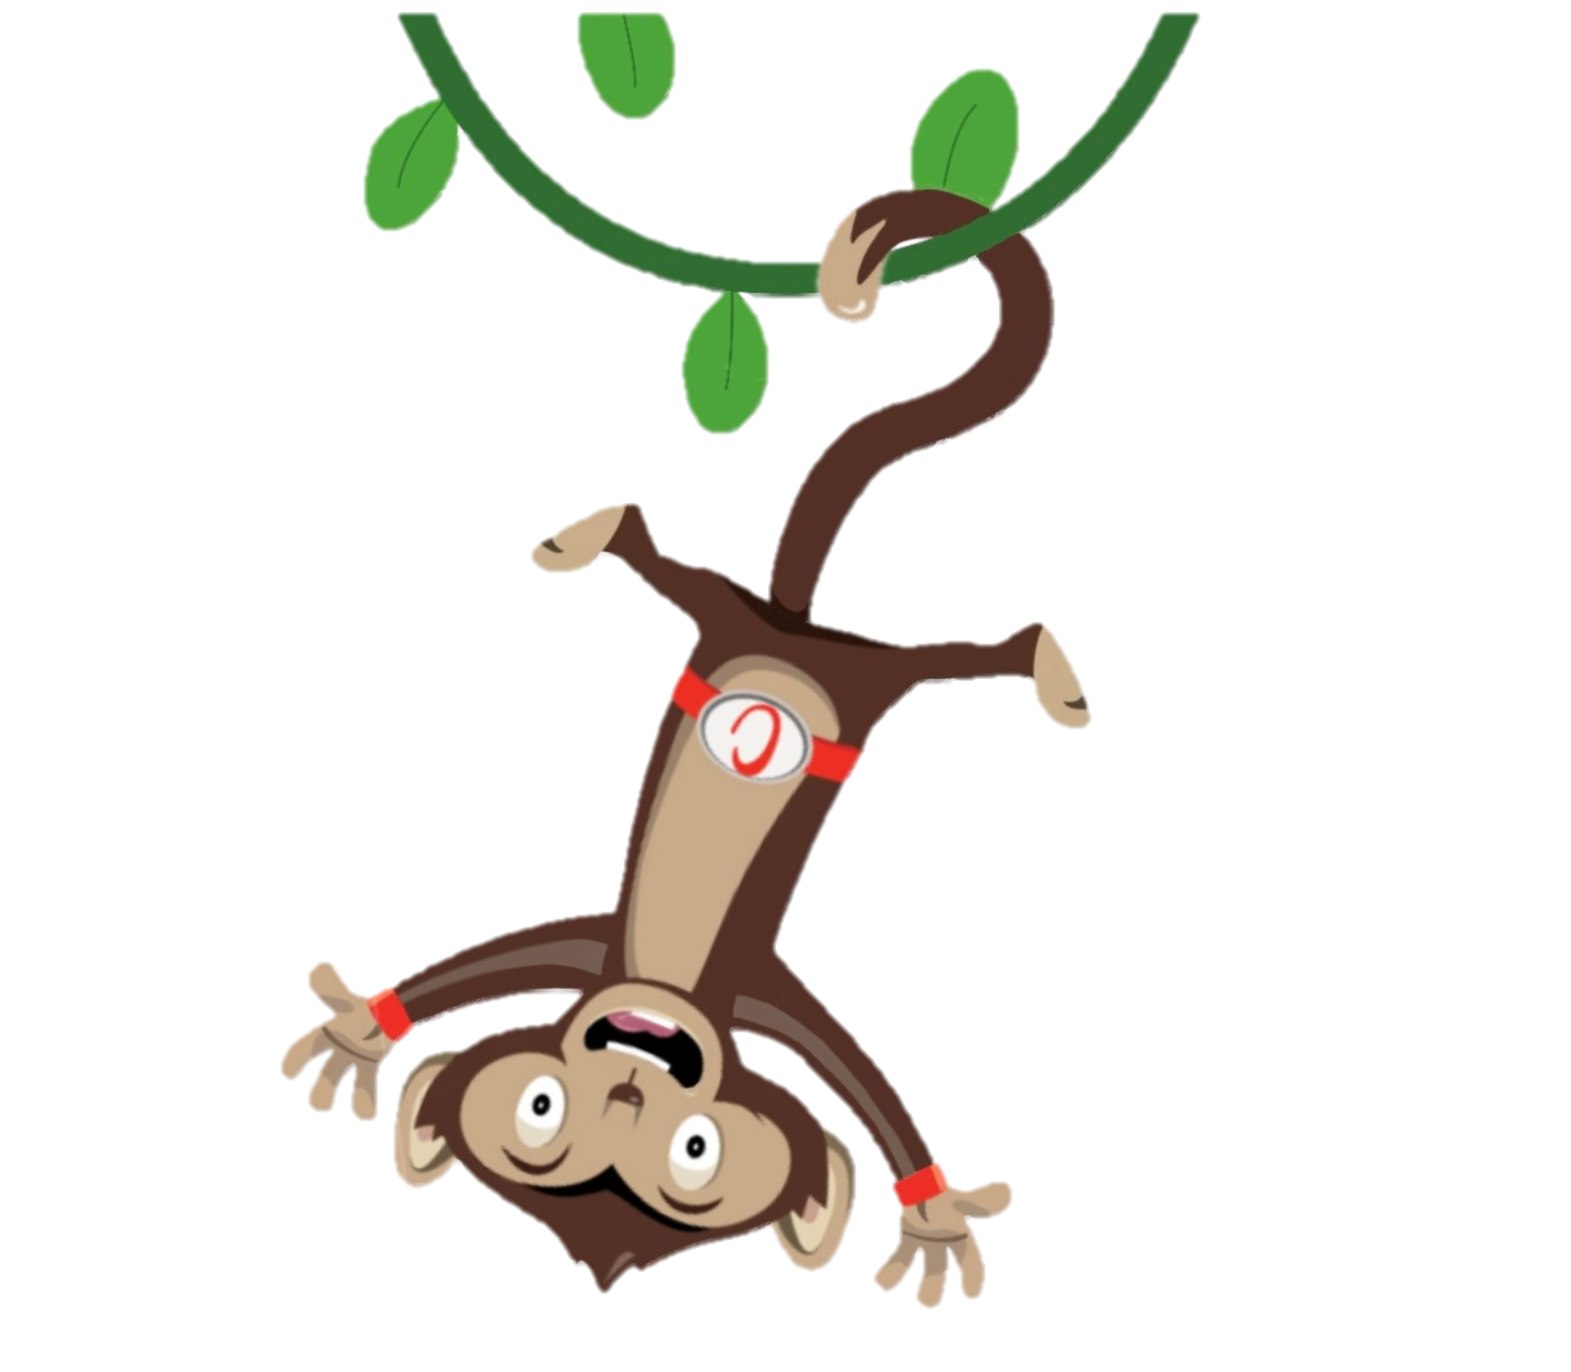
Monkey Madness
Playing games with your friends at break and lunch time is so much fun.
Moving more and sitting less keeps us healthy.
Why not try a Monkey Madness Activity
Notes:
This week why not try one of our monkey madness activities each day and have fun with your friends.

