Slide 1
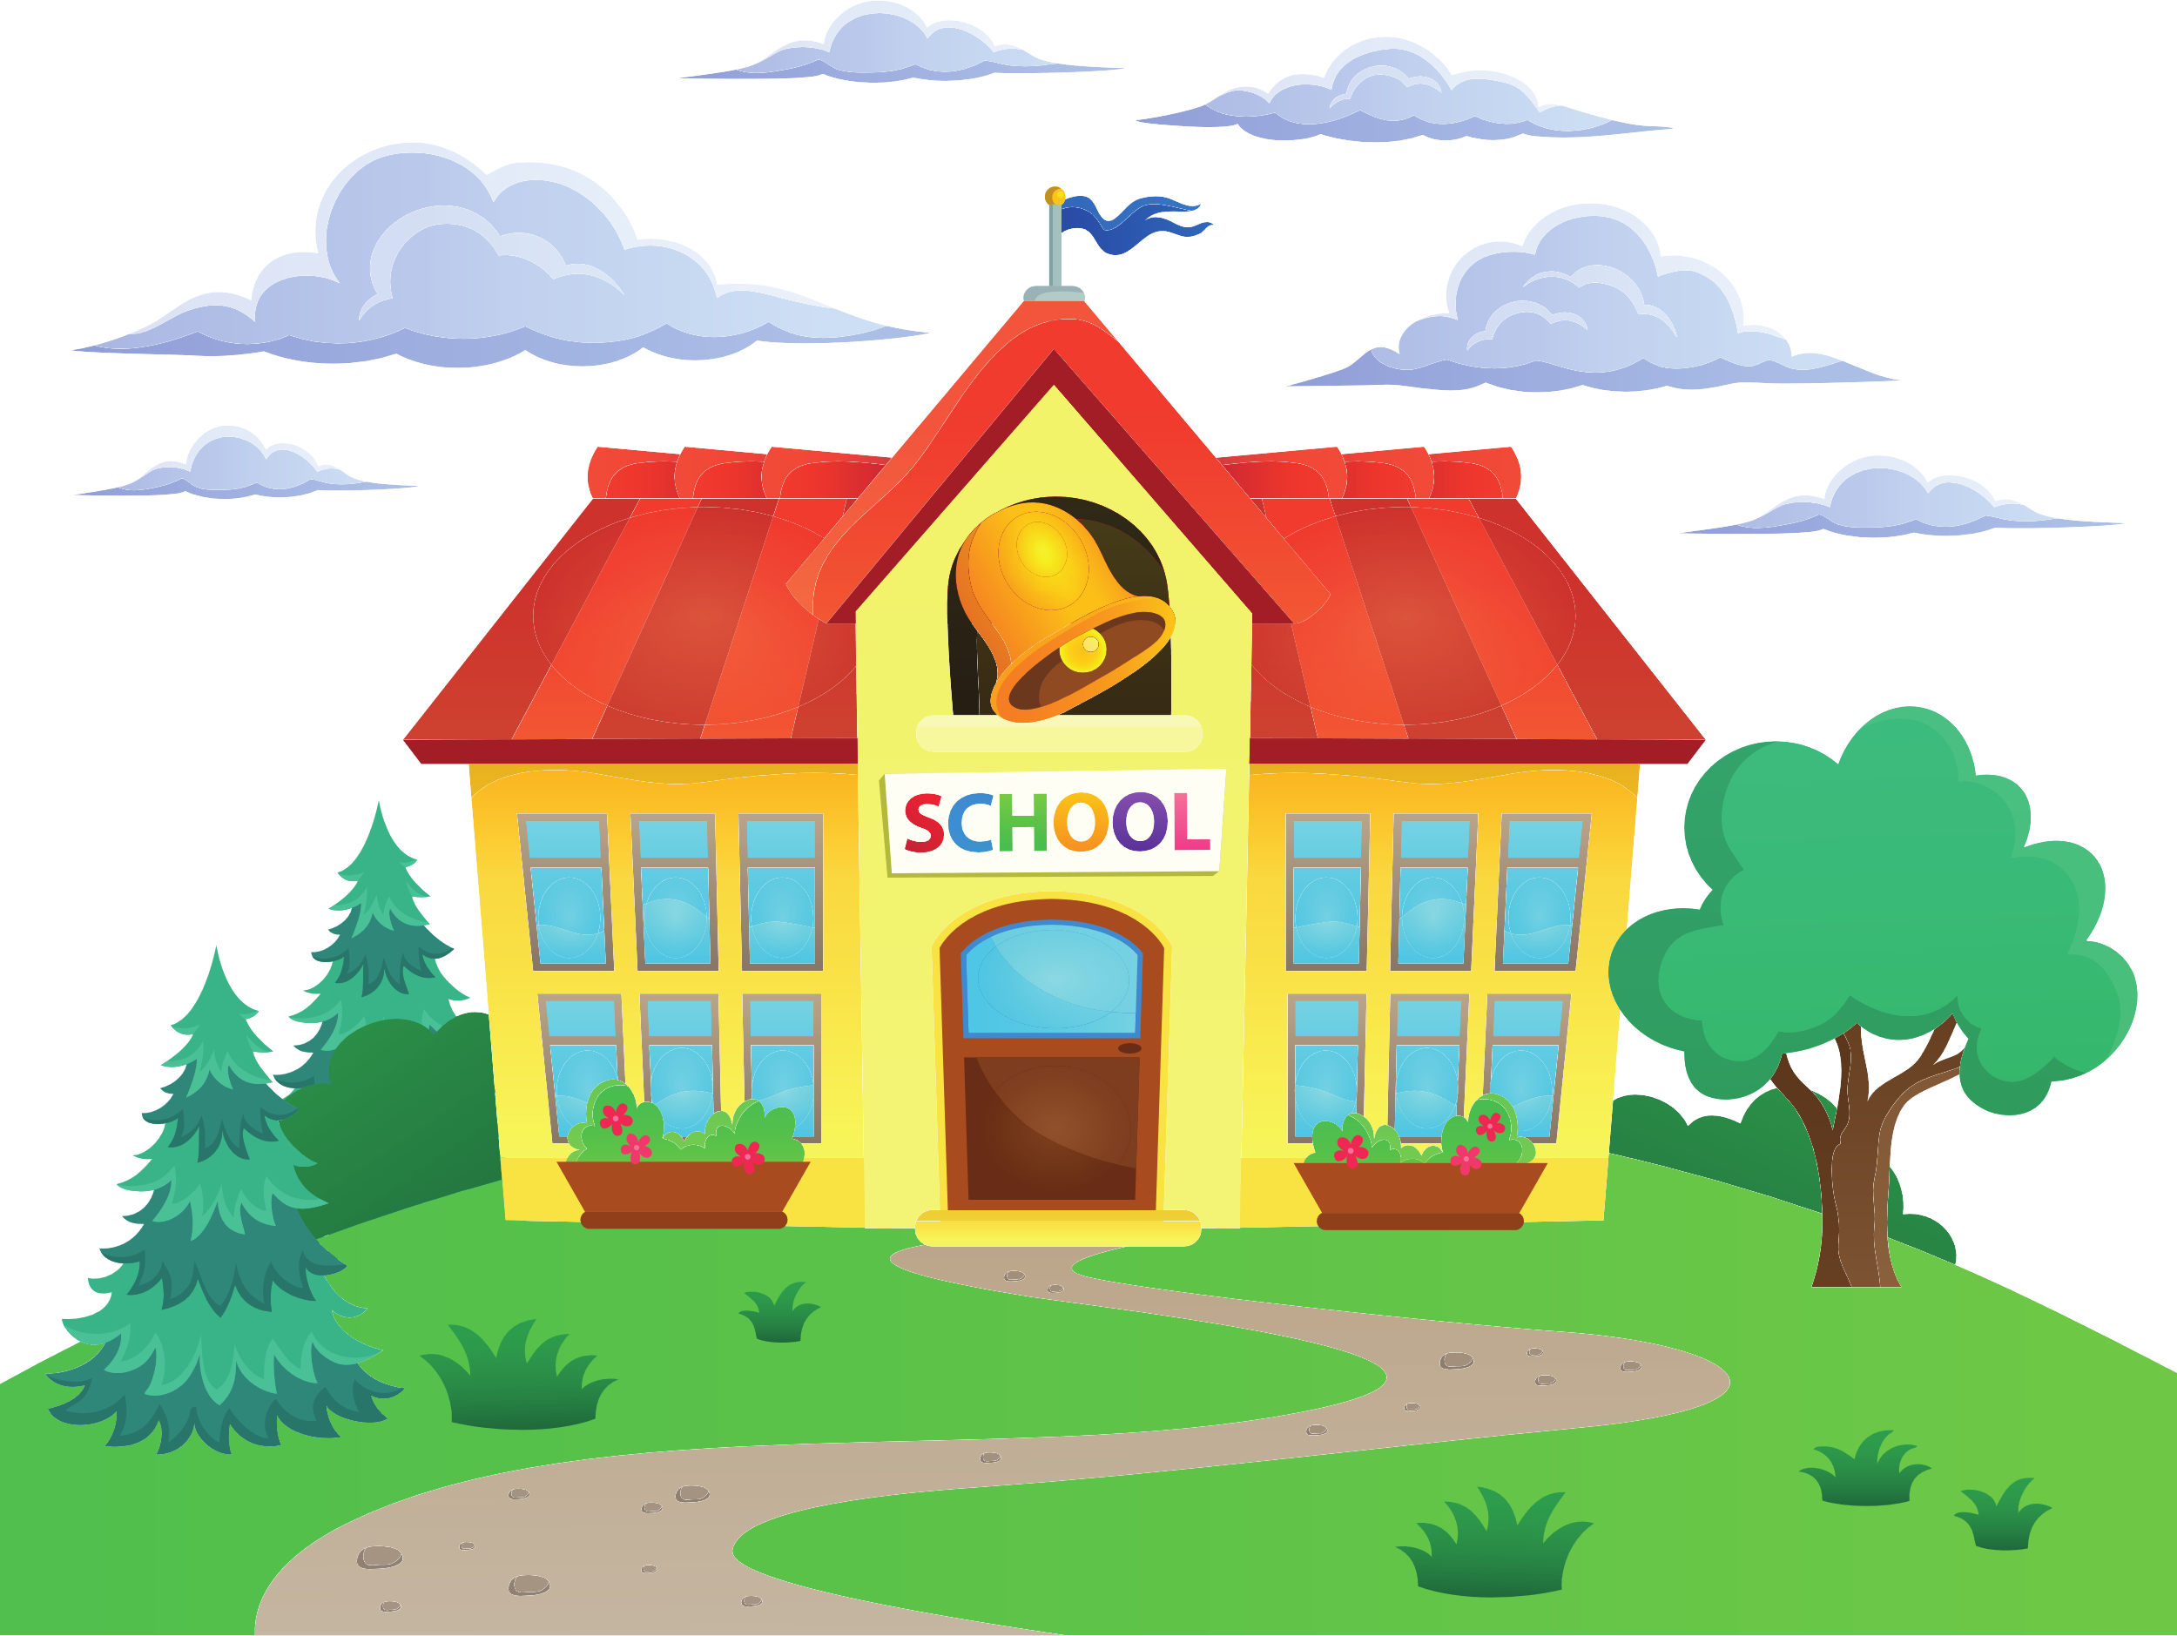
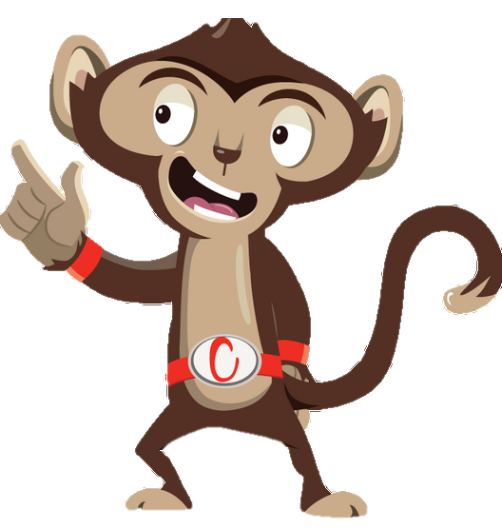


Chester’s Active Quest: Week 3

Slide 2
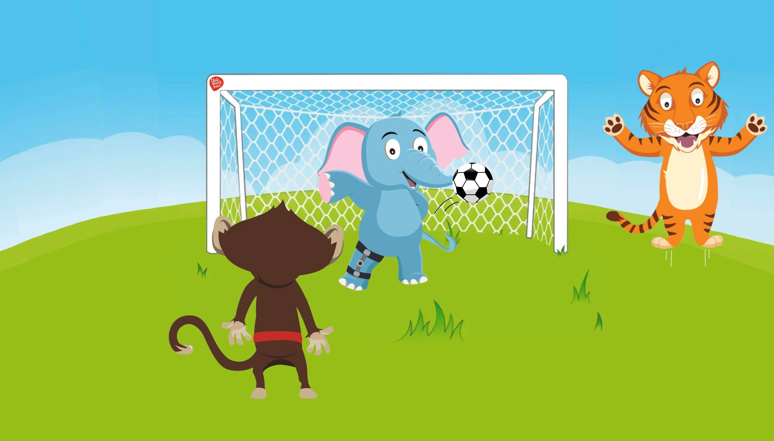

Notes:
The sun is shining outside in the grassy playground. Chester and Timmy love to play football together at breaktime. Chester has been practicing a new trick, where he uses his agile monkey moves to pass the ball to Timmy. The ball soars through the air, bounces off the wall and lands beside Ellie the elephant, who looks very sad. They ask if she wants to join in. She shakes her head and says quietly, “I’d like to, but I’m not very fast because of my leg”. Timmy and Chester know exactly what to do. They don’t want Ellie to feel left out so they include her in their game. Chester says, “We can play a new ball game and make our own rules together”. Ellie smiles and says, “Can I be the goalkeeper?”. She steps into the goal and gets ready. Timmy kicks the ball towards her, she swishes her trunk and quickly blocks the ball. It was so fast that it took them a moment to find the ball. Timmy and Chester are amazed, “Well Done Ellie! That was great!” they shout. Everyone in the playground joined in celebrating and cheering Ellie’s fantastic save. Playing together with your friends at break and lunch is a great way of having fun and moving more and sitting less.

Slide 3
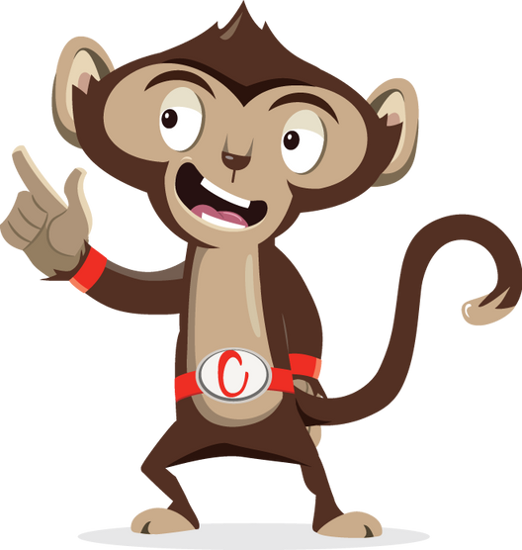
How can you keep moving at break and lunch time?
1
2
3
Notes:
Ask pupils to answer the question while standing. If pupils think the answer is A = they stand with their hands on their head, B = stand with arms crossed and C = stand with both hands in the air. If space is not limited, put the letters A, B and C around the room and ask pupils to move to the area they think the answer is.

Slide 4

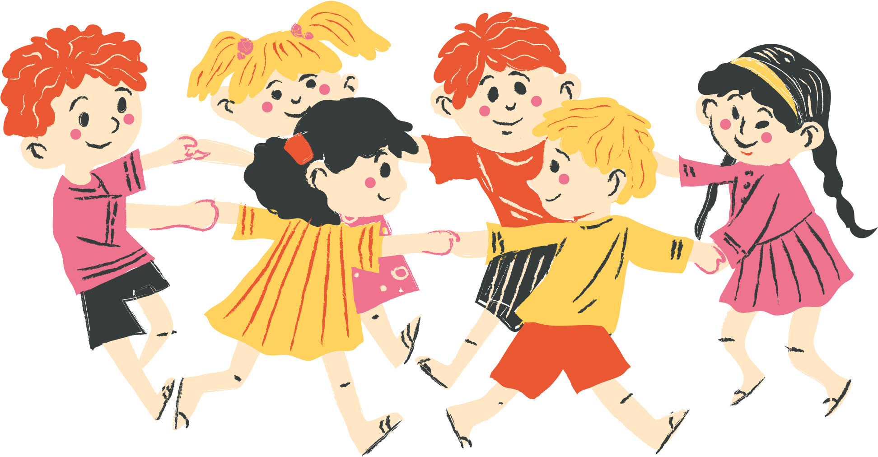
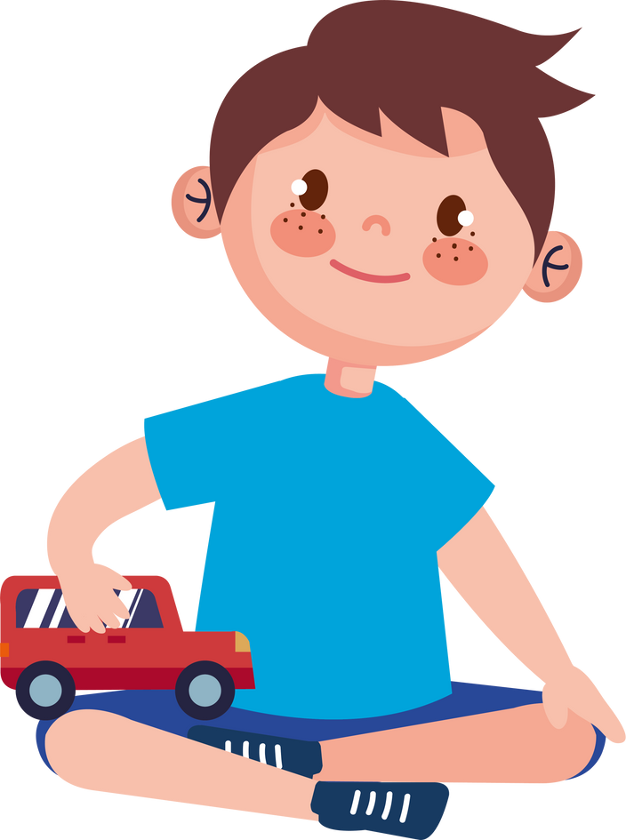
How can you keep moving at break and lunch time?
1
Sit down and relax
2
Play games with friends
3
Play with my toys

Slide 5
How can you keep moving at break and lunch time?
2
Play games with friends
Notes:
Record: Playing games with friends at break and lunch time is a great way to have fun and keep moving. Just like Chester, Timmy and Ellie playing football and having a great time. It helps us move more and sit less.

Slide 6
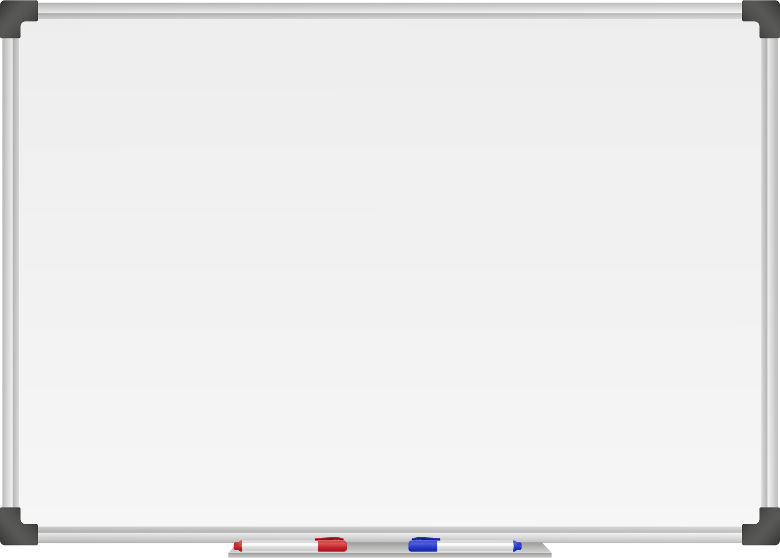







WELL DONE! You have unlocked number 3!
10 Ways to Move More Sit Less
  ____ __ ____ ____ ____
  ____ ___ __ ____ _ ___
  ____ ____ ____ ____ ____
  ____ ____ ____ ___ _ ____ ____
  ____ ________
  ____ ____ __ ____
  ____ ____ ____ ____ _ ____ _ ____
Morning Stretch
Walk, cycle or scoot to school
Play games with friends at break and lunch

Slide 7
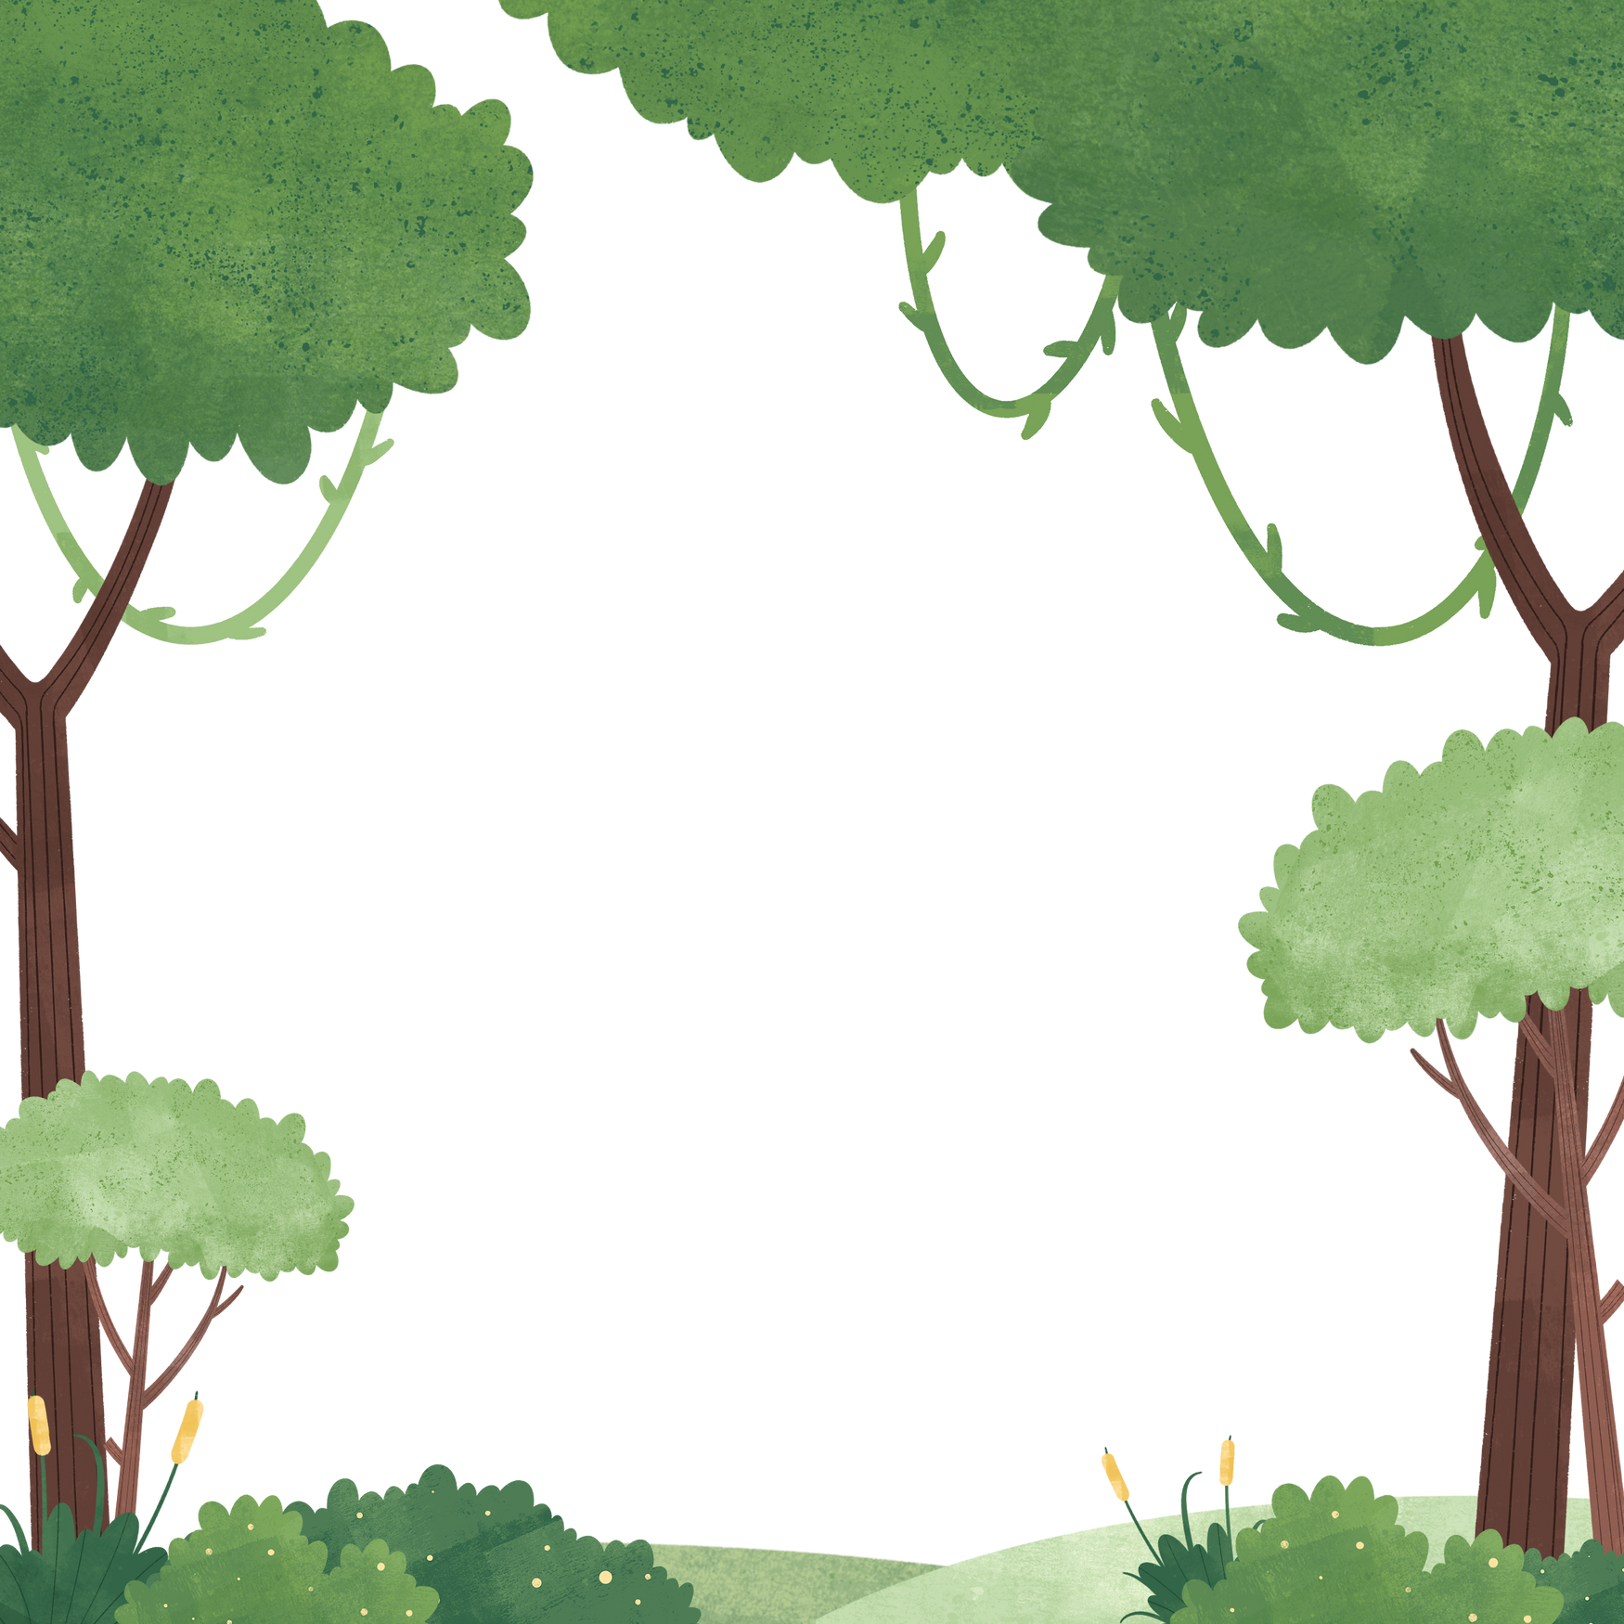

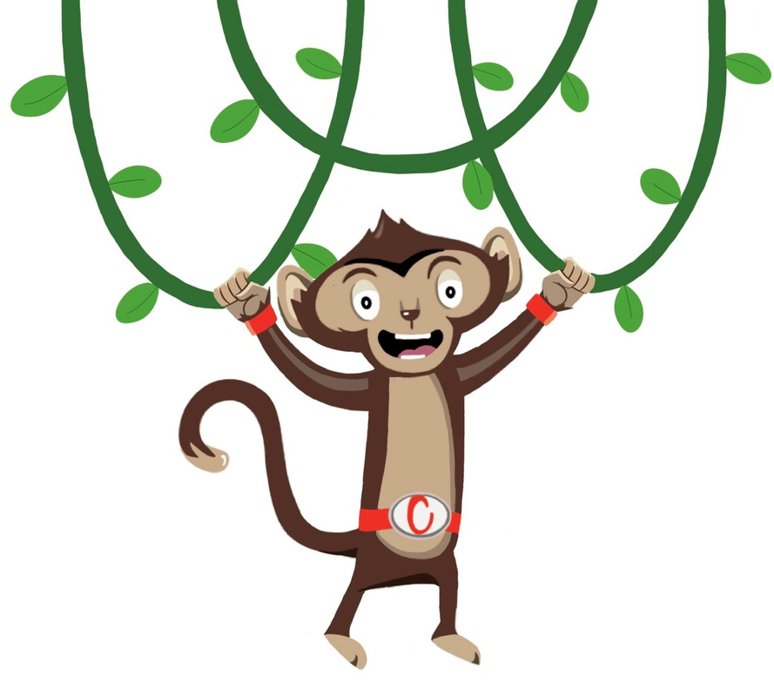

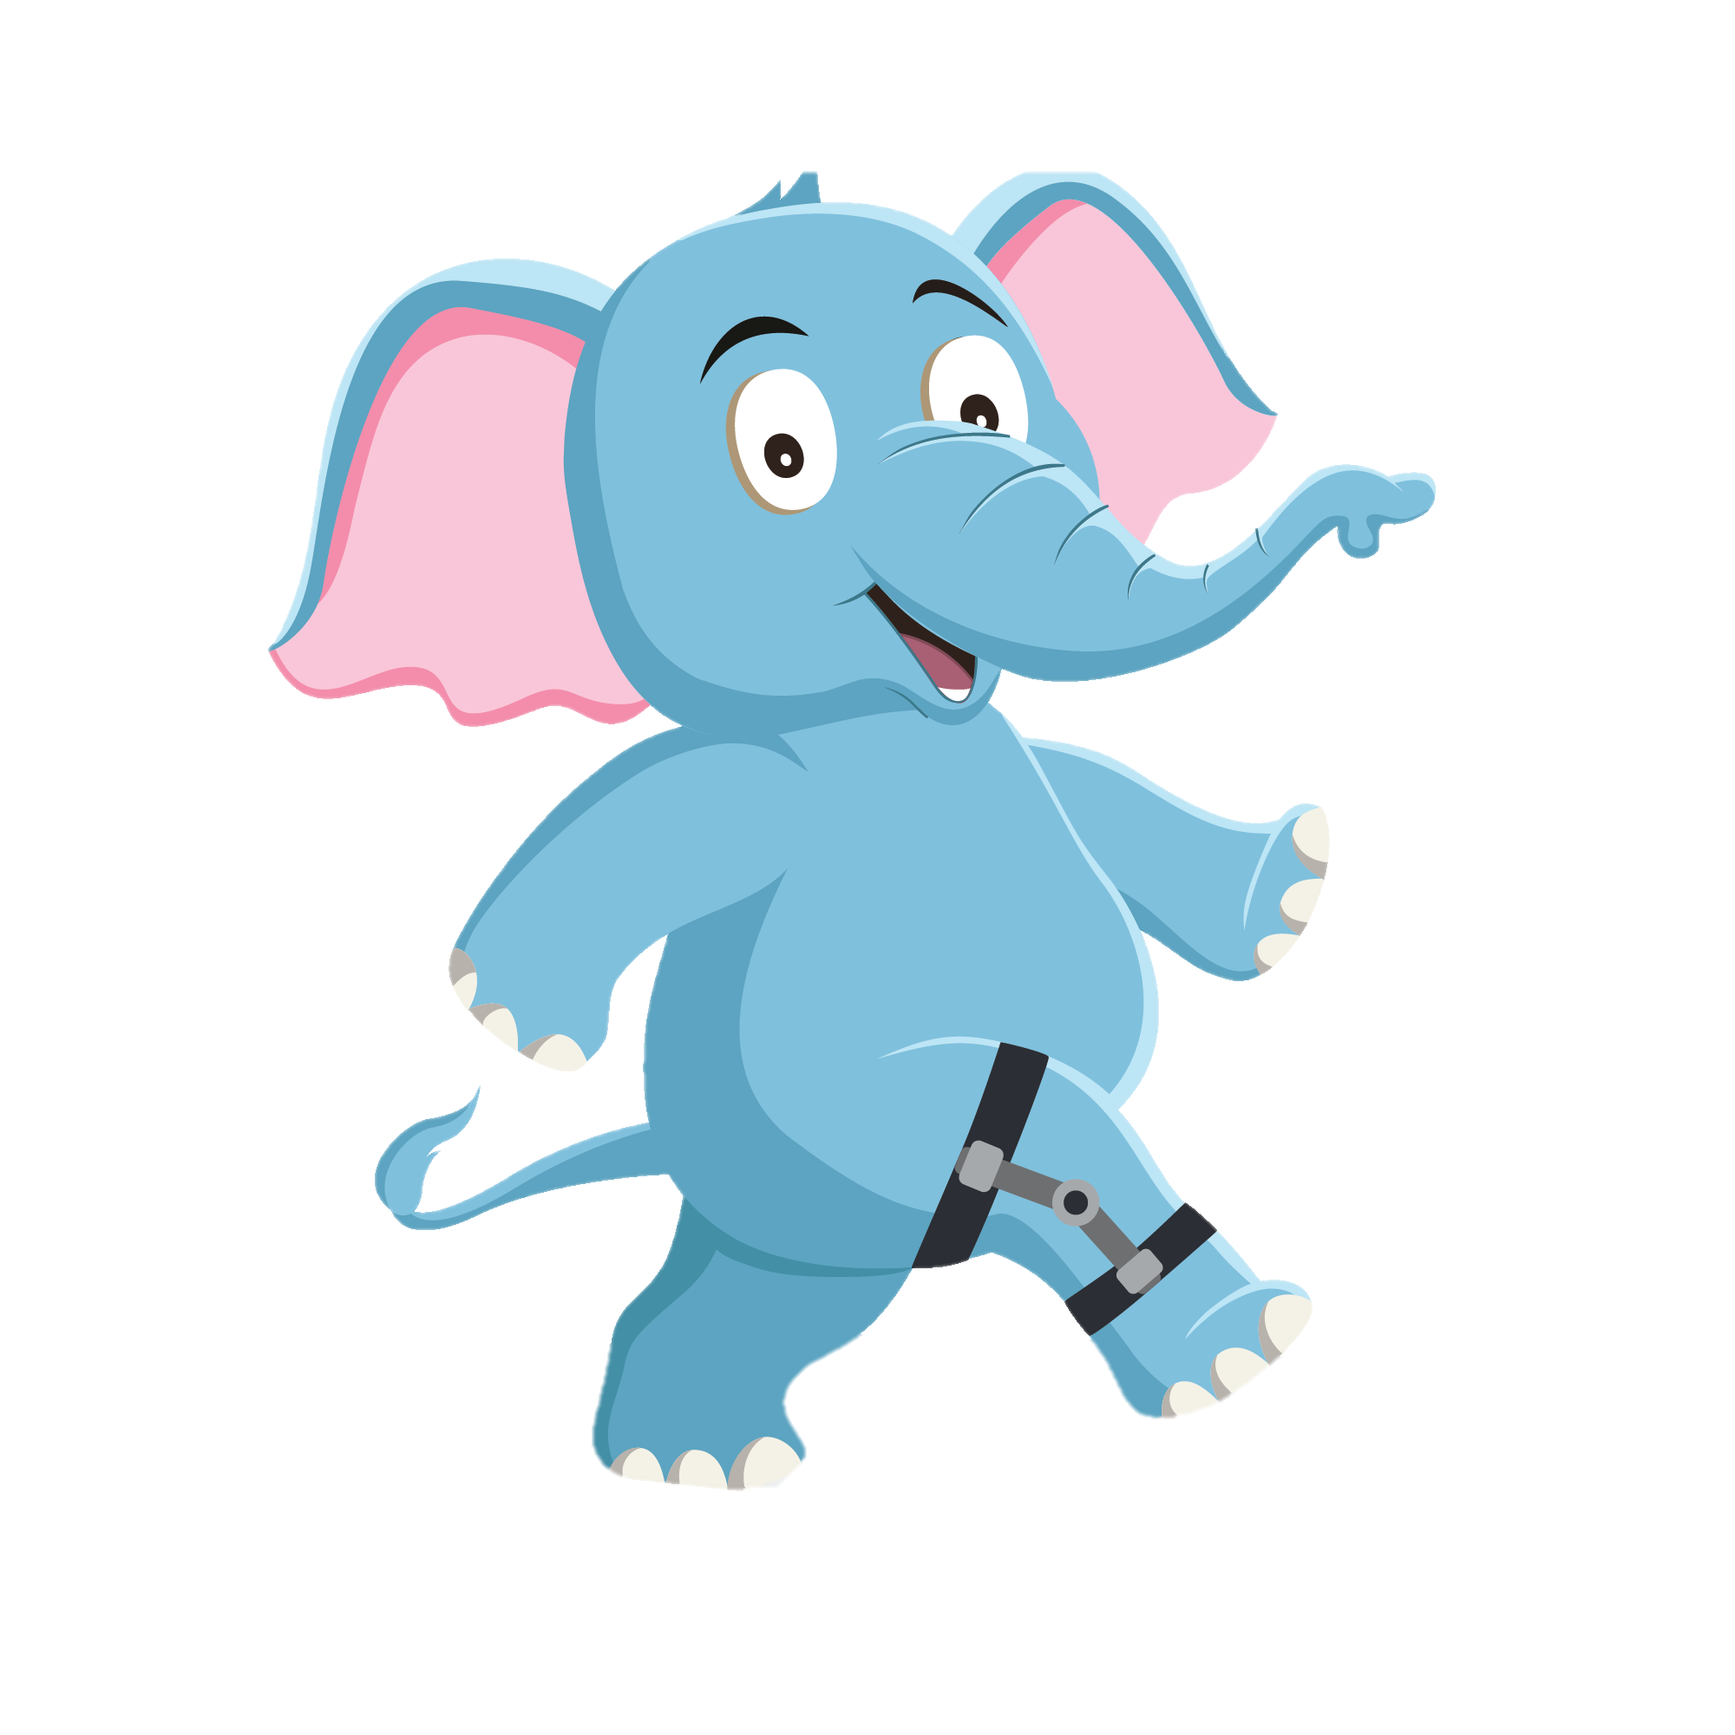
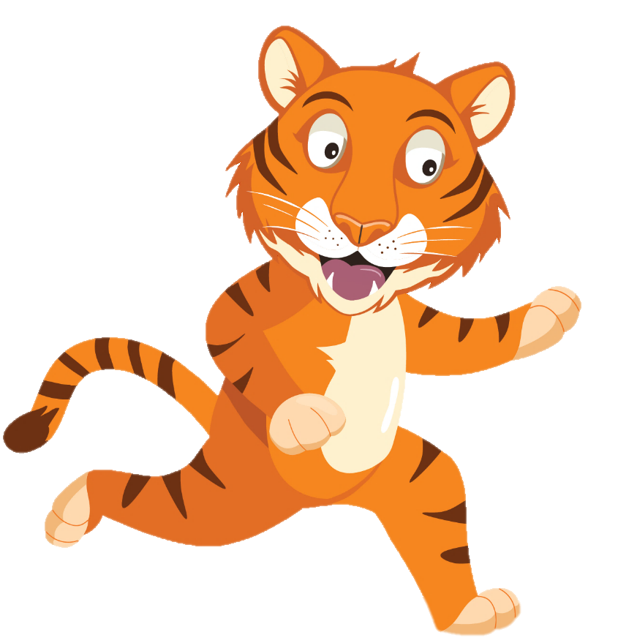
“I’ll get the ball, don’t worry”
“WOW! Timmy that kick was awesome”
“ Uh oh”
You have gained 3 healthy hearts!

Slide 8
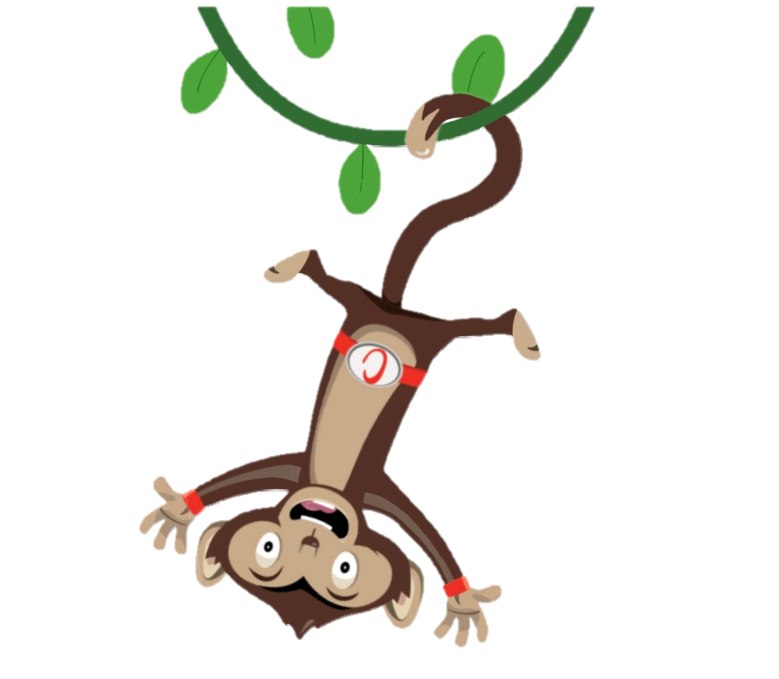
Monkey Madness
Moving more and sitting less keeps our bodies healthy.
Why not try a Monkey Madness Activity
Notes:
This week why not try one of our monkey madness activities each day and have fun with your friends.

