Slide 1
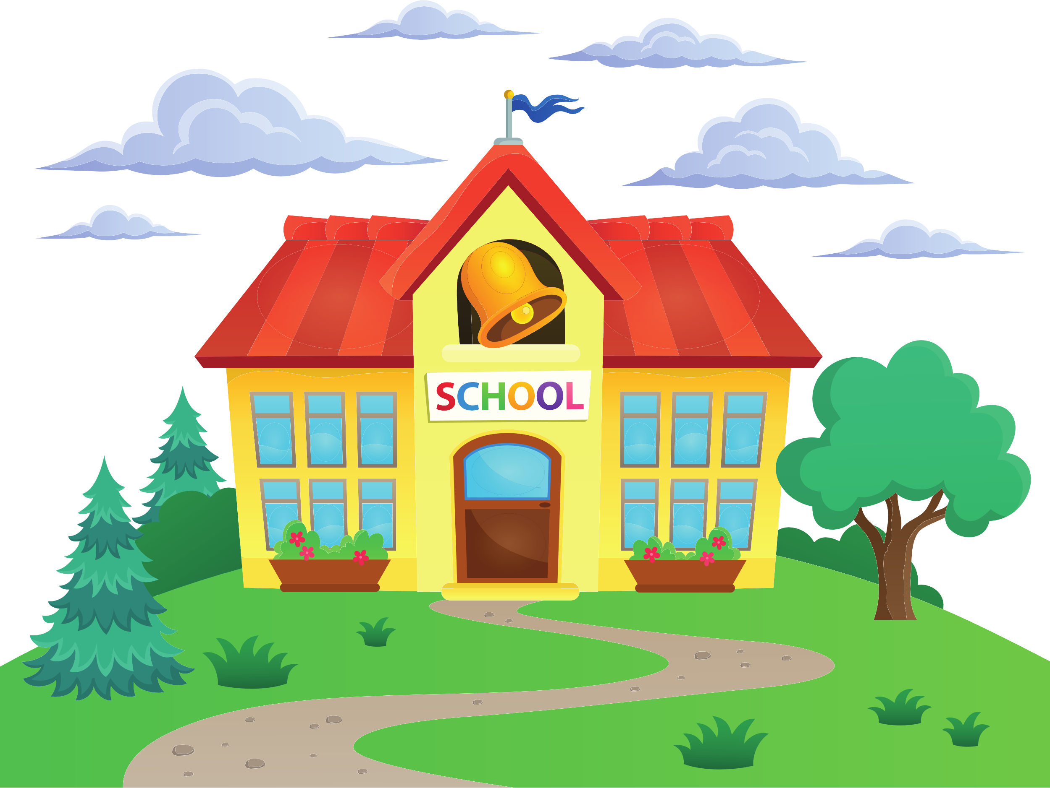
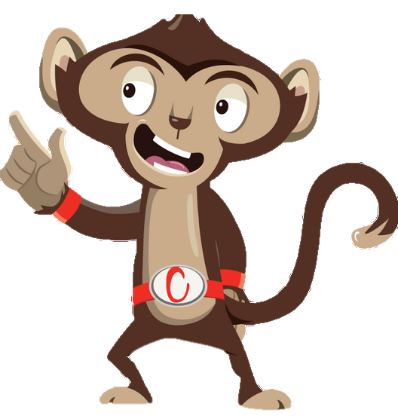


Chester’s Active Quest: Week 3

Slide 2
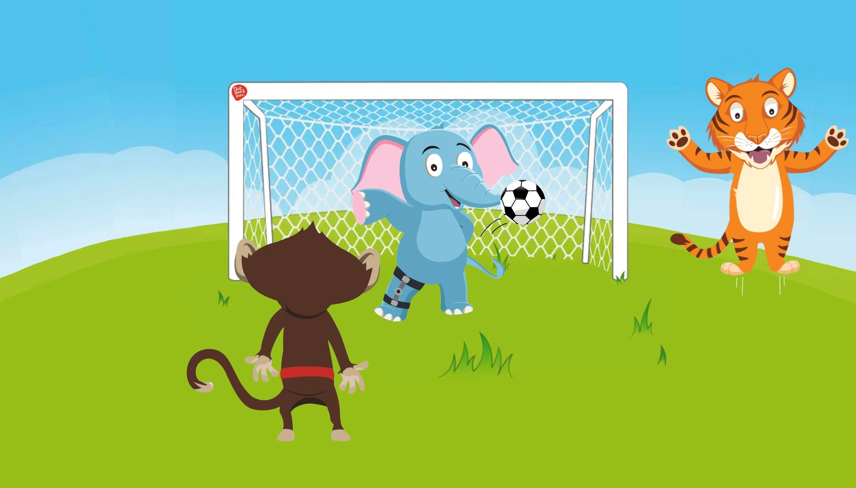

Notes:
The sun is beaming through the trees on the grassy playground. Chester and Timmy love to play football together at breaktime. Chester uses a nearby tree to do an incredible pass (that he’s been practicing at home) towards Timmy. The ball is so fast it soars through the air. It flies past Timmy, bounces off the wall and lands beside Ellie the elephant, who looks very sad. They ask if she wants to join in. She shakes her head and says quietly, “I’d like to, but I’m not very fast because of my leg”. Chester and Timmy know that it is important that no one feels left out in the playground.
Chester says, “We can play a new ball game and make our own rules together”. Ellie smiles and says, “Can I be the goalkeeper?”. She steps into the goal and gets ready. Timmy tries to score a goal with a swift kick, but in one quick motion Ellie swooshes her trunk and blocks the ball. Sending ti flying towards the other end of playground. What a save. Timmy and Chester shouts “Wow Ellie that was amazing”. Everyone in the playground joins in a cheer to celebrate. Playing together with your friends at break and lunch is a great way of staying active, having fun and keeping your body healthy.

Slide 3
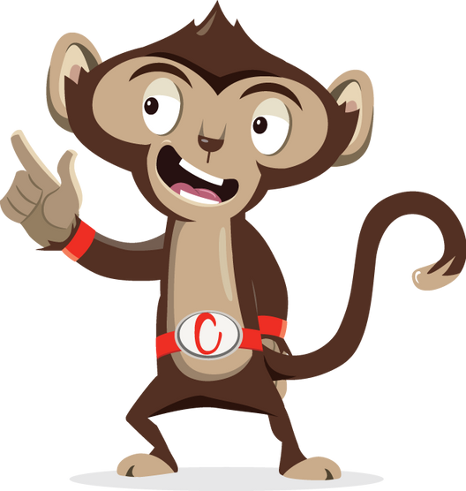
Why is it important to stay active with friends during break and lunch time?
1
2
3
Notes:
Ask pupils to answer the question while standing. If pupils think the answer is A = they stand with their hands on their head, B = stand with arms crossed and C = stand with both hands in the air. If space is not limited, put the letters A, B and C around the room and ask pupils to move to the area they think the answer is.

Slide 4
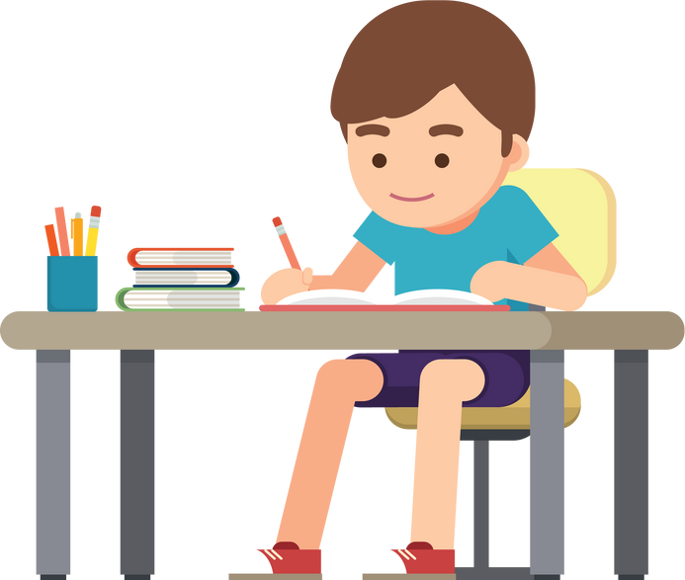
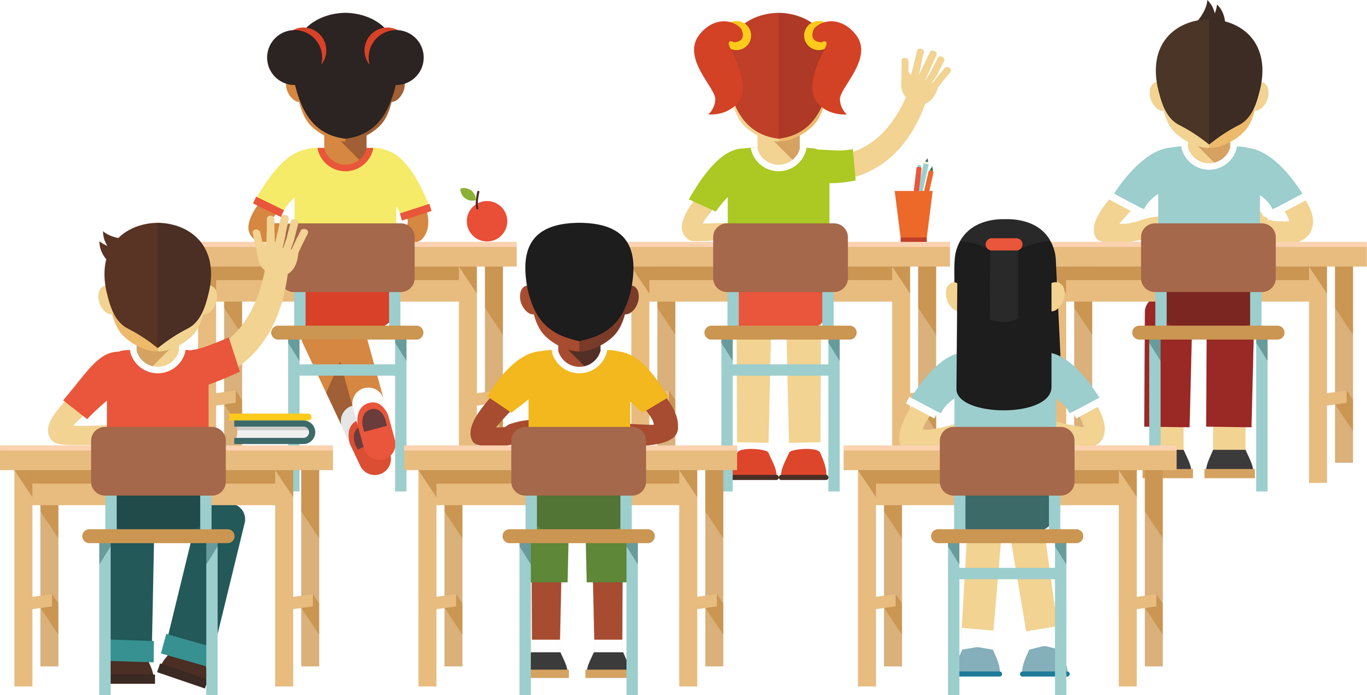
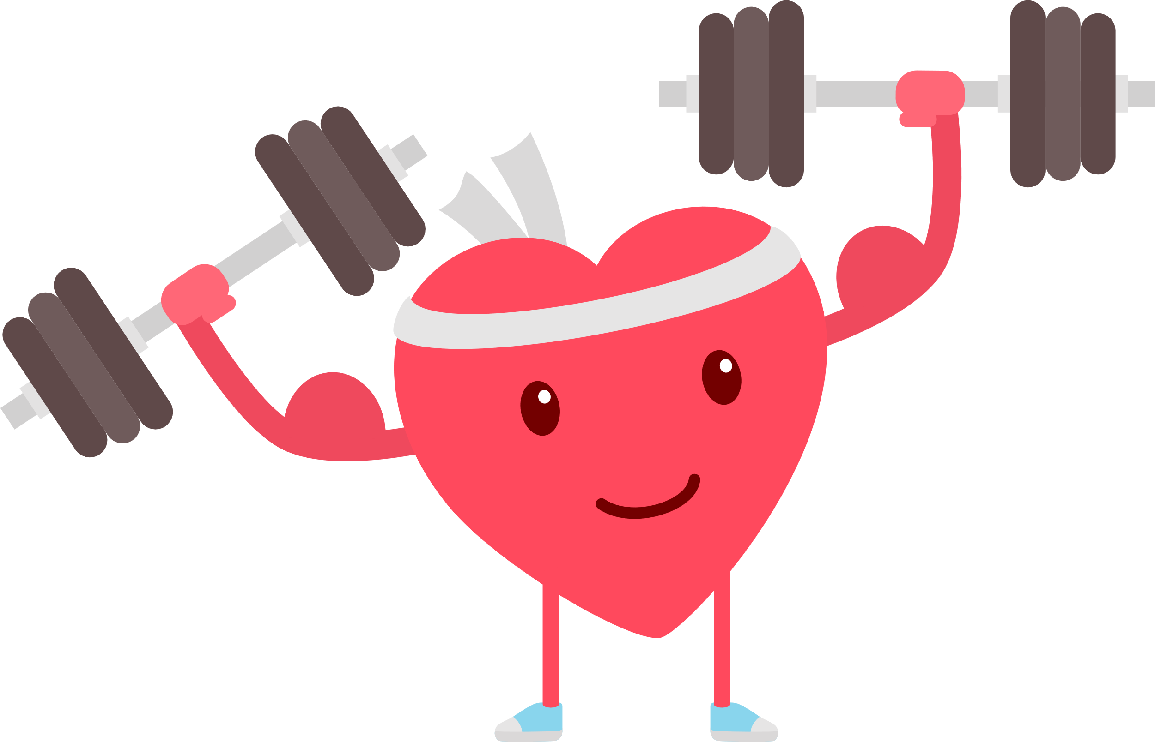
Why is it important to stay active with friends during break and lunch time?
1
You will be able to do homework faster
2
You will do well in class tests
3
It keeps your heart healthy

Slide 5
Why is it important to stay active with friends during break and lunch time?
3
It keeps your heart healthy

Slide 6
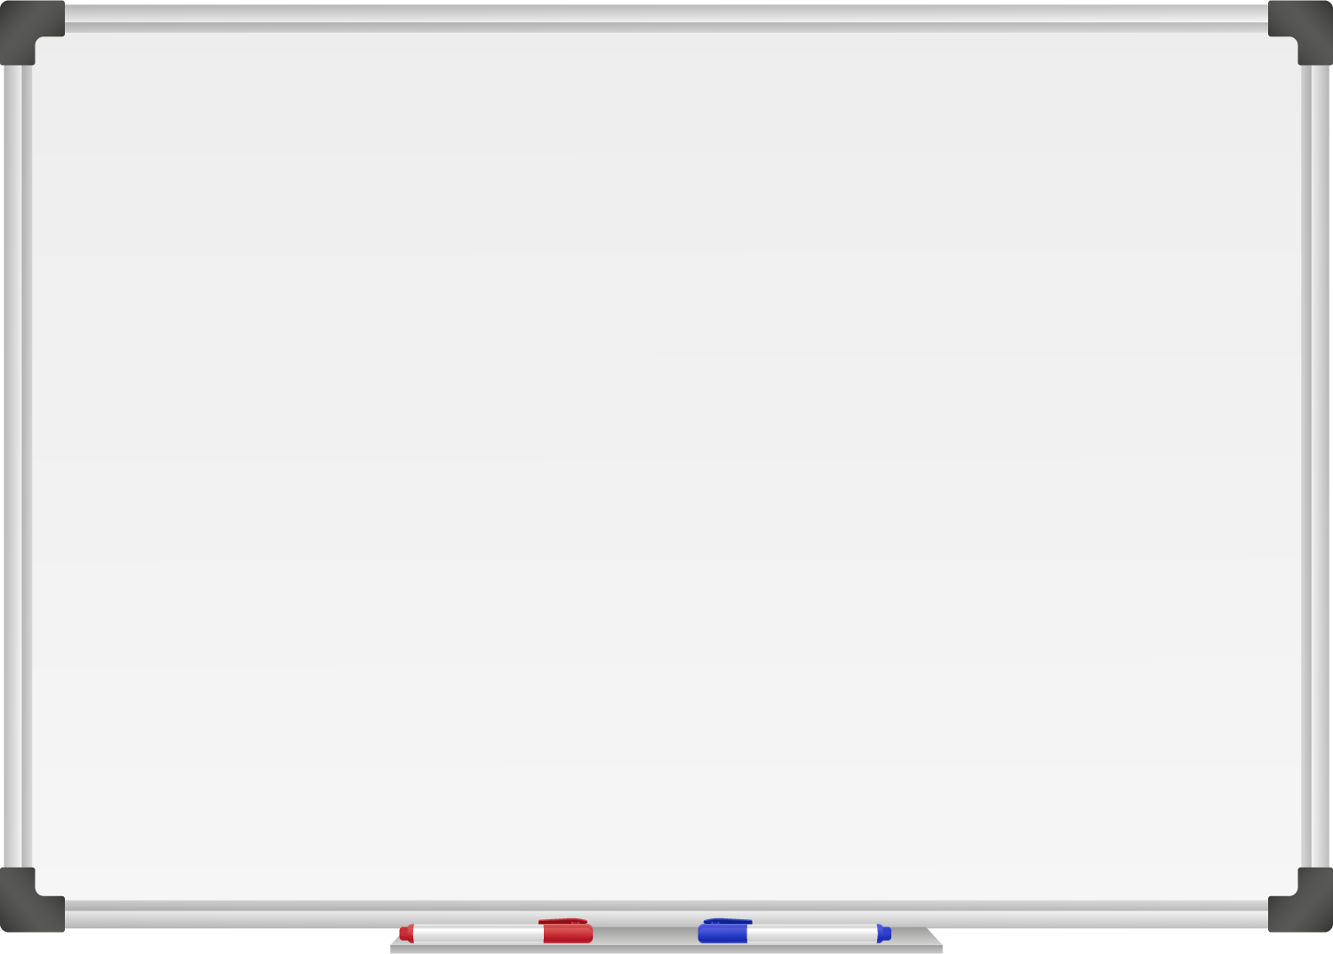







WELL DONE! You have unlocked number 3!
10 Ways to Move More Sit Less
  ____ __ ____ ____ ____
  ____ ___ __ ____ _ ___
  ____ ____ ____ ____ ____
  ____ ____ ____ ___ _ ____ ____
  ____ ________
  ____ ____ __ ____
  ____ ____ ____ ____ _ ____ _ ____
Morning Stretch
Walk, cycle or scoot to school
Play games with friends at break and lunch

Slide 7
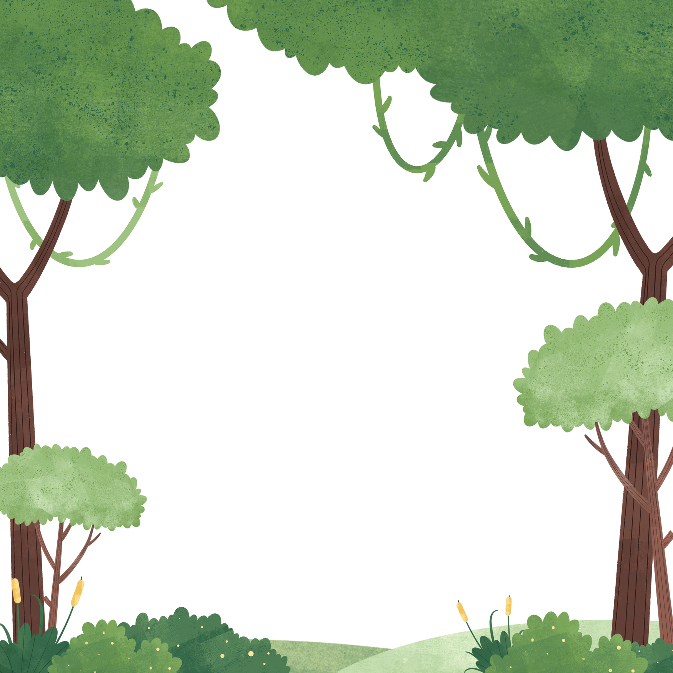

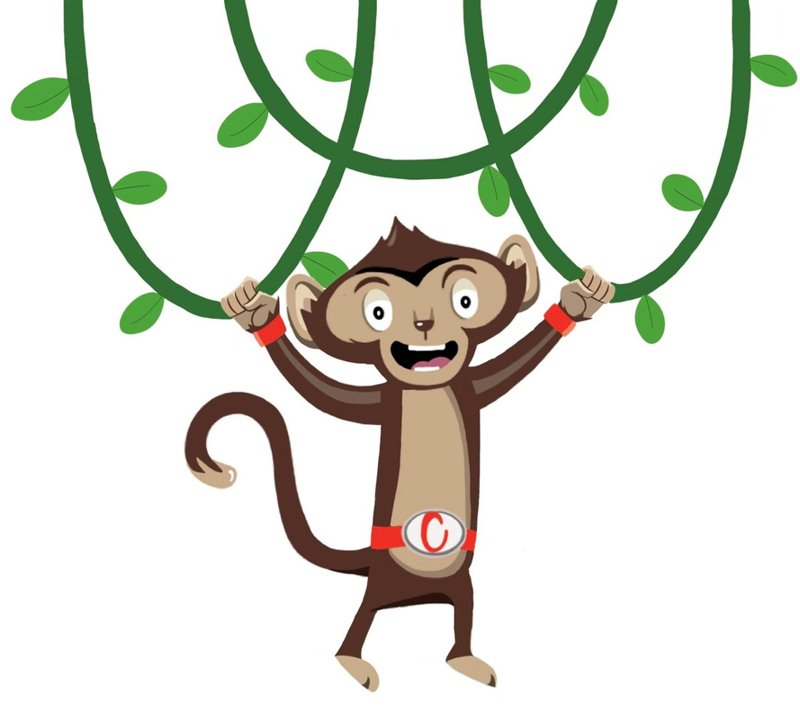

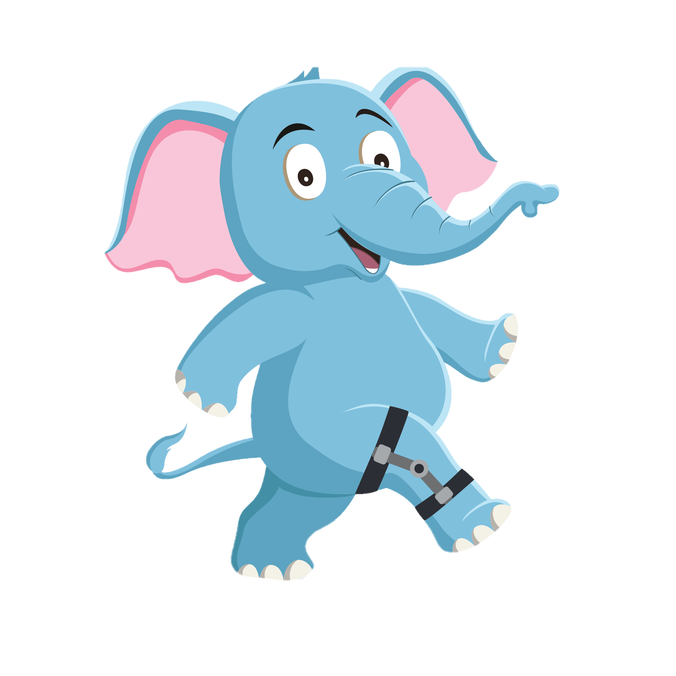
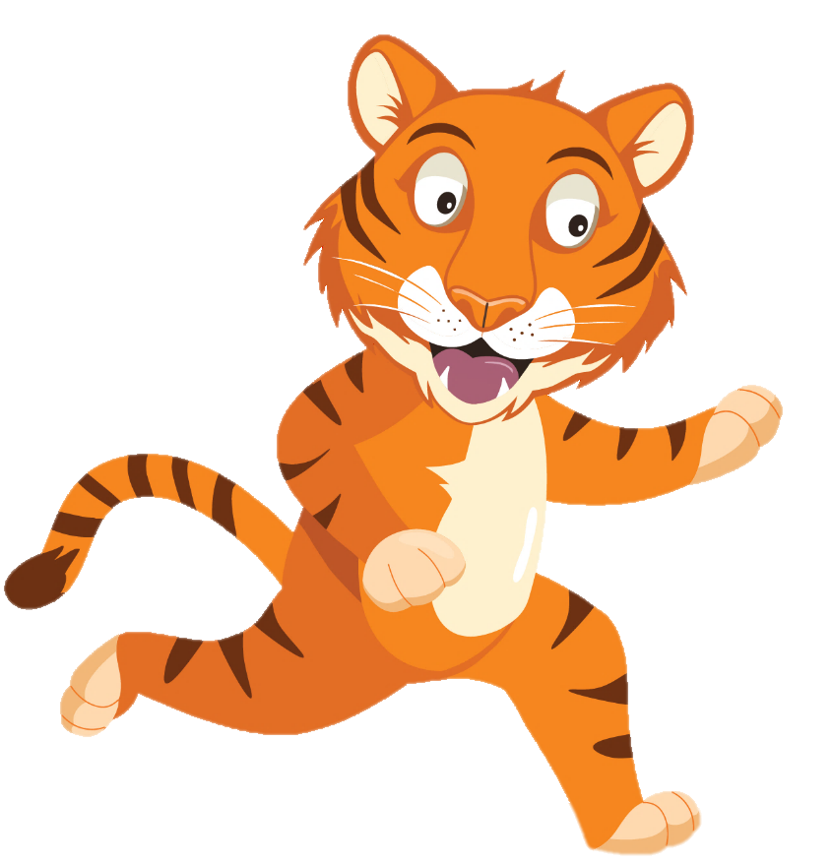
“I’ll get the ball, don’t worry”
“WOW! Timmy that kick was awesome”
“ Uh oh”
You have gained 3 healthy hearts!

Slide 8
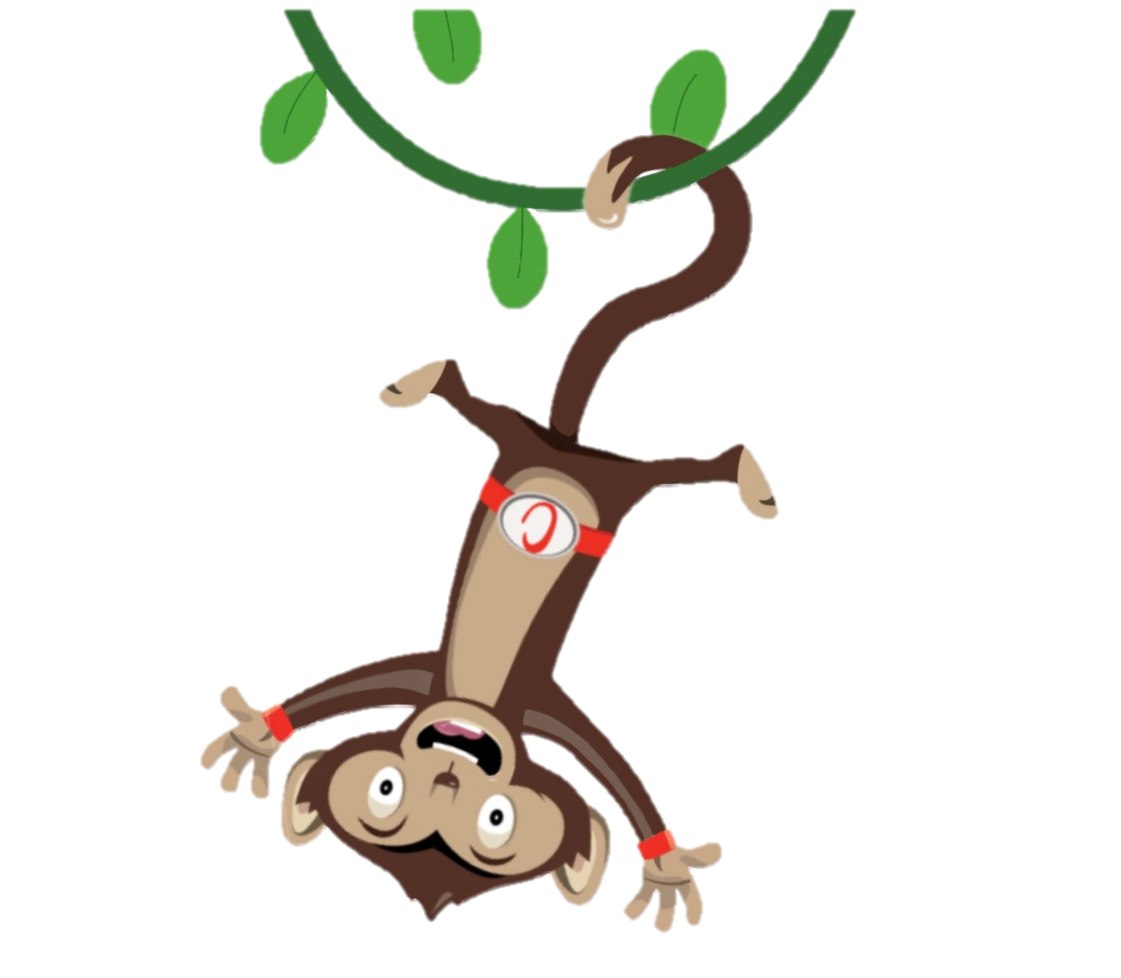
Monkey Madness
Moving more and sitting less keeps our hearts healthy.
Why not try a Monkey Madness Activity
Notes:
This week why not try one of our monkey madness activities each day and have fun with your friends.

