Slide 1

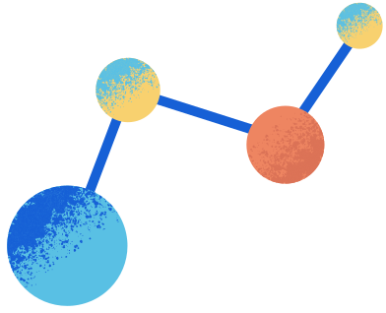

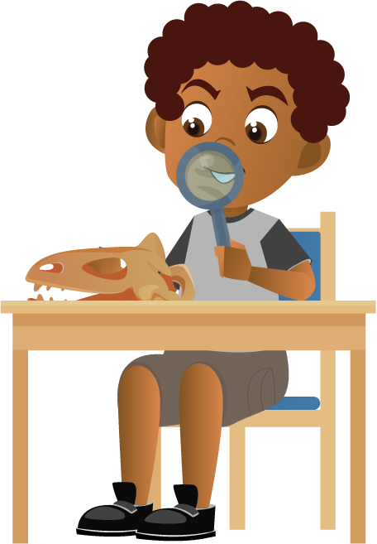
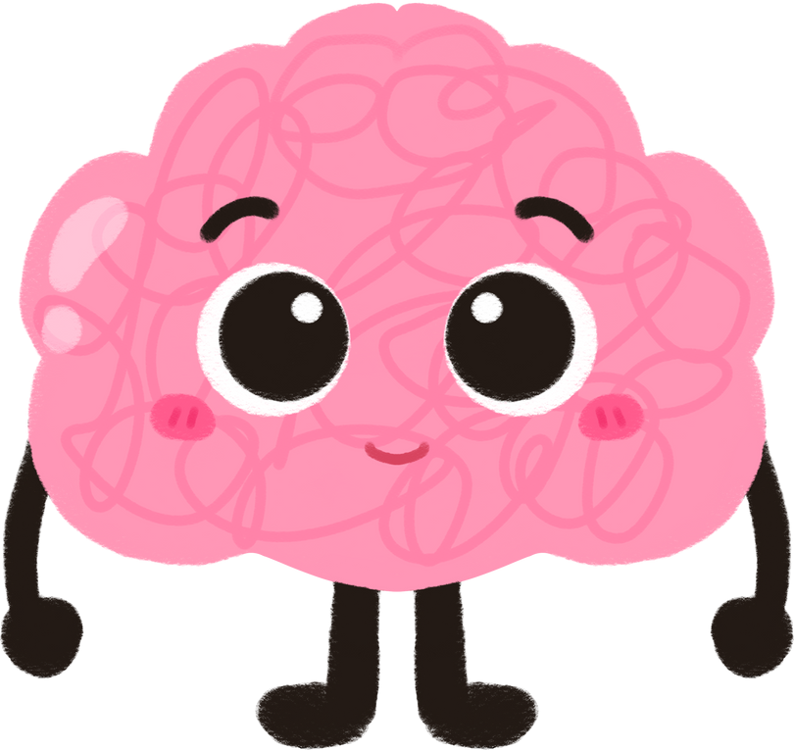


Take Care of Your Body
Notes:
Talking Points:
Hi class, we will be starting our unit today on e-cigarettes, other tobacco products, and nicotine!
Let's begin our first lesson today, it's called: take care of your body. Weʻll look at what happens to a body that smokes.

Slide 2



Topics
Wants, needs, addiction, and nicotine
How nicotine affects the body
What is Nicotine?
Notes:
Talking Points:
Today we will cover the following topics:
(Teacher Note): Read from slides

Slide 3
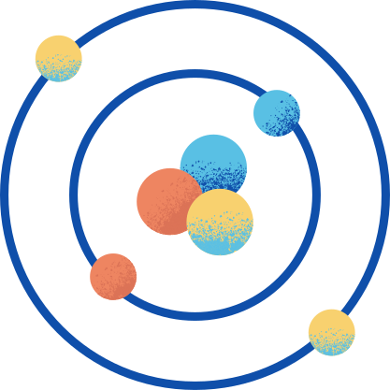
I WILL LEARN...
The effects of
e-cigarette chemicals on the body
About the chemical called nicotine
About the other chemicals in e-cigarette aerosol
Notes:
Talking Points:
Here's what we will learn:
(Teacher Note): Read from slides.

Slide 4


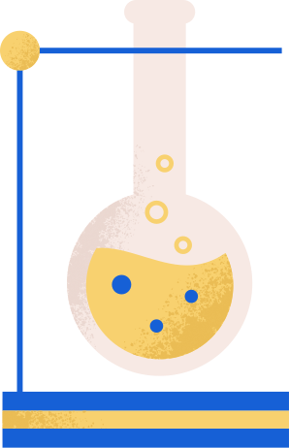
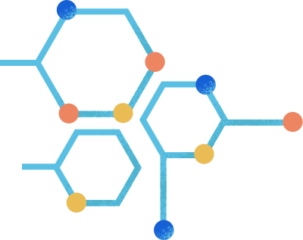
SHOUT OUT ACTIVITY:
1.WHAT DO YOU KNOW ABOUT NICOTINE AND
E-CIGARETTES?
2.WHAT DO YOU WANT TO KNOW?
Notes:
Talking Points:
(Ask Students): Shout out: what do you know about nicotine and e-cigarettes? (Pause for a few responses)
Ok, now what do you want to know about nicotine and e-cigarettes that you don't know yet?
(Pause for a few responses, and write answers on the board or a piece of paper)
Ok! You all have some great ideas, let's move on.

Slide 5


KEY TERMS
Chemical: A compound or substance that has been made artificially.
Drug: A medicine or substance that has an effect on the body.
Notes:
Talking Points:
Here are our key terms for this lesson! Keep these in mind as we continue.
(Teacher Note): Read definitions on slide or pick one or two students to read aloud.
Ok, now let's answer the question about what nicotine is.

Slide 6



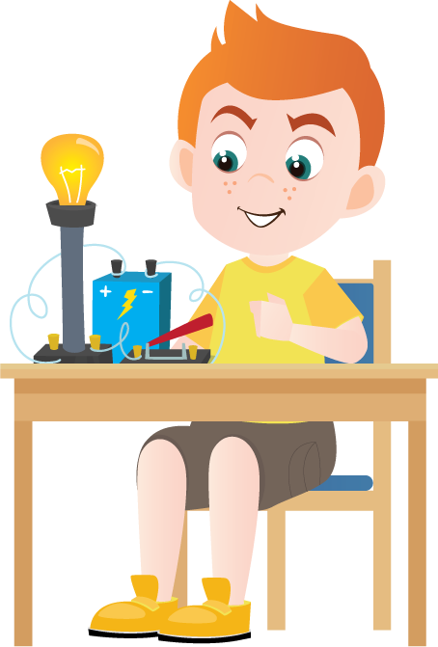



Nicotine is the chemical found in the tobacco plant.
It is usually "smoked" in cigarettes or "vaped" in e-cigarettes.
Notes:
Talking Points:
Nicotine is the chemical found in the tobacco plant.
It is usually "smoked" in cigarettes or cigars (burned) or "vaped" in e-cigarettes (electronically heated).
When inhaled into the lungs, nicotine travels to your brain. When in your brain, the chemicals trick your brain into feeling good. This can sometimes cause problems.
So, why are we concerned about the brain? (Take a few responses).

Slide 7
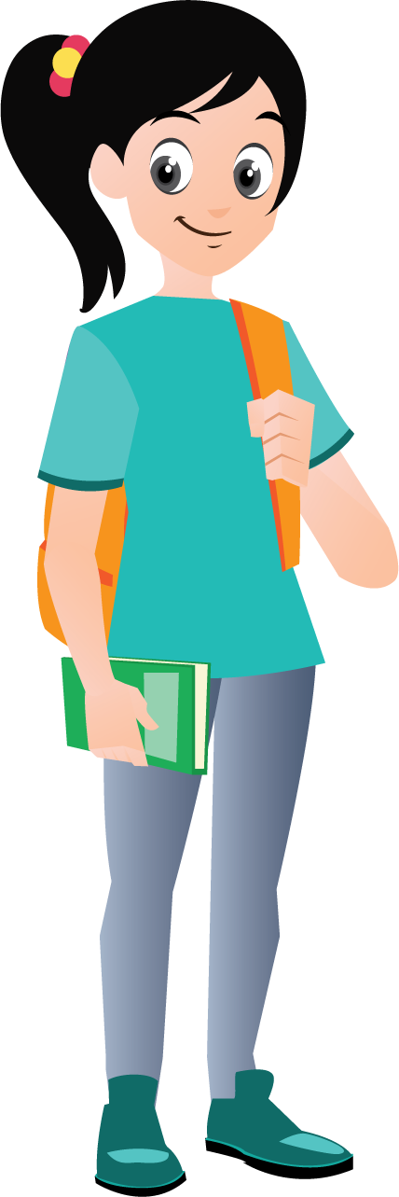
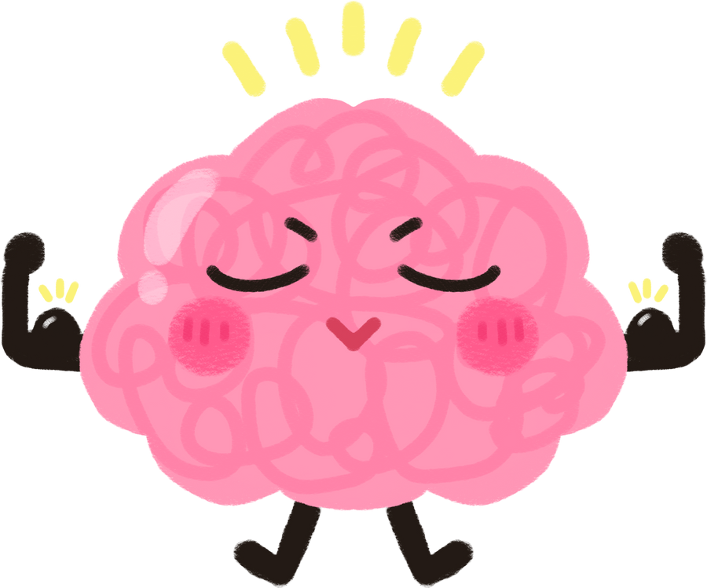
Your brain is awesome and does a LOT!
Notes:
Talking Points:
We're concerned about your brain because it's awesome and does a lot of amazing things!
As you're young and still growing, your brain is still figuring out what it likes and doesn't like.
While it's figuring this out, your brain may become impacted by something called "addiction."

Slide 8

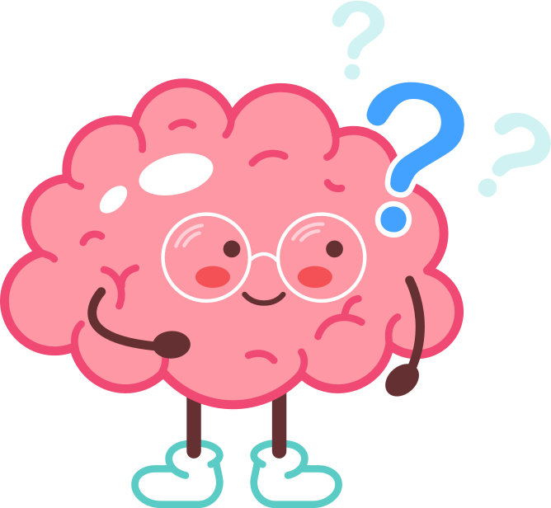
Who knows what "addiction" means?
Notes:
Talking Points:
(Ask students): Does anyone know what the word "addiction" means?
(Take a few answers).

Slide 9


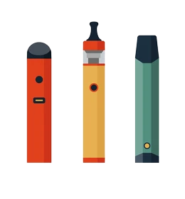


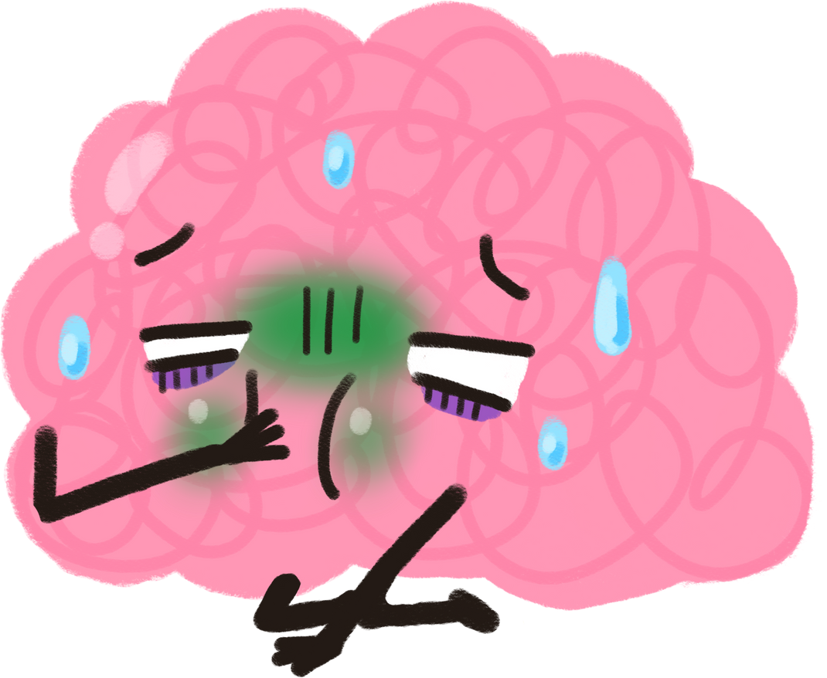
NICOTINE ADDICTION
FEELS LIKE THEY CANʻT STOP USING THE DRUG, EVEN IF IT CAUSES PROBLEMS IN DAILY LIFE
Notes:
Talking Points:
When nicotine is introduced to a developing brain, it changes the chemistry! It fools the brain into feeling so good, nothing else feels good without the drug.
Now, the user feels like they can’t stop using the drug, even when it causes problems in their life and using it isn’t enjoyable anymore.
This is addiction and it is bad for a brain that is still developing.

Slide 10
Wants, Needs, & Addictions Activity
Notes:
Talking Points:
Now that we know a little more about what an addiction is, we're going to do a wants, needs, and addictions activity!
(Teacher Note):
Instructions:
- Make three large signs that say "want," "need," and "addiction." Tape or hang these in separate parts of the room before beginning activity.
-When beginning the activity, tell the students "I am going to read a list of objects and activities. After I read it, walk to the poster that you think best describes the example given".
Examples (feel free to use others that are most relevant to your class):
- A cell phone
-Your computer
-Fast food
-Nicotine to people who smoke 1 cigarette
-Nicotine to people who smoke 5 cigarettes
-Nicotine to people who smoke more than 5 cigarettes
-Teenagers that drink because they want to be socially accepted
-Heroine
-Cocaine
-2+ hours of video games every day
-Facebook
-Water
-Instagram
-Friends
-Snapchat
-Food
Now, divide students into groups of 3-5. Give them 10 minutes to write down their own definitions of a "want" a "need" and an "addiction."
Discuss the definitions, particularly the similarities and differences between each group and the dictionary definitions (below):
Want (noun)
• the state or condition of not having any or enough of something
• something that is desired or needed
• the state or condition of being poor
Need (noun)
• a situation in which someone or something must do or have something
• something that a person must have
• something that is needed in order to live or succeed or be happy
• a strong feeling that you must have or do something
Addiction (noun)
• compulsive need for and use of a habit-forming substance (as heroin, nicotine, or alcohol)
• characterized by tolerance and by well-defined physiological symptoms upon withdrawal
• persistent compulsive use of a substance known by the user to be harmful

Slide 11

Nicotine affects the growing brain!
Notes:
Talking Points:
Activity Discussion:
Hopefully now you understand more about what things are addictions vs. what you want and what you need.
It all goes back to nicotine, and the growing brain. You are more likely to become addicted to drugs like nicotine when you are young and your brain is still developing.

Slide 12

What else is in an e-cigarette?
Notes:
Talking Points:
Ok, we have discussed nicotine and addiction, but there are other ingredients in e-cigarettes and they affect your body too!
So, what else is in an e-cigarette?
(Teacher note): Take some responses.

Slide 13


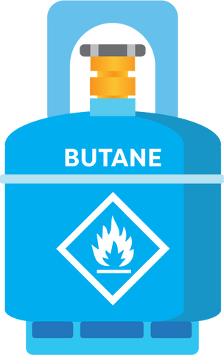
There are lots of nasty chemicals that are in
e-cigarettes
Notes:
Talking Points:
Well, there are lots of nasty chemicals that can be found in the aerosol (cloud of smoke) from e-cigarettes!

Slide 14
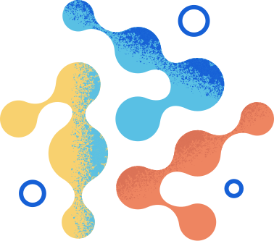
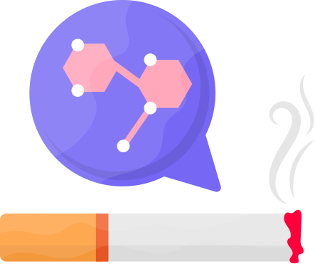

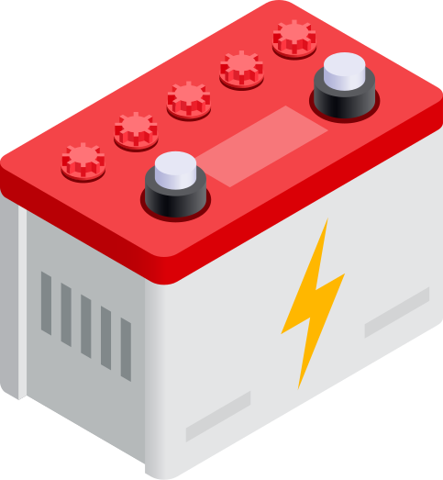

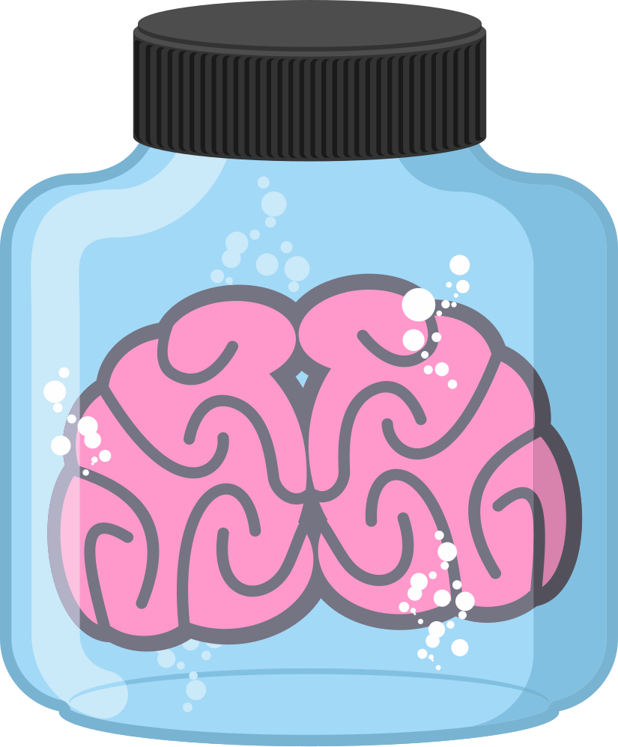
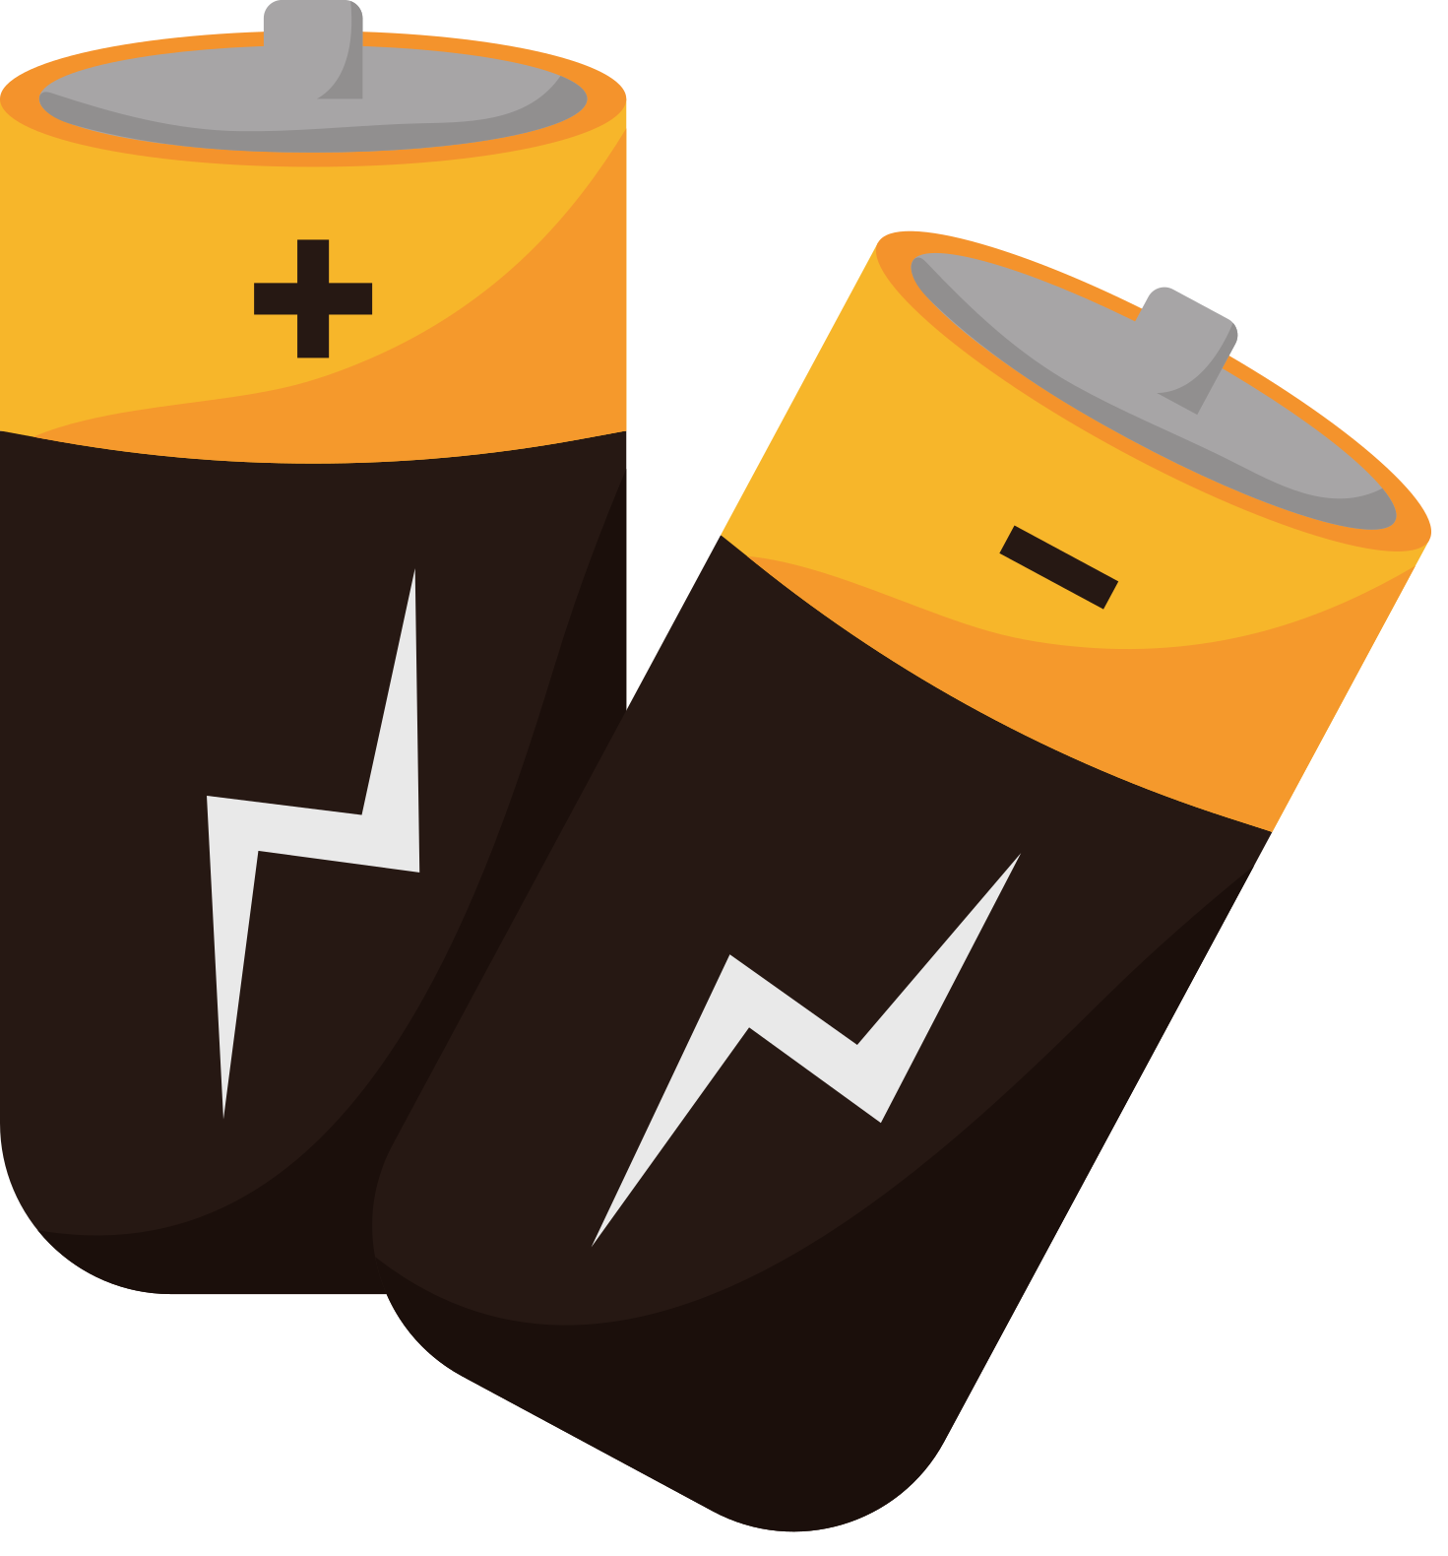
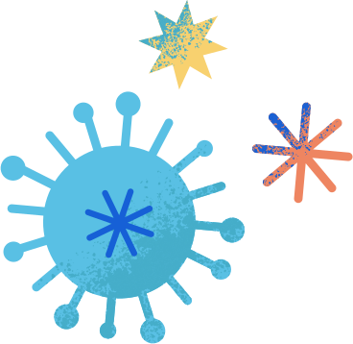

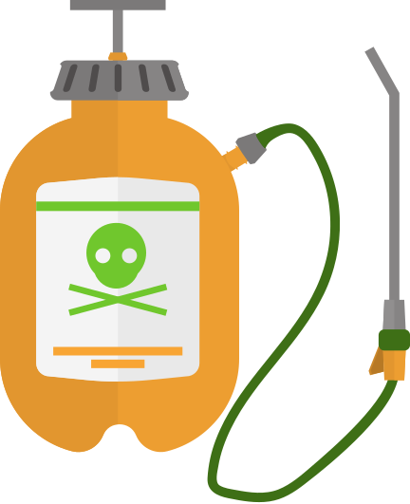
NICOTINE (TOBACCO)
NICKEL
(toaster Ovens)
LEAD
(car batteries)
BENZENE (GASOLINE)
CADMIUM (BATTERIES)
FORMALDEHYDE
(dead tissue preservative)
N-NITROSONORNICOTINE
(pesticides)
TOLUENE
(paint thinner)
Notes:
Talking Points:
Here are just a few of them!
Did you know that many of these ingredients found in e-cigarettes are also found in household products, products that I am sure you do not want to put into your mouth or body.
(Teacher Note): Have a few student volunteers read the chemical words on the slide (some of them will be unfamiliar with the words and have to sound it out, but that's the point!).

Slide 15

Activity:
Whatʻs in that cup?
Notes:
Talking Points:
OPTIONAL CLASSROOM ACTIVITY (10-15 minutes)
Prep work:
-Buy food coloring (many different colors)
-Disposal cups (Paper)
-Obtain 4-5 medium to large pitchers
Procedures:
-Label disposal cups with chemical names (Propylene Glycol (PG), Vegetable Glycerin (VG), Cinnamaldehyde, menthol, and vanilla).
-Put food coloring and water into disposal cups.
-Place the pitcher in the middle of the table of each group.
-Make 4-5 groups, each group should have 3-4 participants.
-Tell students who have the PG cup to pour into the pitcher first.
-Tell students who have the Cinnamaldehyde cup to pour into the pitcher second.
-Tell students who have the menthol cup to pour into the pitcher third.
-Tell students who have the Vegetable Glycerin cup to pour into the pitcher fourth.
-Tell students who have the vanilla cup to pour into the pitcher last.
Follow up:
(Ask students):
-Do you think this looks good to drink? Why or why not?
-Would you tell a friend to drink this?
-What would you do if someone offered you this to drink?
-How would you refuse to drink this?
-So if you would not drink this, that truly just has colored water, why would someone put something with so many chemicals including ones you don't know into their mouth and body?
- Have a discussion as a class

Slide 16
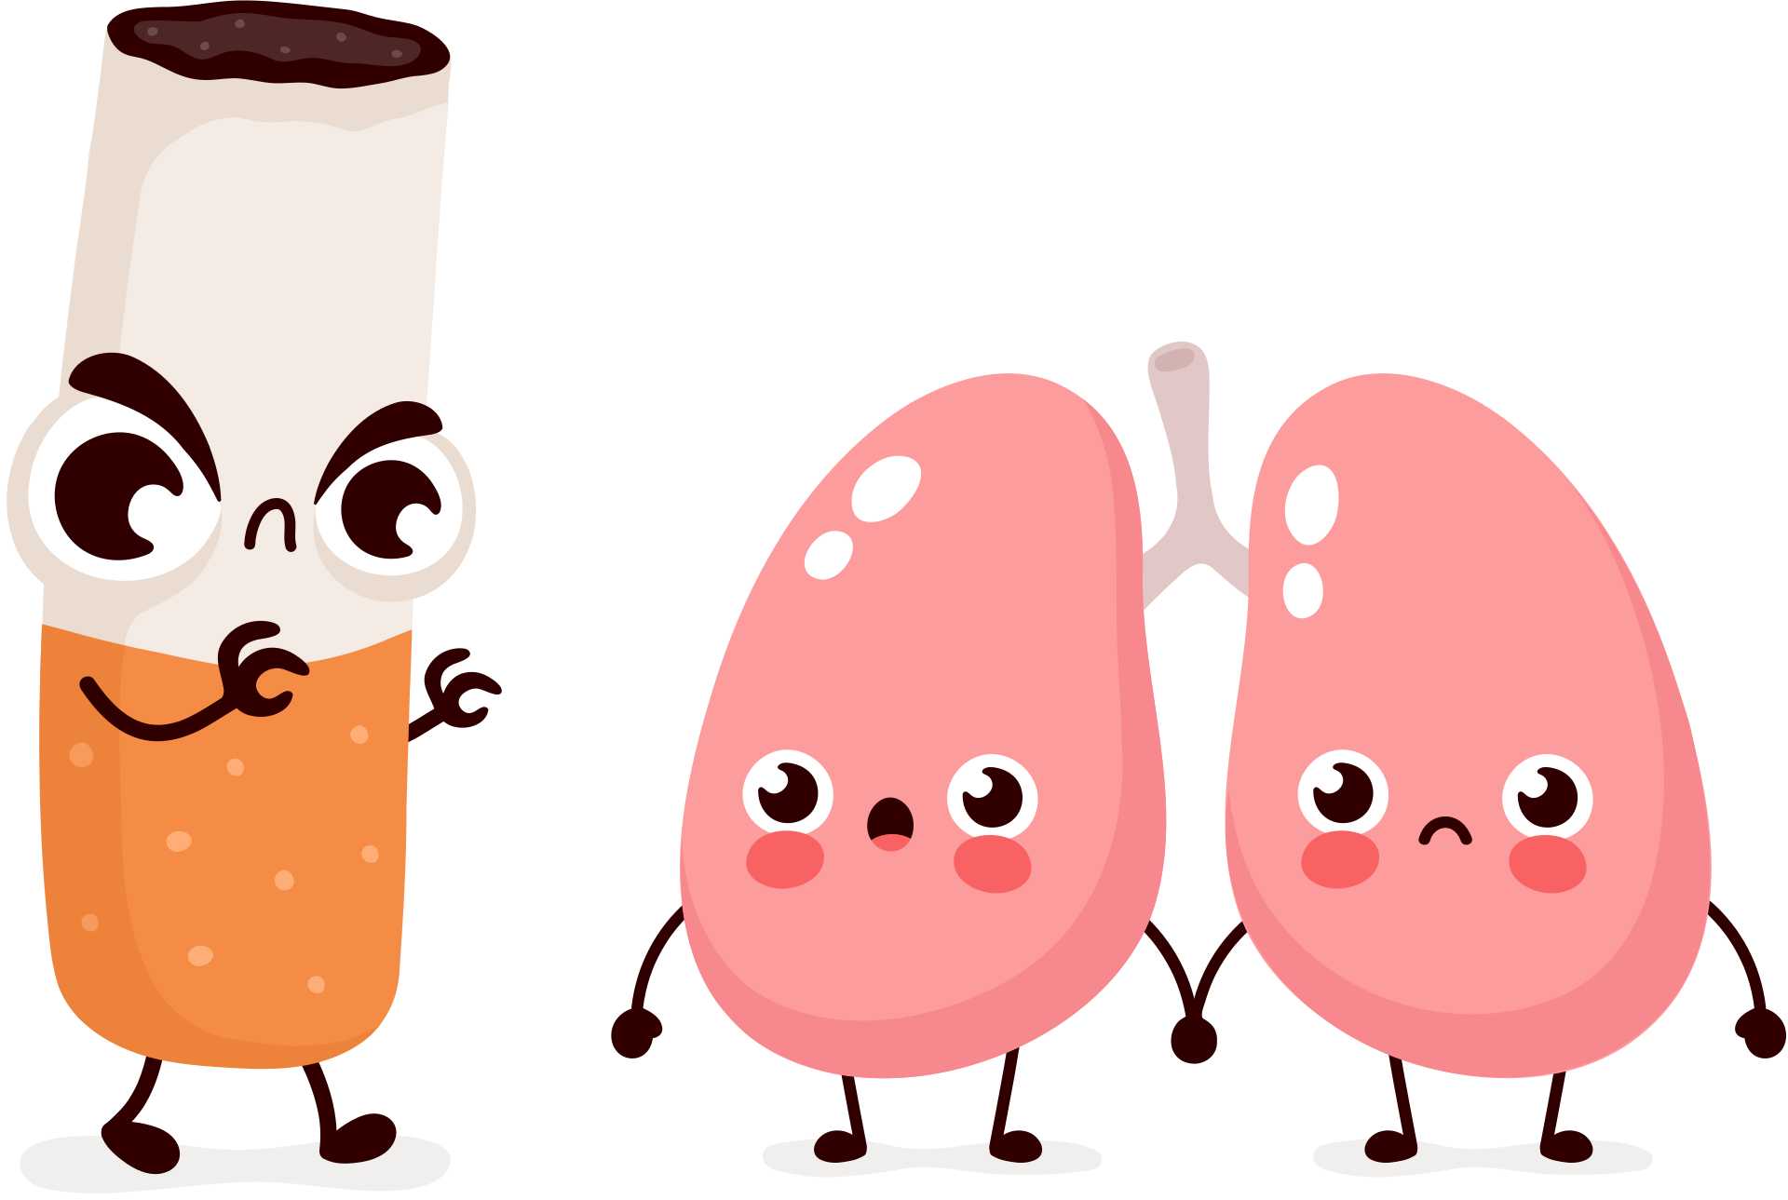
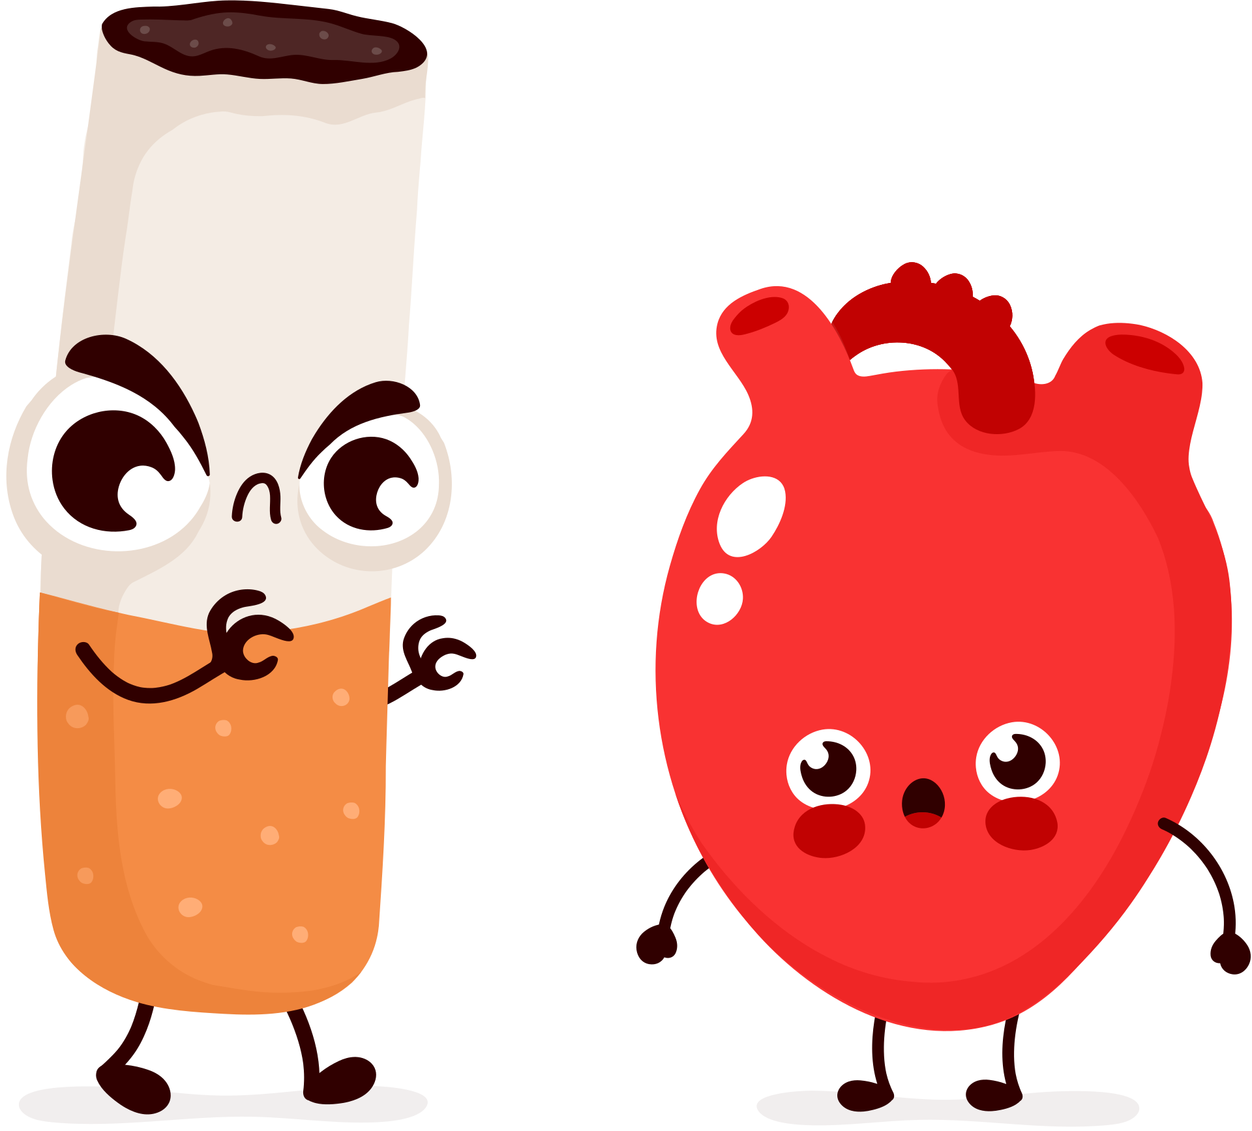
What about the rest of the body?
Notes:
Talking Points:
Ok so now that we know about these chemicals in e-cigarettes, how do they affect the body?
Well...

Slide 17
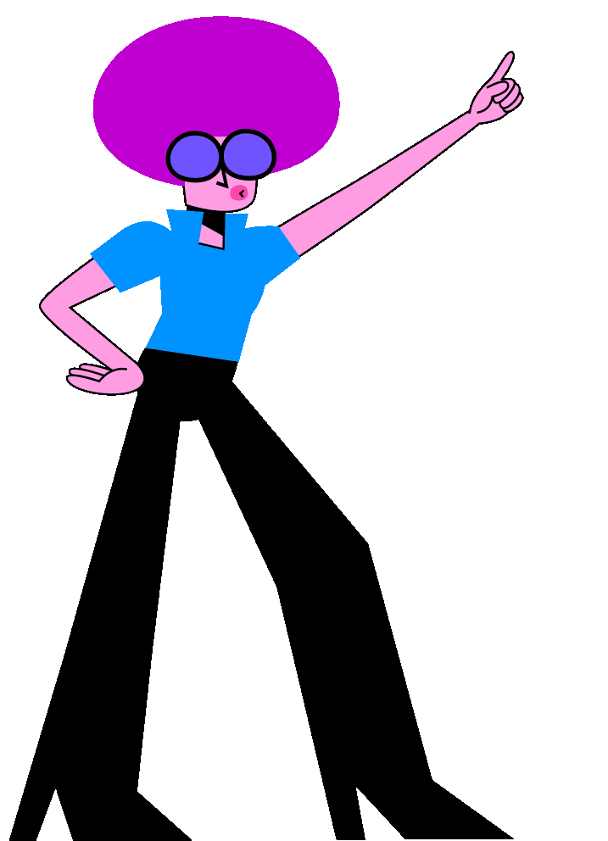
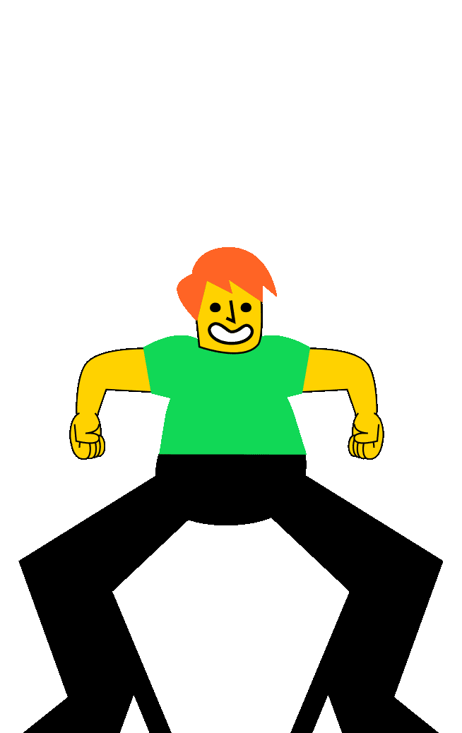

RAISE YOUR HAND IF...
YOU LIKE TO DANCE!
Notes:
Talking Points:
Raise your hand if....
You like to dance?

Slide 18
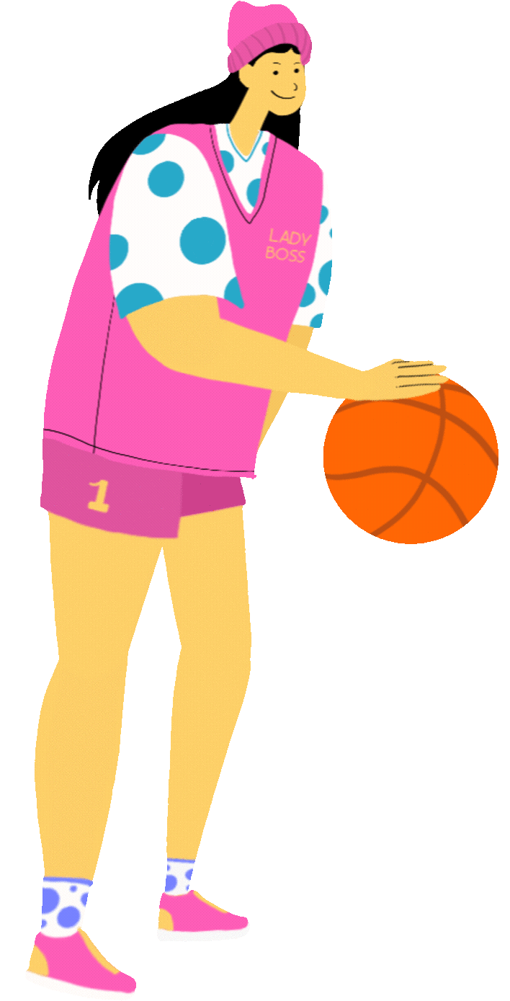
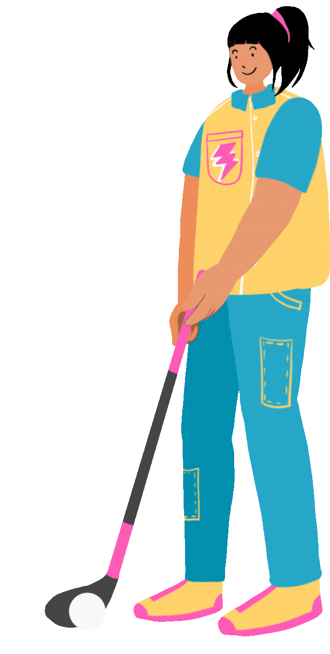
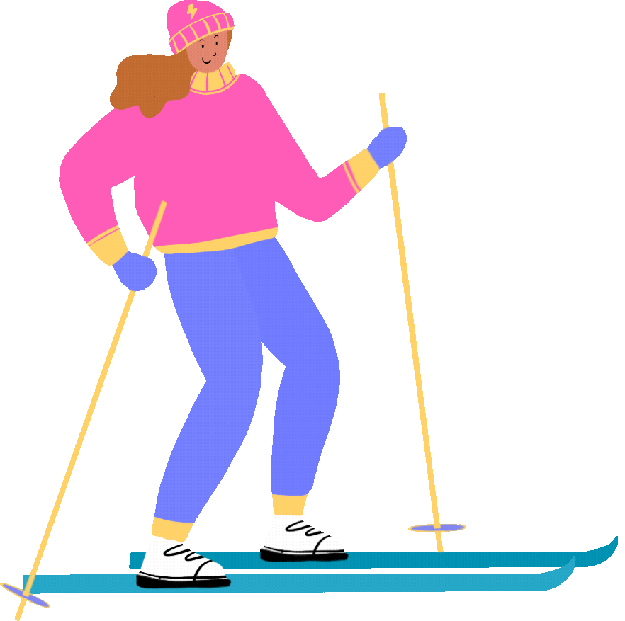
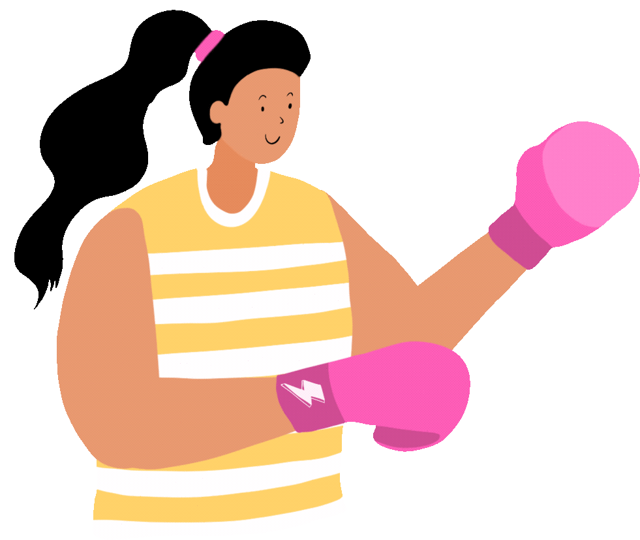
RAISE YOUR HAND IF...
YOU LIKE TO PLAY SPORTS!
Notes:
Talking Points:
Raise your hand if....
You like to play sports?

Slide 19



RAISE YOUR HAND IF...
YOU LIKE TO SING!
Notes:
Talking Points:
Raise your hand if....
You like to you like to sing?

Slide 20
DID YOU KNOW?
USING E-CIGARETTES CAN HARM YOUR ABILITY TO DO ALL OF THESE FUN THINGS AND MORE!
Notes:
Talking Points:
Well, did you know that using e-cigarettes can harm your ability to do all of these fun things and more?

Slide 21
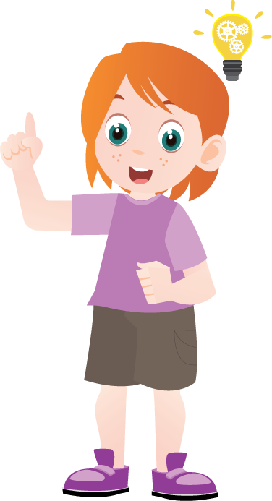
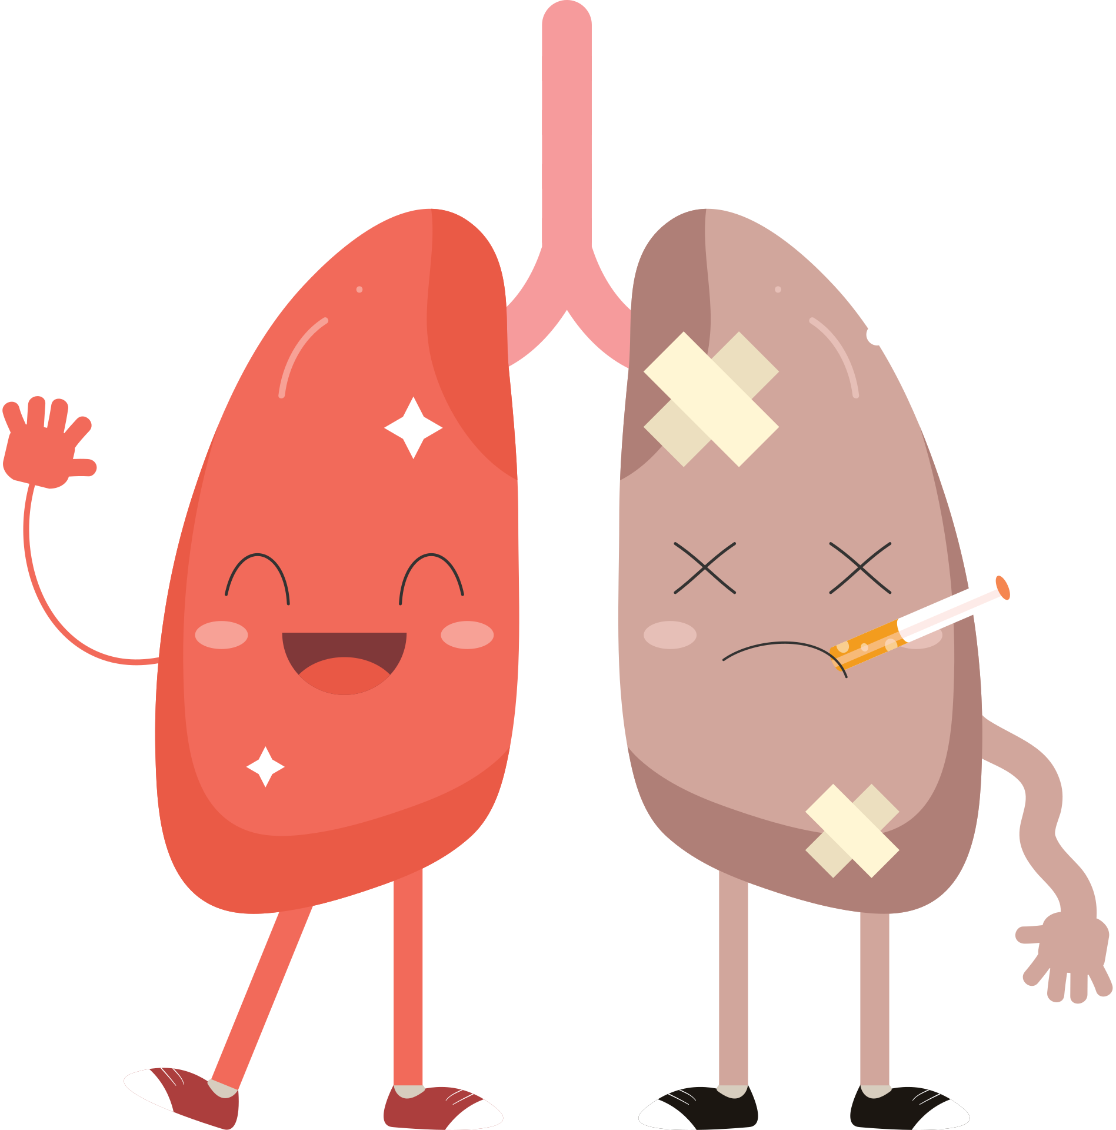
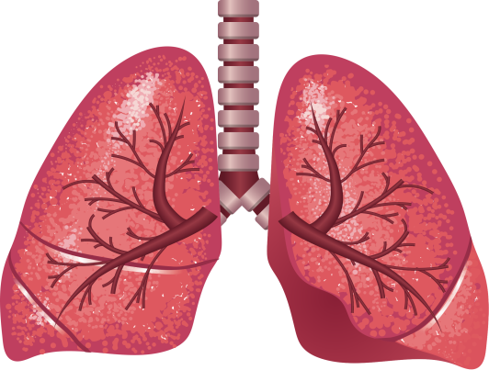
Worse when you get sick
Irritates and damages your lungs
Notes:
Talking Points:
Since e-cigarettes are used by inhaling, let's discuss how those chemicals hurt your lungs.
They irritate and damage your lungs and airways.
Because they damage your airways, your body also has a harder time trying to heal when you become sick! Like with Covid-19 or other lung infections, for example.
So youth who use e-cigarettes have had asthma, bronchitis, and other health issues.

Slide 22
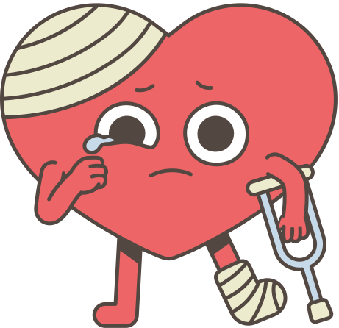
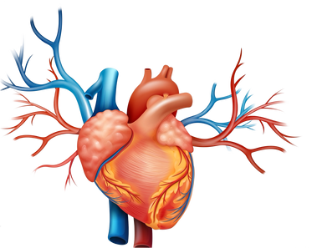
Hurts the heart!
Canʻt pump blood properly
Notes:
Talking Points:
In addition to harming the lungs, e-cigarettes hurt your heart.
Breathing in the aerosol from an e-cigarette, even if you're not the one using it, is bad for the heart.
Now, the heart can't pump blood properly through the body and into the brain!
This makes it hard to do fun activities like dancing or playing sports or singing.

Slide 23




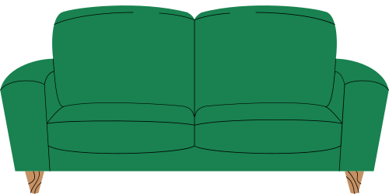


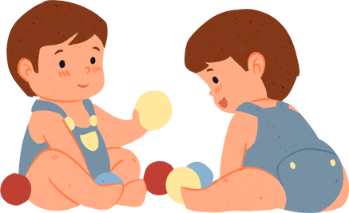
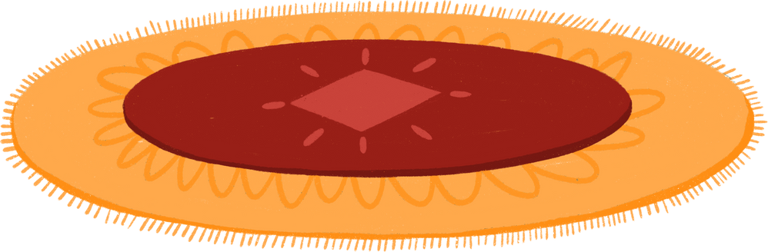

Smoking and "vaping" hurts others too!
Notes:
Talking Points:
Secondhand aerosol is the cloud of "smoke" that is released when someone is smoking or using an e-cigarette. The aerosol contains all of those harmful chemicals! If anyone nearby breathes it in, it can hurt them!
After the cloud is gone, the chemicals can land on things nearby. That is thirdhand aerosol! We donʻt want your pets or younger siblings stepping on those chemicals or accidentally getting it in their mouth!
So smoking and using e-cigarettes hurts others too! The best way to avoid harm to yourself and others is to not use or try e-cigarettes at all.

Slide 24

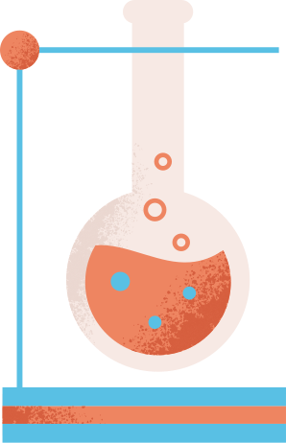

WHAT TO DO IF YOU NEED HELP?
Tell your parents, teacher, doctor, or any adult you trust
SAMHSA's National Helpline
1-800-662-HELP (4357) or https://findtreatment.samhsa.gov
Notes:
Talking Points:
So, what do you do if you need help?
If you or someone you know is using e-cigarettes and is having a hard time stopping, it is important to ask a doctor, parent, teacher, or counselor for help.
You can also text or call SAMHSA's National Helpline for more resources!

Slide 25

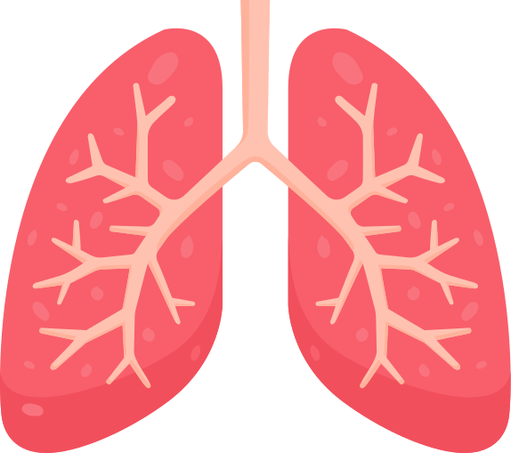
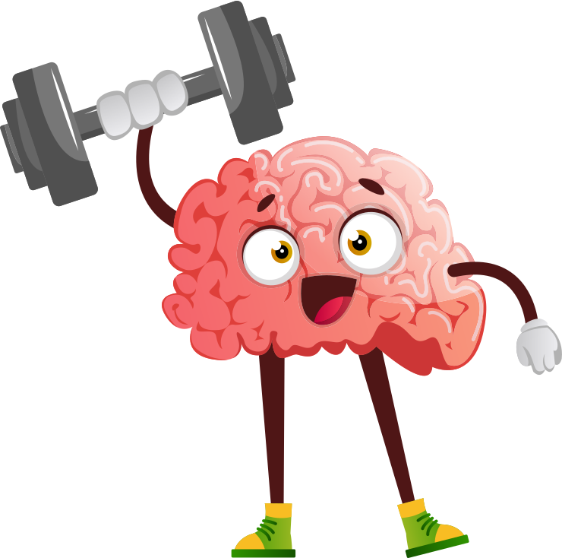
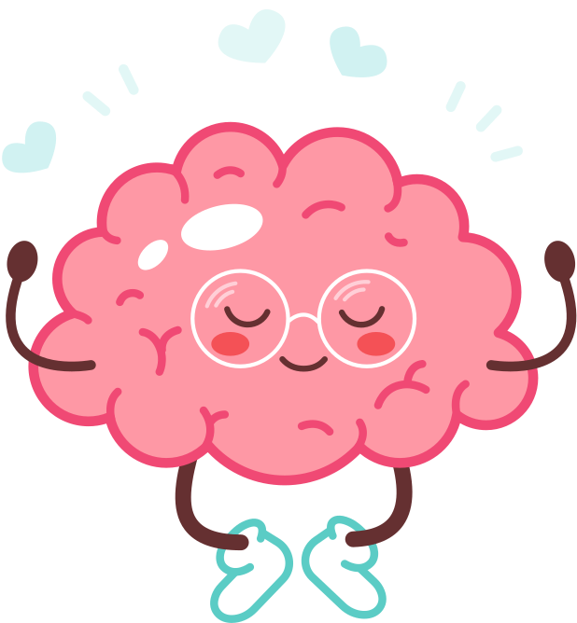

Nicotine has negative effects on your brain, lungs, and heart.
The chemicals in e-cigs are dangerous for you and others!
KEY TAKEAWAYS
Your brain is awesome and full of potential! Your job is to figure out what makes you - you!
Notes:
Talking Points:
Thank you for a great class! Let's review our key takeaways.
(Teacher Note): Read points on slide or have students read them.

Slide 26

SHH..
SNEAK PEEK
Notes:
OPTIONAL HOMEWORK ASSIGNMENT - If doing the homework assignment, continue with the next few slides.
Talking Points:
Here is a sneak peek for our lesson next class.

Slide 27

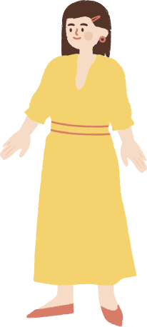
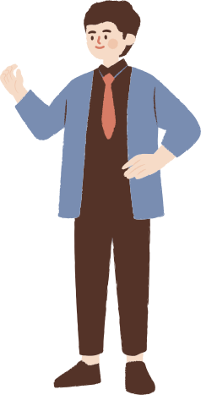
DON'T BE FOOLED!
Notes:
Talking Points:
Our next lesson is called "don't be fooled" and it's about how tobacco companies try to trick kids into thinking e-cigarette use is ok/ cool.

Slide 28




PHOTOVOICE PROJECT
Notes:
OPTIONAL HOMEWORK
Talking Points:
Let’s watch a video on a garbology project using a research tool called photovoice. Photovoice is used by community advocates to document through pictures and storytelling their community needs.
This particular video was created by youth peer health educators. As a class, we will be doing a similar project.
(Play video)
So, when you go home tonight, you can take a picture with your phone (or use newspaper clippings or magazine pages) to document how e-cigarette use affects our own school, community, and neighborhoods. We'll share this homework in our next class.

Slide 29

Notes:
Talking Points:
Click on image for link to Kahoot! or see below
https://create.kahoot.it/details/ac73b6aa-0516-43e9-9a55-cd4ba45134ee

