Slide 1
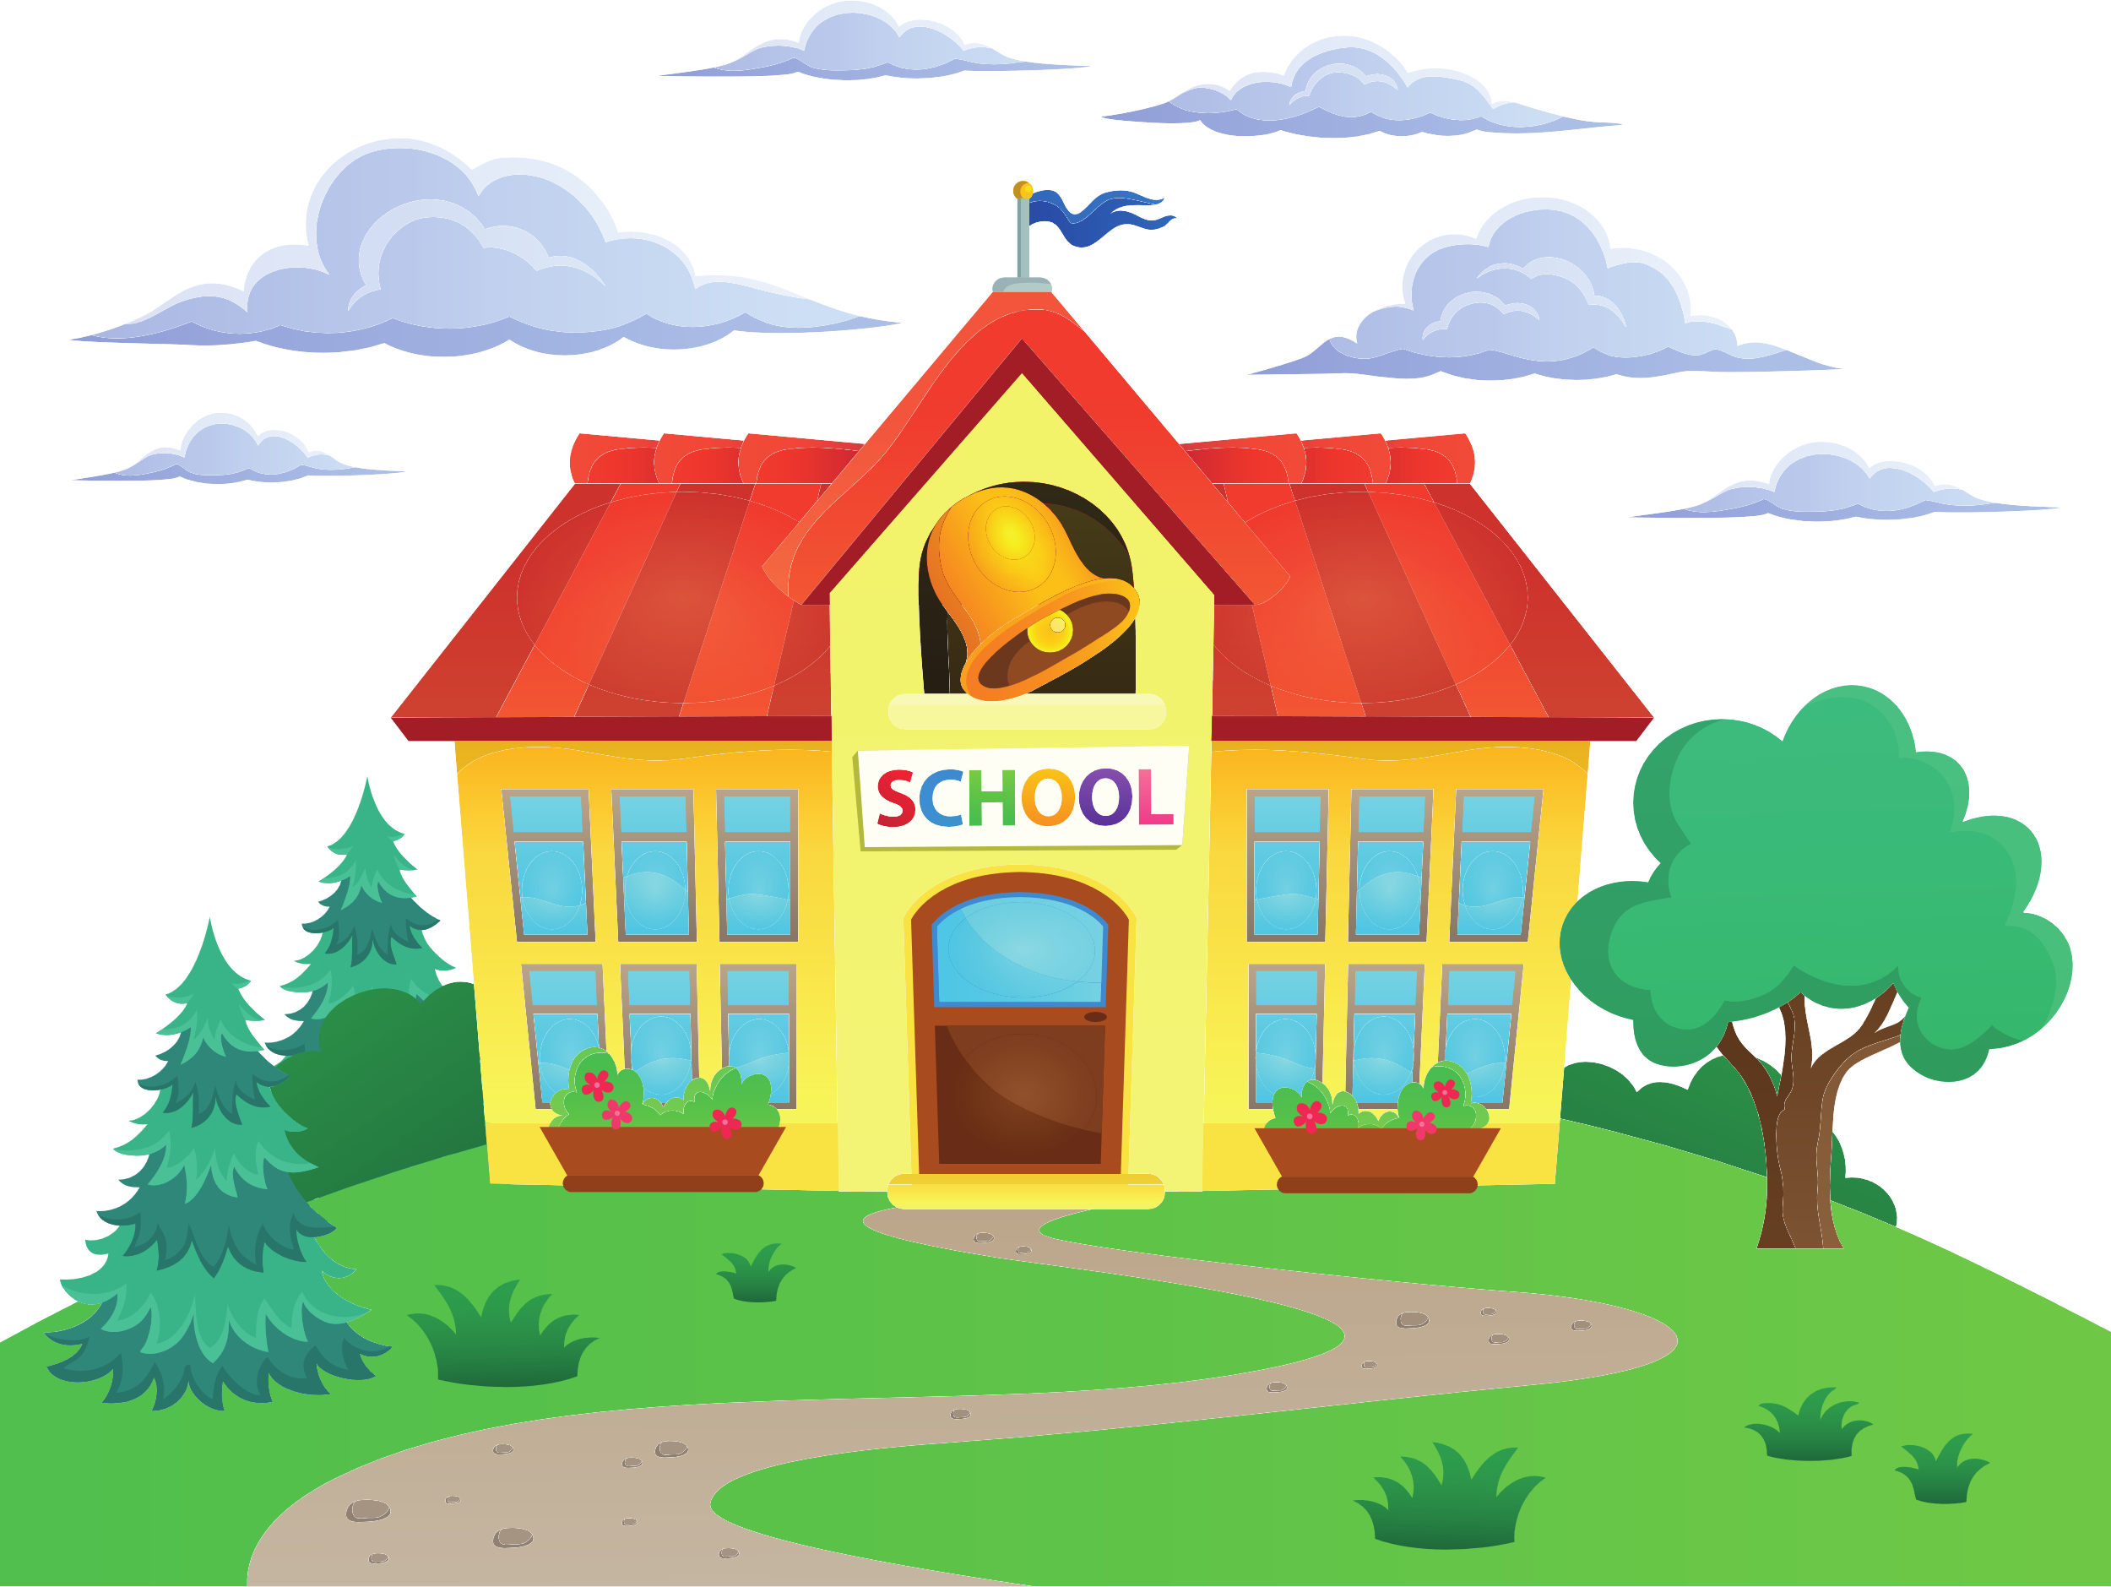
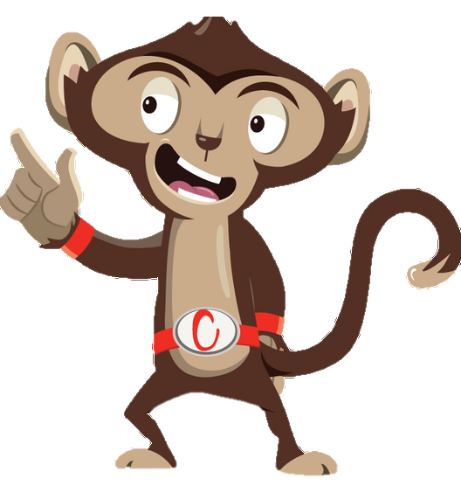


Chester’s Active Quest: Week 2

Slide 2
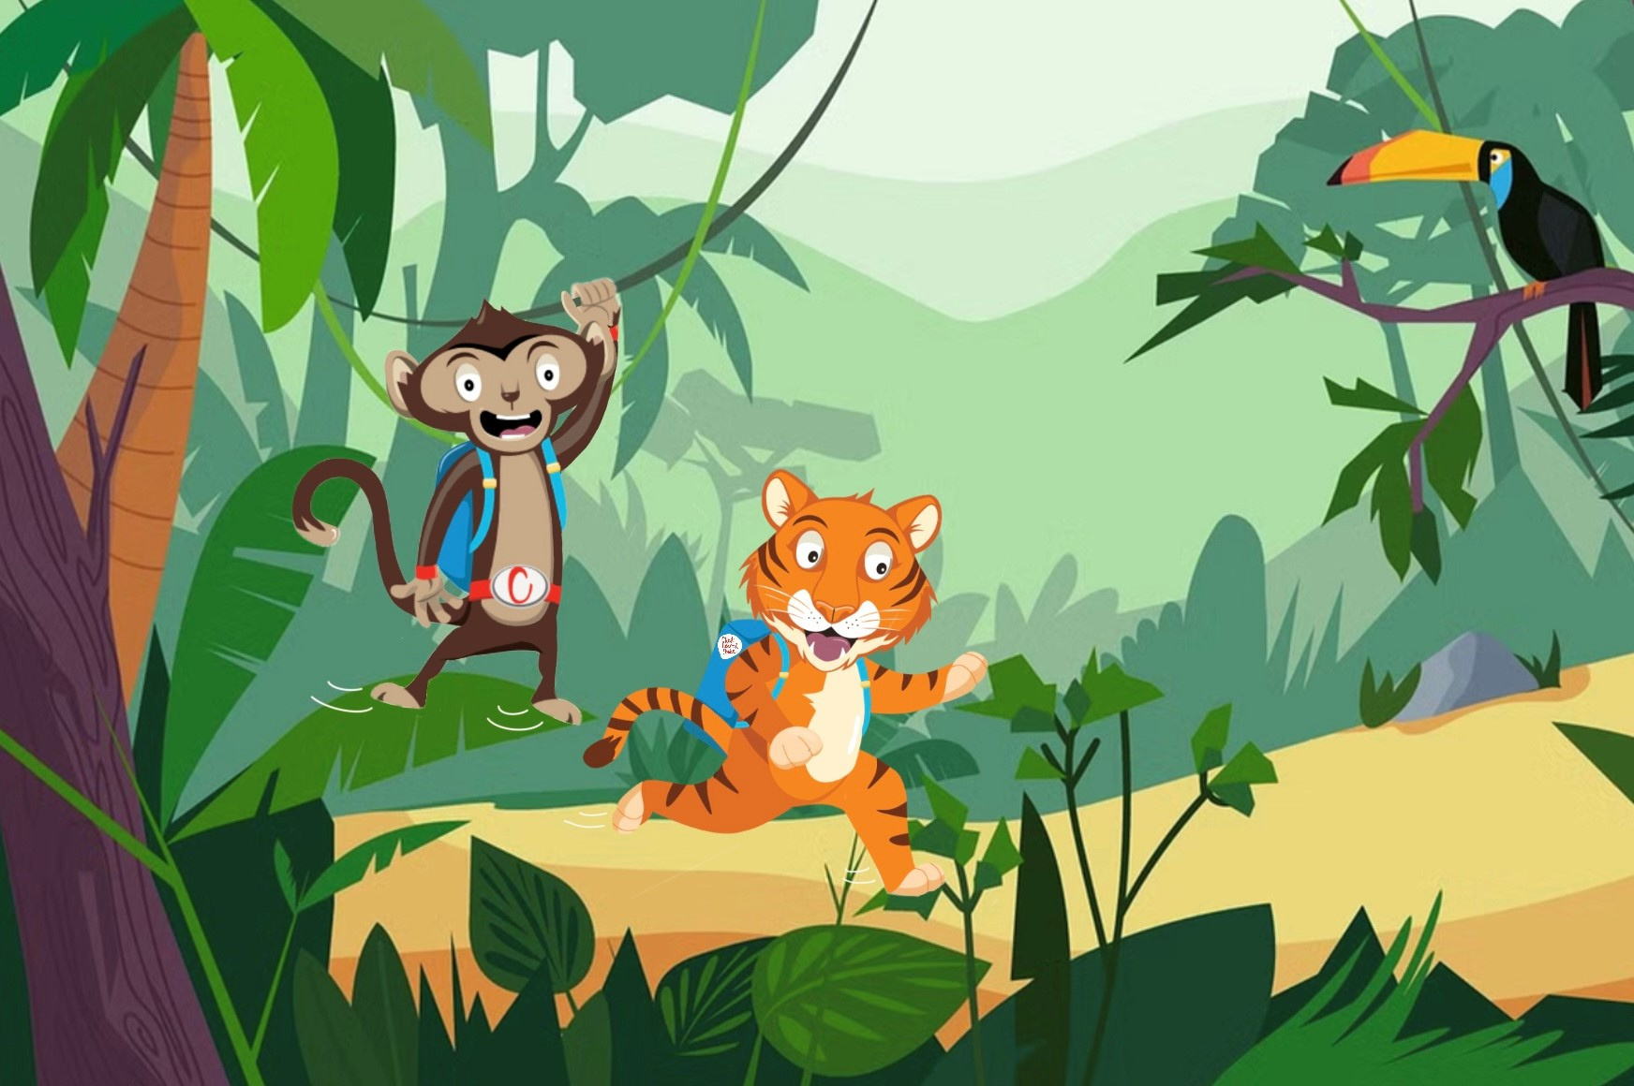

Notes:
Chester is swinging from vine to vine towards school. The jungle is alive with sounds of chatter, rustling leaves and the thrilling hustle and bustle to school. He sees his friend Timmy the tiger. “Good morning, Timmy, would you like to go to school together?”, Chester shouts. “Yes of course”, Timmy replies. Chester continues to swing from vine to vine above Timmy’s head, while they discuss what they are most looking forward to today. Chester says he can’t wait to find out about their science trip and Timmy can’t wait to practice his part in the play as he’s been working hard on it. They chat all the way to school gate and don’t realize how quickly they travelled as they were having so much fun. Chester carefully climbs down the tall, sturdy tree to join Timmy. He loves walking to school with his friends. What a great way to stay active and have fun in the morning.

Slide 3
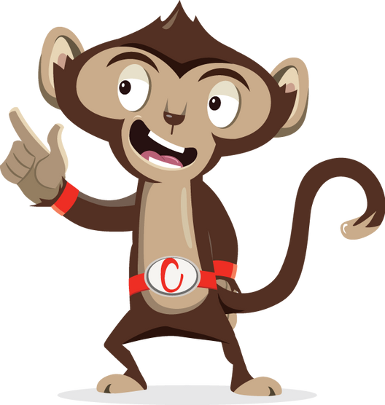
Listen to the clues to find out what other active ways Chester can use to travel to school?
_ Y_ _ E
Clue:
OR
S _ _ _ T
Clue:

Slide 4
What else can Chester use to travel to school?
C Y C L E
OR
S C O O T

Slide 5
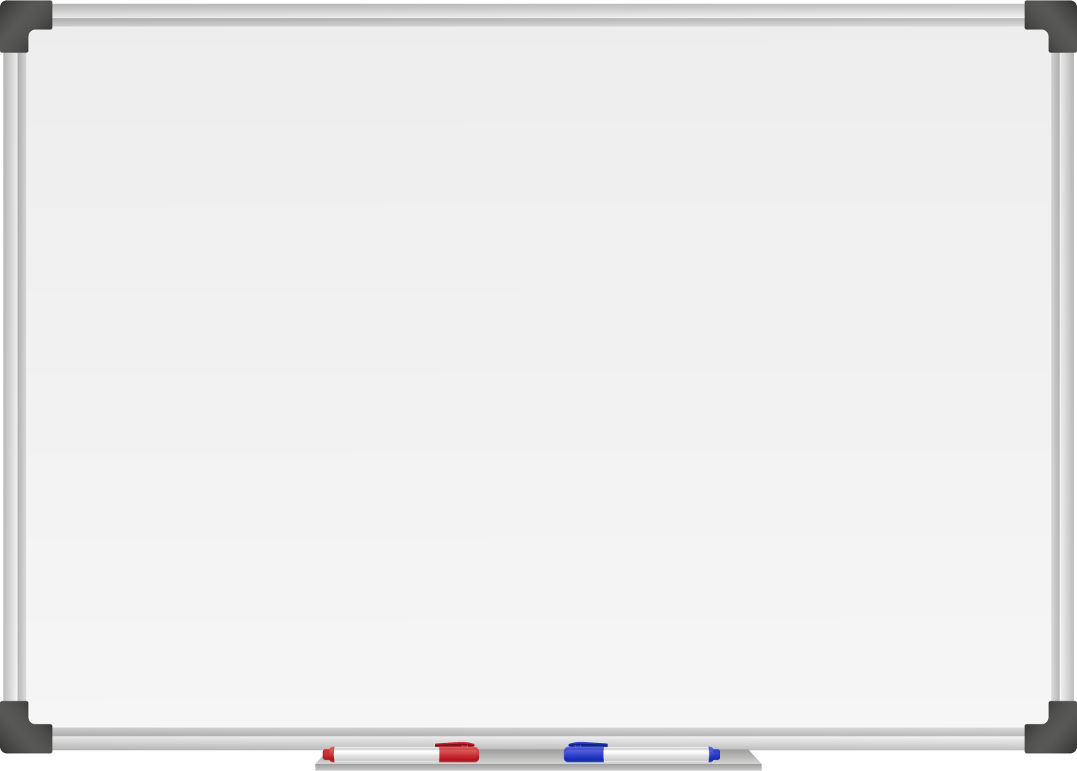







WELL DONE! You have unlocked number 2!
10 Ways to Move More Sit Less
  ____ ____ ____ ____ __ ____ ____
  ____ __ ____ ____ ____
  ____ ___ __ ____ _ ___
  ____ ____ ____ ____ ____
  ____ ____ ____ ___ _ ____ ____
  ____ ________
  ____ ____ __ ____
  ____ ____ ____ ____ _ ____ _ ____
Morning Stretch
Don’t be late get a move on as you walk, cycle or scoot to school

Slide 6

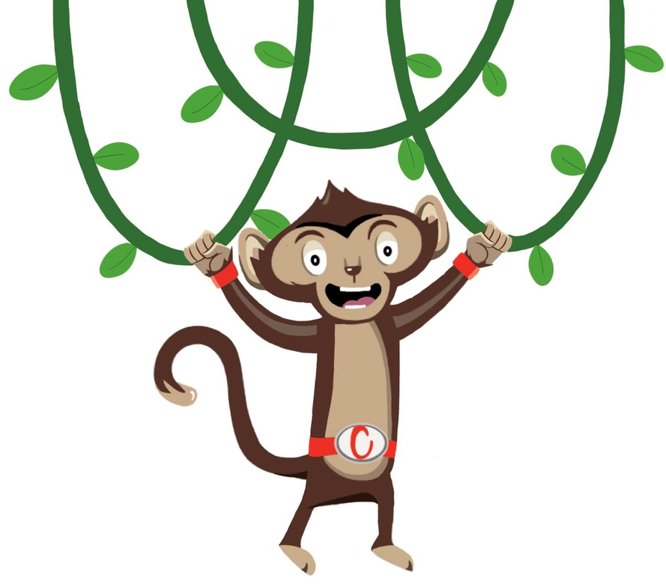
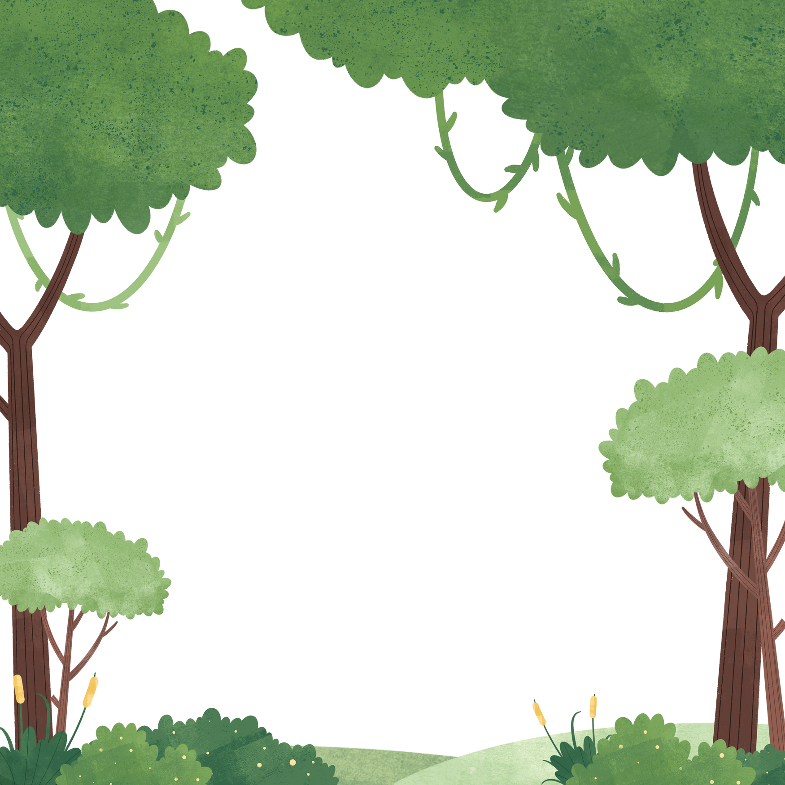
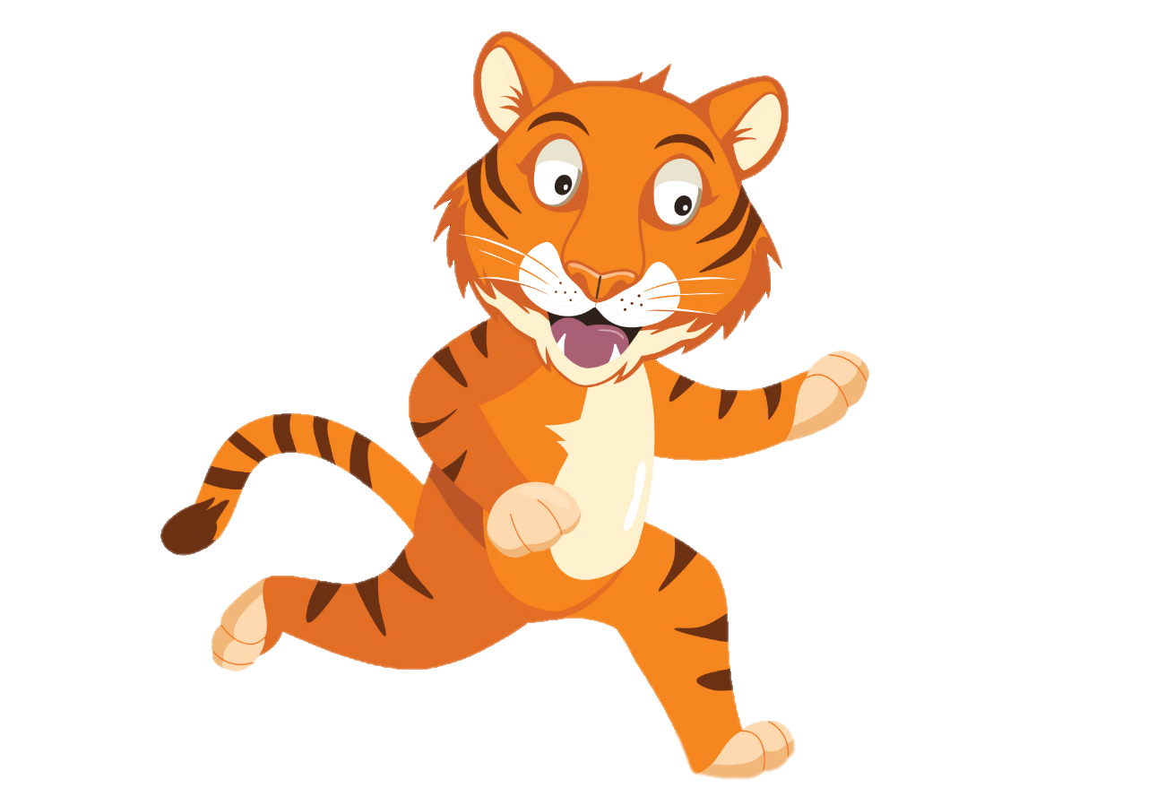
“ Travelling to school with friends is so much fun”
“ Wait for me
Chester!”
You have gained 2 healthy hearts!

Slide 7
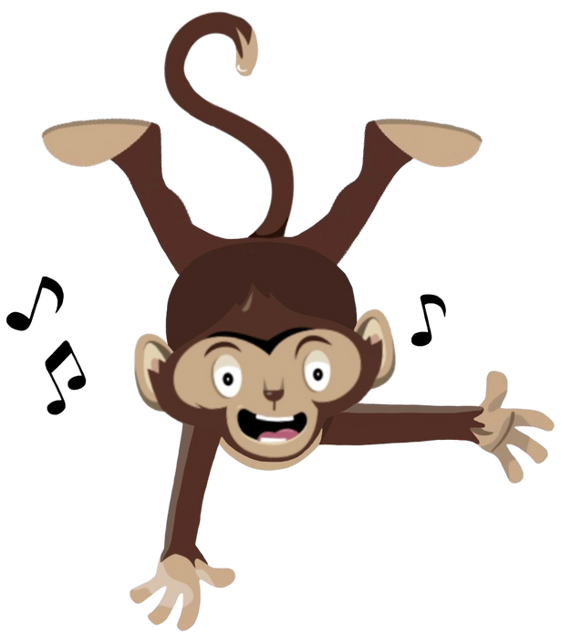
Lively Lesson
Active Travel to school is a great way to move more and sit less.
Why not try a Chester’s Lively Lesson
Notes:
This week why not try one of our lively lessons each day this week and see if you feel energized

