Slide 1
Chester’s Active Quest: Week 4

Slide 2
Notes:
Chester is sitting at his desk in class, working on his counting sheet. He is doing well until he gets stuck and can’t remember the next number. Instead of getting cross, he picks up his pencil and decides to draw a picture instead. The teacher notices that many of the pupils appear to be fidgeting and have lost their focus. Mrs Liona jumps up and shouts excitedly, “Ok everyone, let’s all have a brain break”. They push their chairs in and find a space in the classroom. The class is now buzzing full of excitement. Mrs Liona goes to the front of the classroom and beings to sing, “Head, shoulders, knees and toes, knees and toes”. Everyone eagerly joins in, copying her every move and singing along. Soon the class is filled with cheerful singing. Once the song is over, she asks the class to finish their work. Chester needed a brain break. He sits down and is ready to focus and figure out the next number on his sheet.

Slide 3
What is hidden behind the wall?
1
2
3

Slide 4
What is hidden behind the wall?
1
Red circle
2
Red heart
3
Red square
Notes:
Ask pupils to answer the question while standing. If pupils think the answer is A = they stand with their hands on their head, B = stand with arms crossed and C = stand with both hands in the air. If space is not limited, put the letters A, B and C around the room and ask pupils to move to the area they think the answer is.

Slide 5
What is hidden behind the wall?
1
3

Slide 6
What is hidden behind the wall?
1
3

Slide 7
What is hidden behind the wall
2
Red heart
Notes:
To keep our hearts healthy we need to move more and sit less

Slide 8
WELL DONE! You have unlocked number 4!
10 Ways to Move More Sit Less
____ ___ __ ____ _ ___
____ ____ ____ ____ ____
____ ____ ____ ___ _ ____ ____
____ ________
____ ____ __ ____
____ ____ ____ ____ _ ____ _ ____
Morning Stretch
Walk, cycle or scoot to school
Play games with friends at break and lunch
Remember to move more every hour

Slide 9
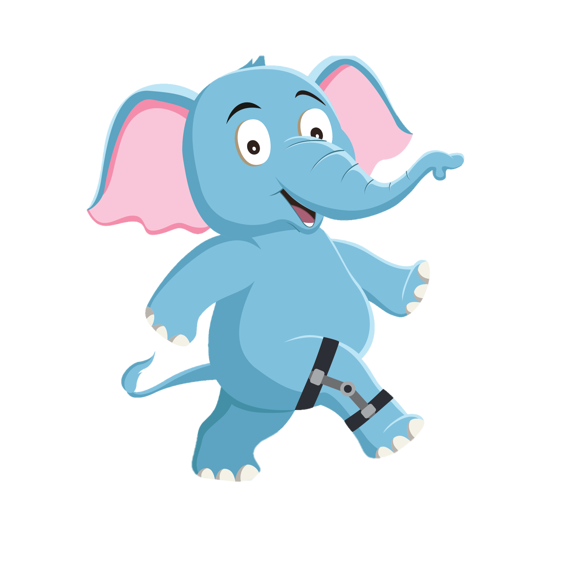
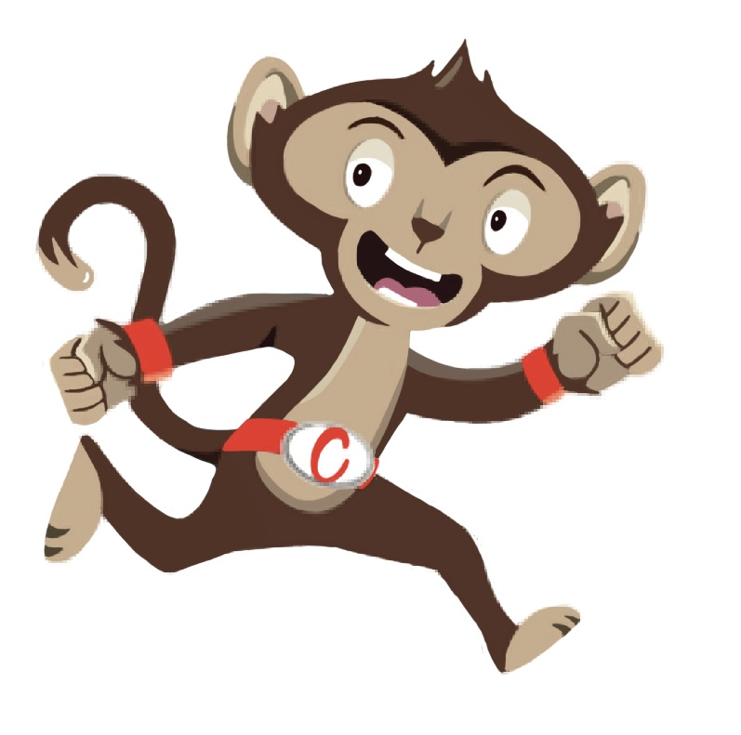
“Moving more helps me with my work”
“We need to move more often”
“Brain breaks are
a fun way
to move”
You have gained 4 healthy hearts!

Slide 10
Brain Break
Brain breaks can help with schoolwork
Why not try a Brain Break Activity
Notes:
Sometimes we need to give our brain a break when we have been sitting for a long time. This can help us concentrate on our work after. This week why not try one of our brain break activities each day and get creative.

