Slide 1
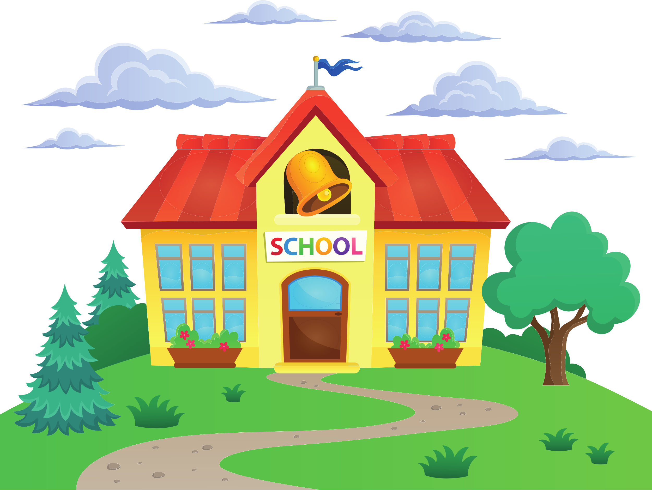
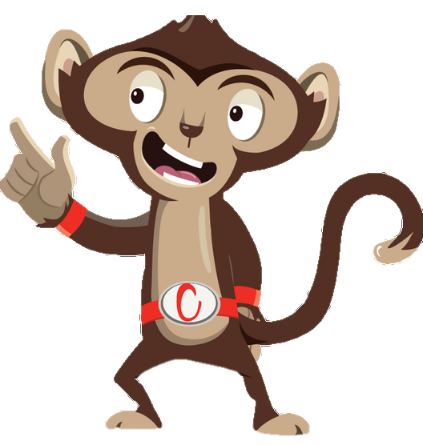


Chester’s Active Quest: Week 4

Slide 2
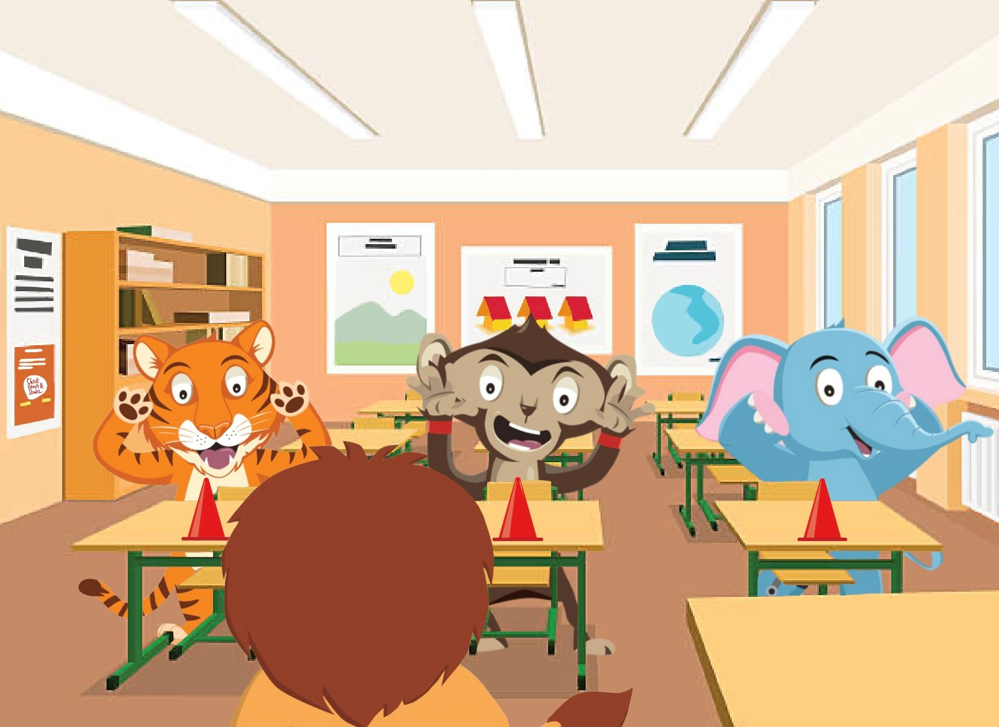

Notes:
Chester is sitting at his desk in class, working on his times tables sheet. He finds maths a bit tricky and is finding it hard to concentrate so he takes his pencil and begins to doodle on the page. The teacher notices that many of the pupils appear to be fidgeting and have lost their focus. Mrs Liona jumps up and shouts excitedly, “Ok everyone, let’s all have a brain break”. The class push their chairs in eagerly and find a space in the classroom. She instructs everyone to grab a cone and place it in front of them. “Make sure you listen carefully and don’t be the last person to touch the cone”, Mrs Liona explains. The class pay close attention. “I’m going to tell you where to place your hands, it could be on your head, shoulder, knees or cone, in any order”, she continues. The game begins and Chester tries to be a quick as he can. The teacher continues to try and trick the class, but everyone is doing so well. The class is laughing and having a good time. A brain break was just what Chester needed. The short game finishes and the class take their seats. Chester feels focused and ready to tackle that maths challenge.

Slide 3
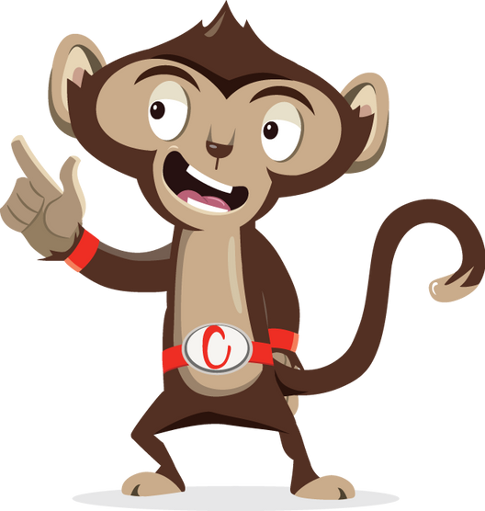
You need to use your brain if you want to be smart.
If you want your blood pumped
You need to use your
_ _ _ _ _ ?
Can you solve this riddle?

Slide 4
Can you solve this riddle?
1
2
3

Slide 5

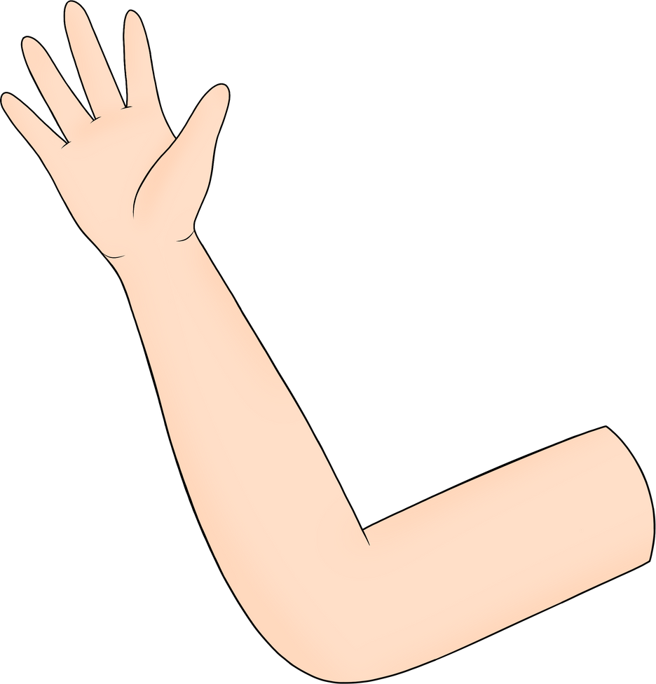

Can you solve this riddle?
1
Head
2
Arms
3
Heart
Notes:
Ask pupils to answer the question while standing. If pupils think the answer is A = they stand with their hands on their head, B = stand with arms crossed and C = stand with both hands in the air. If space is not limited, put the letters A, B and C around the room and ask pupils to move to the area they think the answer is.

Slide 6
Can you solve this riddle?
3
Heart
Notes:
The more we move the stronger our heart is becomes.

Slide 7
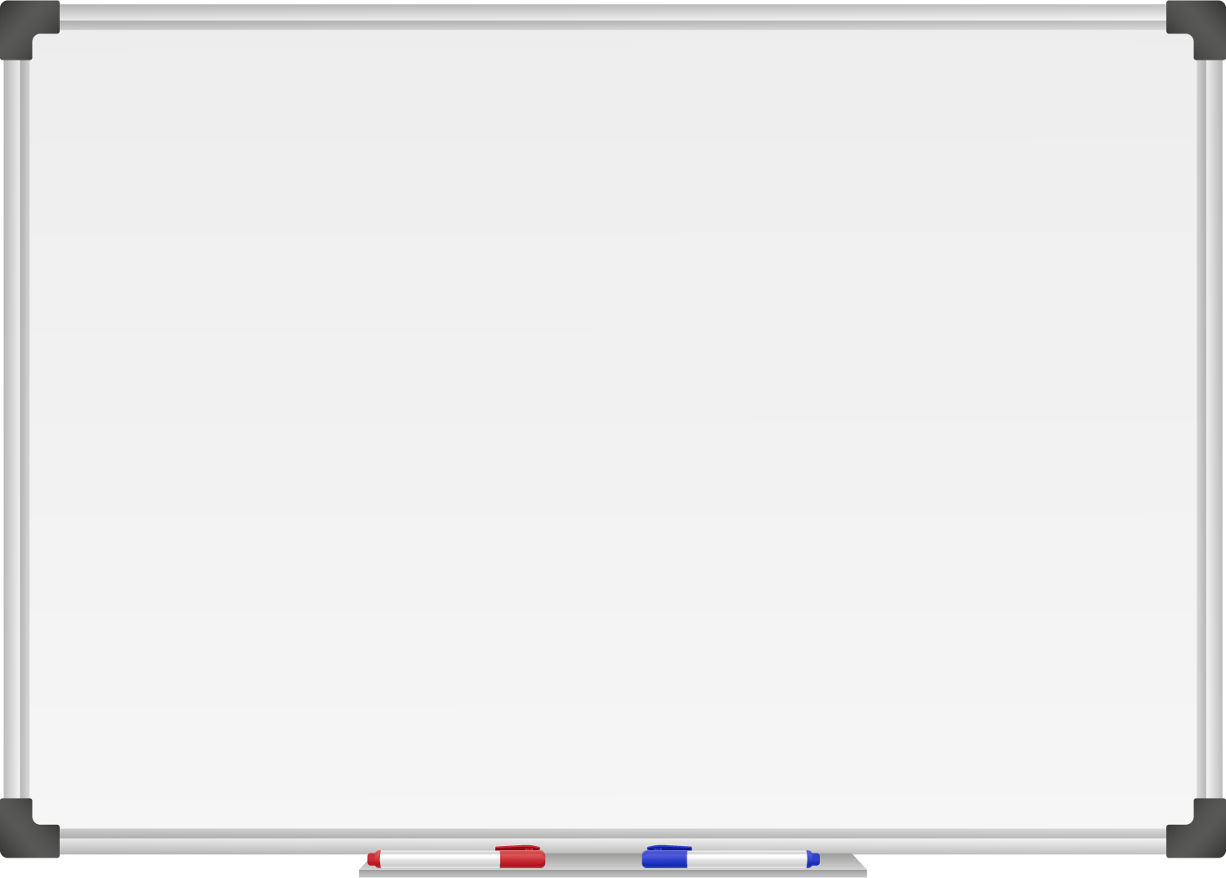







WELL DONE! You have unlocked number 4!
10 Ways to Move More Sit Less
  ____ ___ __ ____ _ ___
  ____ ____ ____ ____ ____
  ____ ____ ____ ___ _ ____ ____
  ____ ________
  ____ ____ __ ____
  ____ ____ ____ ____ _ ____ _ ____
Morning Stretch
Walk, cycle or scoot to school
Play games with friends at break and lunch
Remember to move for 5 – 10 minutes every hour

Slide 8
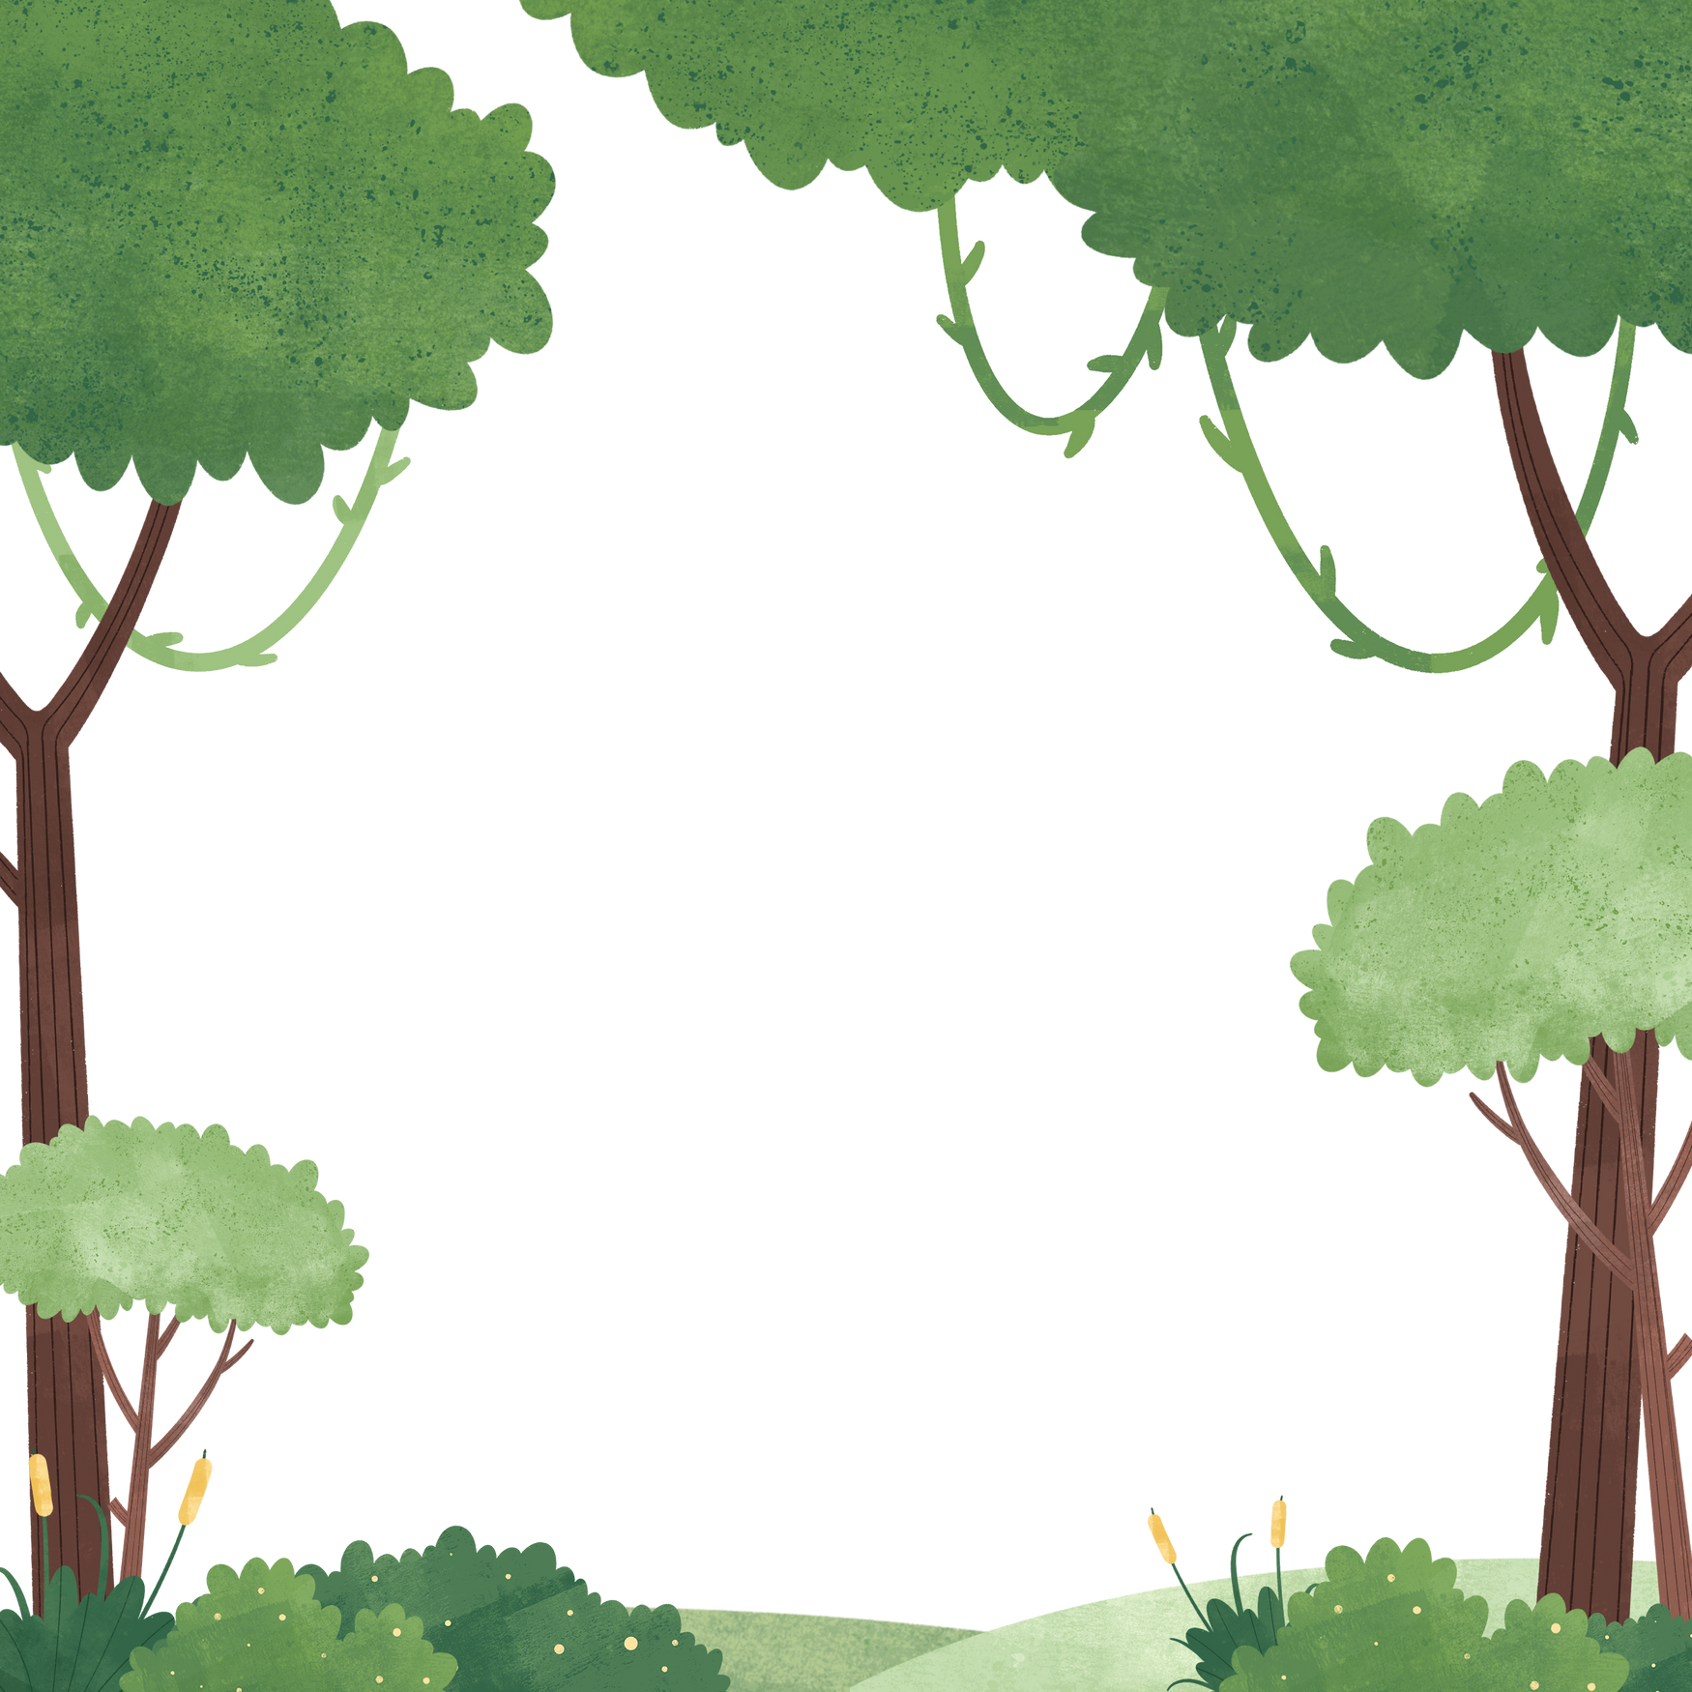

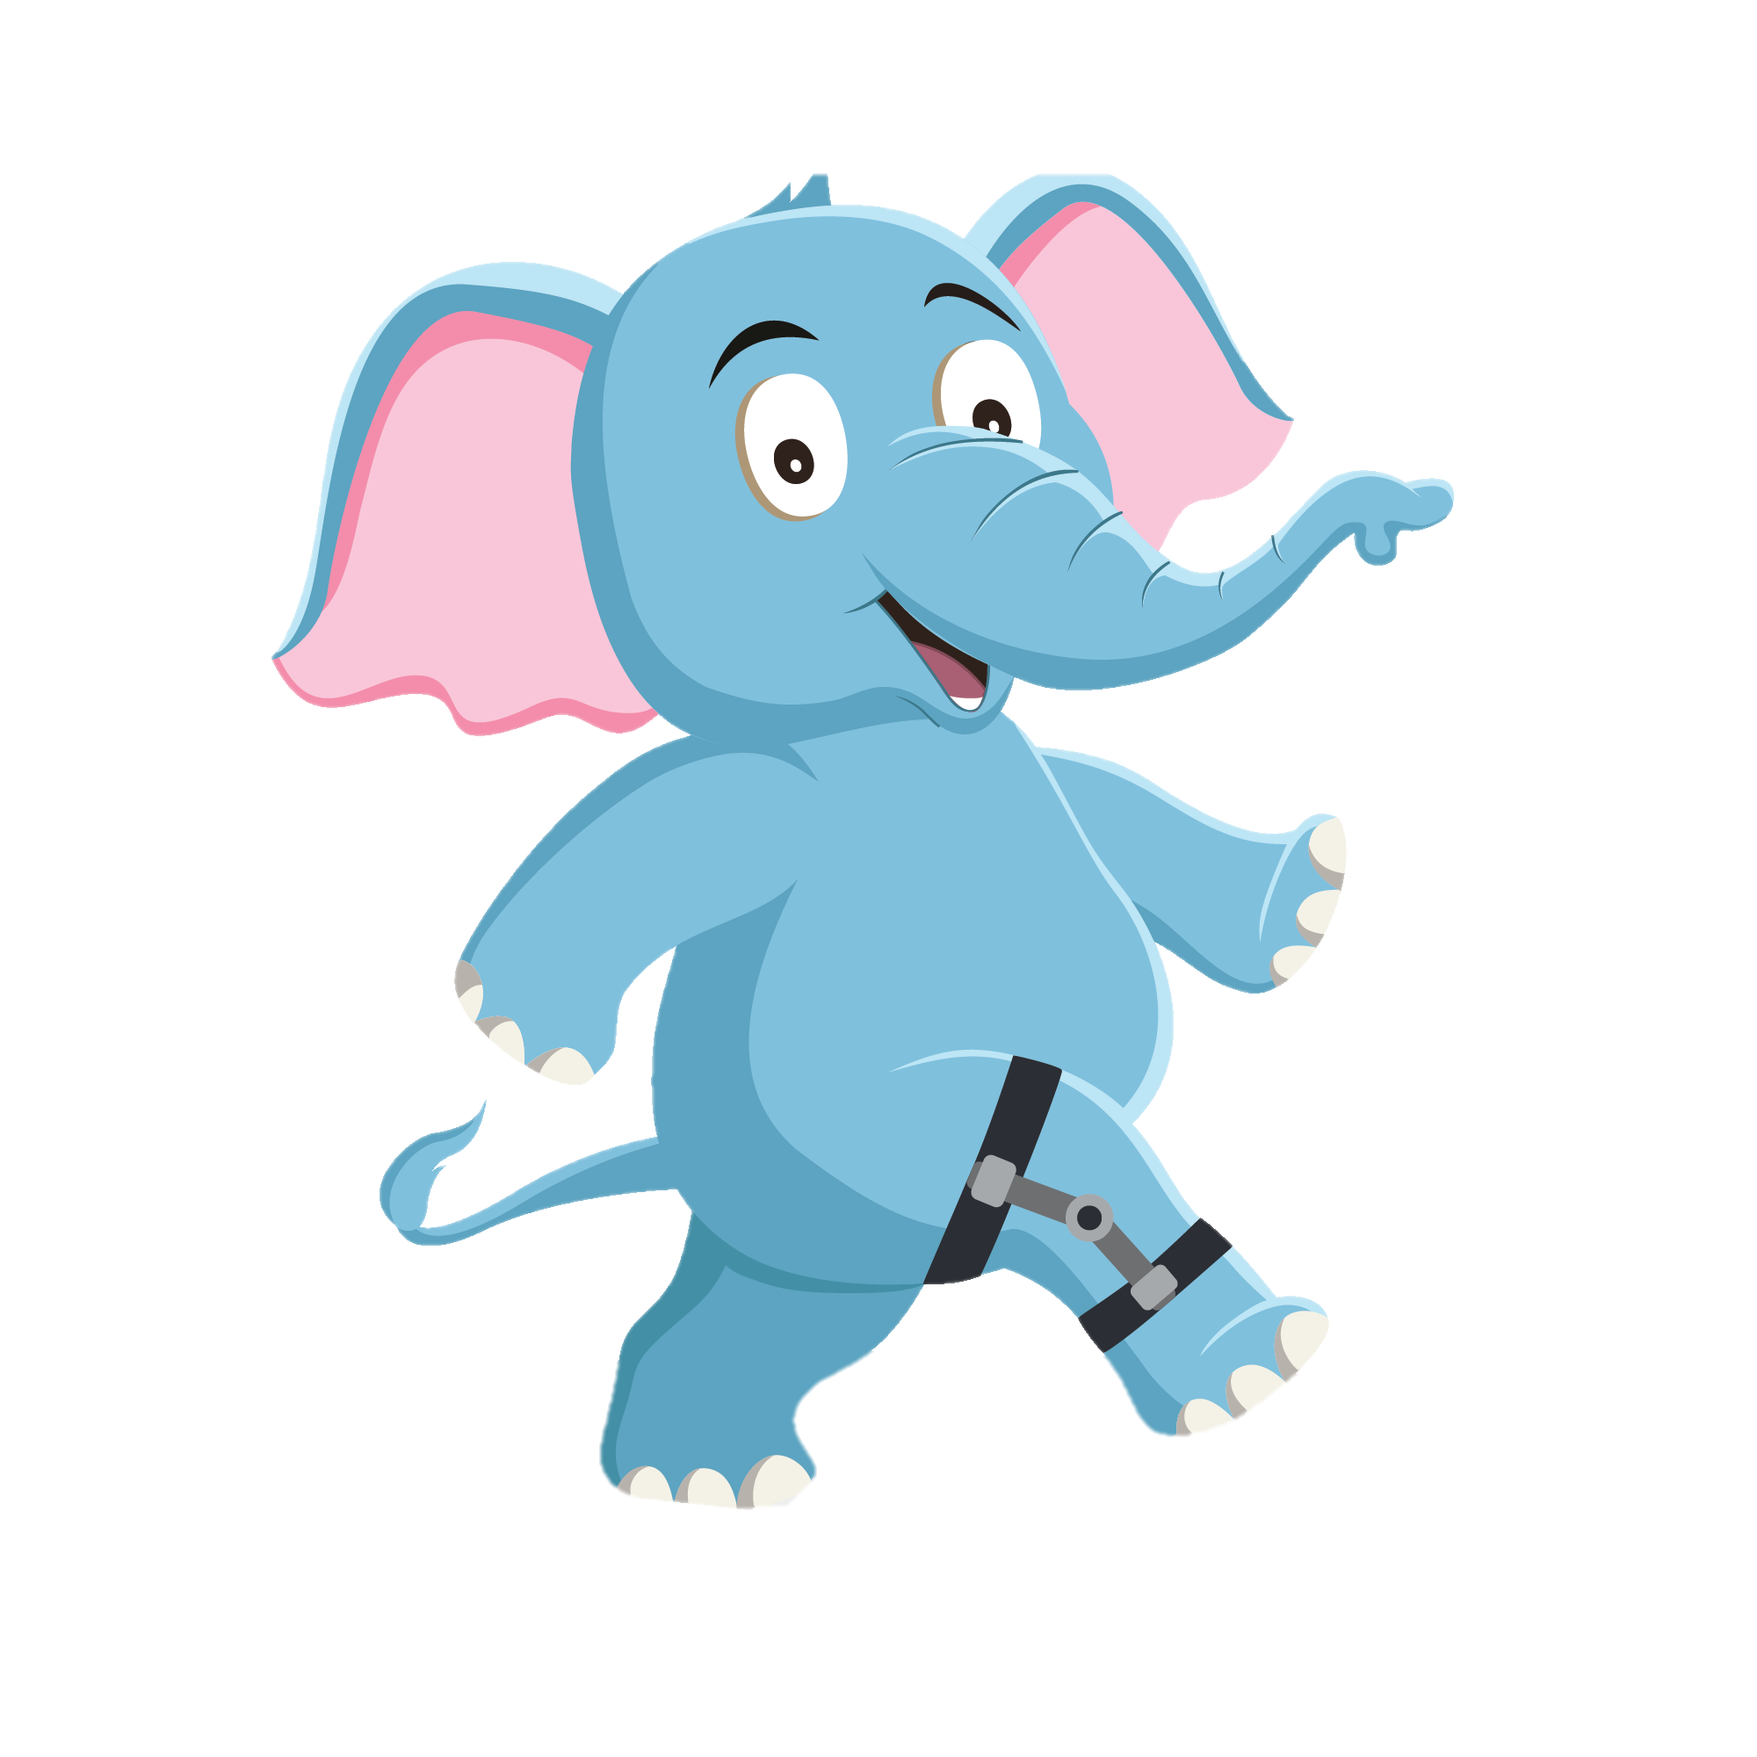
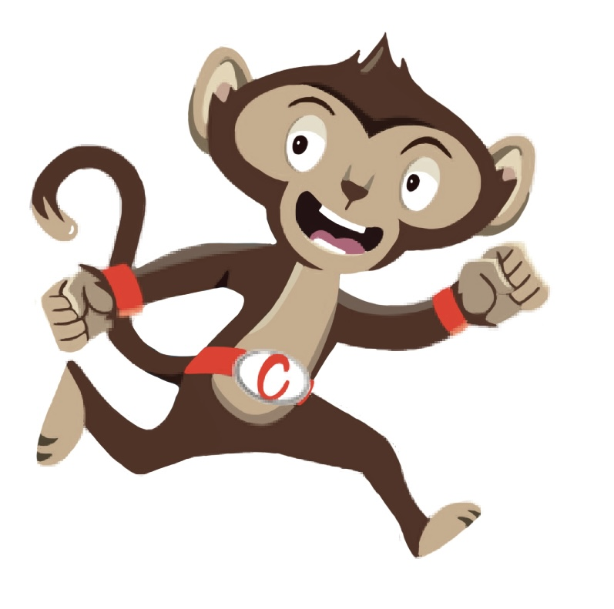
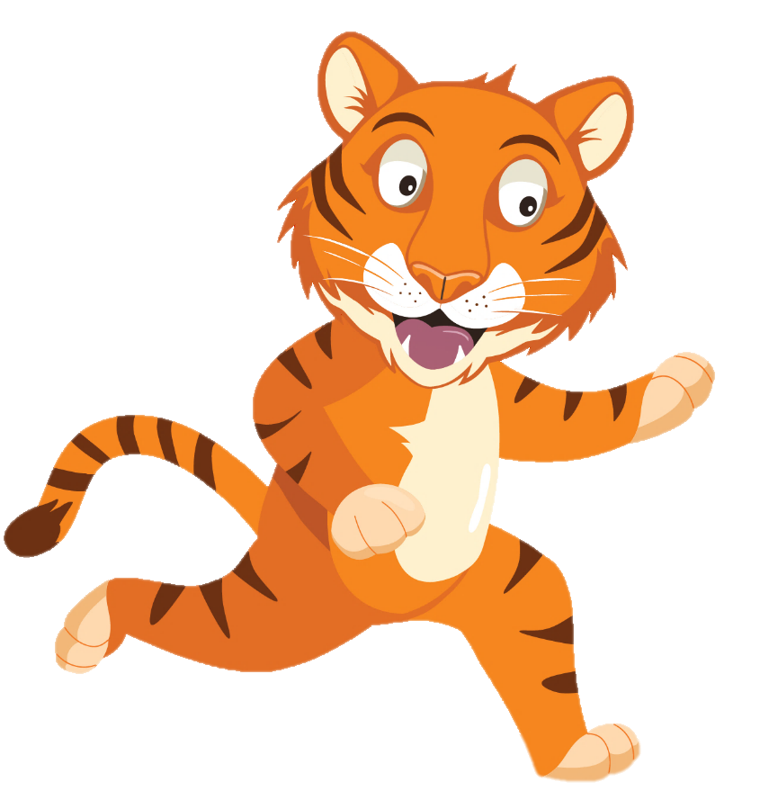
“Moving more helps me with my work”
“We need to move more often”
“Brain breaks are
a fun way
to move”
You have gained 4 healthy hearts!

Slide 9
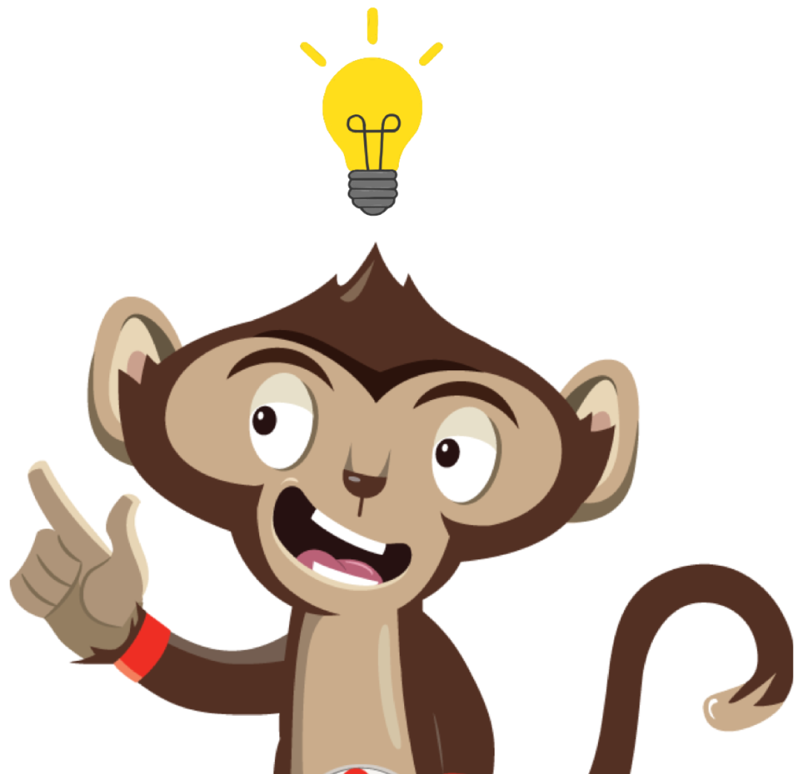
Brain Break
Brain breaks can help with schoolwork and make us move more.
Why not try a Brain Break Activity
Notes:
Sometimes we need to give our brain a break when we have been sitting for a long time. This can help us concentrate on our work after. This week why not try one of our brain break activities each day and get creative.

