Slide 1
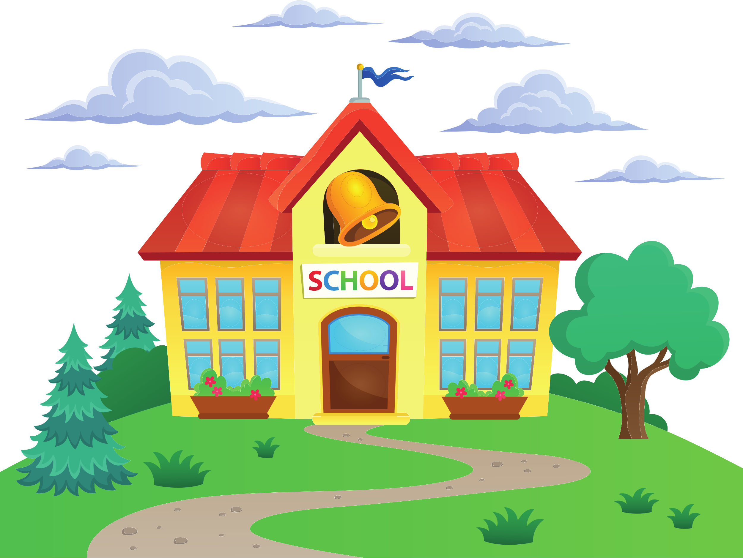
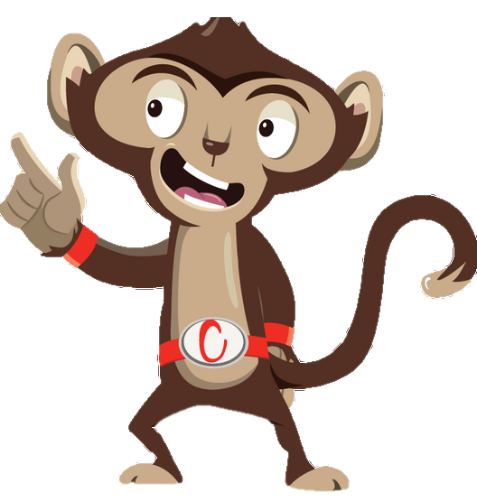


Chester’s Active Quest: Week 4

Slide 2
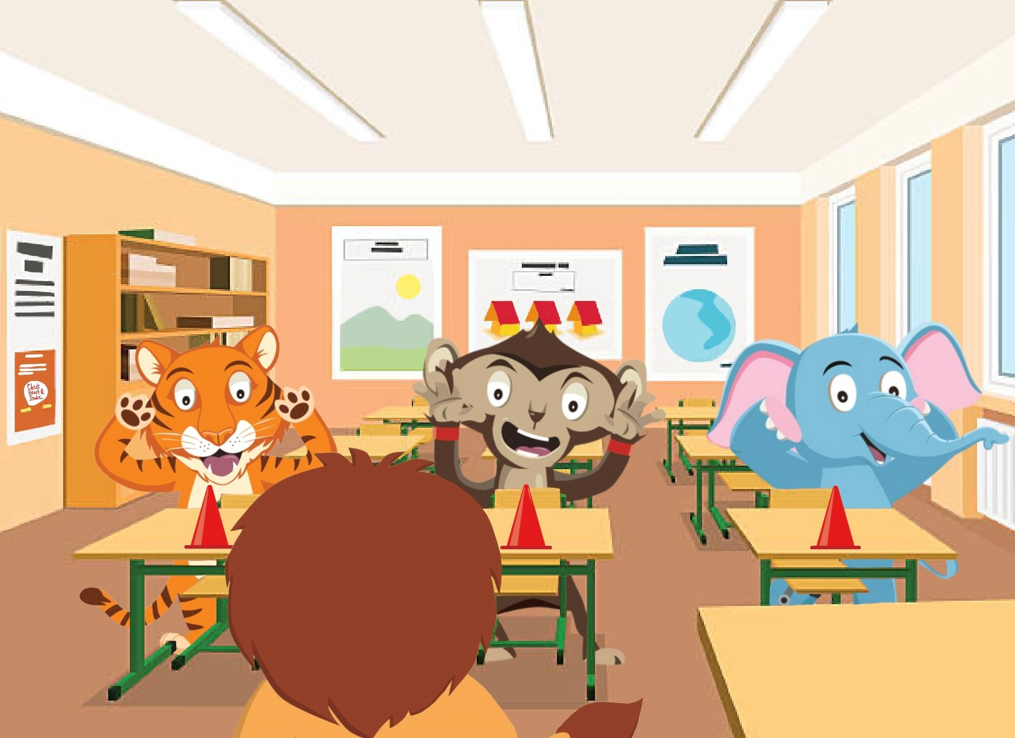

Notes:
Chester is sitting at his desk working on a problem solving work sheet. He gets to the final question and suddenly his mind goes blank. He can’t think of the answer, so he decides to work on his art homework. The teacher notices that many of the pupils appear to be fidgeting, have lost their focus, and the noise level in the room is beginning to rise. Mrs Liona needs something to energize her class. She jumps up and shouts excitedly, “Ok everyone, let’s all have a brain break”. The class push their chairs in eagerly and find a space in the classroom. She instructs everyone to grab a cone and place it in front of them. “Make sure you listen carefully and don’t be the last person to touch the cone”, Mrs Liona explains. The class pay close attention. “I’m going to tell you where to place your hands, it could be on your head, shoulder, knees or cone, in any order”, she continues. “Let’s see who is faster than me”, Mrs Liona says confidently. The game begins and Chester tries not to get caught out as best he can. The teachers continues to try and trick the class, but everyone is doing so well. The class is laughing and having a great time. A brain break was just what Chester needed. The short game finishes and the class take their seats. Chester feels focused and ready to take on that problem solving challenge.

Slide 3
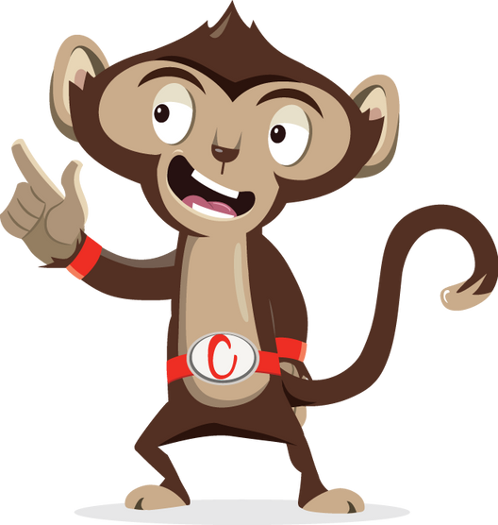
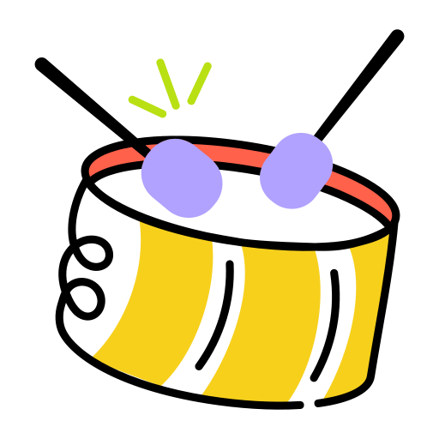
Can you solve this riddle?
I beat like a drum, but your ears can’t hear me, what am I?

Slide 4
Can you solve this riddle?
1
2
3

Slide 5
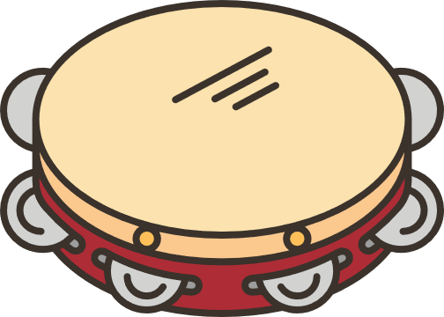
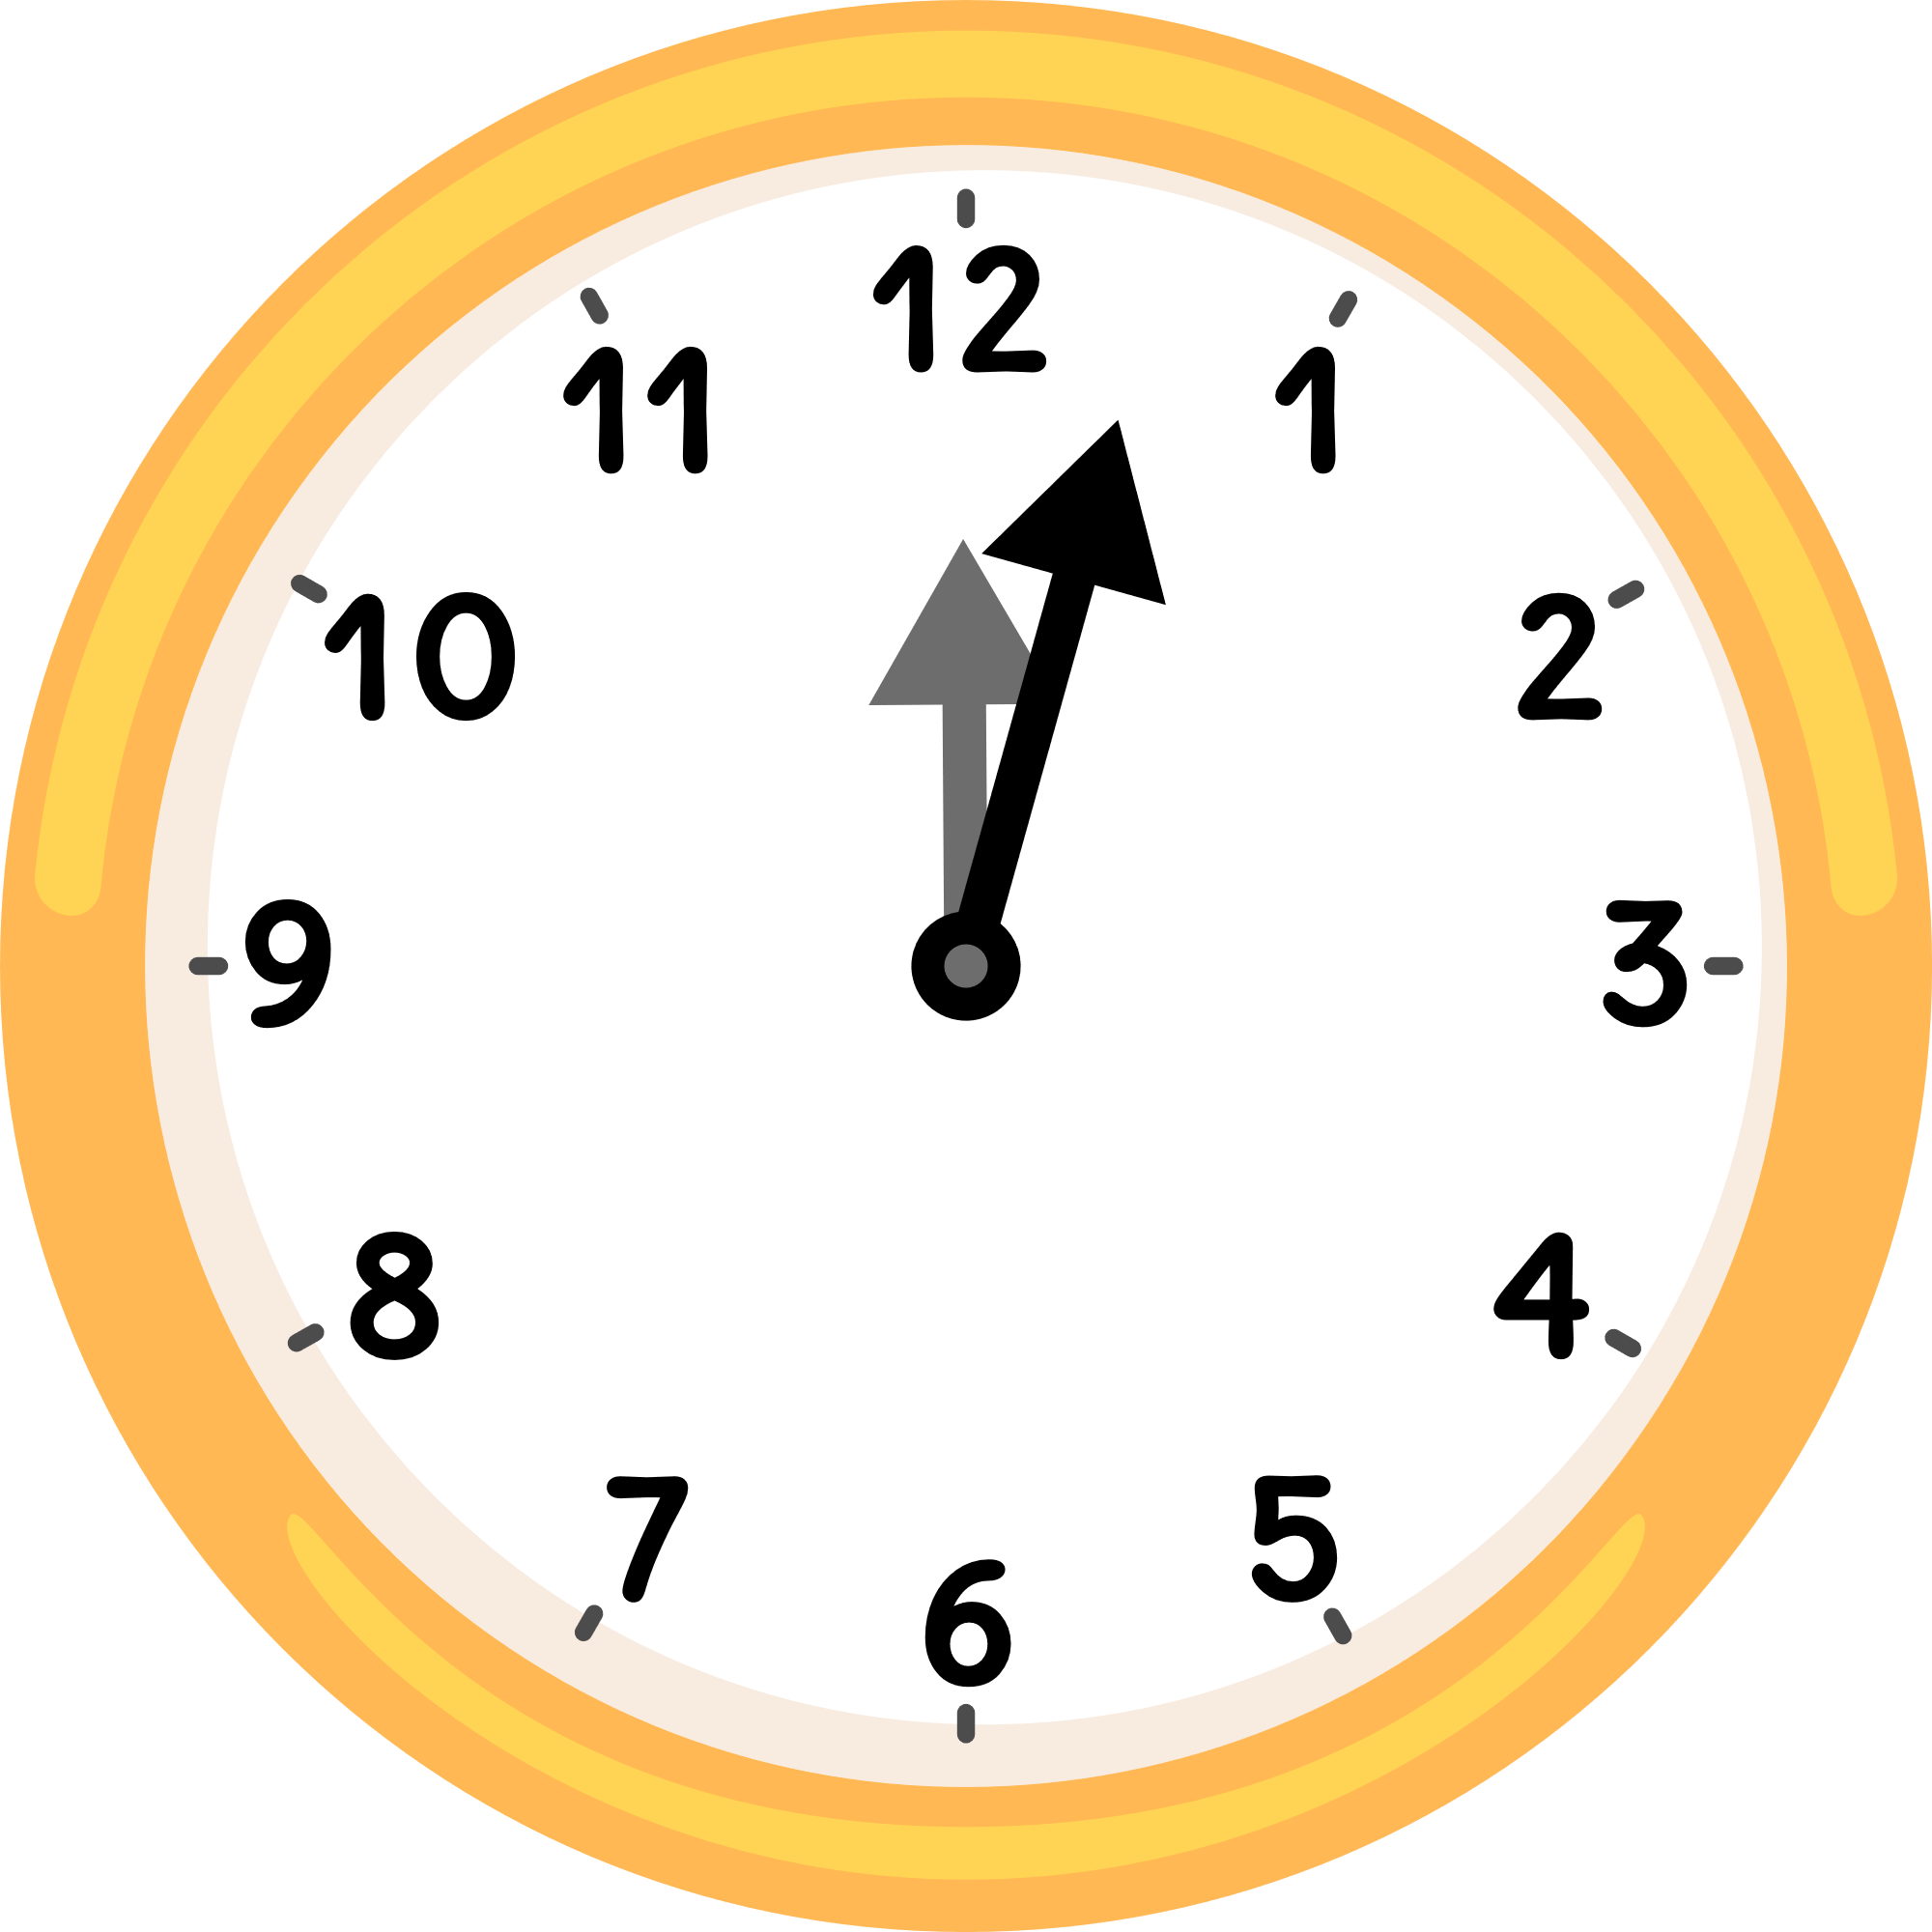
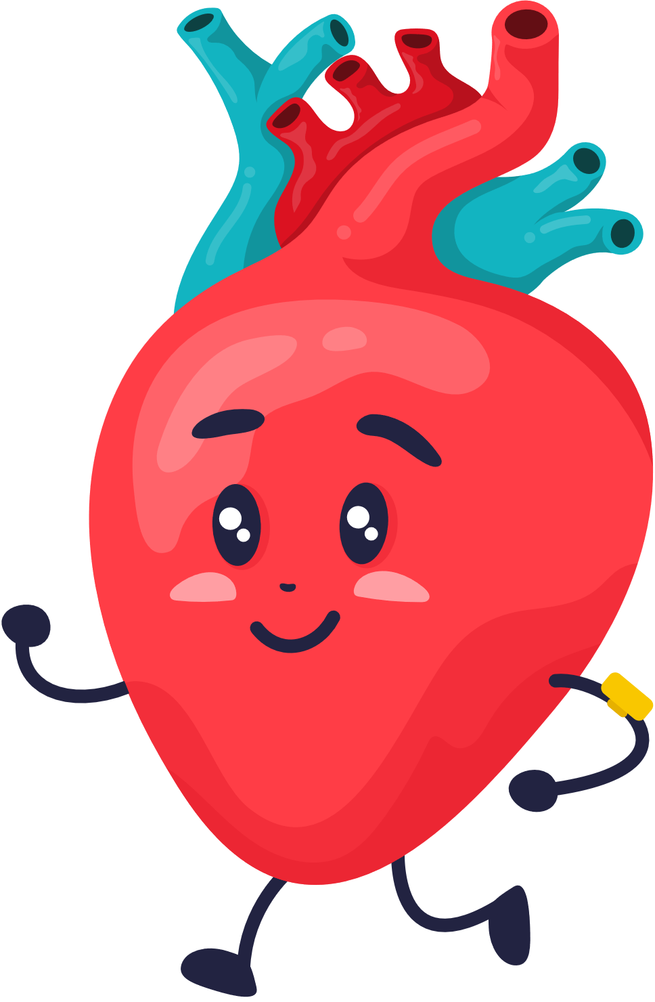
Can you solve this riddle?
1
Tambourine
2
Clock
3
Heart

Slide 6
Can you solve this riddle?
3
Heart
Notes:
Regular activity keeps our heart healthy and strong because it beats faster when we are moving

Slide 7
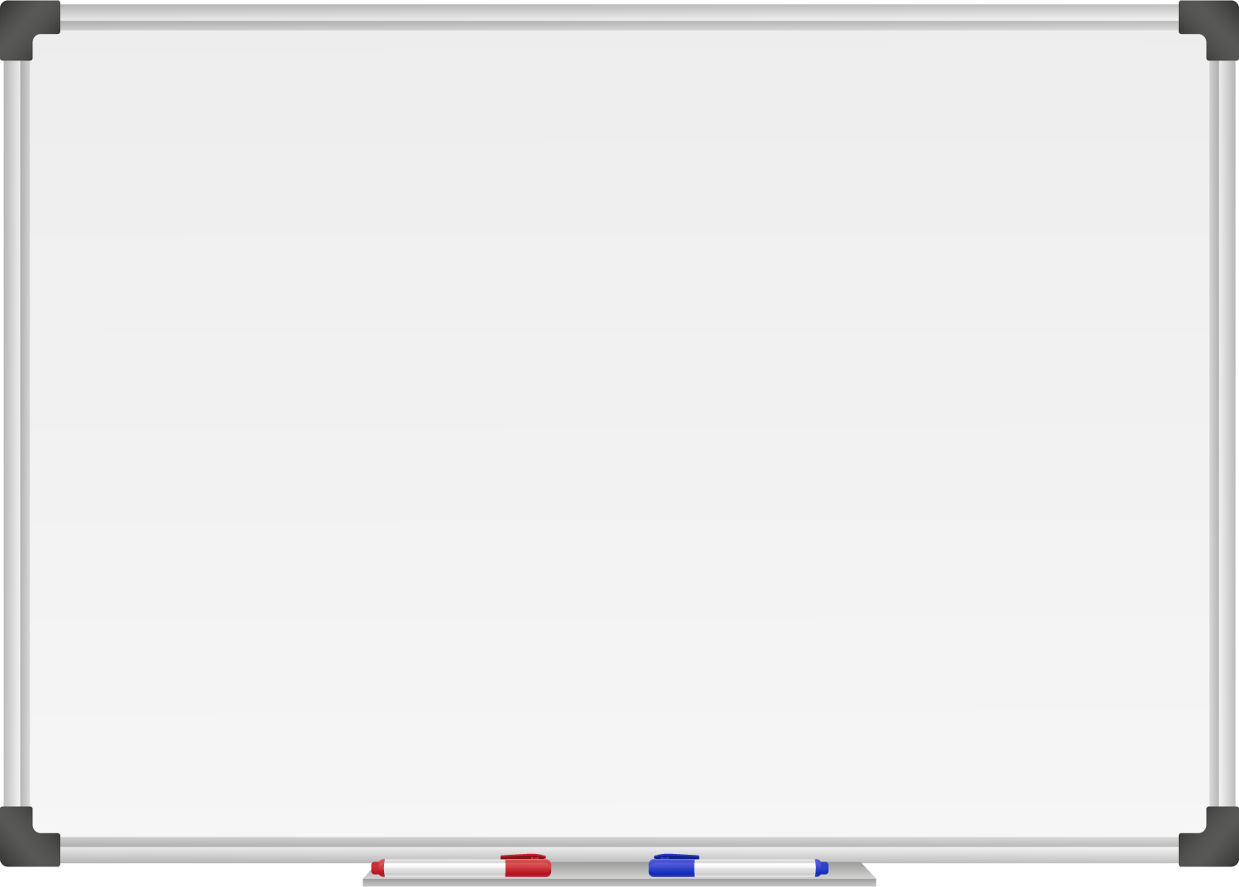







WELL DONE! You have unlocked number 4!
10 Ways to Move More Sit Less
  ____ ___ __ ____ _ ___
  ____ ____ ____ ____ ____
  ____ ____ ____ ___ _ ____ ____
  ____ ________
  ____ ____ __ ____
  ____ ____ ____ ____ _ ____ _ ____
Morning Stretch
Walk, cycle or scoot to school
Play games with friends at break and lunch
Remember to move for 5 – 10 minutes every hour
Notes:
The more physically active (where we are out of breath but could still talk to a friend) we are, the more effective our heart gets at pumping blood full of oxygen to the other important organs in our body.

Slide 8
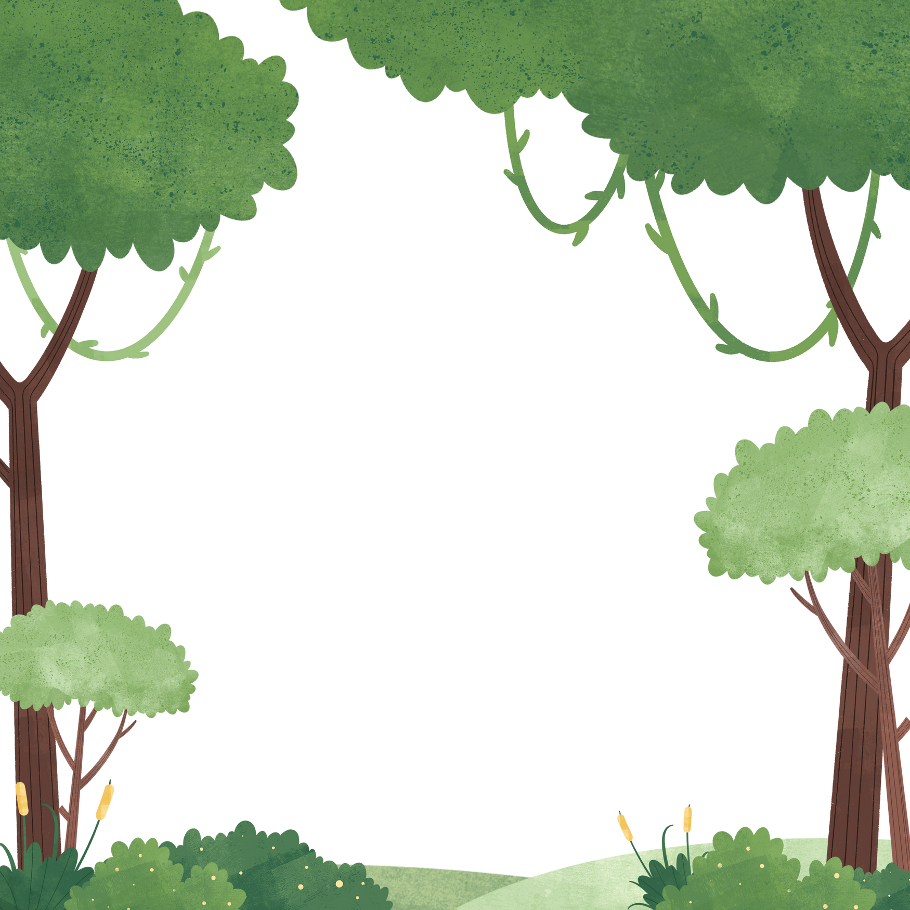

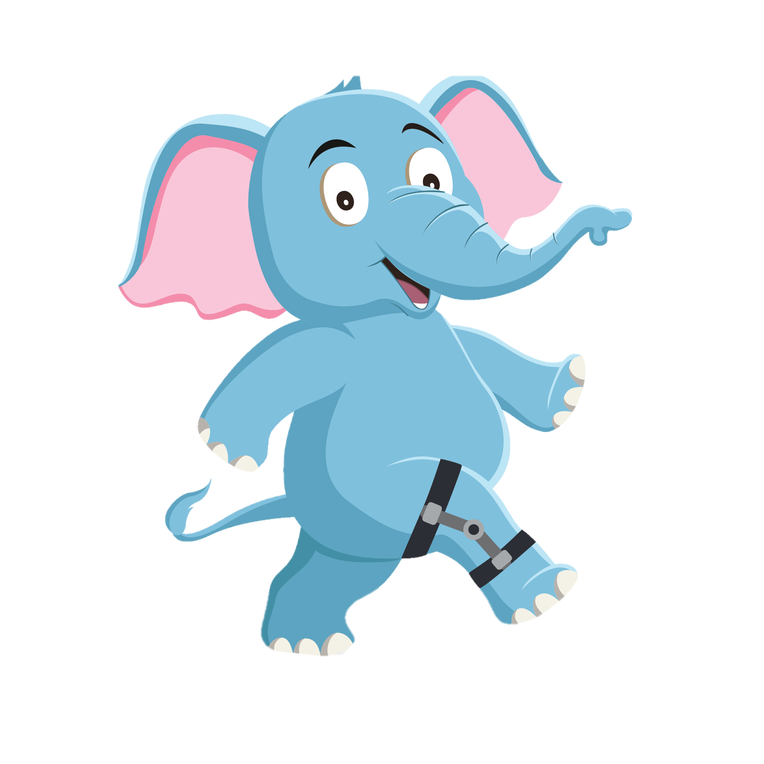
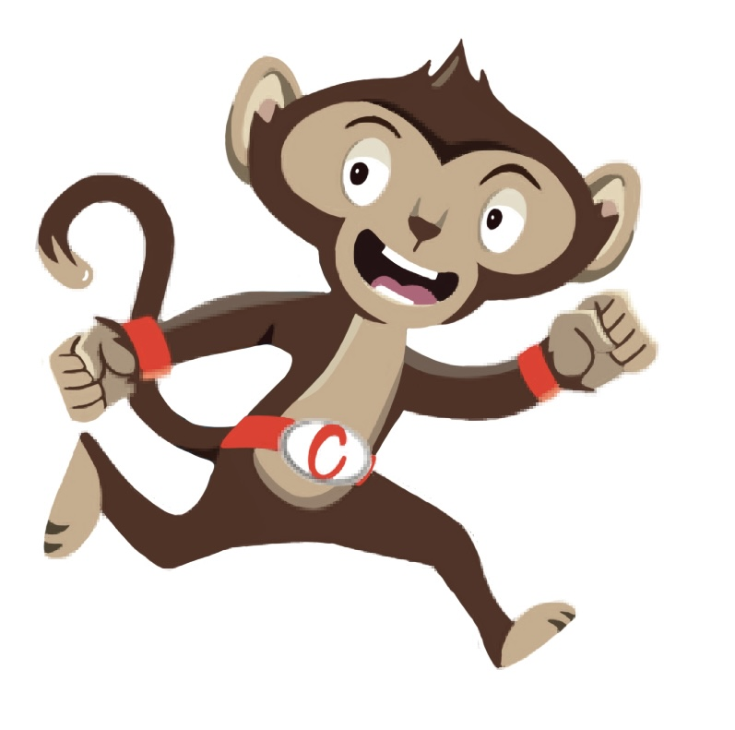
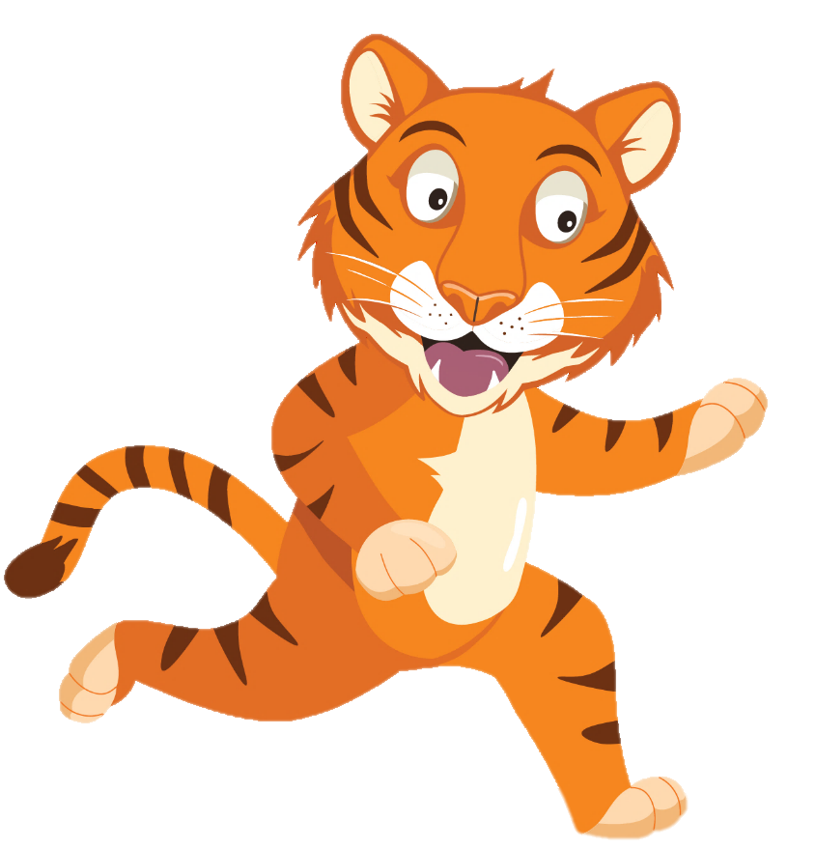
“Moving more helps me with my work”
“We need to move more often”
“Brain breaks are
a fun way
to move”
You have gained 4 healthy hearts!

Slide 9
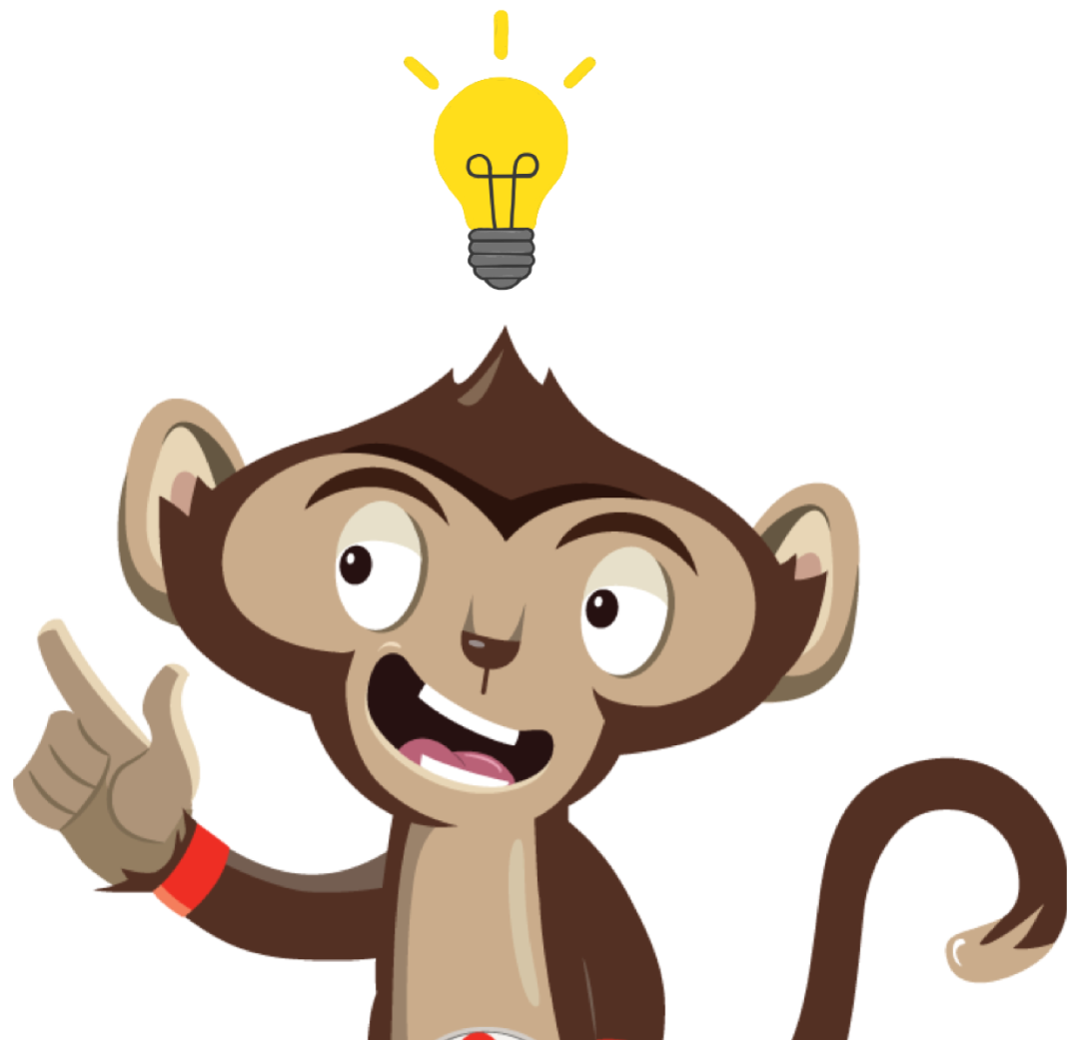
Brain Break
Brain breaks can help with schoolwork and make us move more.
Why not try a Brain Break Activity
Notes:
Sometimes we need to give our brain a break when we have been sitting for a long time. This can help us concentrate on our work after. This week why not try one of our brain break activities each day and get creative.

