Slide 1
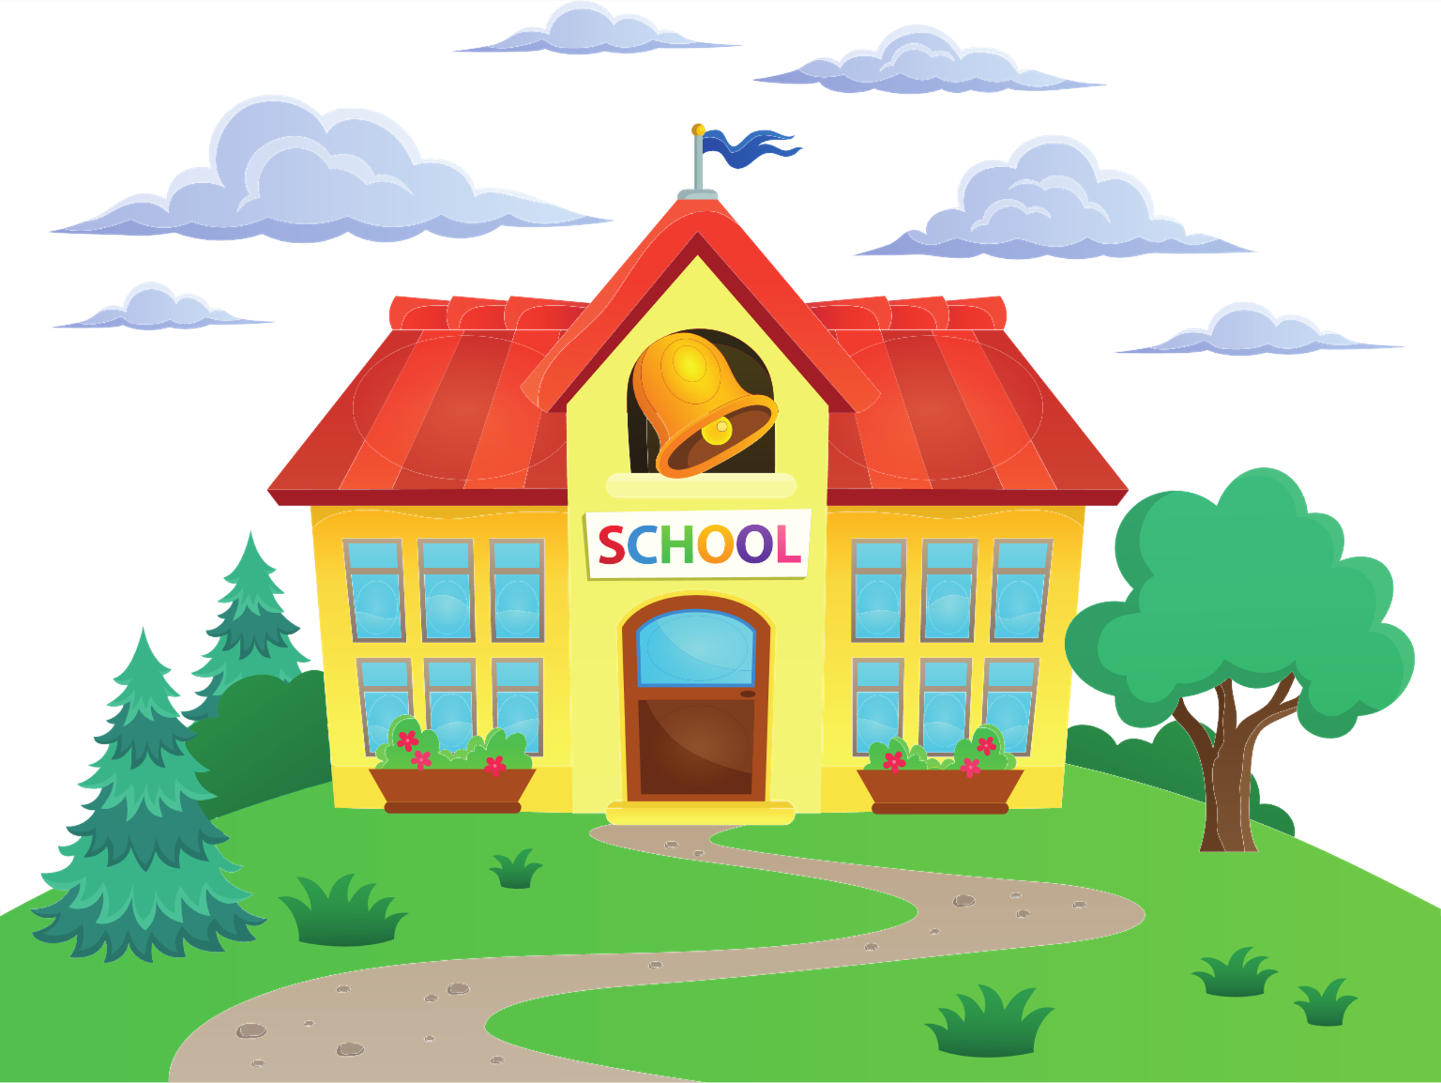
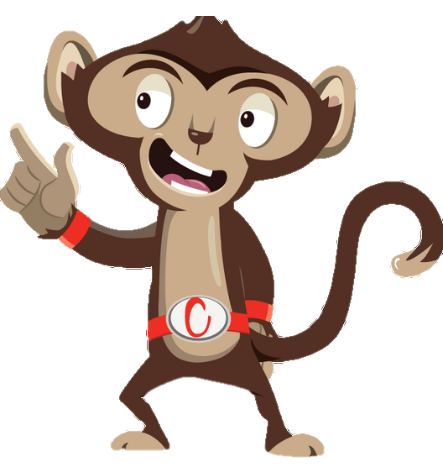


Chester’s Active Quest: Week 5

Slide 2
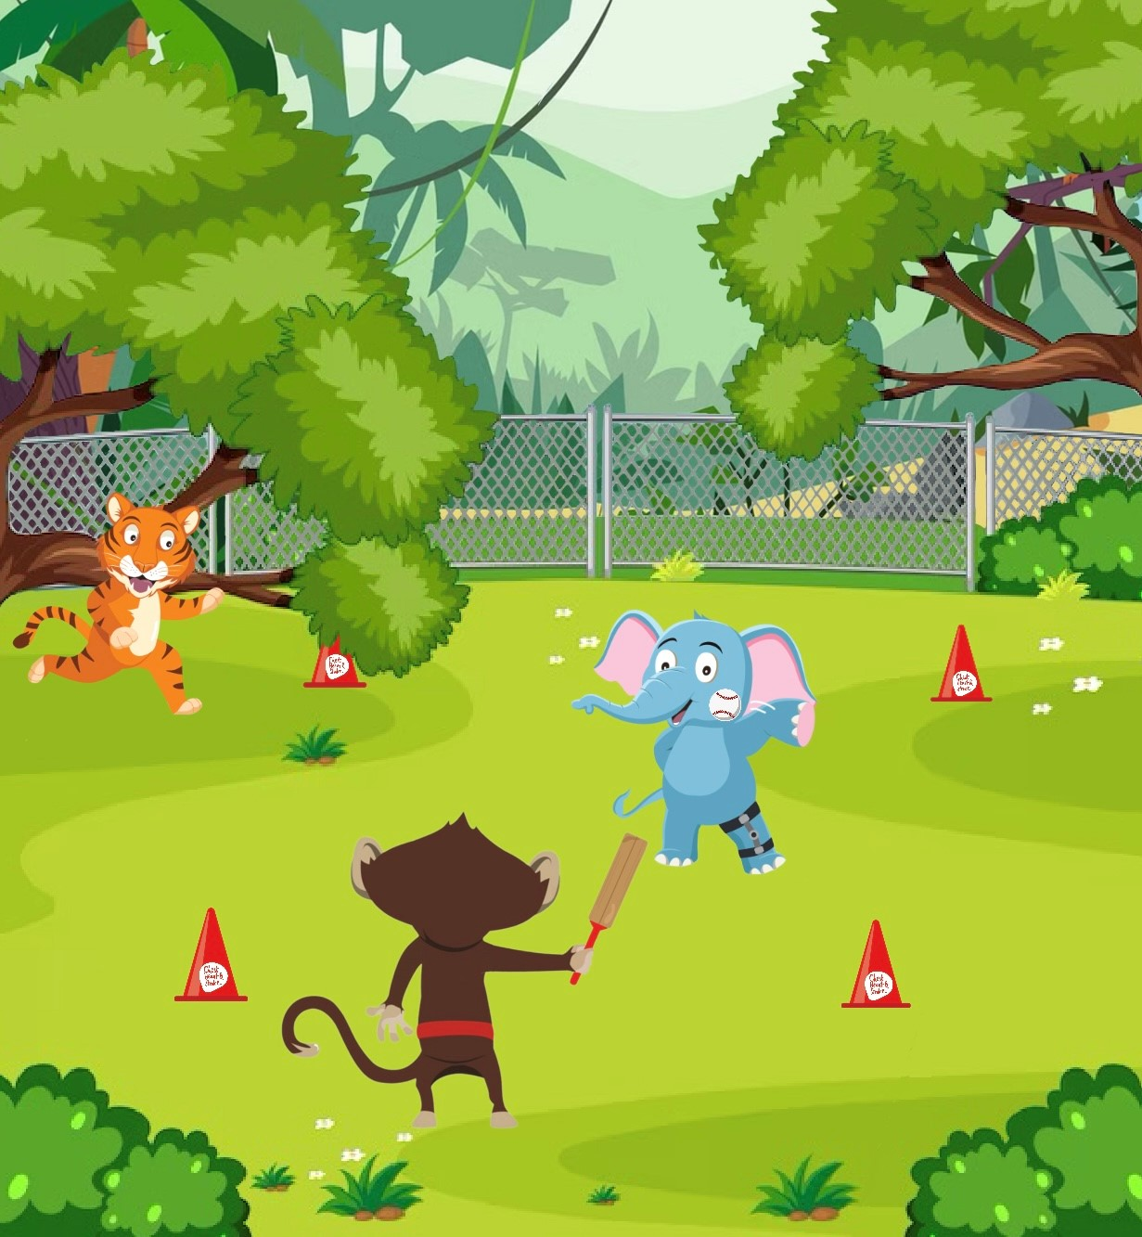

Notes:
The bell rings for lunchtime. Ellie, Chester and Timmy can’t wait to get back outside and have some fun in the sun. They head toward the green, grass playground. "Let's play a new game!" Chester said, hopping up and down with excitement. "Ellie, you can throw the ball, I'll hit it with the bat, and Timmy can try to catch it." “What a great idea, then we can all change places”, Timmy says. Ellie picks up the ball with her trunk, leans back, and with a powerful swing, throws the ball high into the air. Chester stands ready with his bat, eyes focused on the ball. As the ball comes towards him, Chester swings the bat with all his might. "BANG!" The ball flies through the air, heading straight for Timmy. Timmy zooms past so quickly that his stripes become blurry. "I got it! I got it!" Timmy shouted, leaping into the air and catches the ball before it hits the ground. "Great catch, Timmy!" Ellie cheers, clapping her big elephant ears. Chester jumps into the air with excitement. They take turns throwing the ball, laughing, running and catching their breath. They make sure they spend as much time as they can playing. This is because they know they need to get at least 60 minutes of physical activity every day. An activity that makes their hearts beat fast, makes them slightly out of breath but can still talk to a friend. This will help their hearts, minds and bodies healthy.

Slide 3
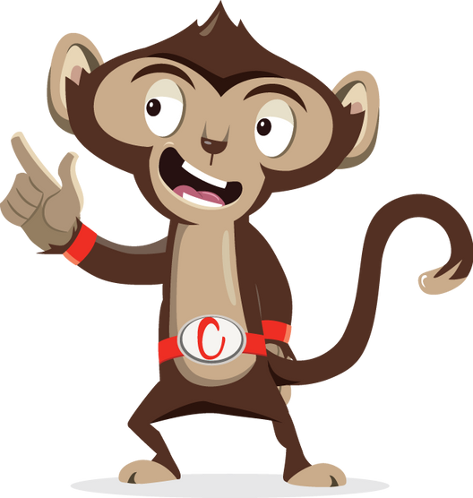
How many minutes of physical activity should you do everyday?
1
2
3
Notes:
Ask pupils to answer the question while standing. If pupils think the answer is A = they stand with their hands on their head, B = stand with arms crossed and C = stand with both hands in the air. If space is not limited, put the letters A, B and C around the room and ask pupils to move to the area they think the answer is.

Slide 4
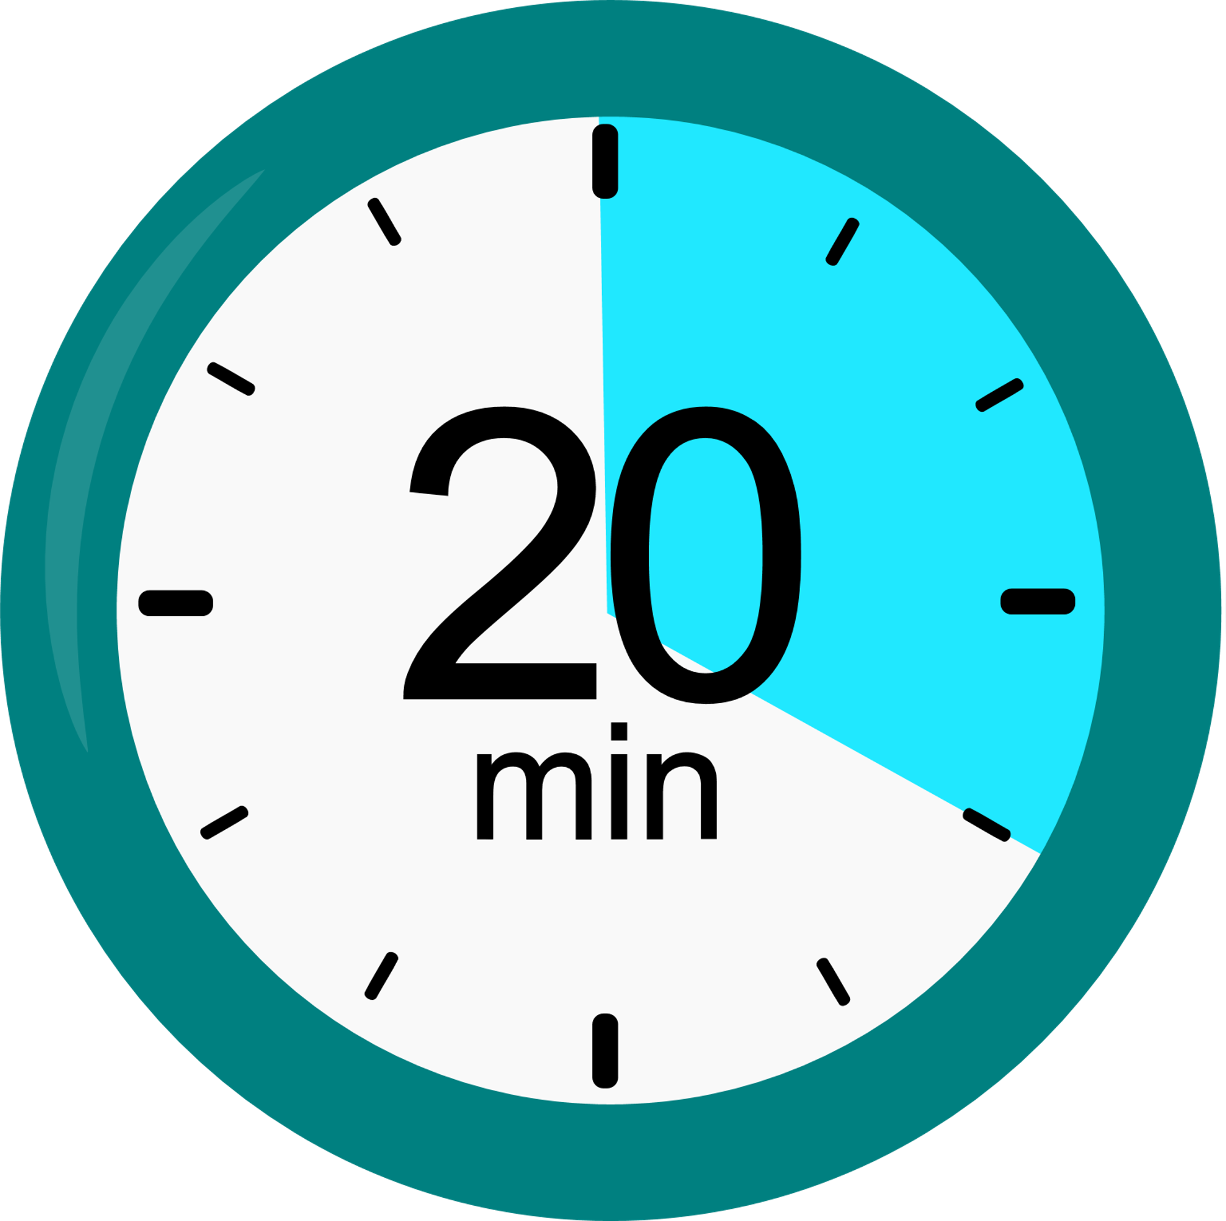
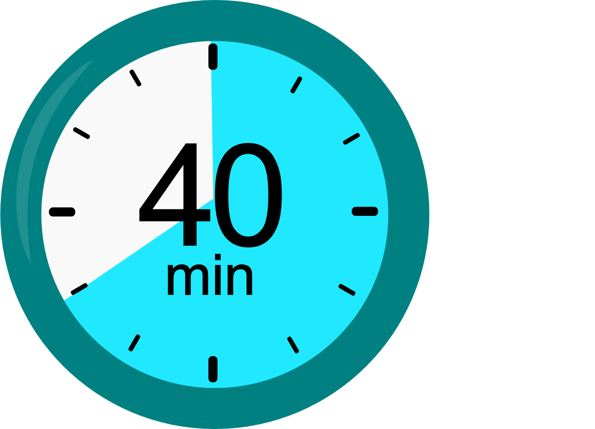
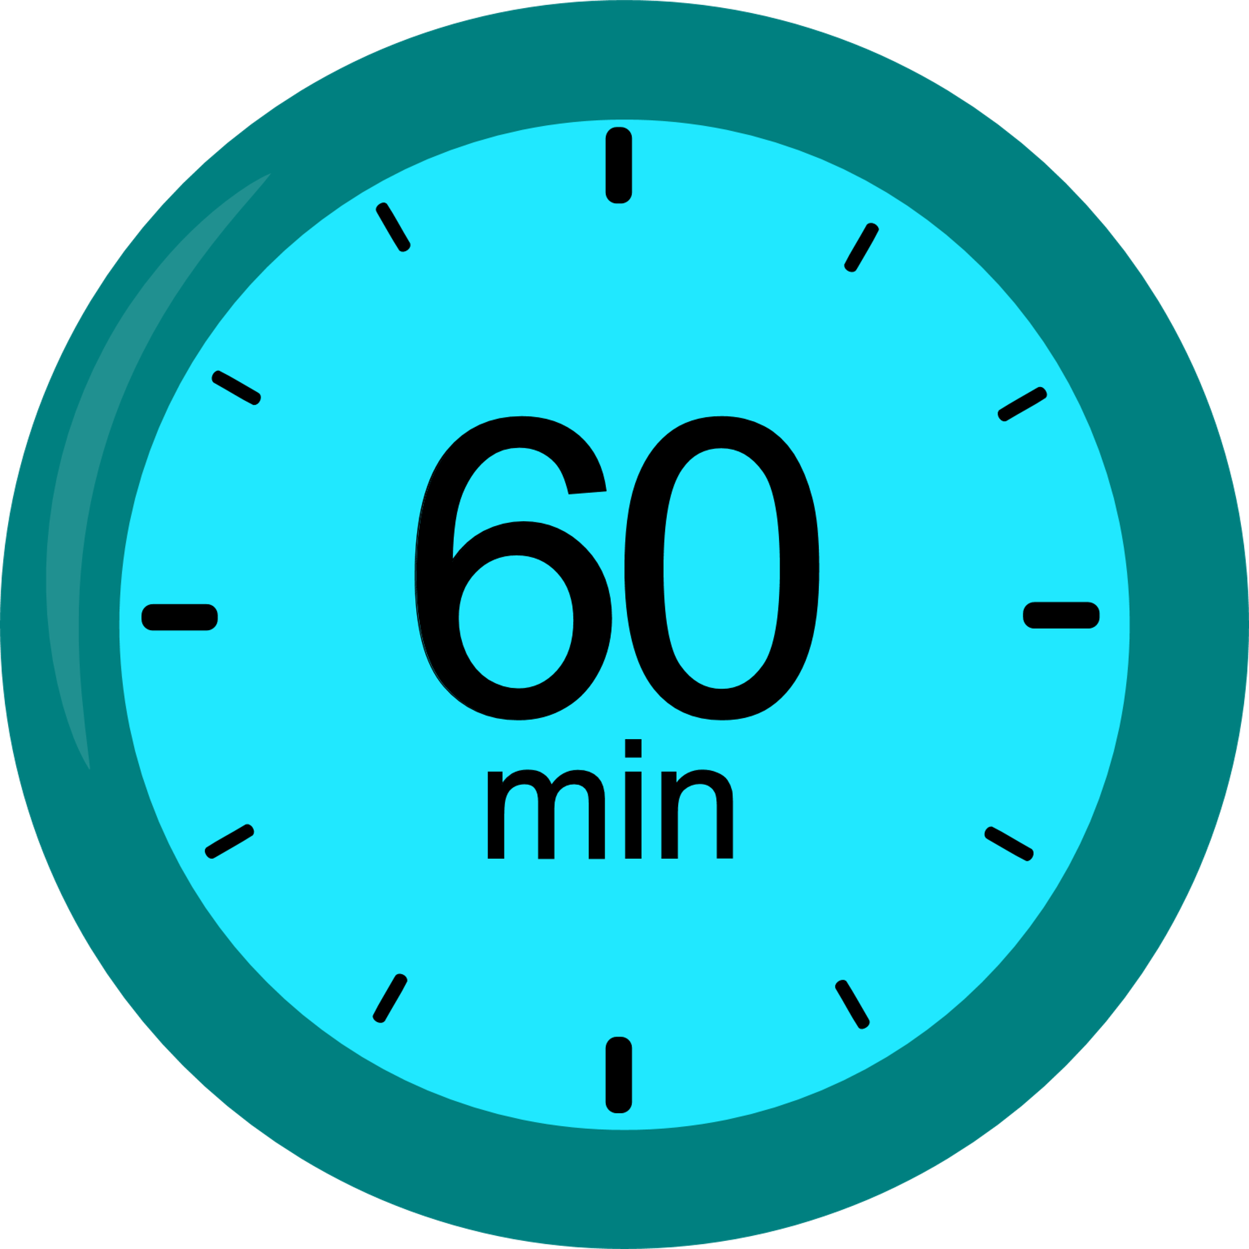
How many minutes of physical activity should you do everyday?
1
20 minutes
2
40 minutes
3
60 minutes (1hour)
Notes:
Ask pupils to answer the question while standing. If pupils think the answer is A = they stand with their hands on their head, B = stand with arms crossed and C = stand with both hands in the air. If space is not limited, put the letters A, B and C around the room and ask pupils to move to the area they think the answer is.

Slide 5
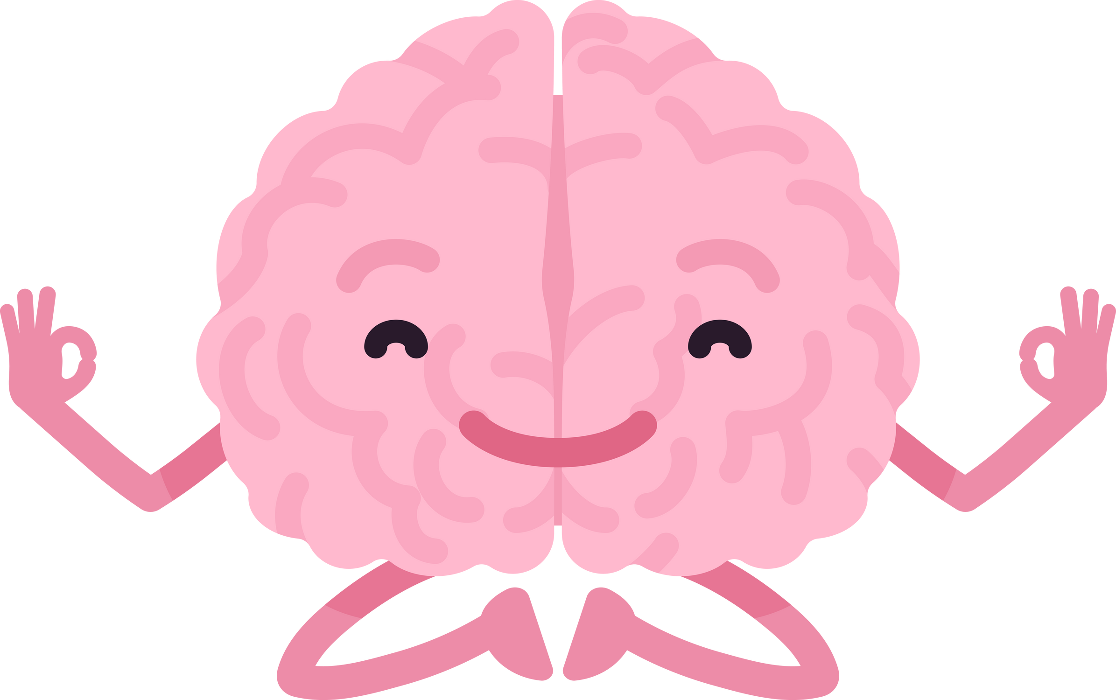
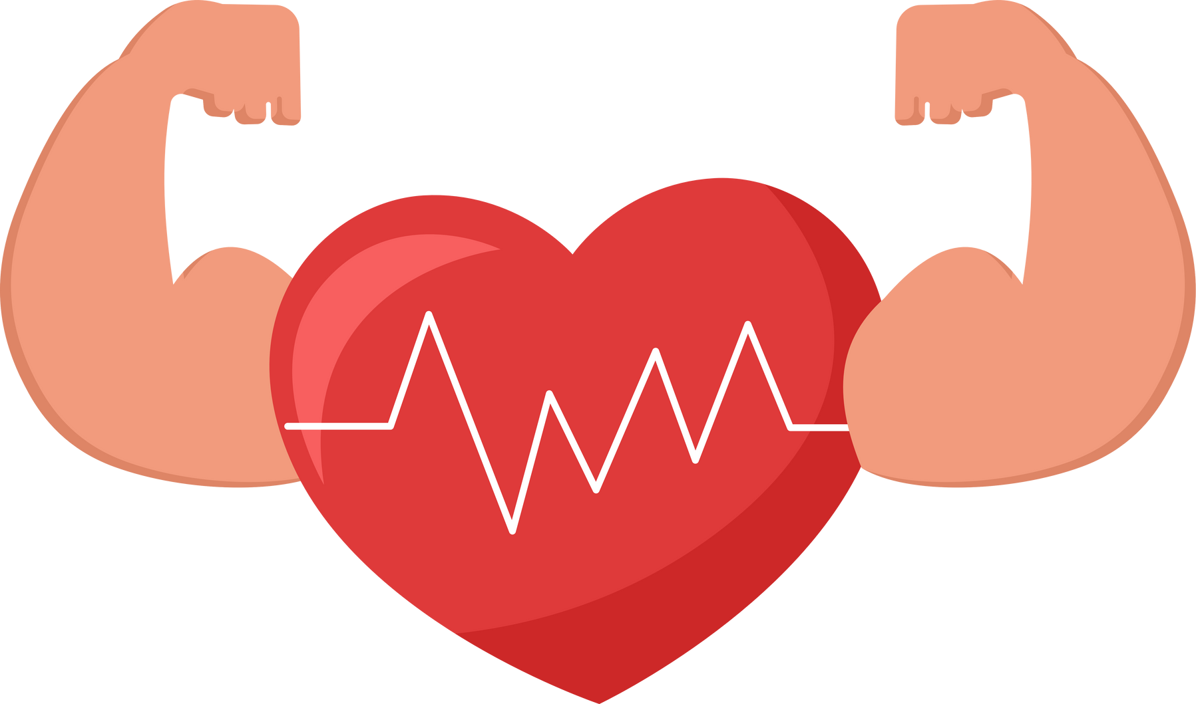
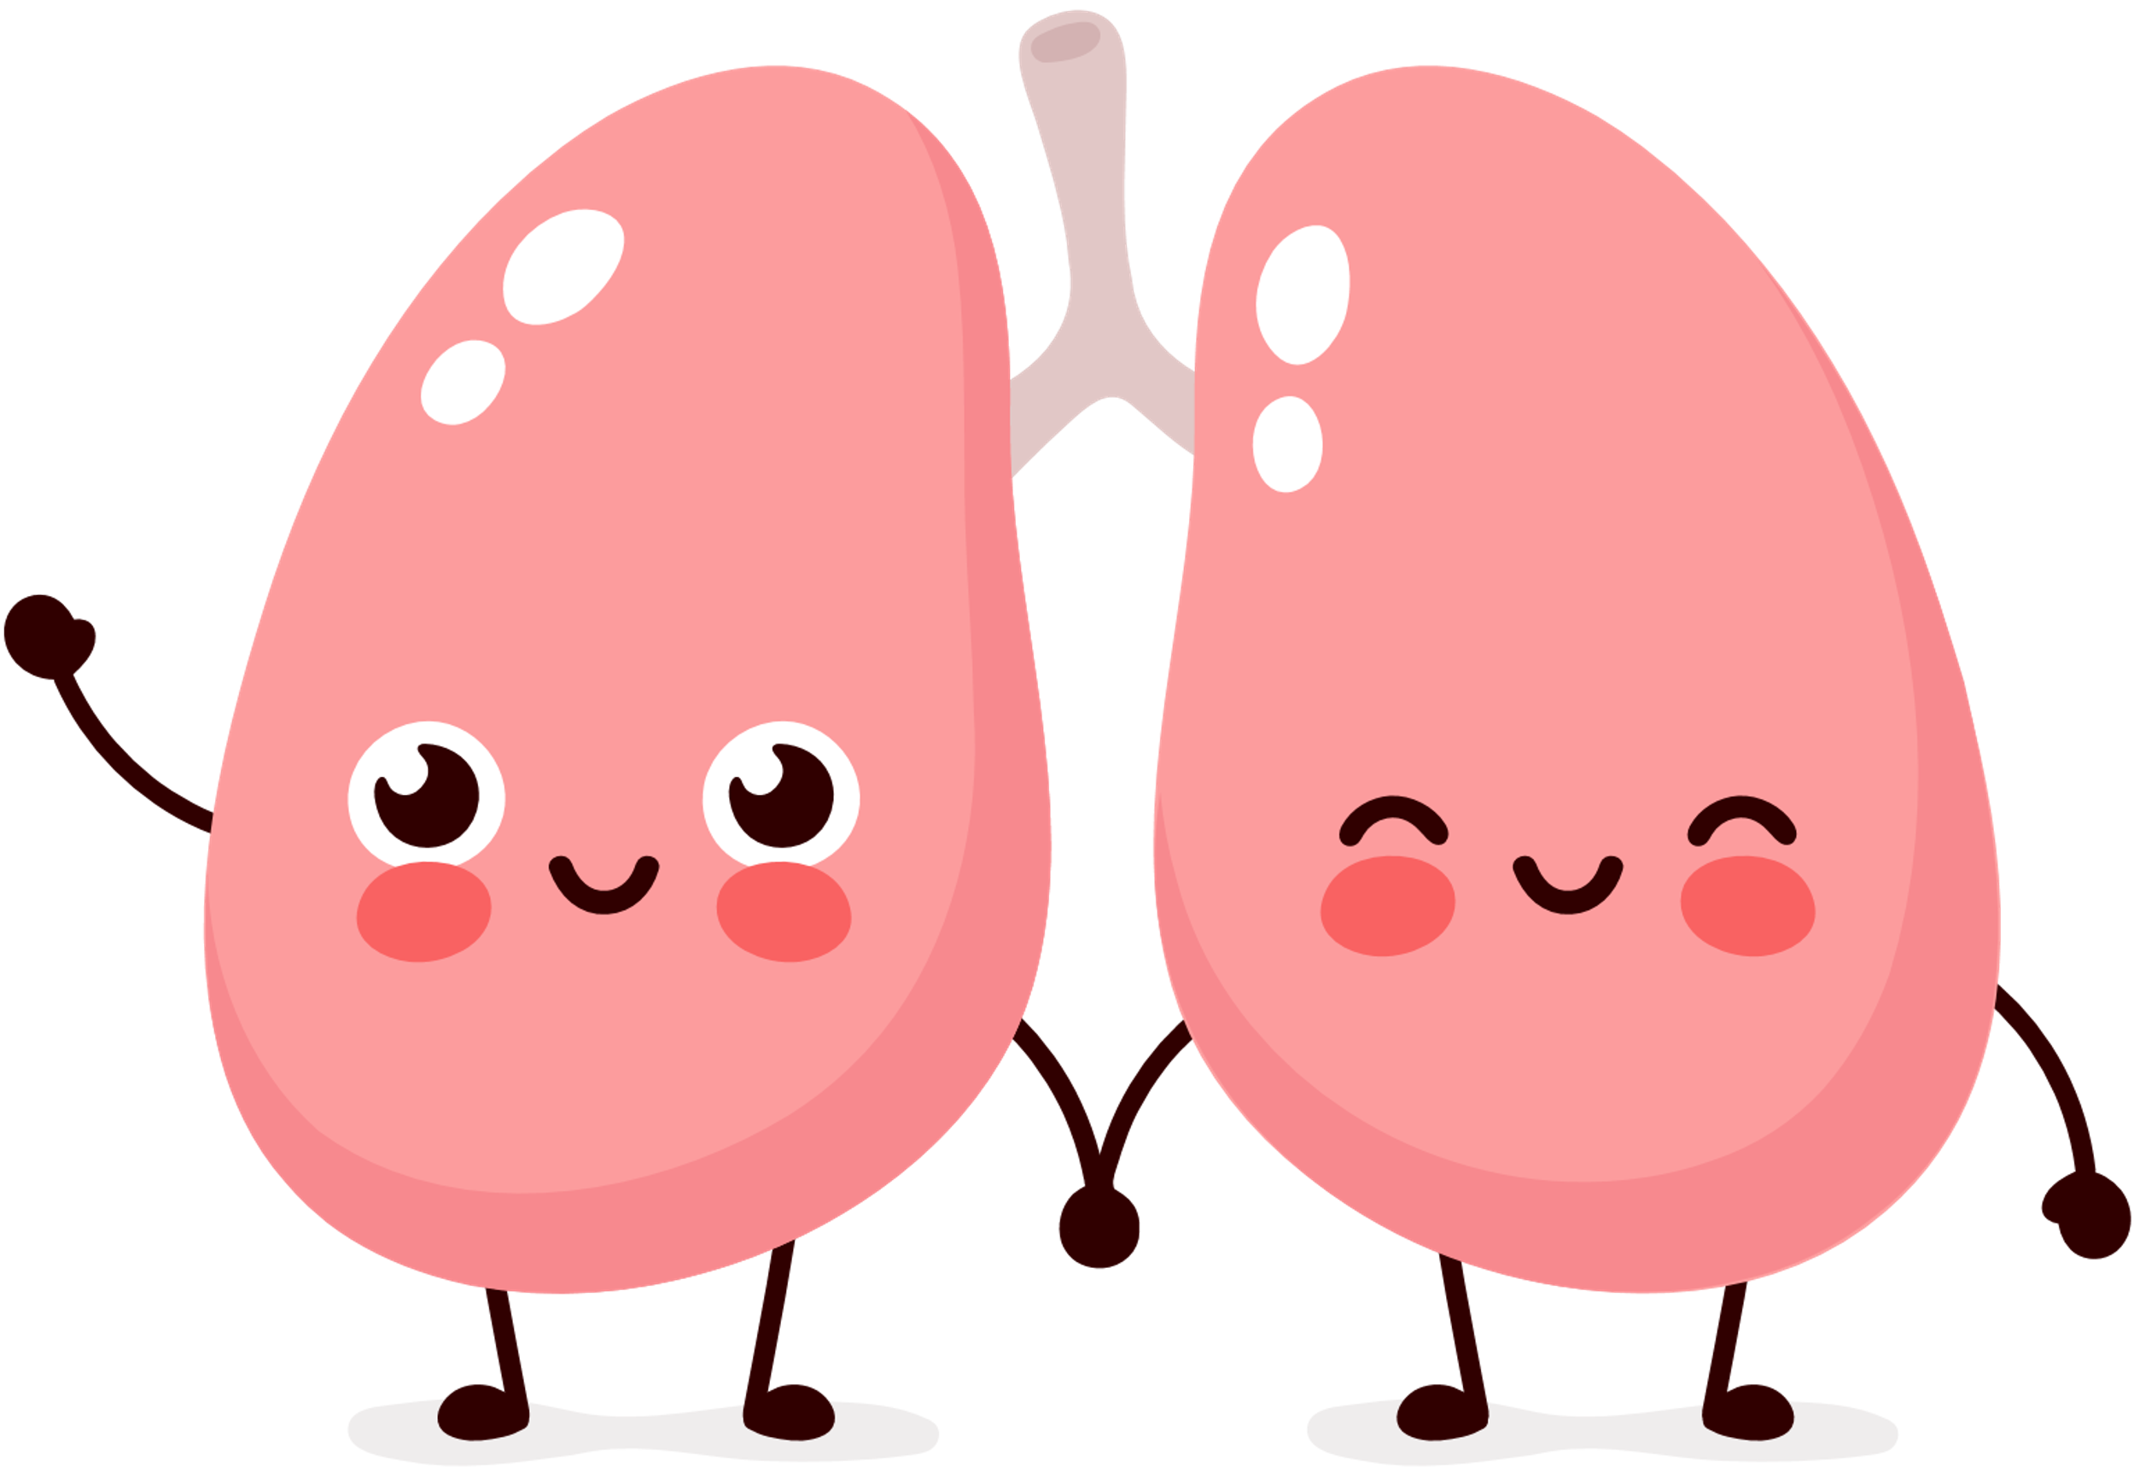
How many minutes of physical activity should you do everyday?
3
60 minutes (1 hour)
Notes:
Physical activity has many benefits it keeps our heart and, lungs healthy. It reduces our risk of disease in adult life, helps maintain a healthy weight, keeps our muscles and bones strong, increases concentration and improves our mental health.

Slide 6
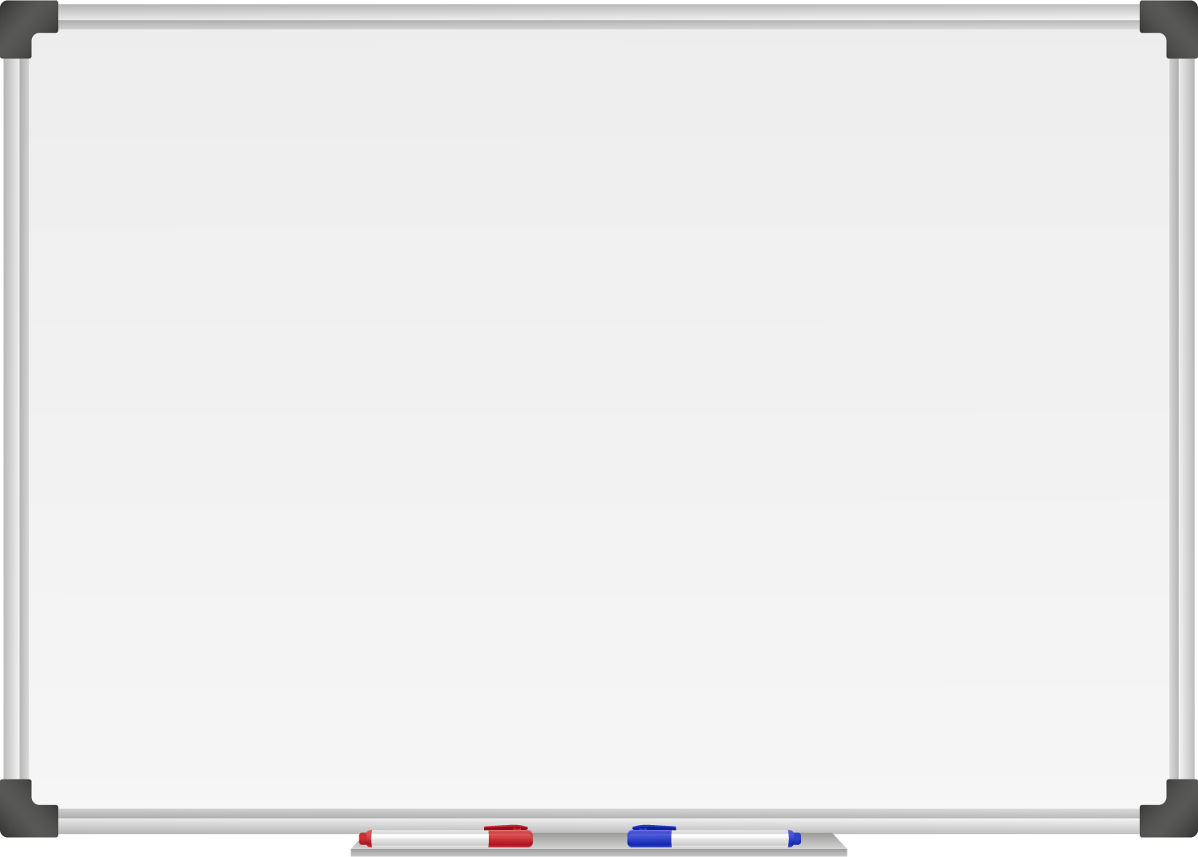







WELL DONE! You have unlocked number 5!
10 Ways to Move More Sit Less
  ____ ____ ____ ____ ____
  ____ ____ ____ ___ _ ____ ____
  ____ ________
  ____ ____ __ ____
  ____ ____ ____ ____ _ ____ _ ____
Morning Stretch
Walk, cycle or scoot to school
Play games with friends at break and lunch
Remember to move for 5 – 10 minutes every hour
Get 60 minutes of physical activity everyday
Notes:
Well done you have unlocked the 5th way to move more sit less. Which is to be active for 60 minutes a day, everyday. This might seem like a long time but you can break it up throughout the day. Remember your break, lunch and PE count. Make it something you enjoy, skating, skipping, cycling it can be anything that gets you slightly out of breath, where you can feel your heart beat fast, but you could still talk to a friend.

Slide 7
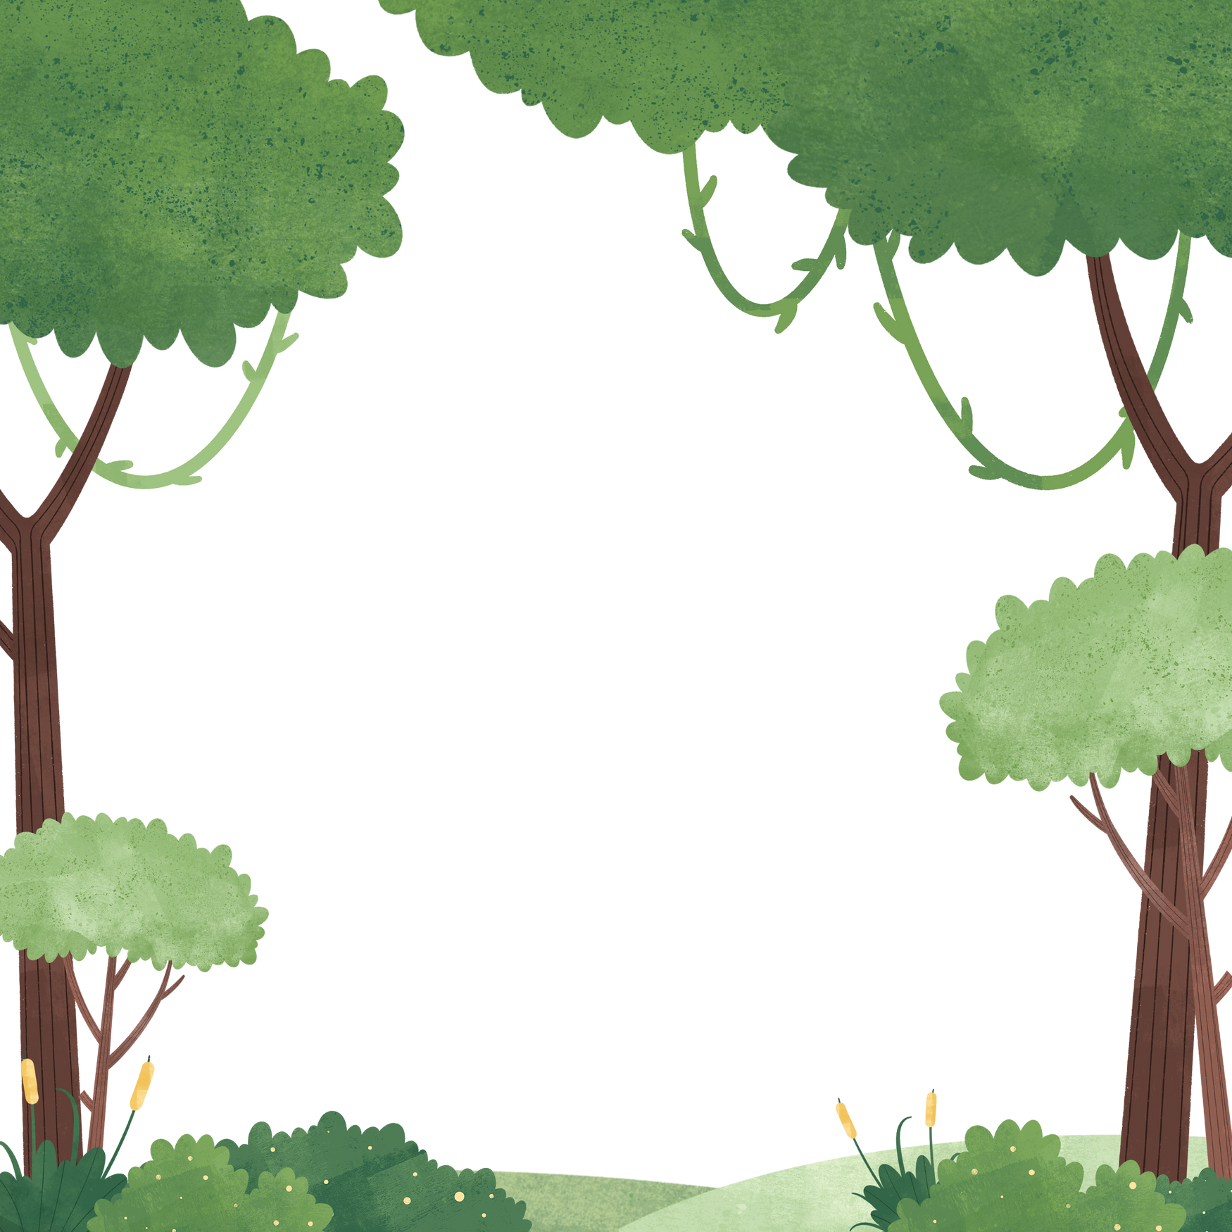

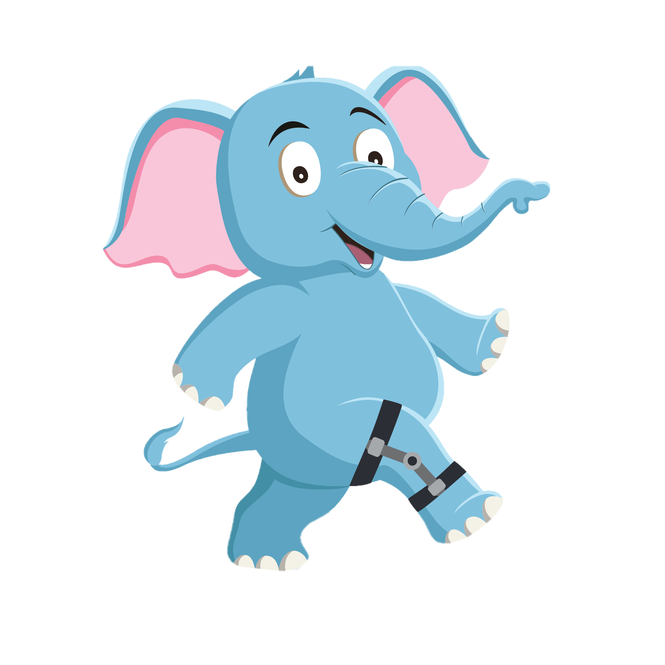
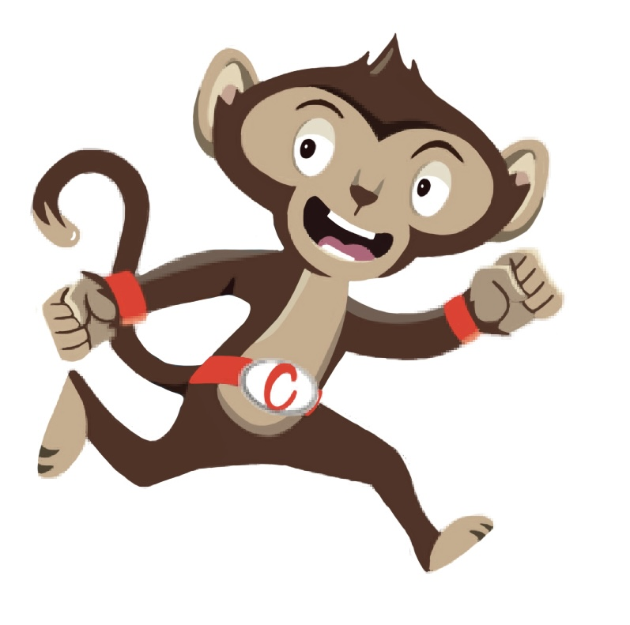
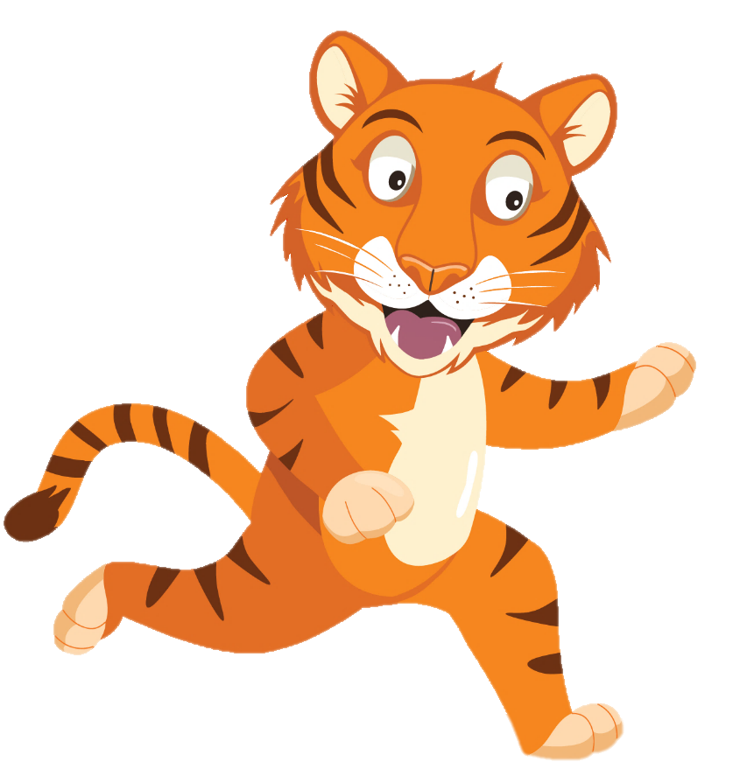
“After school I love to play football with my little brother”
“We need to move more and sit less for 60 minutes a day ”
“My favourite activity is running as fast as I can ”
You have gained 5 healthy hearts!

Slide 8
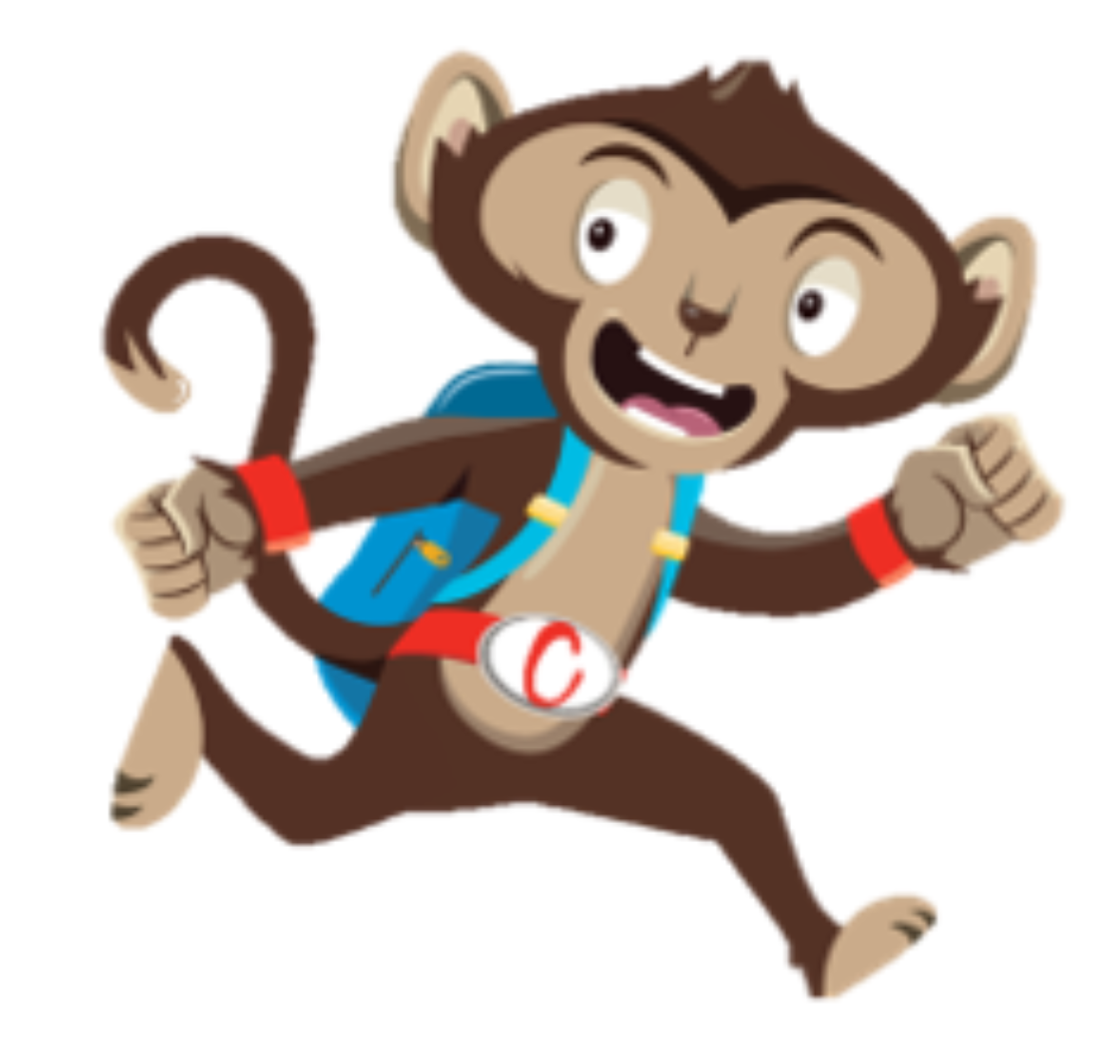
Cardio Booster
Being active helps us concentrate, build strong muscles and be healthy
Why not try a Cardio Booster Activity
Notes:
Physical activity is so important to staying healthy. Make sure its something fun that you enjoy eg, playing games , skating, cycling, swimming, something that gets you moving throughout the day. It can be anything that gets you slightly out of breath, where you can feel your heart beat faster, but you could still talk to a friend. This week why not try one of our cardio booster activities, get your heart pumping and have fun along the way.

