Slide 1
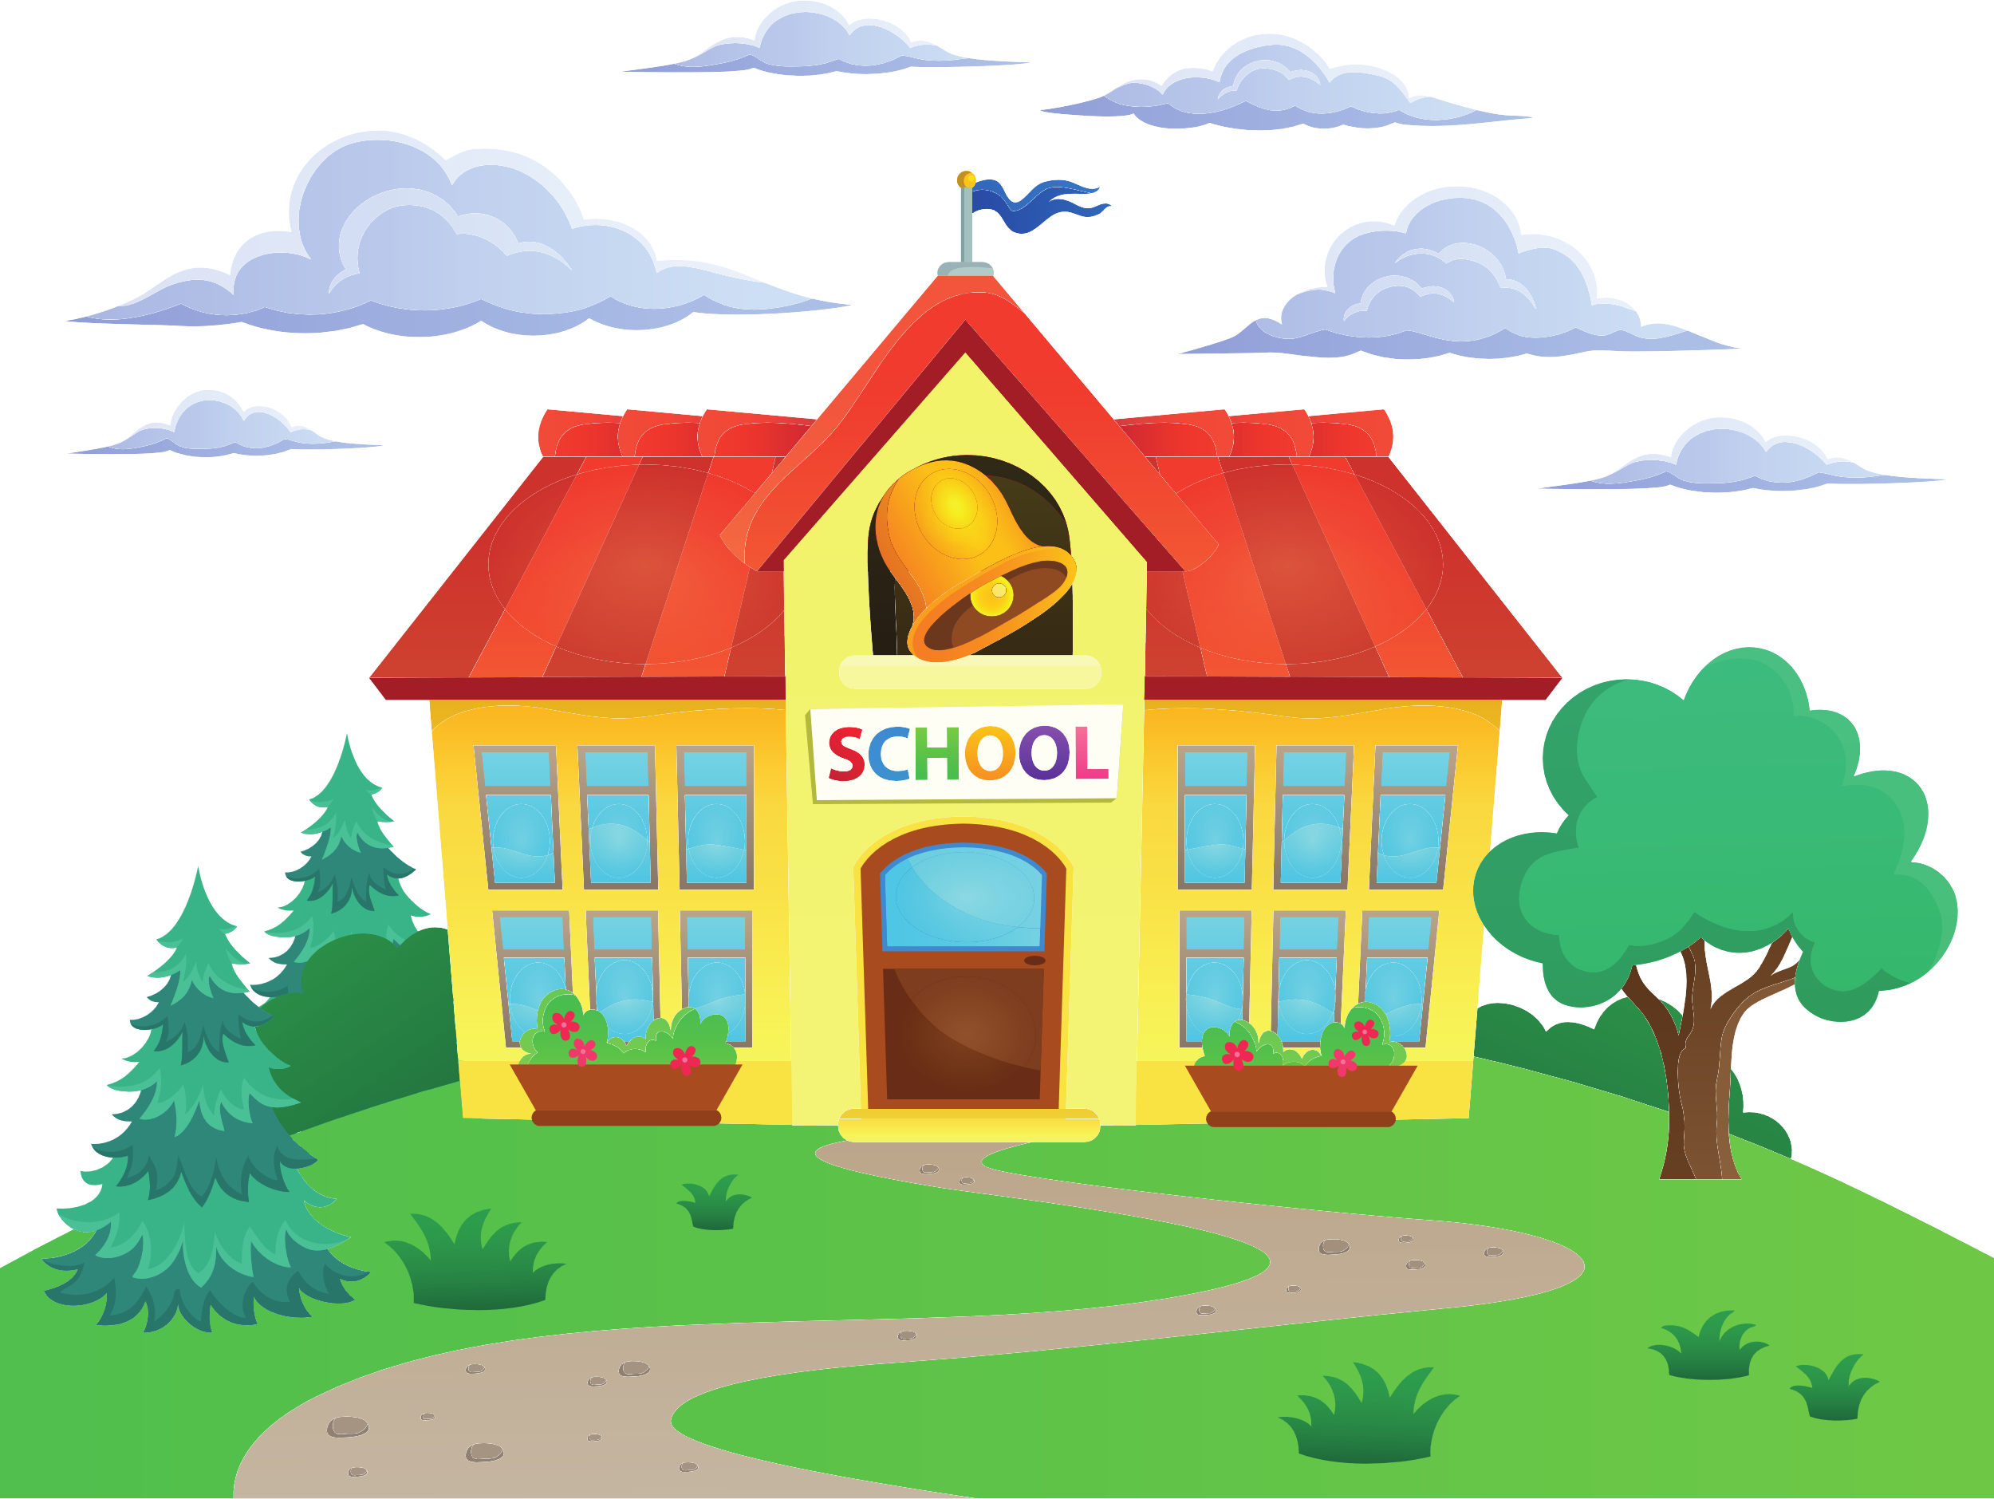
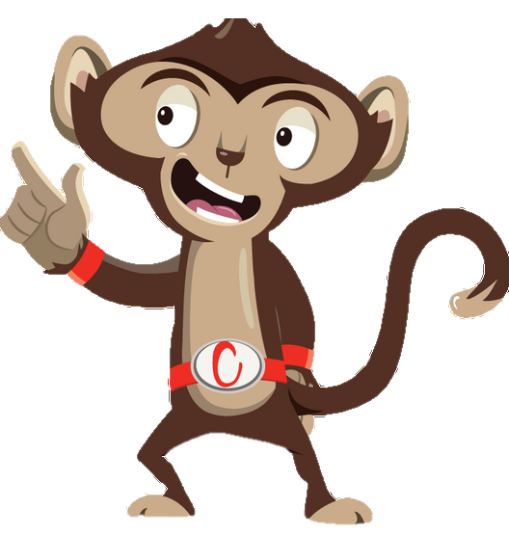


Chester’s Active Quest: Week 6

Slide 2
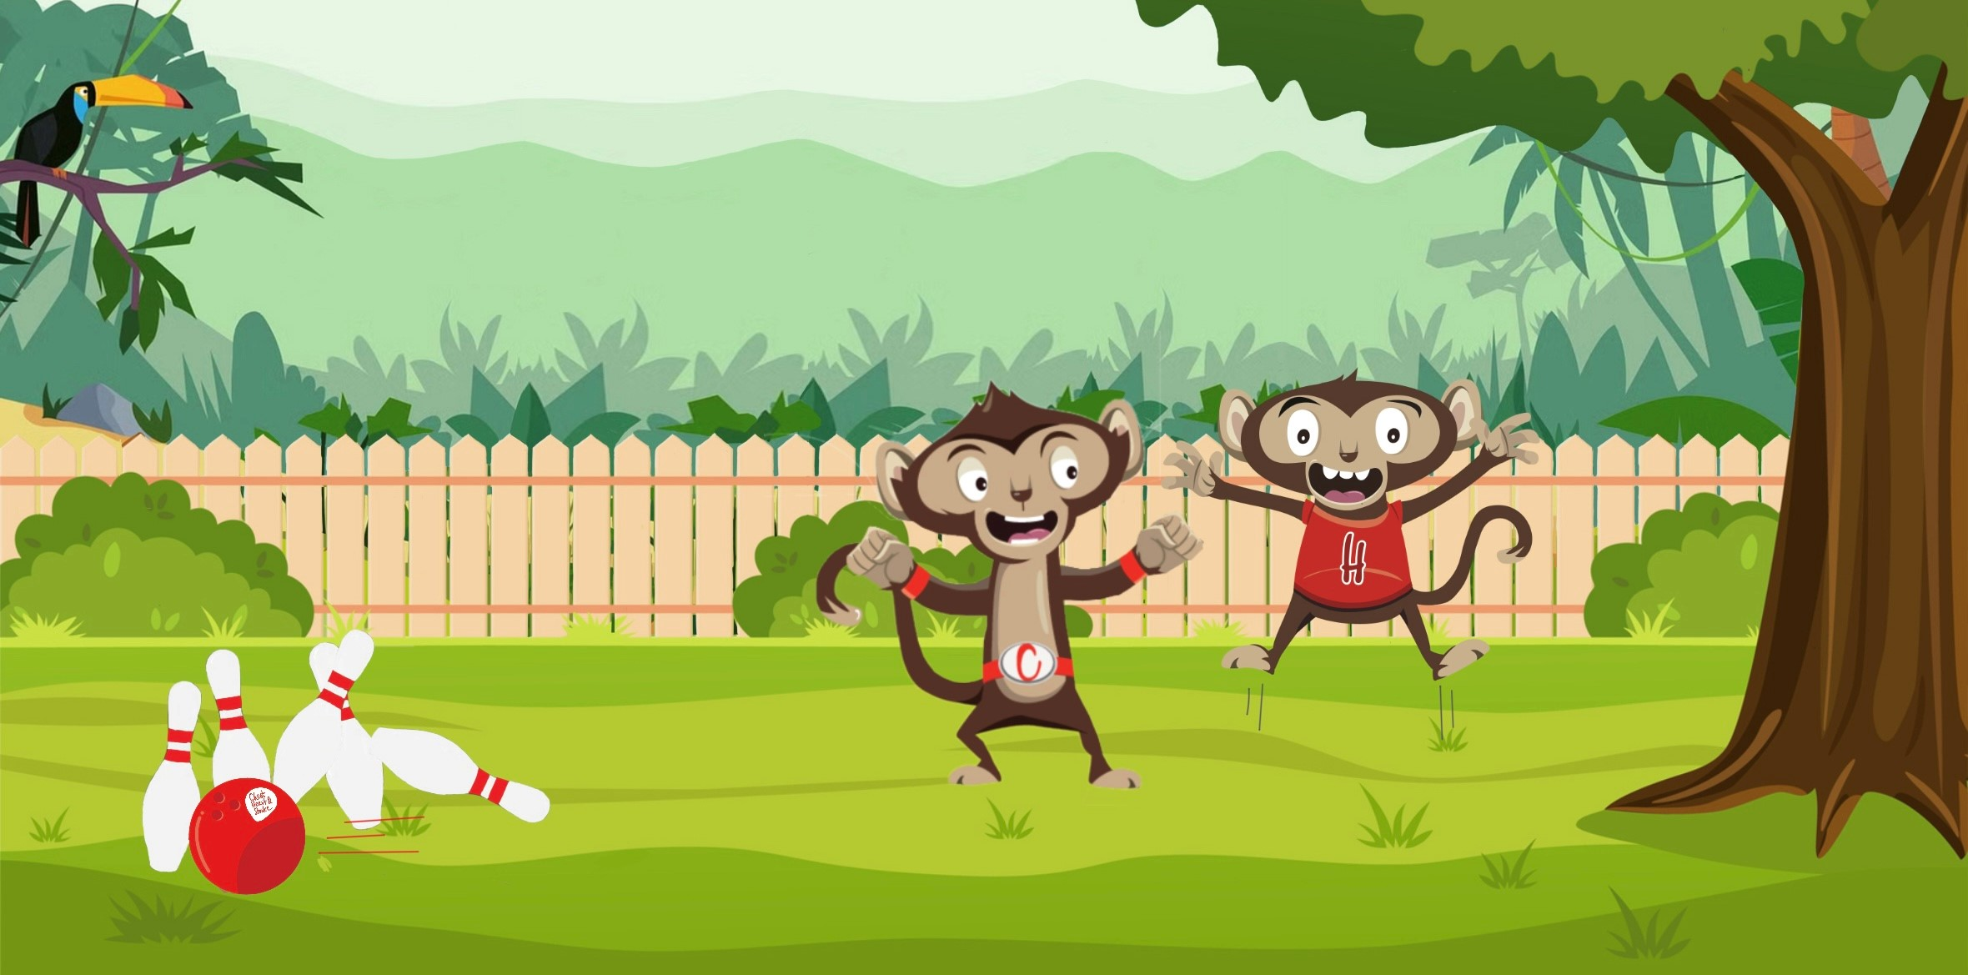

Notes:
Chester swings home from school with a big smile on his face. He reaches his treehouse, where his younger brother Heartley comes bouncing out, full of energy and excitement. "Chester! Let's play a game of 10-pin bowling!" Heartley exclaims, waving his arms. "Great idea, Heartley!" Chester replied. "Let's go outside and enjoy the sunshine." They set up their bowling game on a smooth patch of grass outside their treehouse. They carefully place the 10 pins in a perfect triangle, and then Chester picks up the bright, colorful bowling ball. "Watch this!" Chester said with a grin. He takes a deep breath and rolls the ball quickly along the ground. The ball speeds towards the pins and – crash! – knocks all 10 pins down in one go. "Wow, Chester! That was amazing!" Heartley shouted, jumping up and down with excitement. He ran over and gave Chester a big high five. "You're a bowling superstar!” Heartley laughed. "Thanks, Heartley! Chester says. Now it's your turn. Let's see what you've got!" Heartley eagerly set the pins back up, making sure each one is standing tall. He picks up the ball, feeling a little nervous. "Here goes nothing!". He takes a few steps back, aims carefully, and rolls the ball with all his might. The ball rolls, crashing into the pins and knocking down seven of them.
"Great job, Heartley! You almost got them all!" Chester cheered. “Having fun with family outside is a great way to spend the day, instead of sitting inside”, Heartley says with a smile.

Slide 3
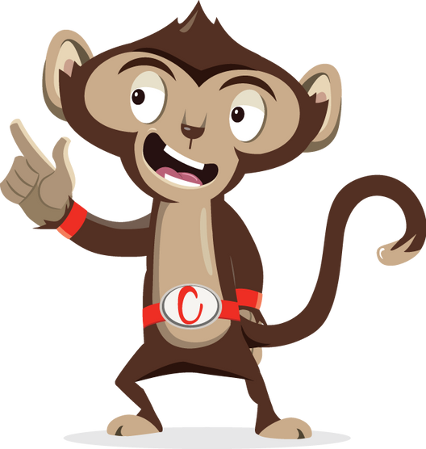
I am filled with water, but have no fish. Before you go in, you must wear a special outfit before making a splish..…
What am I?
Can you solve this riddle?
Notes:
What other ways of being active and having fun can you think of? Try solving this riddle to figure out a great way to have fun with family.

Slide 4
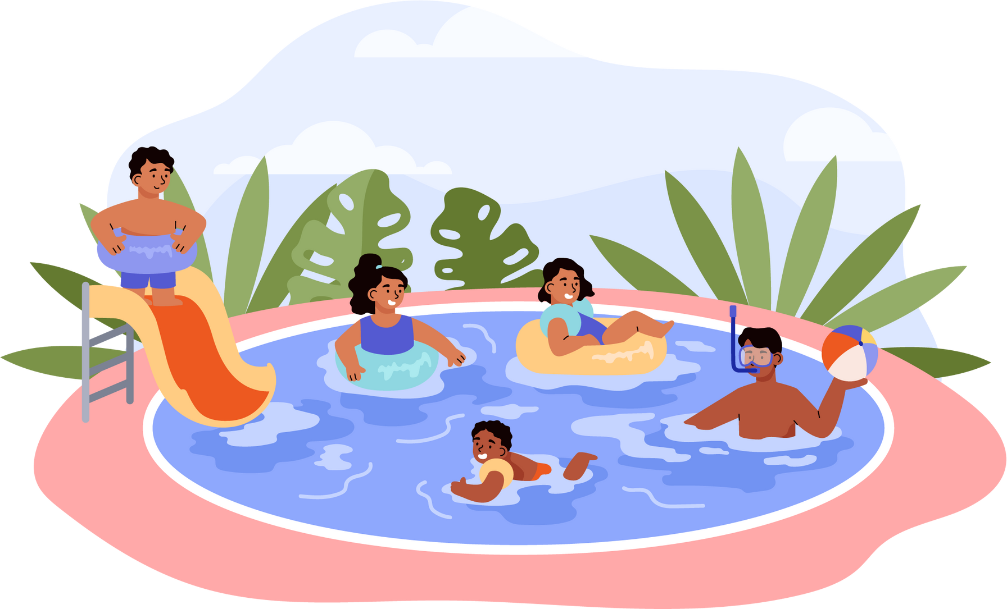
A swimming pool
The correct answer to the riddle was:
Notes:
Well done the correct answer is a swimming pool. This is just one of the many great activities that you can do with family. Other ideas could be going for a family bike ride, a treasure hunt outside, going to the park or maybe helping out in the garden. Any activity that keeps you moving while having fun, all at the same time.
Can anyone think of your favourite ways to be active and have fun with your family?

Slide 5
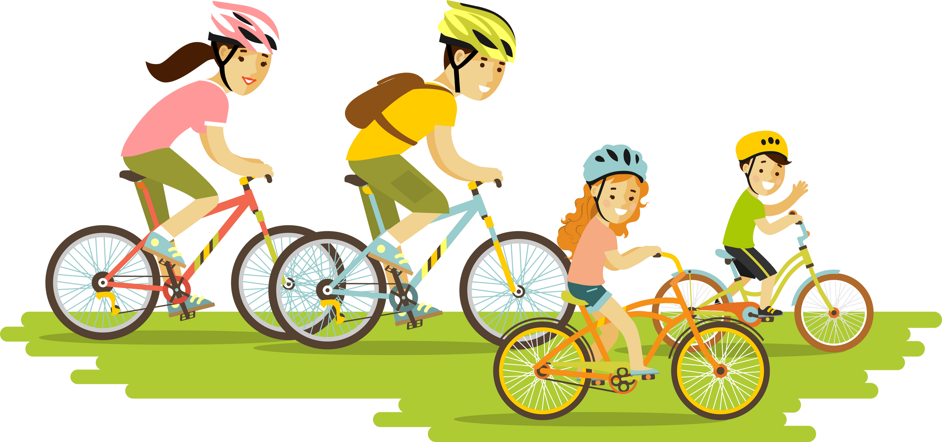
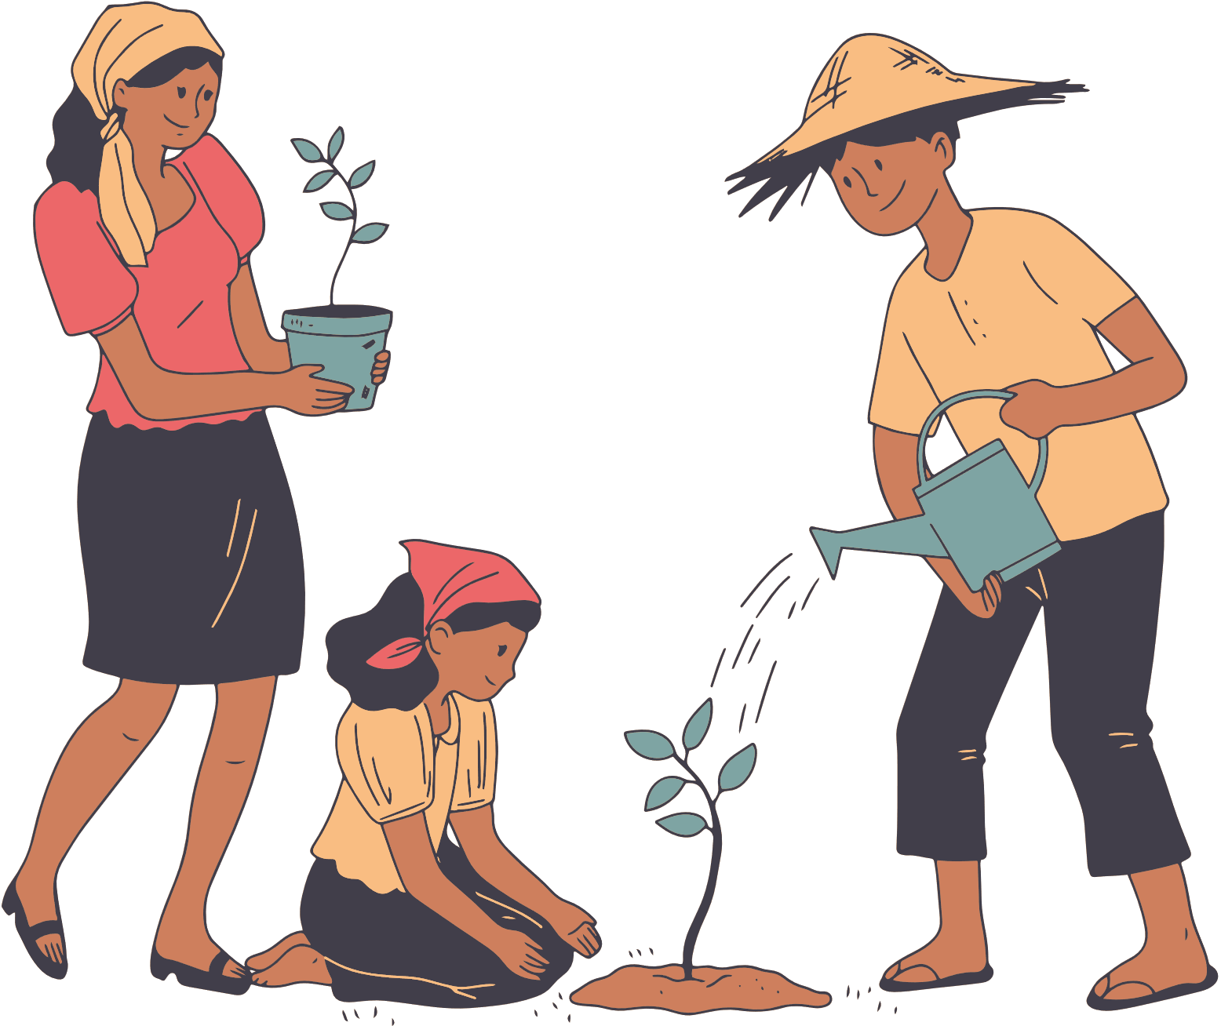
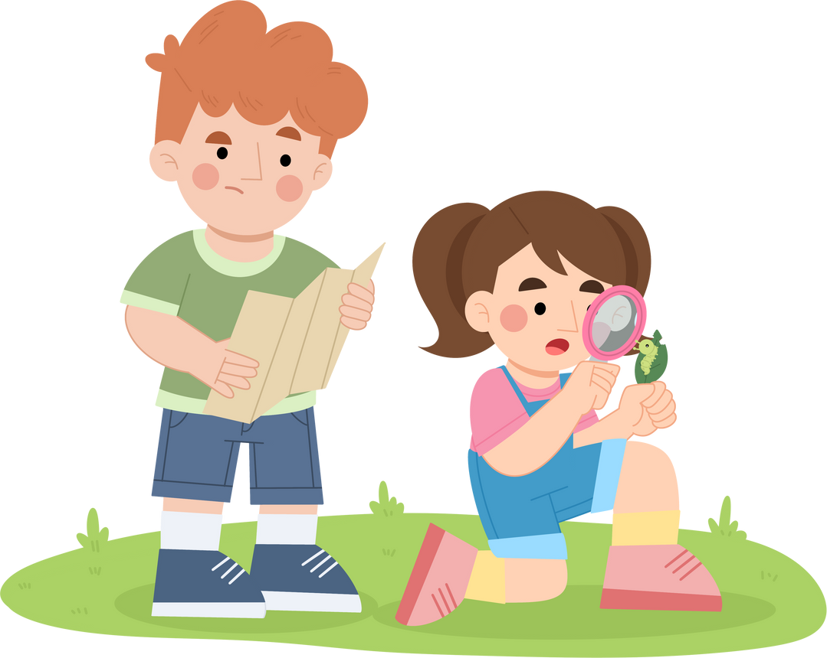
Ways to stay active and have fun
Notes:
Well done the correct answer is a swimming pool. This is just one of the many great activities that you can do with family. Other ideas could be going for a family bike ride, a treasure hunt outside, going to the park or maybe helping out in the garden. Any activity that keeps you moving while having fun, all at the same time.
Can anyone think of your favourite ways to be active and have fun with your family?

Slide 6
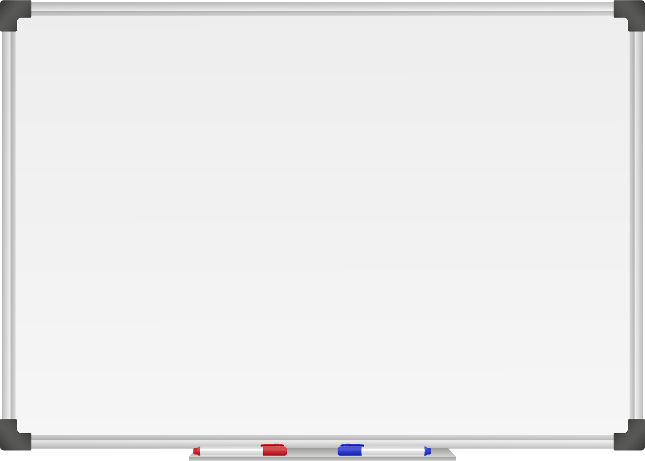







WELL DONE! You have unlocked number 6!
10 Ways to Move More Sit Less
  ____ ____ ____ ___ _ ____ ____
  ____ ________
  ____ ____ __ ____
  ____ ____ ____ ____ _ ____ _ ____
Morning Stretch
Walk, cycle or scoot to school
Play games with friends at break and lunch
Remember to move for 5 – 10 minutes every hour
Play for 60 minutes a day
Active adventure with family outdoors
Notes:
Well done you have unlocked the 6th way to move more sit less. Which is active adventure with family outdoors. There are so many great activities that you can do with whoever is at home, get outside and start your adventure.

Slide 7
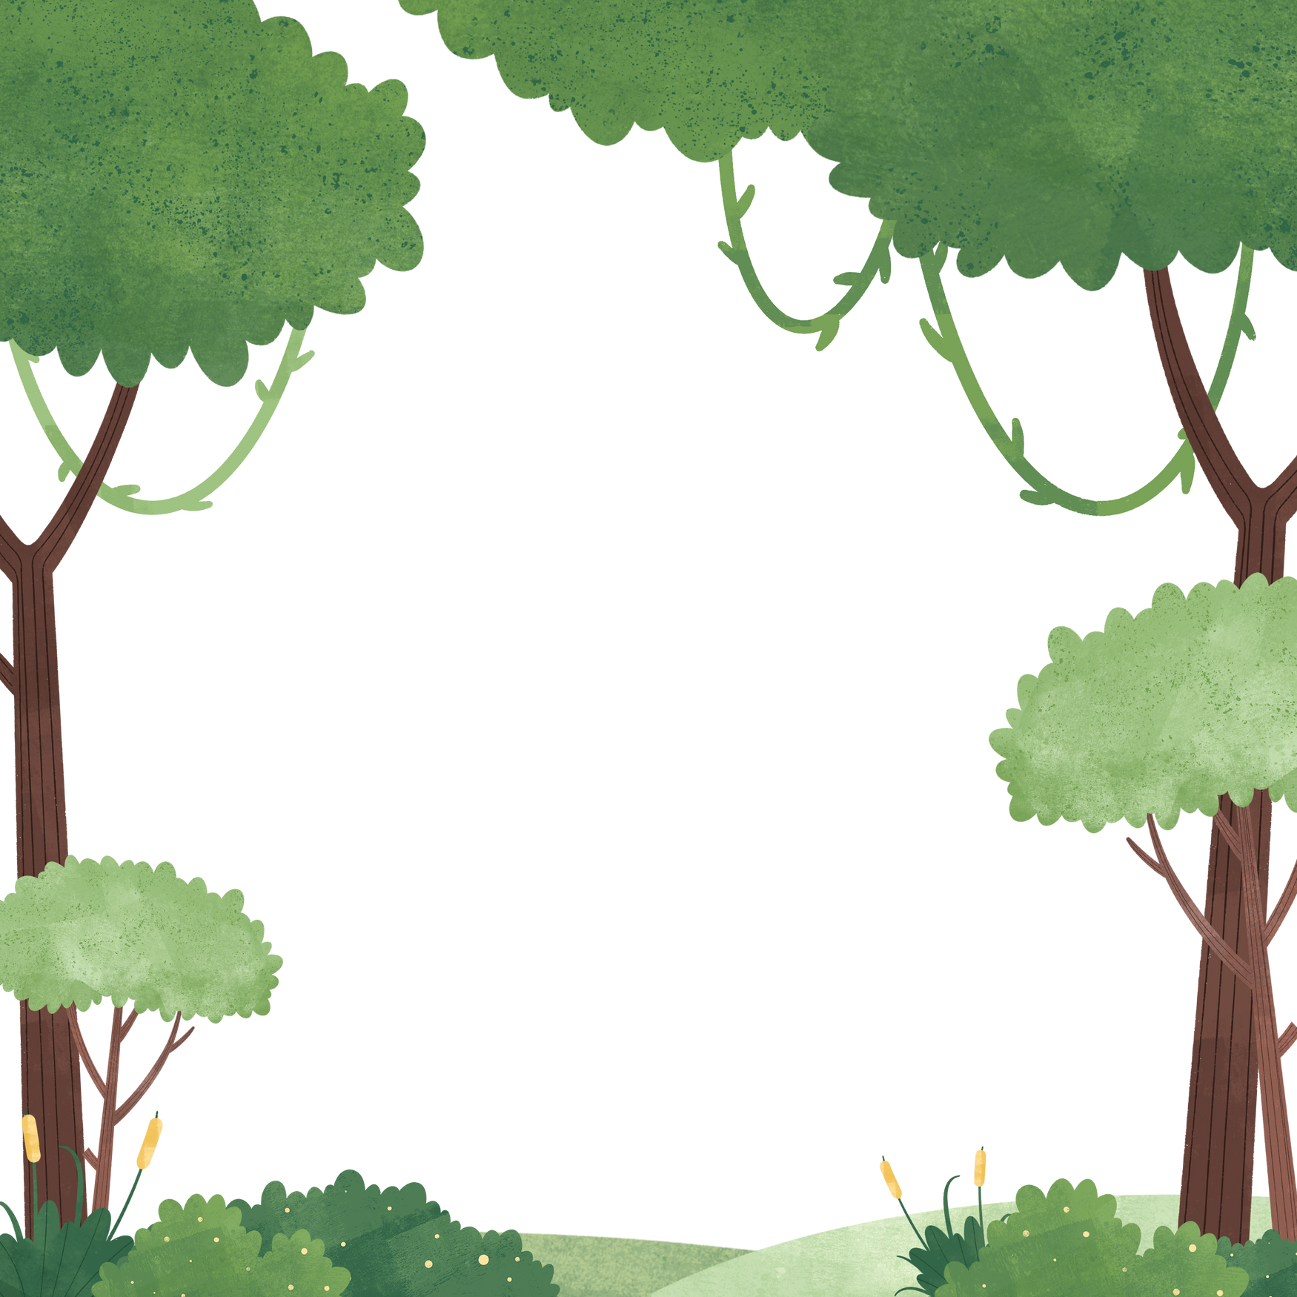

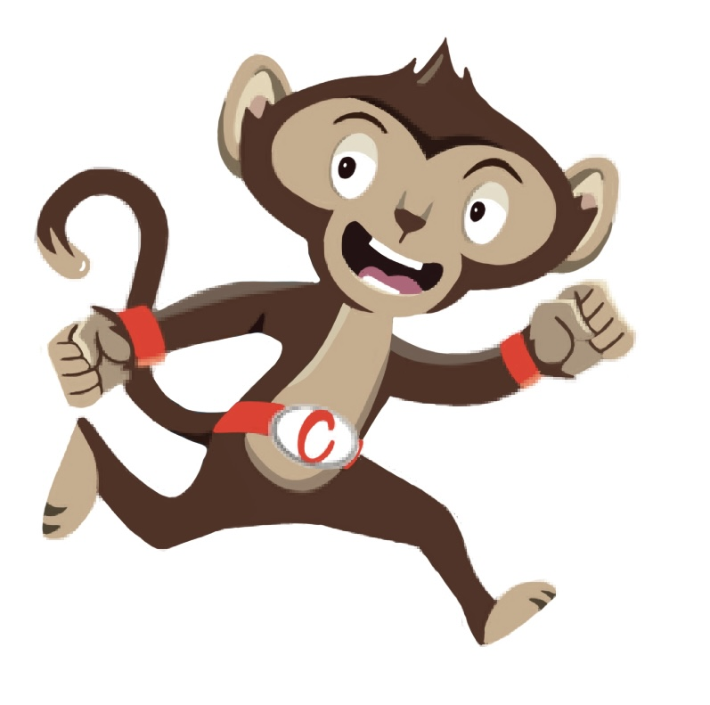
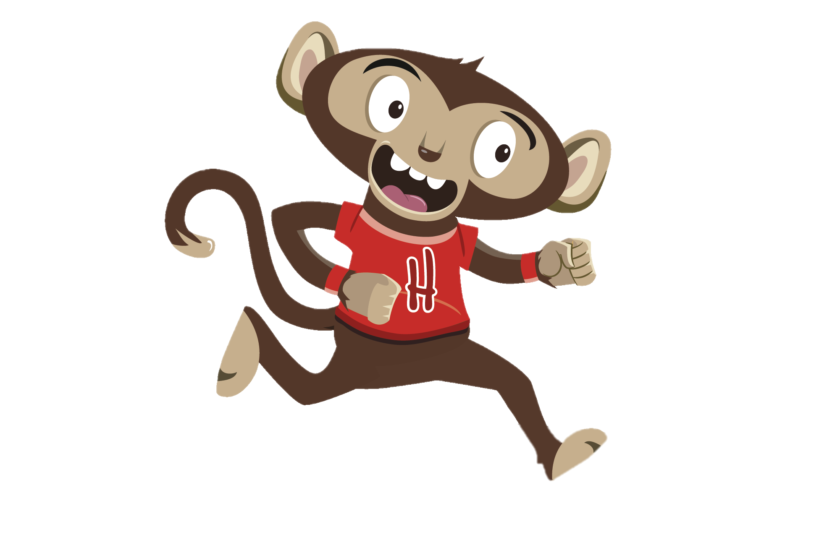
“I love teaching my little brother lots of fun games to play”
“I can’t wait until Chester comes home from school”
You have gained 6 healthy hearts!

Slide 8
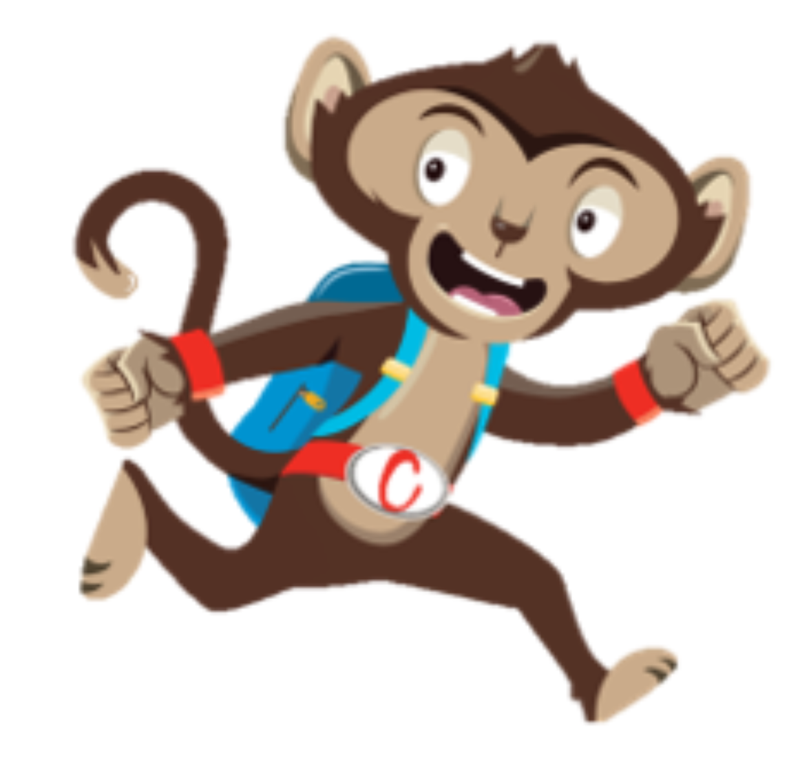
Monkey Madness
Being active with others is a great way to stay healthy and have fun
Why not try a Monkey Madness Activity
Notes:
If you like doing fun activities with family at home, then you will enjoy our class activities. This week why not try one of our exciting monkey madness activities and move more with your friends too.

