Slide 1
Chester’s Active Quest: Week 6

Slide 2
Notes:
Chester swings home from school with a big smile on his face. He reaches his treehouse, where his younger brother Heartley comes bouncing out, full of energy and excitement. "Chester! Let's play a game of 10-pin bowling!" Heartley says, waving his arms. "Great idea, Heartley!" Chester replied. "Let's go outside and enjoy the sunshine." They set up their bowling game on a flat patch of grass outside their treehouse. They carefully place the 10 pins in a triangle, and then Chester picks up the bright, colorful bowling ball. "Watch this!" Chester said with a grin. He takes a deep breath and rolls the ball quickly along the ground. The ball speeds towards the pins and – crash! – knocks all 10 pins down in one go. "Wow, Chester! That was amazing!" Heartley shouted, jumping up and down with excitement. He ran over and gave Chester a big high five. "You're a bowling star!” Heartley says laughing. "Thanks, Heartley! Says Chester. Now it's your turn. Let's see what you've got!" Heartley quickly sets the pins back up, making sure each one is standing tall. He picks up the ball, feeling a little nervous. "Here goes nothing!". He takes a few steps back, aims carefully, and rolls the ball with all his might. The ball rolls, crashing into the pins and knocking down seven pins.
"Great job, Heartley! You almost got them all!" Chester cheered. “Having fun with family outside is a great way to spend the day”, Heartley says with a smile.

Slide 3
What are Chester and Heartley doing in this picture?
1
2
3

Slide 4
What are Chester and Heartley doing in this picture?
1
Walking
2
Running
3
Going to the park
Notes:
Can you guess what other activity Chester and Heartley love to do? See if you can figure it out by looking behind the wall. Do you think they are walking, running or going to the park?
Ask pupils to answer the question while standing. If pupils think the answer is A = they stand with their hands on their head, B = stand with arms crossed and C = stand with both hands in the air. If space is not limited, put the letters A, B and C around the room and ask pupils to move to the area they think the answer is.

Slide 5
What are Chester and Heartley doing in this picture?
1

Slide 6
What are Chester and Heartley doing in this picture?
1

Slide 7
What are Chester and Heartley doing in this picture?
3
Going to the park
Notes:
Well done, the correct answer was going to the park. Chester and Heartley love going to the park because there is so much to do. Do you like going to the park?

Slide 8
Have fun with your family
Notes:
There are so many great ways to move more with your family. You can go swimming, going on a family bike ride, do a treasure hunt, explore the park and even help in the garden. Something that keeps you moving and where you can have fun. Can you think of your favourite ways to have fun with your family?

Slide 9
WELL DONE! You have unlocked number 6!
10 Ways to Move More Sit Less
____ ____ ____ ___ _ ____ ____
____ ________
____ ____ __ ____
____ ____ ____ ____ _ ____ _ ____
Morning Stretch
Walk, cycle or scoot to school
Play games with friends at break and lunch
Remember to move for 5 – 10 minutes every hour
Play for 60 minutes a day
Move more with family outdoors
Notes:
Well done you have unlocked the 6th way to move more sit less. Which is to move more with family outdoors. There are so many great activities that you can do with whoever is at home, get outside and start having fun and keep moving.

Slide 10
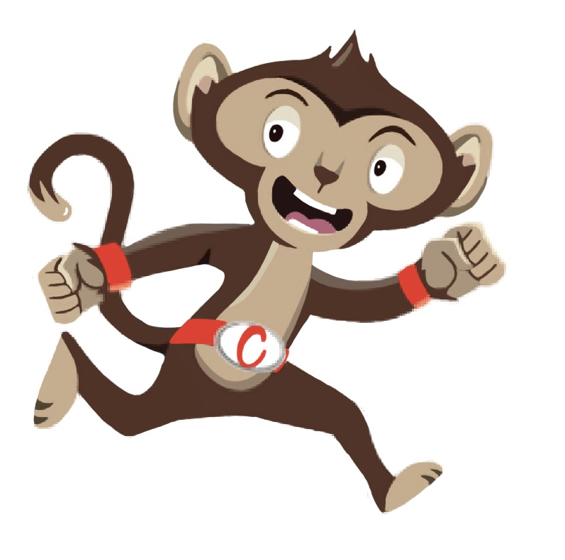
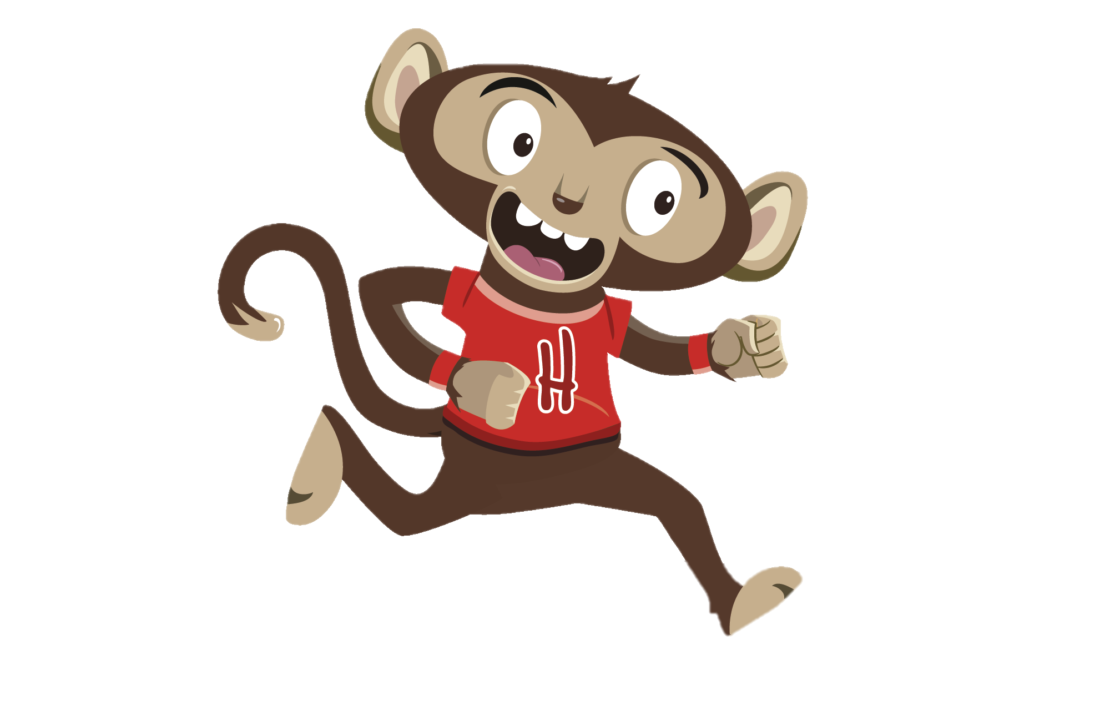
“I love teaching my little brother lots of fun games to play”
“I can’t wait until Chester comes home from school”
You have gained 6 healthy hearts!

Slide 11
Monkey Madness
Being active with others is a great way to stay healthy and have fun
Why not try a Monkey Madness Activity
Notes:
If you like doing fun activities with family at home, then you will enjoy our class activities. This week why not try one of our monkey madness activities and move more with your friends too.

